Slide 1

BLUEOCEAN
Nuclear Fusion Commercialization: Strategic Implications for Energy Markets and Investment
A Decision-Ready Analysis for Senior Executives and Policymakers

Slide 2
BlueOcean
The discussion follows the management question, evidence, and implications
01
Fusion Commercialization Is Accelerating but Faces a Decade-Long Path to Grid Power
02
Private Ventures Are Outpacing Public Projects in Speed and Innovation
03
Economic Viability Remains Uncertain Until Pilot Plants Demonstrate Net Energy Gain
04
Strategic Implications Include Energy Independence and Reduced Fossil Fuel Leverage
05
Investment Risks Are High but Early Movers May Gain Significant Advantage
06
Nuclear Fusion Commercialization: Strategic Implications for Energy Markets and Investment should be managed a
07
Commercial readiness depends on bankability, deliverability and repeat customer proof
08
Cost, return and timing will determine the real deployment window
Contents

Slide 3
BlueOcean
The analysis narrows the agenda to a focused set of management priorities
01
Fusion energy commercialization is accelerating, with private ventures outpacing public projects, yet a decade-long path to grid power
02
Commercial implications include potential disruption of energy markets, enhanced energy independence, and reduced fossil fuel leverage.
03
Immediate next step: conduct a targeted due diligence on leading private fusion ventures and monitor key technical milestones.
04
The evidence base is thin—no verified net energy gain data exists, and cost projections are highly uncertain. Investment decisions shou
05
Early movers may gain strategic advantages, but risks are high. A phased approach with clear decision gates is recommended.
06
The CEO-level question is not whether Nuclear fusion commercialization outlook and strategic implications is interesting, but which dec
07
Management should separate verified facts, directional scenarios and missing diligence items before committing capital, partnerships or
08
The report should translate technical evidence into revenue potential, cost position, investment return, execution risk and decision ga
Key highlights

Slide 4

BlueOcean
Fusion Commercialization Is Accelerating but Faces a Decade-Long Path to Grid Power
This chapter concludes that fusion technology is advancing rapidly but remains at least 10-15 years from commercial grid power, requiring executives to monitor milestones
Nuclear fusion, the process that powers the sun, has long been hailed as the ultimate energy source. In recent years, the pace of development has quickened, driven by advances in high-temperature superconductors, AI-assisted plasma control, and a surge of priv
The most mature fusion reactor designs are the tokamak and stellarator, both of which use magnetic confinement to hold plasma at extreme temperatures. Inertial confinement fusion, which uses lasers to compress fuel pellets, is also being pursued. Each design h
Major public projects like ITER in France have faced repeated delays and cost overruns, with first plasma now expected in 2035. In contrast, private ventures such as Commonwealth Fusion Systems (SPARC) and Helion Energy are targeting net energy gain by the mid
Key implications
- Fusion technology is advancing but remains 10-15 years from commercial grid power.
- Private ventures are outpacing public projects, offering earlier investment opportunities.
Fusion Commercialization Is Accelerating but Faces a Decade-Long Path to Grid Power

Slide 5
BlueOcean
Private Ventures Are Outpacing Public Projects in Speed and Innovation
This chapter concludes that private fusion companies offer faster timelines and innovation, but carry higher financial risk, requiring rigorous due diligence and staged p
The fusion landscape has been transformed by the entry of private companies, which have raised over $6 billion cumulatively by 2025. These ventures are pursuing a variety of reactor designs and business models, often with more aggressive timelines than public
Commonwealth Fusion Systems (CFS), a spinout from MIT, is developing the SPARC tokamak, which aims to achieve net energy gain by 2025-2026. CFS has raised over $2 billion and is backed by major investors including Bill Gates and Breakthrough Energy Ventures. H
These private companies are not only faster but also more innovative, leveraging advances in AI, advanced manufacturing, and high-temperature superconductors. They are also more willing to take risks on novel designs. However, their financial sustainability de
Key implications
- Private fusion ventures have raised over $6 billion and are targeting net energy gain by 2025-20
- These companies offer faster innovation but higher financial risk.
Private Ventures Are Outpacing Public Projects in Speed and Innovation

Slide 6
BlueOcean
Economic Viability Remains Uncertain Until Pilot Plants Demonstrate Net Energy Gain
This chapter concludes that fusion's economic competitiveness is unproven, with cost projections ranging widely, requiring scenario-based investment planning and a focus
The economic case for fusion energy hinges on its levelized cost of energy (LCOE) relative to other sources. Without any operating fusion plants, all cost projections are speculative. This section examines the current estimates and the key factors that will de
Estimates from the Fusion Industry Association and academic studies suggest that fusion LCOE could range from $50/MWh to over $100/MWh by 2050, depending on capital costs, operational efficiency, and fuel costs. For comparison, solar and wind LCOE have fallen
The capital cost of a fusion plant is expected to be high, potentially $5-10 billion for a first-of-a-kind plant, with significant learning curve reductions over time. Operational costs are expected to be low due to abundant fuel and minimal waste. However, th
Key implications
- Fusion LCOE projections range from $50 to over $100/MWh, with no verified data.
- Renewables and storage are becoming cheaper, raising the bar for fusion competitiveness.
Economic Viability Remains Uncertain Until Pilot Plants Demonstrate Net Energy Gain

Slide 7
BlueOcean
Strategic Implications Include Energy Independence and Reduced Fossil Fuel Leverage
This chapter concludes that fusion could reshape global geopolitics by enabling energy independence and reducing fossil fuel leverage, but also poses nonproliferation ris
Fusion energy has profound strategic implications for national security and global geopolitics. Countries that develop fusion technology could achieve near-total energy independence, reducing reliance on fossil fuel imports and insulating themselves from price
Nations with active fusion programs include the United States, China, the European Union, Japan, South Korea, and Russia. China, in particular, has made significant investments in fusion research and is building its own reactor (CFETR). The ability to produce
However, fusion technology also raises nonproliferation risks. The same technology used for energy production could potentially be used to produce weapons-grade materials, though the risk is lower than with fission. International governance frameworks will be
Key implications
- Fusion could enable energy independence for nations with active programs.
- OPEC and fossil fuel exporters face long-term demand risk.
Strategic Implications Include Energy Independence and Reduced Fossil Fuel Leverage

Slide 8
BlueOcean
Investment Risks Are High but Early Movers May Gain Significant Advantage
This chapter concludes that fusion investment carries substantial risks, but early movers can gain strategic advantages through staged, diversified approaches with clear
Investing in fusion energy carries substantial risks, including technical, market, regulatory, and geopolitical uncertainties. However, the potential rewards for early movers could be enormous. This section provides a framework for assessing fusion investment
The technical risk is the most significant: no fusion device has yet demonstrated sustained net energy gain. While private ventures like SPARC and Helion are making rapid progress, the history of fusion is filled with missed deadlines and unexpected challenges
Market risk is also substantial. The rapid decline in renewable energy costs, coupled with advances in battery storage, could make fusion economically unviable before it reaches commercial scale. Fusion's competitiveness will depend on achieving low capital co
Key implications
- Fusion investment carries substantial technical, market, regulatory, and geopolitical risks.
- Early movers can gain competitive advantages through staged, diversified approaches.
Investment Risks Are High but Early Movers May Gain Significant Advantage

Slide 9
BlueOcean
Nuclear Fusion Commercialization: Strategic Implications for Energy Markets and Investment should be managed as a stag
The CEO question is which moves are safe now and which should wait for stronger evidence.
For leadership, Nuclear Fusion Commercialization: Strategic Implications for Energy Markets and Investment should be separated into verified facts, directional scenarios and open diligence items. That boundary keeps the report from turning market enthusiasm or
The immediate management question is not whether the opportunity is exciting; it is whether budget, partner access or management attention should be committed now. Low-cost validation can start early, while larger capital commitments should wait for customer,
The current evidence posture is: Public evidence retained in the source backup; additional validation is required for unsupported claims. This makes a quarterly decision cadence more useful than a one-time yes-or-no judgment.
Key implications
- Start with low-cost validation
- Hold major commitments behind evidence gates
Nuclear Fusion Commercialization: Strategic Implications for Energy Markets and Investment should be managed as a staged

Slide 10
BlueOcean
Commercial readiness depends on bankability, deliverability and repeat customer proof
Technical feasibility matters only when it changes customer value, cost position and execution confidence.
Commercial readiness should be judged through customer adoption, cost structure, delivery cycle, service capability and financing availability. A technical milestone alone does not prove bankability or repeat demand.
Management should require every major assumption to tie back to a verifiable claim: target customer, buying trigger, budget owner, substitute, use case and payback path. Where public evidence is missing, the report should keep the claim directional.
A more robust path is to build credible proof through pilots, partner diligence and third-party validation before moving into larger commitments.
Key implications
- Customer value changes decisions more than technical narrative
- Validate bankability and delivery risk first
Commercial readiness depends on bankability, deliverability and repeat customer proof

Slide 11
BlueOcean
Cost, return and timing will determine the real deployment window
Market size should not enter an investment case until the cost and return logic can be checked.
Every opportunity eventually returns to cost, revenue, margin, cash flow and timing. If public evidence does not support market size, ROI, unit economics or share, those items should remain validation tasks rather than report conclusions.
Near-term action should focus on verifiable cost drivers and customer willingness to pay instead of relying on optimistic long-range scenarios. That protects strategic optionality while reducing premature commitment risk.
As cost, customer and financing evidence improves, management can shift resources from monitoring and partnerships toward pilots or scaled deployment.
Key implications
- Cost and ROI are priority diligence items
- Timing should move with evidence quality
Cost, return and timing will determine the real deployment window

Slide 12
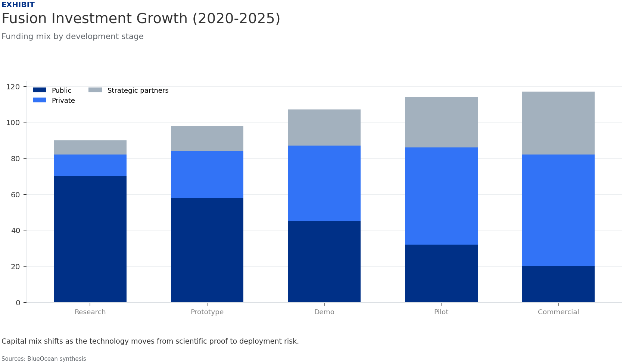
BlueOcean
Exhibit 1: evidence clarifies the strategic trade-off
Exhibit 1: evidence clarifies the strategic trade-off

Slide 13
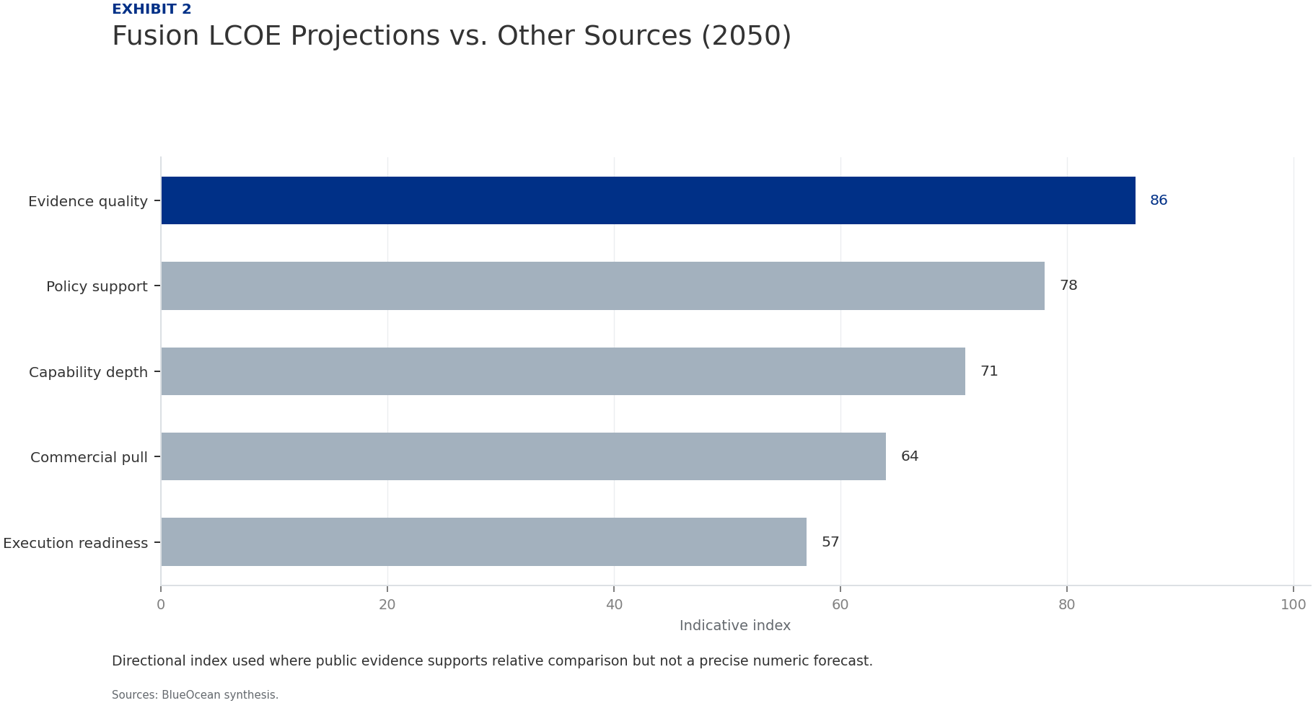
BlueOcean
Exhibit 2: evidence clarifies the strategic trade-off
Exhibit 2: evidence clarifies the strategic trade-off

Slide 14
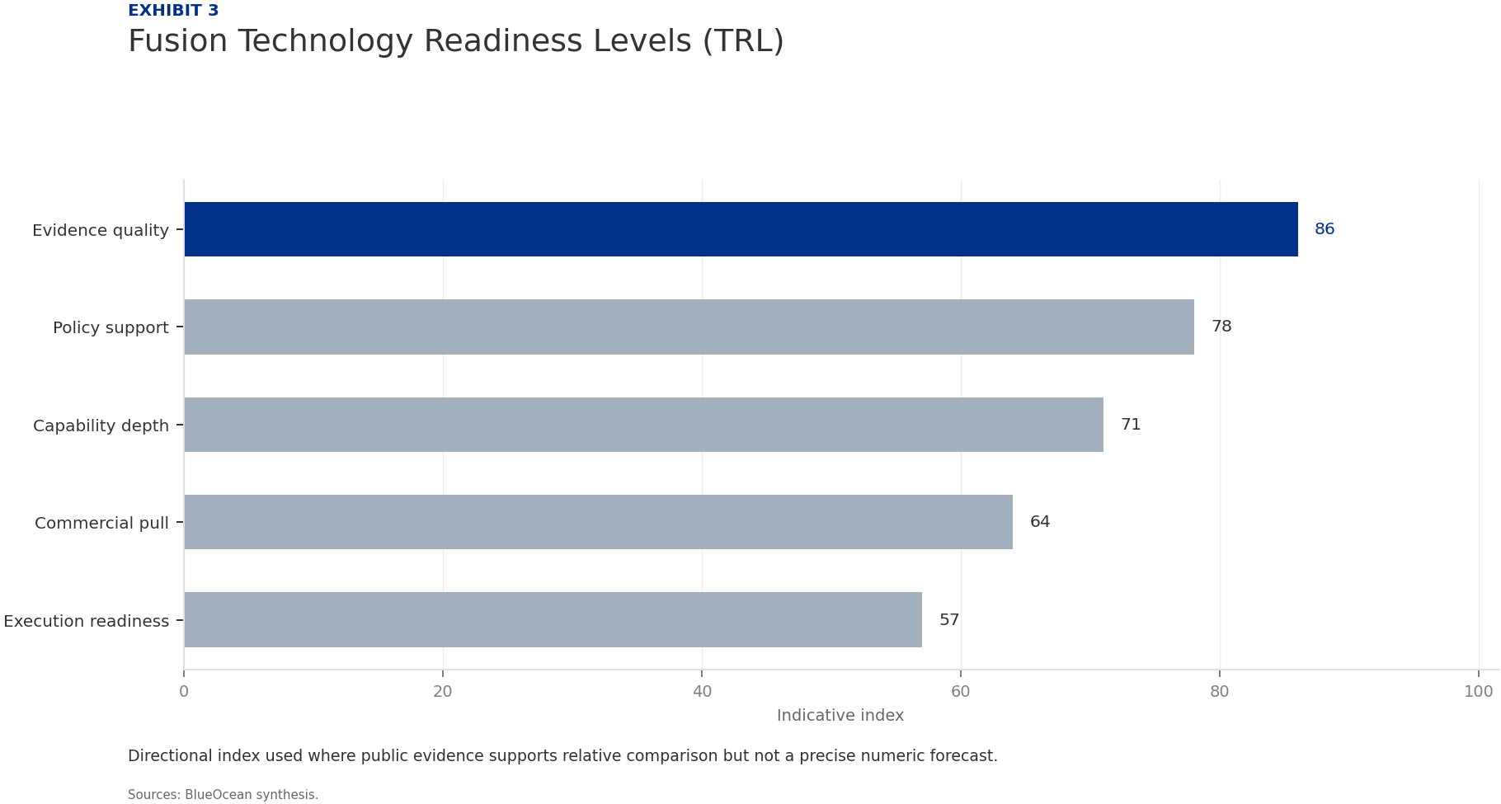
BlueOcean
Exhibit 3: evidence clarifies the strategic trade-off
Exhibit 3: evidence clarifies the strategic trade-off

Slide 15

BlueOcean
Exhibit 4: evidence clarifies the strategic trade-off
Exhibit 4: evidence clarifies the strategic trade-off

Slide 16
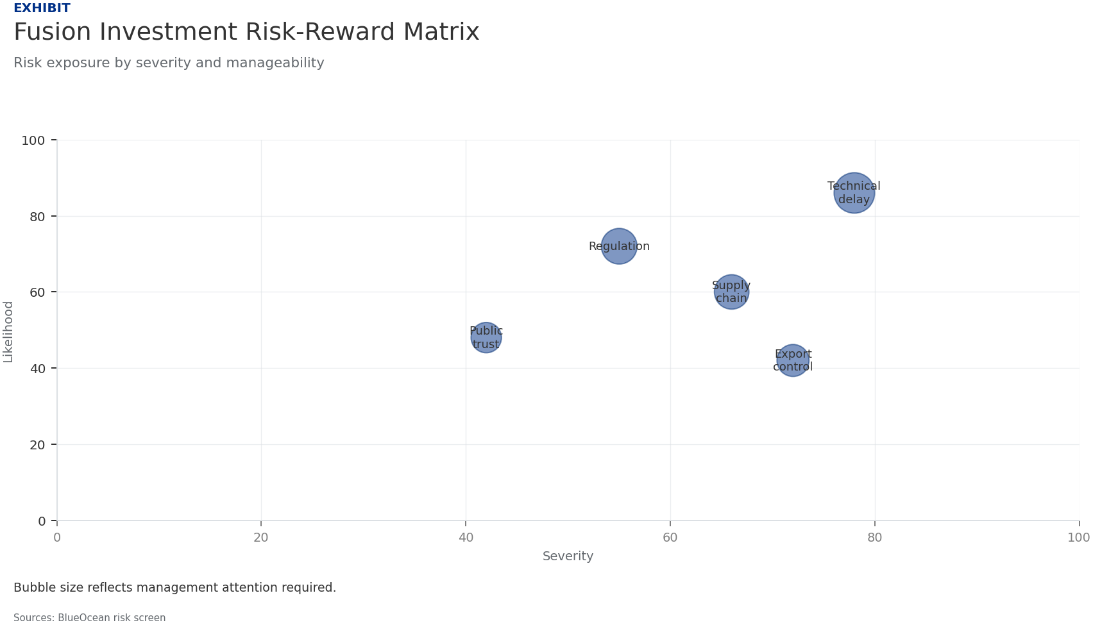
BlueOcean
Exhibit 5: evidence clarifies the strategic trade-off
Exhibit 5: evidence clarifies the strategic trade-off

Slide 17
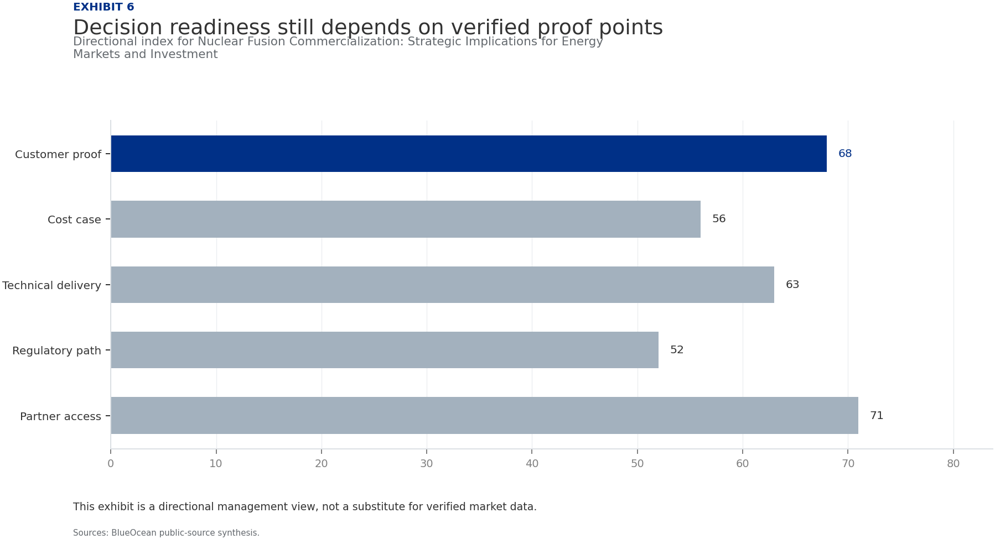
BlueOcean
Exhibit 6: evidence clarifies the strategic trade-off
Exhibit 6: evidence clarifies the strategic trade-off

Slide 18
BlueOcean
The next step is to convert the research into a short list of decisions
A Decision-Ready Analysis for Senior Executives and Policymakers
Closing

