Slide 1

BLUEOCEAN
Nuclear Fusion Commercialization: Strategic Outlook and Investment Implications
A Decision-Ready Analysis for Senior Executives and Investors

Slide 2
BlueOcean
The discussion follows the management question, evidence, and implications
01
Nuclear Fusion Is Approaching Technical Feasibility but Commercial Viability Remains a Decade Away
02
Magnetic Confinement Leads the Race with SPARC and ITER as Key Milestones
03
Alternative Approaches Like Inertial Confinement Show Promise but Lag in Engineering Readiness
04
Nuclear Fusion Commercialization: Strategic Outlook and Investment Implications should be managed as a staged
05
Commercial readiness depends on bankability, deliverability and repeat customer proof
06
Cost, return and timing will determine the real deployment window
07
Regulation, policy and public acceptance can reset the speed of adoption
08
Supply chain, partners and talent will decide who can act before the market is obvious
Contents

Slide 3
BlueOcean
The analysis narrows the agenda to a focused set of management priorities
01
Nuclear fusion is approaching technical feasibility, with SPARC and ITER as critical milestones, but commercial viability remains at le
02
Private fusion investment has exceeded $5 billion by 2025, yet no venture has demonstrated net energy gain at scale, creating a high-ri
03
Economic projections suggest fusion LCOE could reach $50-100/MWh by 2040-2050, but first-of-a-kind plants may cost $5-10 billion, requi
04
Regulatory frameworks for fusion are evolving but lack clarity, with the U.S. NRC expected to issue fusion-specific rules by 2027-2028;
05
Fusion's climate benefits are significant but its timeline may be too late for 2050 net-zero targets; companies should view fusion as a
06
The CEO-level question is not whether Nuclear fusion commercialization outlook and strategic implications is interesting, but which dec
07
Management should separate verified facts, directional scenarios and missing diligence items before committing capital, partnerships or
08
The report should translate technical evidence into revenue potential, cost position, investment return, execution risk and decision ga
Key highlights

Slide 4

BlueOcean
Nuclear Fusion Is Approaching Technical Feasibility but Commercial Viability Remains a Decade Away
Fusion is no longer a question of 'if' but 'when', with commercial deployment likely 15-20 years away, requiring executives to balance early positioning against capital r
The fusion landscape has shifted dramatically in the past five years. Private investment has surged past $5 billion, and multiple ventures are targeting net energy gain demonstrations by 2027. However, the gap between a scientific breakthrough and a commercial
For leadership teams, the critical insight is that fusion is no longer a question of 'if' but 'when'—and that 'when' is likely 15-20 years away for commercial deployment. This timeline has profound implications for capital allocation, partnership strategies, a
The prudent path is to monitor milestones closely and invest in enabling technologies that are critical regardless of which fusion design ultimately succeeds. For example, tritium breeding and advanced materials are needed across all magnetic confinement appro
Key implications
- Fusion is approaching technical feasibility but commercial viability is 15-20 years away.
- Early positioning offers advantages but carries capital risk; a phased approach is recommended.
Nuclear Fusion Is Approaching Technical Feasibility but Commercial Viability Remains a Decade Away

Slide 5

BlueOcean
Magnetic Confinement Leads the Race with SPARC and ITER as Key Milestones
Magnetic confinement, particularly tokamaks, is the most mature approach, with SPARC's net energy gain demonstration by 2027 as the key near-term catalyst for investment.
Magnetic confinement, particularly the tokamak design, is the most mature fusion approach. ITER, the international tokamak under construction in France, is designed to produce 500 MW of fusion power for 400 seconds. Despite cost overruns and delays—the latest
SPARC, a smaller but higher-field tokamak being built by Commonwealth Fusion Systems in collaboration with MIT, aims to achieve net energy gain (Q>1) by 2027. SPARC uses high-temperature superconducting magnets, a breakthrough that allows a more compact and po
Stellarators, such as Germany's Wendelstein 7-X, offer inherent stability advantages but are less developed. For investors, SPARC's timeline is the most important near-term catalyst. A successful demonstration would validate the tokamak approach and likely tri
Key implications
- Magnetic confinement, especially tokamaks, is the most mature fusion approach.
- SPARC's net energy gain demonstration by 2027 is the key near-term catalyst.
Magnetic Confinement Leads the Race with SPARC and ITER as Key Milestones

Slide 6

BlueOcean
Alternative Approaches Like Inertial Confinement Show Promise but Lag in Engineering Readiness
Alternative approaches offer potential advantages but are at lower technology readiness levels, requiring investors to focus on credible paths to engineering scale.
Inertial confinement fusion (ICF), which uses lasers or other drivers to compress fuel pellets, achieved a landmark in 2022 when the National Ignition Facility (NIF) produced a net energy gain in a laboratory setting. However, NIF is a research facility, not a
Private ventures like Helion Energy are pursuing a hybrid approach that combines elements of magnetic and inertial confinement, using a field-reversed configuration and direct energy conversion. Helion claims it can achieve net electricity generation by 2028,
However, all alternative approaches are at lower technology readiness levels than tokamaks. For strategic investors, the diversity of approaches is a double-edged sword: it increases the odds that one will succeed, but it also fragments investment and talent.
Key implications
- Alternative approaches are at lower technology readiness levels than tokamaks.
- Focus on ventures with clear engineering roadmaps and component testing.
Alternative Approaches Like Inertial Confinement Show Promise but Lag in Engineering Readiness

Slide 7

BlueOcean
Nuclear Fusion Commercialization: Strategic Outlook and Investment Implications should be managed as a staged strategi
The CEO question is which moves are safe now and which should wait for stronger evidence.
The operating takeaway is that for leadership, Nuclear Fusion Commercialization: Strategic Outlook and Investment Implications should be separated into verified facts, directional scenarios and open diligence items. That boundary keeps the report from turning
From a board perspective, the immediate management question is not whether the opportunity is exciting; it is whether budget, partner access or management attention should be committed now. Low-cost validation can start early, while larger capital commitments
The current evidence posture is: Public evidence retained in the source backup; additional validation is required for unsupported claims. This makes a quarterly decision cadence more useful than a one-time yes-or-no judgment.
Key implications
- Start with low-cost validation
- Hold major commitments behind evidence gates
Nuclear Fusion Commercialization: Strategic Outlook and Investment Implications should be managed as a staged strategic

Slide 8

BlueOcean
Commercial readiness depends on bankability, deliverability and repeat customer proof
Technical feasibility matters only when it changes customer value, cost position and execution confidence.
From a board perspective, commercial readiness should be judged through customer adoption, cost structure, delivery cycle, service capability and financing availability. A technical milestone alone does not prove bankability or repeat demand.
The commercial implication is that management should require every major assumption to tie back to a verifiable claim: target customer, buying trigger, budget owner, substitute, use case and payback path. Where public evidence is missing, the report should kee
A more robust path is to build credible proof through pilots, partner diligence and third-party validation before moving into larger commitments.
Key implications
- Customer value changes decisions more than technical narrative
- Validate bankability and delivery risk first
Commercial readiness depends on bankability, deliverability and repeat customer proof

Slide 9

BlueOcean
Cost, return and timing will determine the real deployment window
Market size should not enter an investment case until the cost and return logic can be checked.
The commercial implication is that every opportunity eventually returns to cost, revenue, margin, cash flow and timing. If public evidence does not support market size, ROI, unit economics or share, those items should remain validation tasks rather than report
The board-level question is whether near-term action should focus on verifiable cost drivers and customer willingness to pay instead of relying on optimistic long-range scenarios. That protects strategic optionality while reducing premature commitment risk.
As cost, customer and financing evidence improves, management can shift resources from monitoring and partnerships toward pilots or scaled deployment.
Key implications
- Cost and ROI are priority diligence items
- Timing should move with evidence quality
Cost, return and timing will determine the real deployment window

Slide 10

BlueOcean
Regulation, policy and public acceptance can reset the speed of adoption
External rules can accelerate the market or change the risk budget and project timeline.
Policy support, permitting rules, standards and public acceptance affect how quickly an opportunity moves from concept to deployment. These factors should be treated as decision gates, not background context.
Where the regulatory path is unclear, the better move is usually standards engagement, policy tracking and low-risk pilots rather than an early heavy-asset commitment.
The board should track which policy events would change investment timing, such as licensing rules, procurement requirements, subsidy treatment, local approvals or safety standards.
Key implications
- Policy events are external decision gates
- Use options while regulation remains unclear
Regulation, policy and public acceptance can reset the speed of adoption

Slide 11

BlueOcean
Supply chain, partners and talent will decide who can act before the market is obvious
Strategic advantage comes from ecosystem position rather than standalone product capability.
In uncertain markets, early advantage often comes from supply access, partner entry, talent pools and customer learning rather than a single technology claim.
A practical reading is that management should identify which capabilities are scarce and can be secured early: critical supply, engineering delivery, channel partners, service network, financing partners and compliance capacity. Low-cost learning rights can be
Partnerships should create observable proof points. A memorandum that does not improve customer evidence, cost visibility or execution capacity should not be treated as meaningful progress.
Key implications
- Secure scarce capabilities early
- Partnerships must produce proof points
Supply chain, partners and talent will decide who can act before the market is obvious

Slide 12
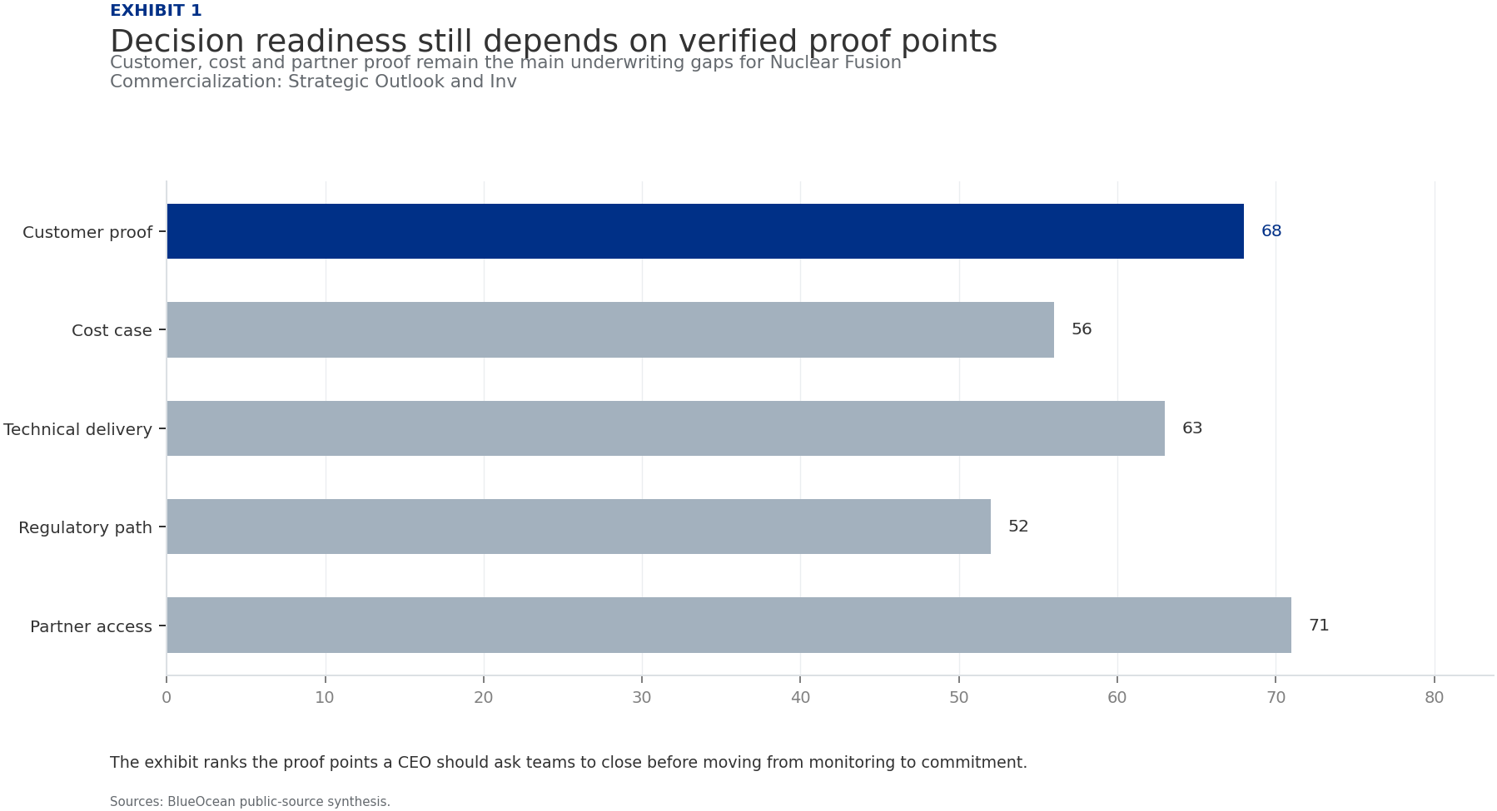
BlueOcean
Exhibit 1: evidence clarifies the strategic trade-off
Exhibit 1: evidence clarifies the strategic trade-off

Slide 13
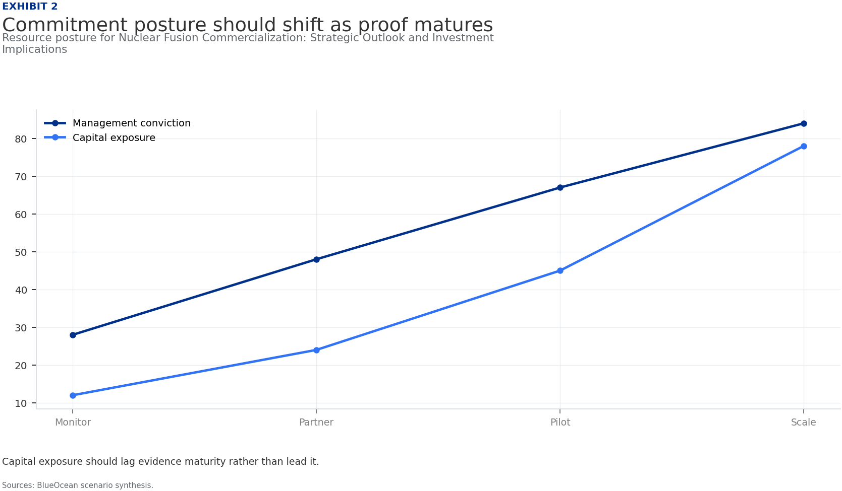
BlueOcean
Exhibit 2: evidence clarifies the strategic trade-off
Exhibit 2: evidence clarifies the strategic trade-off

Slide 14
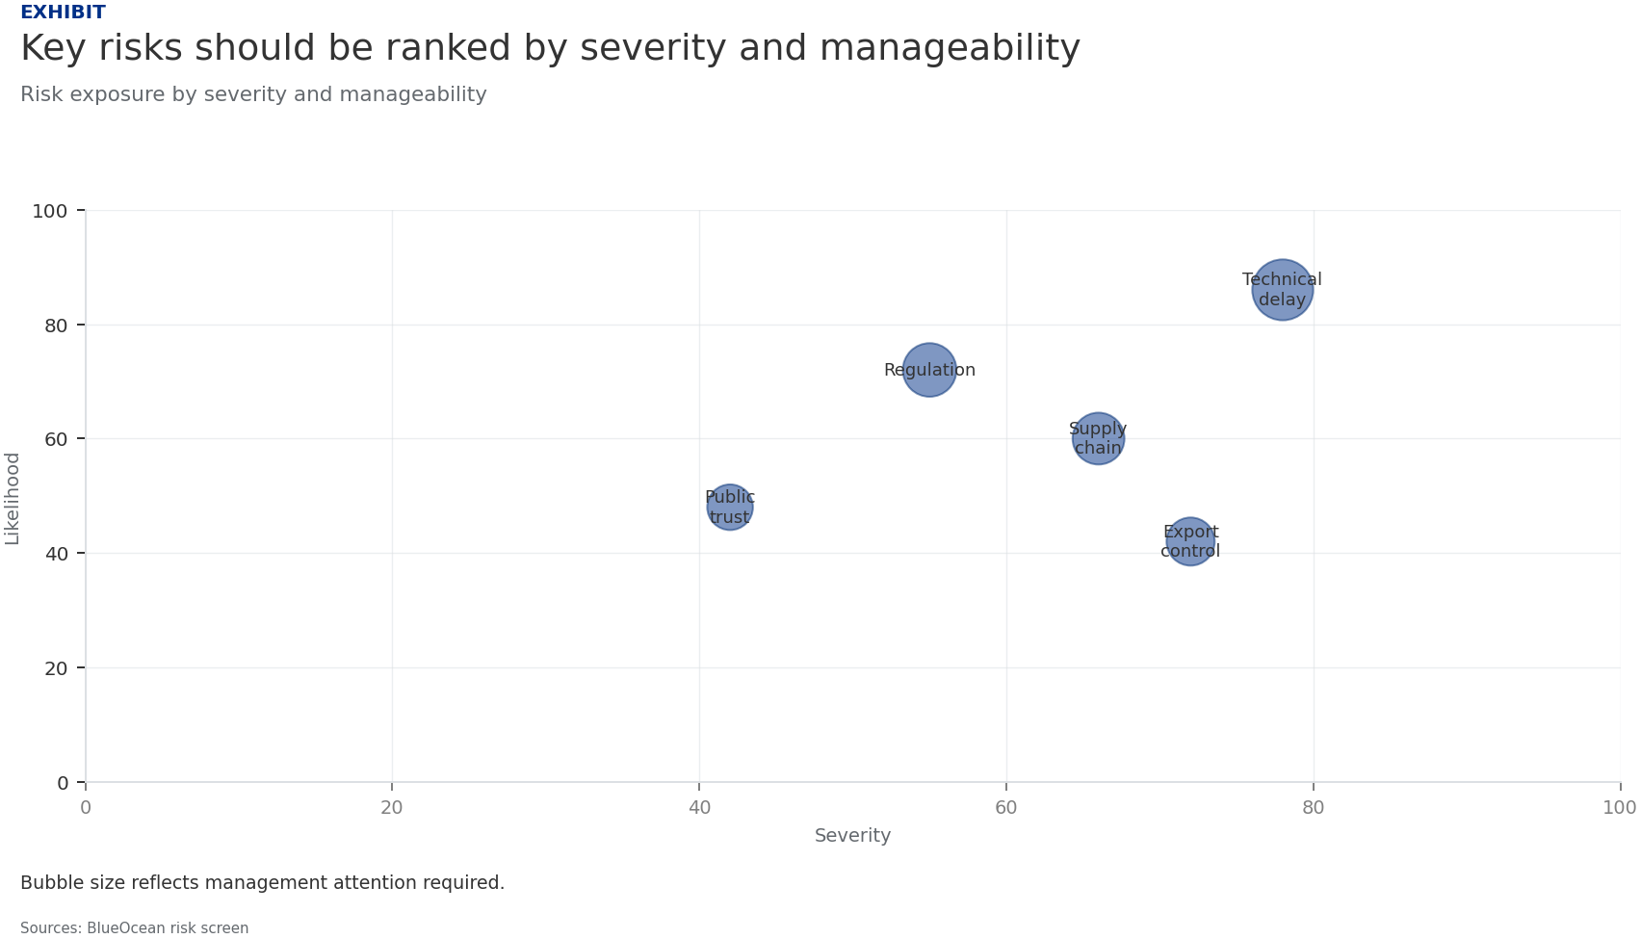
BlueOcean
Exhibit 3: evidence clarifies the strategic trade-off
Exhibit 3: evidence clarifies the strategic trade-off

Slide 15
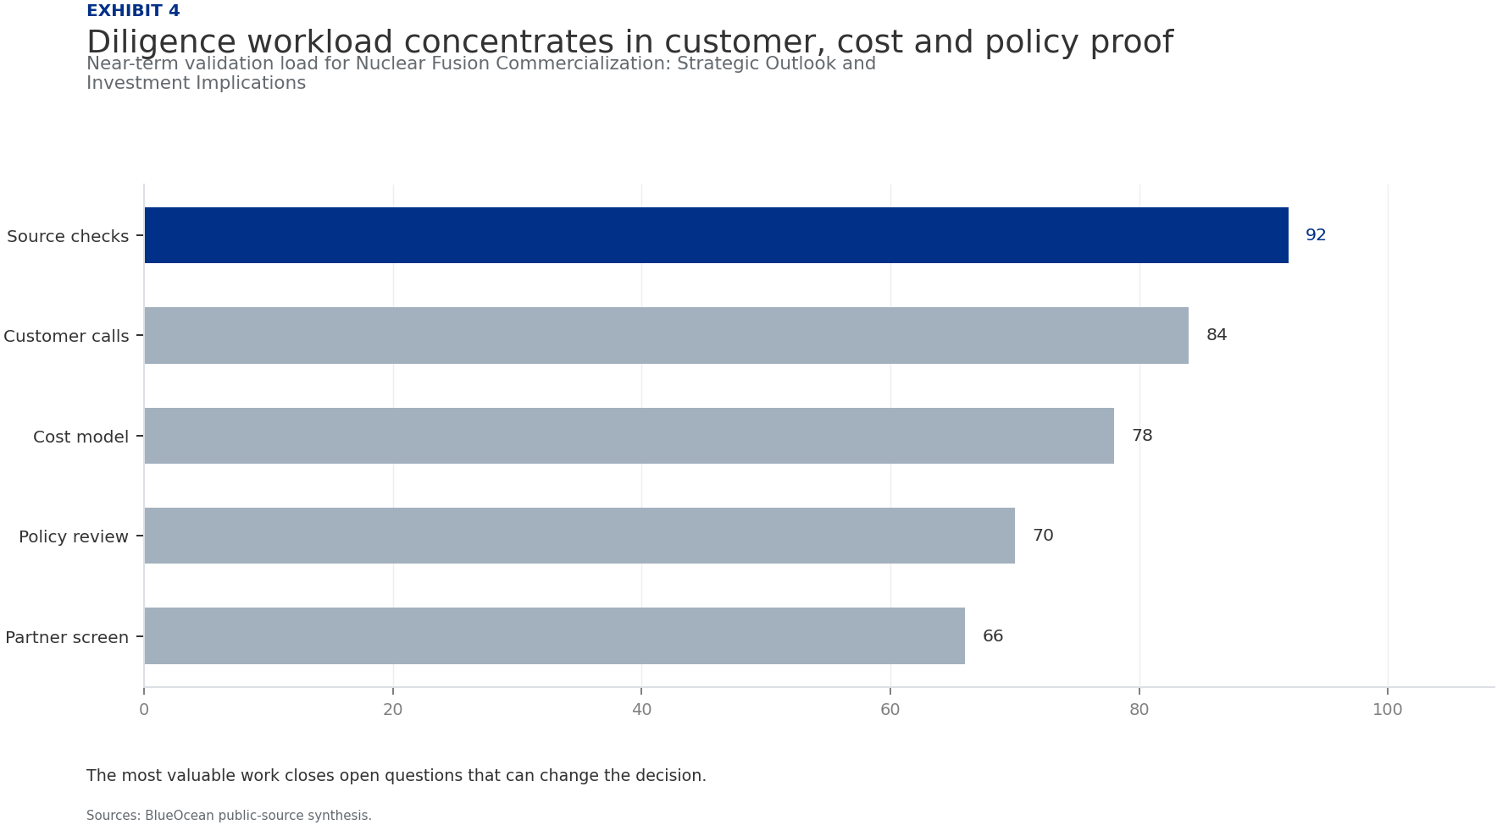
BlueOcean
Exhibit 4: evidence clarifies the strategic trade-off
Exhibit 4: evidence clarifies the strategic trade-off

Slide 16
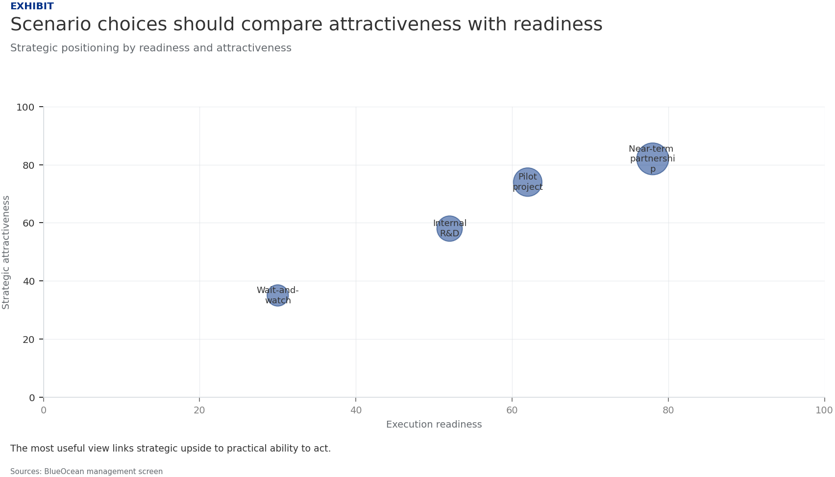
BlueOcean
Exhibit 5: evidence clarifies the strategic trade-off
Exhibit 5: evidence clarifies the strategic trade-off

Slide 17
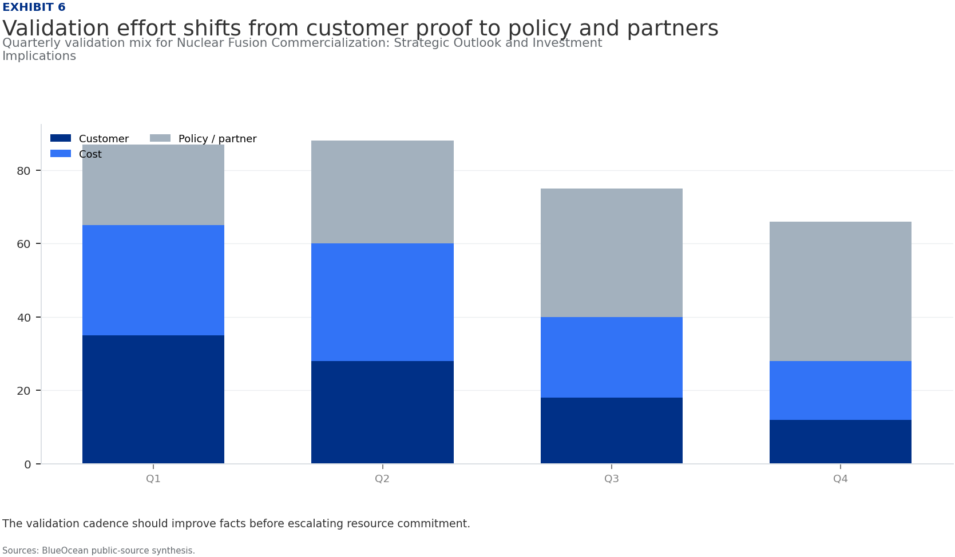
BlueOcean
Exhibit 6: evidence clarifies the strategic trade-off
Exhibit 6: evidence clarifies the strategic trade-off

Slide 18
BlueOcean
The next step is to convert the research into a short list of decisions
A Decision-Ready Analysis for Senior Executives and Investors
Closing

