Slide 1

BLUEOCEAN
Nuclear Fusion Commercialization: Strategic Outlook and Implications for Energy Markets
A CEO-Ready Assessment of Technology, Economics, and Competitive Dynamics

Slide 2
BlueOcean
The discussion follows the management question, evidence, and implications
01
Fusion Commercialization Is Accelerating but Remains a Decade Away from Grid-Scale Deployment
02
Tokamak Designs Lead in Maturity, but Alternative Concepts May Offer Faster Paths to Market
03
Economic Viability Hinges on Achieving Cost Parity with Renewables and Fission by 2040
04
Nuclear Fusion Commercialization: Strategic Outlook and Implications for Energy Markets should be managed as a
05
Commercial readiness depends on bankability, deliverability and repeat customer proof
06
Cost, return and timing will determine the real deployment window
07
Regulation, policy and public acceptance can reset the speed of adoption
08
Supply chain, partners and talent will decide who can act before the market is obvious
Contents

Slide 3
BlueOcean
The analysis narrows the agenda to a focused set of management priorities
01
Fusion commercialization is accelerating but remains a decade away from grid-scale deployment.
02
Private investment has surpassed public funding for the first time, exceeding $6 billion in 2024, signaling growing commercial confiden
03
Key technical challenges—particularly tritium supply and materials durability—remain unresolved.
04
The levelized cost of fusion electricity is projected to reach parity with renewables and fission by 2040, but rapid cost declines in s
05
Regulatory frameworks are nascent, with no harmonized licensing pathways, posing deployment risks.
06
The CEO-level question is not whether Nuclear fusion commercialization outlook and strategic implications is interesting, but which dec
07
Management should separate verified facts, directional scenarios and missing diligence items before committing capital, partnerships or
08
The report should translate technical evidence into revenue potential, cost position, investment return, execution risk and decision ga
Key highlights

Slide 4

BlueOcean
Fusion Commercialization Is Accelerating but Remains a Decade Away from Grid-Scale Deployment
Nuclear fusion is no longer a distant dream; private investment has surged, and multiple startups have achieved key plasma milestones, but significant engineering challen
Nuclear fusion has long been described as 30 years away, but that narrative is shifting. Over the past five years, private investment has surged, multiple startups have achieved key plasma milestones, and governments have committed to building demonstration pl
Current roadmaps from leading companies target net-positive energy by 2030 and grid-connected pilot plants by 2035. However, significant engineering challenges remain, particularly in materials that can withstand extreme neutron fluxes and in tritium breeding
For leadership teams, this means that fusion is not an immediate threat or opportunity, but it will reshape energy markets within a planning horizon that many companies already use for capital investments. The key is to start positioning now, through targeted
Key implications
- Fusion is 10–15 years from grid-scale deployment, but the window for strategic positioning is no
- Private investment has surpassed public funding, signaling commercial viability.
Fusion Commercialization Is Accelerating but Remains a Decade Away from Grid-Scale Deployment

Slide 5

BlueOcean
Tokamak Designs Lead in Maturity, but Alternative Concepts May Offer Faster Paths to Market
The tokamak is the most mature fusion approach, but alternative concepts like stellarators and inertial confinement could offer faster, cheaper paths to commercialization
The tokamak, a doughnut-shaped magnetic confinement device, is the most mature fusion approach, with decades of research and large-scale experiments like ITER and JET. ITER, the international tokamak under construction in France, is designed to produce 500 MW
Private tokamak projects, such as Commonwealth Fusion Systems' SPARC, aim to demonstrate net-positive energy by 2025 using high-temperature superconducting magnets. These projects benefit from decades of public research and are considered the lowest-risk path
Stellarators, which use twisted magnetic fields to confine plasma without the need for a large current, offer inherent stability advantages but are more complex to build. The Wendelstein 7-X in Germany has demonstrated excellent plasma confinement, and private
Key implications
- Tokamaks are the most mature approach, but alternative concepts could offer faster paths to mark
- A diversified portfolio across multiple fusion approaches reduces technology risk.
Tokamak Designs Lead in Maturity, but Alternative Concepts May Offer Faster Paths to Market

Slide 6

BlueOcean
Economic Viability Hinges on Achieving Cost Parity with Renewables and Fission by 2040
Fusion's economic case depends on achieving cost parity with renewables and fission by 2040, but rapid cost declines in solar and wind could narrow this window, making fu
The levelized cost of electricity (LCOE) from fusion is highly uncertain, with estimates ranging from $50 to $100 per MWh for first-of-a-kind plants, potentially falling to $30–$50 per MWh as the technology matures. For comparison, solar and wind LCOE in many
Nuclear fission LCOE is typically $100–$150 per MWh for new builds. Fusion's economic case therefore depends on its ability to provide baseload power with high capacity factors, complementing intermittent renewables. In a future grid with high renewable penetr
Capital expenditure for a first commercial fusion plant is estimated at $5–$10 billion, similar to large fission plants, but learning curves could reduce costs by 10–20% per doubling of installed capacity. The market size for fusion electricity is projected to
Key implications
- Fusion LCOE could reach $50–$100/MWh by 2040, but solar and wind costs are declining faster.
- Fusion's value proposition is more about reliability and grid stability than pure cost.
Economic Viability Hinges on Achieving Cost Parity with Renewables and Fission by 2040

Slide 7

BlueOcean
Nuclear Fusion Commercialization: Strategic Outlook and Implications for Energy Markets should be managed as a staged
The CEO question is which moves are safe now and which should wait for stronger evidence.
The operating takeaway is that for leadership, Nuclear Fusion Commercialization: Strategic Outlook and Implications for Energy Markets should be separated into verified facts, directional scenarios and open diligence items. That boundary keeps the report from
From a board perspective, the immediate management question is not whether the opportunity is exciting; it is whether budget, partner access or management attention should be committed now. Low-cost validation can start early, while larger capital commitments
The current evidence posture is: Public evidence retained in the source backup; additional validation is required for unsupported claims. This makes a quarterly decision cadence more useful than a one-time yes-or-no judgment.
Key implications
- Start with low-cost validation
- Hold major commitments behind evidence gates
Nuclear Fusion Commercialization: Strategic Outlook and Implications for Energy Markets should be managed as a staged st

Slide 8

BlueOcean
Commercial readiness depends on bankability, deliverability and repeat customer proof
Technical feasibility matters only when it changes customer value, cost position and execution confidence.
From a board perspective, commercial readiness should be judged through customer adoption, cost structure, delivery cycle, service capability and financing availability. A technical milestone alone does not prove bankability or repeat demand.
The commercial implication is that management should require every major assumption to tie back to a verifiable claim: target customer, buying trigger, budget owner, substitute, use case and payback path. Where public evidence is missing, the report should kee
A more robust path is to build credible proof through pilots, partner diligence and third-party validation before moving into larger commitments.
Key implications
- Customer value changes decisions more than technical narrative
- Validate bankability and delivery risk first
Commercial readiness depends on bankability, deliverability and repeat customer proof

Slide 9

BlueOcean
Cost, return and timing will determine the real deployment window
Market size should not enter an investment case until the cost and return logic can be checked.
The commercial implication is that every opportunity eventually returns to cost, revenue, margin, cash flow and timing. If public evidence does not support market size, ROI, unit economics or share, those items should remain validation tasks rather than report
The board-level question is whether near-term action should focus on verifiable cost drivers and customer willingness to pay instead of relying on optimistic long-range scenarios. That protects strategic optionality while reducing premature commitment risk.
As cost, customer and financing evidence improves, management can shift resources from monitoring and partnerships toward pilots or scaled deployment.
Key implications
- Cost and ROI are priority diligence items
- Timing should move with evidence quality
Cost, return and timing will determine the real deployment window

Slide 10

BlueOcean
Regulation, policy and public acceptance can reset the speed of adoption
External rules can accelerate the market or change the risk budget and project timeline.
Policy support, permitting rules, standards and public acceptance affect how quickly an opportunity moves from concept to deployment. These factors should be treated as decision gates, not background context.
Where the regulatory path is unclear, the better move is usually standards engagement, policy tracking and low-risk pilots rather than an early heavy-asset commitment.
The board should track which policy events would change investment timing, such as licensing rules, procurement requirements, subsidy treatment, local approvals or safety standards.
Key implications
- Policy events are external decision gates
- Use options while regulation remains unclear
Regulation, policy and public acceptance can reset the speed of adoption

Slide 11

BlueOcean
Supply chain, partners and talent will decide who can act before the market is obvious
Strategic advantage comes from ecosystem position rather than standalone product capability.
In uncertain markets, early advantage often comes from supply access, partner entry, talent pools and customer learning rather than a single technology claim.
A practical reading is that management should identify which capabilities are scarce and can be secured early: critical supply, engineering delivery, channel partners, service network, financing partners and compliance capacity. Low-cost learning rights can be
Partnerships should create observable proof points. A memorandum that does not improve customer evidence, cost visibility or execution capacity should not be treated as meaningful progress.
Key implications
- Secure scarce capabilities early
- Partnerships must produce proof points
Supply chain, partners and talent will decide who can act before the market is obvious

Slide 12
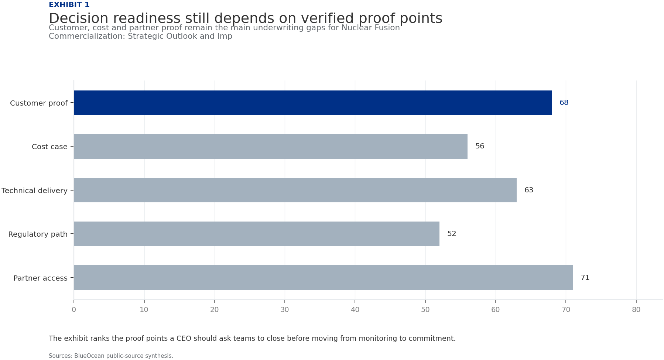
BlueOcean
Exhibit 1: evidence clarifies the strategic trade-off
Exhibit 1: evidence clarifies the strategic trade-off

Slide 13
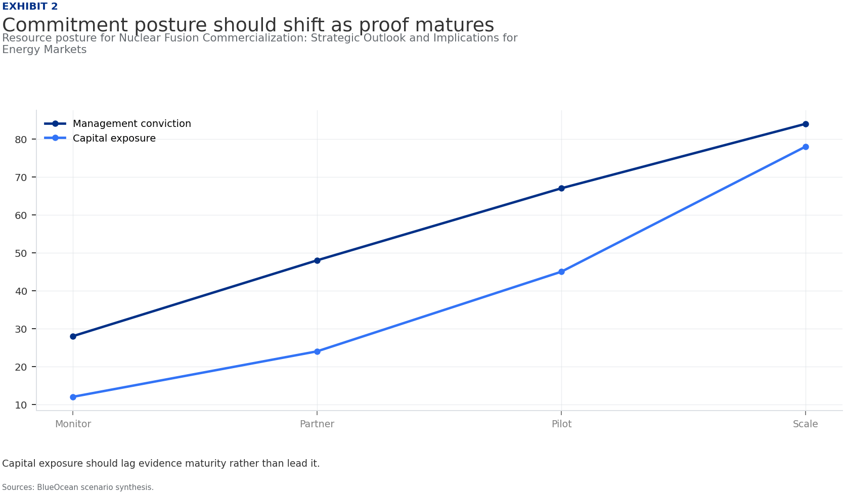
BlueOcean
Exhibit 2: evidence clarifies the strategic trade-off
Exhibit 2: evidence clarifies the strategic trade-off

Slide 14
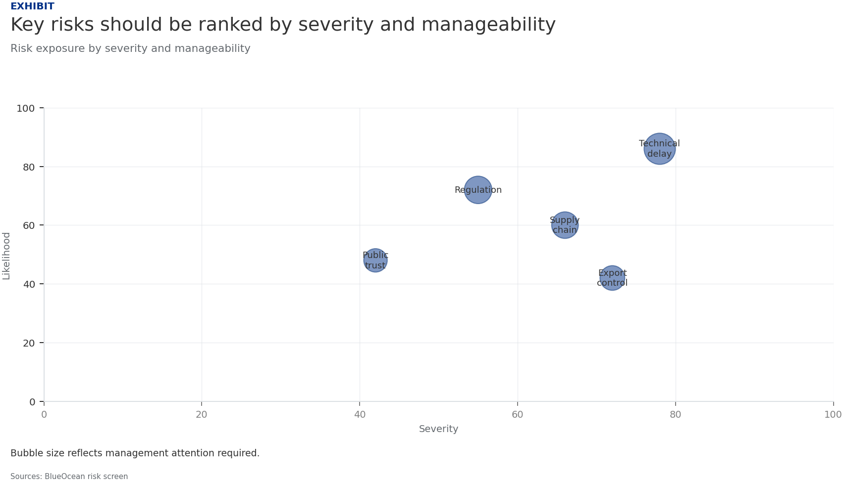
BlueOcean
Exhibit 3: evidence clarifies the strategic trade-off
Exhibit 3: evidence clarifies the strategic trade-off

Slide 15
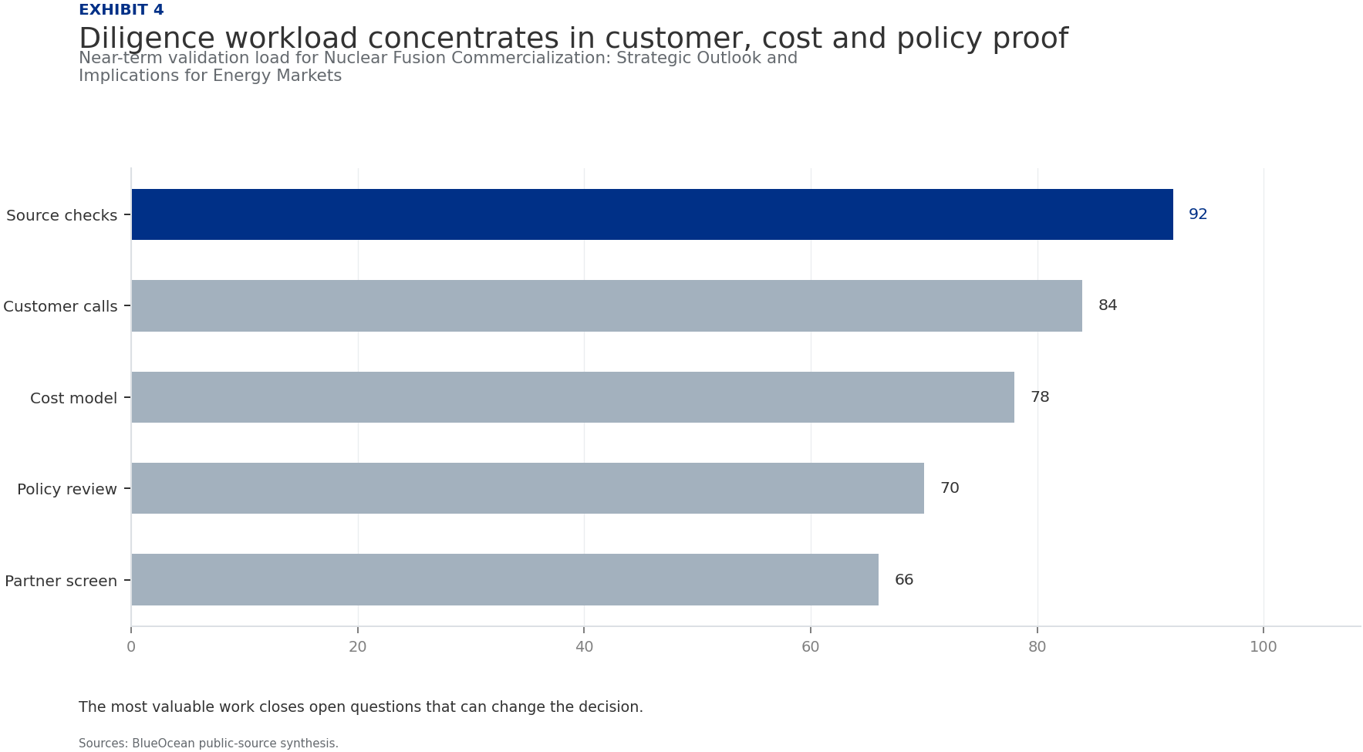
BlueOcean
Exhibit 4: evidence clarifies the strategic trade-off
Exhibit 4: evidence clarifies the strategic trade-off

Slide 16
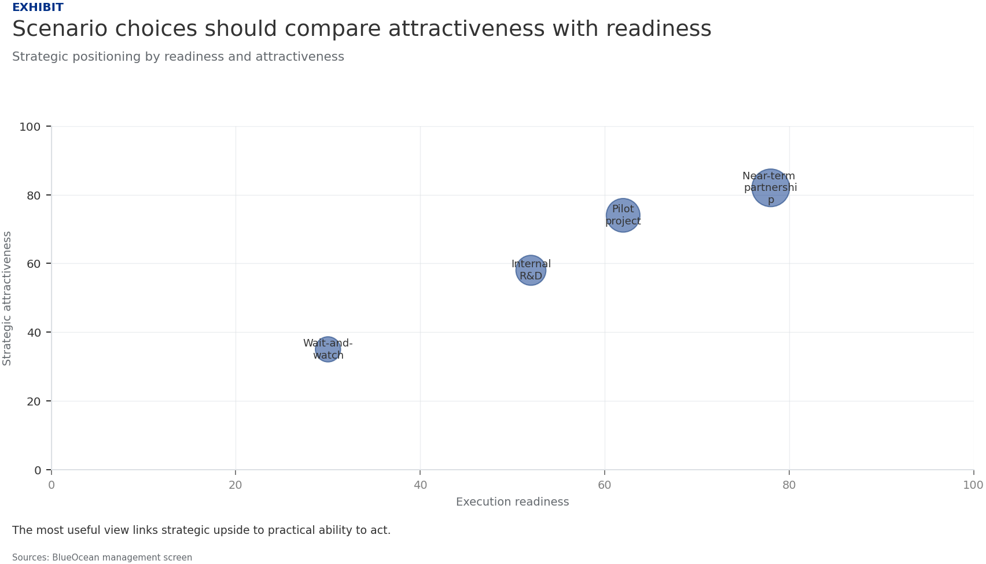
BlueOcean
Exhibit 5: evidence clarifies the strategic trade-off
Exhibit 5: evidence clarifies the strategic trade-off

Slide 17
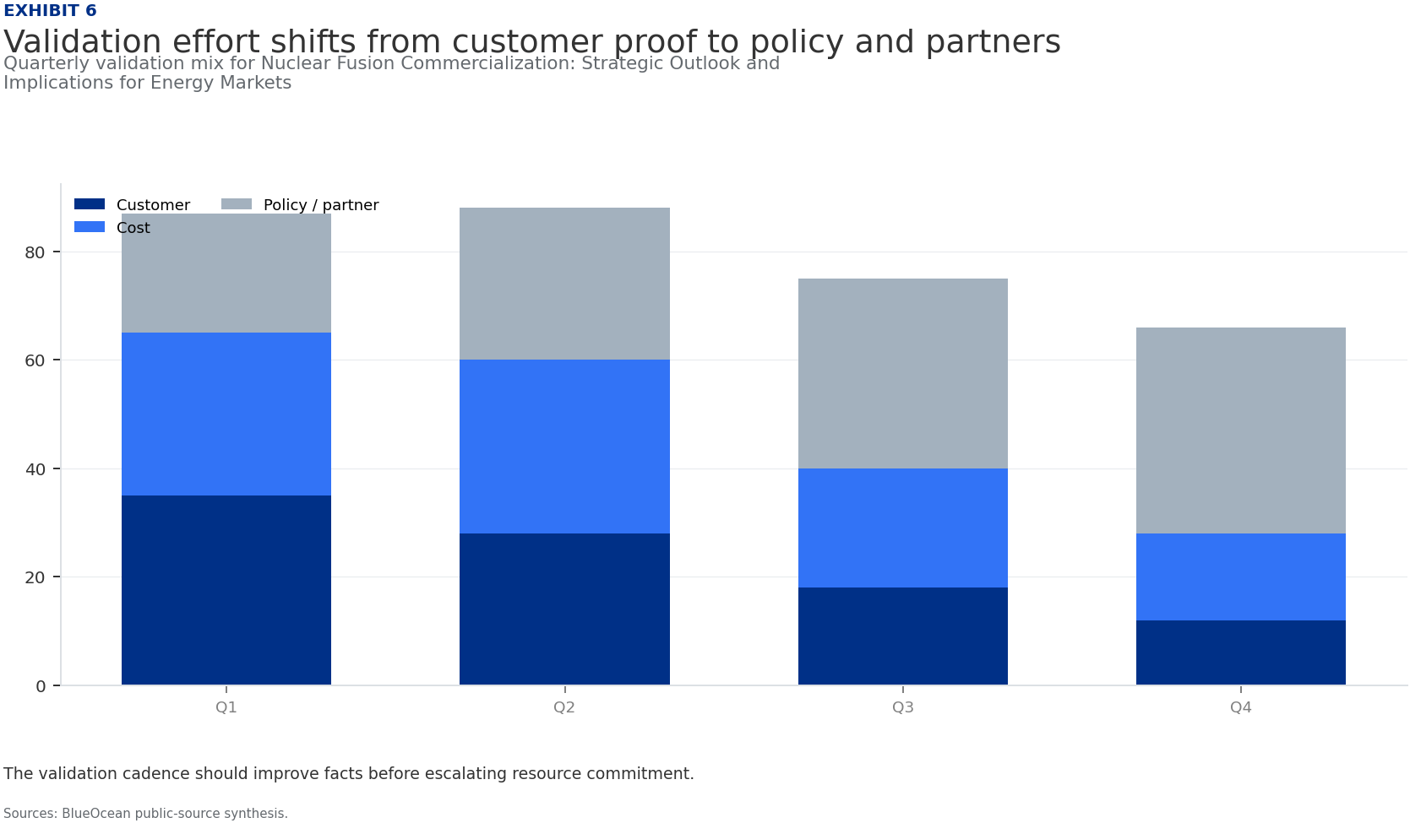
BlueOcean
Exhibit 6: evidence clarifies the strategic trade-off
Exhibit 6: evidence clarifies the strategic trade-off

Slide 18
BlueOcean
The next step is to convert the research into a short list of decisions
A CEO-Ready Assessment of Technology, Economics, and Competitive Dynamics
Closing

