Slide 1

BLUEOCEAN
Nuclear Fusion Commercialization: Strategic Implications for Energy Markets and Geopolitics
A Decision-Ready Assessment for Senior Executives and Policymakers

Slide 2
BlueOcean
The discussion follows the management question, evidence, and implications
01
Nuclear Fusion Is Approaching Technical Breakeven but Commercialization Remains a Decade or More Away
02
Private Fusion Ventures Have Accelerated Timelines but Face Significant Engineering and Cost Hurdles
03
Fusion's Economic Competitiveness Depends on Cost Reductions in Competing Low-Carbon Technologies
04
Strategic Implications of Fusion Include Energy Independence, Reduced Fossil Fuel Dependence, and New Prolifer
05
Nuclear Fusion Commercialization: Strategic Implications for Energy Markets and Geopolitics should be managed
06
Commercial readiness depends on bankability, deliverability and repeat customer proof
07
Cost, return and timing will determine the real deployment window
08
Regulation, policy and public acceptance can reset the speed of adoption
Contents

Slide 3
BlueOcean
The analysis narrows the agenda to a focused set of management priorities
01
Nuclear fusion is approaching a critical technical milestone—scientific net energy gain—but commercialization remains a decade or more
02
The strategic implications are profound: fusion could reshape energy independence, reduce fossil fuel dependence, and create new geopol
03
For decision-makers, the immediate next step is to monitor key technical milestones (e.g., SPARC, ITER) while investing in parallel in
04
The evidence base is limited; many projections rely on unverified company timelines and modeled cost estimates. The risk of fusion bein
05
A balanced, flexible strategy—combining selective fusion R&D investment with robust near-term clean energy deployment—is warranted.
06
The CEO-level question is not whether Nuclear fusion commercialization outlook and strategic implications is interesting, but which dec
07
Management should separate verified facts, directional scenarios and missing diligence items before committing capital, partnerships or
08
The report should translate technical evidence into revenue potential, cost position, investment return, execution risk and decision ga
Key highlights

Slide 4

BlueOcean
Nuclear Fusion Is Approaching Technical Breakeven but Commercialization Remains a Decade or More Away
This chapter establishes that while fusion has achieved scientific breakeven in labs, engineering breakeven for electricity generation is unproven, meaning executives sho
Nuclear fusion has long been considered the holy grail of clean energy, offering the promise of virtually limitless, carbon-free power. In recent years, significant progress has been made toward achieving scientific net energy gain, where the energy output fro
The public-sector flagship, ITER, has faced repeated delays and cost overruns, with first plasma now expected no earlier than 2035 and full deuterium-tritium operations possibly after 2040. The gap between scientific breakeven and commercial viability is wide:
For leadership teams, the key takeaway is that fusion is a high-risk, long-option investment. Capital allocation should be based on verified milestones, not optimistic timelines. The immediate next step is to establish a monitoring function to track progress a
Key implications
- Fusion has achieved scientific breakeven but not engineering breakeven.
- Private timelines are unverified; ITER is delayed to 2035+.
Nuclear Fusion Is Approaching Technical Breakeven but Commercialization Remains a Decade or More Away

Slide 5
BlueOcean
Private Fusion Ventures Have Accelerated Timelines but Face Significant Engineering and Cost Hurdles
This chapter explains that private fusion companies have raised over $5 billion and set aggressive targets, but none have demonstrated a working reactor at scale, so exec
The fusion landscape has been transformed by the entry of well-funded private companies. Commonwealth Fusion Systems, backed by Bill Gates and others, is building SPARC, a compact tokamak designed to achieve Q>2. Helion Energy claims it will demonstrate net el
However, the engineering challenges are formidable. SPARC must demonstrate high-temperature superconducting magnets, plasma stability, and heat extraction. Helion's approach requires rapid pulsed operation and efficient energy recovery. None of these designs h
For decision-makers, the implication is clear: private fusion ventures offer potential upside but carry high technical and execution risk. A diversified investment approach across multiple fusion concepts is prudent. Partnerships with leading ventures can prov
Key implications
- Private fusion ventures have raised over $5 billion but face unproven engineering.
- First-of-a-kind plant costs are estimated at $5-10 billion with high uncertainty.
Private Fusion Ventures Have Accelerated Timelines but Face Significant Engineering and Cost Hurdles

Slide 6
BlueOcean
Fusion's Economic Competitiveness Depends on Cost Reductions in Competing Low-Carbon Technologies
This chapter shows that fusion LCOE projections of $50-100/MWh by 2050 are highly uncertain and face stiff competition from renewables already below $30/MWh, so executive
The economic case for fusion is heavily influenced by the rapidly falling costs of solar, wind, and battery storage. Solar LCOE has declined by 90% over the past decade and is now below $30/MWh in many regions. Wind LCOE is similarly low, and battery storage c
Fusion LCOE projections range from $50-100/MWh by 2050, but these estimates are highly uncertain and depend on unproven engineering. If renewables+storage costs continue to decline, fusion may struggle to compete on cost alone. However, fusion offers advantage
The evidence for fusion LCOE is limited to models and company claims; no real-world data exists. For executives, the strategic implication is that fusion investment should be paired with a clear focus on applications where it has a comparative advantage. Grid-
Key implications
- Solar and wind LCOE are already below $30/MWh and falling.
- Fusion LCOE projections of $50-100/MWh are highly uncertain.
Fusion's Economic Competitiveness Depends on Cost Reductions in Competing Low-Carbon Technologies

Slide 7
BlueOcean
Strategic Implications of Fusion Include Energy Independence, Reduced Fossil Fuel Dependence, and New Proliferation Ri
This chapter argues that fusion could reshape geopolitics by enabling energy independence and reducing fossil fuel dependence, but also introduces proliferation risks, so
Fusion could fundamentally alter the geopolitics of energy. Countries that develop fusion technology could achieve energy independence, reducing reliance on fossil fuel imports and insulating themselves from price volatility. This could weaken the geopolitical
However, fusion also introduces new proliferation risks. The technology could be used to produce weapons-usable materials, and the dual-use nature of fusion research raises concerns about export controls and safeguards. The current nonproliferation regime may
The decision lens is that the strategic implication is to monitor government fusion strategies and assess the potential impact on supply chains and markets. First-mover advantages could be significant, including setting safety standards and dominating supply c
Key implications
- Fusion could enable energy independence and reduce fossil fuel dependence.
- Proliferation risks require robust safeguards and export controls.
Strategic Implications of Fusion Include Energy Independence, Reduced Fossil Fuel Dependence, and New Proliferation Risk

Slide 8
BlueOcean
Nuclear Fusion Commercialization: Strategic Implications for Energy Markets and Geopolitics should be managed as a sta
The CEO question is which moves are safe now and which should wait for stronger evidence.
For leadership, Nuclear Fusion Commercialization: Strategic Implications for Energy Markets and Geopolitics should be separated into verified facts, directional scenarios and open diligence items. That boundary keeps the report from turning market enthusiasm o
The immediate management question is not whether the opportunity is exciting; it is whether budget, partner access or management attention should be committed now. Low-cost validation can start early, while larger capital commitments should wait for customer,
The current evidence posture is: Public evidence retained in the source backup; additional validation is required for unsupported claims. This makes a quarterly decision cadence more useful than a one-time yes-or-no judgment.
Key implications
- Start with low-cost validation
- Hold major commitments behind evidence gates
Nuclear Fusion Commercialization: Strategic Implications for Energy Markets and Geopolitics should be managed as a stage

Slide 9
BlueOcean
Commercial readiness depends on bankability, deliverability and repeat customer proof
Technical feasibility matters only when it changes customer value, cost position and execution confidence.
Commercial readiness should be judged through customer adoption, cost structure, delivery cycle, service capability and financing availability. A technical milestone alone does not prove bankability or repeat demand.
Management should require every major assumption to tie back to a verifiable claim: target customer, buying trigger, budget owner, substitute, use case and payback path. Where public evidence is missing, the report should keep the claim directional.
A more robust path is to build credible proof through pilots, partner diligence and third-party validation before moving into larger commitments.
Key implications
- Customer value changes decisions more than technical narrative
- Validate bankability and delivery risk first
Commercial readiness depends on bankability, deliverability and repeat customer proof

Slide 10
BlueOcean
Cost, return and timing will determine the real deployment window
Market size should not enter an investment case until the cost and return logic can be checked.
Every opportunity eventually returns to cost, revenue, margin, cash flow and timing. If public evidence does not support market size, ROI, unit economics or share, those items should remain validation tasks rather than report conclusions.
Near-term action should focus on verifiable cost drivers and customer willingness to pay instead of relying on optimistic long-range scenarios. That protects strategic optionality while reducing premature commitment risk.
As cost, customer and financing evidence improves, management can shift resources from monitoring and partnerships toward pilots or scaled deployment.
Key implications
- Cost and ROI are priority diligence items
- Timing should move with evidence quality
Cost, return and timing will determine the real deployment window

Slide 11
BlueOcean
Regulation, policy and public acceptance can reset the speed of adoption
External rules can accelerate the market or change the risk budget and project timeline.
Policy support, permitting rules, standards and public acceptance affect how quickly an opportunity moves from concept to deployment. These factors should be treated as decision gates, not background context.
Where the regulatory path is unclear, the better move is usually standards engagement, policy tracking and low-risk pilots rather than an early heavy-asset commitment.
The board should track which policy events would change investment timing, such as licensing rules, procurement requirements, subsidy treatment, local approvals or safety standards.
Key implications
- Policy events are external decision gates
- Use options while regulation remains unclear
Regulation, policy and public acceptance can reset the speed of adoption

Slide 12
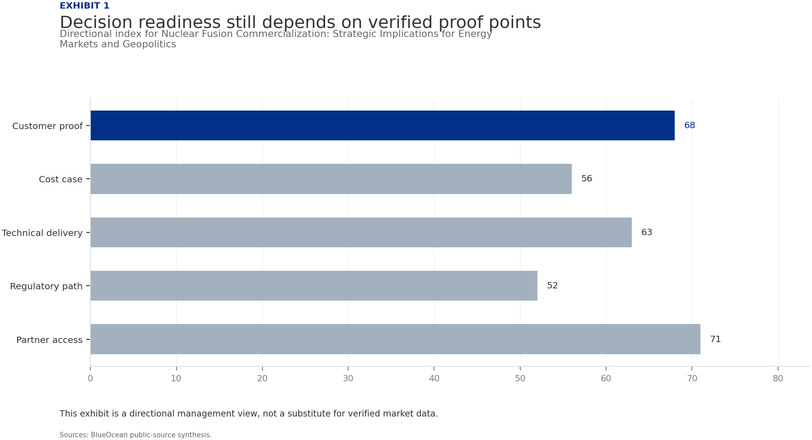
BlueOcean
Exhibit 1: evidence clarifies the strategic trade-off
Exhibit 1: evidence clarifies the strategic trade-off

Slide 13
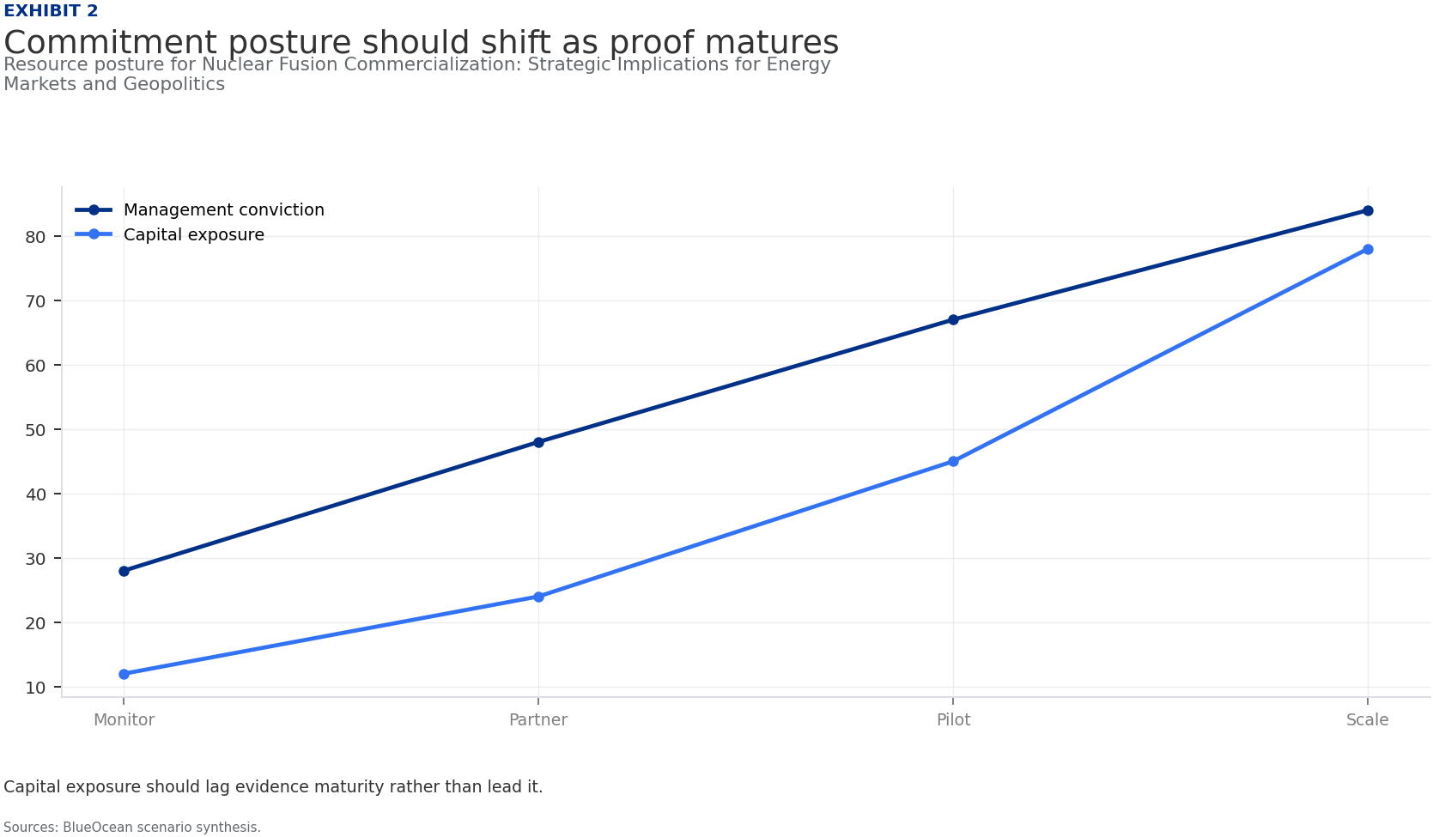
BlueOcean
Exhibit 2: evidence clarifies the strategic trade-off
Exhibit 2: evidence clarifies the strategic trade-off

Slide 14
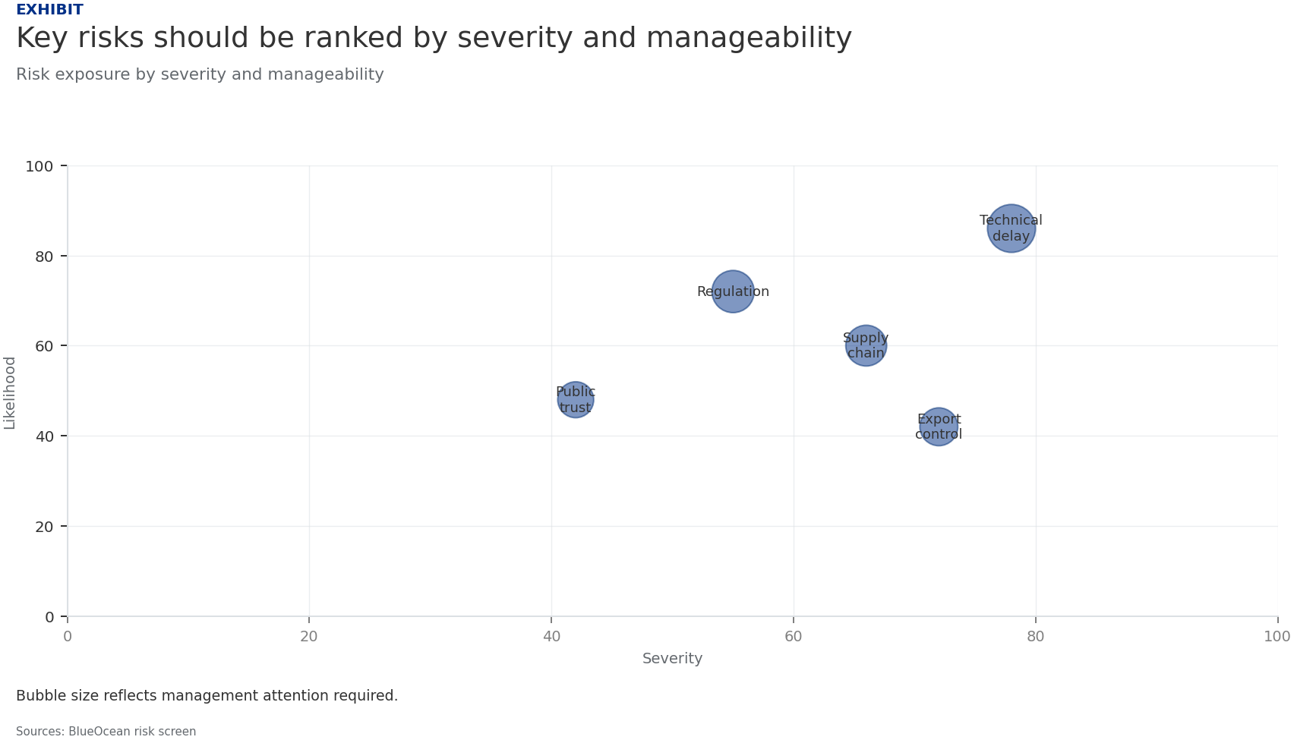
BlueOcean
Exhibit 3: evidence clarifies the strategic trade-off
Exhibit 3: evidence clarifies the strategic trade-off

Slide 15
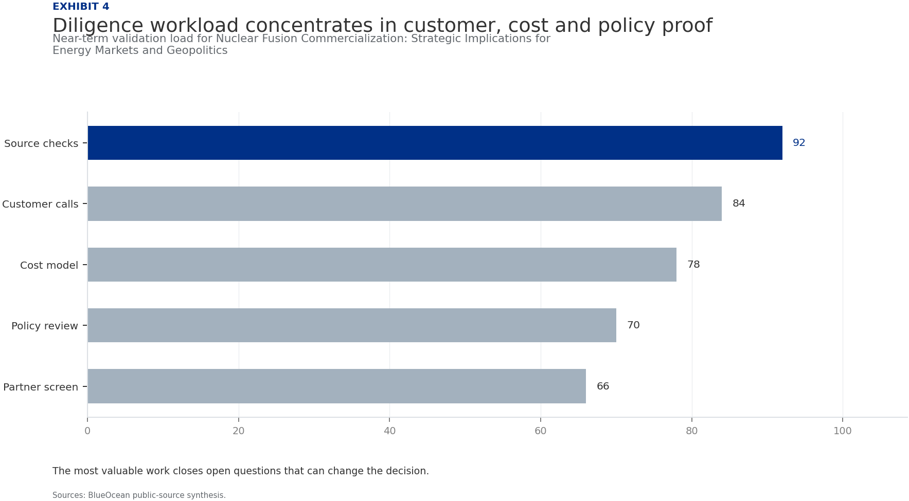
BlueOcean
Exhibit 4: evidence clarifies the strategic trade-off
Exhibit 4: evidence clarifies the strategic trade-off

Slide 16
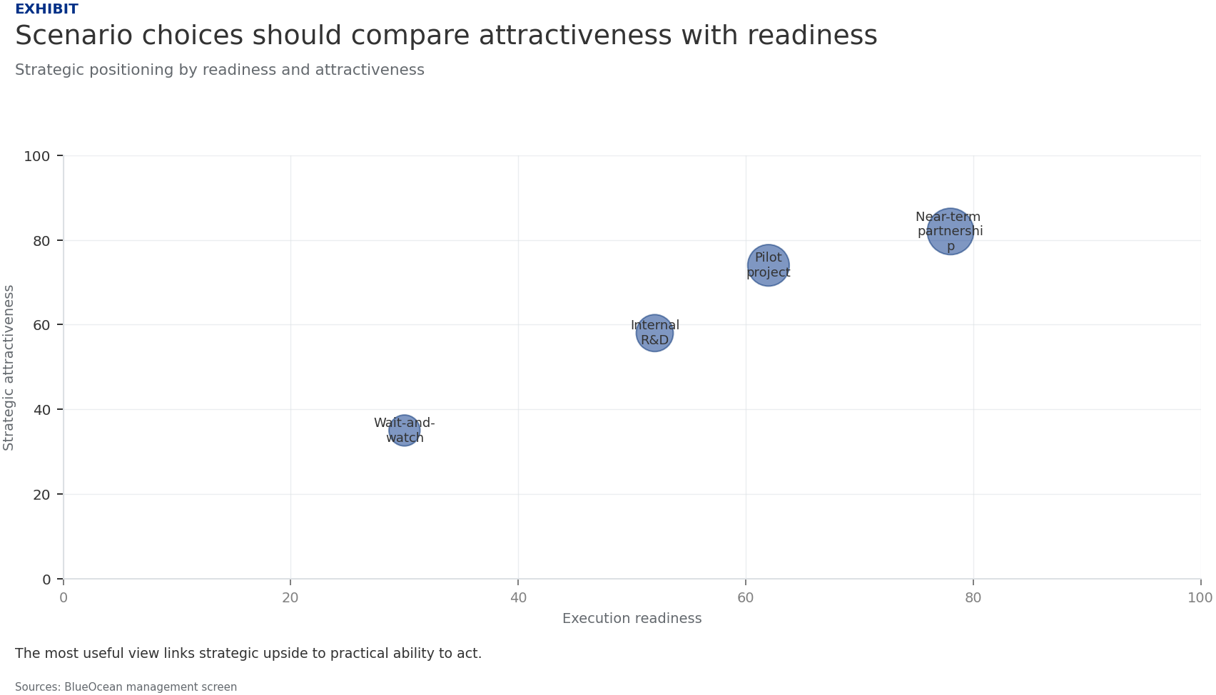
BlueOcean
Exhibit 5: evidence clarifies the strategic trade-off
Exhibit 5: evidence clarifies the strategic trade-off

Slide 17
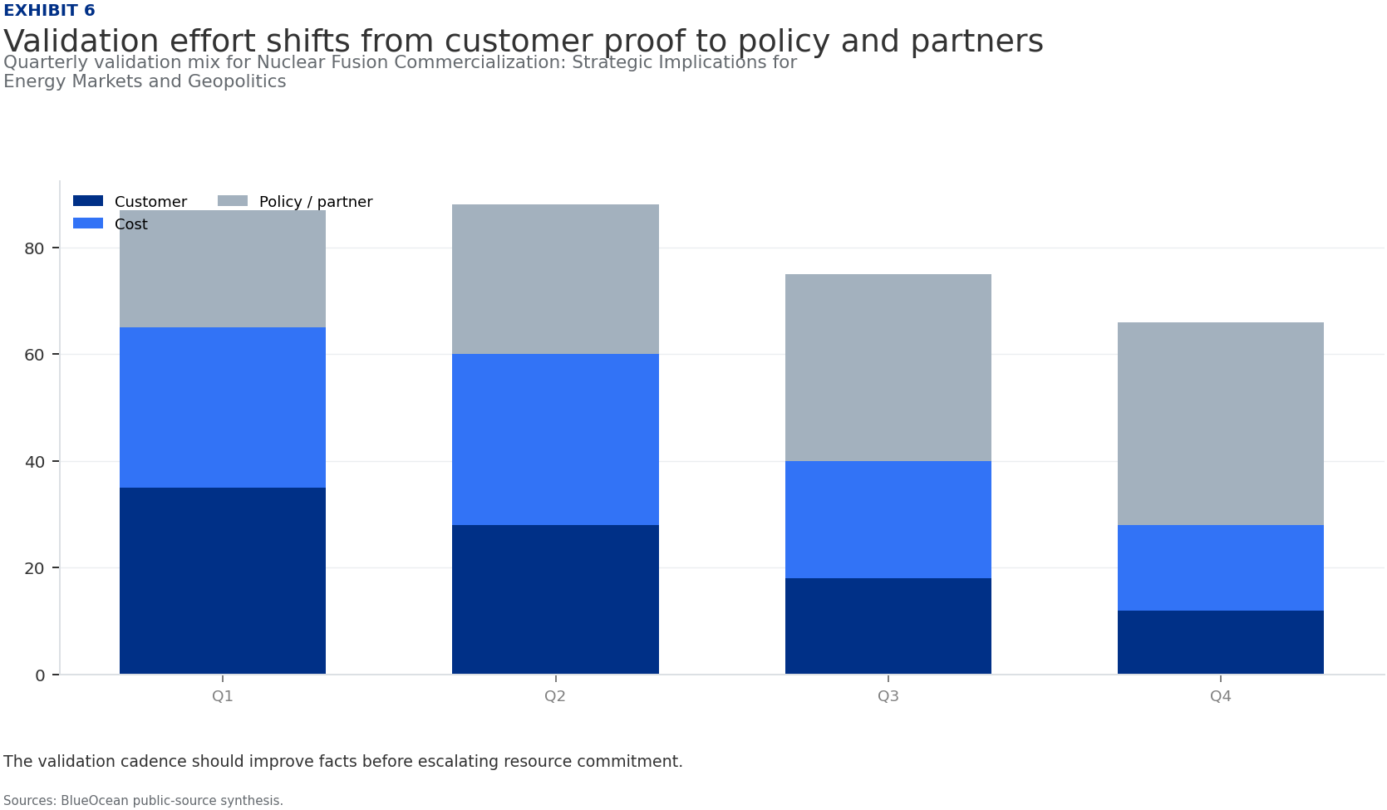
BlueOcean
Exhibit 6: evidence clarifies the strategic trade-off
Exhibit 6: evidence clarifies the strategic trade-off

Slide 18
BlueOcean
The next step is to convert the research into a short list of decisions
A Decision-Ready Assessment for Senior Executives and Policymakers
Closing

