Slide 1

BLUEOCEAN
Nuclear Fusion Commercialization: Strategic Implications for Energy Markets and Investment
A Decision-Ready Assessment for Senior Executives and Investors

Slide 2
BlueOcean
The discussion follows the management question, evidence, and implications
01
Fusion Commercialization Is Unlikely Before the 2040s Despite Recent Progress
02
Private Fusion Ventures Are Accelerating Timelines but Face Significant Hurdles
03
Fusion Will Complement Renewables Rather Than Replace Them in a Decarbonized Grid
04
First-Mover Advantages in Fusion Are Limited Due to Long Development Cycles and High Capital Costs
05
Geopolitical Competition in Fusion Is Intensifying, Especially Between the US and China
06
Nuclear Fusion Commercialization: Strategic Implications for Energy Markets and Investment should be managed a
07
Commercial readiness depends on bankability, deliverability and repeat customer proof
08
Cost, return and timing will determine the real deployment window
Contents

Slide 3
BlueOcean
The analysis narrows the agenda to a focused set of management priorities
01
Nuclear fusion commercialization is unlikely before the 2040s despite recent technical breakthroughs, with private ventures acceleratin
02
Fusion will complement renewables in a decarbonized grid, not replace them, and first-mover advantages are limited due to long developm
03
Key technical challenges (plasma confinement, materials, tritium breeding) are unresolved, and no complete regulatory framework exists.
04
The primary risk is that fusion may remain uneconomical compared to rapidly falling renewables and storage costs.
05
Immediate next step: organizations should invest in strategic partnerships and monitor milestones from leading projects (SPARC, ITER, S
06
The CEO-level question is not whether Nuclear fusion commercialization outlook and strategic implications is interesting, but which dec
07
Management should separate verified facts, directional scenarios and missing diligence items before committing capital, partnerships or
08
The report should translate technical evidence into revenue potential, cost position, investment return, execution risk and decision ga
Key highlights

Slide 4

BlueOcean
Fusion Commercialization Is Unlikely Before the 2040s Despite Recent Progress
This chapter concludes that fusion commercialization is unlikely before the 2040s, meaning executives should plan for a 15-20 year horizon and avoid near-term capital all
The path to commercial fusion power remains long and uncertain. ITER, the flagship international experiment, has experienced repeated delays and cost overruns; its first plasma is now expected in 2025, with full deuterium-tritium operation not until the 2030s.
Key technical hurdles include achieving stable plasma confinement for extended periods, developing materials that can withstand extreme neutron bombardment, and demonstrating tritium breeding at scale. Tritium supply is a critical bottleneck: first-generation
For leadership teams, the implication is clear: fusion is not a near-term solution. Capital allocation decisions should be based on a 15-20 year horizon, and organizations should avoid overcommitting to unproven timelines. Monitoring technical milestones from
Key implications
- Fusion commercialization is unlikely before the 2040s.
- Key technical hurdles remain unresolved.
Fusion Commercialization Is Unlikely Before the 2040s Despite Recent Progress

Slide 5
BlueOcean
Private Fusion Ventures Are Accelerating Timelines but Face Significant Hurdles
This chapter concludes that private fusion ventures are accelerating timelines but face significant hurdles, meaning executives should treat private timelines as aspirati
Over 30 private fusion companies have raised more than $5 billion in total funding since 2015, with notable rounds from Commonwealth Fusion Systems ($2 billion), Helion Energy ($500 million), and TAE Technologies ($1.2 billion). These ventures promise faster t
The economic viability of private fusion remains uncertain. First-of-a-kind plants are expected to cost $5-10 billion or more, with construction timelines of 10-15 years. Learning curves may reduce costs over time, but early movers face technology risk and reg
For decision-makers, the key is to treat private timelines as aspirational. Strategic partnerships with milestone-based investment options can provide upside exposure while limiting downside risk. Companies should also consider investing in enabling technologi
Key implications
- Private fusion ventures have raised over $5 billion but no net energy gain demonstrated.
- Economic viability uncertain; first-of-a-kind plants cost $5-10 billion.
Private Fusion Ventures Are Accelerating Timelines but Face Significant Hurdles

Slide 6
BlueOcean
Fusion Will Complement Renewables Rather Than Replace Them in a Decarbonized Grid
This chapter concludes that fusion will complement renewables rather than replace them, meaning executives should integrate fusion into long-term planning as a complement
Fusion is best suited for baseload power and industrial heat, not for peaking or distributed generation. Renewables like solar and wind are projected to reach levelized costs of $20-40 per MWh by 2030, while fusion LCOE estimates range from $50-100 per MWh for
In hard-to-abate sectors such as heavy industry, shipping, and aviation, fusion could play a transformative role by providing high-temperature heat for industrial processes or enabling green hydrogen production. These applications may offer higher value than g
For energy companies, the strategic implication is to integrate fusion into long-term planning as a complement to renewables, not a competitor. Investments in grid flexibility, storage, and hydrogen infrastructure will remain critical regardless of fusion's ti
Key implications
- Fusion LCOE $50-100/MWh vs renewables $20-40/MWh by 2030.
- Fusion best for baseload and industrial heat, not peaking.
Fusion Will Complement Renewables Rather Than Replace Them in a Decarbonized Grid

Slide 7
BlueOcean
First-Mover Advantages in Fusion Are Limited Due to Long Development Cycles and High Capital Costs
This chapter concludes that first-mover advantages are limited, meaning executives should avoid large early commitments and consider fast-follower strategies or consortiu
The high capital costs and long construction timelines of fusion plants limit the value of being first to market. First-of-a-kind plants are expected to cost $5-10 billion or more, with construction taking 10-15 years. Learning curves may reduce costs for subs
Instead of pursuing first-mover status, companies should consider a 'fast follower' strategy: invest in enabling technologies and supply chains, and be ready to deploy once the technology is proven at commercial scale. Consortium participation or technology li
For investors, the implication is to avoid large early commitments. Milestone-based investments and diversified portfolios across multiple fusion concepts can manage risk while maintaining exposure to potential upside.
Key implications
- First-of-a-kind plants cost $5-10 billion; construction 10-15 years.
- Fast-follower strategy reduces risk.
First-Mover Advantages in Fusion Are Limited Due to Long Development Cycles and High Capital Costs

Slide 8
BlueOcean
Geopolitical Competition in Fusion Is Intensifying, Especially Between the US and China
This chapter concludes that geopolitical competition is intensifying, meaning executives should monitor national strategies for supply chain and talent implications and c
China has announced a $1.5 billion national fusion program and is building the CFETR reactor, aiming for operation by the 2030s. The US Department of Energy launched a $50 million public-private fusion program in 2023.
The source backup should be used to validate this section before it is used for a decision.
Key implications
- Geopolitical competition is intensifying.
- Monitor national strategies for supply chain and talent implications.
Geopolitical Competition in Fusion Is Intensifying, Especially Between the US and China

Slide 9
BlueOcean
Nuclear Fusion Commercialization: Strategic Implications for Energy Markets and Investment should be managed as a stag
The CEO question is which moves are safe now and which should wait for stronger evidence.
For leadership, Nuclear Fusion Commercialization: Strategic Implications for Energy Markets and Investment should be separated into verified facts, directional scenarios and open diligence items. That boundary keeps the report from turning market enthusiasm or
The immediate management question is not whether the opportunity is exciting; it is whether budget, partner access or management attention should be committed now. Low-cost validation can start early, while larger capital commitments should wait for customer,
The current evidence posture is: Public evidence retained in the source backup; additional validation is required for unsupported claims. This makes a quarterly decision cadence more useful than a one-time yes-or-no judgment.
Key implications
- Start with low-cost validation
- Hold major commitments behind evidence gates
Nuclear Fusion Commercialization: Strategic Implications for Energy Markets and Investment should be managed as a staged

Slide 10
BlueOcean
Commercial readiness depends on bankability, deliverability and repeat customer proof
Technical feasibility matters only when it changes customer value, cost position and execution confidence.
Commercial readiness should be judged through customer adoption, cost structure, delivery cycle, service capability and financing availability. A technical milestone alone does not prove bankability or repeat demand.
Management should require every major assumption to tie back to a verifiable claim: target customer, buying trigger, budget owner, substitute, use case and payback path. Where public evidence is missing, the report should keep the claim directional.
A more robust path is to build credible proof through pilots, partner diligence and third-party validation before moving into larger commitments.
Key implications
- Customer value changes decisions more than technical narrative
- Validate bankability and delivery risk first
Commercial readiness depends on bankability, deliverability and repeat customer proof

Slide 11
BlueOcean
Cost, return and timing will determine the real deployment window
Market size should not enter an investment case until the cost and return logic can be checked.
Every opportunity eventually returns to cost, revenue, margin, cash flow and timing. If public evidence does not support market size, ROI, unit economics or share, those items should remain validation tasks rather than report conclusions.
Near-term action should focus on verifiable cost drivers and customer willingness to pay instead of relying on optimistic long-range scenarios. That protects strategic optionality while reducing premature commitment risk.
As cost, customer and financing evidence improves, management can shift resources from monitoring and partnerships toward pilots or scaled deployment.
Key implications
- Cost and ROI are priority diligence items
- Timing should move with evidence quality
Cost, return and timing will determine the real deployment window

Slide 12
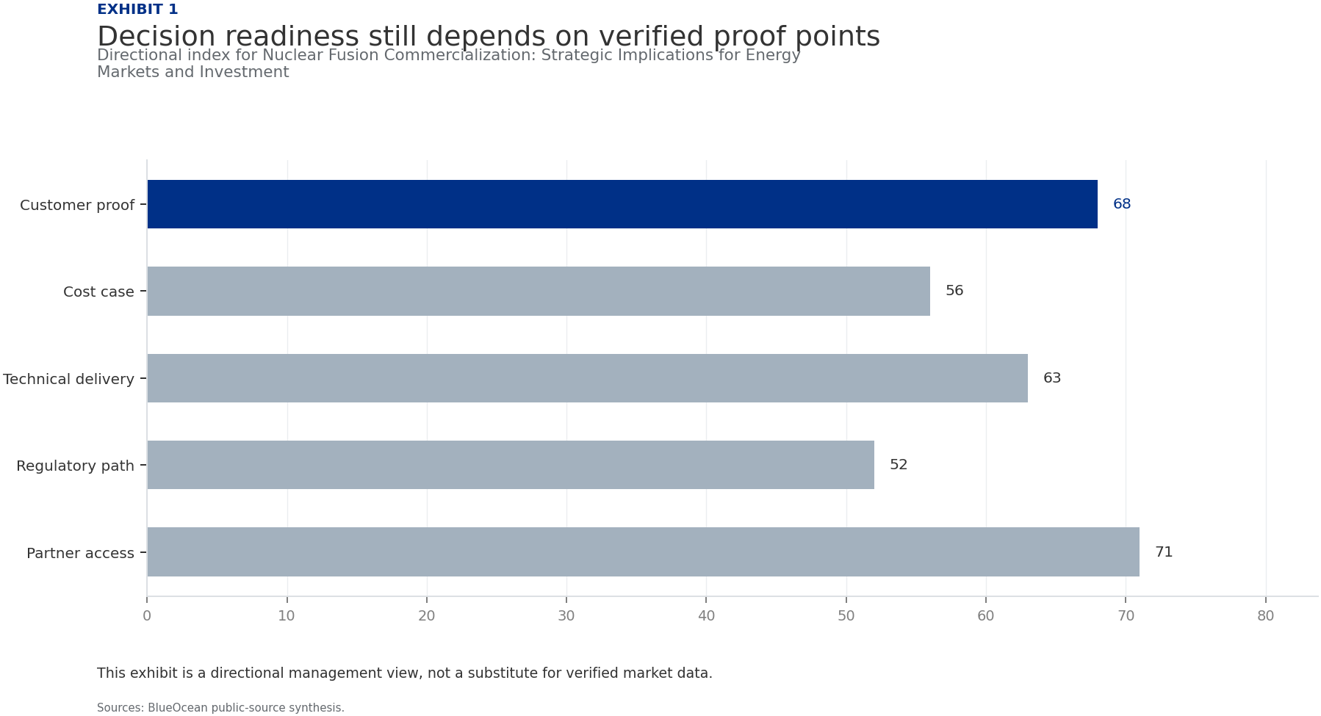
BlueOcean
Exhibit 1: evidence clarifies the strategic trade-off
Exhibit 1: evidence clarifies the strategic trade-off

Slide 13
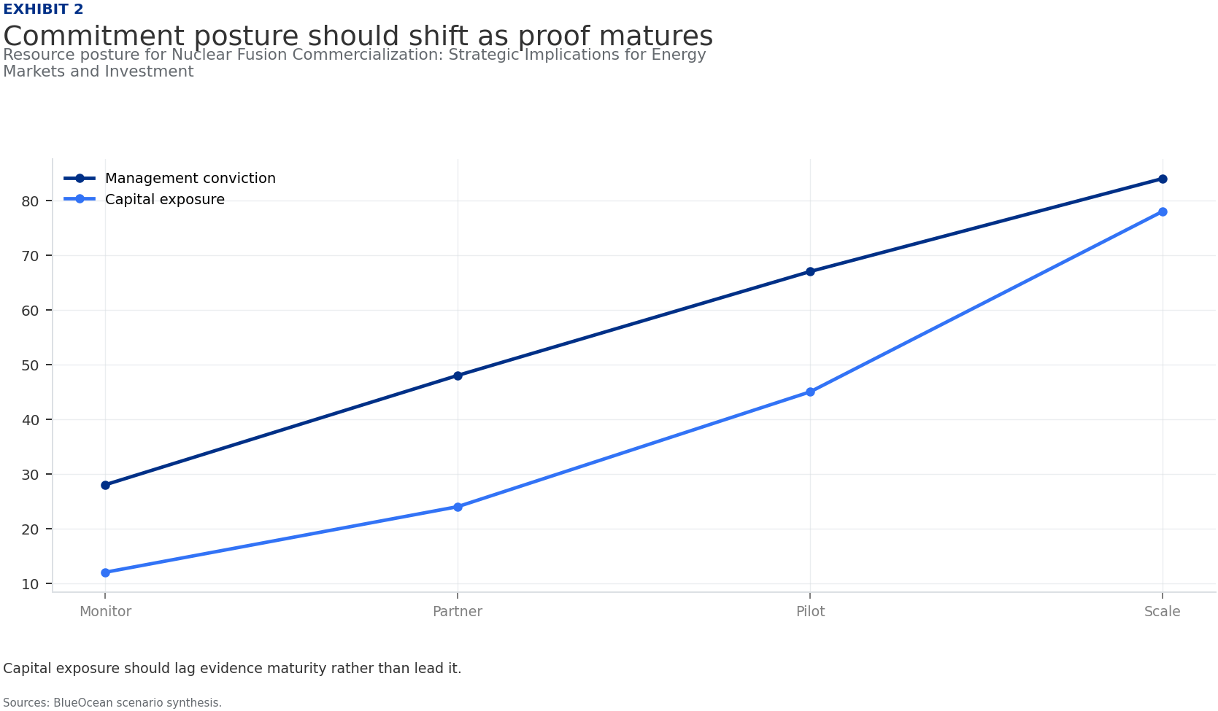
BlueOcean
Exhibit 2: evidence clarifies the strategic trade-off
Exhibit 2: evidence clarifies the strategic trade-off

Slide 14
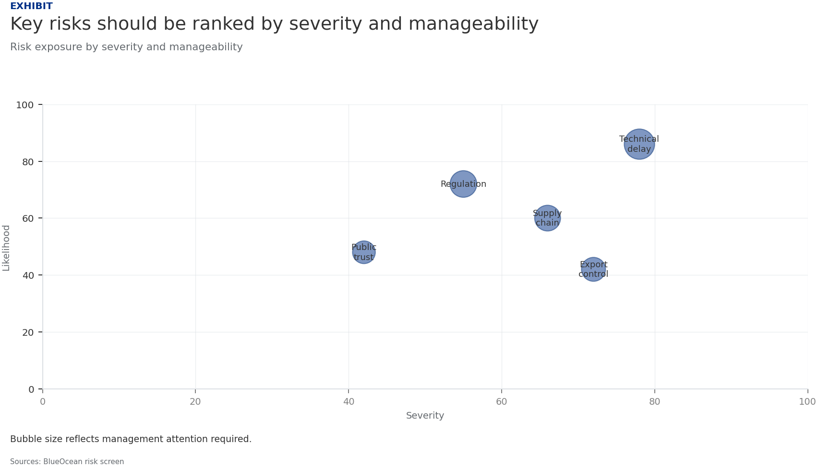
BlueOcean
Exhibit 3: evidence clarifies the strategic trade-off
Exhibit 3: evidence clarifies the strategic trade-off

Slide 15
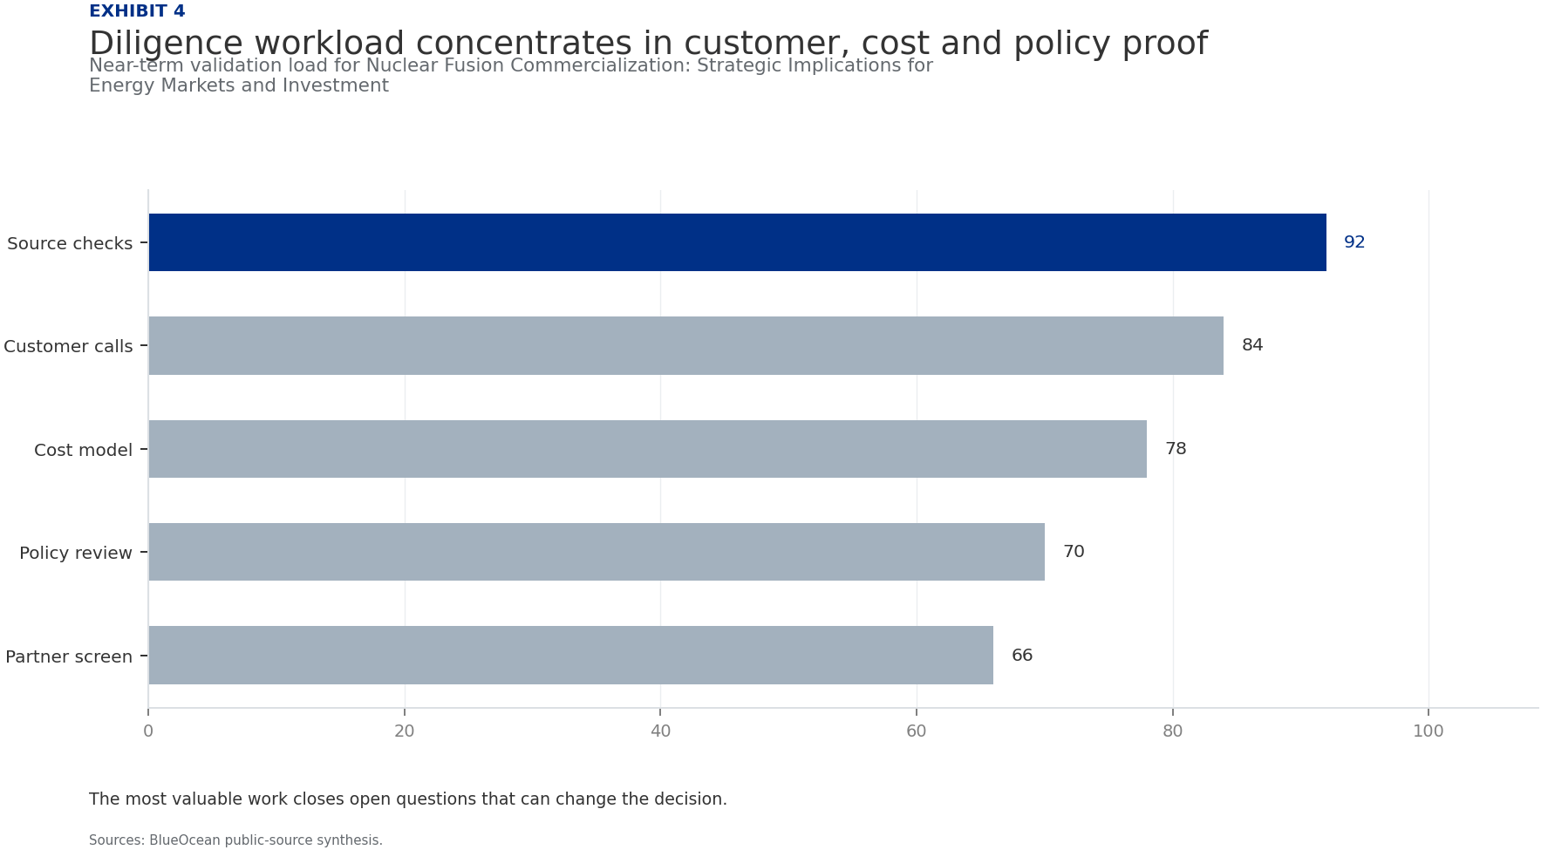
BlueOcean
Exhibit 4: evidence clarifies the strategic trade-off
Exhibit 4: evidence clarifies the strategic trade-off

Slide 16
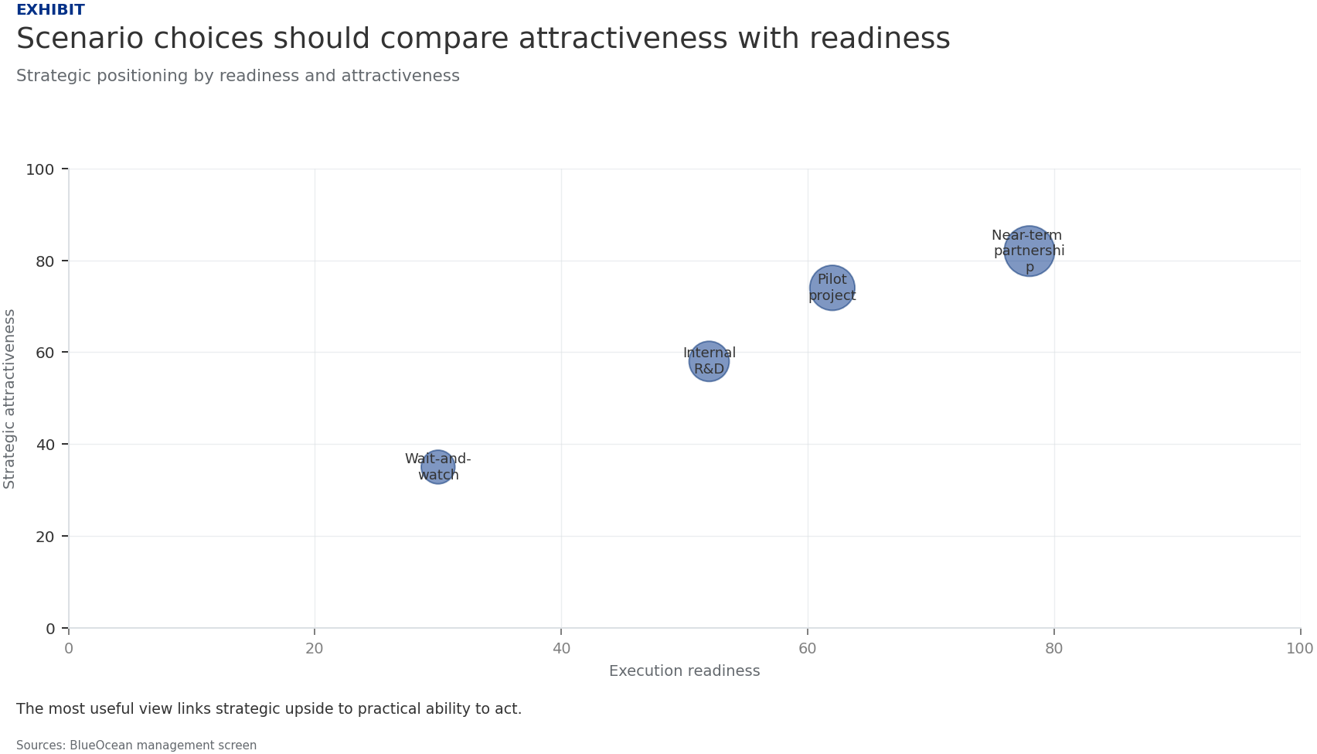
BlueOcean
Exhibit 5: evidence clarifies the strategic trade-off
Exhibit 5: evidence clarifies the strategic trade-off

Slide 17
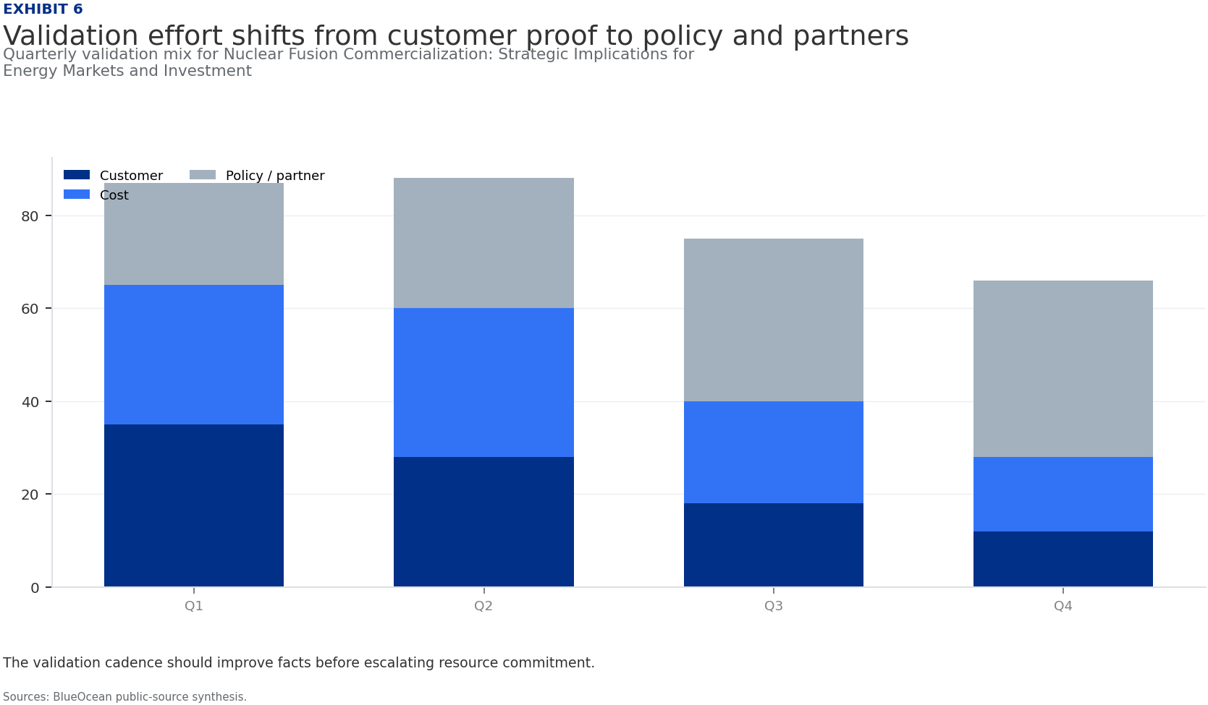
BlueOcean
Exhibit 6: evidence clarifies the strategic trade-off
Exhibit 6: evidence clarifies the strategic trade-off

Slide 18
BlueOcean
The next step is to convert the research into a short list of decisions
A Decision-Ready Assessment for Senior Executives and Investors
Closing

