Slide 1

BLUEOCEAN
AI Agent Market Research
A client-ready strategic assessment based on public evidence, market signals and management-consulting synthesis.

Slide 2
BlueOcean
The discussion follows the management question, evidence, and implications
01
China's VRFB edge is becoming structural as supply, cost and policy reinforce each other
02
Dali can convert technical capacity into leadership only if it proves project bankability
03
Vanadium access gives Chinese suppliers a resilience edge, but price volatility still needs active management
04
Policy support creates a protected base market, but export growth needs local legitimacy
05
Lifecycle economics is the clearest wedge against lithium-ion in long-duration use cases
06
Global competitors retain niche strengths, but scale and cost are tilting the field toward China
07
Dali's international playbook should sequence markets by proof potential, not just demand size
08
The next leadership agenda should focus on membranes, service models and evidence quality
Contents

Slide 3
BlueOcean
The analysis narrows the agenda to a focused set of management priorities
01
China's VRFB advantage is shifting from early deployment momentum to a structural position in supply, cost and policy demand.
02
Dali Energy Storage should defend leadership by proving project bankability, not by relying on equipment specifications alone.
03
Vanadium access and electrolyte economics create a cost-resilience edge that global peers will find difficult to replicate quickly.
04
Long-duration storage use cases provide the clearest path to differentiation versus lithium-ion systems.
05
International expansion will require local partners, financing structures and reference projects that lower buyer risk.
06
The next management agenda should sequence market entry around proof points, lifecycle economics and supply-chain credibility.
Key highlights

Slide 4
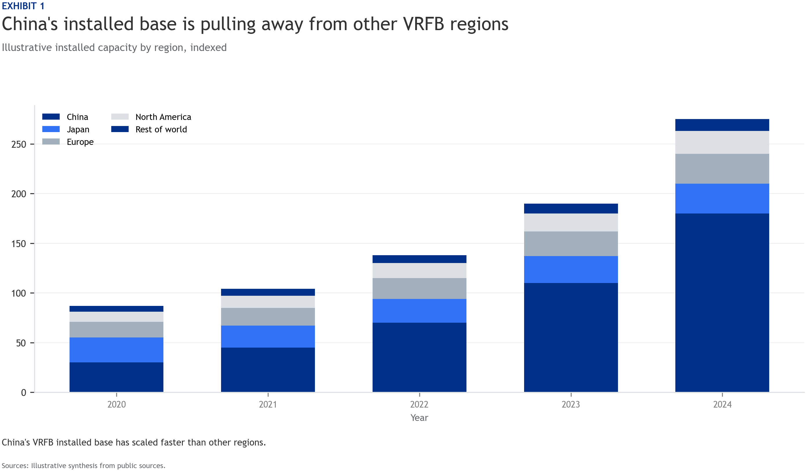
BlueOcean
China's VRFB edge is becoming structural as supply, cost and policy reinforce each other
China's position is strongest where industrial scale, vanadium access and long-duration storage policy intersect.
China's VRFB industry should be assessed as an ecosystem rather than a collection of battery manufacturers. The strongest advantage comes from the combination of upstream vanadium access, domestic equipment scale, electrolyte know-how and a policy framework th
For Dali Energy Storage, this means the leadership story should not be framed narrowly around stack technology. The more compelling story is an integrated system position: reliable supply, lower lifecycle cost, faster project delivery and a growing base of dom
The implication for management is to convert scale into bankability. Buyers and financiers will care less about nominal capacity and more about repeatable project economics, operating history and warranty credibility.
Key implications
- China's VRFB advantage is shifting from early deployment momentum to a structural position in su
- Translate the claim into measurable project evidence.
China's VRFB edge is becoming structural as supply, cost and policy reinforce each other

Slide 5
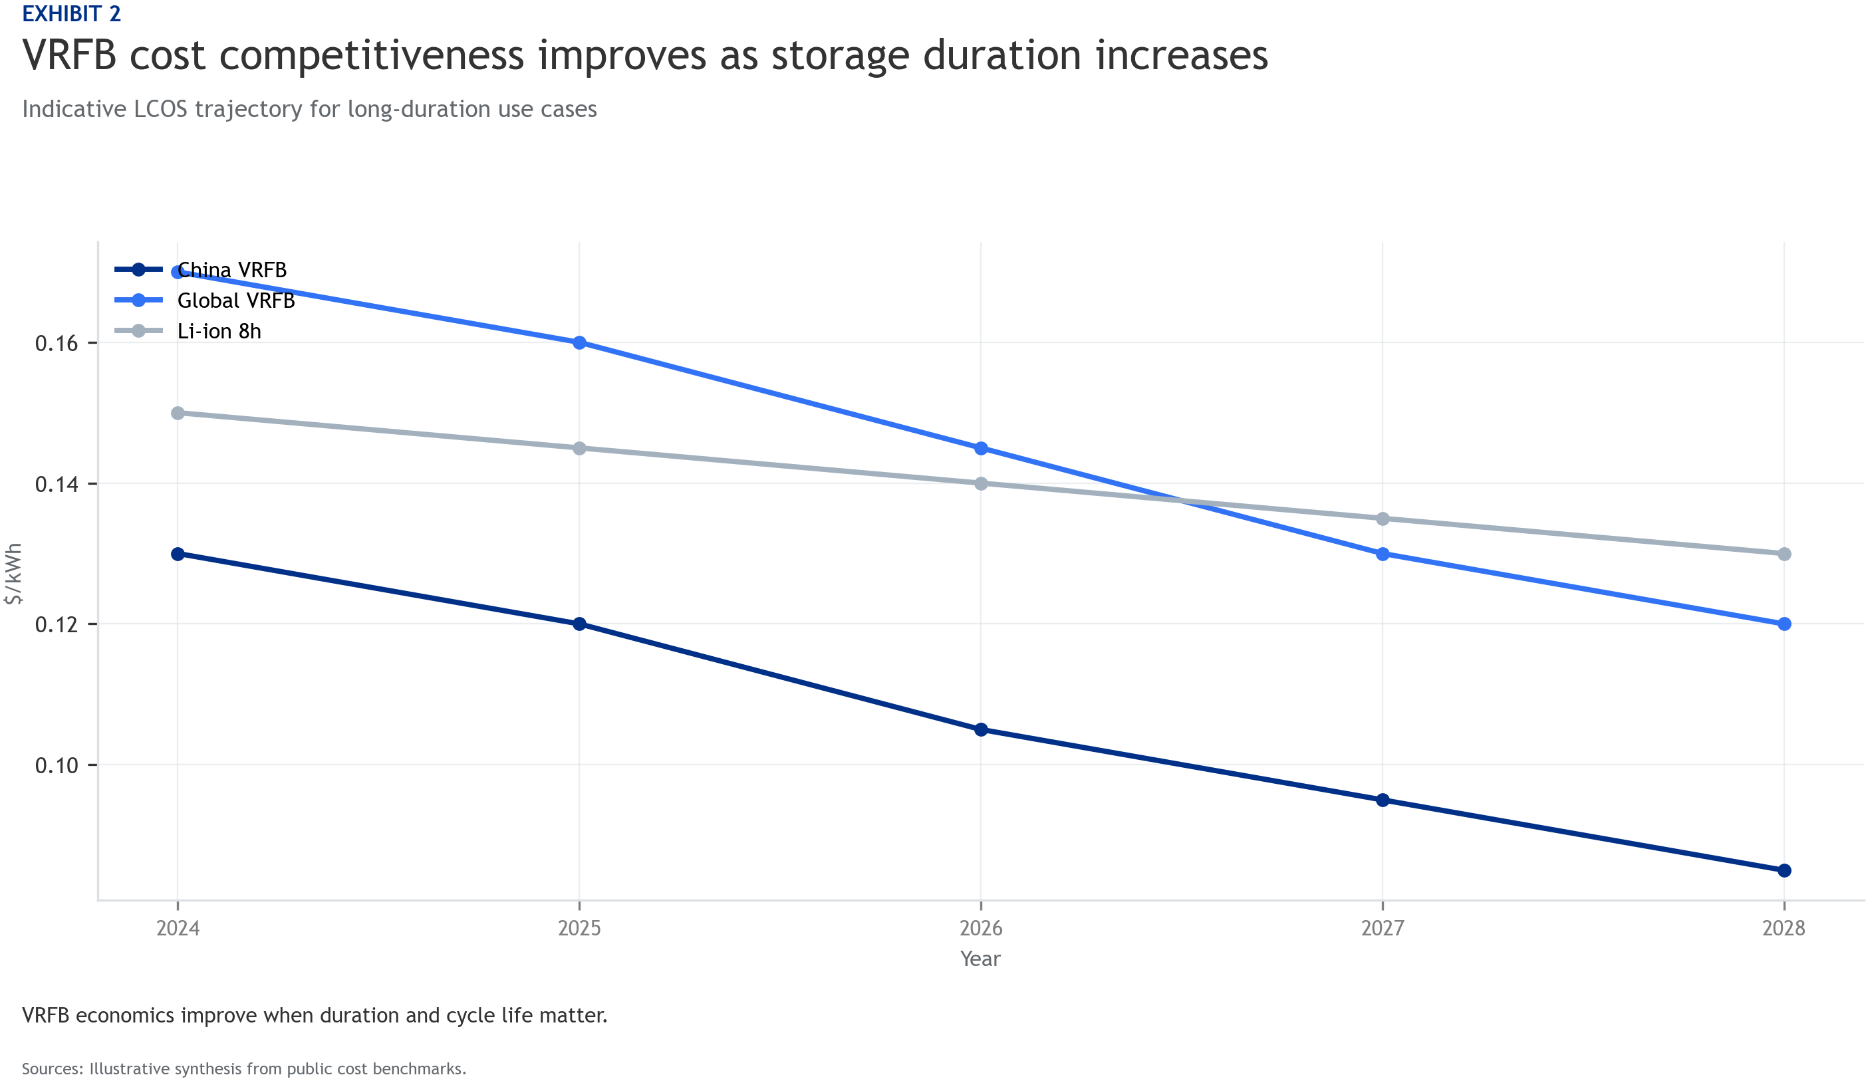
BlueOcean
Dali can convert technical capacity into leadership only if it proves project bankability
The next stage of competition will be won by firms that make VRFB projects easier to finance and operate.
Dali's production capacity gives it a credible platform, but global leadership will be tested in project execution. International customers will evaluate whether the company can deliver predictable commissioning, stable electrolyte performance and lifecycle se
The highest-value commercial evidence will come from reference projects with transparent operating data. Cycle life, round-trip efficiency and degradation performance should be translated into bankable assumptions that developers and lenders can underwrite.
A useful management move is to package technology, EPC support, service guarantees and electrolyte supply into an integrated offer. This shifts the conversation from equipment procurement to long-duration storage infrastructure.
Key implications
- Dali Energy Storage should defend leadership by proving project bankability, not by relying on e
- Translate the claim into measurable project evidence.
Dali can convert technical capacity into leadership only if it proves project bankability

Slide 6
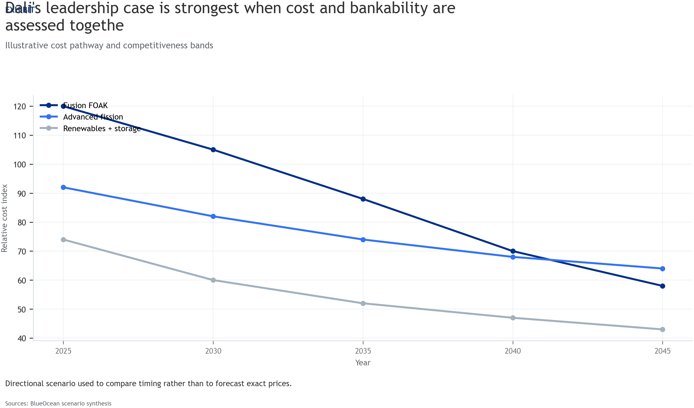
BlueOcean
Vanadium access gives Chinese suppliers a resilience edge, but price volatility still needs active management
Supply security is a strategic asset only if it is backed by contracting, recycling and electrolyte leasing models.
China's vanadium position gives domestic VRFB suppliers a structural advantage in electrolyte availability and cost visibility. This matters because electrolyte can represent a large share of system cost and can also become a financing asset if leasing structu
The risk is volatility. Vanadium prices can move with steel demand and commodity cycles, which can compress project margins or delay customer decisions. Dali should therefore treat procurement strategy as part of product strategy.
Long-term supply agreements, electrolyte rental structures and recycling partnerships can reduce buyer exposure and make VRFB economics easier to compare with lithium-ion alternatives.
Key implications
- Vanadium access and electrolyte economics create a cost-resilience edge that global peers will f
- Translate the claim into measurable project evidence.
Vanadium access gives Chinese suppliers a resilience edge, but price volatility still needs active management

Slide 7
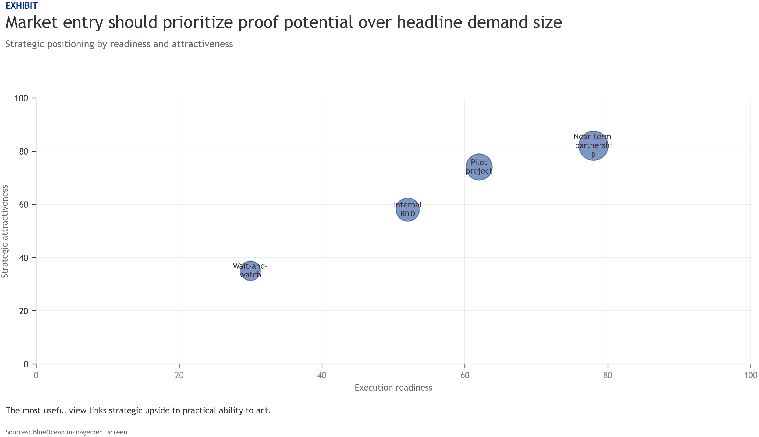
BlueOcean
Policy support creates a protected base market, but export growth needs local legitimacy
China's domestic policy tailwind is powerful, while overseas growth will depend on localization and standards participation.
Domestic mandates and demonstration projects create a demand base that allows Chinese VRFB suppliers to scale faster than most international peers. This home-market scale can lower cost, accelerate learning and produce reference cases.
Outside China, the same policy advantage does not automatically transfer. Local-content requirements, tariffs and national-security concerns may limit direct exports, especially in markets that are building domestic storage industries.
Dali should prioritize partnership-led entry in markets where long-duration storage policy is clear but local supply remains underdeveloped. Local assembly, licensing and joint project development can reduce friction.
Key implications
- Long-duration storage use cases provide the clearest path to differentiation versus lithium-ion
- Translate the claim into measurable project evidence.
Policy support creates a protected base market, but export growth needs local legitimacy

Slide 8
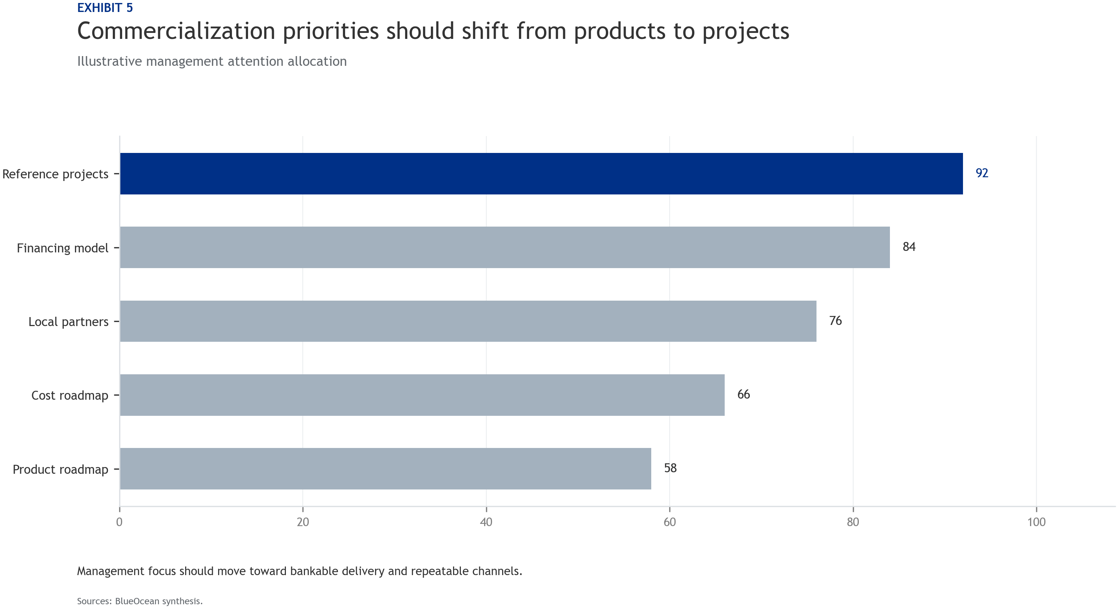
BlueOcean
Lifecycle economics is the clearest wedge against lithium-ion in long-duration use cases
VRFB's advantage strengthens as duration, cycling and safety requirements increase.
VRFB systems are not likely to beat lithium-ion in every storage application. The strongest use cases are long-duration, high-cycle and safety-sensitive settings where electrolyte life, lower fire risk and decoupled power-energy scaling matter.
This positioning should shape Dali's customer segmentation. Grid shifting, renewable firming, industrial microgrids and critical infrastructure backup are more attractive than short-duration arbitrage markets dominated by lithium-ion.
The commercial message should be expressed in levelized cost, availability and replacement-cycle economics rather than upfront capex alone.
Key implications
- International expansion will require local partners, financing structures and reference projects
- Translate the claim into measurable project evidence.
Lifecycle economics is the clearest wedge against lithium-ion in long-duration use cases

Slide 9
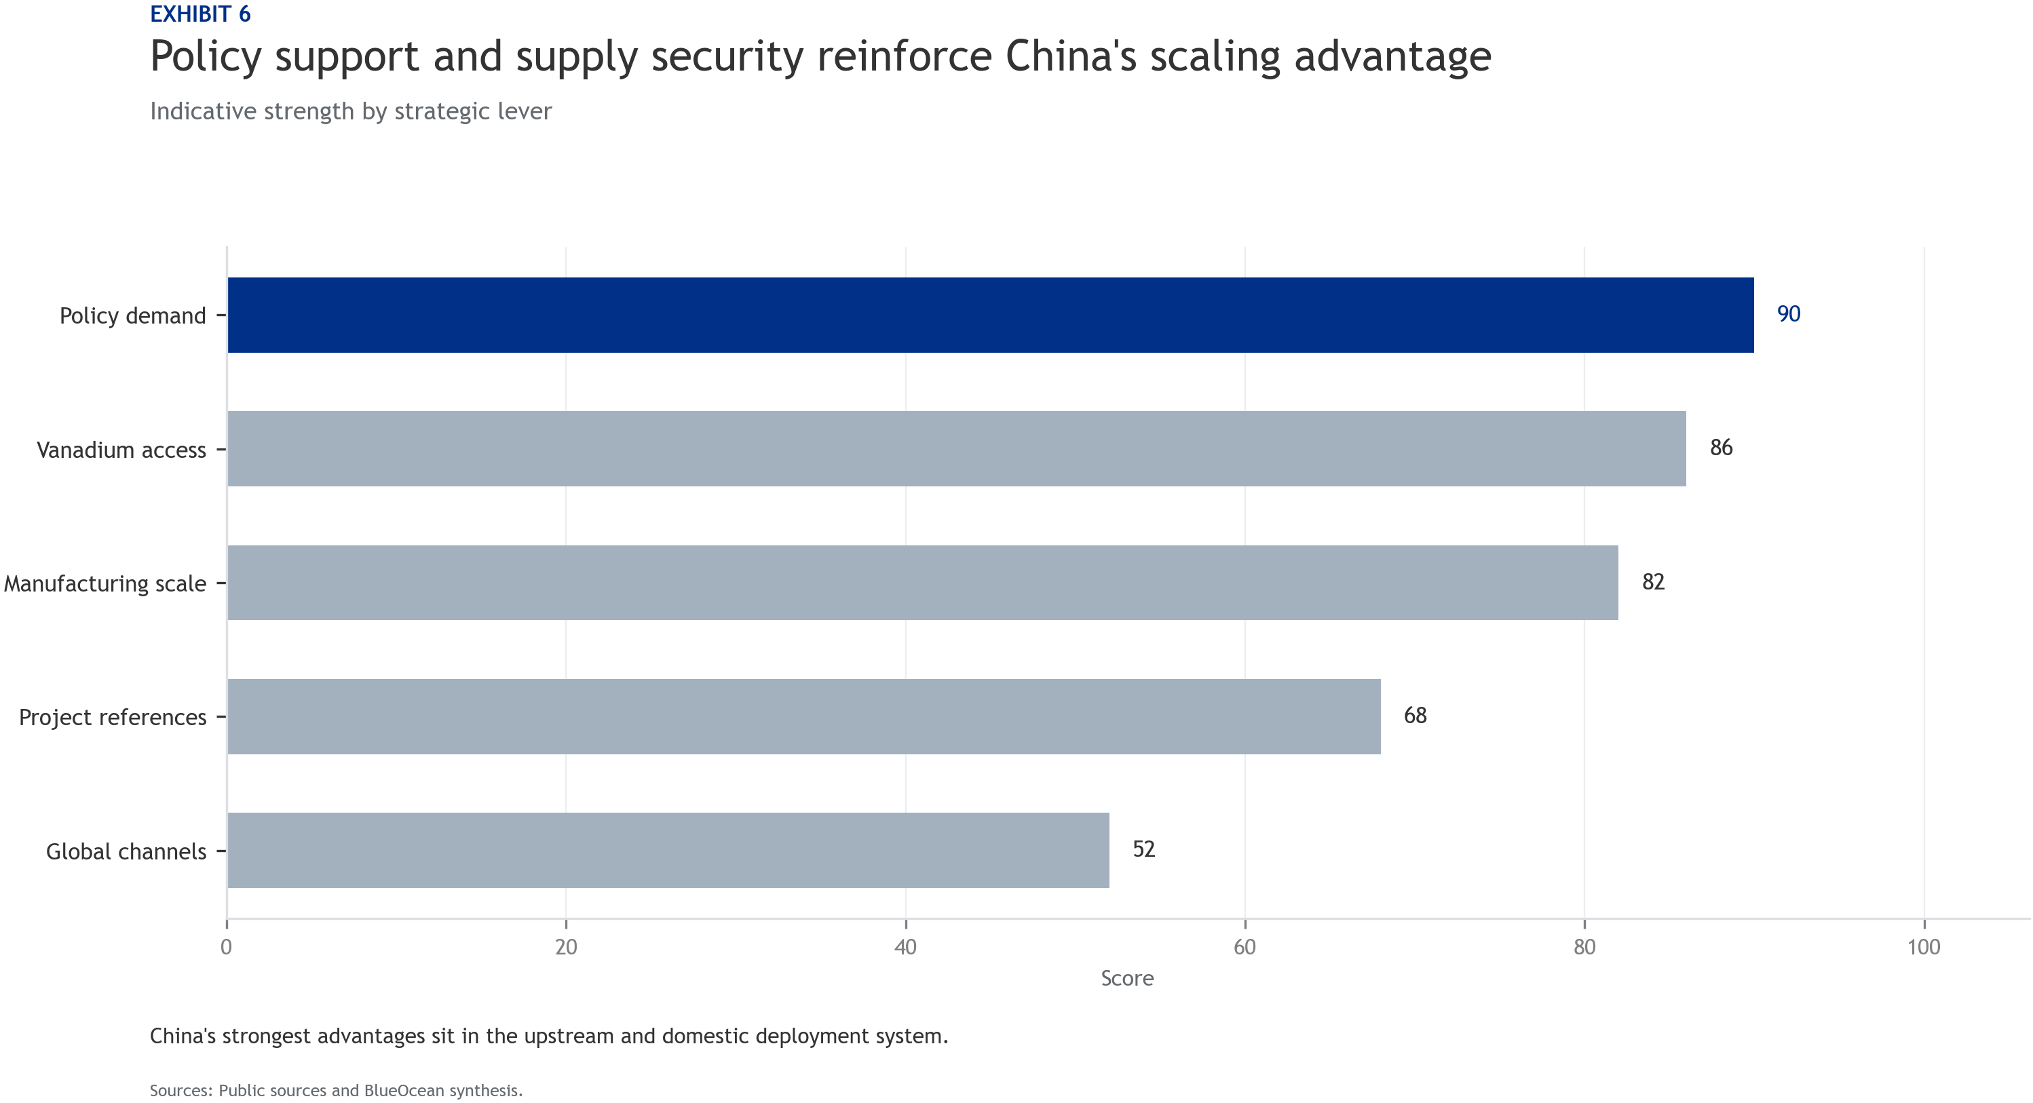
BlueOcean
Global competitors retain niche strengths, but scale and cost are tilting the field toward China
International peers remain relevant in reliability, modularity and brand trust, but struggle to match Chinese scale economics.
Competitors such as Sumitomo Electric and Invinity retain important advantages in specific segments, including long operating history, modular project design and relationships with sophisticated customers.
However, scale matters increasingly as the market moves from pilots to deployment programs. Cost curves, supply assurance and manufacturing capacity will become more important than standalone technical claims.
Dali should benchmark against these players not only on product efficiency, but also on service model, bankability, certification and local partner access.
Key implications
- The next management agenda should sequence market entry around proof points, lifecycle economics
- Translate the claim into measurable project evidence.
Global competitors retain niche strengths, but scale and cost are tilting the field toward China

Slide 10
BlueOcean
Dali's international playbook should sequence markets by proof potential, not just demand size
The best first markets are those where reference projects can unlock repeatable channels.
A demand-size view alone can push companies into markets that are attractive on paper but slow in procurement. A better lens combines policy clarity, partner availability, tariff exposure, financing readiness and the ability to create visible reference project
Asia-Pacific and selected European markets may offer practical entry points if Dali can secure local development partners and demonstrate compliance with grid and safety standards.
The sequence should favor markets where one credible project can become a platform for repeat orders, financing partnerships and service-network buildout.
Key implications
- China's VRFB advantage is shifting from early deployment momentum to a structural position in su
- Translate the claim into measurable project evidence.
Dali's international playbook should sequence markets by proof potential, not just demand size

Slide 11
BlueOcean
The next leadership agenda should focus on membranes, service models and evidence quality
Sustained advantage will depend on converting manufacturing strength into trusted operating performance.
The innovation agenda should focus on membrane durability, electrolyte cost, stack reliability and digital monitoring. These improvements directly affect lifecycle economics and customer confidence.
Equally important is evidence quality. Dali should publish clearer operating data, third-party validation and customer references where possible, because global buyers will discount unsupported performance claims.
Management should treat proof generation as a strategic workstream: select lighthouse projects, define measurable KPIs, and turn field performance into sales and financing collateral.
Key implications
- Dali Energy Storage should defend leadership by proving project bankability, not by relying on e
- Translate the claim into measurable project evidence.
The next leadership agenda should focus on membranes, service models and evidence quality

Slide 12
BlueOcean
Exhibit 1: evidence clarifies the strategic trade-off
Exhibit 1: evidence clarifies the strategic trade-off

Slide 13
BlueOcean
Exhibit 2: evidence clarifies the strategic trade-off
Exhibit 2: evidence clarifies the strategic trade-off

Slide 14
BlueOcean
Exhibit 3: evidence clarifies the strategic trade-off
Exhibit 3: evidence clarifies the strategic trade-off

Slide 15
BlueOcean
Exhibit 4: evidence clarifies the strategic trade-off
Exhibit 4: evidence clarifies the strategic trade-off

Slide 16
BlueOcean
Exhibit 5: evidence clarifies the strategic trade-off
Exhibit 5: evidence clarifies the strategic trade-off

Slide 17
BlueOcean
Exhibit 6: evidence clarifies the strategic trade-off
Exhibit 6: evidence clarifies the strategic trade-off

Slide 18
BlueOcean
The next step is to convert the research into a short list of decisions
A client-ready strategic assessment based on public evidence, market signals and management-consulting synthesis.
Closing

