Slide 1

MLflow: From Experiment Tracking to Business Impact
By Rupesh Pund / Mlops | 08-05-2025
Explore how MLflow transforms machine learning projects into measurable business results.

Slide 2
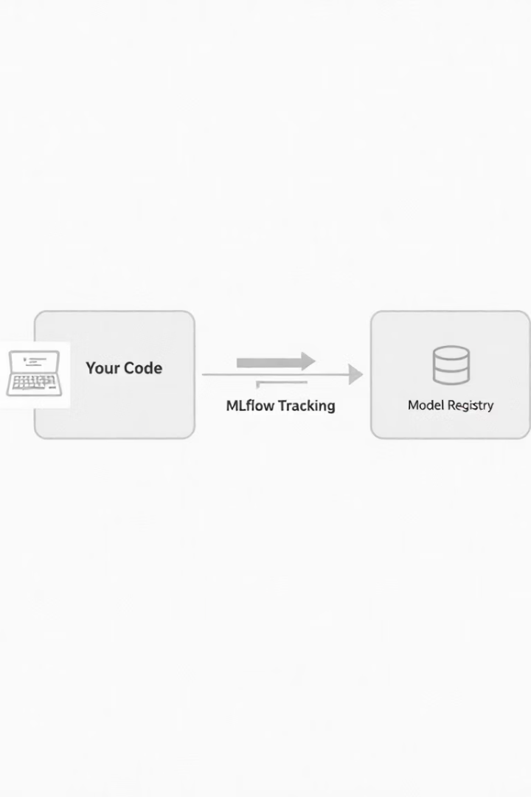
What is MLflow?
1
Open-source platform to manage the ML lifecycle. Helps streamline collaboration between data science and engineering teams
2
Four key components
🏷️ Tracking: Log experiments
📂 Projects: Reproducible code
🧩 Models: Packaging
🗂️ Registry: Versioning
3
Real-world analogy
Like GitHub for Machine Learning—tracks changes, stores versions, and enables teamwork.

Slide 3
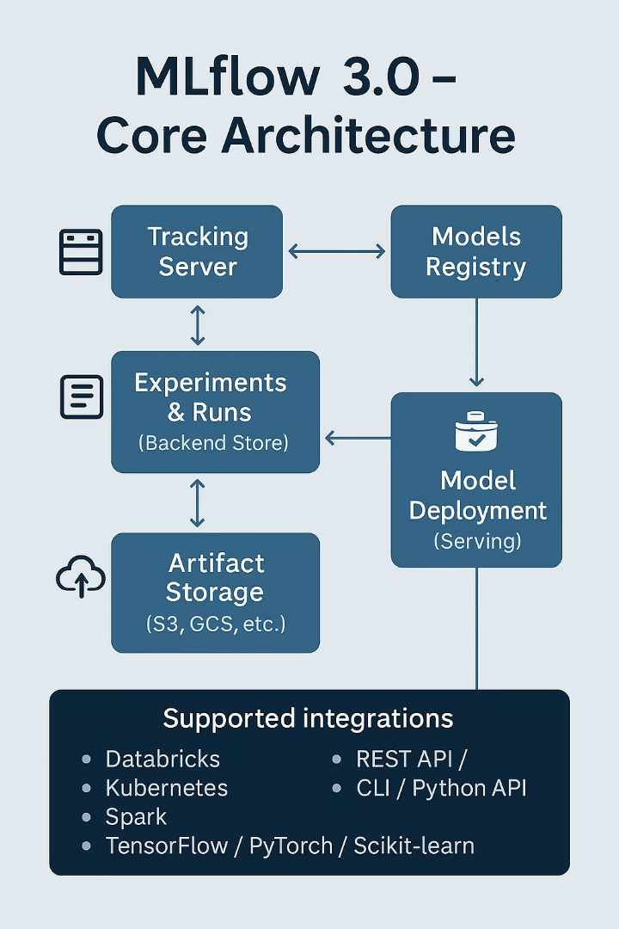
MLflow Architecture Overview
Client Interface
Tracking Server
Storage Layers
User Interface
Web dashboard accessible locally for monitoring and management.
Python or CLI tools call MLflow APIs for easy interaction.
Records parameters, metrics, and artifacts for each experiment.
Backend Store: SQL or database for metadata.
Artifact Store: File system or cloud storage like S3/GCS.
Tracking: Logs parameters, metrics, artifacts
Projects: Define a standard way to run code (entry points + env)
Models: Standardized packaging format for deployment
Registry: Central repository for managing model versions, stages

Slide 4
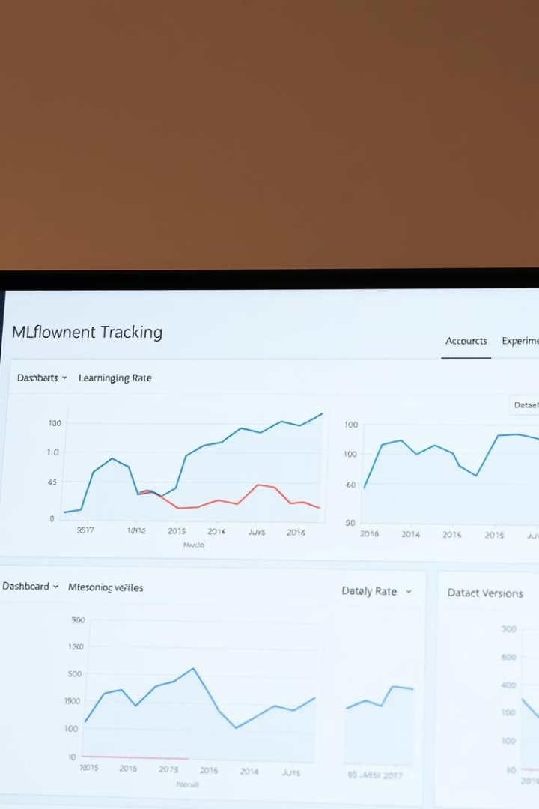
MLflow Tracking: The Foundation
Core function
Tracks parameters, metrics, code versions, and artifacts.
Automatic logging
Requires minimal code changes to reliably log experiments.
Example usage
Easily track learning rate, accuracy, and dataset versions.
Key benefit
Supports reproducible experiments and seamless comparisons.

Slide 5
MLflow Projects: Standardizing Execution
Purpose
Features
Real example
Business impact
Package ML code for reproducible and scalable runs.
Defines dependencies
Using Docker images to ensure identical project runs anywhere.
Portable workflows simplify deployment across teams and platforms.
Consistent execution environments

Slide 6




Where Does MLflow Fit in MLOps?
MLOps Stages:
Development → Training → Deployment → Monitoring
MLFLow's Role:
Development
Training
Deployment
Limitations
Tracks experiments and packages code with MLflow Projects.
Manages model versions using MLflow Model Registry.
Delivers deployable models in formats like PyFunc and Docker.
Does not natively manage data pipelines, serving, or monitoring.
[Data Prep] → [Training] → [MLflow Tracking/Registry] → [Deployment] → [Monitoring] ↑____________MLflow Focus____________↓

Slide 7
Churn Prediction Project Overview
Goal: Predict customer churn to reduce service cancellations.
Model: RandomForestClassifier on structured telecom data.
Tracking: Logged accuracy, test size, and n_estimators in MLflow.
Experiment management: Used MLflow UI for seamless version control. [Data Cleaning] → [Feature Engineering] → [Model Training] → [MLflow Tracking]

Slide 8
Project Outcome
Aspect
Before MLflow
After MLflow
Tracking
manual Excel tracking
automated experiment logging
Model Management
disorganized storage
centralized model registry
Accuracy
untracked
78.8%

Slide 9
Tech Stack with MLflow in MLOps
Data Versioning
Workflow Orchestration
CI/CD & Serving
Monitoring
DVC
Jenkins
Prometheus
Delta Lake
Airflow
GitHub Actions
EvidentlyAI
Pachyderm
Prefect
GitLab CI
Kubeflow
MLflow
Seldon
BentoML

Slide 10
What MLflow Can't Do
Pipeline orchestration: Not designed for end-to-end data workflows like ingestion or validation.
Real-time serving: Limited native capabilities to serve models instantly in production.
Version control: No built-in system for code or data versioning like Git or DVC.
CI/CD replacement: Does not substitute continuous integration/delivery tools or orchestration frameworks.

Slide 11
Real-World Impact: Use Cases
Customer Churn Prediction
Fraud Detection
Operational Benefits
Improved accuracy by 15%, reducing lost revenue significantly.
Cut false positives by 20%, enhancing trust and efficiency.
Faster deployment times and higher model precision.

Slide 12
MLflow vs Kubeflow
MLflow
Kubeflow
Lightweight and language-agnostic platform.
Comprehensive ML pipeline orchestration on Kubernetes.
Simple to integrate with various tools.
Focused on experiment tracking and model management.
Manages complex workflows and scaling.
Designed for production-grade deployments.
Easier setup for small to medium projects.
Better suited for end-to-end pipeline automation.

Slide 13
Who Uses MLflow and Why?
Databricks: Core contributor and provides commercial support.
Zynga: Uses MLflow for game churn prediction models.
Booking.com: Ensures reproducibility of ML experiments.
Airbnb: Manages full model lifecycle efficiently.
Popular across finance, e-commerce, and SaaS industries.

Slide 14



Thank You
We appreciate your time and attention.
Any questions?
Contact
Feedback
Next Steps
Reach out anytime for deeper discussions or support.
Your insights help us improve our work and service.
Looking forward to collaborating on your MLflow journey.

