Slide 1
Speech Emotion Recognition
Using Python
YASH DIXIT (2001320100168)
SAKSHI CHAUHAN(2001320100117)
SURAJ YADAV(2001320100147)
SHIVAM SINGH (2101320100117)

Slide 2
Table of contents
1 What is Speech Emotion Recognition
2 Difference Between emotion and sentiments
3 Speech emotion recognition vs Text sentiment analysis
4 Sample Rate
5 Method for speech emotion recognition
6 Working
7 Librosa
8 Lstm model
9 Application

Slide 3
WHAT Is Speech emotion recognition
Speech emotion recognition (SER) is the process of predicting human emotions from audio signals using artificial intelligence (AI) techniques. SER technologies have a wide range of applications in areas such as psychology, medicine, education, and entertainment.
Sentiment information can be gathered from various voice characteristics, such as
Pitch
Loudness
Sample Rate

Slide 4
Difference between emotion and sentiments
Emotions - Happy , Sad , unconscious , surprise etc
Sentiments – true/false , 1/0, positive/negative
SER VS TEXT SENTIMENT ANALYSIS
As evident from the title, Speech Emotion Recognition (SER) is a system that can identify the emotion of different audio samples. From the description, this task is similar to text sentiment analysis, and both also share some applications since they differ only in the modality of the data.

Slide 5
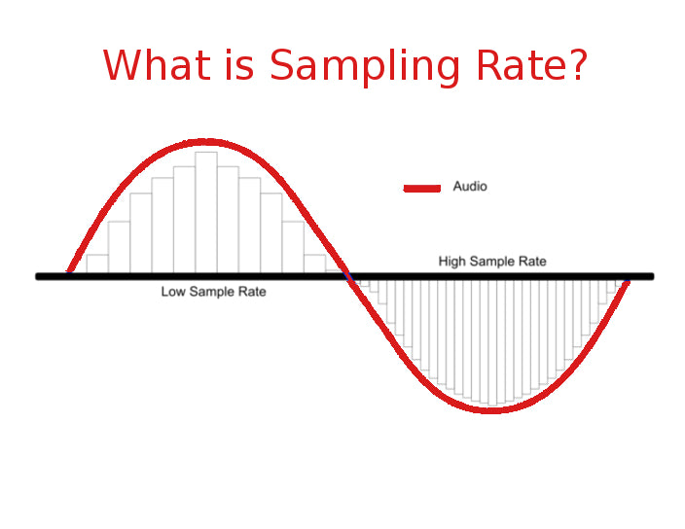
Sample rate
The sample rate (or sampling rate) is the number of samples taken per second.
The units for sample rate are samples per second (sps) or Hertz (Hz).

Slide 6
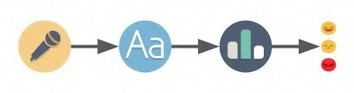
Methods for speech emotion recognition
1. Feature Extraction: Techniques such as Mel-frequency cepstral coefficients (MFCC), pitch, energy.
2. Machine Learning and Pattern Recognition: Supervised learning algorithms, including Support Vector Machines (SVM), Random Forest, and deep learning models .
3. Natural Language Processing (NLP): NLP techniques are used to process and analyze the linguistic content of speech.

Slide 7
How does speech emotion recognition work?
4. Emotion Databases and Corpora: Databases of emotional speech samples and corpora annotated with emotional labels are used for training and testing emotion recognition models, enabling the development of robust and accurate systems.
5. Signal Processing and Audio Analysis: Signal processing methods, such as time-frequency analysis, spectrogram analysis, and audio feature extraction, are applied to capture emotional characteristics from speech signals.

Slide 8

Audio Data Analysis Using librosa 📈
Libraries for audio acquisition and playback:
Librosa
It is a Python module to analyze audio signals in general but geared more towards music. It includes the nuts and bolts to build a MIR(Music information retrieval) system.
IPython.display.Audio
IPython.display.Audio lets you play audio directly in a jupyter notebook.

Slide 9

Librosa
Librosa is a Python package for music and audio analysis. Librosa is basically used when we work with audio data like in music generation(using LSTM’s), Automatic Speech Recognition.
It provides the building blocks necessary to create the music information retrieval systems. Librosa helps to visualize the audio signals and also do the feature extractions in it using different signal processing techniques.

Slide 10
LSTM(sequential model)
LSTM, which stands for Long Short-Term Memory, is a type of recurrent neural network (RNN) architecture that is designed to effectively capture and process long-range dependencies in sequential data, making it well-suited for tasks such as speech recognition, language modeling, and time series prediction

Slide 11
Application
Nowadays, Emotion recognition using speech signals plays a significant role in various applications:
Law Enforcement and Security : Potential threat detection or identifying distress in emergency calls.
Healthcare :Detect signs of depression or anxiety, and provide early intervention or support.
Customer Service : Analyze customer emotions during interactions, leading to improved customer satisfaction and better service quality.
Speech emotion recognition can be used to detect such as fear, sadness, and happiness that could help in making effective decisions.

Slide 12


