Slide 1
PFSD
Review-1

Slide 2
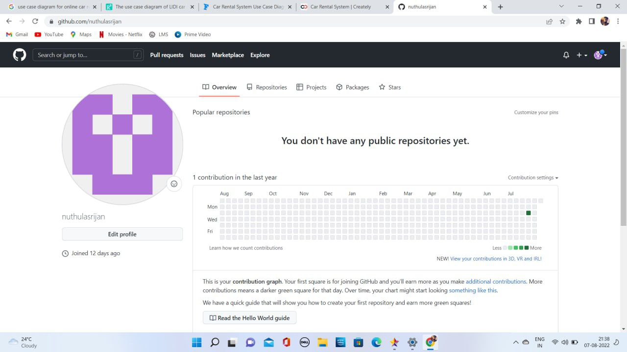
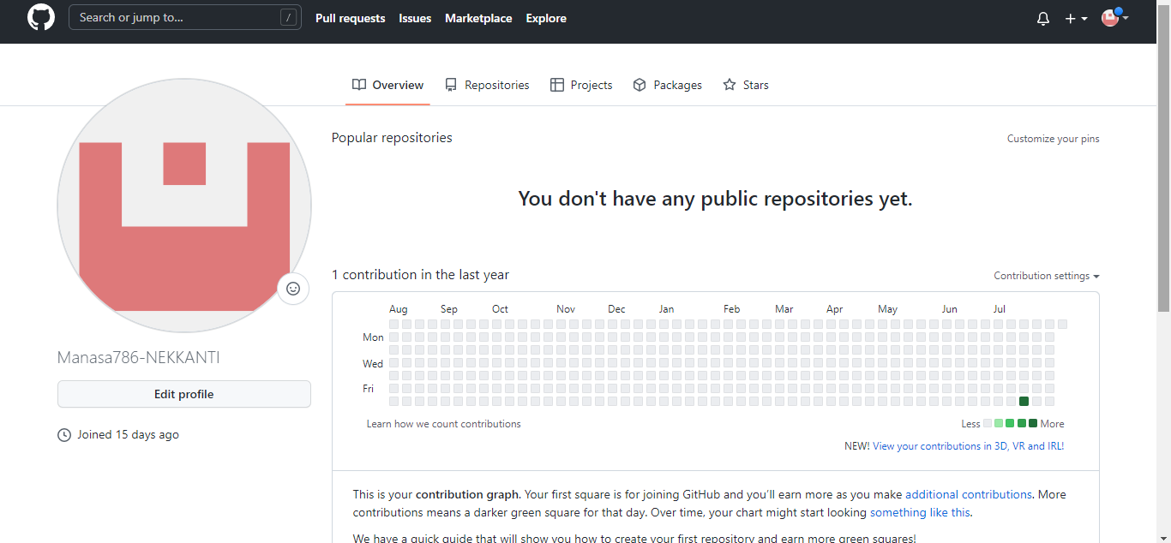
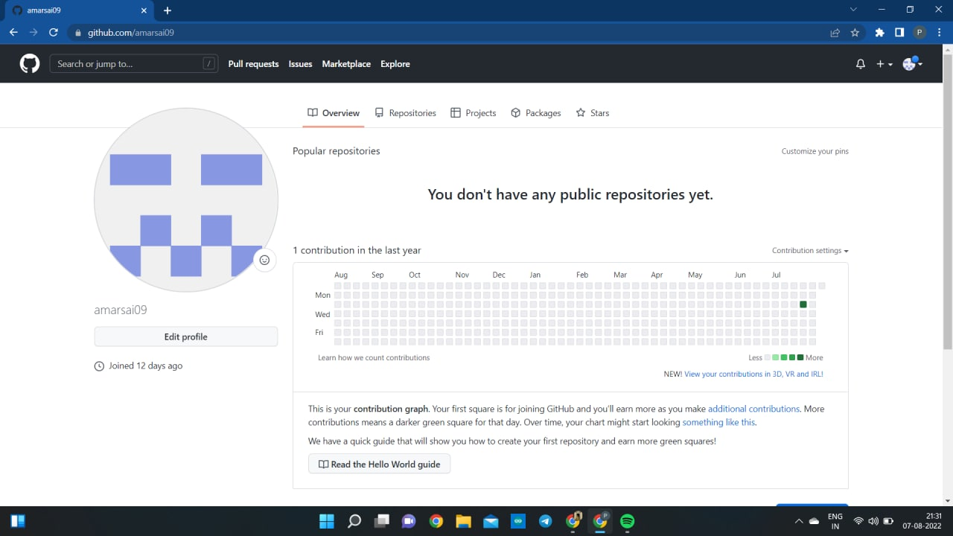
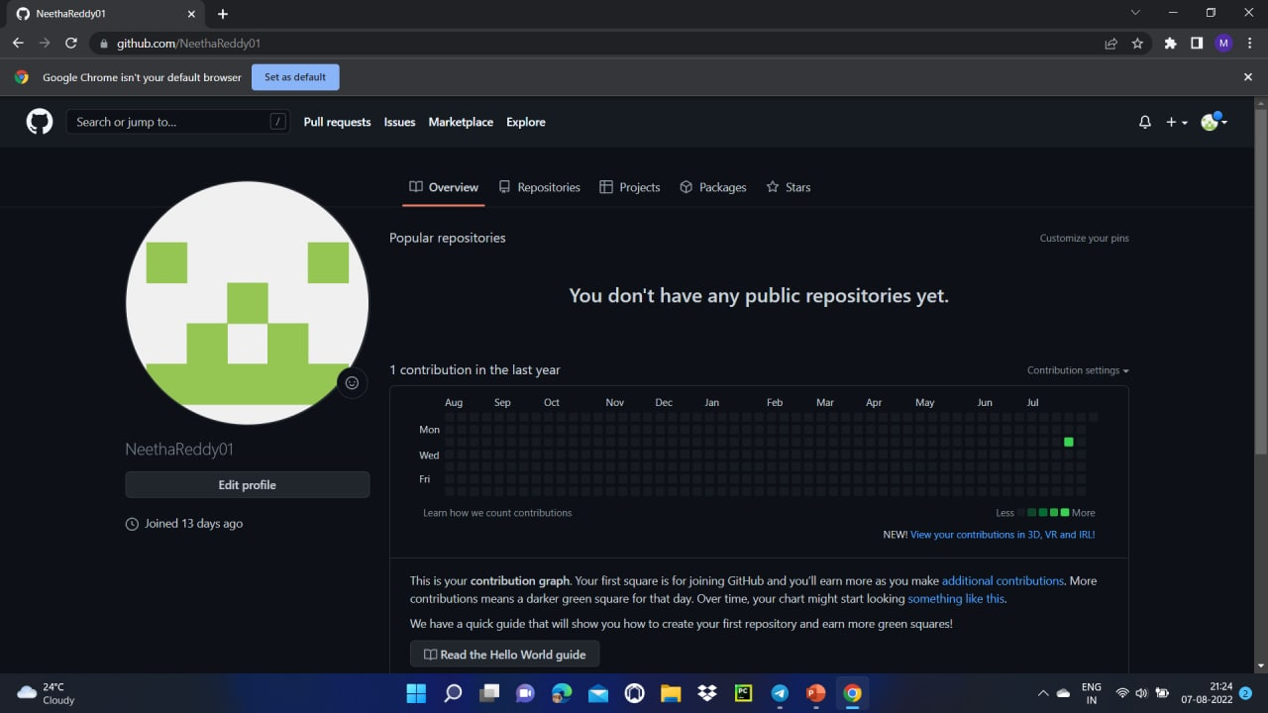
Github Setup:

Slide 3
Work allocation to team members
2110030297-github setup and tools verification.
2110030348- documentation and work allotment.
2110030304-Data set collection and tools setup.
2110030308-documentation and tools verification.

Slide 4
Data set collection and tools setup
Python-All the business logic has been implemented in python.
Django-This has been used for the framework.

Slide 5
Cofigurations for this project:
Windows: This project can be configured in windows easily,need to install Python, Django,PIP.
Linux: we can run this project on all versions of operating systems.
Mac :we can run this project on operating systems also.

