Slide 1
Library Management
System
By-
Yash Mishra
Parag Gunjal

Slide 2
To Create Backend APIs for Library Management

Slide 3
TECHSTACK
IDE: PyCharm Community Edition
Database: SQLite
Programming Language: Python
Framework: Django & Django REST

Slide 4
OBJECTIVE
Person with membership can search, return or reissue book.
Librarian can manage books, person’s membership and inventory.
Librarian issues permission to person for books.

Slide 5
FEATURES
Person can search books in Library:
Based on Title, Author, Genre, Language or Publisher.
Person can search, issue, return or reissue books.
Librarian manages books and membership.
Librarian can add, remove or edit books count .
Librarian can grant or cancel membership.
Librarian takes care of inventory.

Slide 6
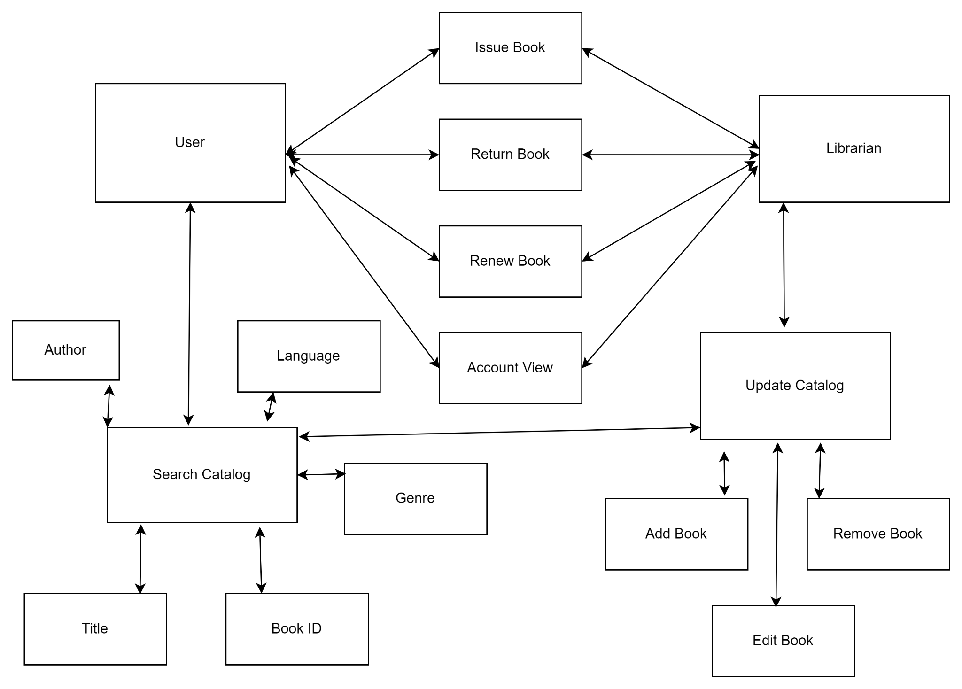
USE CASE DIAGRAM

Slide 7
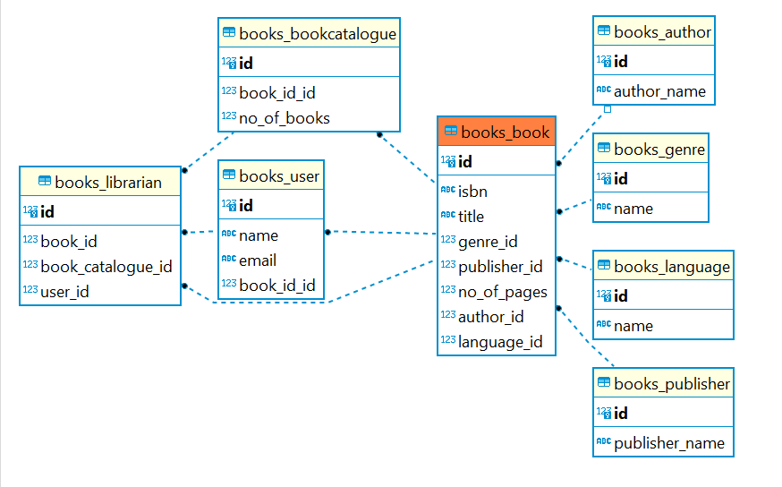
ERD

Slide 8
THANK YOU !

