Slide 1

Laravel CRUD Operation
Gagandeep Sethi

Slide 2
Steps 1 (Install Laravel)
Make sure composer is installed
composer create-project --prefer-dist laravel/laravel laravel-crud cd laravel-crud php artisan serve

Slide 3
Step 2 (Configure Database)
Create Database
Update .env file
DB_CONNECTION=mysql DB_HOST=127.0.0.1 DB_PORT=3306 DB_DATABASE=laravel_crud DB_USERNAME=root DB_PASSWORD=your_password

Slide 4
Step 3 (Create a Model, Migration, and Controller)
php artisan make:model Product –mcr
This will create below:
Product.php model
create_products_table migration
ProductController.php controller

Slide 5
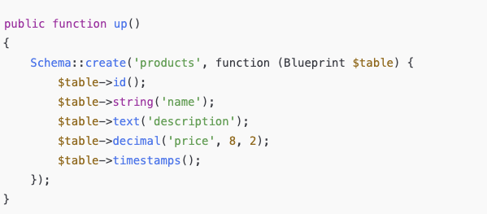
Step 4 (Define Table Structure)
Open database/migrations/*_create_products_table.php and add:
Run migration
php artisan migrate

Slide 6

Step 5: Add Routes
Open routes/web.php and define routes:

Slide 7
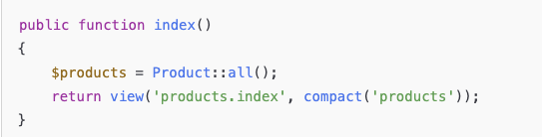
Step 6: Write Controller Methods
Open ProductController.php and fill in methods:
Index: Display Products

Slide 8
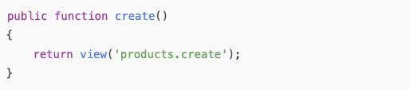
Create: Show Form

Slide 9
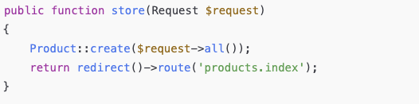
Store: Save Data

Slide 10
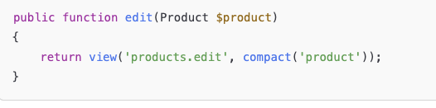
Edit: Show Edit Form

Slide 11
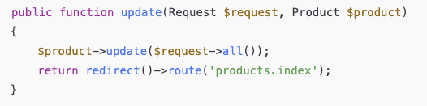
Update: Save Changes

Slide 12
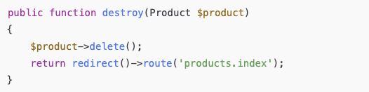
Destroy: Delete Product

Slide 13
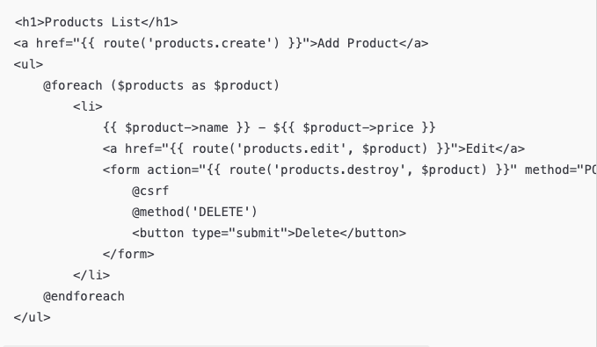
Step 7: Create Blade Views
Create a resources/views/products folder.
index.blade.php

Slide 14
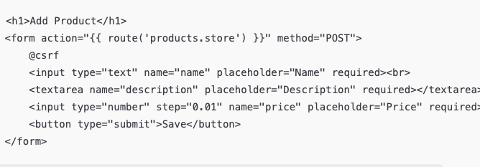
create.blade.php

Slide 15
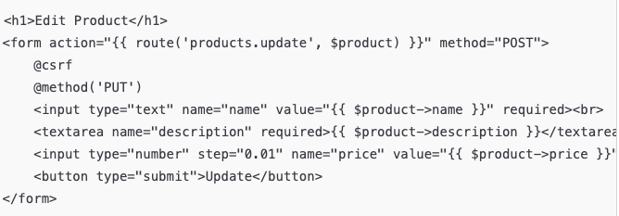
edit.blade.php

Slide 16
Step 8: Run the Application
php artisan serve

