Slide 1
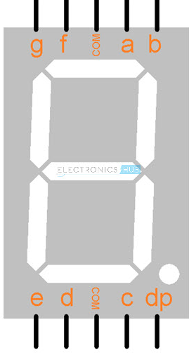
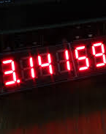
Introduction to 7 Segment Display
It consists of 7 LEDs know as LED segment + 1 LED to display decimal point
LEDs are HEXAGON in shape and arranged in “8” like fashion
It mainly use to display digits from 0 to 9
Application :

Slide 2
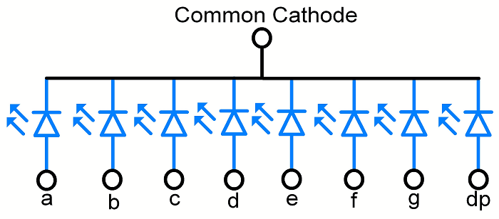
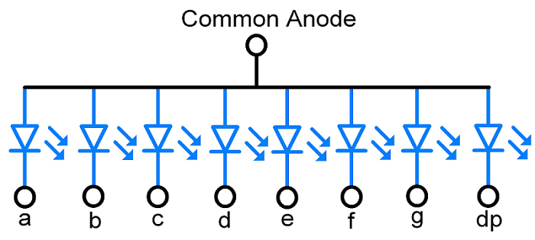
Types of 7 segment
Common Cathode
Common Anode
All Cathode terminal (-ve) of LED are connected to common supply (GND) and Anode Terminal (+ve ) left open to control 7-Segment by applying logic 1 (HIGH)
All Anode terminal (+ve) of LED are connected to common supply (VCC) and Cathode Terminal (-ve ) left open to control 7-Segment by applying logic 0 (LOW)

Slide 3
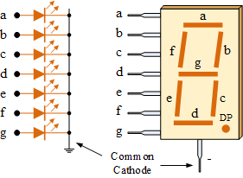
Common Cathode lookup Table
Logic High ( 1 ) to glow led
HEX df g f e d c b a 7-Seg
0 0 0 1 1 1 1 1 1
0X3F
0X06
0X5B
0X4F
0X66
0X6D
0X7D
0X07
0X7F
0X6F
3
F
1 0 0 0 0 0 1 1 0
0
6
2 0 0 1 1 1 0 1 1
5
B
F
3 0 1 0 0 1 1 1 1
4
6
6
4 0 1 1 0 0 1 1 0
6
D
5 0 1 1 0 1 1 0 1
7
D
6 0 1 1 1 1 1 0 1
7
7 0 0 0 0 0 1 1 1
0
7
F
8 0 1 1 1 1 1 1 1
5
9 0 1 1 0 1 1 1 1
6

Slide 4
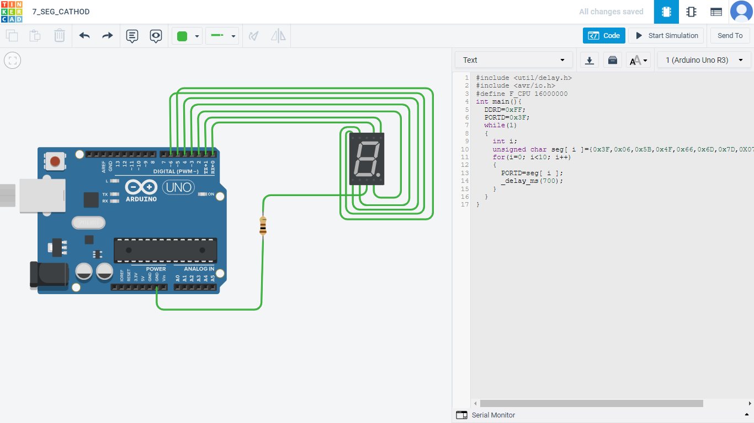
7 segment Code ( cathode )
#include <avr/io.h>
#include <util/delay.h>
#define F_CPU 16000000
int main()
{
DDRD=0xFF;
PORTD=0x3F;
while(1)
{
int i;
unsigned char seg[ i ]={0x3F,0x06,0x5B,0x4F,0x66,0x6D,0x7D,0X07,0X7F,0x6F};
for(i=0; i<10; i++)
{
PORTD=seg[ i ];
_delay_ms(700);
}
}
}

Slide 5
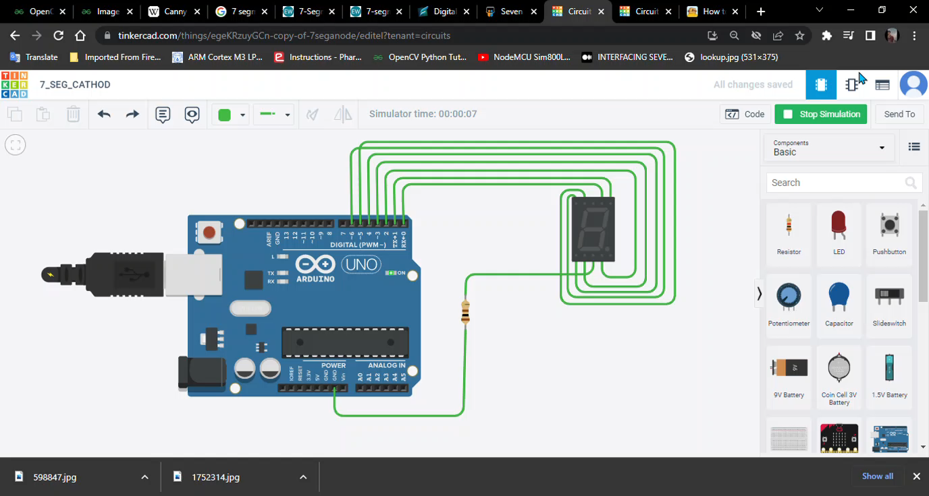

Slide 6
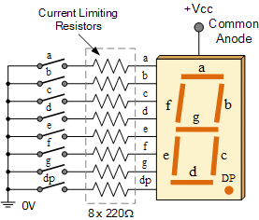
Common Anode lookup Table
Logic low ( 0 ) to glow led
HEX | df | g | f | e | d | c | b | a | 7-Seg eqn.
0 | 1 | 1 | 0 | 0 | 0 | 0 | 0 | 0 | 0xC0
1 | 1 | 1 | 1 | 1 | 1 | 0 | 0 | 1 | 0xF9
2 | 1 | 1 | 0 | 0 | 0 | 1 | 0 | 0 | 0xA4
3 | 1 | 0 | 1 | 1 | 0 | 0 | 0 | 0 | 0xB0
4 | 1 | 0 | 0 | 1 | 1 | 0 | 0 | 1 | 0x99
5 | 1 | 0 | 0 | 1 | 0 | 0 | 1 | 0 | 0x92
6 | 1 | 0 | 0 | 0 | 0 | 0 | 1 | 0 | 0x82
7 | 1 | 1 | 1 | 1 | 1 | 0 | 0 | 0 | 0xF8
8 | 1 | 0 | 0 | 0 | 0 | 0 | 0 | 0 | 0x80
9 | 1 | 0 | 0 | 1 | 0 | 0 | 0 | 0 | 0x90

Slide 7
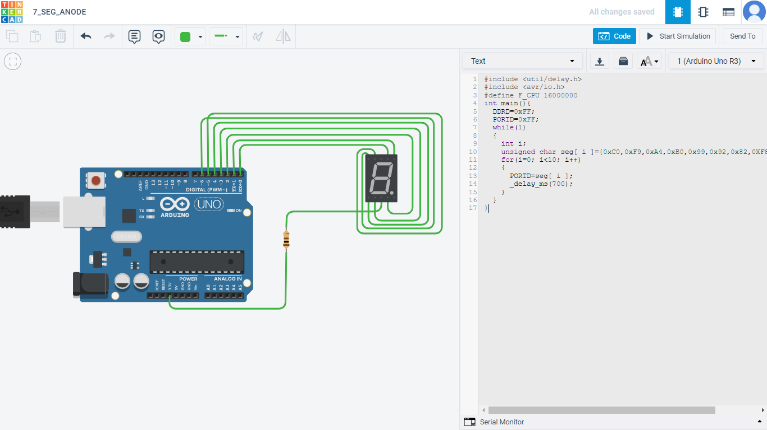
7 segment Code ( anode )
#include <avr/io.h>
#include <util/delay.h>
#define F_CPU 16000000
int main()
{
DDRD=0xFF;
PORTD=0xFF;
while(1)
{
int i;
unsigned char seg[ i ]={0xC0,0xF9,0xA4,0xB0,0x99,0x92,0x82,0XF8,0X80,0x90};
for(i=0; i<10; i++)
{
PORTD=seg[ i ];
_delay_ms(700);
}
}
}

Slide 8
