Slide 1


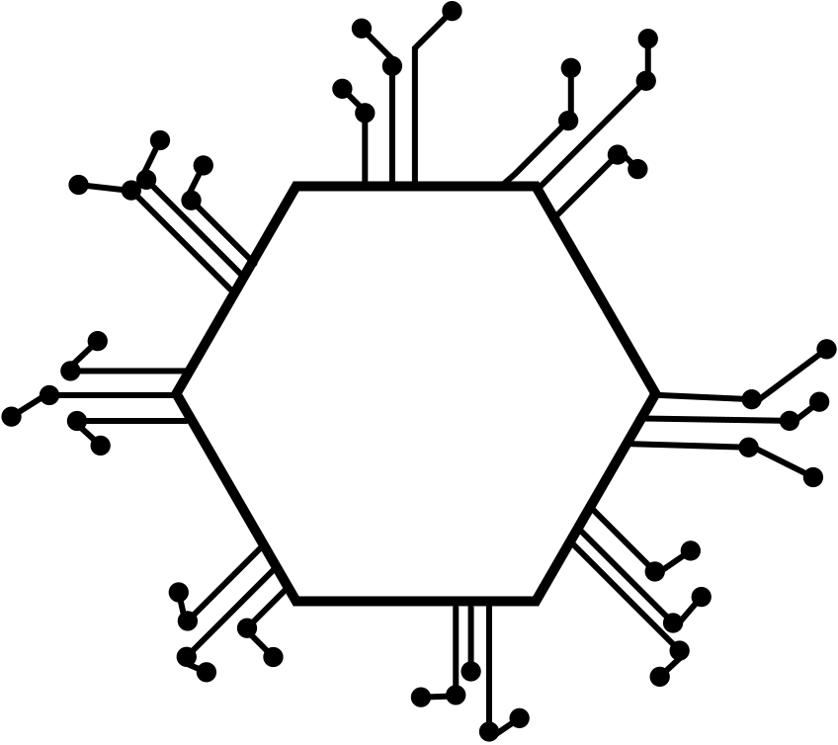


OneLogica
AI/ML Engineer - Intern
Assignment

Slide 2
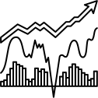
Advanced Stock Price Prediction Model
In the dynamic world of financial markets, predicting stock prices is a challenging yet crucial task for investors, traders, and financial analysts.
The integration of advanced technologies, data analytics, and machine learning has paved the way for the development of sophisticated stock price prediction systems.

Slide 3

These systems aim to leverage historical stock data, market indicators, and various features to generate more accurate and informed predictions.

Slide 4
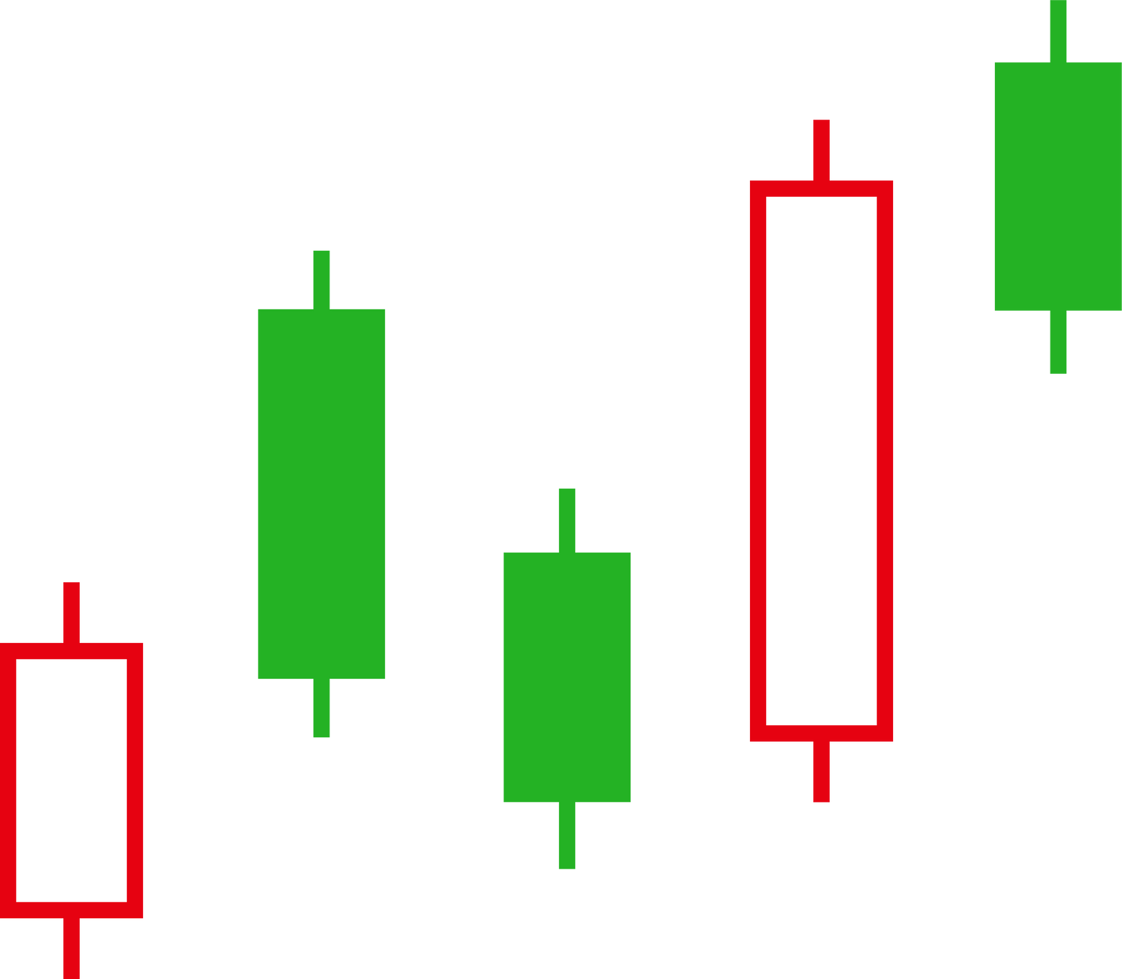
Summary
The Advanced Stock Price Prediction System represents a fusion of cutting-edge technologies and financial expertise to enhance decision-making in the volatile world of stock markets. As financial markets continue to evolve, these systems play a pivotal role in empowering investors with actionable insights and intelligent predictions.

Slide 5

Developing Predictive Models Enhancing Decision-Making Real-Time Predictions User-Friendly Interface Data Exploration and Visualization.

Slide 6

Key Components of the Advanced Stock Price Prediction System:
Data Collection and Processing
Feature Engineering
Machine Learning Models
Deep Learning Architectures
Evaluation Metrics
Real-Time integration
User Interface and Visualization
Risk Management

Slide 7

Algorithm Flow
“yfinance” Library
Numpy
Pandas
Keras Library
Streamlit Framework
Matplotlib and Seaborn

Slide 8
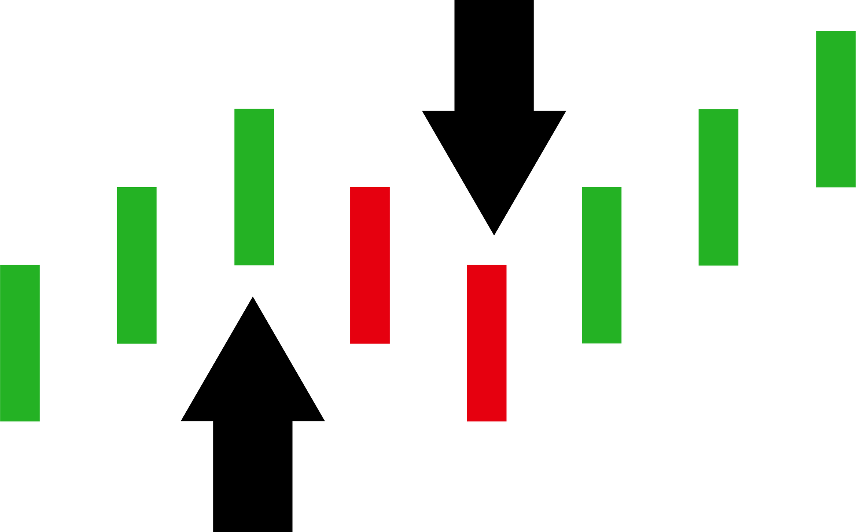
Overall Architecture of the Solution
The Stock Trend Prediction project leverages advanced machine learning techniques, specifically the Long Short-Term Memory (LSTM) neural network architecture, to forecast stock prices based on historical data.
Utilizing the “yfinance library” , the project collects and preprocesses extensive stock price data, transforming it into sequences suitable for training the LSTM model.

Slide 9


The methodology involves splitting the dataset into training and testing sets, training the model on past 100 and 200 days' stock prices, and evaluating its performance using metrics such as Mean Absolute Error (MAE) and Root Mean Squared Error (RMSE).

Slide 10
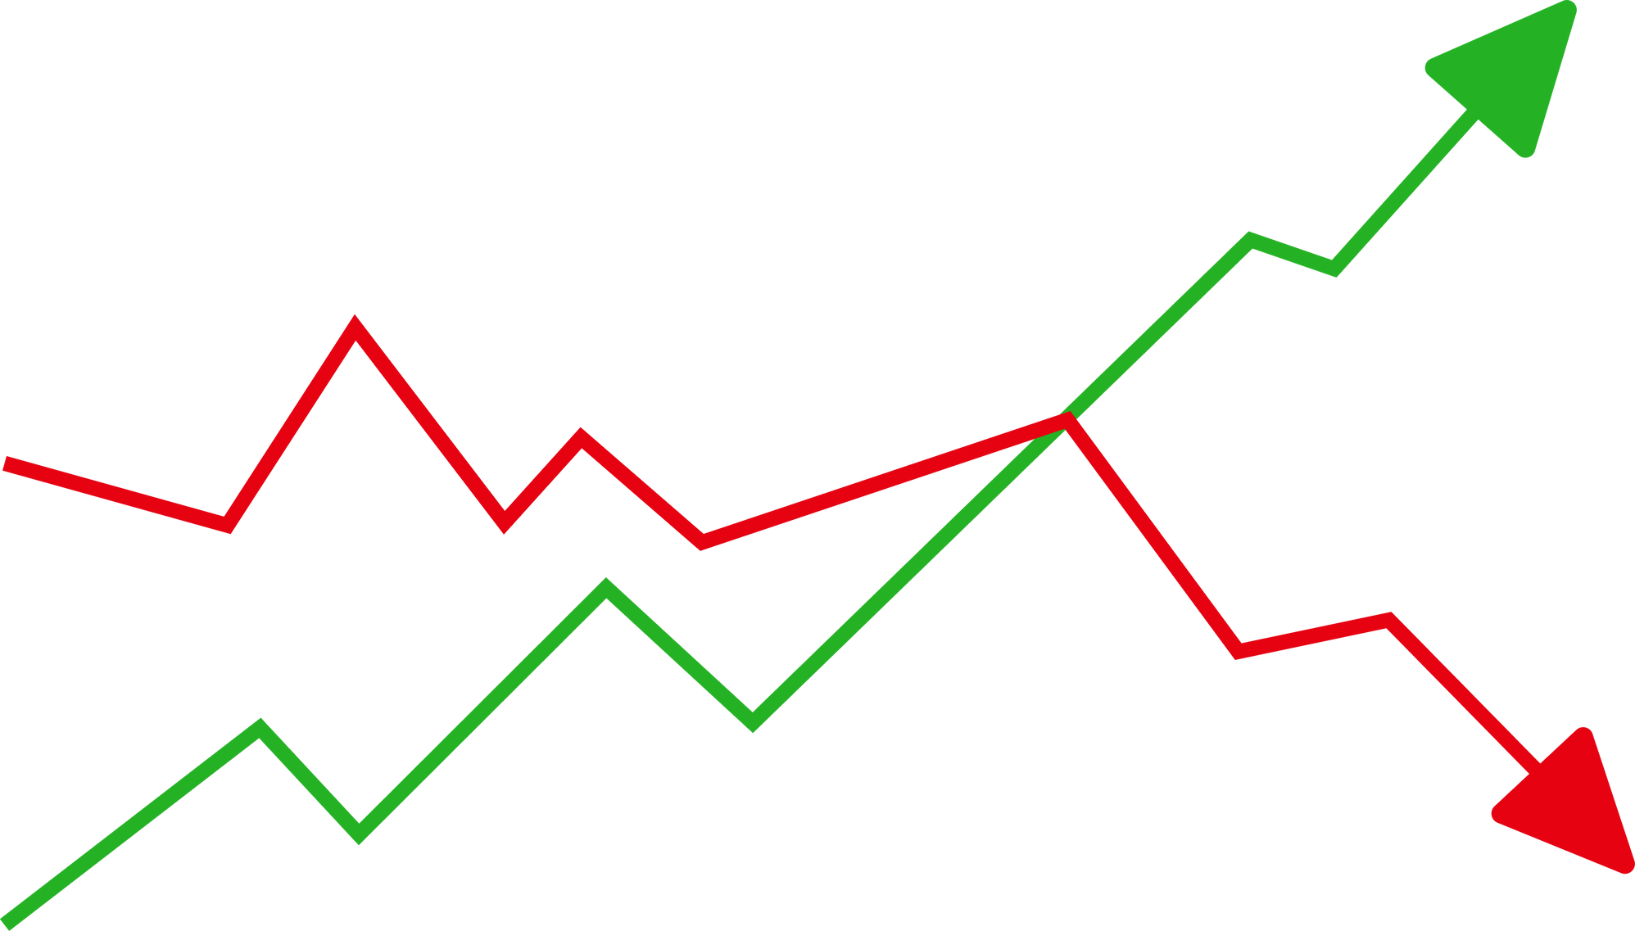
Model Validation
Model validation is an iterative process that involves refining the model based on insights gained during evaluation.
It is crucial for building trustworthy and reliable machine learning models that can be deployed confidently in real-world scenarios.

Slide 11
It Incorporates the following :
Data Splitting for training and testing
Scaling Dataset with help of MinMaxScaler
Selecting Appropriate Machine Learning Algorythms
Model Robustness
Final Prediction

Slide 12
Final Outcome
The project incorporates the Streamlit framework to providing a dynamic platform to visualize stock trends.
Users can input a stock ticker symbol, and the LSTM model dynamically predicts and displays future stock prices, allowing for real-time analysis and decision-making.

Slide 13
Link:-
https://github.com/Yash10gajbhiye/OneLogica_Assignment

