Slide 1


Titel: ShikshaAI – AI-Powered Education Chatbot (SDG 4: Quality Education)
IBM AI-ML Internship Project
Presented by: Yash Nandasana
College: Government Engineering College, Modasa

Slide 2
Introduction:
There is a growing need for accessible and personalized educational support for students, especially in underserved areas. Many learners lack timely help, multilingual resources, or structured answers to their doubts. To solve this,
I developed ShikshaAI — an AI-powered chatbot that works via Telegram , enabling students to ask education-related questions in any language, at any time..

Slide 3
Problem Statement:
SDG chosen:
SDG Chosen: Goal 4 – Quality Education
Overview:
Many students don't have access to 24/7 doubt-solving.
Most current platforms are either paid, app-based, or limited to English.
Students in rural or low-income areas don’t have personalized learning tools.
Goal:
To create a chatbot that:
Works on familiar apps like WhatsApp/Telegram
Supports multi-language learning
Uses AI (Google Gemini) to give instant, accurate answers

Slide 4

Solution
I developed a smart education chatbot called ShikshaAI that:
Connects to Telegram (and soon WhatsApp)
Supports multilingual education queries
Delivers real-time, AI-generated responses using Gemini
Requires no new app download — just chat to learn
Is scalable, free to use, and aligned with UN SDG 4

Slide 5
Flow:
1. Student sends a question to the bot (text)
2. Bot uses Gemini to generate an intelligent answer
4. Future scope: accept images of questions, analyze and reply
3. Reply is sent instantly in the user’s language

Slide 6
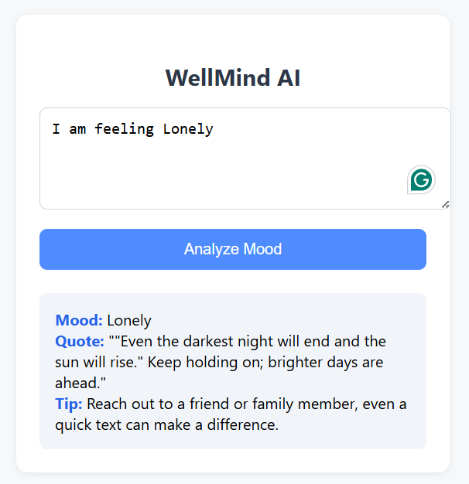

Slide 7
Technology used:
Language Model | Bot Framework | Deployment | Messaging Apps
Google Gemini (Generative AI) | Python + python-telegram-bot | Local / Cloud-hosted (future) | Telegram (live), WhatsApp (next)

Slide 8
Link to the ShikshaAI
GitHub Repository
https://github.com/Yash1124233/ShikshaAI

