Slide 1
Embedded Systems
Smart voice Lights Hands - Hands Free Home Automation Using ESP32
Chinta Mounika(Team Lead)
Kanuri Kanaka Durga
Asapu Radhikamahalakshmi
Thodam Yaswanth
Page | 1

Slide 2
Embedded Systems
ABSTRACT
This project proposes an Smart Voice Lights – Hands Free Home Automation using ESP32 board, aimed at automating home appliances through voice commands without relying on internet connectivity. It utilizes the VC02 Voice Recognition Module for offline command processing and a Relay Module to control devices. For added flexibility, the system also supports remote control via the Blynk IoT mobile app. This setup offers a reliable, cost effective solution for smart home automation, especially in areas with limited or unstable internet access.
Page | 2

Slide 3
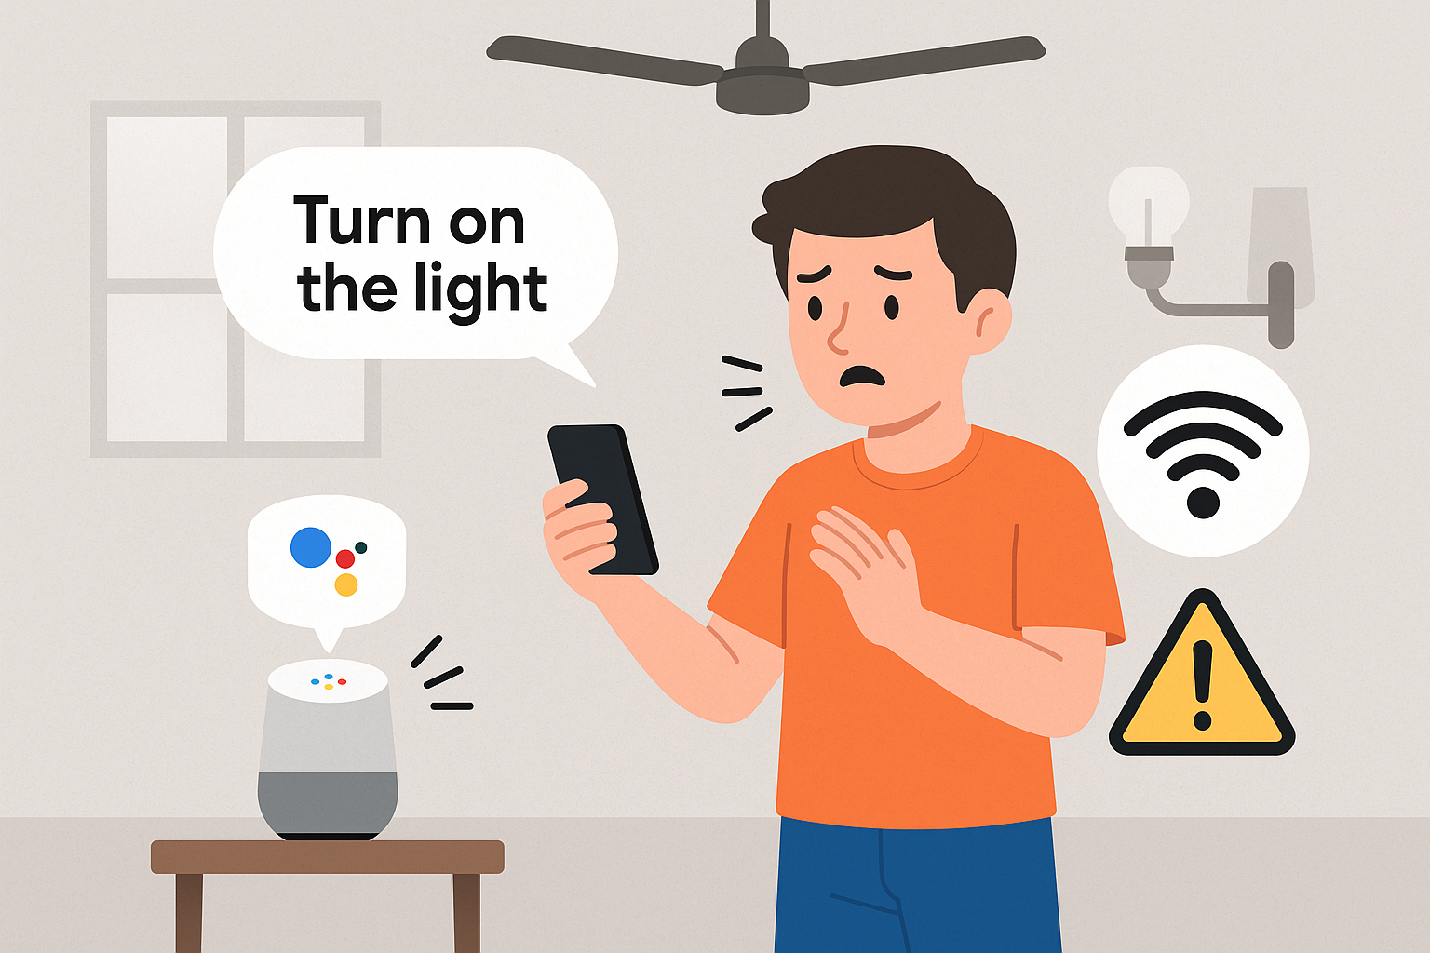
Embedded Systems
PROBLEM STATEMENT
Most smart home systems need a constant internet connection to work. In places where the internet is slow or unreliable, these systems become hard to use. They are also often costly, complicated, and offer very few offline voice control options. Sending data to the internet can also cause privacy issues.
Main Problems:
Internet dependency
High cost
Complexity Limited
offline features Privacy
Concerns Not easily accessible for all users
Page | 3

Slide 4
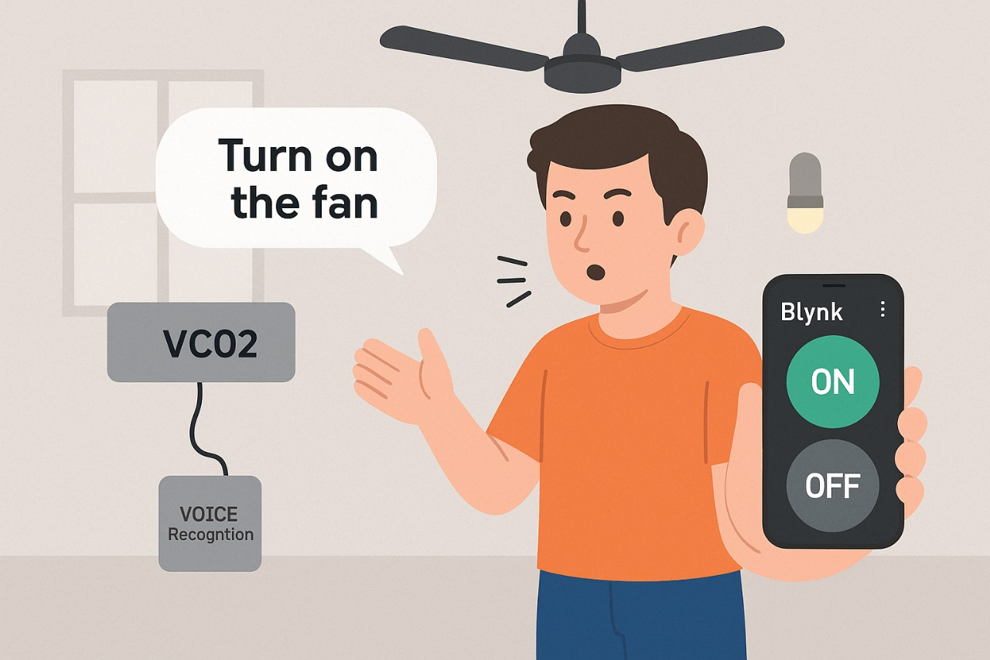
Embedded Systems
PROPOSED SYSTEM
This project introduces an Offline Voice-Controlled Smart Home System using the ESP8266 board. It uses a voice recognition module to process commands locally and a relay module to control appliances without the internet. For added flexibility, it also allows remote control through the Blynk IoT app when internet is available. This makes it a low-cost, reliable, and practical solution for places with poor connectivity.
50%
Page | 4

Slide 5
Embedded Systems
COMPONENTS REQUIRED
VC02 Voice Recognition Module:
It will recognize the voice commands and sends signal to the ESP32.
Microcontroller: ESP32 Development Board
Output Control Unit: 2-Channel or 4-Channel Relay Module (depending on number of devices)
Appliances: Light bulb, fan, or any AC/DC device for switching
Power Supply: 5V/3.3V adapter or USB power source compatible with ESP32 and VC02
Optional Component: Smartphone (with Blynk app installed for remote control via Wi-Fi)
Page | 5

Slide 6
Embedded Systems
Working Principle:
Voice commands processed locally by VC02 Voice Recognition Module. (No internet needed — works offline)
Recognized command sent to ESP32 microcontroller via serial communication.
ESP32 processes the command and triggers the connected Relay Module.
Relay Module controls the connected home appliance (Fan, Light, etc.) ON or OFF.
Optional remote operation via Blynk IoT mobile app through Wi-Fi when network is available.
ESP32 communicates with the Blynk server to update appliance status.
User can monitor and control devices from anywhere via Blynk app.
System ensures both offline voice control and optional online remote control.
Cost-effective and suitable for areas with limited or unstable internet connectivity.
Low-power, compact, and scalable solution for multiple appliances.
Improved privacy as offline voice commands don’t go through cloud servers.
Page | 6

Slide 7
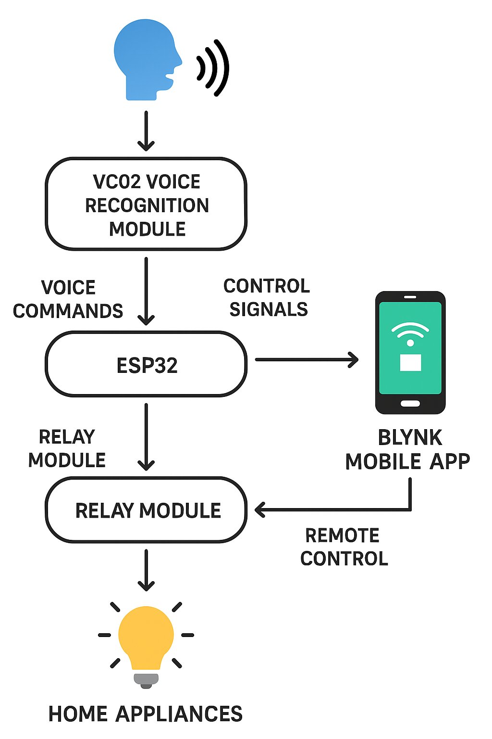
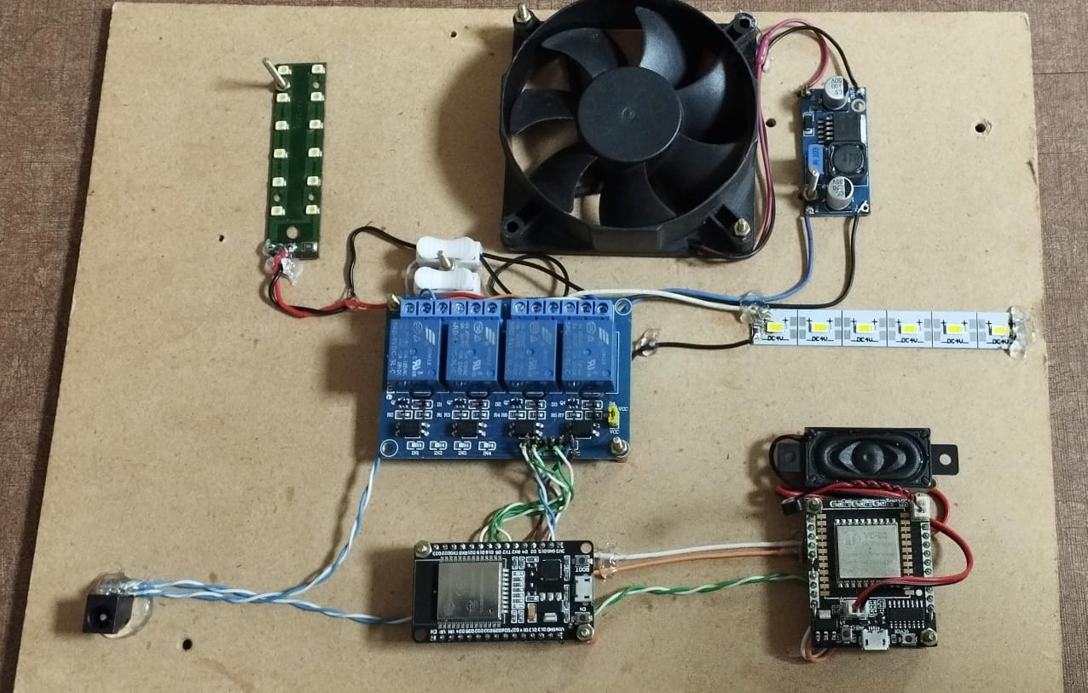
Embedded Systems
Flow Chart:
Circuit Diagram:
ESP32
4 - Channel Relay Module
VC02 Module

Slide 8
Embedded Systems
Features:
Offline Voice Recognition
Dual control modes: voice + mobile app
Cost-effective
Reliable operation without internet
User-friendly mobile interface
Advantages:
It is also useful for Dumb people through mobile app.
No dependency on continuous internet.
Useful in remote or unstable network areas.
Easy to integrate and expand.
Energy-efficient and secure (local processing).
Page | 8

Slide 9
Embedded Systems
Applications:
Home automation in rural or low-internet areas
Smart control for elderly or physically challenged people
Secure, offline automation for sensitive places
Energy-saving smart homes
Low-cost automation for hostels and rental homes
Quick setup for disaster relief shelters
Page | 9

Slide 10

Embedded System
Conclusion:
Successfully developed an offline smart home system using ESP8266 and VC02.
Appliances can be controlled by voice or through the Blynk app when Wi-Fi is available.
The system is low-cost, reliable, and easy to use in any environment.
A practical and scalable solution for smart homes, especially in areas with poor internet.
Future Scope:
Add support for more voice commands.
Multi-room control capability.
Support voice commands in different language.
Allow control only for trusted, trained voices.
Page | 10

Slide 11

Embedded Systems
Thanks for Your Attention
End Presentation
Page | 11

