Slide 1

Real Estate Analysis for Cities in California
Data Analytics-BAN612
Under the Guidance
Dr. Lan Wang
Group Members
Yash Shah
Nishtha Ranpara
Mahavir Parmar
Sagar Jethwa
Karan Malik
Viral Patel
Vanshika Gupta

Slide 2
Contents
Introduction
Web Scraping Process
Dataset Description
Data Cleaning & Wrangling
Research Questions
Conclusion

Slide 3

Introduction
Redfin is an American online real estate marketplace
Aids buyers & renters to find homes across United States
Enumerates property details such as address, region, listed price, estimated mortgage, area, interior features, etc.
List recommendations, local insights & map overlays
Provides details about commute, reported crime, schools & nearby businesses, etc.

Slide 4
Web Scraping Process
Main URL= https://www.redfin.com/
Objective: To extract data of various properties listed amongst popular cities of California on Redfin website
Libraries: Beautiful Soup and Requests
The a[href] tags listed on the main URL are extracted.
All property extensions are filtered by searching for presence of a tag and basic-card-photo’ as the class name in the source code.
The property extension are concatenated with href = https://www.redfin.com/ to get the complete web address of each property
‘Span’ tags,’h3’ tags, ‘li’ tags, ‘div’ tags, ‘td’ tags along with respective attributes are used to extract information of each property.
We have also used try catch block for several attributes to avoid the error.
The output is a list of dictionary and is saved as a csv file

Slide 5
Dataset Description
The data extracted consists of 877 rows and 14 columns
Street | Location of the property
City | City of the property
State | State of the property
Zipcode | Zipcode of the property
Price | Listed price/selling price/market vale for the property
Bed | Number of rooms in the property
Bath | Number of baths in the property
Sqft | Overall area in square feet
Walk score | Walk Score measures the walkability of any address using a patented system
Transit score | Transit Score is a patented measure of how well a location is served by public transit on a scale from 0 to 100
Bike score | Bike Score measures whether an area is good for biking
Competitive score | Redfin exclusive score that determines the demand of the property
Price/sqft | Gives you the price per unit sqft of the property

Slide 6
Data Cleaning & Wrangling
Data Anomalies observed:
Price per Sq.Ft had some data point with values scraped as “#Value!”
Sq.Ft attribute consists of special characters such as "Äî'"
How did we tackle this:
Normalization
There were some observation in ‘City’ attribute which had inconsistent values such as “ALAMEDA” & “Alameda”

Slide 7
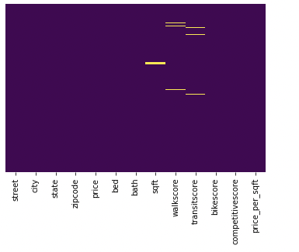
Data Cleaning & Wrangling
Handling Null Values
Observation of null values using seaborn heatmap
After Data Cleaning stage our final data set consisted of 814 records

Slide 8
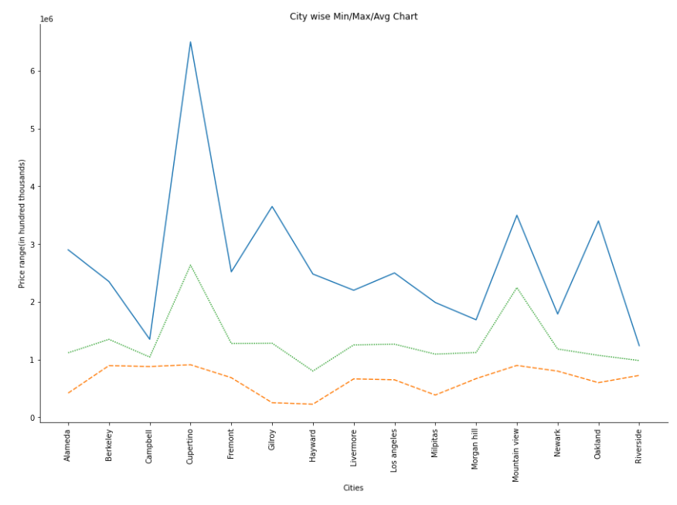

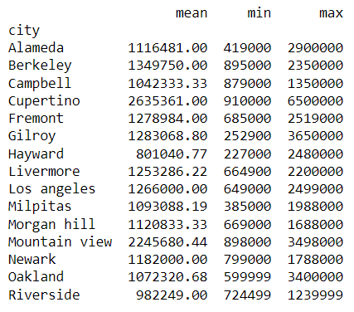
City Wise Minimum/Maximum and Avg Price Details

Slide 9
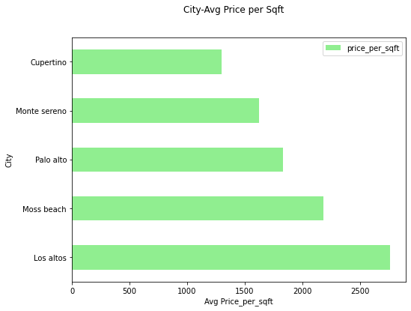
2. Top 5 cities in CA as per the Average price per square feet
Los Altos is the most expensive city in California as per price per square feet.
Top 5 cities lies between $1300-$2800, shows a vast range in dollar amount.
This analysis also shows that all other cities are comparatively affordable as all are below $1300 per square feet.

Slide 10
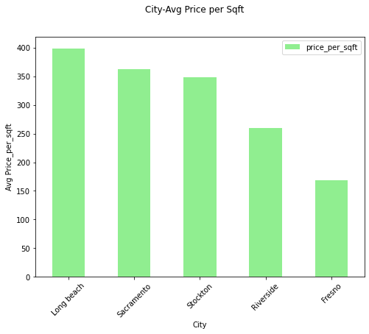
3. Bottom 5 cities in CA as per the Average price per square feet
Fresno is the least expensive city in California as per price per square feet.
Bottom 5 cities lies between $165-$400, making it quite affordable compared to other cities.
Stockton and Sacramento are almost same in their average price per square feet costing.
Another interesting fact after the analysis implies that 85% of the cities lie between $400 -$1300

Slide 11
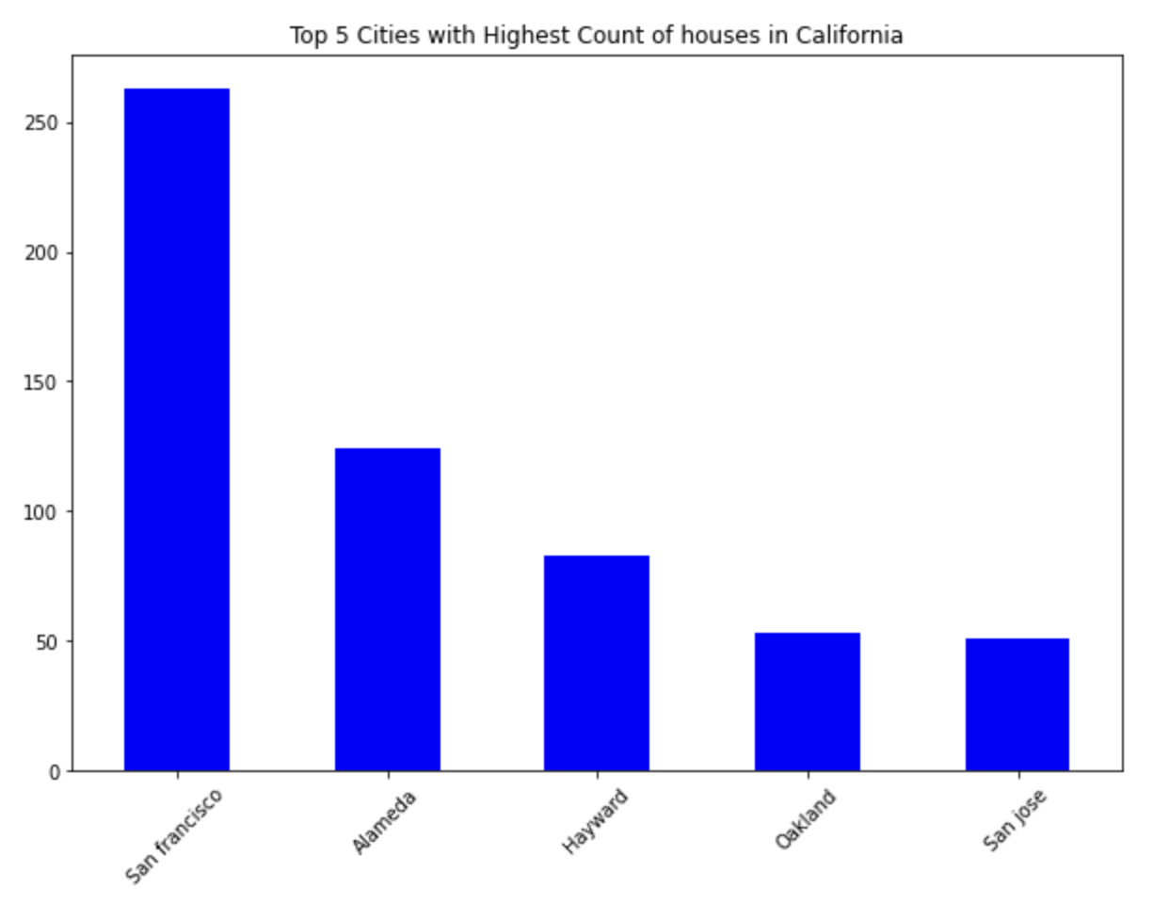
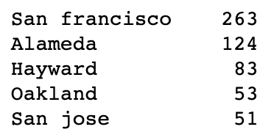
•Highest count of houses in 5 cities of California.
•San Francisco has highest count of houses from all the cities.
•San Jose has lowest count of houses from top 5 highest house count cities.
4. Count of houses per City

Slide 12
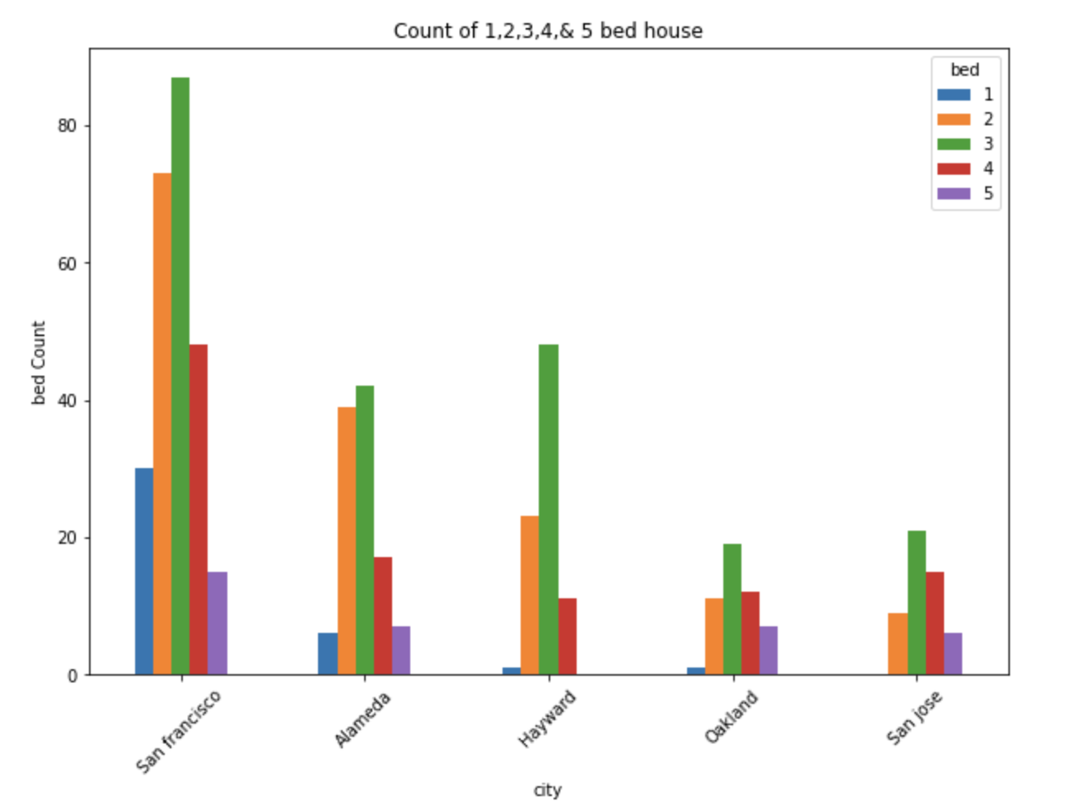
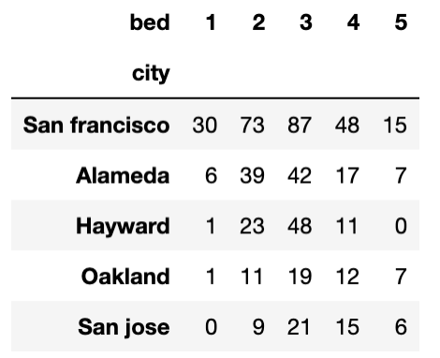
•Further splitting total house count as per number of bed.
5. Bifurcation of houses based on Number of Beds per City

Slide 13
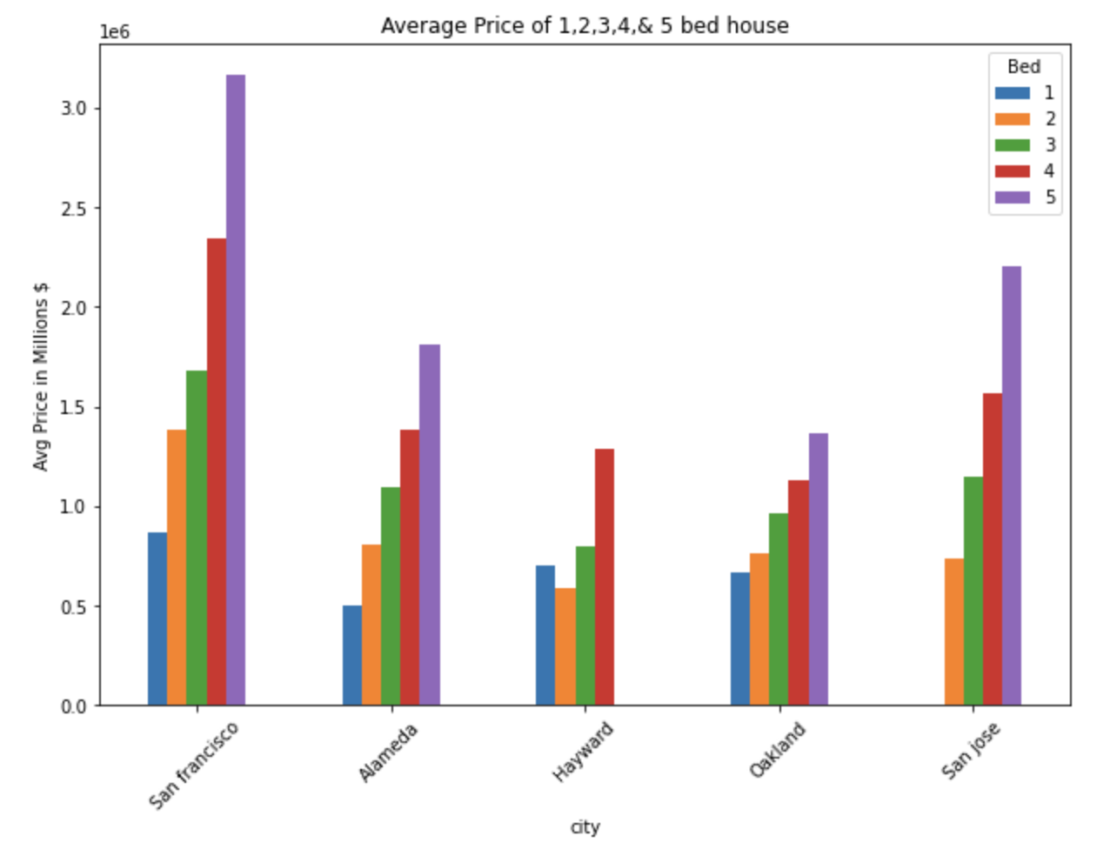
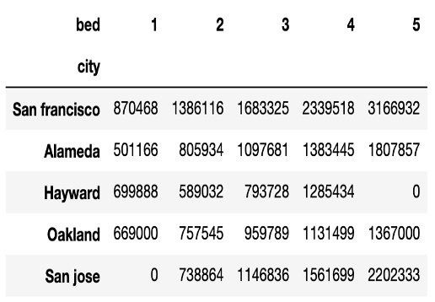
6. Average price of House per Bed
As number of bed increases in a property, the average property Price also increases.

Slide 14
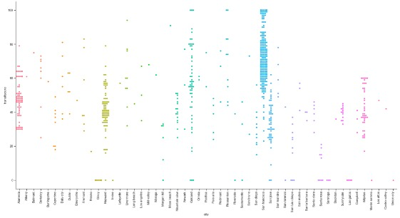
Variation in Transit Score per City

Slide 15
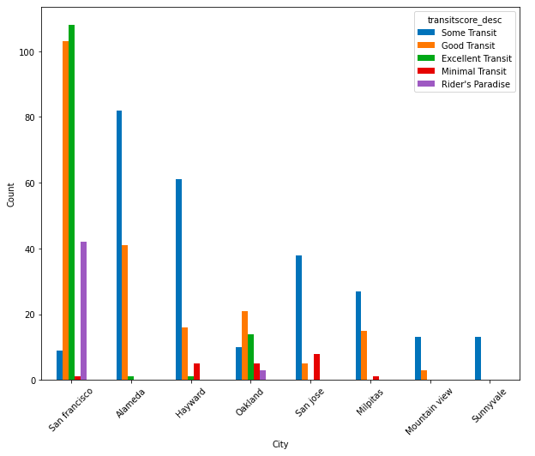
7. How good is the City transit system
► San Francisco has many transit options and hence the number of houses sold are relatively more
► Sunnyvale has only some transit options

Slide 16
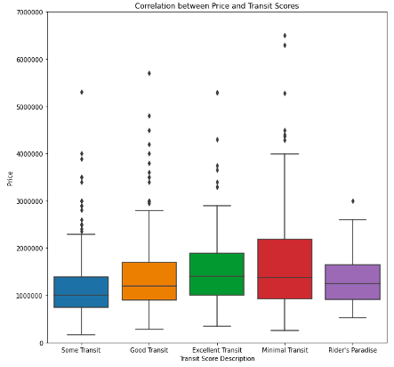
8. How transit availability affects prices
House price range for the areas having minimal transit is the largest as compared to other four categories
Though areas are rider’s paradise yet, the price range is relatively smallest
As we can observe, transit systems do not affect the pricing of houses and we notice that the median value of price for all the categories are nearabout

Slide 17
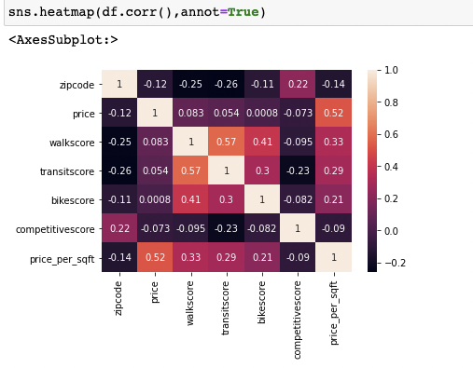
9. Linear Regression Model Analysis
Understanding the correlation between price and other attributes
Features selected : walkscore, bed, sqft, bath, price_per_sqft, transitscore, competitive score, bike score [8 predictors]

Slide 18
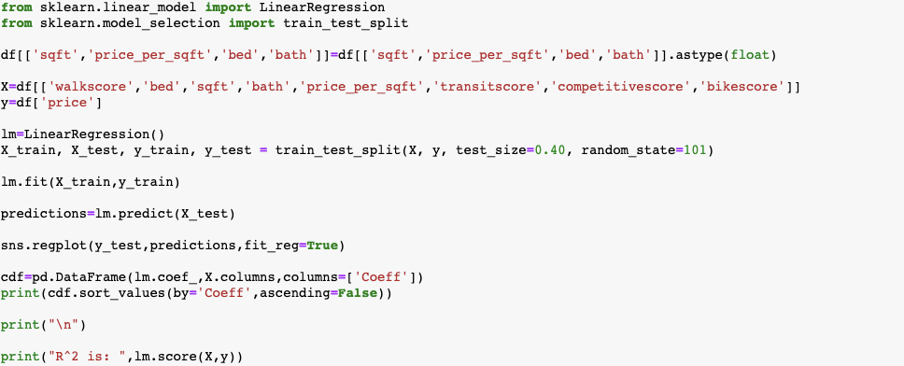
9. Linear Regression Model Analysis
Understanding the correlation between price and other attributes

Slide 19
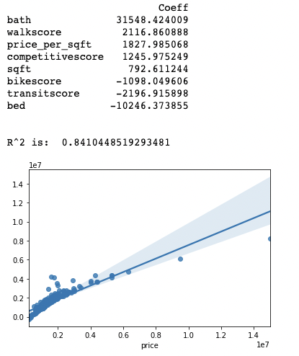
9. Linear Regression Model Analysis
Regression Equation coefficients, R^2 value and predictions
Equation : y=m1x1+ m2x2 + m3x3 + m4x4 + m5x5 +m6x6 + (-1556438.691))

Slide 20
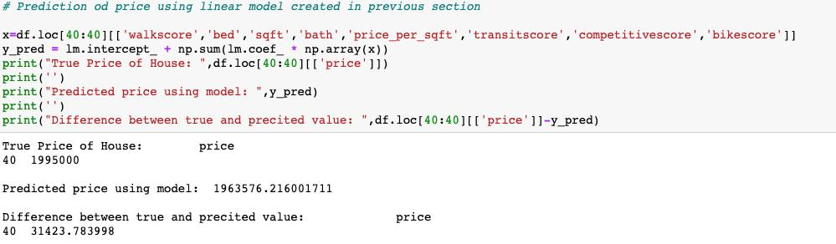
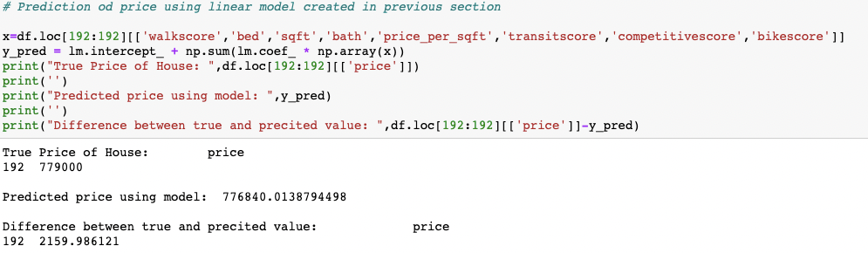
9. Linear Regression Model Analysis
Prediction's testing
Test case 1
Test case 2

Slide 21
Observations
‘Cupertino’ has a more properties with higher prices compared to other Cities in California
‘Los Altos’ has the highest Price/Sq. Ft. properties where as ‘Fresno’ has the lowest Price/Sq. Ft properties
‘Hayward’ has a cheaper Average price for 2Bed Properties when compared to 1Bed Properties
‘San Francisco’ has good options for houses with nearby Transit availability

Slide 22
Thank you ☺ Please feel free to bring up your questions!

