Slide 1



Team Members:
Ayush Kr.Burnwal(RA2411056010256
Yash A(RA2411056010262)
Arya Phanase(RA2411056010308)
Sanjeevani: Early Warning of Water-Borne Disease Risk Using Machine Learning
1

Slide 2
INTRODUCTION
Water-borne diseases can spread rapidly when contaminated water goes unnoticed, especially in rural and peri-urban communities. Traditional monitoring often depends on reported cases, which means action may happen only after people become sick. Sanjeevani aims to use AI and water-quality data to identify changing risk conditions earlier and support proactive monitoring.
Key Points:
  Water quality directly affects public health.
  Early detection can support faster intervention.
  Multiple parameters such as pH, turbidity, TDS, EC and dissolved oxygen can be monitored.
  AI/ML can identify patterns in water-quality data.
  Future integration of environmental, community and health signals can support an early-warning framework.

Slide 3
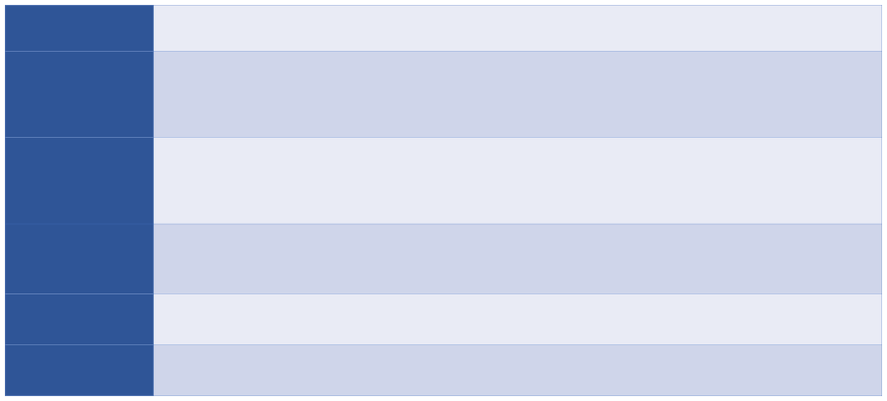
LITERATURE SURVEY
Jinal Patel, Charmi Amipara, Tariq Ahamed Ahanger, Komal Ladhva, Rajeev Kumar Gupta, Hashem O. Alsaab, Yusuf S. Althobaiti, Rajnish Ratna
Title, Name of the Journal, Year of the
A Machine Learning-Based Water Potability Prediction Model by Using Synthetic Minority Oversampling Technique and Explainable AI”
Computational Intelligence and Neuroscience, 2022
Publications
Proposed Approach /
Uses SVM, Decision Tree, Random Forest, Gradient Boosting and AdaBoost for water-potability classification. Z-score normalization is applied; SMOTE is used to handle class imbalance, and LIME-based explainable AI is used to interpret predictions.
Alg o rithm / Methodology
Your paragraph text
Sailent Features
  Specifically addresses water potability classification.
  Handles imbalanced water-quality data using SMOTE.
  Adds explainability instead of treating the model as a pure black box.
  Random Forest and Gradient Boosting achieved about 81% accuracy.
In fer en ce s
Ensemble models such as Random Forest and Gradient Boosting can outperform individual conventional classifiers for water-potability prediction, while XAI helps explain why a water sample receives a particular prediction.
Challenges
Model transparency is a major concern in conventional ML. Performance also depends on the quality and representatives of the training dataset; a model trained on one public dataset may require validation before deployment in another region.

Slide 4
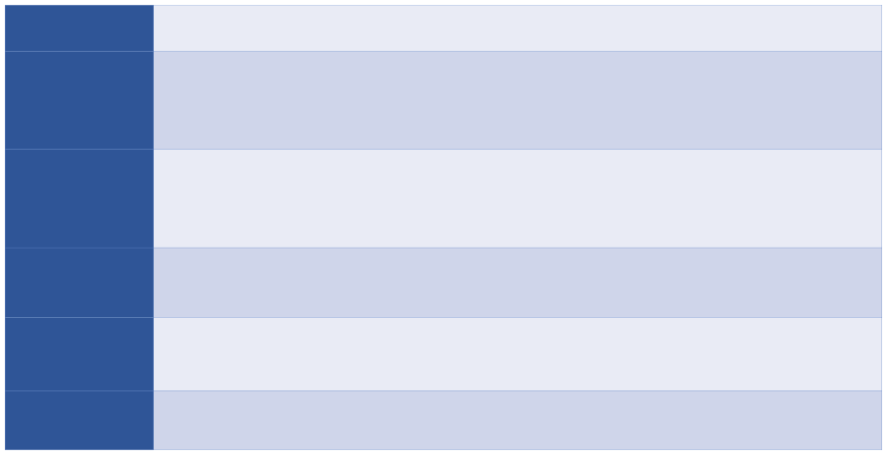
LITERATURE SURVEY
Au th or
M. K. Nallakaruppan, E. Gangadevi, M. Lawanya Shri, Balamurugan Balusamy, Sweta Bhattacharya, Shitharth Selvarajan
Title, Name of the Journal, Year of the
“Reliable Water Quality Prediction and Parametric Analysis Using Explainable AI Models”
Scientific Reports, 2024
Publications
Proposed Approach /
Compares Logistic Regression, SVM, Gaussian Naive Bayes, Decision Tree and Random Forest for binary water-potability classification. Missing values are imputed, the data are split for training/testing, and SHAP-based XAI is used to explain feature contributions.
Alg o rithm / Methodology
Sailent Features
The study works with the same type of parameters relevant to your main dataset: pH, hardness, sulfate, chloramines, conductivity, organic carbon, trihalomethanes and turbidity, with Potability as the binary target. It combines model comparison with explainable predictions.
Inferences
Random Forest produced the strongest reported results in their experiment, and SHAP demonstrated how individual physicochemical parameters contributed to predicted potability. This supports using an interpretable ensemble model in Sanjeevani rather than providing only a binary output.
Challenges
The authors note limitations in global applicability: models trained on one data distribution may need retraining or validation for different geographical conditions. The work also focuses on static potability classification rather than real-time outbreak prediction.

Slide 6
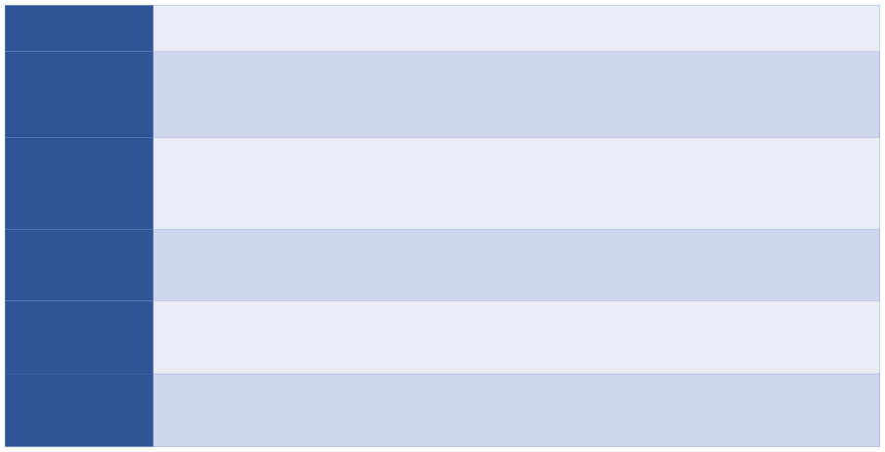
LITERATURE SURVEY
Author
Kangyang Chen, Hexia Chen, Chuanlong Zhou, Yichao Huang, Xiangyang Qi, et al.
Title, Name of the Journal, Year of the
“Comparative Analysis of Surface Water Quality Prediction Performance and Identification of Key Water Parameters Using Different Machine Learning Models Based on Big Data”
Water Research, 2020
Publications
Proposed Approach /
Evaluated 10 ML models: Logistic Regression, LDA, SVM, Decision Tree, Completely Random Tree, Naive Bayes, KNN, Random Forest, Completely Random Tree Forest and Deep Cascade Forest.
The models were tested on 33,612 observations collected from major rivers and lakes in China between 2012 and 2018.
Algorithm / Methodology
Sailent Features
  Large real-world dataset.
  Compares traditional and ensemble ML models under the same conditions.
  Evaluates Precision, Recall, F1 and weighted F1.
  Performs feature/parameter selection to reduce monitoring cost.
Inferences
Decision Tree, Random Forest and Deep Cascade Forest showed strong performance. The study found that a reduced group of important water parameters could retain useful prediction performance, indicating that intelligent feature selection can reduce the number of measurements needed for monitoring.
Challenges
The study uses Chinese surface-water classifications rather than a binary drinking-water potability target. Therefore, the trained models and regulatory classes cannot be directly transferred to Indian drinking-water data without adaptation..

Slide 7
LITERATURE SURVEY
Author
Md Abdullah Al Mamun Hridoy, Abdullah Ibna Shawkat, Chiara Bordin, Mahima Ranjan Acharjee, Andleeb Masood, Azeez Olalekan Baki, Md Abdullah Al Mamun
Title, Name of the
Journal, Year of the
Publications
“Advanced Machine Learning Models for Accurate Water Quality Classification and WQI Prediction: Implications for Aquatic Disease Risk Management”
Science of the Total Environment, 2025
Compares LightGBM, XGBoost, Random Forest and SVM, using grid-search hyperparameter optimization. Both water-quality classification and WQI regression are studied, with SHAP used for explaining model predictions.
Proposed Approach
  Combines classification and regression.
  Uses advanced boosting methods.
  Integrates explainability.
  Explicitly discusses real-time water-quality data and early-warning applications.
  Identifies DO, BOD, turbidity, nitrate and electrical conductivity as important features.
Salient Features
LightGBM/XGBoost showed very strong classification performance, while XGBoost produced R² ≈ 0.9685 for WQI regression. The research shows the potential of combining real-time water sensing, ML and XAI to support proactive environmental-risk monitoring
Inferences
The health-risk component primarily concerns aquatic/aquaculture disease management, not direct prediction
of human water-borne disease outbreaks. Human-health deployment therefore requires
different clinical labels and validation.
Challenges

Slide 8
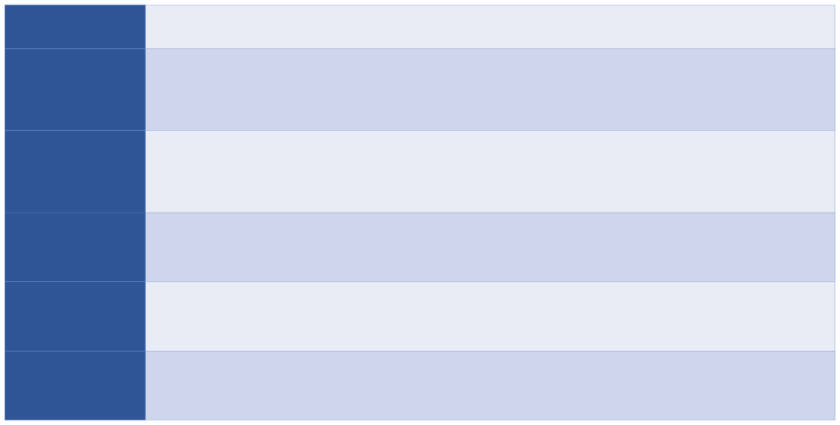
LITERATURE SURVEY
Author
Rakesh Choudhary, Ajay Kumar, Priyadharsini C., Mude Murali Naik, Moharana Choudhury, Nadeem A. Khan
Title, Name of the Journal, Year of the
“Predicting Water Quality Index Using Stacked Ensemble Regression and SHAP Based Explainable Artificial Intelligence”
Scientific Reports, 2025
Publications
Proposed Approach /
Uses 1,987 Indian river-water samples from 2005–2014. Six ensemble regressors—XGBoost, CatBoost, Random Forest, Gradient Boosting, Extra Trees and AdaBoost—are combined using Linear Regression as a stacking meta-learner.
Algorithm / Methodology
  Stacked ensemble architecture.
  SHAP-based model interpretation.
  Connects prediction with real-time environmental monitoring.
  Uses DO, BOD, conductivity and pH as important predictors.
Sailent Features
Inferences
The stacked ensemble outperformed individual models, reaching R² ≈ 0.9952 in the reported WQI experiment. SHAP indicated that DO, BOD, conductivity and pH were particularly influential
Challenges
The study predicts continuous WQI, not your binary Potability target. The data also originate from a limited set of Indian monitoring locations, so geographic generalization still needs validation.
13

Slide 9
LITERATURE SURVEY
Author
Ajayakumar Appukuttan, C. D. Aju, Rajesh Reghunath, Reji Srinivas, K. Anoop Krishnan, Arya S.
Title, Name of the Journal, Year of the Publications
“Exploring Hydrochemical Drivers of Drinking Water Quality in a Tropical River Basin Using Self-Organizing Maps and Explainable AI”
Water Research, 2025
Proposed Approach / Algorithm / Methodology
Combines hydrochemical analysis with:
  Self-Organizing Maps (SOM)
  Entropy Water Quality Index
  Random Forest-based prediction
  SHAP explainability
  Indian geographical context.
  Combines unsupervised learning with supervised ML.
  Includes interpretable feature analysis.
  Investigates spatial and hydrochemical water-quality patterns.
Sailent Features
Inferences
SOM identified distinct water-quality clusters, while Random Forest obtained R² ≈ 0.871. SHAP identified sodium, potassium and TDS as important drivers of quality degradation
Challenges
The dataset is region-specific and relatively limited compared with large monitoring datasets. It focuses on
groundwater/hydrochemistry rather than your exact nine-feature binary Potability problem.

Slide 10
LITERATURE SURVEY
Author
Amy Marie Campbell, Marie-Fanny Racault, Stephen Goult, Angus Laurenson
Title, Name of the Journal, Year of the Publications
“Cholera Risk: A Machine Learning Approach Applied to Essential Climate Variables”
International Journal of Environmental Research and Public Health, 2020
Proposed Approach / Algorithm / Methodology
Uses Random Forest classification to predict environmental cholera risk in coastal India using environmental and climate variables including:
Chlorophyll-a Sea-surface salinity Land-surface temperature Sea-level anomaly
Soil moisture Sea-surface temperature Precipitation
Sailent Features
  Focused directly on cholera risk.
  Coastal India application.
  Uses remotely sensed/climate variables.
  Demonstrates environmental early-warning capability without waiting only for case counts.
The Random Forest model reported approximately 0.99 accuracy, F1 ≈ 0.942 and sensitivity ≈ 0.895, indicating that environmental signals can provide useful information about cholera-risk conditions
Inferences
Challenges
The outbreak classes were imbalanced, which can affect sensitivity. Cholera-reporting data quality also differs by region, making reliable ground-truth labels difficult to obtain

Slide 11
LITERATURE SURVEY
Author
Arman Hossain Chowdhury, Md. Siddikur Rahman
Title, Name of the Journal, Year of the Publications
“Machine Learning and Spatio-Temporal Analysis of Meteorological Factors on Waterborne Diseases in Bangladesh”
PLOS Neglected Tropical Diseases, 2025
Proposed Approach / Algorithm / Methodology
Uses district-level cases of:
  Cholera Typhoid
  Hepatitis A Amoebiasis
along with meteorological parameters such as temperature, humidity, wind and precipitation between 2017–2020.
Directly studies human waterborne diseases.
Combines disease surveillance with environmental information.
Includes spatial/geographic analysis.
Uses tree-based ML suitable for nonlinear relationships.
Sailent Features
Inferences
Mean/minimum temperature, relative humidity and precipitation were important disease-associated factors. XGBoost identified climatic determinants effectively, demonstrating that environmental data can support targeted early-warning and surveillance.
Only about four years of annual data were available. Important confounders such as population density, socioeconomic conditions and several environmental variables were not included, limiting the completeness of the risk model.
Challenges

Slide 12
LITERATURE SURVEY
Author
A. K. Sahai, Raju Mandal, Susmitha Joseph, Shubhayu Saha, Pradip Awate, Somenath Dutta, et al.
Title, Name of the Journal, Year of the Publications
“Development of a Probabilistic Early Health Warning System Based on Meteorological Parameters”
Scientific Reports, 2020
Proposed Approach / Algorithm / Methodology
Uses Self-Organizing Maps (SOM) as an unsupervised pattern-recognition technique to associate:
  Rainfall
  Maximum temperature
  Minimum temperature
with acute diarrhoeal disease and malaria.
  Explicit early-warning system.
  Produces probabilistic disease-risk categories.
  Uses climate conditions over different temporal windows.
  Designed to forecast disease incidence 2–3 weeks in advance.
Sailent Features
Inferences
The study showed that weather patterns can provide useful disease-risk information at least around two weeks ahead, and probabilistic forecasts were more useful than simple deterministic case-count predictions
The study itself notes that socioeconomic conditions, hygiene and drinking-water access were not incorporated due to lack of data. Disease data were also available for only a limited number of years and locations.
Challenges

Slide 13
LITERATURE SURVEY
Author
Ismael Villanueva-Miranda, Guanghua Xiao, Yang Xie
Title, Name of the Journal, Year of the Publications
“Artificial Intelligence in Early Warning Systems for Infectious Disease Surveillance: A Systematic Review”
Frontiers in Public Health, 2025
Proposed Approach / Algorithm / Methodology
A PRISMA-based systematic review examining AI-driven infectious-disease early-warning systems. The review screened around 600 records and included 67 relevant studies.It evaluates the use of : ML, DL, NLP, Ensemble approaches, Hybrid Systems with data from epidemiological surveillance, climate, web sources and wastewater.
  Reviews the complete AI early-warning landscape rather than one specific model.
  Supports multi-source data fusion.
  Discusses practical deployment issues.
  Covers environmental and epidemiological surveillance together.
Sailent Features
Inferences
AI can improve early outbreak detection and prediction by integrating multiple heterogeneous data sources. This strongly supports Sanjeevani's proposed architecture of combining sensor + environmental + community + clinical information
The review identifies major issues involving: Data Quality and Bias, Black - Box models, System Integration, Privacy,Equity and Lack of explainability. These challenges are directly relevant when Sanjeevani moves from a college prototype to a public-health deployment.
Challenges

Slide 14
Problem Statement
Water-borne disease outbreaks are usually noticed only after people fall ill and cases are reported.
Signals that arrive earlier (sensors, laboratory tests, ASHA-style reports, outpatient visits) are partial and delayed.
Health teams cannot examine every area every week.
Key Challenges:
Reactive surveillance: outbreaks are identified after reported cases rise.
Delayed and noisy observations: formal reports lag behind the start of an outbreak.
Real surveillance data record report dates, not true onset, so warning lead time is hard to measure.
Goal:
Rank areas (simulated units) for review each week, using only observations available at decision time.
Test this idea in a controlled synthetic simulation; no claim is made about real outbreaks or real water safety.

Slide 15
Research Gap
Studies in the literature survey use real data, each with its own region, target and time scale.
Key Research Gaps Addressed:
Time scale: weekly, unit-level ranking is not covered by yearly district counts (Chowdhury & Rahman, 2025) or weather-only outlooks (Sahai et al., 2020).
Timing: lead before true onset and lead before a delayed formal report are different clocks and need separate measurement.
Ground truth: real data do not show true onset, so a simulation with known events is needed to test timing.
Leakage control: features must be cut at decision time and splits made by independent world to avoid optimistic scores.
Surveillance quality: reporting coverage and delay can be varied in simulation while the hidden event truth stays fixed.

Slide 16
Objectives & Scope
Key Objectives:
Build a reproducible synthetic generator of weather, water-system state, cases and outbreak events, with delayed surveillance.
Define two binary tasks: M1 early warning (new onset within 7 days) and M2 current detection (outbreak active now).
Construct 34 as-of features that exclude hidden truth and future data.
Compare six methods, including a handwritten NumPy logistic regression.
Evaluate on a held-out simulated world: average precision, prevalence and event timing.
Show the saved results in a local Simulation Lab.
Scope:
Synthetic simulation only: 43 simulated units and three surveillance scenarios.
Scores rank units for human review; they are not diagnoses or citizen alerts.
Not covered: real-data validation, live sensors, public-health deployment.

Slide 17
DOMAIN & INDUSTRY RELEVANCE
1. PUBLIC HEALTH SURVEILLANCE
Ranks areas for investigation from weak, delayed signals.
Separates early warning (M1) from detection of active outbreaks (M2).
Tests review-capacity ideas in simulation only.
2. ENVIRONMENTAL HEALTH
Uses rainfall, dry spells, turbidity, chlorine, TDS and E. coli observations.
Studies how water-system conditions relate to simulated outbreaks.
Findings depend on the simulator's stated assumptions.
3. HEALTHCARE INFORMATICS
Combines ASHA-style, outpatient and formal-bulletin reports.
Uses only observations available by the decision time.
Records configuration and code hashes for audit.
4. COMMUNITY HEALTH
ASHA-style community reports enter as delayed observations.
Human review decides any action; no citizen alert is produced.
Real community use needs validation and stakeholder review.
Simulated Data
(generator)
→
As-of Features
(34 inputs)
→
M1 / M2 Scores
(saved models)
→
Ranked Units
(for review)
→
Human Review
(real-world use pending)

Slide 18
Sanjeevani – System Workflow
From Simulated Data to Human Review
1. Data Generation
Daily weather
Water-system state
Exposure, cases and outbreak events
Hidden event truth
2. Observations
Sensors and lab tests
ASHA-style reports
Outpatient visits
Delayed formal bulletins
3. As-of Features
Cut at end of Monday
34 inputs
No hidden truth
No future backfill
4. Labels
M1: new onset within 7 days
M2: outbreak active at t
Operational onset definition
5. Models
Seasonal baseline
Weather/water rule
Two logistic regressions
Random forest
XGBoost
6. Evaluation
Validation world: choose model and thresholds
Test world: score once
AP, Brier, event timing
7. Demonstration
Saved test predictions
Local read-only API
Simulation Lab replay
Planned Next Steps (pending)
Full 20/5/10-world run
Real-data validation
Human and stakeholder review
Generate → Observe → Predict → Evaluate → Review

Slide 19
INNOVATION & FEASIBILITY
Feasibility
Innovation
1. Technical Feasibility: Implemented in Python (NumPy, pandas, scikit-learn, XGBoost); 13 Python tests and a smoke run passed.
2. Data Feasibility: The generator produces labelled worlds with known event truth; seeds, configuration and code hashes are recorded.
3. Implementation Feasibility: A local read-only API and the React Simulation Lab already read the saved results.
1. Two Separate Clocks: Early warning (M1) is measured before operational onset; detection (M2) is measured against the formal report.
2. As-of Leakage Control: Features are cut at the end of Monday and splits are made by independent simulated world.
3. Controlled Surveillance Scenarios: Baseline, improved and enhanced observations share the same hidden event truth.

Slide 20
PROJECT PLAN & METHODOLOGY
01 — SYNTHETIC DATA GENERATION
Simulate weather, water system, exposure, cases and outbreak events for 43 units over 2017–2022.
02 — OBSERVATION SCENARIOS
Add delayed, noisy sensor, laboratory, ASHA-style, outpatient and formal reports in baseline, improved and enhanced settings.
03 — AS-OF FEATURES AND LABELS
Build 34 features at the end of each Monday; label M1 (new onset within 7 days) and M2 (outbreak active at t).
04 — MODEL TRAINING
Fit a seasonal baseline, a weather/water rule, handwritten and library logistic regression, random forest and XGBoost on training worlds.
05 — EVALUATION
Choose model and thresholds on validation worlds; score one held-out test world with average precision, Brier score and event timing.
06 — DEMONSTRATION
Replay saved test predictions in the Simulation Lab through a local read-only API.

Slide 21
STATISTICAL ANALYSIS
All final data are generated by the simulator; EpiClim, NFHS-5 and NASA POWER are background context only.
The smoke run uses one training world (seed 1001), one validation world (2001) and one test world (3001).
Each world covers 43 simulated units over 2017–2022, with 259 weekly decisions per unit.
Key Findings:
43 units × 259 weeks = 11,137 unit-weeks per scenario in each world.
M1 test cohort: 8,197 eligible unit-weeks, 428 positives (5.22%).
M2 test cohort: 11,137 unit-weeks, 2,940 positives (26.40%).
Counts are identical across baseline, improved and enhanced scenarios because the hidden event truth is shared.
Pooling the three scenario views gives 24,591 M1 and 33,411 M2 rows; these are correlated, not independent.
427 eligible events per scenario; 92 censored events are excluded from event recall.
Single synthetic test-world smoke run; no real-world validation.

Slide 22
STATISTICAL ANALYSIS
Average precision is read against prevalence: a no-skill score equals prevalence (M1 0.052, M2 0.264).
Right chart pools three correlated scenario views of one hidden test world; XGBoost was chosen on validation.
Single synthetic test-world smoke run; no real-world validation.

Slide 23
STATISTICAL ANALYSIS
M1 early warning: clock is the operational onset
M2 current detection: onset and formal-report clocks
 | Baseline | Improved | Enhanced
Events warned | 290 / 427 | 304 / 427 | 303 / 427
Event recall | 67.9% | 71.2% | 71.0%
Median days before onset | 3 | 3 | 3
 | Baseline | Improved | Enhanced
Active events detected | 416 / 427 | 420 / 427 | 424 / 427
Median days after onset | 4 | 4 | 3
Detected while unreported | 395 / 424 | 352 / 370 | 233 / 254
Median days before report* | 8 | 4 | 3
Key Findings:
M1 warned 290–304 of 427 events, a median 3 days before operational onset in every scenario.
M2 detected 416–424 of 427 active events, a median 3–4 days after onset.
The two clocks are separate: M2 detects after onset, so its before-report lead is never lead before onset.
Thresholds: validation target recall (M1 0.75, M2 0.85). 92 censored events per scenario are excluded.
*Before-report median covers only detected events that have a simulated report date.
Single synthetic test-world smoke run; no real-world validation.

Slide 24
MILESTONES & DEVELOPMENT ROADMAP
Completed
Completed
Completed
Completed
Completed
Pending
1. Research & Problem Framing
Literature survey
Research question
Scope: synthetic simulation
2. Synthetic Generator
43 simulated units
Weather, water, cases, events
Three observation scenarios
3. Features & Labels
34 as-of features
M1 and M2 labels
Leakage guards
4. Models & Smoke Run
Six methods compared
Train, validation, test worlds
Metrics and event timing
5. Demonstration
Local read-only API
Simulation Lab replay
13 Python tests pass
6. Full Study & Validation
20/5/10-world run
Real-data and independent validation
Human review
Filled circles mark stages completed for the synthetic smoke run; the hollow circle marks work still pending.
Completion of the full study and real-data validation is required before any claim about real-world use.

Slide 25
REFERENCES
1. Patel et al., “Machine Learning-Based Water Potability Prediction Using SMOTE and XAI,” 2022.
2. Nallakaruppan et al., “Reliable Water Quality Prediction Using Explainable AI Models,” 2024.
3. Chen et al., “Surface Water Quality Prediction Using Machine Learning Models,” 2020.
4. Choudhary et al., “WQI Prediction Using Stacked Ensemble and SHAP,” 2025.
5. Hridoy et al., “Advanced ML Models for Water Quality Classification and WQI Prediction,” 2025.
6. Appukuttan et al., “Drinking Water Quality Analysis Using SOM and Explainable AI,” 2025.
7. A. H. Chowdhury and M. S. Rahman, “Machine learning and spatio-temporal analysis of meteorological factors on waterborne diseases in Bangladesh,” PLOS Neglected Tropical Diseases, 2025. doi:10.1371/journal.pntd.0012800
8. A. M. Campbell, M.-F. Racault, S. Goult and A. Laurenson, “Cholera risk: a machine learning approach applied to essential climate variables,” Int. J. Environ. Res. Public Health, 17(24), 9378, 2020. doi:10.3390/ijerph17249378
9. A. K. Sahai et al., “Development of a probabilistic early health warning system based on meteorological parameters,” Sci. Rep., 10, 14741, 2020. doi:10.1038/s41598-020-71668-6
10. I. Villanueva-Miranda, G. Xiao and Y. Xie, “Artificial intelligence in early warning systems for infectious disease surveillance: a systematic review,” Front. Public Health, 13, 1609615, 2025. doi:10.3389/fpubh.2025.1609615
11. J. S. Brownstein, C. C. Freifeld and L. C. Madoff, “Digital disease detection — harnessing the web for public health surveillance,” N. Engl. J. Med., 360(21), 2153–2157, 2009. doi:10.1056/NEJMp0900702
12. G. Kaur et al., EpiClim dataset, Zenodo, 2024 (historical context only, not used as training data). doi:10.5281/zenodo.14580510
13. F. Pedregosa et al., “Scikit-learn: Machine Learning in Python,” J. Mach. Learn. Res., 12, 2825–2830, 2011.
14. T. Chen and C. Guestrin, “XGBoost: A Scalable Tree Boosting System,” Proc. KDD, 2016. doi:10.1145/2939672.2939785
15. Sanjeevani code and provenance record: github.com/Yash13606/sanjeevani (ml/data_provenance.json).

