Slide 1


Library
Management
System
C++ terminal application
Presented By: Yash Vardhan Tiwari
Mentored By: Varsha Yaduvanshi
Notes:
Source: supplied C++ code and Netlink / netSEED logo. Cover illustration generated for this presentation.

Slide 2

Project overview
A terminal application for maintaining library records using local files.
Library users
Register, sign in, view books and record a book issue.
Administrators
Sign in, add books, view user details and remove a user record.
Storage approach
Binary credential files and text records, with no database.
2
Notes:
Source: supplied Pasted text(3).txt. Background illustrations generated for this presentation.

Slide 3
Problem statement and objectives
Problem
Manual records require repeated entry and make book and member information harder to review.
Objective 1
Provide separate menus for library users and administrators.
Objective 2
Store member, book and issue records across program runs using file handling.
Project boundary
A learning prototype for one local terminal session at a time.
3
Notes:
Source: supplied Pasted text(3).txt. Background illustrations generated for this presentation.

Slide 4
Functional scope
Library user | Administrator
Create an account and member details | Authenticate using admin.bin
Authenticate using users.bin | Add a book with availability text
View all stored book records | View all stored user details
Append a dated issue record | Remove a user details record
Return to the main menu | Exit to the main menu
Book returns, fines and automatic availability updates are future work.
4
Notes:
Source: supplied Pasted text(3).txt. Background illustrations generated for this presentation.

Slide 5

Technology and execution requirements
C++ and standard library
iostream for input/output, fstream for files, cstring for comparisons, ctime for dates.
Core language features
Classes, nested classes, access control, static members and exception handling.
Local setup
A C++11 or newer compiler, a terminal and write access to the working directory.
Administrator prerequisite
Create a valid admin.bin first. Its setup code is currently commented out.
5
Notes:
Source: supplied Pasted text(3).txt. Background illustrations generated for this presentation.

Slide 6
Program structure
Component | Responsibility
main() | Repeats User, Admin Login and Exit options
Details | Holds user, book and availability fields
User::UserRegister | Collects credentials, saves and lists user details
User::UserLogin | Authenticates, lists books, issues books, deletes details
Admin::AdminLogin | Authenticates admins and routes admin operations
deleteUser() belongs to UserLogin, but the admin menu calls it.
6
Notes:
Source: supplied Pasted text(3).txt. Background illustrations generated for this presentation.

Slide 7
File storage design
File | Format | Stored content
users.bin | Binary | Repeated username[30] + password[30]
admin.bin | Binary | One username[30] + password[30] pair
userdetails.txt | Text | User ID, name, mobile number
bookdetails.txt | Text | Book ID, name, availability
issueddetails.txt | Text | User and book details, issue date
temp.txt | Text | Temporary records during user deletion
Binary storage does not encrypt passwords.
7
Notes:
Source: supplied Pasted text(3).txt. Background illustrations generated for this presentation.

Slide 8
ER diagram: library records
LIBRARY USER
uid (intended identifier)
uname
umobno
ISSUE RECORD
uid · bid
uname · umobno
bname · date
BOOK
bid (intended identifier)
bname
available
has issues
appears in
1
1
0..*
0..*
Conceptual relationships over time. Files do not enforce IDs or relationships.
Each issue row stores both user and book details. No unique issue ID exists.
8
Notes:
Source: supplied Pasted text(3).txt. Conceptual one-to-many relationships over time. IDs represent intended identifiers, not enforced primary or foreign keys. Issue rows repeat names and mobile numbers. The code does not validate that entered IDs exist. Background illustrations generated for this presentation.

Slide 9
ER diagram: credential boundaries
USER CREDENTIAL
username[30] and password[30], stored in users.bin.
ADMIN CREDENTIAL
username[30] and password[30], stored separately in admin.bin.
No saved account-to-member link
users.bin contains no uid. userdetails.txt contains no login username.
Design implication
The logged-in account is not tied to the user ID entered when issuing a book.
9
Notes:
Source: supplied Pasted text(3).txt. Background illustrations generated for this presentation.

Slide 10
User process flow
Main menu: User
New user
Save credentials + details
New or existing?
Login
Read users.bin
User operations
Match?
Yes
No
View all books
Issue book
Return
Main menu
Every operation returns to the main menu. “Return” means menu navigation.
10
Notes:
Source: supplied Pasted text(3).txt. Actual return behavior: registration, a failed login and each user operation unwind to the main menu. Return is menu navigation, not a book-return operation. Background illustrations generated for this presentation.

Slide 11
Admin process flow
No: retry
Enter admin credentials
Match admin.bin?
Yes
Admin menu
Add book
View all users
Remove a user
Exit
Append bookdetails.txt
Call admin menu again
Return through calls
to the main menu
Missing admin.bin also leads to repeated prompts in the current implementation.
11
Notes:
Source: supplied Pasted text(3).txt. Invalid credentials repeat within loginAdmin(). Add Book calls adminMenu() recursively. View users, remove user and Exit return through the current call stack toward main(). Background illustrations generated for this presentation.

Slide 12
Book issue process
01 Enter details
The user enters member ID, name, mobile number, book ID and book name.
02 Create the issue date
time(0) and localtime() supply the date in day/month/year format.
03 Save the issue record
issueBook() appends the entered values to issueddetails.txt.
Current behavior
The function does not check IDs or availability, and does not update the book record.
12
Notes:
Source: supplied Pasted text(3).txt. Background illustrations generated for this presentation.

Slide 13
C++ concepts in the implementation
Concept | Example in the code
Classes and objects | Details emp; User user; Admin::AdminLogin adlogin;
Nested classes | UserRegister and UserLogin inside User
Access control | Private credential arrays in UserRegister
File handling | read(), write(), getline() and append/truncate modes
Date and string operations | localtime(), to_string(), strcmp(), find(), substr()
Exceptions and control flow | try/catch, if/else, loops and function returns
Inheritance and runtime polymorphism are not used in this version.
13
Notes:
Source: supplied Pasted text(3).txt. Background illustrations generated for this presentation.

Slide 14
Testing plan
Scenario | Expected check
New user registration | Credentials and profile persist in separate files
Valid / invalid login | Correct credentials open the menu, invalid ones fail or retry
Add and view books | Stored book details appear when a user views books
Issue a book | An issue row includes entered values and the current date
Remove existing / unknown ID | Matching profile is removed, unknown ID shows a message
Missing files and invalid input | Check error handling and whether execution stops safely
Planned scenarios. Add execution results after running the program.
14
Notes:
Source: supplied Pasted text(3).txt. These are suggested test cases, not claimed execution results. Background illustrations generated for this presentation.

Slide 15
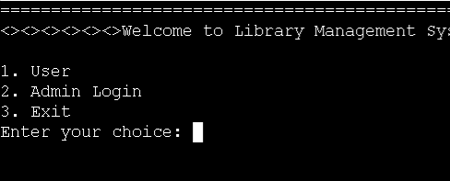
Program output: main menu and login
Suggested capture: welcome screen, role selection and a successful login.
Insert program output screenshot here
15
Notes:
Screenshot placeholder requested by the user. Replace this editable rectangle with the corresponding terminal capture.

Slide 16
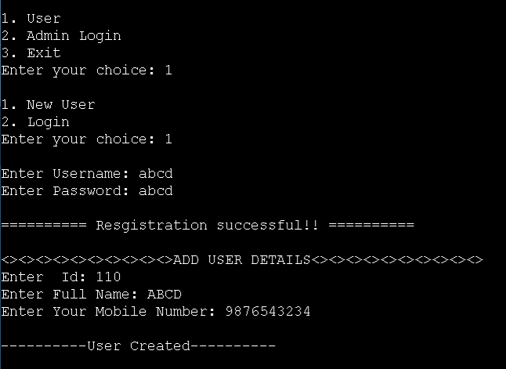
Program output: user registration
Suggested capture: account creation and saved member details.
Insert program output screenshot here
16
Notes:
Screenshot placeholder requested by the user. Replace this editable rectangle with the corresponding terminal capture.

Slide 17
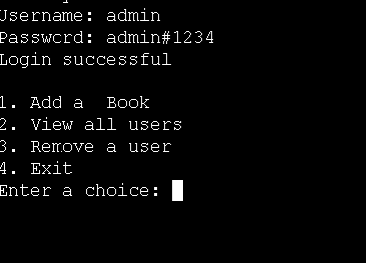
Program output: admin operations
Suggested capture: adding a book, viewing users or deleting a user record.
Insert program output screenshot here
17
Notes:
Screenshot placeholder requested by the user. Replace this editable rectangle with the corresponding terminal capture.

Slide 18
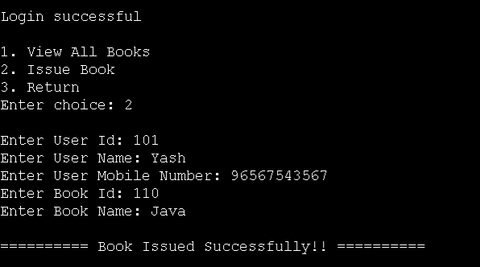
Program output: books and issuing
Suggested capture: book listing and the book issue confirmation.
Insert program output screenshot here
18
Notes:
Screenshot placeholder requested by the user. Replace this editable rectangle with the corresponding terminal capture.

Slide 19
Current limitations
Data consistency
Duplicate IDs are possible. Book issues do not validate records or change availability.
Account integrity
Deleting user details leaves credentials and previous issue records intact.
Authentication
Passwords remain readable in binary files. The program has no password hashing.
Error and menu handling
Statements after throw are unreachable. Some catches continue after failure, and Add Book uses recursion.
19
Notes:
Source: supplied Pasted text(3).txt. Background illustrations generated for this presentation.

Slide 20
Future improvements
Reliable borrowing
Connected records
Validate user and book IDs, update availability and add a genuine book-return operation.
Link each account to a member ID and give each issue a unique identifier.
Safer persistence
Simpler navigation
Hash passwords, validate input lengths and check every file write or replacement.
Use menu loops, handle invalid options and stop the operation after a file error.
20
Notes:
Source: supplied Pasted text(3).txt. Background illustrations generated for this presentation.

Slide 21
Conclusion
The project applies C++ file handling to a working library record workflow.
What the implementation demonstrates
Separate role menus, credential checks and persistent local records.
What comes next
Improve validation and record consistency, then complete the borrowing lifecycle.
21
Notes:
Source: supplied Pasted text(3).txt. Background illustrations generated for this presentation.

Slide 22
Questions and discussion
Thank you
Library Management System
C++ terminal project
22
Notes:
Source: supplied Pasted text(3).txt. Background illustrations generated for this presentation.

