Slide 1
SPOTIFY CLONE
Team Members:
Saumya Gaur
Yamini Khanduri
Yash Bahuguna
Ravi Negi

Slide 2
What is a Spotify clone?
A Spotify clone app is a music streaming software that offers a free platform for listening to music without having to download anything.
From the time you log in until the time you listen to music, the program is simple to use. Users may listen to their favorite music with ease thanks to the many features.

Slide 3
Language Used: Python
Python is relatively easy to learn and read, has a massive library to help you solve many of your coding problems, and has a very active and welcoming community of users.
Applications created with Python:
  YouTube
  Reddit
  Instagram
  Dropbox

Slide 4
Dataset Used: GTZAN Dataset
A collection of 10 genres with 100 audio files each, all having a length of 30 seconds.
images original - A visual representation for each audio file, the audio files were converted to Mel Spectrograms to make this possible.
CSV files - Containing features of the audio files. One file has for each song (30 seconds long) a mean and variance computed over multiple features that can be extracted from an audio file. The other file has the same structure, but the songs were split before into 3 seconds audio files (this way increasing 10 times the amount of data we fuel into our classification models).

Slide 5
K-NEAREST NEIGHBOUR ALGORITHM

Slide 6
KNN
K-Nearest Neighbors (KNN)
Simple, but a very powerful classification algorithm
Classifies based on a similarity measure
Non-parametric
Lazy learning
◉ Does not “learn” until the test example is given
◉ Whenever we have a new data to classify, we find its K-nearest neighbors from the training data

Slide 7
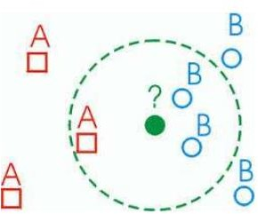
KNN: Classification Approach
Classified by “MAJORITY VOTES” for its neighbor
classes
◉ Assigned to the most common class amongst its K- nearest neighbors (by measuring “distant” between data)

Slide 8
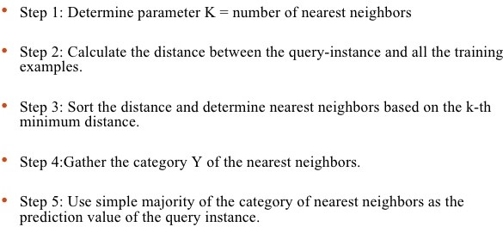
KNN: Pseudocode

Slide 9
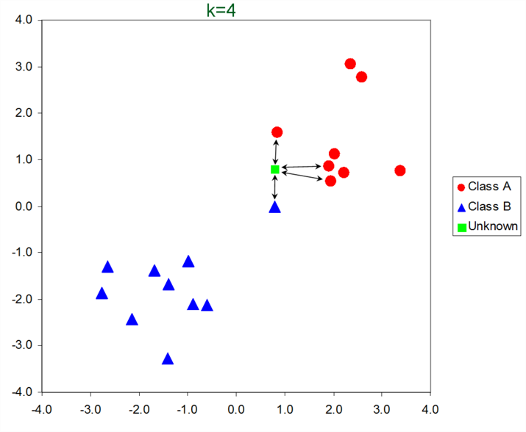
KNN: Example

Slide 10
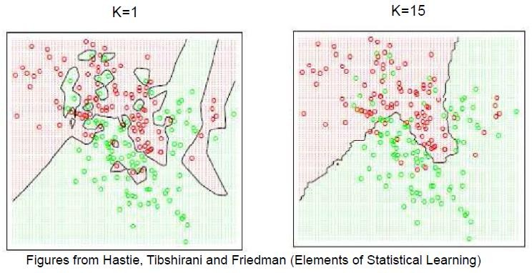
Effect of K
Larger k produces a smoother boundary effect
When K==N, always predict the majority class
Ref: https://www.slideshare.net/tilanigunawardena/k-nearest-neighbors

Slide 11
Euclidean Distance
Euclidean Distance
_{σ}𝑝
₎2
𝑑𝑖𝑠𝑡 =
(𝑎 − 𝑏
𝑘=1
𝑘
𝑘
Where p is the number of dimensions (attributes) and
𝑎_{𝑘} and 𝑏_{𝑘} are, respectively, the k-th attributes (components) or data objects a and b.
Standardization is necessary if scales differ.

Slide 12
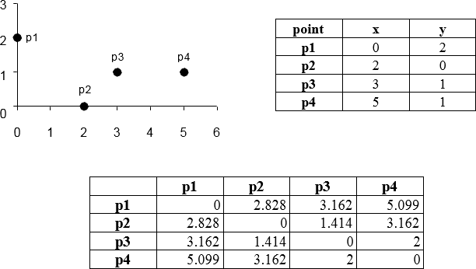
Euclidean Distance

Slide 13
Features Of Spotify Clone
Using music genre classification to auto-play the next song by using the genre of the previous song played by the user.
Creating a playlist for the user by using the song’s genre played by the user most of the time.

