Slide 1
SQL OLYMPICS PROJECT – YASH PAWAR

Slide 2
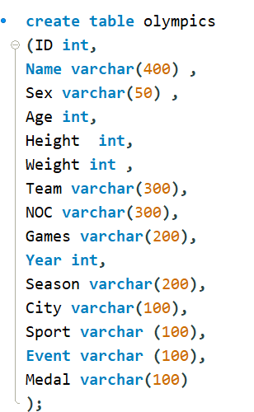
Creating olympics Table

Slide 3
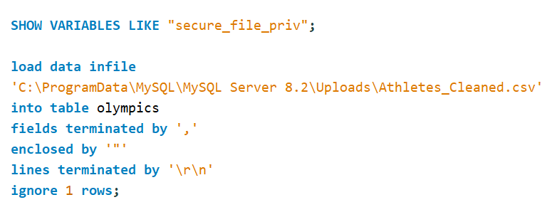
Load Data In file

Slide 4
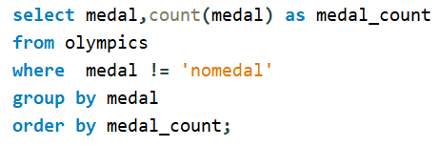

1. Show how many medal counts present for entire data

Slide 5
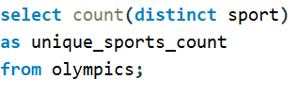

2. Show count of unique sports present in Olympics

Slide 6
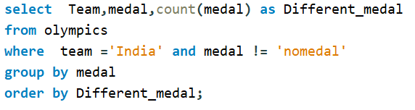

3. Show how many different medals won by team India.

Slide 7
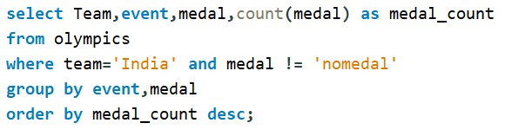
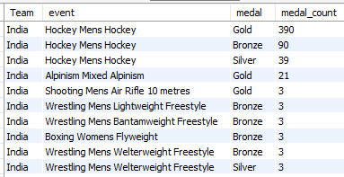
4. Show event wise medals won by India show from highest to lowest medals won in order .

Slide 8
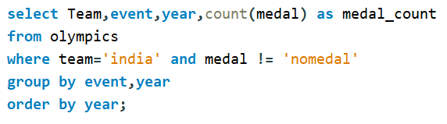
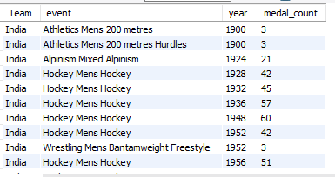
5. Show event wise medals won by India in order of year .

Slide 9
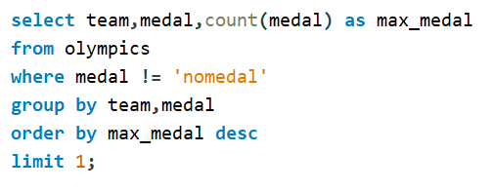

6. show country who won maximum medals.

Slide 10
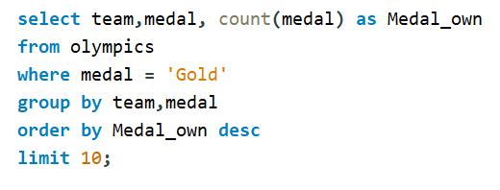
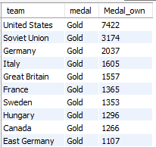
7.show top 10 countries who won gold

Slide 11
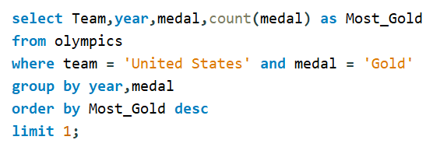

8. show in which year did United states won most gold medal ?

Slide 12
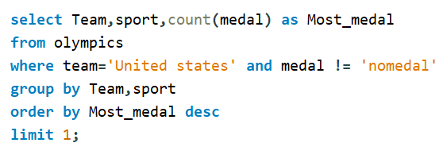

9. In which sports United States has most medals.

Slide 13
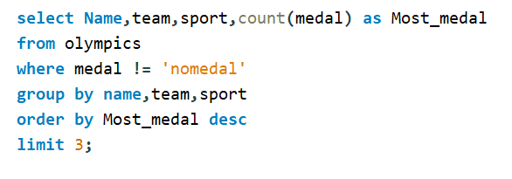

10. Find top three players who won most medals along with their sports and country ?

Slide 14
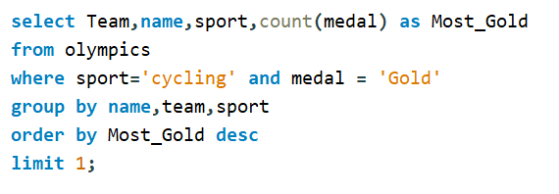

11. Find player with most gold medals in cycling along with his country.

Slide 15
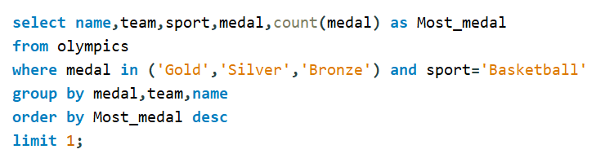

12.Find player with most medals (Gold+Silver+Bronze) in Basketball also show his country.

Slide 16
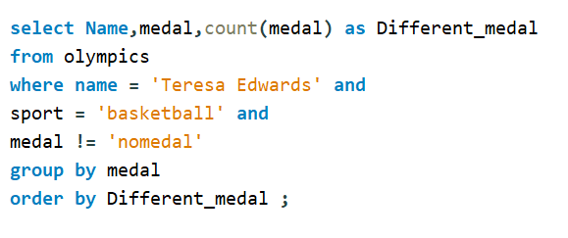

13. Find out the count of different medals of the top basketball player Teresa Edwards

Slide 17
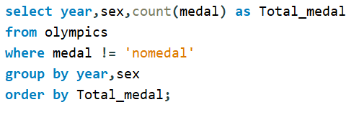
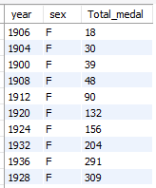
14. Find out medals won by male,female each year , Export this data and plot graph in excel

