Slide 1
Platelet Count from Microscopic Blood Image through Image Processing Techniques
Supervised By
Prottoy Saha
Lecturer
Department of Computer Science and Engineering
Khulna University of Engineering & Technology
Presented by
Kazi Ziaul hassaN
Roll:1607061
Shanta kumar das
Roll:1607068

Slide 2
Introduction to our system
To Introduce an automated system in diagnosis
To design a software for counting Platelets
To make the diagnosis system better in providing the blood test report
To count Platelet using Image Processing

Slide 3
.
Showing result
Display the count
Features
04
Image source
Provide an image to the system
Counting platelets
Apply sort of algorithms
03
01
02
Image processing
Process the image through system requirement

Slide 4
Input image

Slide 5
Input Image
To press the Load Image button
To select an expected image from computer source
To send that for pre-processing

Slide 6
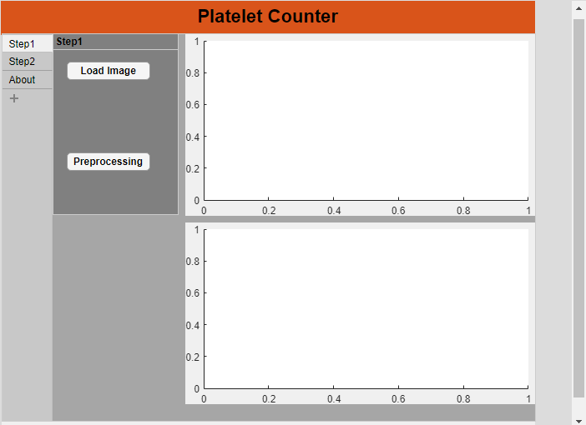
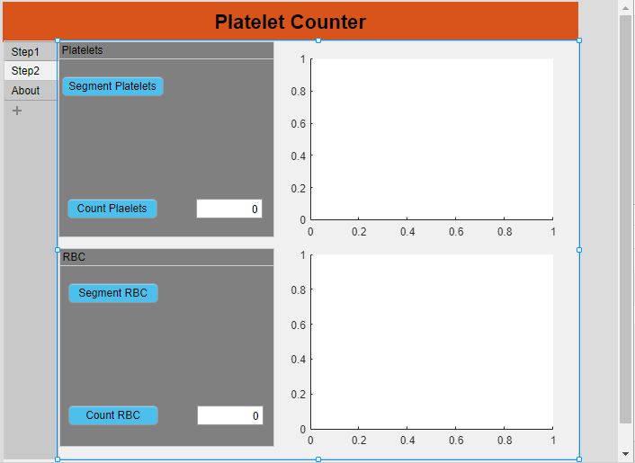
UI For Input
Fig 1: UI_1
Fig 2: UI_2

Slide 7
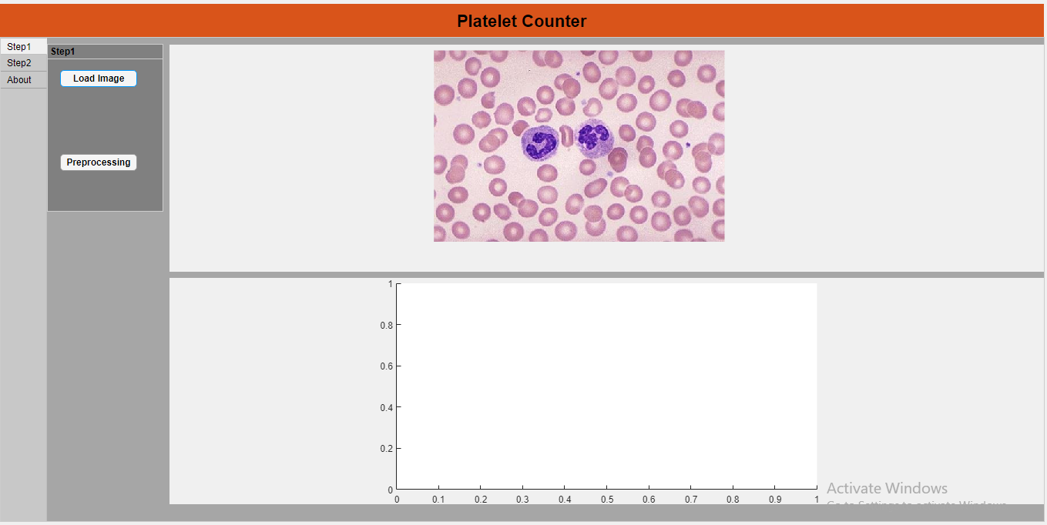
UI For Input Contd..
Fig 3: Loading Input

Slide 8
Pre-processing
Contrast Adjustment : To make the image system compatible.
Transformation of gray scale: Instead of multiple color channel , to work with only two channels (0,1)
Image binarization: White background, black objects
Infilling Image: After inversion of the binarized image, some holes may be created. They should be filled

Slide 9
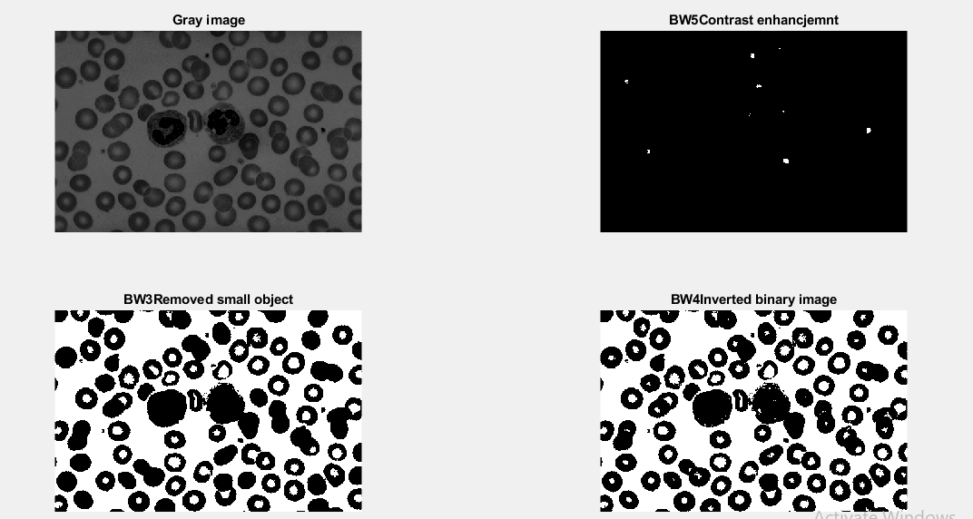
After pre-processing
Fig 4: Pre-processing
finished

Slide 10
Segmentation
There are many algorithms of Segmentation techniques. Some of them are of my need.
Region based segmentation/ Thresholding segmentation
K-Means Clustering
Mask-RCNN segmentation
Edge detection segmentation

Slide 11
Segmentation Contd..
Among the all segmentation algorithms,
Region based segmentation or Thresholding
segmentation shows the best result.

Slide 12
Region Based Segmentation
Firstly we should know the area range of the expected object (Platelets) out of all the objects. Here needs a bit approximation.
Then we keeps the objects other than the expected objects (Platelets) from the pre-processed image in a variable X.
Then XOR operation is applied to the main pre-processed image and the image that stored in variable X.
Now the newly generated image consists of only the expected objects. There also may have some other tiny objects.

Slide 13
Edge Detection Segmentation
There are two methods in detecting the edges.
1. Sobel method
2. Canny method

Slide 14
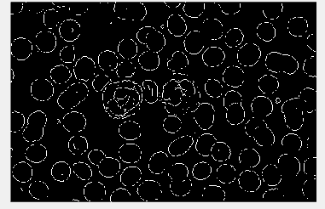
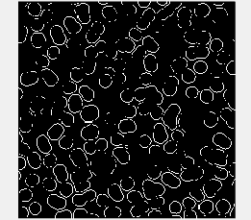
After using Sobel method
Fig 5: Sobel on Image1
Fig 6: Sobel on Image 2

Slide 15
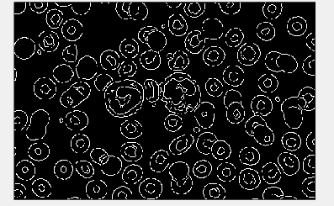
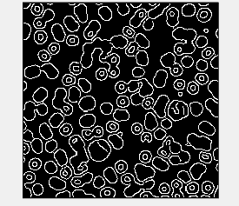
After using Canny method
Fig 7: Canny on Image1
Fig 8: Canny on Image 2

Slide 16
Why we can’t use Edge detection ?
From the above pictures, It seems that if we use Edge detection method, the borders of the consisting objects in the image fragment into several curly lines. That is totally unexpected.
It is like working with some unnecessary things. It creates extra burdens.

Slide 17
Erosion Technique
Erosion is the method of compressing the pixels applying some structuring element around the border of all the objects.
By applying this method, the objects that are smaller than the expected objects can be removed.

Slide 18
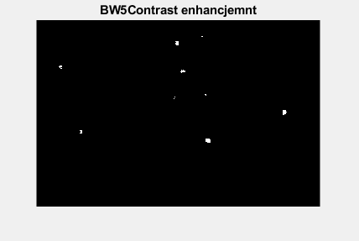
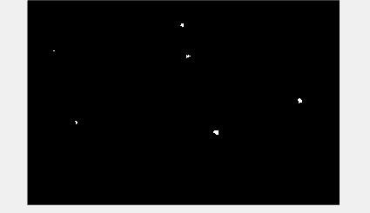
After applying Erosion
Fig 9: With small objects
Fig 10: Without small objects

Slide 19
Result Analysis

Slide 20
Result Analysis
Images | Real Platelets | System Counts | Extra
1 | 6 | 9 | 3
2 | 8 | 7 | 1
3 | 4 | 5 | 1
4 | 9 | 10 | 1
5 | 3 | 4 | 1
6 | 2 | 7 | 5
7 | 5 | 9 | 4
Fig 11: Accuracy Table

Slide 21
Result Analysis
Average extra count = 2.28%
Average real platelets = 5.28%
Average error in count = 43.24%

Slide 22
Limitations
Diagnostic stuffs add some solution in the blood sample to change the color of the sample image into a compatible one. Thus they can differentiate the platelets. The solution must be added in the blood sample before capturing the image which will be input of the system.
If the larger objects in the sample image are split into tiny objects when we do the pre-processing, the tiny objects may look like real platelets. That may be one of the reasons for lessening the accuracy.

Slide 23
Conclusion
An applicable Platelets counting system has been designed for medical or diagnostic center or related organizations in this project. If this project can be designed practically, it would help to reduce many times such as providing the blood test report, taking real time action according to the given result. It will be a revolutionary work if it can be implemented properly in the application field.

Slide 24
Thanks All!

