Slide 1

PIJ Project Phase 1 Bank Management System
Members:
Rajat Dwivedi 23070126100
Utkarsh Dhar Dwivedi 23070126140
Yash Keshari 23070126148

Slide 2
Work Distribution
Rajat Dwivedi:JDBC and OOPS implementation
Utkarsh Dhar Dwivedi:Program structure(classes,methods and interfaces)
Yash Keshari :Exception handling,file handling and OOPS Implementation

Slide 3

Objectives
Develop
Develop a Java-based banking system to simulate real-world banking operations.
Enable
Enable users to create accounts, deposit/withdraw funds, and check balances.
Provide
Provide loan application functionality (Personal and Home Loans) with eligibility checks.
Integrate
Integrate a MySQL database for persistent data storage.
Implement
Implement file handling to store loan application records.
Ensure
Ensure robust input validation and error handling for a user-friendly experience.

Slide 4
Skeleton of Project: Classes, Methods, Interfaces
Classes
1. BankingSystem
Description: The main class that serves as the entry point for the application. It manages user interactions and orchestrates various system functionalities.
Methods:
main(String[] args): Initializes the system, validates command-line arguments, and displays a menu for user interaction.
2. Account
Description: Represents a bank account and provides methods to manage account-related operations.
Attributes:
int accountNumber: Unique identifier for the account.
String accountHolder: Name of the account holder.
int age, String nationality, String occupation, double salary, etc.: Personal details of the account holder.
double balance: Current balance of the account.

Slide 5
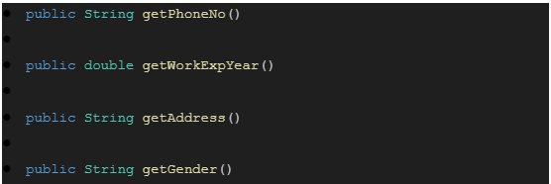
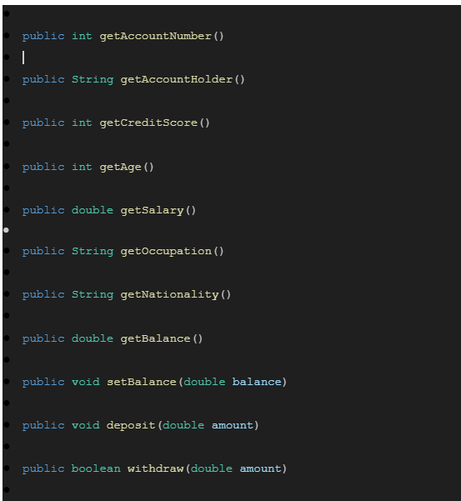
Methods:
Public account

Slide 6
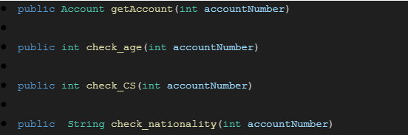
3. Bank
Description: Manages multiple accounts and provides operations like creating accounts, depositing, withdrawing, and checking balances.
Methods:
Bank(int maxAccounts, double least_balance): Constructor to initialize the bank with a maximum number of accounts and minimum balance requirements.
createAccount(...): Creates a new account with user-provided details.
deposit(int accountNumber, double... amounts): Deposits funds into an account.
withdraw(int accountNumber, double amount): Withdraws funds from an account if valid.
checkBalance(int accountNumber): Displays the current balance of an account.
ValidAccNum(int accountNumber): Checks if an account number is valid.
4. Loan
Description: Abstract class representing a loan. It provides methods to calculate monthly installments and check eligibility.
Methods:
checkEligibility(Account account, double loanAmount): Determines if an account is eligible for a loan based on criteria like salary and balance.
calcMonthlyInstallments(double loanAmount, int loanTerm): Calculates monthly installments based on loan amount and term.

Slide 7
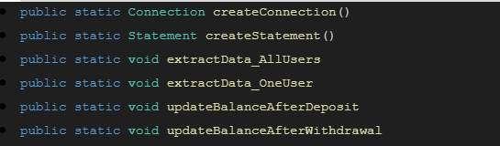
5. HomeLoan (extends Loan)
Description: Represents a home loan with specific eligibility criteria and interest rates.
Methods:
checkEligibility(Account account, double loanAmount): Checks eligibility based on salary and balance requirements specific to home loans.
calcMonthlyInstallments(double loanAmount, int loanTerm): Calculates monthly installments for a home loan using a fixed interest rate.
6. PersonalLoan (extends Loan)
Description: Represents a personal loan with its own eligibility criteria and interest rates.
Similar methods as in HomeLoan, but with different interest rates or criteria.
Methods:
7. JDBC_Database
Description: Handles database connectivity using JDBC for storing and retrieving data related to accounts and transactions.
Methods:
loadDriver(), createConnection(), etc.: Manage database connection setup.
createTable_accounts(): Creates a table in the database for storing accounts.
insertData_accounts(...), etc.: Inserts or retrieves data from the database.

Slide 8
8. LoanApplication
Description: Handles file operations related to saving and retrieving loan application details.
Methods:
createFile(String fileName): Creates a new file for storing loan application details.
writeFile(String content): Writes content to a file.
readFile(): Reads content from a file and displays it
Interfaces
1. AccountOperations
Description: Defines operations related to accounts such as deposits and withdrawals.
Methods:
void deposit(double amount): Adds funds to an account.
void withdraw(double amount): Deducts funds from an account if sufficient balance exists.
2. LoanEligibility
Description: Defines eligibility criteria for loans based on various factors like age, credit score, etc.
Methods:
boolean isEligibleForLoan(Account account): Checks if an account is eligible for a loan based on predefined criteria.
This skeleton provides a modular design using OOP principles, ensuring scalability and maintainability of the Banking Management System.

Slide 9

OOP Principles Used:
Encapsulation: Private fields (e.g., accounts in Bank).
Inheritance: PersonalLoan and HomeLoan inherit from Loan.
Abstraction: Loan abstract class hides implementation details.
Polymorphism: Loan type determined at runtime in BankingSystem.

Slide 10
Exception Handling
Exception Name | Type | Purpose | Example Cause
InvalidInputException | Custom | Validates user inputs (name, age, etc.) | Age < 18 or name with numbers
SQLException | Built-in | Handles database errors | Wrong DB URL or server down
NumberFormatException | Built-in | Thrown when parsing invalid numbers | Entering "12.5a" for initial balance
LoanEligibilityException | Custom | Thrown when loan criteria fail | Salary 15000, needed 20000
AccountLimitExceededException | Custom | Thrown when account limit is exceeded | Creating 6th account with max 5
InvalidNameFormatException | Custom | Thrown for names with special chars/numbers | Entering "rajat.dwivedi"
NegativeAmountException | Custom | Thrown for negative deposit/withdrawal amounts | Depositing or withdrawing -100
LoanTermInvalidException | Custom | Thrown for invalid loan terms (e.g., <= 0) | Loan term of 0 months
SQLDataException | Built-in | Thrown when incorrect data type is used | Storing a string in an integer column
SQLIntegrityConstraintViolationException | Built-in | Thrown when a constraint is violated | Trying to insert duplicate primary key

Slide 11
Implementation of Java Components
Database:
JDBC_Database:
Connects to MySQL (jdbc:mysql://localhost:3306/BankingSystem).
Methods: createTable_accounts(), insertData_accounts(), extractData_AllUsers().
Stores account details in Accounts table with auto-incremented accountNumber.
Threads:
Not implemented in this phase.
Future scope: Could use threads for concurrent deposit/withdrawal operations.

