Slide 1

Mentored by: Rachna Gupta

Slide 2
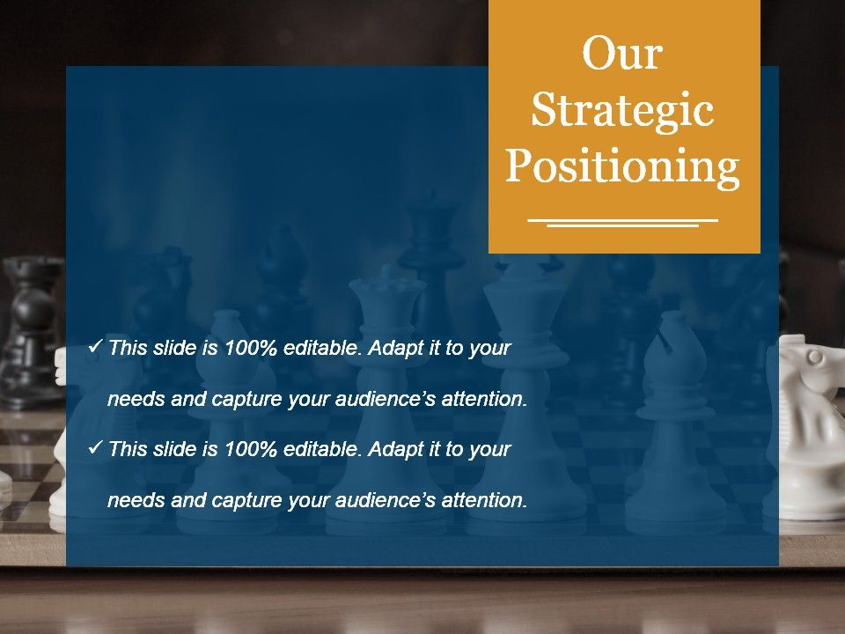
Existing System
Currently accident and reporting the emergency service is done manually.
Many times accident goes unnoticed for hours before help comes in. Due to all these factors there is a high rate of mortality of the accident victims.
There is one death every four minutes due to a road accidents in India. And in most of the cases their lives could be saved if they get the treatment immediately in a minutes of time.
Due to traffic congestion, ambulance does not reaches at time. Sometimes by late informing the ambulance and many other causes the victim gets suffered or looses his life too.
So we are taking a step ahead and creating a system which minimizes or neglects this issue all around the world .

Slide 3
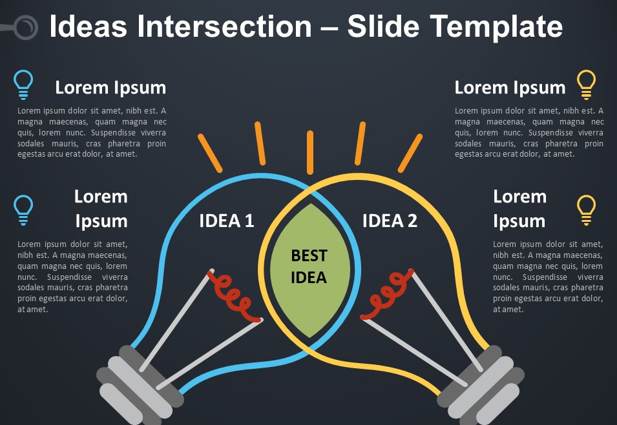
Idea
1
3
Accident Rescue System is an idea to serve a quick and fast help to the victim who has been hurt or injured during a car accident.
When accident occurs
Of any car our device
immediately calls nearby hospital , and their family members and they get the information of accident .
4
2
There is a need of introducing a system to reduce the loss of life due to accidents and the time taken by the ambulance to reach the hospital.
To overcome the drawback of existing system we will implement the new system in which there is an automatic detection of accident.

Slide 4

We will implement the new system in which there is an automatic detection of accident.
Initially we will create a device which will be connected with the vehicle having different sensors which will detect the accident.
Our device will be installed in the vehicle which will detect the accident and automatically informs the ambulance service and also sends location of accident to ambulance service and family of the victim.
location will help the nearby ambulance to reach instantly at the spot of accident to rescue the victim.

Slide 5
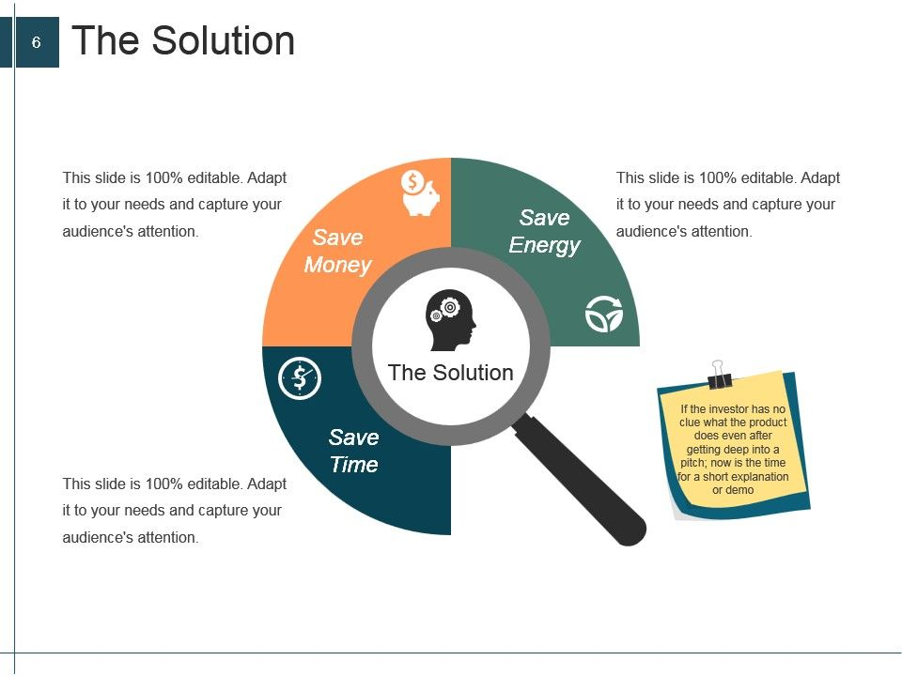
Because of low-cost our device will capture the buyers attention.
Our device will be easily installed in any car.
In many cases accident is detected after long time and due to such delay victim may lose there life.

Slide 6
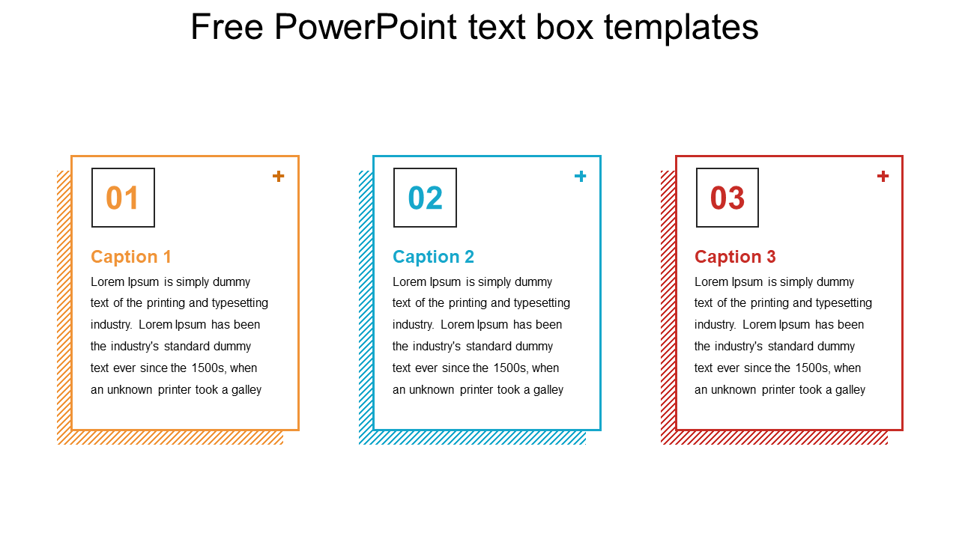
Project Status
Sending GPS location to his/her family member is also done successfully.
Right now our team is working on PCB form of the device.
We also got 10,000 rupees grant from ISEC.
With the help of GPS we get the accurate location of the device.

Slide 7
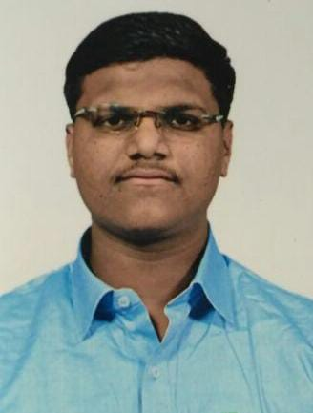
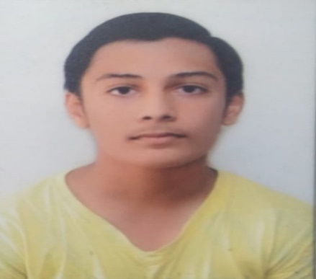
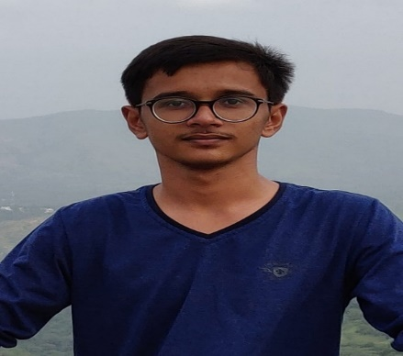
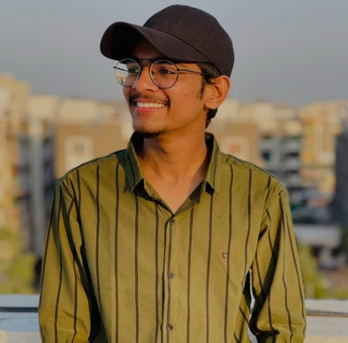
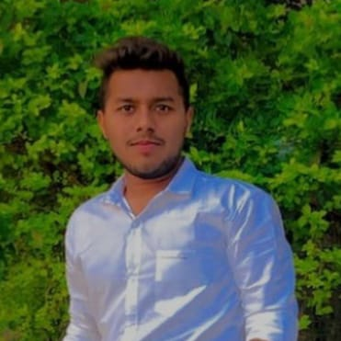
Our Team
Himanshu Bhavsar
B. Tech(CE)
7th Sem
Yash Shah
B. Tech(CE)
7th Sem
Viraj Patel
B. Tech(CE)
7th Sem
Parth Virani
B. Tech(CE)
7th Sem
Abhishek Patel
B. Tech(IT)
7th Sem

Slide 8
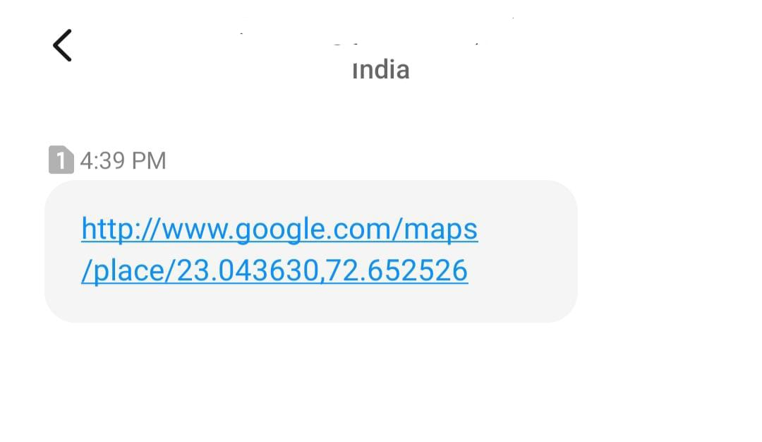
SMS Location

Slide 9


