Slide 1

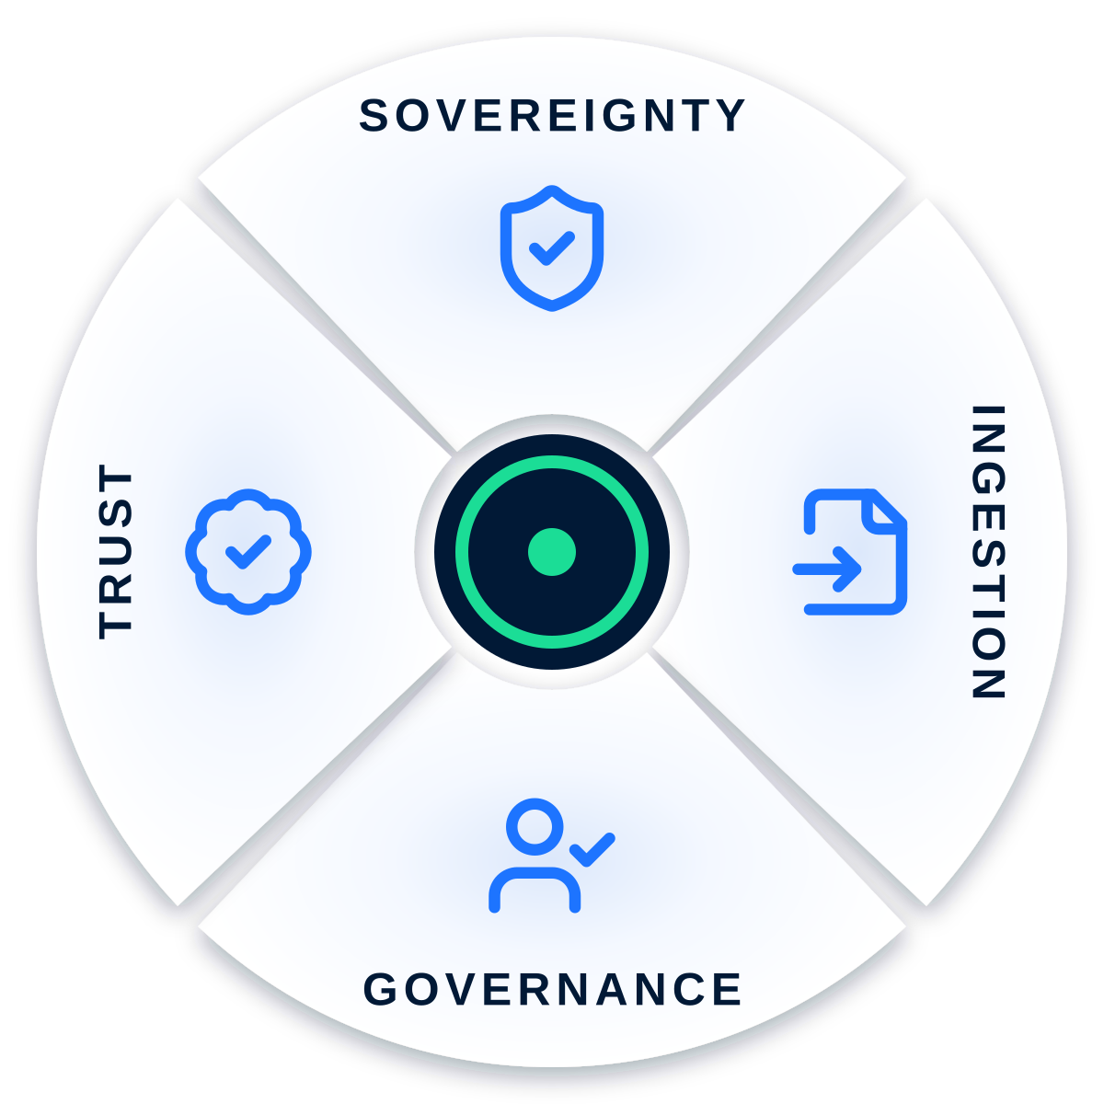


SMART INDIA HACKATHON 2026
SOVEREIGN
AGENTIC AI WORKBENCH
Sovereign On-Premise Agentic AI Workbench using Open-Weight Multimodal LLMs for Confidential Industrial Work
4CE
PS ID
THEME
CATEGORY
SIH26117
Smart Automation
Software
TEAM KERN | 4CE (ACE)
Notes:
Smart India Hackathon 2026, problem statement SIH26117: a sovereign, on-premise agentic AI workbench that runs open-weight multimodal LLMs on confidential industrial data. Theme Smart Automation, category Software. We are Team Kern, and the project is 4CE (ACE).

Slide 2




4CE
OUR SOLUTION
SOVEREIGNTY
Local LLMs → data stays inside
INGESTION
Legacy files → usable intelligence
GOVERNANCE
Tool execution → human approval
TRUST
Generated answer → source-verified
Notes:
Our solution rests on four pillars. Sovereignty: local LLMs, so data stays inside. Ingestion: legacy files become usable intelligence. Governance: tool execution waits for human approval. Trust: every generated answer is source-verified.

Slide 3




WHY
DIFFERENT
Isolated sandbox execution
AI-generated code
→
Isolated environment
→
Controlled execution
Three design choices make agentic AI safe to run on confidential data.
Centralised AI control
Every action
→
Control layer
→
Authorization
→
Execution
Sensitive actions → mandatory human approval
4CE
Model-independent architecture
Qwen
Gemma
Mistral
Other open-source models
Change the model, not the architecture.
Notes:
Why it is different. Generated code never runs on the host: it goes to an isolated sandbox for controlled execution. Every action passes a central control layer for authorization, and sensitive actions need a human to approve them. The architecture is model-independent: Qwen, Gemma, Mistral or another open model - change the model, not the architecture.

Slide 4








TECHNICAL APPROACH
BUILD STATUS
Language & runtime
Application platform
Python · Bash
FastAPI · Uvicorn · Socket.io · SvelteKit · JWT session auth
75%+
AI / ML
Data & storage
Bionic · Qwen models · Gemma models · nomic-embed-text-v1.5
SQLite · ChromaDB
Execution & isolation
Document generation
of the prototype is already built
Docker · hardening flags
python-docx
4CE
View the GitHub repo
Deployment & tooling
Custom test harness
Notes:
Technical approach. Python and Bash at the core; FastAPI, Uvicorn, Socket.io and SvelteKit with JWT session auth for the platform; Bionic with Qwen and Gemma models and nomic-embed-text v1.5 embeddings for AI; SQLite and ChromaDB for storage; Docker with hardening flags for isolated execution; python-docx for document generation; and a custom test harness. Over 75 percent of the prototype is complete, and the code is on GitHub.

Slide 5

FEASIBILITY & VIABILITY
RISK
MITIGATION
Cloud dependency
Data could leave the enterprise
Local-only stack + outbound paths disabled
65K context window
KV cache exceeded 6 GB VRAM → CPU fallback → 20+ min inference
8K context fits VRAM → GPU inference restored
AI hallucination
Generated findings could be incorrect
ULTRON verification + bounded replan
4CE
Generated-code risk
AI code could reach the host or network
Hardened Docker sandbox → isolated execution
Notes:
Feasibility: each real risk we hit has a mitigation. Cloud dependency - solved with a local-only stack and outbound paths disabled. A 65K context overflowed 6 GB of VRAM and fell back to CPU with 20-plus-minute inference; an 8K context fits VRAM and restores GPU inference. Hallucinated findings are caught by ULTRON verification with bounded replanning. Generated code runs only in a hardened Docker sandbox.

Slide 6






RESOURCES & ECONOMICS
RESOURCE REQUIREMENTS
Local compute + GPU (recommended)
Docker + local model server
Persistent storage + enterprise data
Proven frameworks
ECONOMIC APPROACH
4CE
Lower recurring AI costs
Enterprise licensing
Recurring revenue
Potentially lower costs for sustained, high-volume workloads
Monetised through licensing plus setup and integration
Support, maintenance and custom agents
Notes:
What it takes to run: local compute with a GPU recommended, Docker and a local model server, persistent storage next to the enterprise data, and proven frameworks. How it pays: potentially lower recurring AI costs for sustained, high-volume workloads; monetisation through enterprise licensing plus setup and integration; and recurring revenue from support, maintenance and custom agents.

Slide 7
IMPACT & BENEFITS
Real value, higher control, a safer tomorrow.
01
CONVERSATIONAL IMPACT
02
FASTER RESEARCH
Safer AI interactions
Human oversight
Private AI research
Controlled experimentation
03
NATIONAL IMPACT
04
TECHNICAL IMPACT
AI & data sovereignty
Reduced external dependence
Local LLM + RAG
Multi-agent orchestration
Sandbox + verification · auditability
4CE
05
ECONOMIC & INDUSTRIAL IMPACT
Lower recurring AI costs · secure enterprise adoption · regulated industries
Notes:
Impact and benefits. Conversational: safer AI interactions with human oversight. Research: private AI research and controlled experimentation on sensitive data. National: AI and data sovereignty with less external dependence. Technical: local LLM plus RAG, multi-agent orchestration, sandboxing, verification and auditability. Economic and industrial: lower recurring AI costs and secure adoption in regulated industries.

Slide 8





FUTURE PROSPECTS
Multimodal enterprise AI
Vision, audio, video & complex-document understanding
Industry-specific agents
Manufacturing, healthcare, finance, government & defence
Enterprise AI control layer
Evolve into the secure orchestration and governance layer for enterprise AI
Multi-site deployment
Local AI at every site with centralised governance
Continuous security & governance
Policy enforcement, monitoring, audit & compliance
4CE
Notes:
Where it goes next: multimodal enterprise AI across vision, audio, video and complex documents; multi-site deployment with local AI at every site and central governance; industry-specific agents for manufacturing, healthcare, finance, government and defence; continuous security and governance; and finally an enterprise AI control layer - the secure orchestration and governance layer for enterprise AI.

Slide 9





4CE
RESEARCH & REFERENCES
SUPPORTING RESEARCH PAPERS
TECHNICAL DOCUMENTATION
MARKET RESEARCH
Attention Is All You Need
Retrieval-Augmented Generation for Knowledge-Intensive NLP Tasks
Self-Refine: Iterative Refinement with Self-Feedback
AutoGen: Next-Gen LLM Applications via Multi-Agent Conversation
Sovereign AI Project Deep Research
Master Architecture + Phase Specifications
Verification Reports + Security Runbooks
RUNNING.md + Sovereign Configuration
Inference Economics of Enterprise Coding Agents — 2026
Hardware Economics: Cloud vs On-Prem TCO — 2026
On-Premise vs Cloud: Generative AI TCO — 2026
LINKS
GitHub repo
Demo video
PPT video explanation
Notes:
Our work builds on transformer, retrieval-augmented generation, self-refinement and multi-agent research, and is backed by our own architecture, verification and security documentation plus 2026 market research on inference economics and cloud versus on-prem TCO. Links to the GitHub repo and the explanation videos are at the bottom.

Slide 10
YOUR DATA
STAYS YOURS
4CE
Sovereign. Secure. Verifiable. Actionable.
Turns private organisational knowledge into actionable intelligence.
Automates real workflows while keeping humans in control.
Powerful enough for enterprises. Controlled enough to trust.
THANK YOU Team Kern · 4CE (ACE)
Notes:
Your data stays yours. Sovereign, secure, verifiable, actionable: it turns private organisational knowledge into actionable intelligence and automates real workflows while keeping humans in control. Powerful enough for enterprises, controlled enough to trust. Thank you.

