Slide 1




Adapting the Self-Align Pipeline for Go Lang Instruction-Response Dataset Generation
DS677 Final Project
Group: Yash Chaudhary (ygc2)
Kaviya Sree Ravikumar Meenakshi (kr549)
Professor: Dr. Hai Phan

Slide 2


Table of contents
01
02
03
Goal & Framework Diagram
Step 1
Step 2
04
05
06
Step 3
Challenges & Key Learnings
Conclusion

Slide 3






01
Goal & Framework Diagram

Slide 4


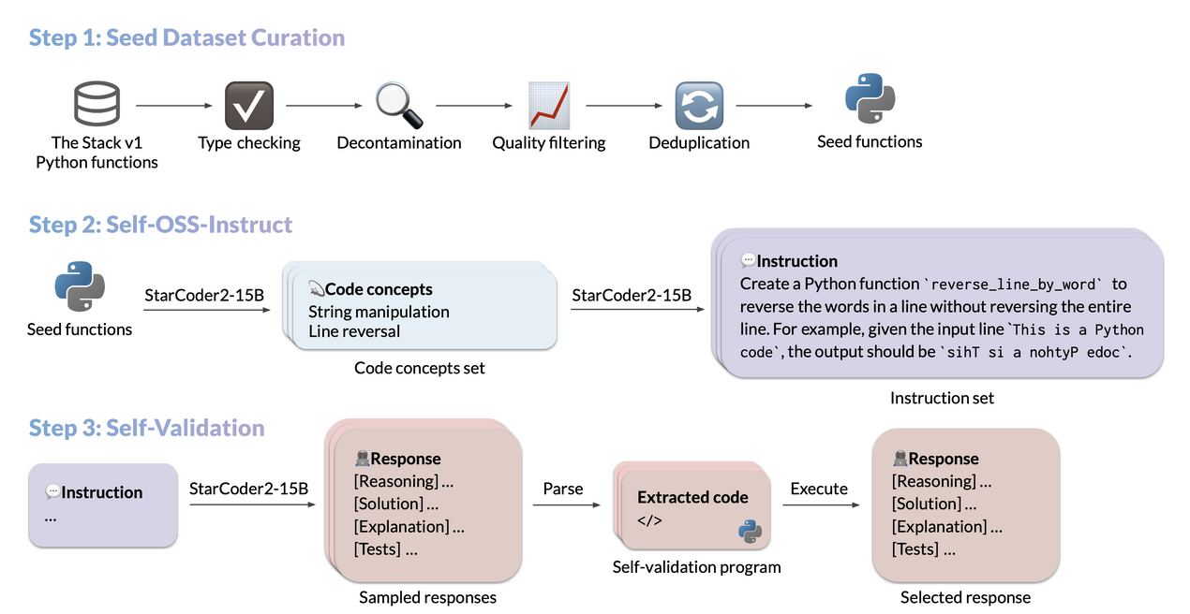



Goal & Framework Diagram
Goal: To implement and adapt the Self-Align pipeline to automatically generate a high-quality dataset of Go instruction-response pairs suitable for fine-tuning instruction-following LLMs.
Framework Diagram:

Slide 5


02
Step 1 - Seed Dataset Curation for Go

Slide 6
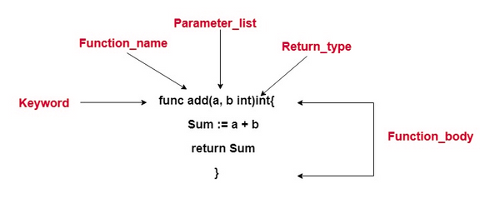
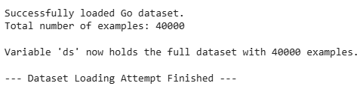
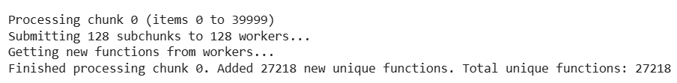
Part 1: Extraction & Initial Size
Data Source: "The Stack v2" dataset (Go language subset).
Initial Extraction:
Used Tree-sitter to parse Go files.
Extracted Go functions and their preceding comments.
Started with an initial sample of ~40,000 Go code snippets.
Filtered out non-parseable or syntactically invalid Go files and those without extractable top-level functions and comments using Tree-sitter.

Slide 7


Part 2: Heuristic Filtering for Go
Applied rules like: functions must have return values, no "TODO/FIXME" in comments, filtered bad Go imports (e.g., unsafe), checked comment/code length, excluded no-argument functions.
Result: Reduced from ~27,000 (post-extraction) to ~19,000 seeds.

Slide 8
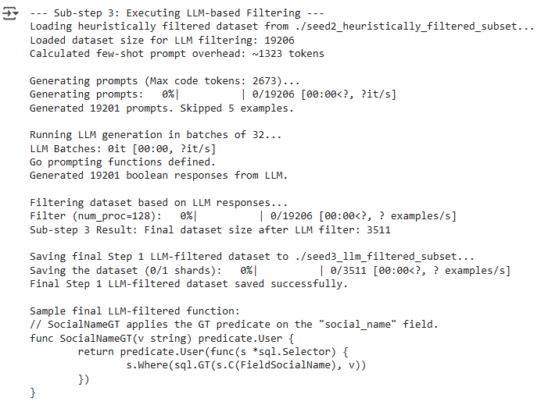

Part 3: LLM-based Comment Quality Filter
Used StarCoder2-15B.
Prompted LLM to check if Go comment adequately described the Go function.
Used Go-specific few-shot examples in the prompt.

Slide 9


03
Step 2 - Self-OSS-Instruct (Generating Go Instructions)

Slide 10
Generating Go Instructions from Seeds
Objective: Create programming task instructions based on the 3,511 Go seeds.
Process:
S->C (Seed to Concepts): LLM (StarCoder2-3B) extracted key Go programming concepts from each seed function's code.
C->I (Concepts to Instruction): LLM used these Go concepts (and the original seed context) to generate a natural language instruction for a Go programming task.
Key Adaptation for Go:
Modified System Prompts in self-ossinstruct-fewshot.txt to target Go concepts and instructions.
Created 6 new Go-specific few-shot examples for the LLM.
Hardcoded language="Go" in the Python script for property generation.

Slide 11
Output Example
Output: ~3,511 instruction-seed pairs
Example JSONL Entry:
{
"instruction": "Write a Go function `sumMap` that takes a map of integers and returns the sum of its values.",
"seed": "// UnaliasFields returns SearchAttributes struct...\nfunc UnaliasFields(...) { ... } // Original seed code",
"concepts": ["map iteration", "map cloning", ...]
}

Slide 12
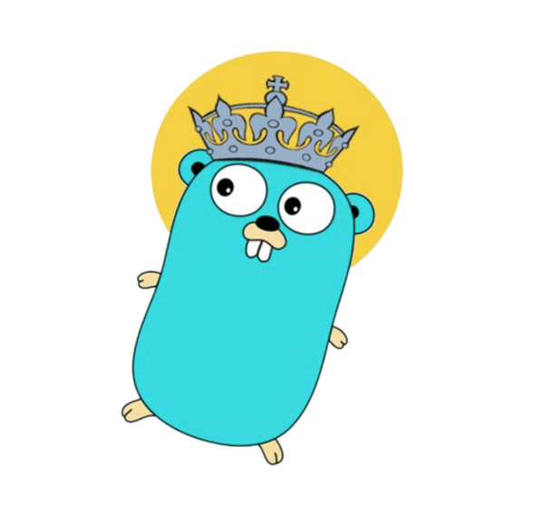
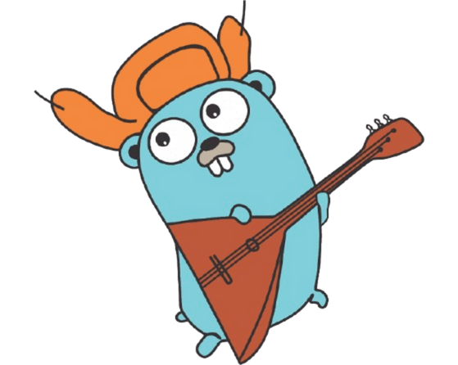
04
Step 3 - Self-Validation (Generating Go Solutions & Tests)

Slide 13
Validating Go Instructions
Objective: Ensure generated instructions are solvable and lead to correct Go code.
Sub-step: I->R (Instruction -> Response + Tests)
Used self_ossinstruct.py (I->R mode) with StarCoder2-3B.
Input: The ~3,511 instructions from Step 2.
Key Adaptation: Modified self-ossinstruct-fewshot.txt with Go-specific I->R system prompt and examples, guiding the LLM to produce:
A Go code solution.
Go test functions (using package testing).
Output: JSONL with instructions, original seeds, new LLM-generated Go solutions, and LLM-generated Go tests.

Slide 14
Executing Go Tests & Filtering
Challenge: Original execution_filter.py was for Python.
Our Solution: Customized the file with our Go Validation Script.
Extracts Go solution and test code from I->R output (handles </response> <tests> tags and markdown).
Writes to temporary .go and _test.go files.
Adds default package main and import "testing".
Runs go mod init solutionmodule (for module context).
Executes go test -v -timeout 20s.
Keeps pairs where go test passes.
Results:
Input: ~3,511 instruction/solution/test sets from I->R.
Final Validated Dataset: 567 Go instruction-solution-test triplets.
Pass Rate: ~16% (This is expected; filters out incorrect/non-compiling LLM generations).

Slide 15
Example of a Final Validated Entry
Example from validated_go_instructions_final.jsonl:
{
"instruction": "Write a Go function `sumMap` that takes a map of integers and returns the sum of its values.",
"seed": "// UnaliasFields ... (original seed for reference)",
"llm_generated_solution": "func sumMap(m map[string]int) int { ... }",
"llm_generated_tests": "func TestSumMap(t *testing.T) { ... }"
}

Slide 16


05
Challenges & Key Learnings

Slide 17
Challenges & Key Learnings
Main Challenge: Adapting the Python-focused Self-Align pipeline to work effectively for the Go language.
Prompt Engineering: Extensive effort to create Go-specific system prompts and few-shot examples for each LLM interaction stage (S->C, C->I, I->R).
Go Execution: Needed a custom script for Go test execution (go test) as the provided filter was Python-based. Handling Go's package and import requirements for testing was important.
LLM Variability: StarCoder2's Go code and test generation quality varied. Many outputs failed compilation or tests, emphasizing the need for the strict validation step.
Environment: Managing Conda environments, HPC resource limits (disk quota, GPU memory), and tooling (vLLM, Go compiler).
Learning: Gained insights into automated data generation pipelines, the nuances of LLM prompting for code, and specifics of Go tooling.

Slide 18
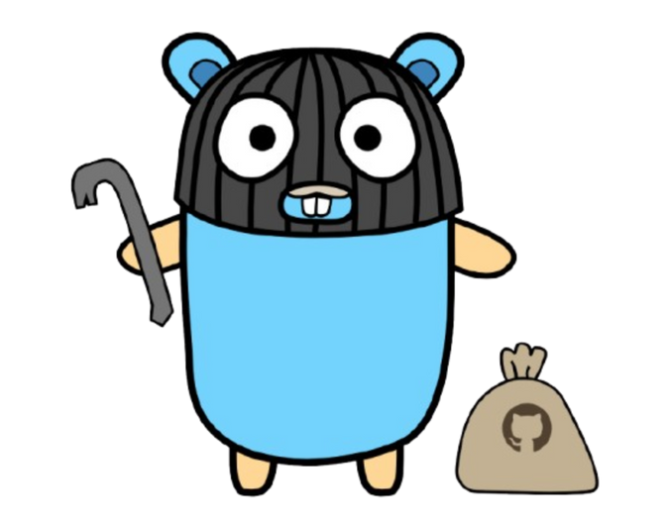
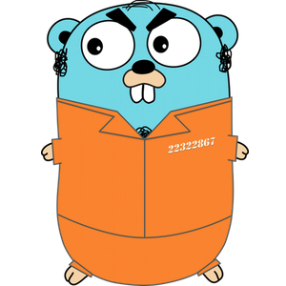
06
Conclusion

Slide 19

Conclusion
Summary:
Successfully adapted and executed the 3-step Self-Align pipeline for Go.
Produced a final validated dataset of 567 Go instruction-response-test pairs.
Dataset Utility: This dataset is suitable for fine-tuning instruction models for Go code generation.
Project Repository: https://github.com/Yash3561/SelfAlign_Project

Slide 20

Thank You!

