Slide 1


EDUCATO
LEARN TO LIVE
MARCOS_IIITSURAT
TEAM MEMBERS
YASH WANDHARE
ASHUTOSH THAKUR
EDUTHON-EDUCATION THEMED HACKATHON
01

Slide 2

PROBLEM STATEMENT
As the nation has been faced a wave of corona pandemic and whole nation was under lockdown since march . But the education must go on so various institutes opted for online mode of education . But various students are not getting access to education or not enjoying it which affects the academic as well as mental growth of the students .
Not just the teaching has been affected but also the issue such as evaluation but teachers are not able to get to know the learning and understanding of students through online means.

Slide 3

PROPOSED SOLUTION
HERE WE ARE WITH A WONDERFUL SOLUTION TO THE PROBLEM.
EDUCATO PROVIDES THE PLATFORM FOR STUDENTS AS WELL AS TEACHERS TO INTERACT WHICH EACH OTHER AND CONTINUE THEIR STUDY THROUGH ONLINE MEANS .
TEACHERS COULD HOST ONLINE CLASSES AND STUDENTS CAN JOIN ANYTIME TO IT.
INTERACTIVE AND EASILY ACCESIBLE CLASSES.
FURTHER A CHAT ROOM BETWEEN PARTICIPANTS OF THE OF THE ONLINE CLASS AVAILABLE.
THUS STUDENTS COULD EASILY CHAT AND CLEAR THEIR DOUBTS WITH TEACHER EASILY AND ON REAL TIME CHAT SERVICE.
THIS MAKES LEARNING FUN AND INTERESTING .

Slide 4

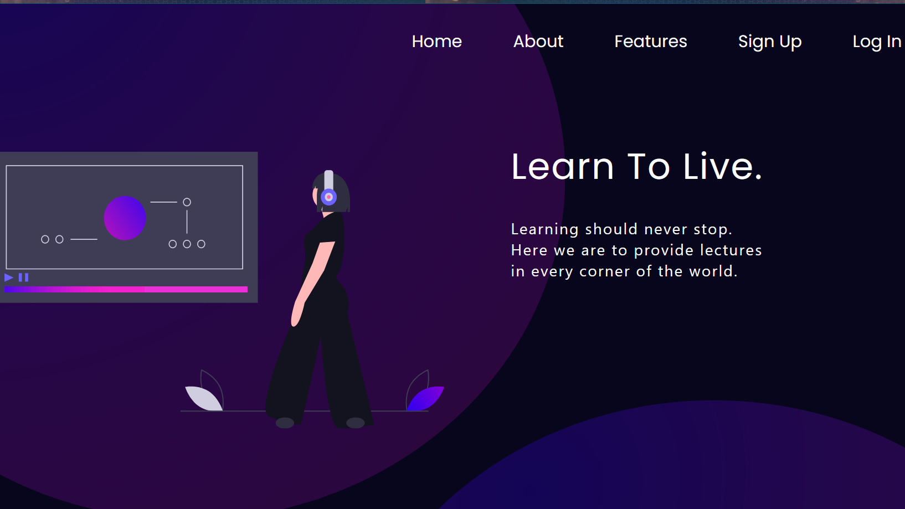
UNIQUE SELLING POINTS
1.
EASY AND ACCESIBLE ONLINE CLASSES
2.
TEACHERS COULD HOST CLASSES FROM ANYWHERE AND STUDENTS COULD ACCES AT ANYTIME.
3.
TEACHERS AND STUDENTS COULD INTERACT WITH EACH OTHER THROUGH LIVE CHAT OPTION .

Slide 5


YOUR TECH STACK
1.
REACT JS
REACT IS USED AS A FRONTEND FRAMEWORK TO MAKE WEBPAGES OF OUR PROJECT
2.
NODE JS & EXPRESS JS
THESE ARE USED TO DESIGN OUR API AND OUR BACKEND AND JWT USED TO PROVIDE AUTHENTICATION
3.
MONGO DB
MONGO DB IS USED AS DATABASE FOR THIS PROJECT AND THUS WHOLE PROJECT IS BEING MADE USING MERN STACK

Slide 6
CHALLENGES
REMOTE POSITION OF PARTICIPANTS MAKING DIFFICULT TO COLLABORATE.
DEVELOPMENT OF AUTHENTICATED SYSTEM IN THE BACKEND.
CONNECTING BACKEND WITH FRONTEND AND MAKING PROJECT WITHIN THE TIME PERIOD OF HACKATHON.

Slide 7
THANK YOU
CONTACT US :-
YASH WANDHARE:- +91 8975744668
ASHUTOSH THAKUR:- +91 9076240992

