Slide 1

Finite Element Analysis of Shape Memory Alloy based members undergoing torsion
M.Tech Thesis presentation
Yash Kumar (214103437)
Under the Supervision of:
Dr. Atanu Banerjee
Department of Mechanical Engineering
IIT Guwahati, ASSAM – 781039

Slide 2
Contents
Introduction
Literature Review
Scope and Objective
Nonlinear Finite Element Formulation
SMA Constitutive Model
FE Analysis of Elastic Structures
FE Analysis of SMA Structures
Conclusion and Future Scope

Slide 3
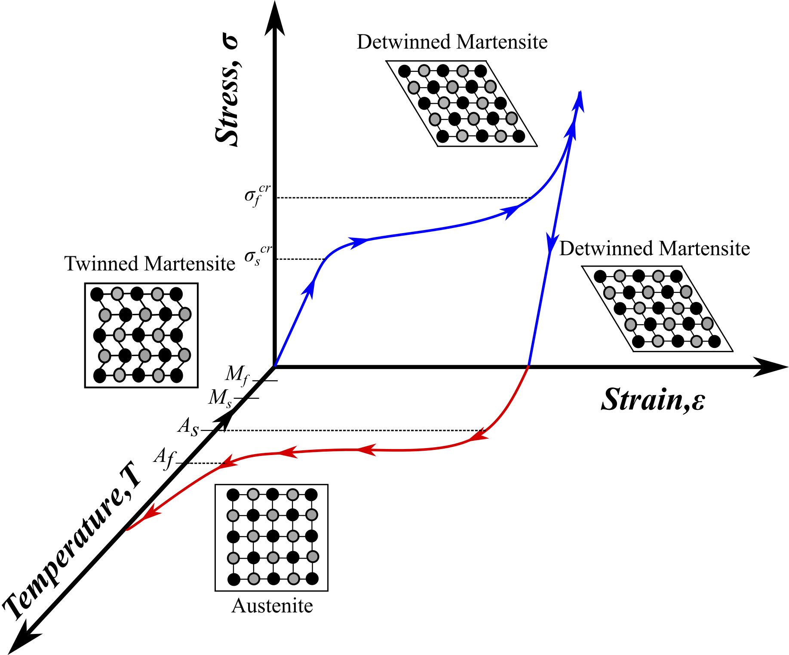
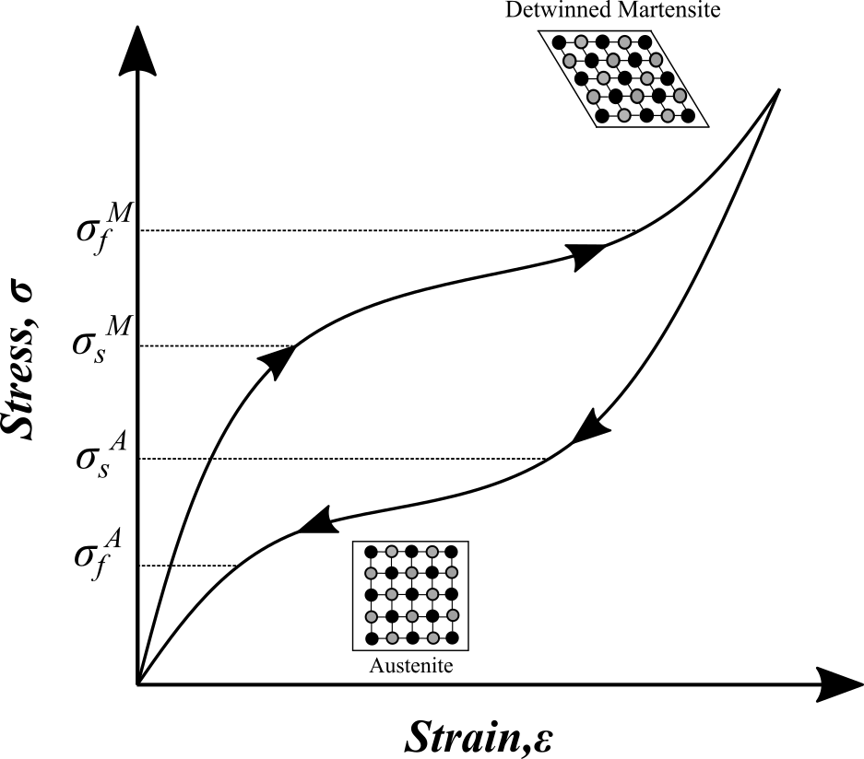
Behaviour of SMA
Shape Memory Effect:
It is the effect of restoring the original shape after deformation of the material.
It is a result of solid state phase transformation that occurs within the material.
Austenite is high-temperature phase, cubic structure.
Martensite is low-temp phase and usually tetragonal.
Pseudo Elasticity
Pseudo elasticity occurs in SMA when the alloy is completely composed of Austenite.
Occurs without a change in temperature.
The martensite phase is generated by stressing the metal in the austenite state, this martensite phase is capable of large strains.
On unloading, the martensite transforms back into the austenite phase to original shape.
Fig. 1: Shape memory effect
Fig. 2: Pseudoelasticity
Notes:
It is the effect of restoring the original shape of plastically deformed material by heating it.
It involves transformation of Detwinned Martensite to Austenite.
Austenite is high-temperature phase, cubic structure.
Martensite is low-temp phase and usually tetragonal.

Slide 4
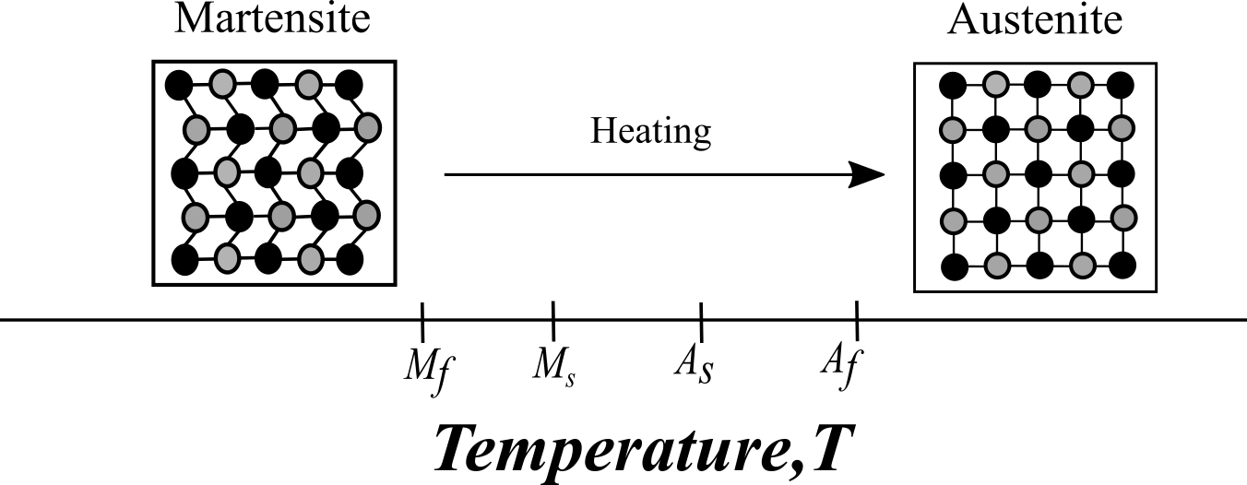
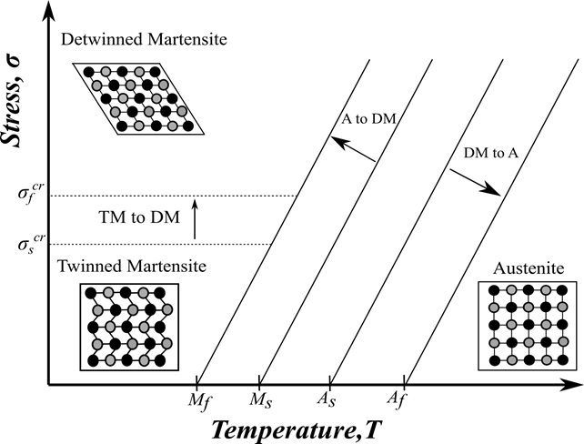
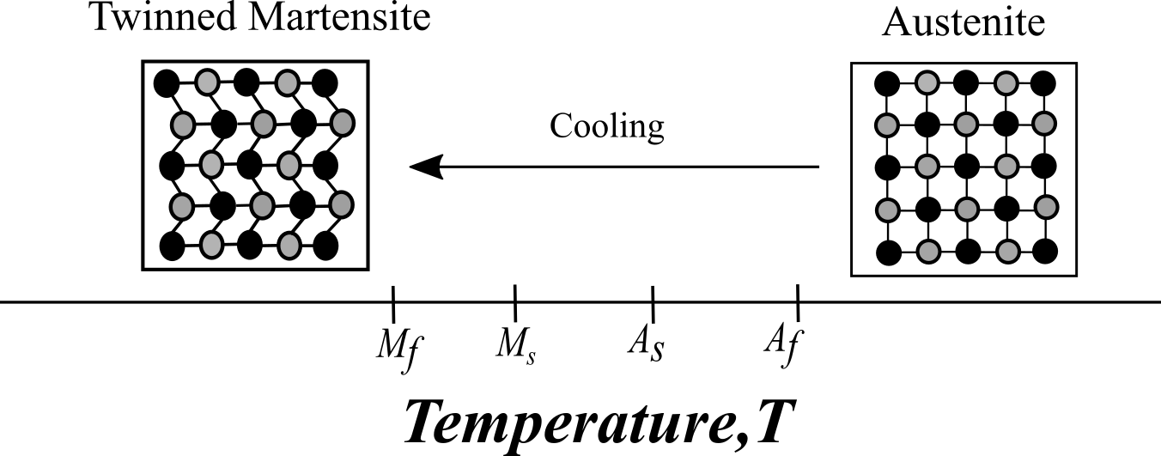
Phases in Shape Memory Alloy
Fig. 4: Stress-temperature phase change
Fig. 3: Temperature induced transformation

Slide 5
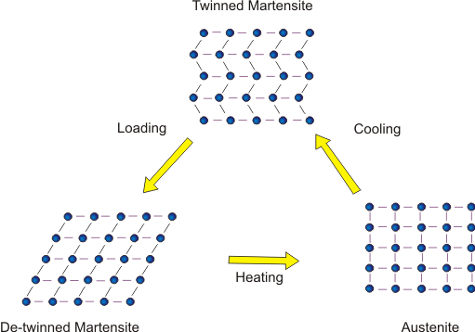
Shape Memory Alloy (SMA)
SMA is an unique class of materials that possess the remarkable ability to "remember" and recover their original shape after being deformed.
They are typically composed of a combination of nickel, titanium, and other elements, such as copper or iron.
Crystallographic phase transformation in SMA is due to shear lattice distortions and not due to atoms diffusion.
SMA has two phases:
1. Austenite: High temperature phase of SMA having BCC crystal structure.
2. Martensite: Low temperature phase having two forms, twinned and detwinned.
Phase transformations are called martensitic phase transformation and they happen between martensite and austenite.
Fig.5: Phase transformation in SMA

Slide 6
Literature Review
Shape Memory Alloy and applications
Buehler et al. (1963) | Discovered mechanical properties and shape recovery ability of Nitinol.
Wang et al. (1965) | Showed that a drastic decrease in SMA transformation temperatures occurs by the addition of elements such as Co and Fe to the existing NiTi system.
Mirzaeifar et al. (2011) | Represented a combined study of analytical, numerical and experimental study of helical spring.
Enemark at al. (2014) | Proposed a theoretical model based on modification of 1D Brinson model to study the nonlinear dynamics of pseudoelastic system.
Constitutive Models
Boyd and Lagoudas (1996) | Proposed a thermodynamic constitutive model SMA in which he modelled Pseudoelasticity and SME as an effect of martensitic transformation and reorientation using free energy function and a dissipation potential.
Lagoudas et al (1996) | Proposed a unified thermodynamic constitutive model based on Gibbs free energy structure associated with martensitic volume fraction.
Brinson et al. (1993) | Proposed constitutive relation by redefining the martensite volume fractions as a new internal state variable.

Slide 7
Scope of study
Material characterization: composition, microstructure, mechanical properties, phase transformation behaviour.
Constitutive modelling: mathematical model and constitutive equations.
Thermomechanical behaviour: response to thermal and mechanical stimuli.
Application and devices: in aerospace, biomedical, automotive, robotics, as sensors, actuators, structures.
Objectives of study
Development of FE code to conduct material nonlinear analysis.
Implementation of the SMA constitutive model to simulate the behavior of SMA based structures undergoing mechanical loading.
Predict the pseudoelastic response of SMA based members.

Slide 8
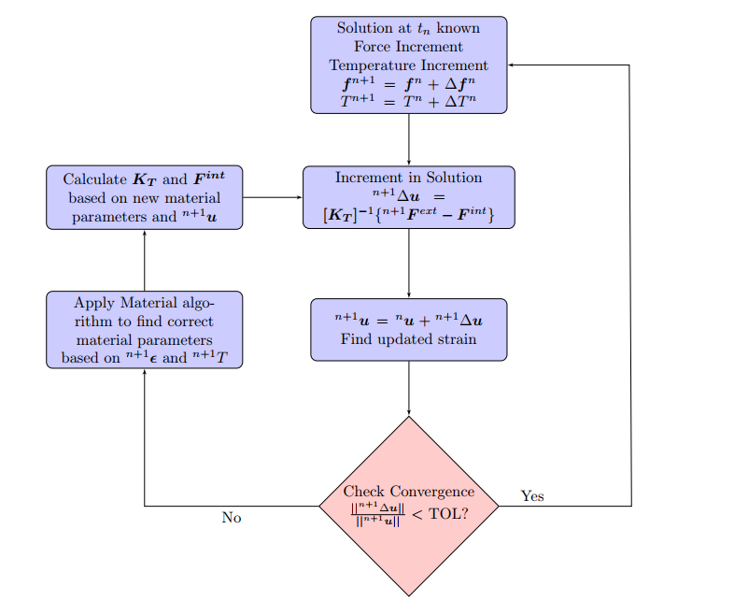
Nonlinear Finite Element Formulation
An incremental displacement based formulation is used to develop the finite element model.
Notes:
Incremental displacement based formulation. The load is increased in stepwise and in each loading step problem is linearized
And an incremental displacement field is found

Slide 9
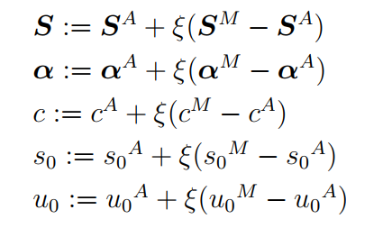
SMA Constitutive Model
The constitutive equations are derived by using Gibbs free energy as the thermodynamic potential and follows the formulation proposed by Boyd and Lagoudas (1996).
The martensite volume fraction (ξ) and Transformation strain (ε^{t}) are taken as the internal state variables of the SMA model.
The Gibbs free energy (G) is given as,
where T₀ is the reference temperature, S is effective compliance tensor, 𝜶 is effective thermal expansion tensor, c is total specific heat, s₀ is total specific entropy at reference state, u₀ is total internal energy at reference state and f (𝜉) is transformation hardening function.
(1)
The material parameters as a function of 𝜉 are defined as,
(2)
Notes:
The constitutive equations are derived by using Gibbs free energy as the thermodynamic potential and follows the formulation proposed by Boyd and Lagoudas (1996).
The martensite volume fraction (ξ) and Transformation strain (ε^{t}) are taken as the internal state variables of the SMA model.

Slide 10

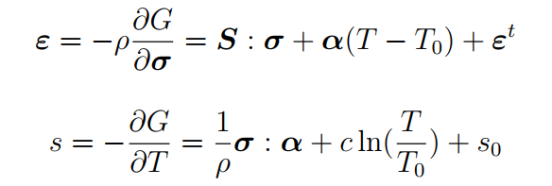
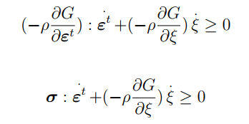

The Gibbs free energy (G) as a function of internal energy (u) is defined as,
(7)
The Eqn.(7) is substituted in 1st and 2nd laws of thermodynamics to obtain the strain tensor (𝜀) and entropy ($s$) respectively results in the following constitutive relations,
(8)
(9)
The Gibbs’s free energy in eq (1) is substituted in Clausius –Plank inequality relation, which yields,
(10)
Then “flow rule” relate the evolution of transformation strain tensor to the evolution of martensitic volume fraction as,
(11)
Where 𝚲 is the transformation tensor, which determines the direction of transformation strain. Using the flow rule the total dissipation rate takes the following form:
Notes:
Using the flow rule total dissipation rate takes the following form

Slide 11

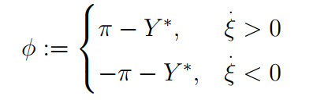
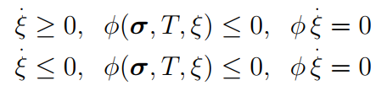
(12)
Where, 𝜋 is the thermodynamic force conjugate to 𝜉, which is obtained from the substitution from eq (1) as,
(13)
A transformation function, 𝜙 is defined in terms of the thermodynamic force as,
(14)
Where, 𝑌* measures the internal dissipation due to phase transformation. Constraints on the evolution of the martensitic volume fraction are determined from the maximum transformation dissipation theory as,
(15)
Here the transformation function, 𝜙(𝞼,T, 𝜉) denotes the transformation surface that defined the elastic domain.
Notes:
Pi is thermodynamics force conjugate to zeta.
The threshold value of pi is Y during forward transformation

Slide 12

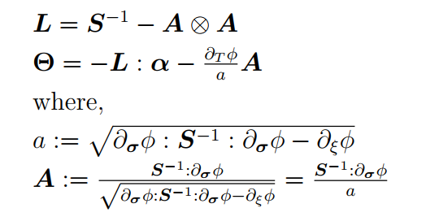
Continuum tangent moduli tensors
In an incremental displacement-based FE framework, the increment of the stress tensor (d𝞼) is obtained through the implementation of incremental constitutive model for given increments of strain (d𝜀) and temperature (T).
(16)
Where 𝑳 is the tangent stiffness tensor and 𝚯 is the tangent thermal moduli tensor. These two tensors are needed for the execution of the global FEA.
To derive 𝑳 and 𝚯, the constitutive relation is written in differential form and transformation flow rule is used. They can be given as,
(17)
Notes:
In an incremental displacement-based FE framework, the increment of the stress tensor (d𝞼) is obtained through the implementation of incremental constitutive model for given increments of strain (d𝜀) and temperature (T

Slide 13

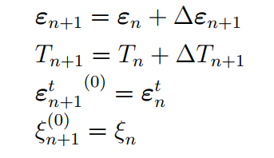

Return mapping algorithm
It utilizes an elastic predictor-transformation corrector procedure to accurately simulate the complex thermomechanical response of SMAs during these phase transformations.
The algorithm iteratively adjusts stresses, strains, and martensite volume fraction. The process continues until convergence is achieved based on a specified tolerance.
It is assumed that the strain and temperature history as well as the initial conditions for 𝜀^{t} and 𝜉 at t = 0 are known. The evolution equation for relating the transformation strain (𝜀^{t}) and martensitic volume fraction (𝜉) are discretized using the generalized trapezoidal rule as,
A thermoelastic predictor problem that is described by assuming that the increment of the transformation strain is zero and the transformation corrector problem that restores consistency if the predicted thermoelastic state is outside the transformation surface are given as
(18)
(19)
(20)
Notes:
The return mapping algorithm is employed to accurately simulate the complex thermomechanical response of SMAs during these phase transformations.
Utilizes an elastic predictor-transformation corrector procedure. In the elastic predictor step, assumed elastic deformation estimates stresses and strains assuming austenitic phase..
Predicted stresses are compared with the transformation surface to determine if a phase transformation occurs.
If stresses exceed the transformation surface, the algorithm proceeds to the plastic corrector step.
In the plastic corrector step, stresses and strains are adjusted to satisfy the phase transformation conditions.
The algorithm iteratively adjusts stresses, strains, and martensite volume fraction.
Iterations use methods like Newton-Raphson to update the consistent tangent modulus and transformation matrix.
The process continues until convergence is achieved based on a specified tolerance.

Slide 14
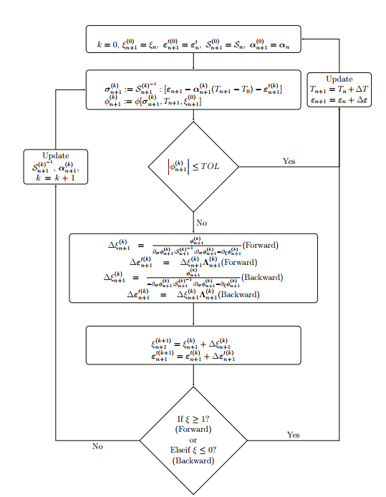
Fig. 6: Return mapping algorithm flow diagram

Slide 15
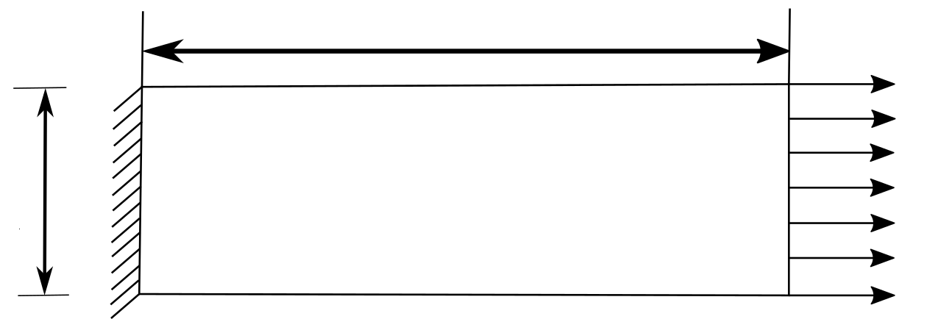
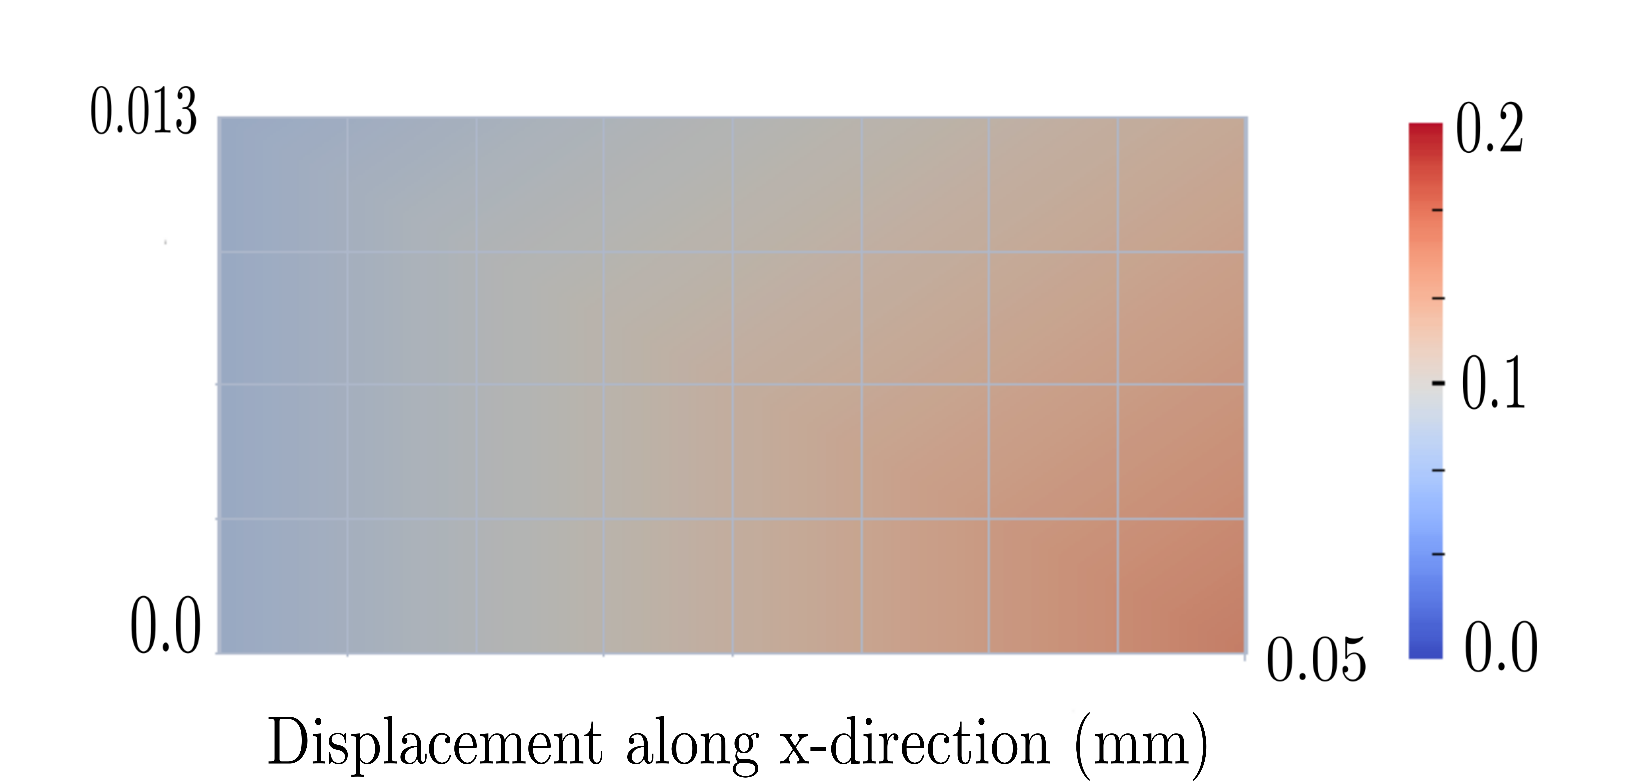
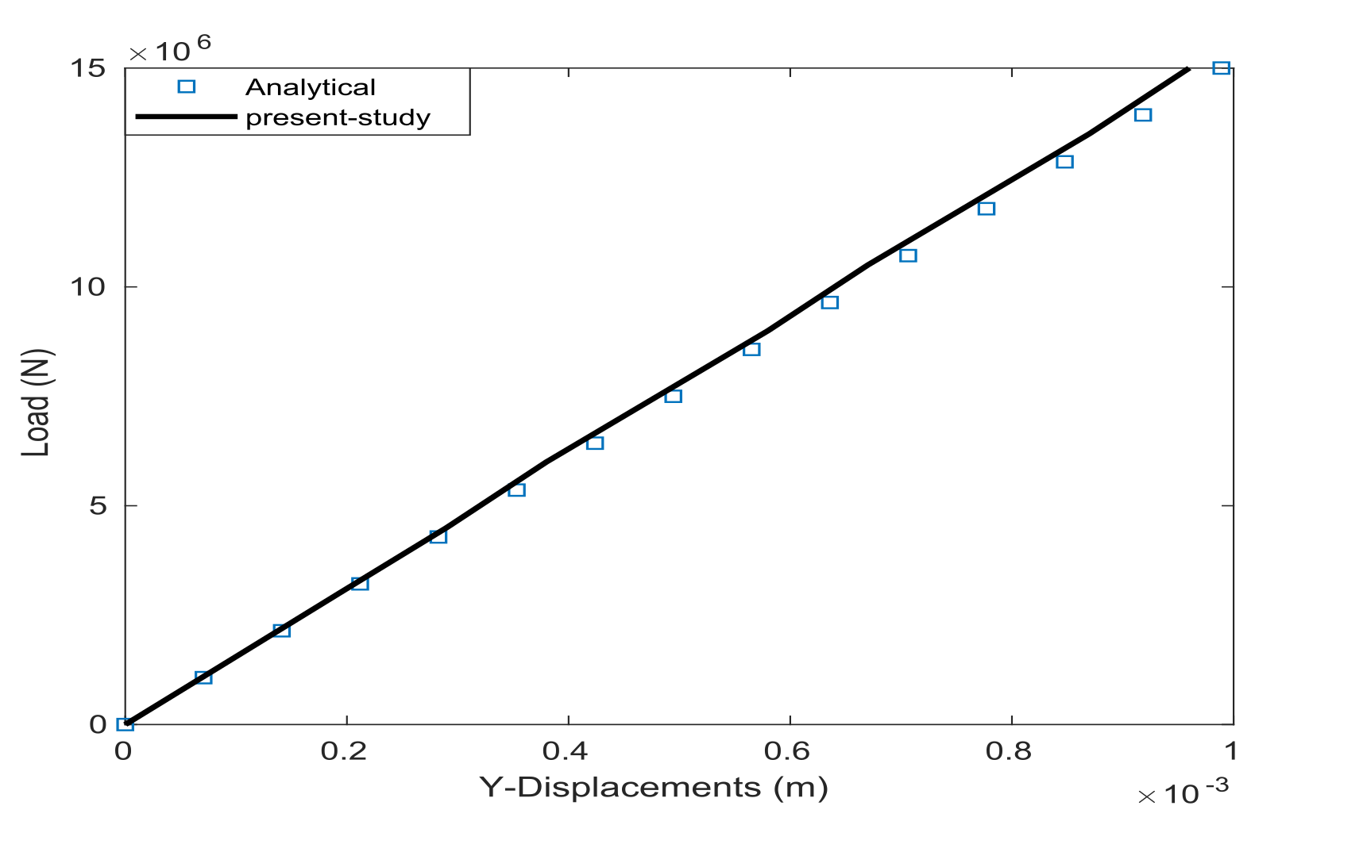
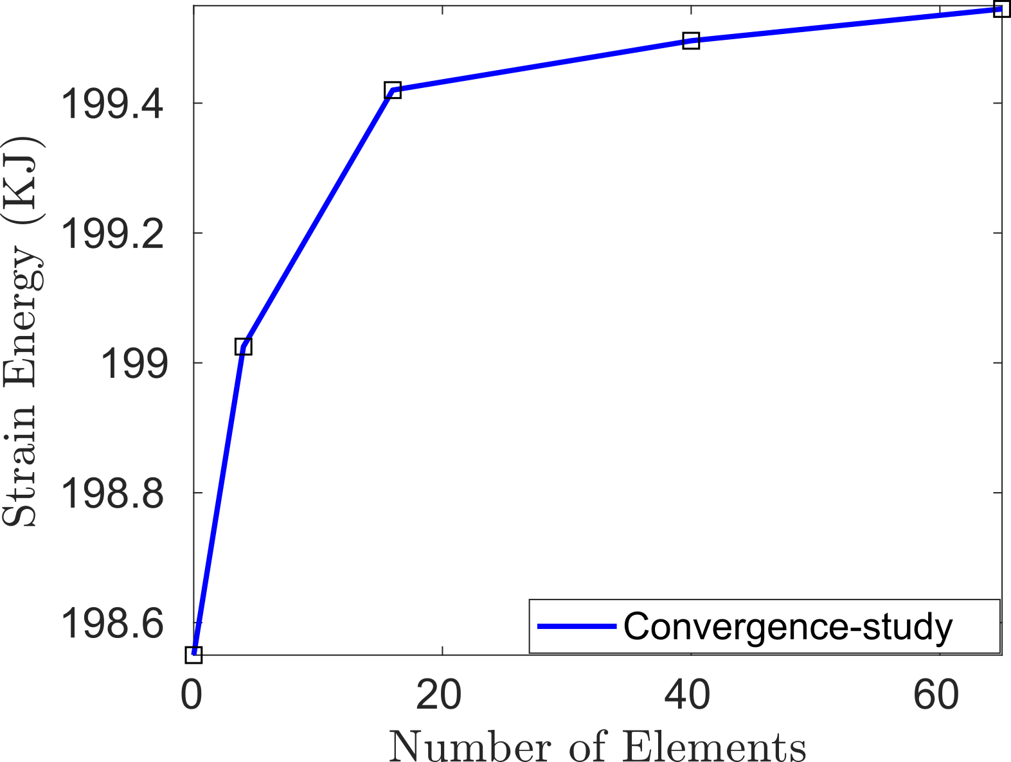
Preliminary Results
1. Rectangular bar
S.No. | Parameters | Value
1 | Length | 5 cm
2 | Width | 3 cm
3 | External traction | 15e6 N
4 | Elastic modulus | 70 GPa
5 | Poisson’s ratio | 0.3
Fig. 7: Rectangular Bar
Fig. 8: Displacement along x color-map
Fig. 9: Convergence study
Fig. 10: Validation

Slide 16
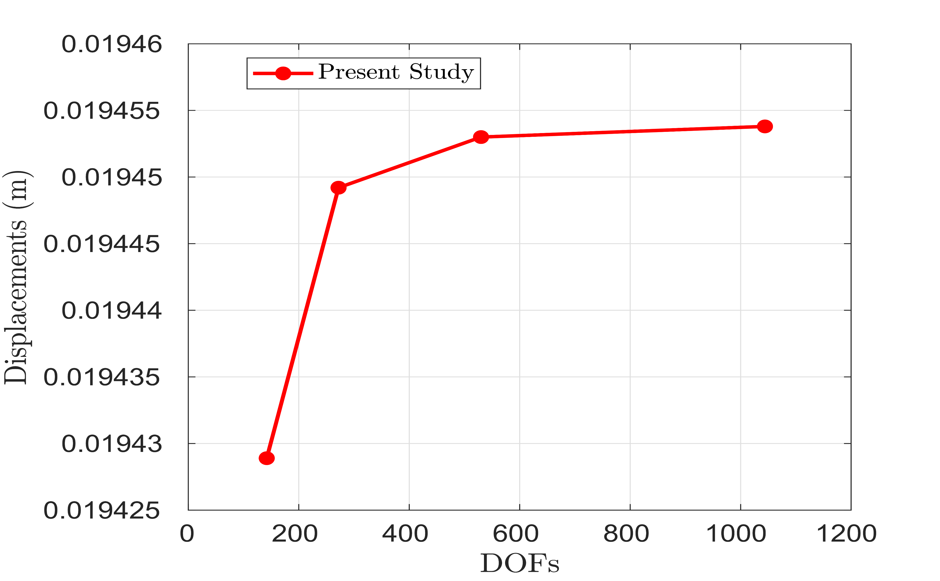
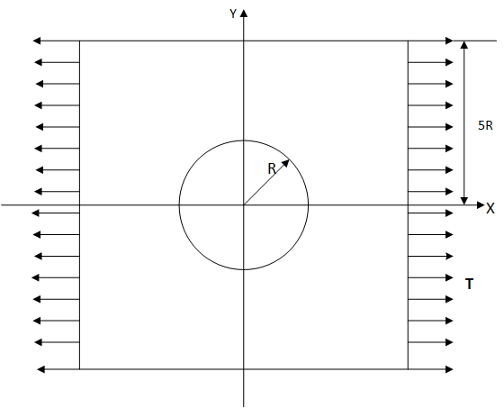
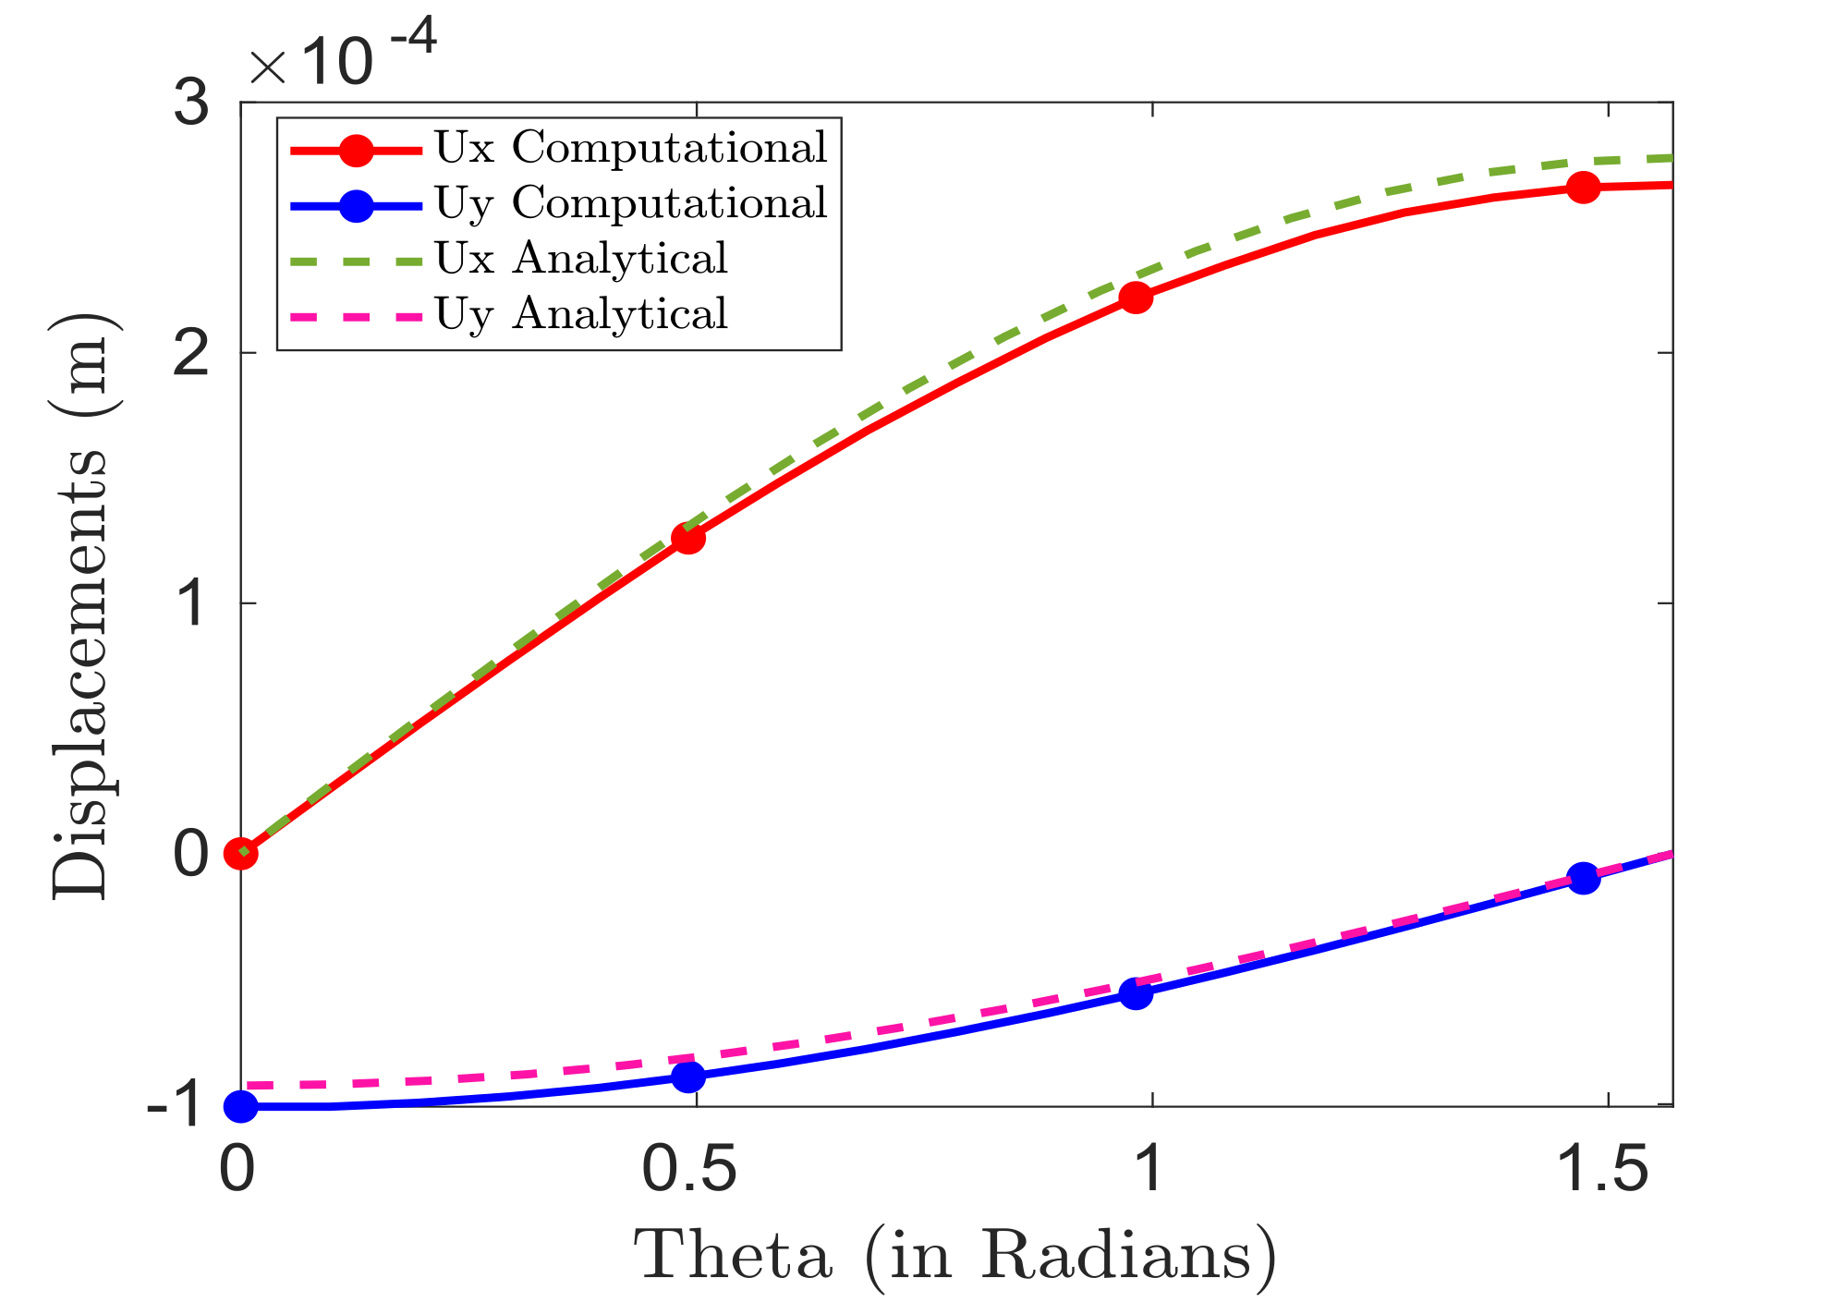
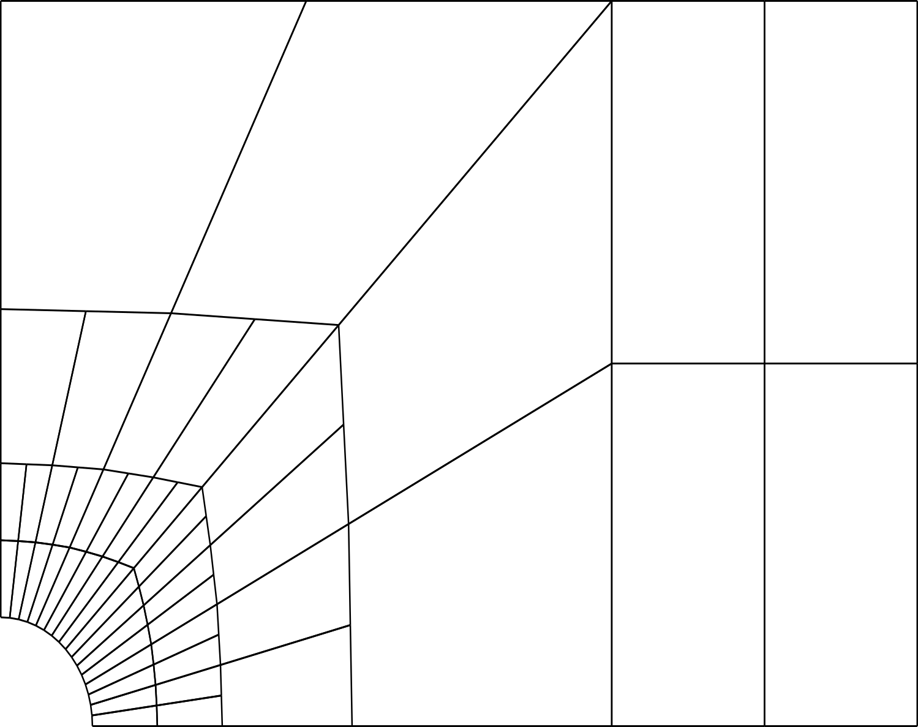
2. Plate with a Hole
An infinite plate with a circular hole under constant in-plane tension is considered.
E = 1MPa
v = 0.3
T = 1 N/m
Plate with a hole
Fig. 12: Convergence study
Section of plate analyzed
Fig. 11: Plate with a hole problem description
Fig.13: Validation study

Slide 17



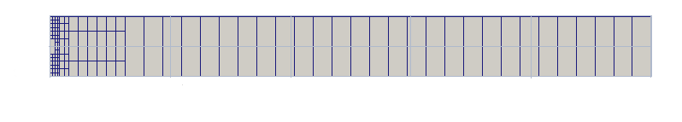
3. Elastic 3D beam
S.No. | parameter | Value
1 | Length | 0.1 m
2 | Height | 0.01 m
3 | Thickness | 0.0015 m
4 | Load | 16.67 MN
5 | Elastic Modulus | 72 GPa
6 | Poisson’ ratio | 0.42
Load
Fig. 14: Beam meshes

Slide 18
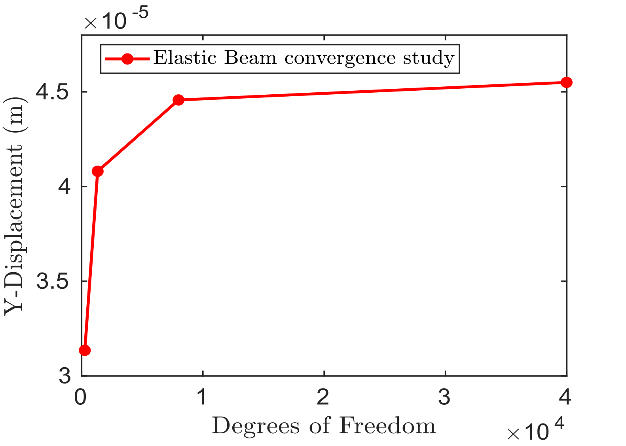
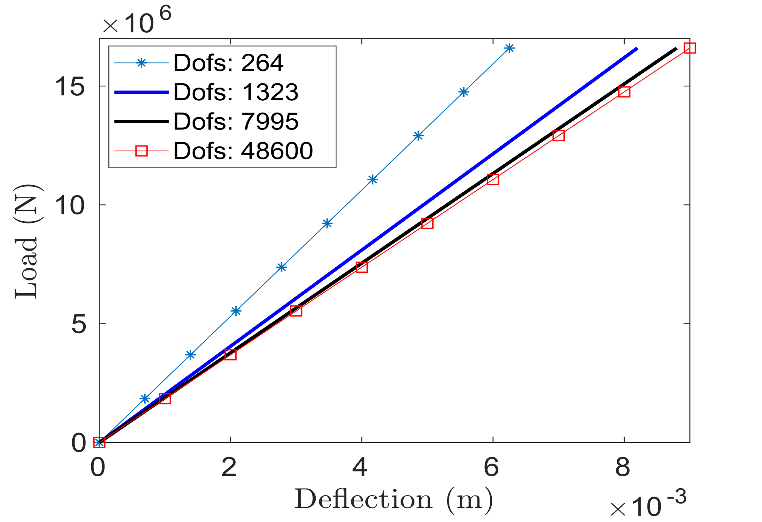
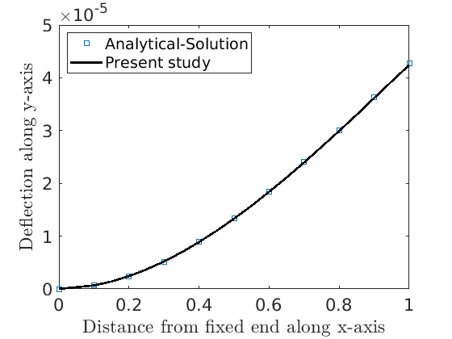
Fig. 15: Convergence study
Fig. 17: Mesh- convergence study
Fig.16: Validation study

Slide 19
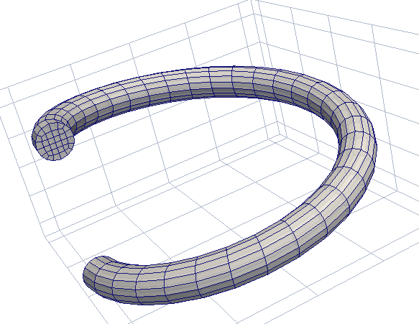
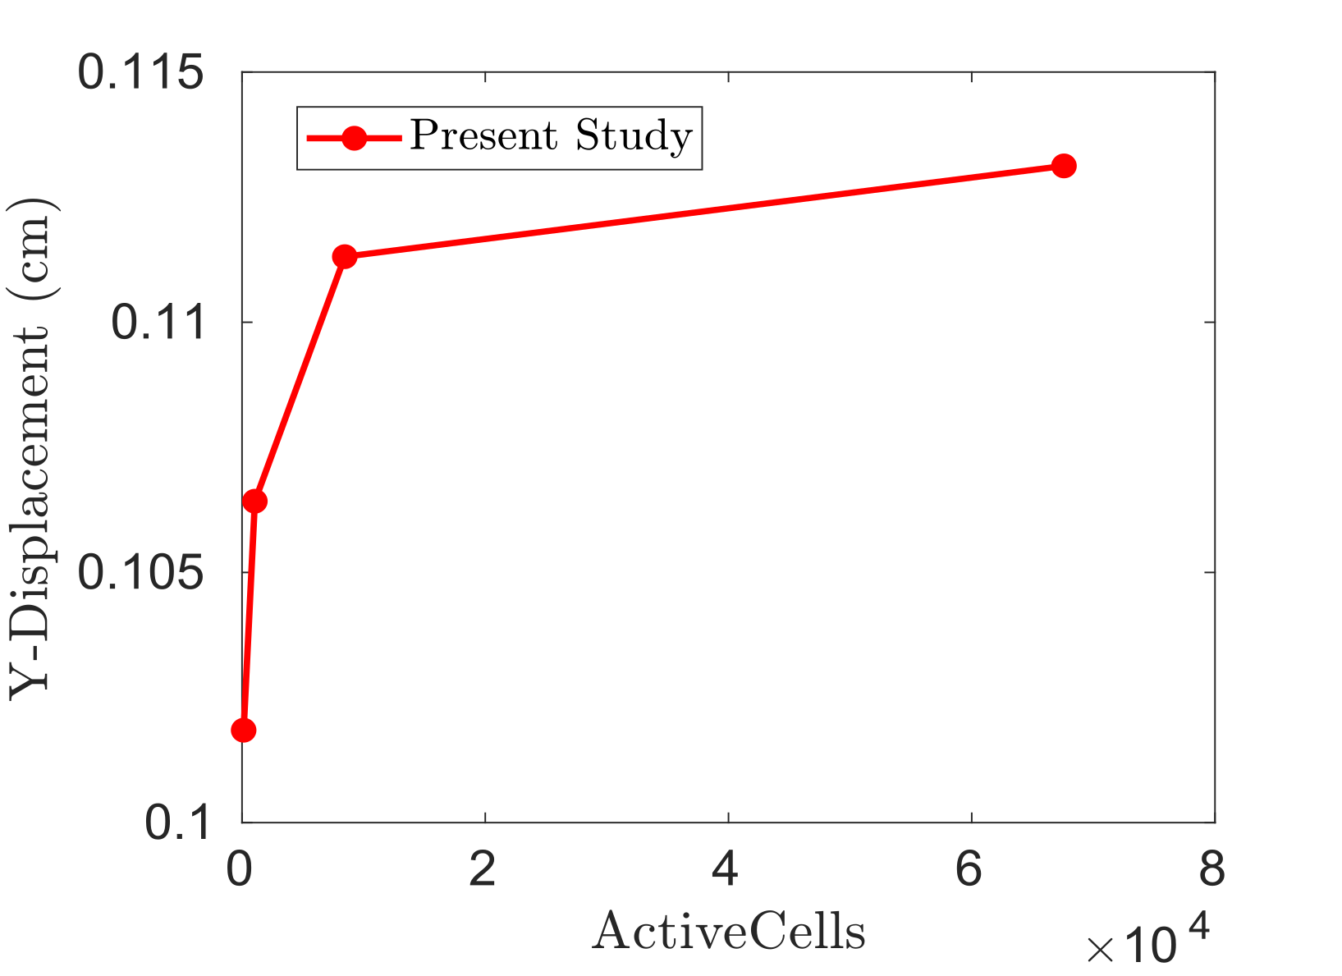
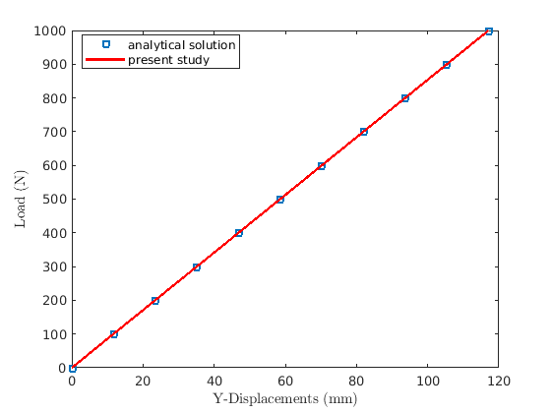
Elastic Spring
S.No. | Parameter | Value
1 | Coil radius | 0.625 cm
2 | Mean coil radius | 2.1 cm
3 | Initial length | 13 cm
4 | Pitch | 2.93 cm
5 | Elastic Modulus | 70 GPa
6 | Poisson’s ratio | 0.3
Fig. 18: Spring-mesh
Fig. 19: Convergence study
Fig. 20: Validation study

Slide 20
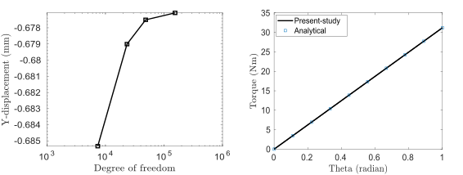
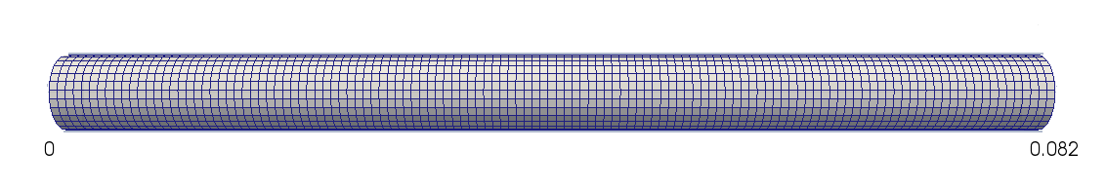
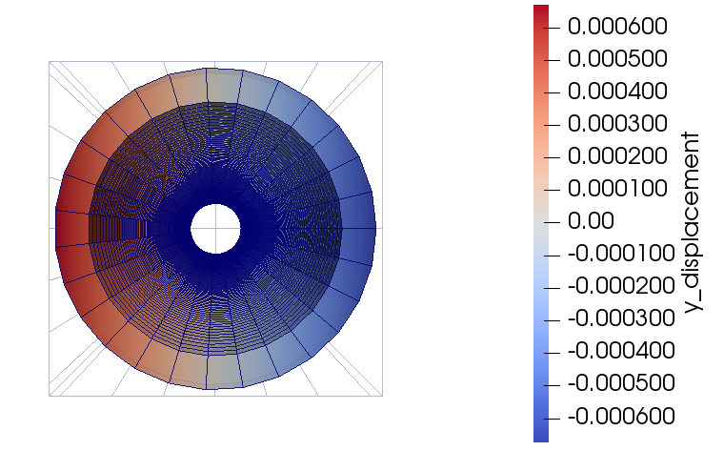
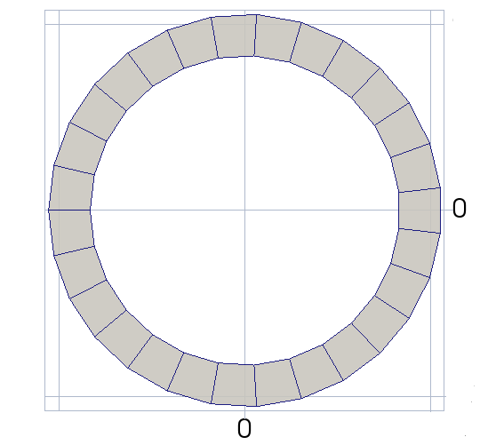
Elastic Torque-tube
S.No. | Parameters | Value
1 | Inner radius | 2.5 mm
2 | Outer radius | 3.17 mm
3 | Length | mm
3 | Rotation | 1 rad
4 | Elastic modulus | 70e9 Pa
5 | Poisson’s ratio | 0.3
Fig. 22: Convergence study
Fig. 23: Validation study
Fig. 21: Torque-tube mesh and cross-section
Fig:24: Displacement color map along y-axis at free end

Slide 21
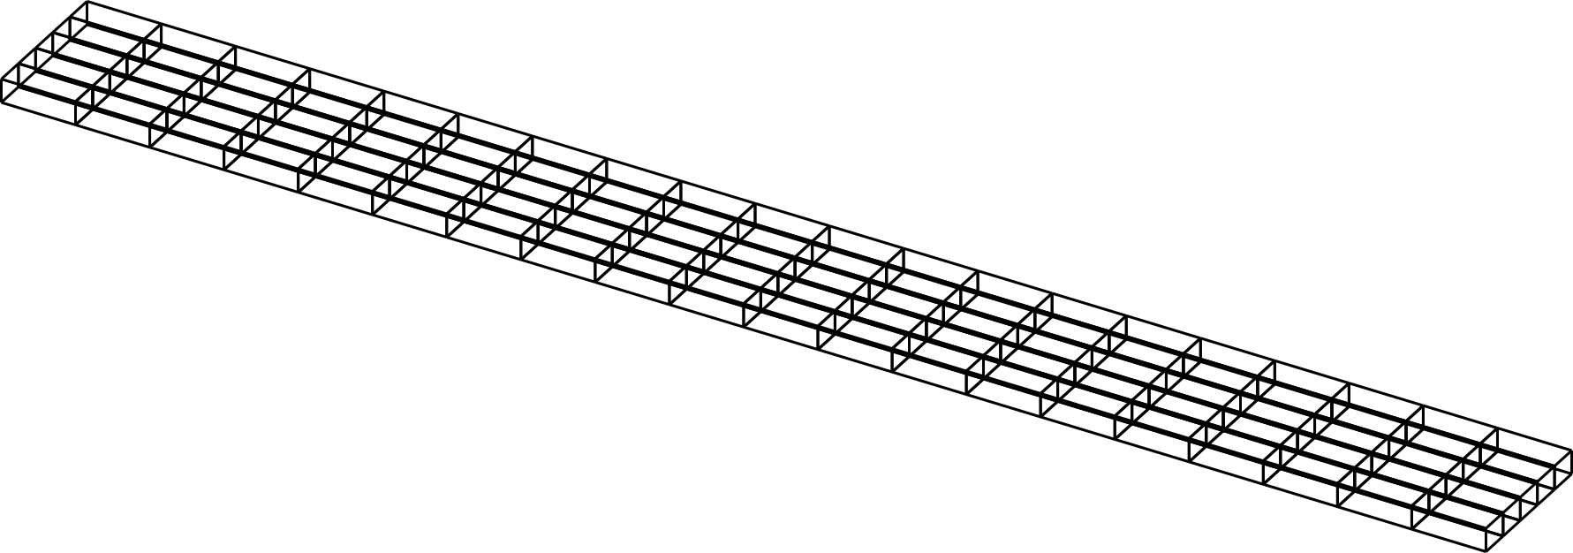

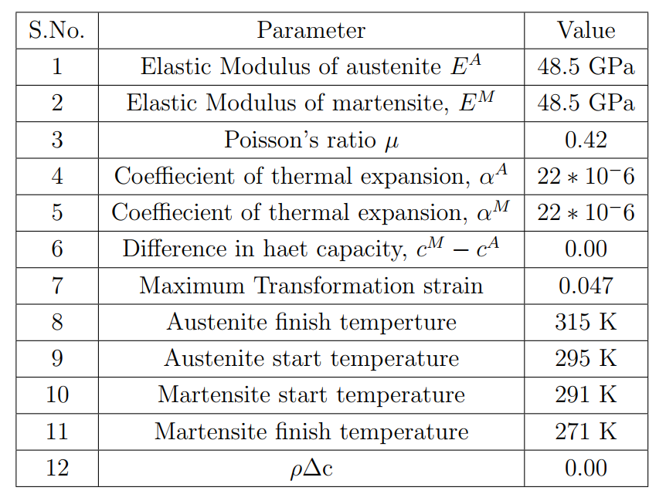
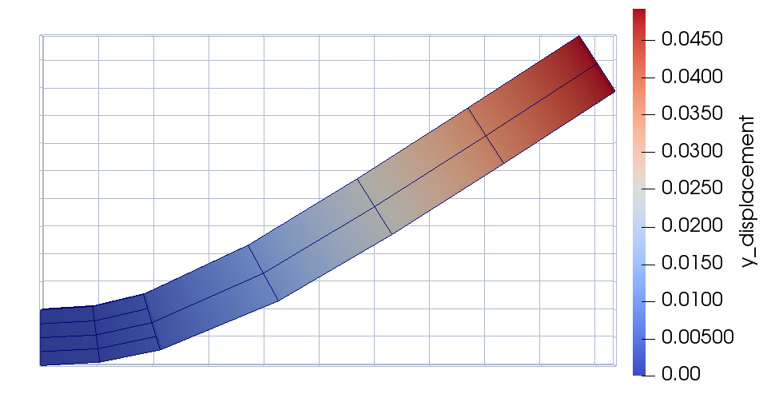
SMA Beam
S.No. | Parameter | Value
1 | Length | 0.1 m
2 | Height | 0.01 m
3 | Thickness | 0.0015 m
4 | Load | 16.67 MN
Fig. 25: SMA beam mesh in 2D and 3D
Fig. 26: Maximum deformation at free end
Table 1: Material parameter of SMA beam

Slide 22
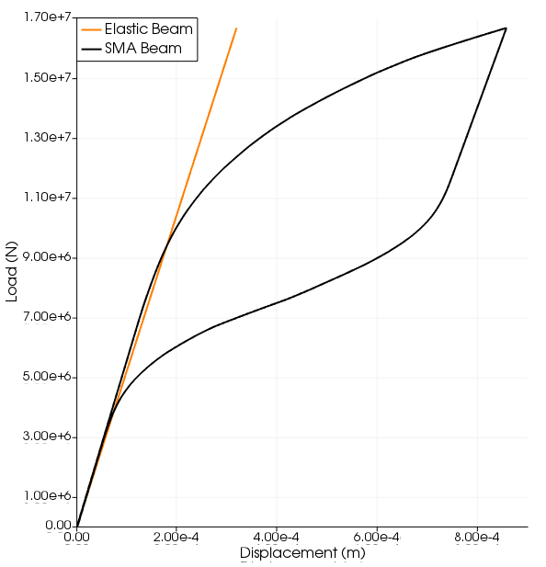
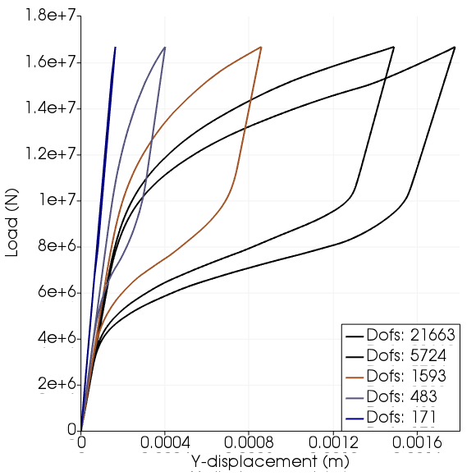
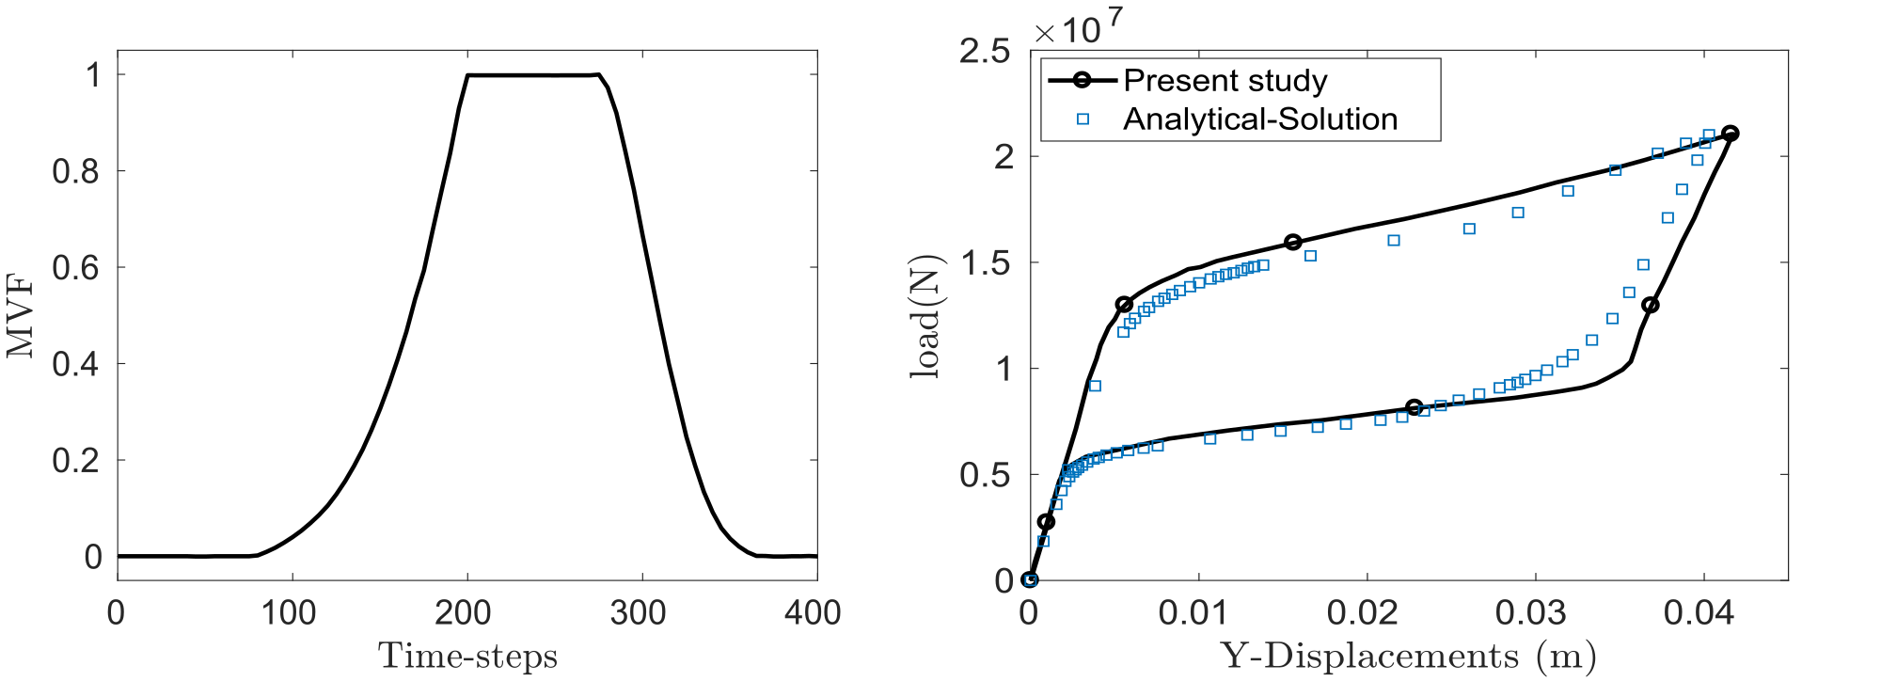
Fig. 27: Comparison between an elastic and SMA beam behaviour
Fig. 28:: Mesh-convergence study
Fig. 29: MVF and Validation study

Slide 23
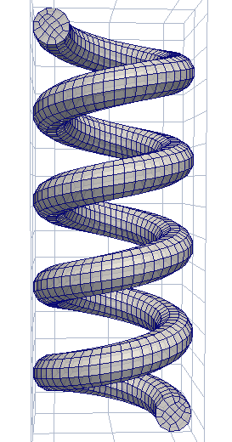
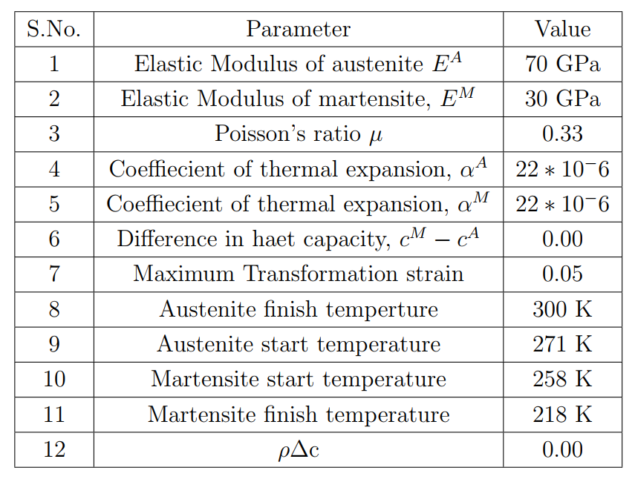
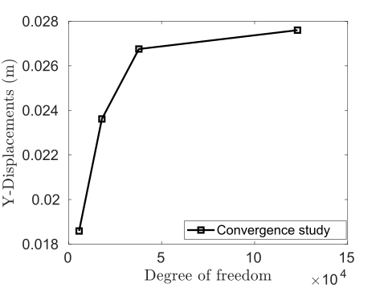
SMA helical spring
S.No. | Parameter | Value
1 | Coil radius | 6.25 mm
2 | Mean coil radius | 21 mm
3 | Initial length | 130 mm
4 | Pitch | 29.3 mm
S.No. | Discretization info | Value
1 | Element type | Hexahedral
2 | Nodes per element | 8
3 | Dofs per element | 24
Fig. 30: SMA spring mesh
Fig. 31: Convergence study
Table 2: SMA spring material parameters

Slide 24
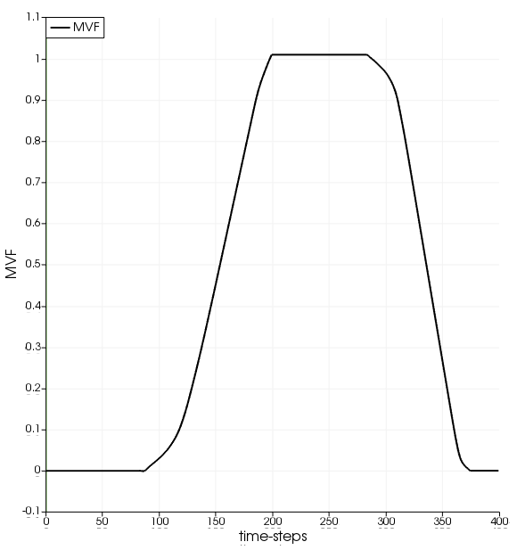
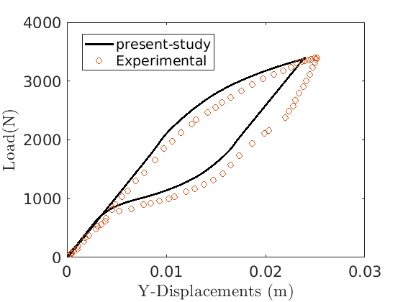
Fig. 32: MVF and Validation study

Slide 25
Conclusion
In the present study, pseudoelastic behavior of SMA members were studied by implementing the SMA constitutive model in FE code.
Postprocessing analysis were carried out in order to study the response of elastic and SMA members.
Future scope
Study the pseudoelastic response of a SMA torque tube.
Study of SMA helical spring in a system such as Non-linear dynamic system, tension torsion coupling system etc, to investigate pseudoelastic response in a complex system.

Slide 26
References
[1] D. C. Lagoudas. Shape memory alloys: Modeling and engineering applications, 2008.
[2] James G Boyd and Dimitris C Lagoudas. A thermodynamical constitutive model for shape memory materials. part i. the monolithic shape memory alloy. International Journal of Plasticity, 12(6):805–842, 1996.
[3] Jaronie Mohd Jani, Martin Leary, Aleksandar Subic, and Mark A Gibson. A review of shape memory alloy research, applications and opportunities. Materials & Design (1980-2015), 56:1078–1113, 2014.
[4] William J Buehler, John V Gilfrich, and RC Wiley. Effect of phase changes on the mechanical properties of alloys near composlow-temperatureition tini. Journal of applied physics, 34(5):1475–1477, 1963.
[5] Frederick E Wang, William J Buehler, and Stanley J Pickart. Crystal structure and a unique“martensitic”transition of tini. Journal of Applied Physics, 36(10):3232–3239, 1965.
[6] Girolamo Costanza and Maria Elisa Tata. Shape memory alloys for aerospace, recent developments, and new applications: A short review. Materials

Slide 27
[7] Reza Mirzaeifar, Reginald DesRoches, Arash Yavari, and Ken Gall. On superelastic bending of shape memory alloy beams. International Journal of Solids and Structures, 50(10):1664–1680, 2013. ISSN 0020-7683
[8] Reza Mehrabi, Mahmoud Kadkhodaei, and Mohammad Elahinia. Constitutive modeling of tension-torsion coupling and tension-compression asymmetry in niti shape memory alloys. Smart materials and structures
[9] L Catherine Brinson. One-dimensional constitutive behavior of shape memory alloys: thermomechanical derivation with non-constant material functions and redefined martensite internal variable. Journal of intelligent material systems and structures, 4(2):229–242, 1993.

Slide 28
Thank you!

