Slide 1
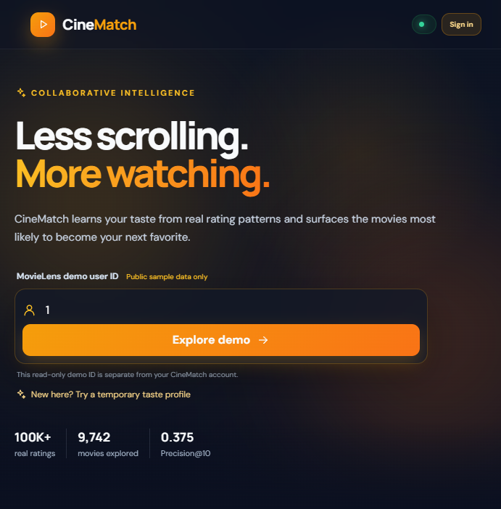
CineMatch
Less scrolling.
More watching.
A movie discovery application powered by collaborative filtering, matrix factorization, and a React + FastAPI product.
INTERNSHIP PROJECT • MOVIELENS SMALL

Slide 2
PROBLEM & OBJECTIVE
A sparse-data discovery problem
Goal
100,836
610
Rank movies a viewer has not rated using patterns in historical ratings, then make those results usable through a local full-stack application.
ratings
users
9,742
98.3%
catalog movies
matrix sparsity
•
Compare user-neighbor, item-neighbor, and SVD approaches.
•
Separate public MovieLens demo data from signed-in account data.
•
Provide a popularity fallback when an account has too little rating history.
CINEMATCH • PROJECT SUBMISSION
02

Slide 3
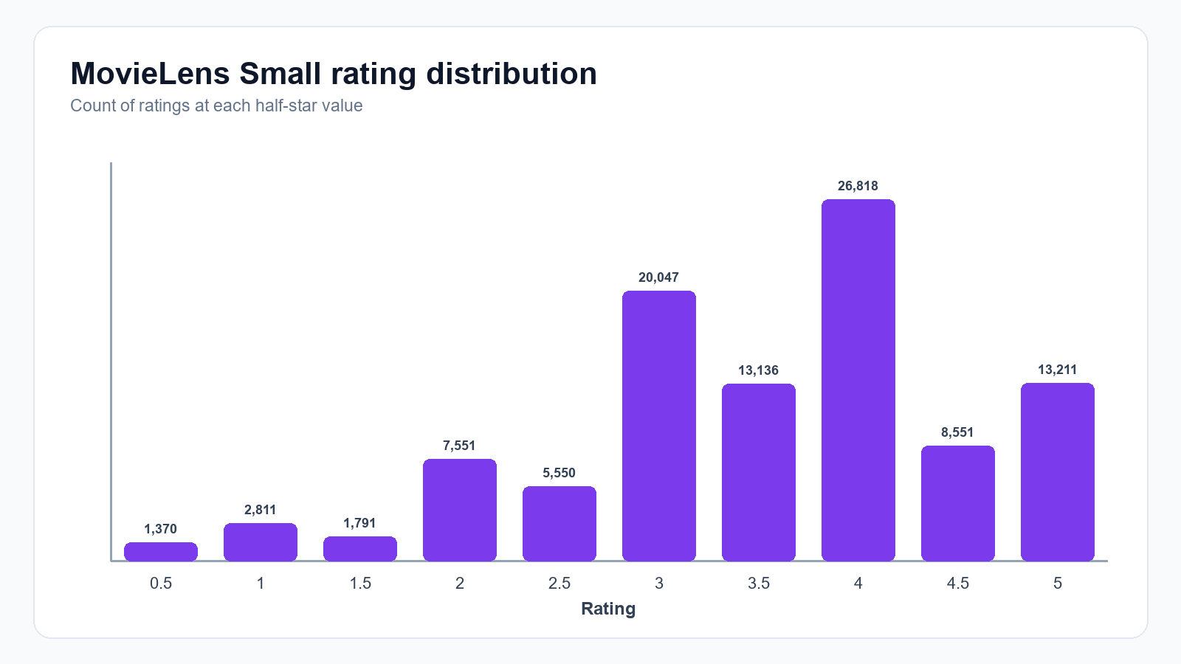
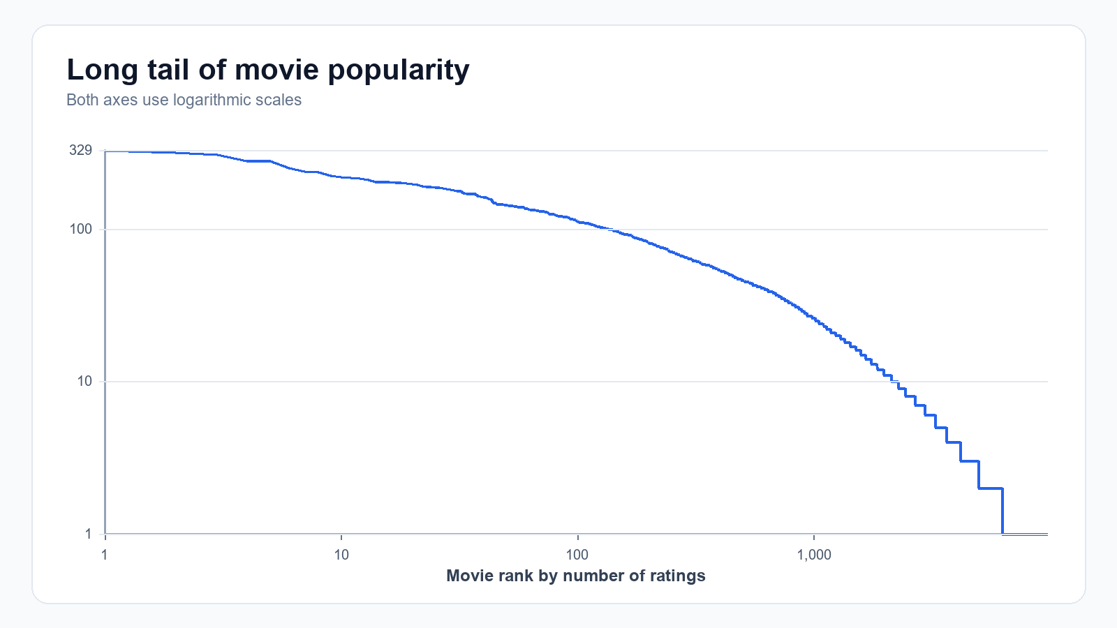
DATA & EDA
Exploratory analysis: uneven evidence
Rating distribution
Long-tail rating activity
Ratings average 3.50/5 (median 3.5); only 1.7% of the user–movie matrix is observed. A small number of titles attract many ratings while most have sparse evidence.
CINEMATCH • PROJECT SUBMISSION
03

Slide 4
METHODOLOGY
A reproducible, shared evaluation
01
02
03
04
Per-user split
Rating test
Ranking test
Relevance
80/20 holdout
Seed 42
Same 2,000 held-out
ratings per model
100 users · K = 10
seeded candidate sets
Held-out rating
≥ 4.0
Each ranking candidate set contains all held-out items plus 100 sampled unseen items. Unrated samples are evaluation candidates, not confirmed dislikes.
80,672 training ratings • 20,164 held out • validation seed 43 for SVD tuning
CINEMATCH • PROJECT SUBMISSION
04

Slide 5
ALGORITHMS
Neighborhood models: two viewpoints
USER–USER
ITEM–ITEM
Find viewers with similar rating patterns.
Find movies with similar rating patterns.
Use neighbors’ ratings to estimate a target viewer’s unseen title.
Aggregate a viewer’s ratings across related items to estimate a new title.
Mean-centered cosine similarity • 30 neighbors • at least 3 common ratings
Item–Item leads rating error; both methods use fallback predictions when neighbor evidence is unavailable.
CINEMATCH • PROJECT SUBMISSION
05

Slide 6
ALGORITHMS
SVD: compact latent representations
Surprise SVD represents users and movies with learned latent-factor vectors. The model predicts a rating from global, user, item, and interaction terms.
Validation RMSE
0.8779
Tune on validation
20 factors selected
20 epochs
Scikit-Surprise 1.1.5
20
50
100
SELECTED
candidate
candidate
Model selection uses validation data; final comparison uses the common held-out test sample.
CINEMATCH • PROJECT SUBMISSION
06

Slide 7
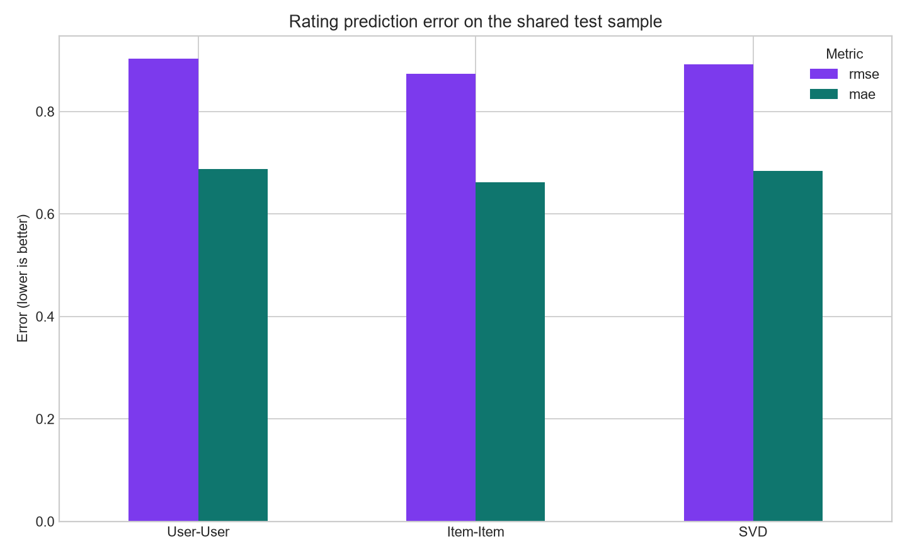
EVALUATION
Rating prediction: Item–Item wins
Best RMSE
Item–Item
0.8740 RMSE
0.6617 MAE
2,000 shared held-out ratings
Lower is better • values rounded to four decimals
CINEMATCH • PROJECT SUBMISSION
07

Slide 8
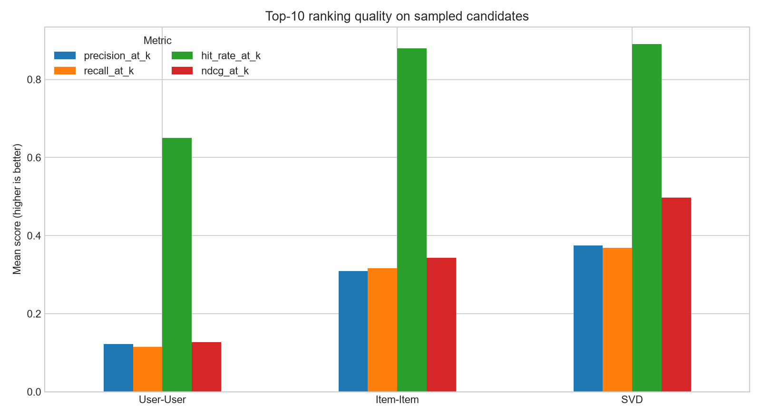
EVALUATION
Top-10 ranking: SVD wins discovery
SVD · selected
Precision@10 0.375
Recall@10 0.369
Hit Rate@10 0.890
NDCG@10 0.497
100 seeded users • same candidate sets
Ranking objective: Precision@10, with NDCG@10 and RMSE as tie-breakers.
CINEMATCH • PROJECT SUBMISSION
08

Slide 9
RESULTS
Model choice follows the product objective
RATING ESTIMATION
RANKED DISCOVERY
Item–Item
SVD
Lowest RMSE and MAE on the shared test sample.
Highest Precision@10 and NDCG@10 in the measured ranking protocol.
The web demo uses SVD for discovery, with Bayesian-weighted popularity (prior 50) for cold-start profiles.
CINEMATCH • PROJECT SUBMISSION
09

Slide 10
SYSTEM ARCHITECTURE
From browser request to ranked movies
React + Vite
FastAPI
Recommendation
Project data
→
→
→
Search · profile
ratings · watchlist
Auth · catalog
recommendation routes
SVD · fold-in
popularity fallback
MovieLens CSVs
model · SQLite
Development: Vite proxies /api/v1 to FastAPI. Local persistence uses SQLite; the final package is for local demonstration, not production deployment.
CINEMATCH • PROJECT SUBMISSION
10

Slide 11
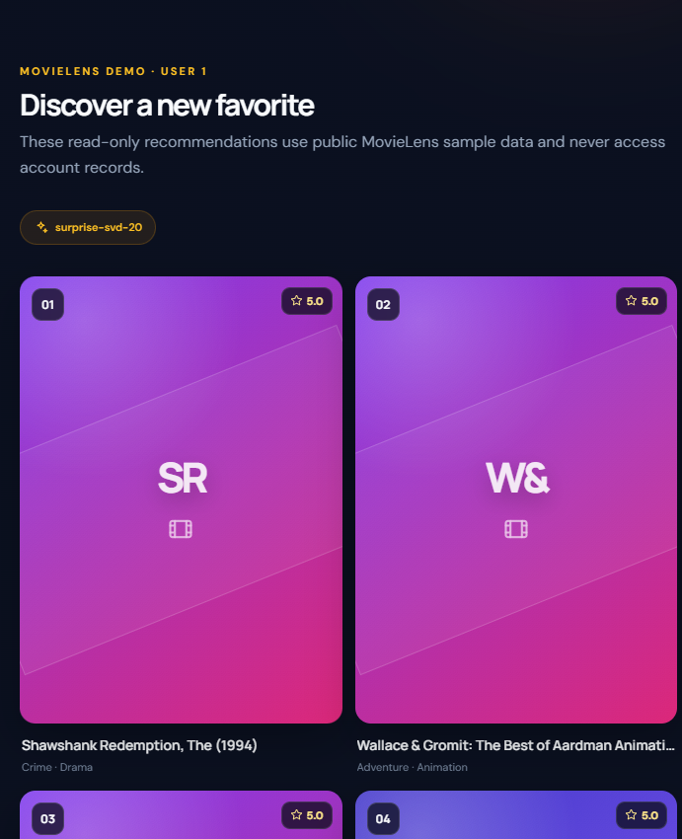
APPLICATION
The model is accessible in the product
User-facing features
•
Movie search & details
•
Public read-only demo
•
Sign-in & session restore
•
Ratings & watchlist
•
Personalized top-10
Captured locally from the logged-out application; demo recommendations use public MovieLens sample data.
CINEMATCH • PROJECT SUBMISSION
11

Slide 12
APPLICATION
Public demo and private accounts stay separate
PUBLIC MOVIELENS DEMO
SIGNED-IN ACCOUNT
Sample user ID selects read-only demo results.
Session identity drives private ratings, watchlist, and recommendations.
GET /api/v1/demo/recommendations/{user_id}
GET /api/v1/demo/predictions/{user_id}/{movie_id}
HttpOnly session cookie
GET /api/v1/me/recommendations
Private actions require authentication
The MovieLens demo ID is not an account identifier.
CINEMATCH • PROJECT SUBMISSION
12

Slide 13
VERIFICATION
Local verification completed
137 passed
15 passed
Passed
backend pytest suite
frontend tests
production frontend build
•
Browser smoke test on local app using a disposable account database.
•
Verified registration, login, restored session, ratings, watchlist, feedback, and logout.
•
Verified public movie search/details and MovieLens demo flow.
•
No real database migration or cloud deployment was performed.
Warnings: 2 existing deprecations in backend test output; no test failures.
CINEMATCH • PROJECT SUBMISSION
13

Slide 14
LIMITATIONS & NEXT STEPS
What this evaluation does—and does not—show
•
MovieLens Small is historical and much smaller than a commercial streaming catalog.
•
Unrated sampled candidates are not confirmed dislikes; ranking scores are protocol-dependent.
•
Offline precision/recall do not measure satisfaction, novelty, fairness, or long-term engagement.
•
New accounts use a popularity fallback until at least three saved ratings enable personalization.
•
Authentication rate limiting is process-local; SQLite is appropriate for this local demo, not multi-instance scale.
Future evaluation: broader temporal splits, diversity/coverage analysis, and consented user feedback.
CINEMATCH • PROJECT SUBMISSION
14

Slide 15
REFERENCES
Sources & reproducibility
•
MovieLens Small data and attribution: GroupLens Research, grouplens.org/datasets/movielens/.
•
Model and test metrics: data/processed/week1_summary.json through week4_summary.json.
•
Evaluation protocol and caveats: reports/week4_evaluation_report.md.
•
Application implementation and limitations: README.md, src/cinematch/, frontend/src/.
•
Recommendation algorithms: Surprise SVD documentation, surprise.readthedocs.io/en/stable/matrix_factorization.html.
CineMatch has been verified locally. No public live deployment URL is currently verified.
CINEMATCH • PROJECT SUBMISSION
15

