Slide 1
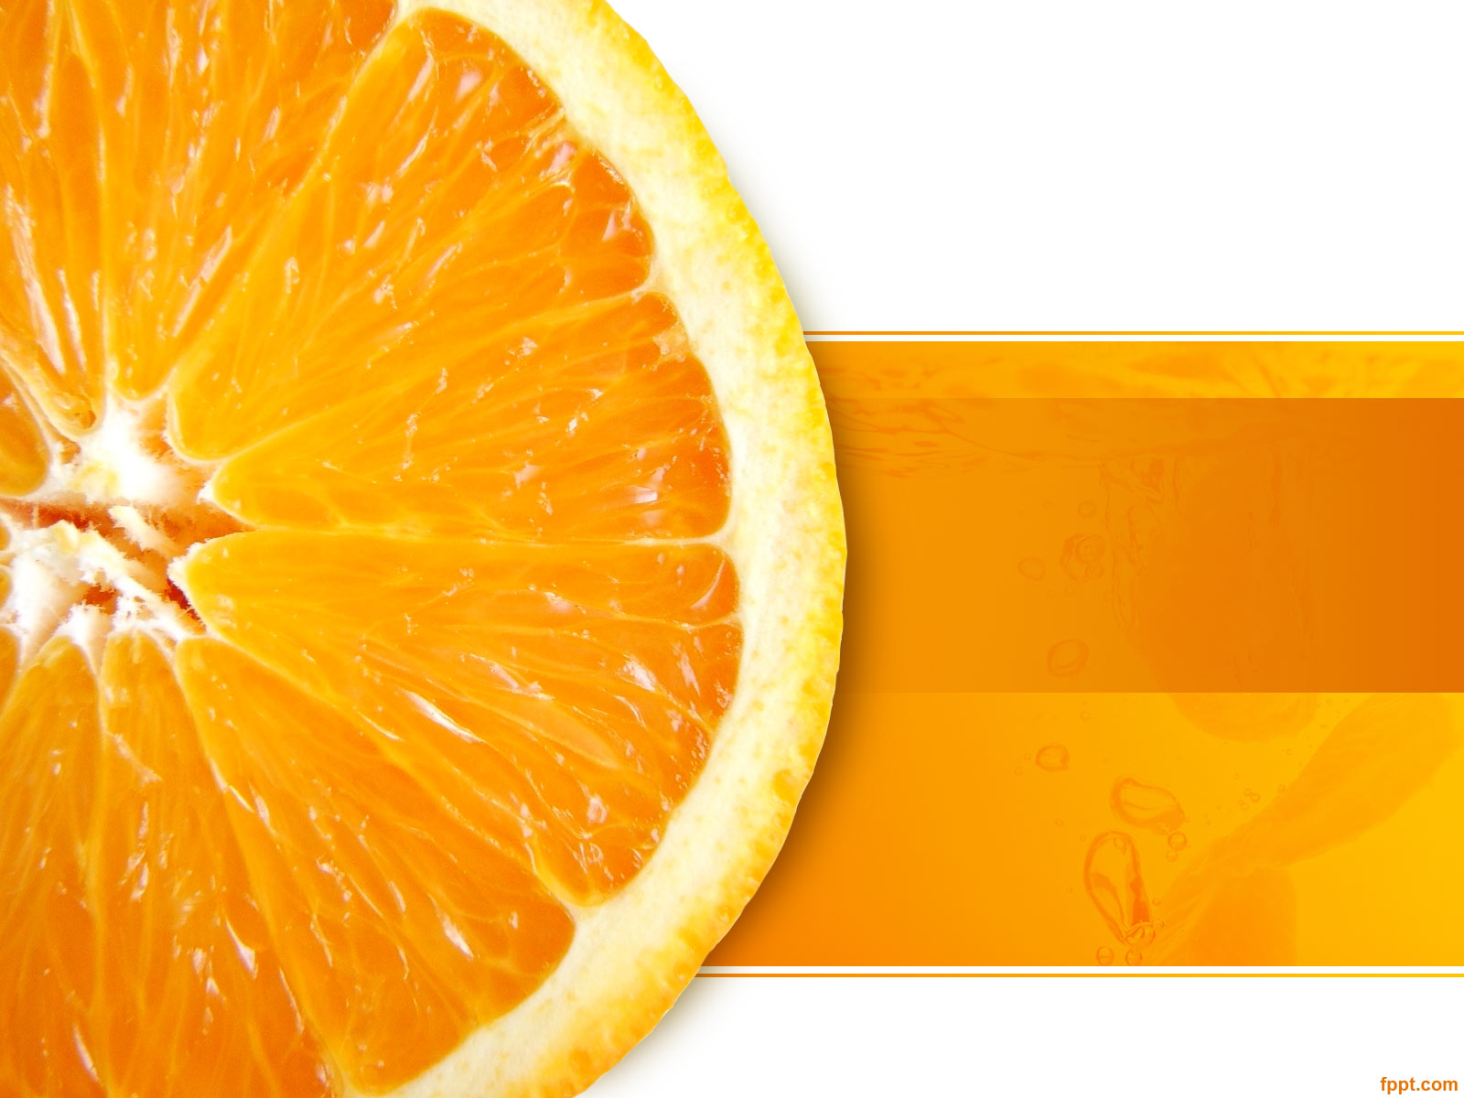
Fruttaspy
Amit Kumar Tiwari
Aravind Siddharth
Palash Sharma
Sirsikar Ajinkya Ashokrao
Yash Sharma

Slide 2
Introduction
Fruttaspy is a web application for the study of various types of fruits and classify them accordingly.
The objective of the project is to develop a web application which can tell us the mineral content in a particular fruit
This web application would be helpful for Botanist, Nutritionist or someone who are interested in the study of fruits and its minerals content.

Slide 3

Methodology:
In the area of image recognition and classiﬁcation, the most successful results were obtained using artiﬁcial neural networks.
We will be training dataset using Convolutional Neural Network (CNNs) and vgg16 model to enhance its accuracy.
Machine Learning model will identify the class of newly introduced images of fruits and in addition, it will specify their mineral contents.
Python library will be used to convert desired output to speech format for more interactive user interface.

Slide 4
CNN
Convolutional neural networks (CNN) are part of the deep learning models. Such a network can be composed of convolutional layers, pooling layers
We will be using combination of network having different activation functions to enhance accuracy of modes

Slide 5


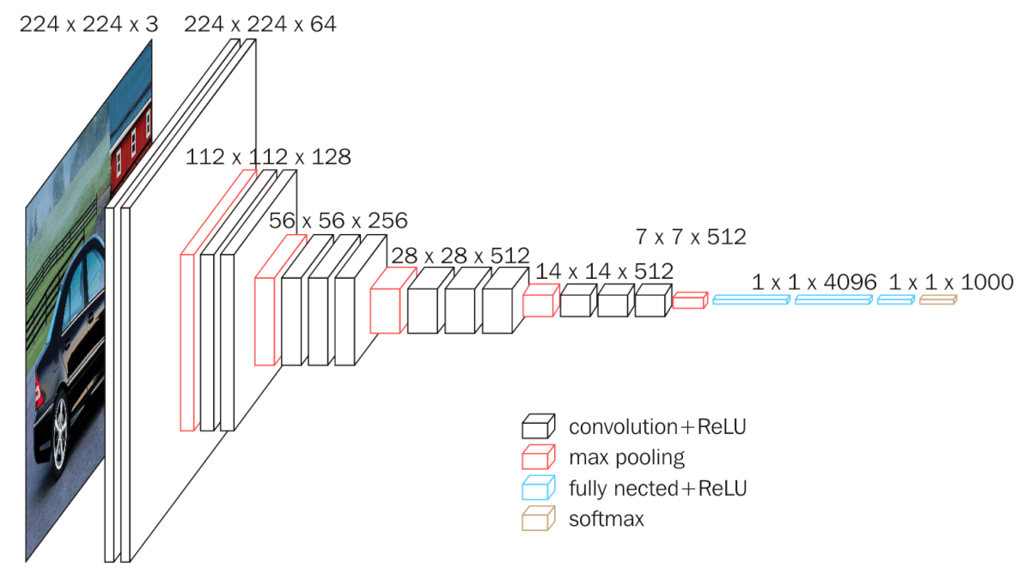

Working
Initially we’re trying with relu activation function with filter size and max pooling layer size as shown in picture.
We will be making modifications in parameters and function to enhance overall accuracy.

Slide 6
Fruttaspy dataset
Total number of images are 59842, image size is 100x100 pixels in jpg format.
Dataset includes: Apples (different varieties: Golden, Golden-Red, Granny Smith, Red, Red Delicious), Apricot, Avocado, Avocado ripe, Banana (Yellow, Red), Cactus fruit, Cantaloupe (2 varieties), Carambula, Cherry (different varieties, Rainier), Cherry Wax (Yellow, Red, Black), Clementine, Cocos, Dates, Granadilla, Grape (Blue, Pink, White (different varieties)), Grapefruit (Pink, White), Guava, Huckleberry, Kiwi, Kaki, Kumsquats, Lemon (normal, Meyer), Lime, Lychee, Mandarine, Mango, Maracuja, Melon Piel de Sapo, Mulberry, Nectarine, Orange, Papaya, Passion fruit, Peach (different varieties), Pepino, Pear (different varieties, Abate, Monster, Williams), Physalis (normal, with Husk), Pineapple (normal, Mini), Pitahaya Red, Plum, Pomegranate, Quince, Rambutan, Raspberry, Redcurrant, Salak, Strawberry (normal, Wedge), Tamarillo, Tangelo, Tomato (different varieties, Maroon, Cherry Red), Walnut.

Slide 7
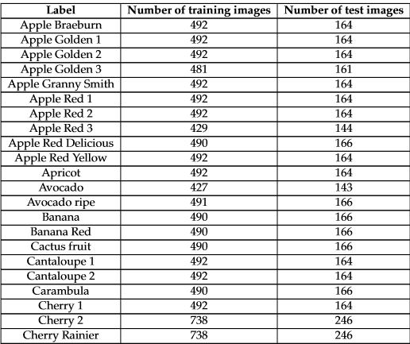
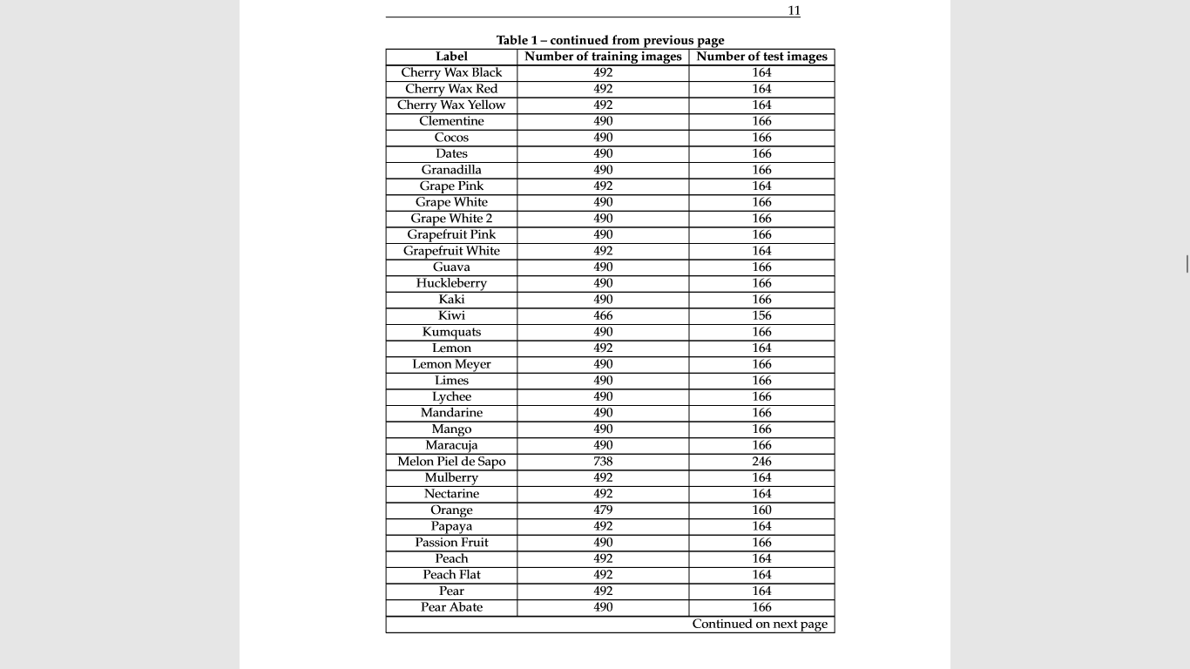
Fruttaspy Categories

Slide 8
Summary
We are classifying different types of models, training ML model using 83 classes of fruits and predicting to identify the class of newly introduced images of fruits and in addition, it will specify their mineral contents.
In addition, we are trying to develop text to speech converter using NLP techniques.

Slide 9
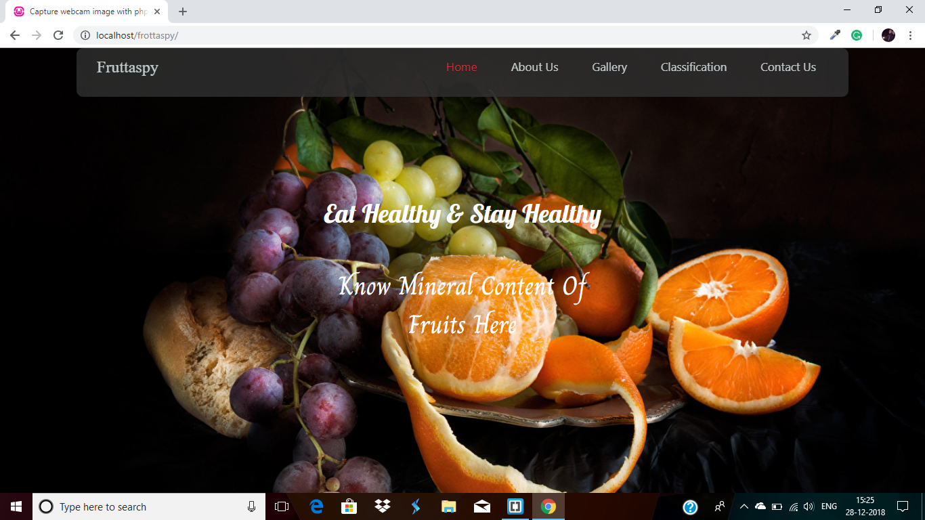
Fruttaspy Web-application

