Slide 1

B.TECH CSE · MILESTONE 3 EVALUATION
Resume Matcher
#1
Job Description
Finds the best resumes for a job, automatically, by comparing their text
AI
#2
TF-IDF
GloVe
Sentence-BERT
Hybrid
#3
TEAM · BATCH NUMBER 3
Yash Agarwal
Raghav Soni
You give it a job and some resumes. It sorts the resumes from best to worst match.
YA
RS
S24CSEU0244
S24CSEU0303
27 October 2026

Slide 2

THE PROBLEM · OUR IDEA · THE DATA
Why do we need this?
?
The problem
→
Our idea
A company can get hundreds of resumes for one job. Reading all of them takes a lot of time. A simple keyword search also misses good people who write the same skill in other words (for example "ML" instead of "Machine Learning").
Give the app a job description and some resumes. It gives every resume a score from 0 to 100 and sorts them from best to worst match. The recruiter starts with the top ones. A person still makes the final decision.
THE DATA WE USED TO TEST IT (real, public resume datasets from Kaggle)
166
Tech jobs dataset (our main one)
2,481
All-industries dataset (extra check)
The file has 962 rows, but 796 were exact copies, so 166 are unique. 25 job types: Java / Python / .NET Developer, Data Science, DevOps, Testing, Database ...
2,484 rows; we removed 1 empty and 2 copies. 24 broad areas such as IT, Engineering, HR, Finance. Very few of them are software resumes.
different tech resumes
resumes, all industries
Why two datasets? Our project is about tech jobs (software, data, AI, testing), so the tech dataset is the main one. The bigger mixed dataset shows how the methods behave when most resumes are not from tech.
Resume Matcher · Milestone 3 · Batch 3
2 / 7

Slide 3
HOW IT WORKS
From a job description to a ranked list, in 5 steps
1
2
3
4
5
Read
Clean
Convert
Compare
Rank
Take the text out of each resume file (PDF, TXT or MD). The job description is typed or pasted.
Make all letters small, remove links, e-mails and extra symbols, fix broken characters. Keep special skill names like C++, C# and .NET.
A computer cannot compare words directly, so each resume and the job are turned into a list of numbers, called a vector.
Cosine similarity checks how close two vectors point. Same direction = very similar = high score.
Sort the resumes from highest to lowest score. Show the top ones and let the user download the list as a CSV file.
What does the score mean? 100 means the resume and the job point in exactly the same direction (very similar text). 0 means they have nothing in common. It only measures how alike the texts are. It is not the chance of getting hired.
No chatbot or LLM writes anything here. The app only measures similarity and sorts.
Resume Matcher · Milestone 3 · Batch 3
3 / 7

Slide 4
METHODOLOGY · THE 4 MATCHING METHODS
Four ways to compare a resume with a job
1
TF-IDF
2
GloVe
3
Sentence-BERT
4
Hybrid
Matches the same words
Knows related words
Understands the meaning
All three together
IN SIMPLE WORDS
IN SIMPLE WORDS
IN SIMPLE WORDS
IN SIMPLE WORDS
Counts the words in each resume. Rare, specific words (like "Selenium") get more weight than common words (like "work").
Uses a ready-made list of 400,000 English words, each stored as 100 numbers. Similar words get similar numbers. A resume = the average of its words.
A small pre-trained AI model (bge-small) reads the whole text and turns its meaning into 384 numbers.
Takes the three scores and averages them, like three judges giving marks and taking the average.
EXAMPLE
EXAMPLE
EXAMPLE
EXAMPLE
Job asks for "Spring Boot" → resumes that mention Spring Boot go up.
"Doctor" and "physician" are close to each other.
"Built ML models in Python" matches a Machine Learning job, even with different words.
To rank high, a resume needs the right skills, related words and the right overall meaning.
Good: Very fast and easy to explain
Good: Understands similar words
Good: Understands context and wording
Good: Best result in our test; default in the app
Weak: "Developer" and "programmer" look like different words to it
Weak: Averaging blurs details, so most resumes get close scores
Weak: Slower, and reads only about the first page of a resume
Weak: Needs all three methods ready (GloVe file + AI model)
Resume Matcher · Milestone 3 · Batch 3
4 / 7

Slide 5
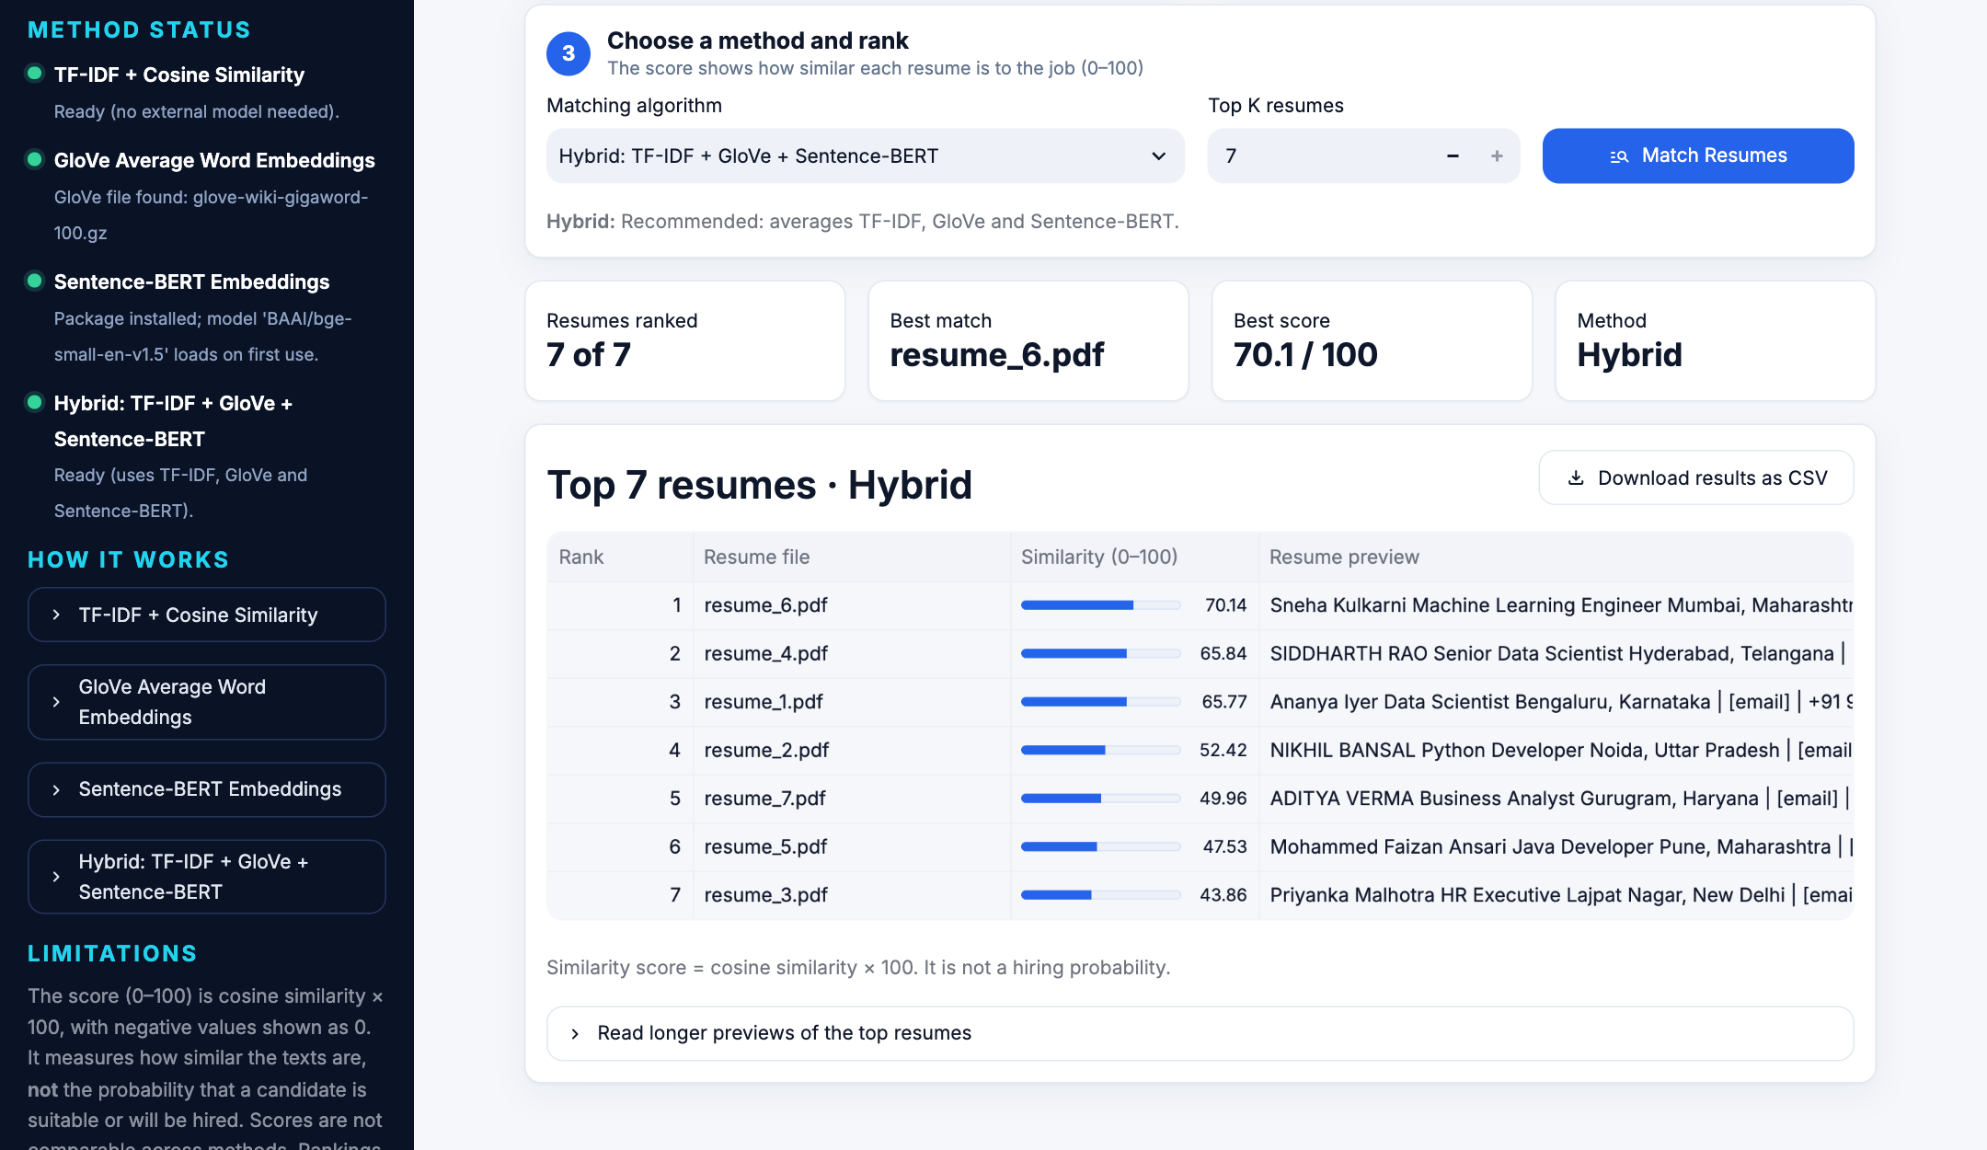
IMPLEMENTATION · LIVE DEMO
Our code and the working app
resume_matcher/preprocessing.py
Cleans the text (step 2)
resume_matcher/data_loader.py
Reads resumes, removes empty and duplicate ones
resume_matcher/matcher.py
The 4 matching methods and the ranking (steps 3–5)
app.py
The web page, built with Streamlit
evaluate.py
Real screenshot: 7 demo resumes, Data Scientist job, Hybrid. Data-science resumes rank first, HR last.
Tests which method works best on real data
1
2
3
4
5
Upload resumes
Paste the job
Pick a method
Click Match
See ranking, download CSV
Resume Matcher · Milestone 3 · Batch 3
5 / 7

Slide 6
EVALUATION · TESTING · RESULTS
Which method works best?
WAS THE #1 RESUME A GOOD FIT? (out of 14 jobs)
TF-IDF
12/14
GloVe
10/14
Sentence-BERT
13/14
Hybrid
14/14
TESTING
119
16
automated tests, all passing
tech job descriptions written for testing
How we measured: for 14 tech jobs we looked at the top 5 resumes and checked if their job type fits (e.g. Backend job → Java / Python Developer). Hybrid 0.83 means about 4 out of 5 were a good fit.
On the all-industries dataset every method scored low (0.27–0.37), because it has very few software resumes.
Honest note: this is a small test, and "job type fits" is only a rough check. The results are a good sign, not a guarantee.
Resume Matcher · Milestone 3 · Batch 3
6 / 7

Slide 7
MILESTONE 3 · LIMITATIONS · NEXT STEPS
Summary
✓
Design and code match
Limitations
Each box in our design is a real module in the code
Resumes and jobs are cleaned in exactly the same way
All 4 methods use the same compare-and-rank code
Small test: only 16 job descriptions
"Job type fits" is only a rough check
No Word (DOCX) files or scanned PDFs yet
✓
Working modules and demo
Next steps
4 matching methods tested on 2 real datasets
Web app: upload resumes, rank, download CSV
Evaluation script and 119 automated tests
Ask real people to mark good matches
Show which skills match or are missing
Support DOCX files and scanned PDFs
Thank You
https://github.com/soniraghav217-cmyk/Resume-Matcher.git
Resume Matcher · Milestone 3 · Batch 3
7 / 7

