Slide 1
Electronic Mail:
SMTP, POP, and IMAP

Slide 2
ARCHITECTURE
To explain the architecture of email, we give four scenarios. We begin with the simplest situation and add complexity as we proceed. The fourth scenario is the most common in the exchange of email.
First Scenario
Second Scenario
Third Scenario
Fourth Scenario

Slide 3
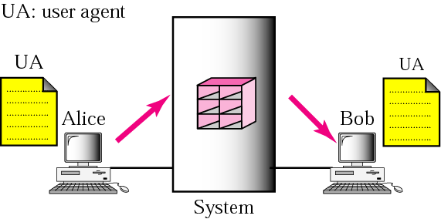
First scenario

Slide 4
When the sender and the receiver of an email are on the same system, we need only two user agents.

Slide 5
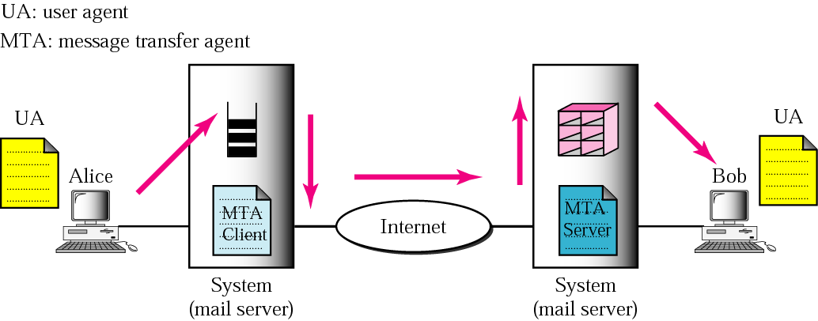
Second scenario

Slide 6
When the sender and the receiver of an email are on different systems, we need two UAs and a pair of MTAs (client and server).

Slide 7
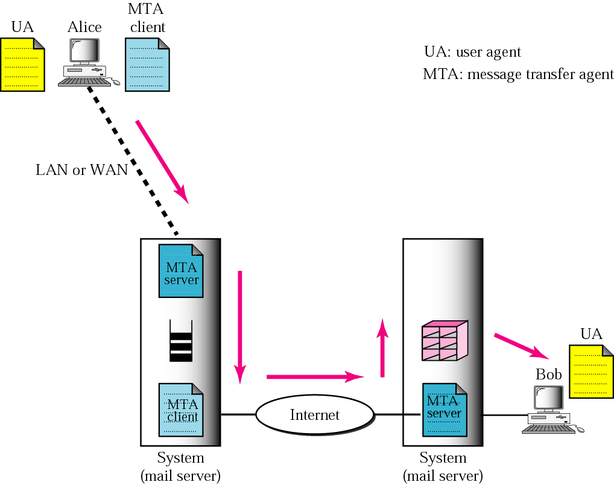
Third scenario

Slide 8
When the sender is connected to the mail server via a LAN or a WAN, we need two UAs and two pairs of MTAs (client and server).

Slide 9
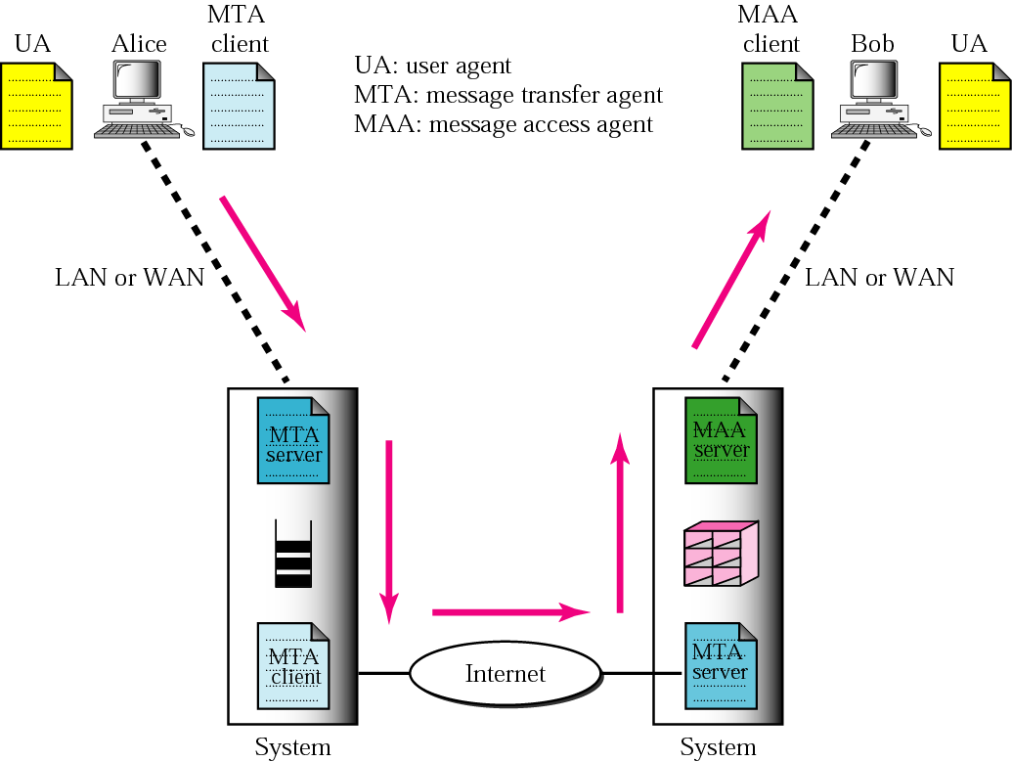
Fourth scenario

Slide 10
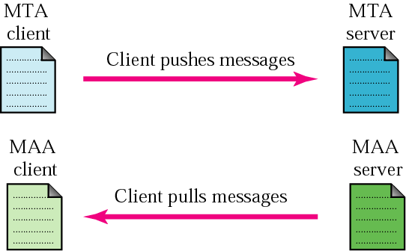
Push vs. pull

Slide 11
When both sender and receiver are connected to the mail server via a LAN or a WAN, we need two UAs, two pairs of MTAs (client and server), and a pair of MAAs (client and server). This is the most common situation today.

Slide 12
USER AGENT
The user agent (UA) provides service to the user to make the process of sending and receiving a message easier.
Services Provided by a User Agent
User Agent Types
Sending Mail
Receiving Mail
Addresses
Mailing List
MIME

Slide 13
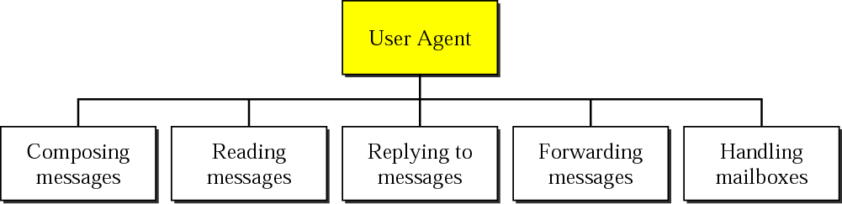
User agent

Slide 14
Some examples of command-driven user agents are mail, pine, and elm

Slide 15
Some examples of GUI-based user agents are Eudora, Outlook, and Netscape.

Slide 16
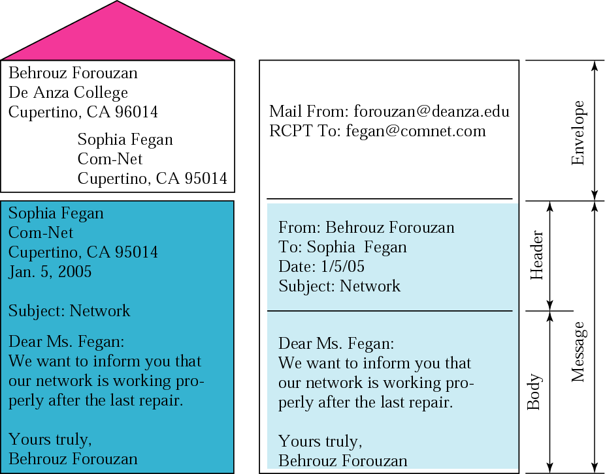
Format of an email

Slide 17
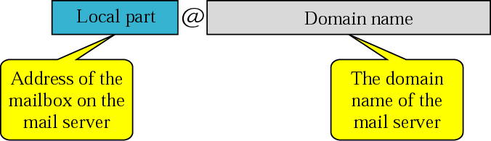
Email address

Slide 18
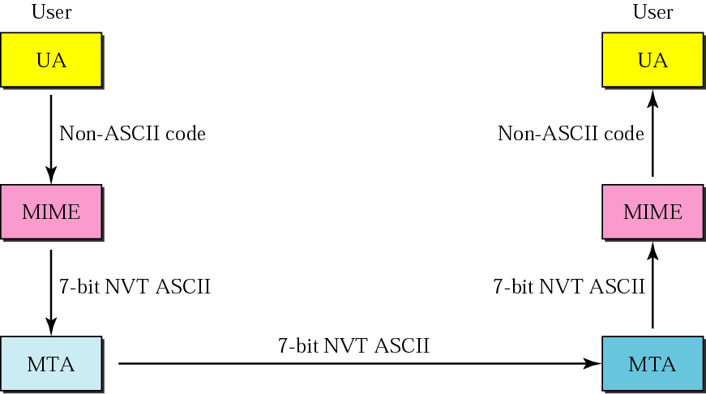
MIME

Slide 19
MESSAGE TRANSFER AGENT:
SMTP
The actual mail transfer requires message transfer agents (MTAs). The protocol that defines the MTA client and server in the Internet is called Simple Mail Transfer Protocol (SMTP).

Slide 20
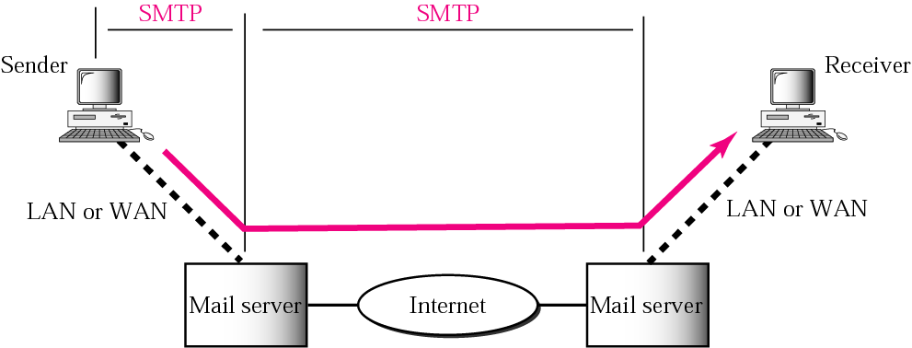
SMTP range

Slide 21
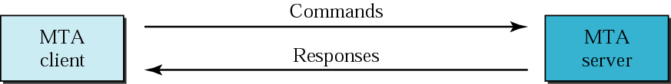
Commands and responses

Slide 22

Command format

Slide 23
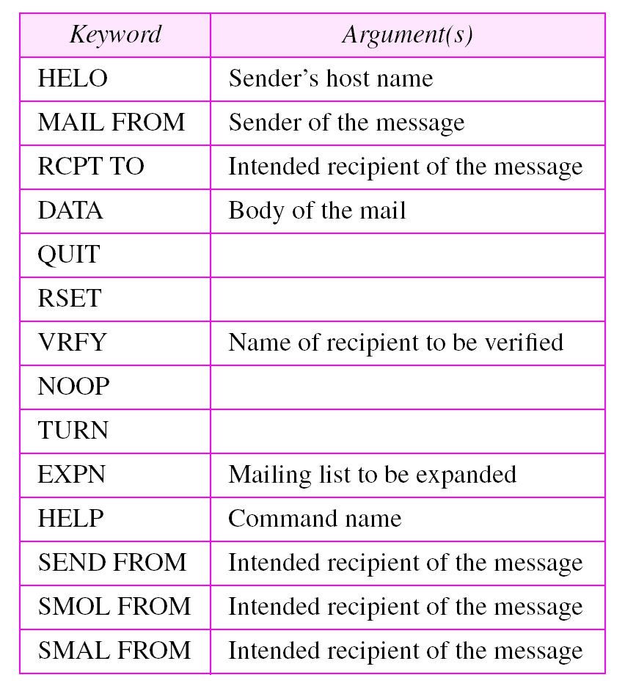
Commands

Slide 24
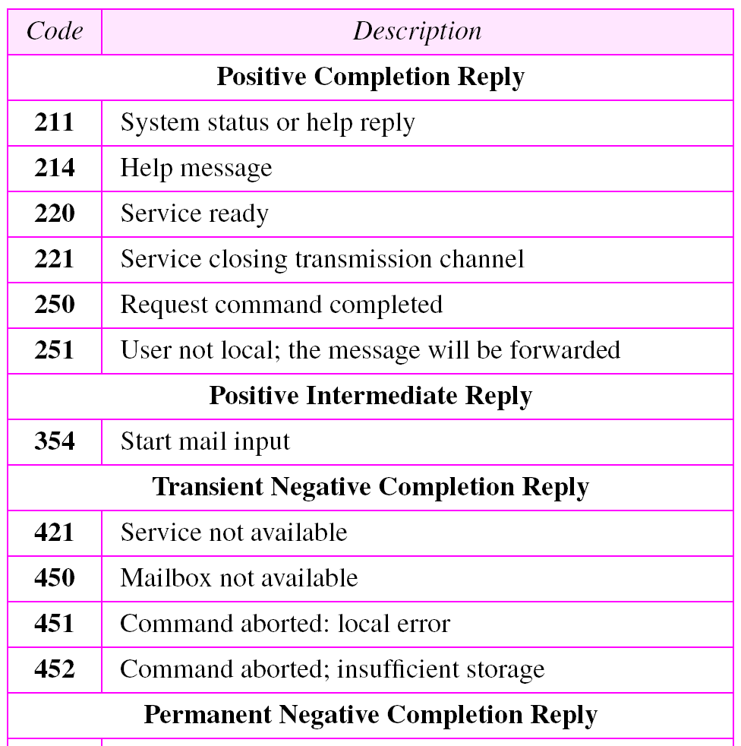
Responses

Slide 25
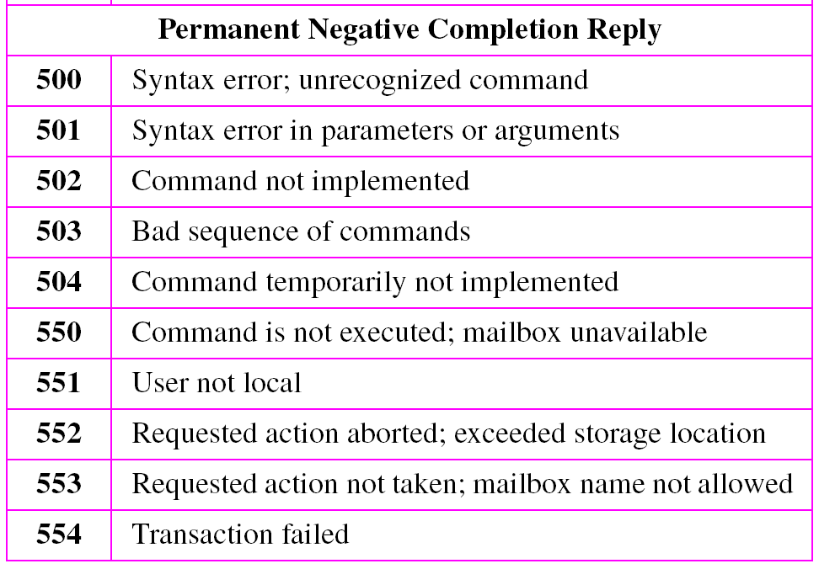
Responses (Continued)

Slide 26
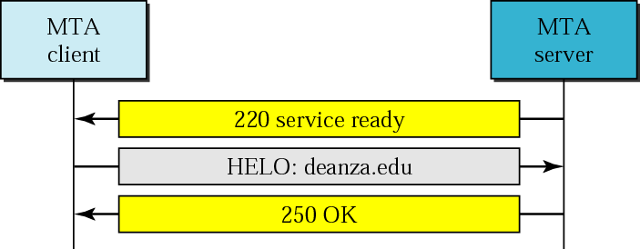
Connection establishment

Slide 27
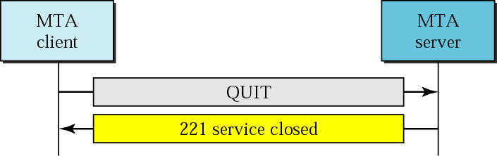
Connection termination

Slide 28
MESSAGE ACCESS AGENT:
POP AND IMAP
The third stage of mail delivery uses a message access agent; the client must pull messages from the server. Currently two message access protocols are available: Post Office Protocol, version 3 (POP3) and Internet Mail Access Protocol, version 4 (IMAP4).

Slide 29
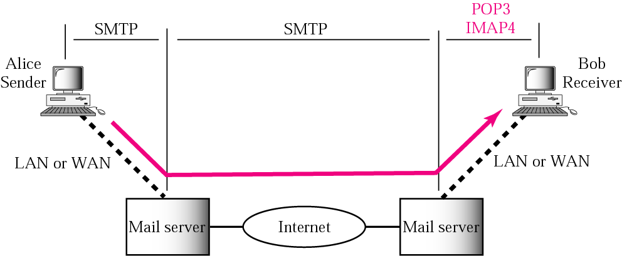
POP3 and IMAP4

Slide 30
WEB-BASED MAIL
Some websites such as Hotmail and Yahoo provide email service to anyone who accesses the site. Mail transfer and retrieval requires the use of HTTP.

