Slide 1
Network Management
SNMP
(Simple Network Management Protocol)

Slide 2
CONCEPT
SNMP defines a manager, usually a host, that controls and monitors a set of agents, usually routers.

Slide 3
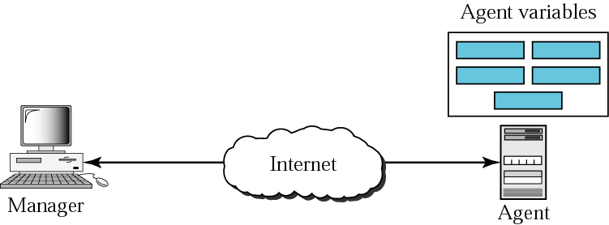
SNMP concept

Slide 4
MANAGEMENT COMPONENTS
SNMP requires the use of two other protocols: Structure of Management Information (SMI) and Management Information Base (MIB). Network management on the Internet is done through the cooperation of SNMP, SMI, and MIB.

Slide 5
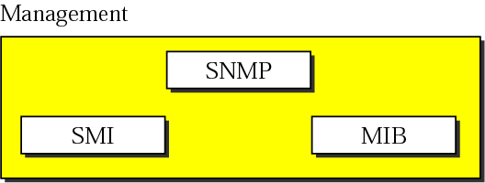
Components of network management on the Internet

Slide 6
SNMP defines the format of packets exchanged between a manager and an agent. It reads and changes the status (values) of objects (variables) in SNMP packets.

Slide 7
SMI defines the general rules for naming objects, defining object types (including range and length), and showing how to encode objects and values. SMI defines neither the number of objects an entity should manage, nor names the objects to be managed nor defines the association between the objects and their values.

Slide 8
MIB creates a collection of named objects, their types, and their relationships to each other in an entity to be managed.

Slide 9
We can compare the task of network management to the task of writing a program.
❏ Both tasks need rules. In network management
this is handled by SMI.
❏ Both tasks need variable declarations. In network
management this is handled by MIB.
❏ Both tasks have actions performed by statements.
In network management this is handled by SNMP.

Slide 10
SMI
SMI is a component used in network management. It names objects, defines the type of data that can be stored in an object, and shows how data can be encoded for transmission over the network

Slide 11
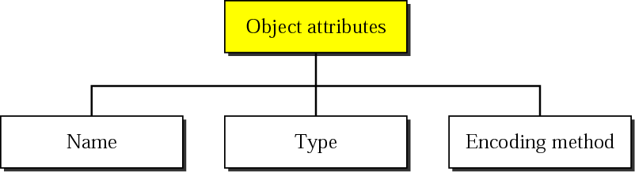
Object attributes

Slide 12
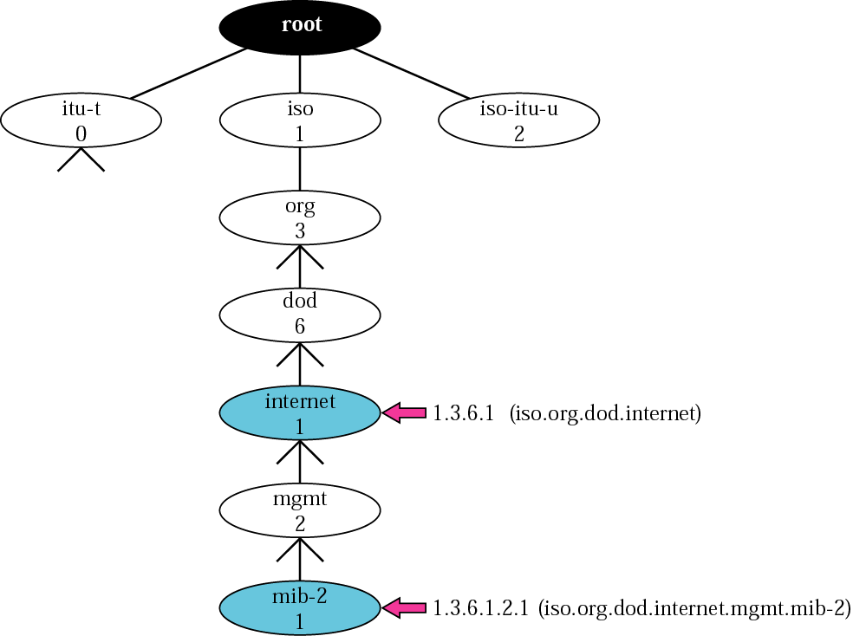
Object identifier

Slide 13
All objects managed by SNMP are given an object identifier. The objects used in SNMP are located under the mib-2 object, so their identifiers always start with 1.3.6.1.2.1

Slide 14
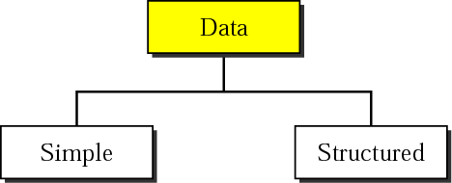
SMI Data type

Slide 15
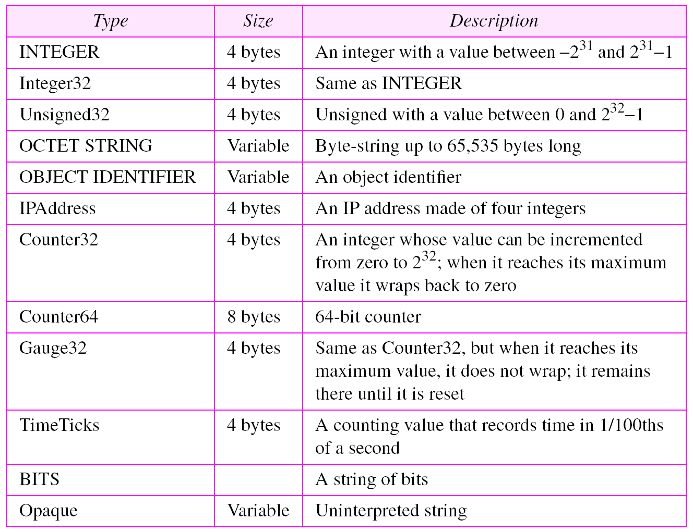
Data types

Slide 16
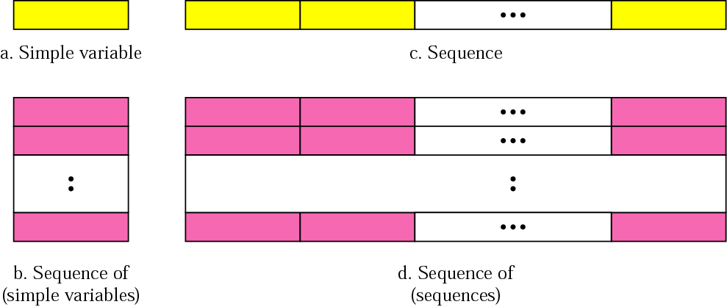
Conceptual data types
SMI defines 2 structured data types : sequence & sequence of
A sequence data type is a combination of simple data types, not necessarily of same type.
A sequence of data type is a combination of simple data types all of the same type.

Slide 17
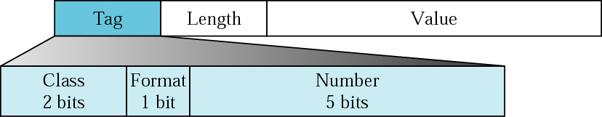
SMI Encoding format

Slide 18
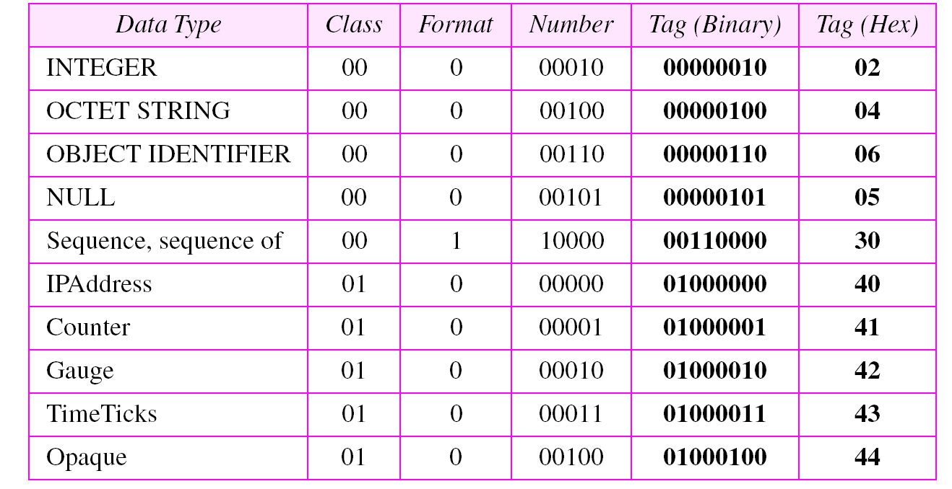
Codes for data types

Slide 19
SNMP
SNMP is an application program that allows
1) a manager to retrieve the value of an object defined in an agent;
2) a manager to store a value in an object defined in an agent; and
3) an agent to send an alarm message about an abnormal situation to the manager

Slide 20
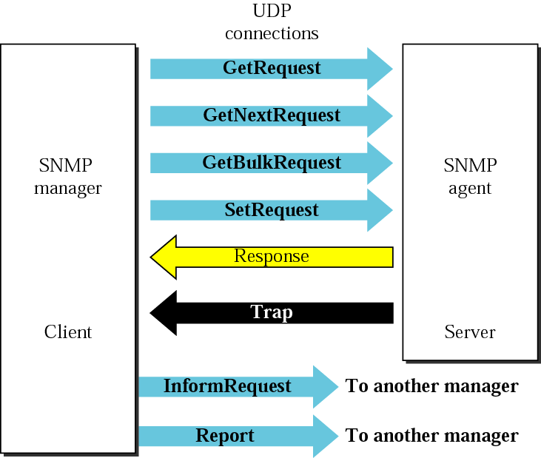
SNMP 8 types of PDUs (Protocol Data Units)

Slide 21
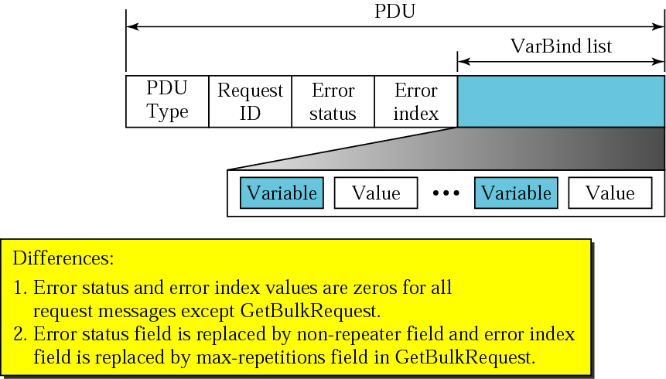
SNMP PDU format

Slide 22
UDP PORTS
SNMP uses the services of UDP on two well-known ports, 161 and 162. The well-known port 161 is used by the server (agent), and the well-known port 162 is used by the client (manager).

