Slide 1
World Wide Web:
HTTP

Slide 2
ARCHITECTURE
The WWW is a distributed client-server service, in which a client using a browser can access a service using a server. The service provided is distributed over many locations called sites.

Slide 3
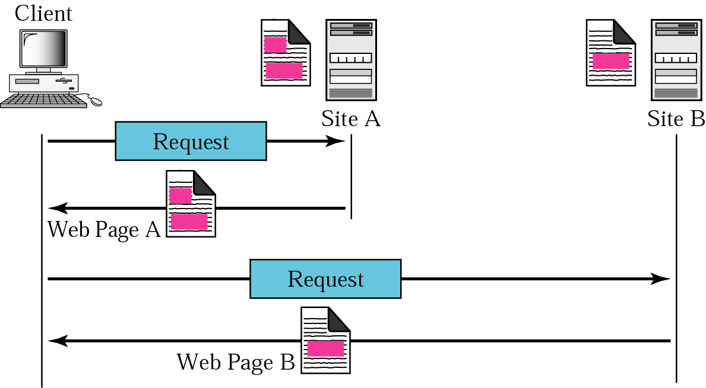
Architecture of WWW

Slide 4
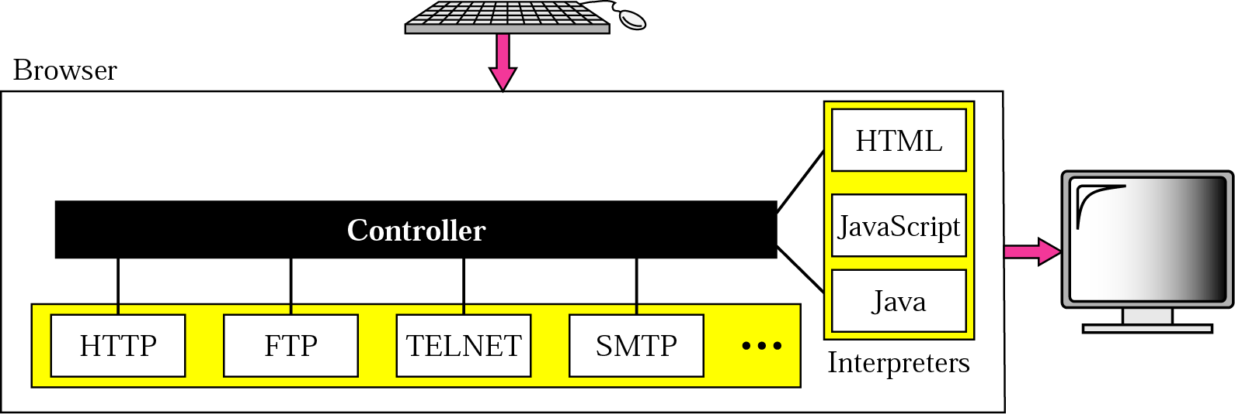
Browser
Browser usually consists of 3 parts:
Controller – receive input from keyboard/mouse and use client
programs to access the document
(b) Client Protocol- to access the document
(c) Interpreters- used to interpret the document

Slide 5
URL

Slide 6
WEB DOCUMENTS
The documents in the WWW can be grouped into three broad categories: static, dynamic, and active. The category is based on the time the contents of the document are determined.

Slide 7
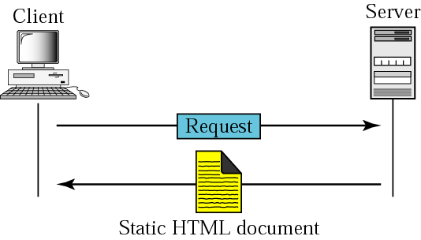
Static document

Slide 8

Boldface tags

Slide 9
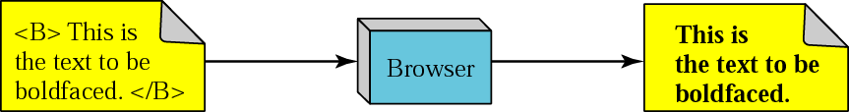
Effect of boldface tags

Slide 10
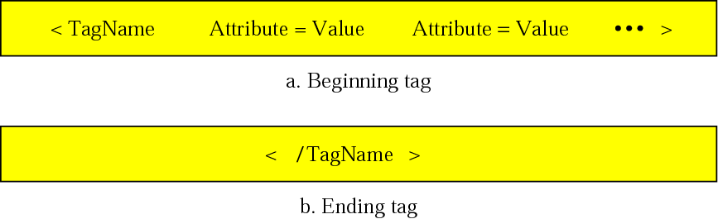
Beginning and ending tags

Slide 11
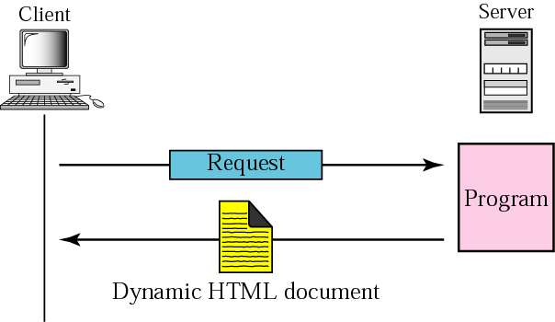
Dynamic document using CGI

Slide 12
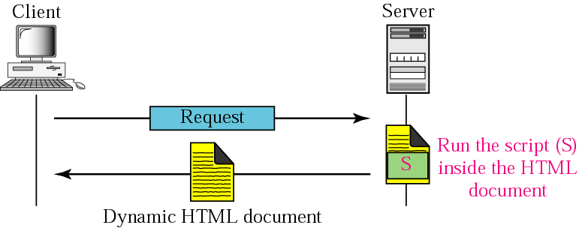
Dynamic document using server-site script

Slide 13
Dynamic documents are sometimes referred to as server-site dynamic documents.

Slide 14
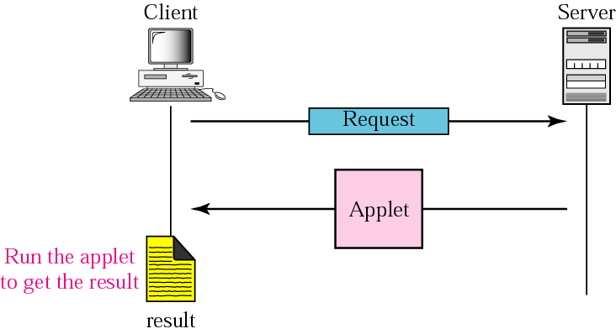
Active document using Java applet

Slide 15
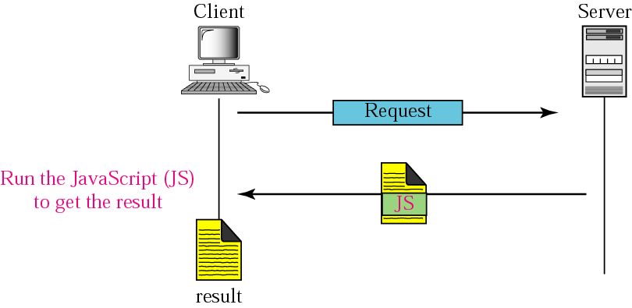
Active document using client-site script

Slide 16
Active documents are sometimes referred to as client-site dynamic documents.

Slide 17
HTTP
The Hypertext Transfer Protocol (HTTP) is a protocol used mainly to access data on the World Wide Web. HTTP functions like a combination of FTP and SMTP.

Slide 18
HTTP uses the services of TCP on well-known port 80.

Slide 19
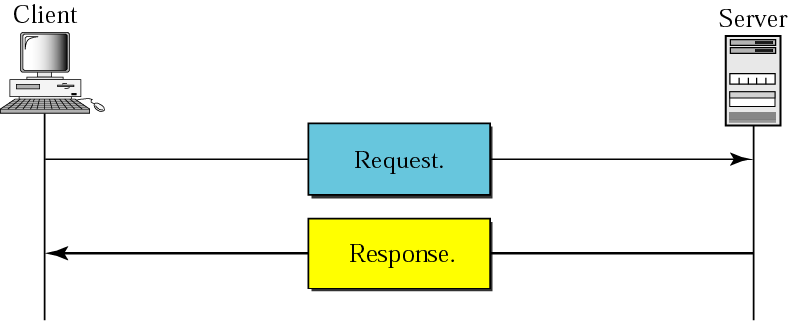
HTTP transaction

Slide 20
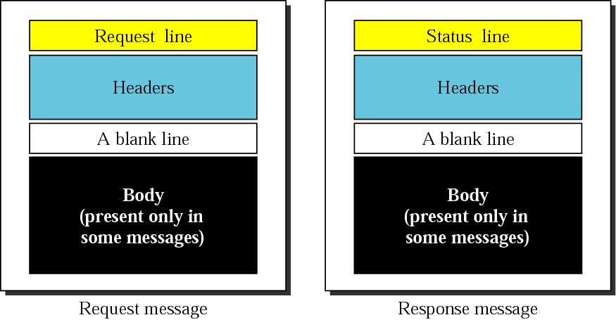
Request and response messages

Slide 21
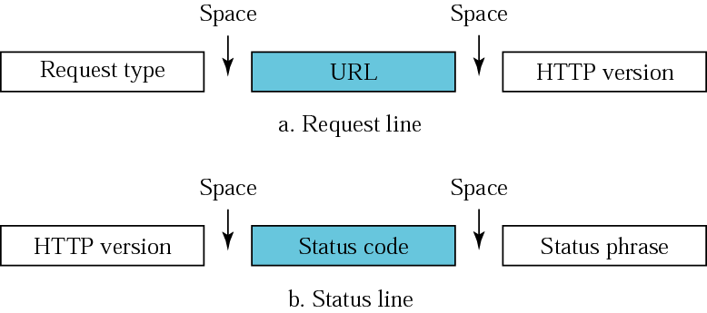
Request and status lines

Slide 22
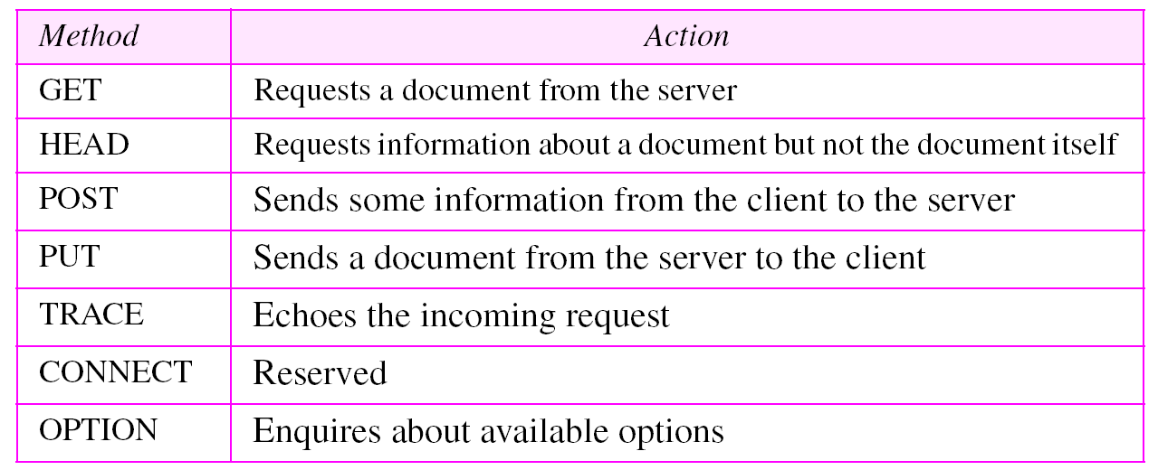
Methods

Slide 23
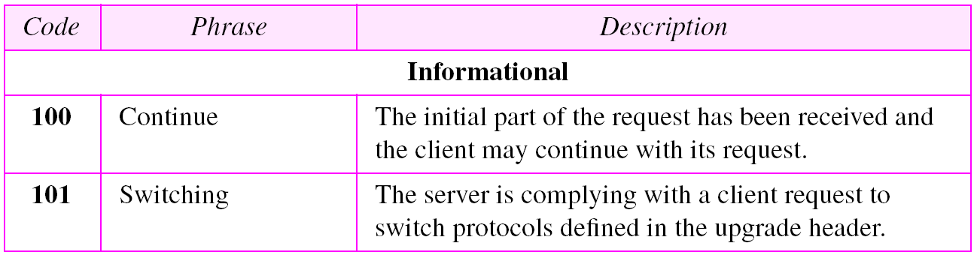
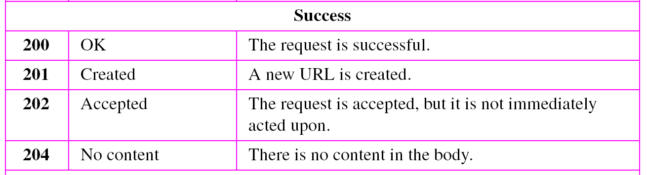
Status codes

Slide 24
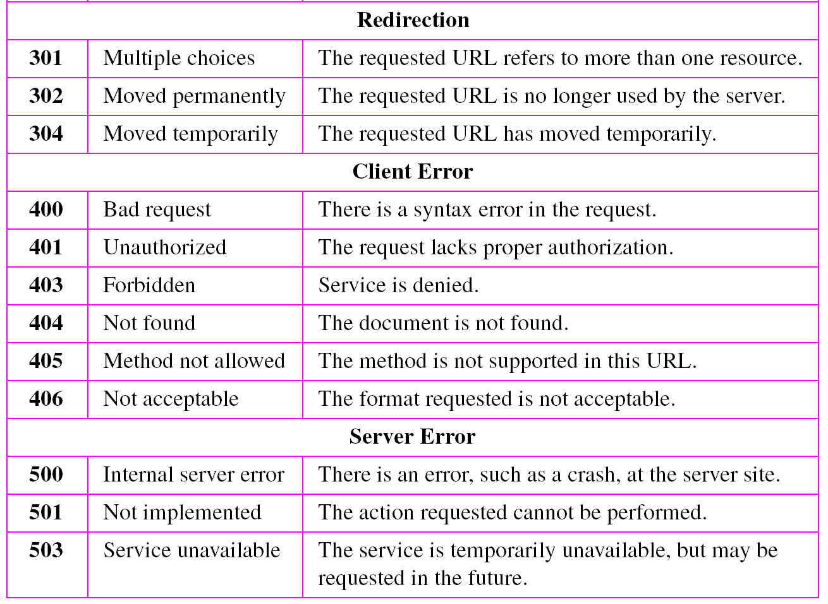
Status codes (continued)

Slide 25
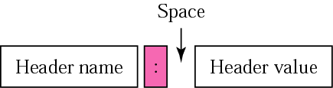
Header format

Slide 26
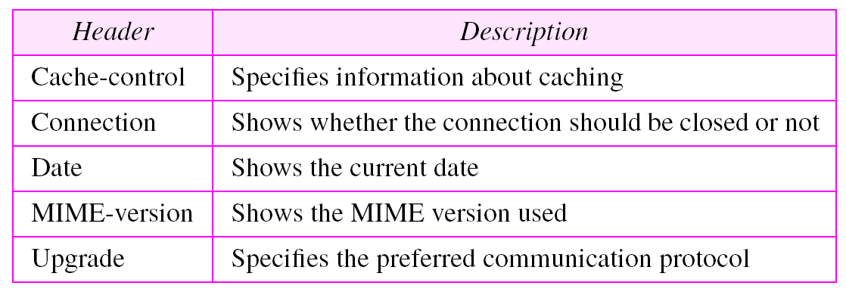
General headers

Slide 27
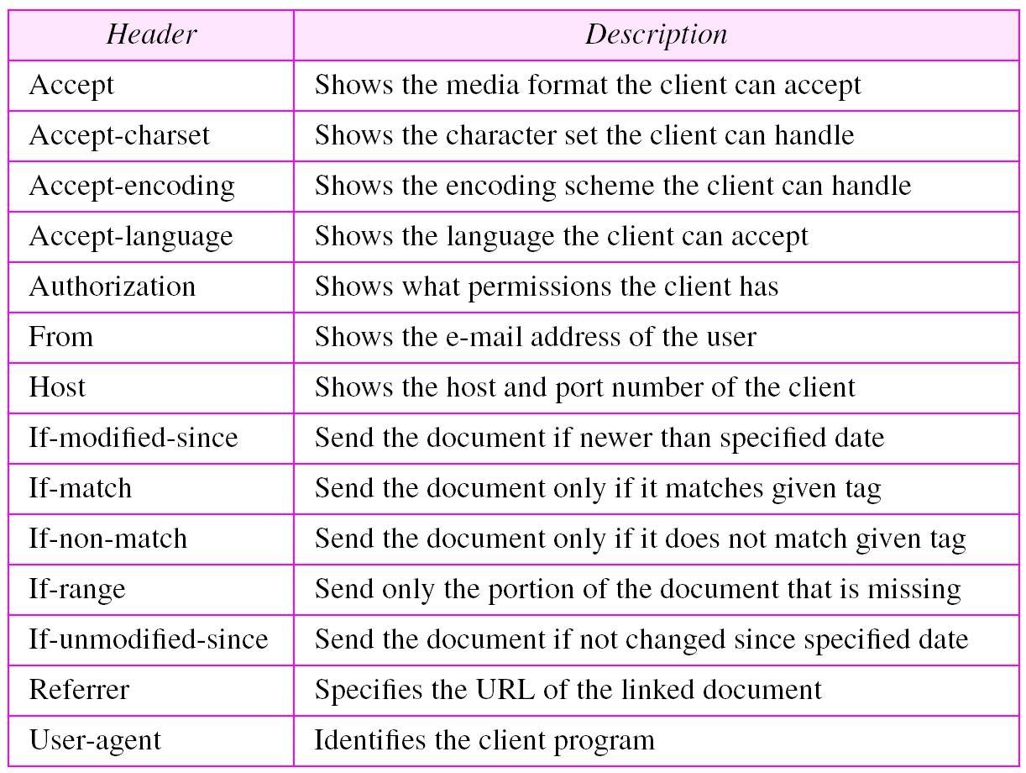
Request headers

Slide 28
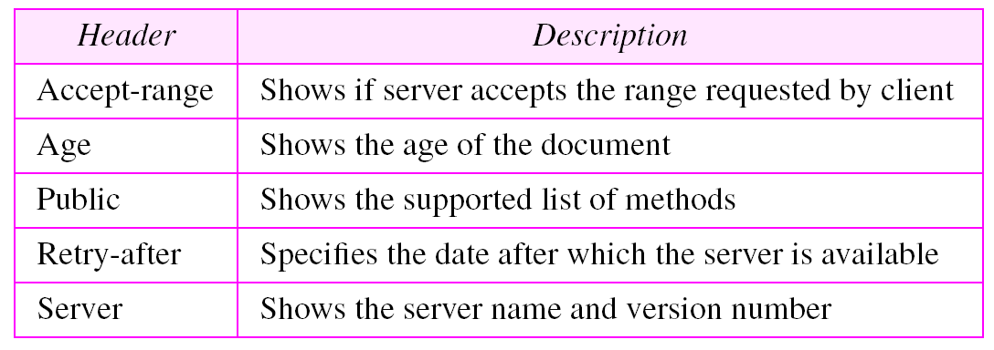
Response headers

Slide 29
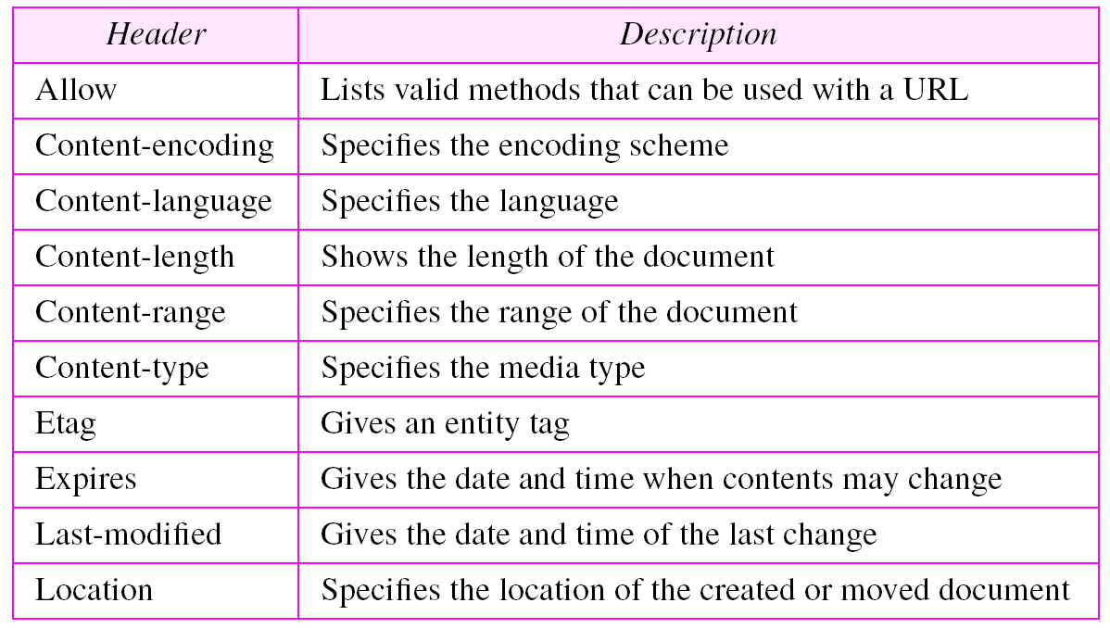
Entity headers

Slide 30
Example 1
This example retrieves a document. We use the GET method to retrieve an image with the path /usr/bin/image1. The request line shows the method (GET), the URL, and the HTTP version (1.1). The header has two lines that show that the client can accept images in the GIF or JPEG format. The request does not have a body. The response message contains the status line
and four lines of header. The header lines define the date, server, MIME version, and length of the document. The body of the document follows the header
See Next Slide

Slide 31
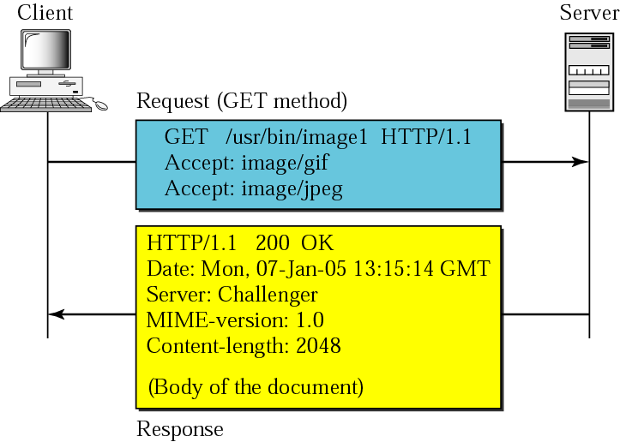
Example 1

Slide 32
HTTP version 1.1 specifies a persistent connection by default.

