Slide 1
IBM University Engagement Project Submission
“Exploring the Power of Agentic AI with IBM Granite and LangFlow”

Slide 2
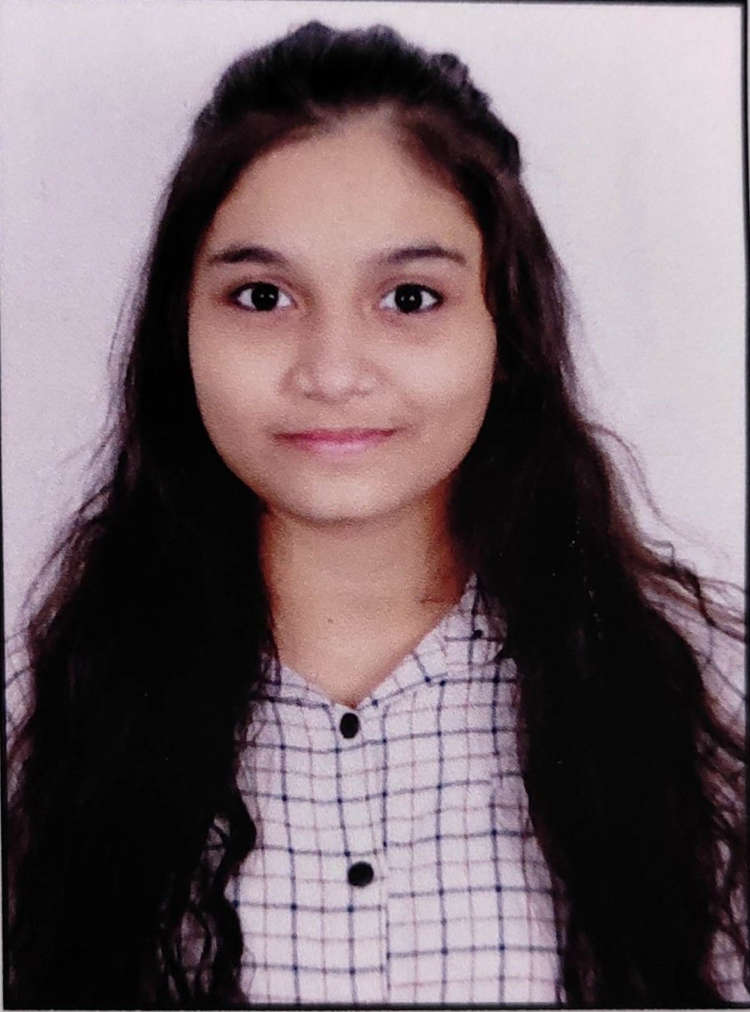
Project Title – Smart Heritage Conservation Platform for Ahmedabad's Walled City & Modhera
Domain of Project – Tourism & Heritage
Student Name | Recent Passport Photo | Email ID | Mobile number [WhatsApp]
Sonar Anjali Shivdas |  | anjalisonar2127@gmail.com | 9725644650

Slide 3
Problem Statement -
Problem Statement : Smart Heritage Conservation Platform
The Challenge
Gujarat's UNESCO heritage sites, including Ahmedabad's Walled City and Modhera Sun Temple, face conservation risks from urban encroachment, weathering, and unmanaged tourist footfall, while digital storytelling for visitors remains largely underutilized, limiting both conservation outcomes and visitor engagement.
The Objective
Build Agentic AI solutions that monitor heritage site structural health, manage visitor flow, and deliver immersive, personalized cultural storytelling experiences for Ahmedabad's Walled City and Modhera Sun Temple. The solution should:
Structural Health Monitoring – Continuously track cracks, vibration, and weathering data from site sensors and imagery to flag deterioration early.
Visitor Flow Management – Analyze real-time footfall and crowd density to optimize visitor routes and prevent overcrowding at sensitive zones.
Personalized Heritage Storytelling – Deliver immersive, multilingual cultural narratives tailored to each visitor's interests.
Encroachment Detection – Use satellite and drone imagery analysis to flag unauthorized construction near protected heritage zones.
Multi-Agent System –
Structural Health Monitoring Agent (monitors site conditions)
Visitor Flow Management Agent (crowd & footfall optimization)
Personalized Heritage Storytelling Agent (immersive visitor experiences)
Encroachment Detection Agent (flags unauthorized activity)
Conservation Reporting Dashboard Agent – Show structural health, footfall trends, and encroachment alerts to conservation authorities.

Slide 4
Proposed Solution -
Proposed Solution: Smart Heritage Conservation Platform
The proposed solution is a multi-agent Agentic AI platform for heritage conservation and visitor experience built using LangFlow, IBM Bob, IBM Granite LLM, and IBM Cloud to protect Ahmedabad's Walled City and the Modhera Sun Temple while enriching the visitor experience through an intelligent, modular architecture.
At its core, the solution uses a Retrieval-Augmented Generation (RAG) pipeline to fetch verified heritage, conservation, and historical data from trusted sources such as ASI records, Gujarat Tourism archives, and site survey reports. This data is embedded and stored in a vector database, enabling the system to retrieve and summarize structural health readings, footfall statistics, and cultural context using IBM Granite models.
The system consists of five key agents:
Structural Health Monitoring Agent continuously analyzes sensor and imagery data to detect early signs of structural stress, cracks, or weathering.
Visitor Flow Management Agent tracks real-time footfall and crowd density to recommend optimal visiting routes and prevent overcrowding.
Personalized Heritage Storytelling Agent delivers immersive, multilingual narratives and cultural context tailored to each visitor's interests.
Encroachment Detection Agent analyzes satellite and drone imagery to flag unauthorized construction near protected heritage zones.
The solution also includes a Conservation Reporting Dashboard Agent (built with Streamlit or React) that consolidates structural health alerts, visitor flow trends, and encroachment reports for conservation authorities and site managers.
LangFlow is used to orchestrate agent workflows, IBM Bob supports development and testing, IBM Cloud ensures scalable and secure deployment, and IBM Granite LLM powers reasoning, summarization, and personalization across all agents.
Overall, this solution delivers an end-to-end intelligent heritage conservation and visitor engagement platform that safeguards Gujarat's UNESCO sites while creating richer, safer, and more personalized experiences for every visitor.

Slide 5
Technology Used
Langflow platform - For visually designing and orchestrating the five-agent heritage conservation and visitor-experience workflow
IBM Granite model - for eg – granite-3-2-8b – For natural language understanding, structural report summarization, and personalized heritage storytelling
IBM Cloud – It provides the infrastructure to build, deploy, and scale the Heritage Conservation Platform. IBM Cloud enables a reliable, secure, and scalable environment for deployment.
RAG– RAG to fetch real conservation and heritage data first, then generate intelligent answers, making the platform more trustworthy and accurate.
IBM Bob - IBM's AI-assisted development platform used to build, test, and troubleshoot the agent workflows
Vector Database (FAISS/Chroma) – For RAG-based retrieval of heritage records, conservation reports, and structural sensor data

Slide 6
Langflow component Used -
1) Chat Input – Interface where visitors or conservation staff enter queries, structural reports, or storytelling requests (text/voice/image).
2) IBM watsonx AI Agent - Processes input using Granite models to generate structural health insights, visitor flow recommendations, or personalized heritage narratives.
3) Name of IBM Granite model - Granite-4.0-8B-Instruct → Efficient for real-time structural alerts and storytelling generation
4) Chat output -Displays AI-generated responses such as structural health alerts, visitor flow recommendations, and heritage stories.
5) File component - Stores and retrieves sensor readings, drone/satellite imagery metadata, and heritage archive documents for analysis and tracking.
6) Vector Store component - Stores embeddings of heritage records and conservation reports for RAG-based retrieval.

Slide 7
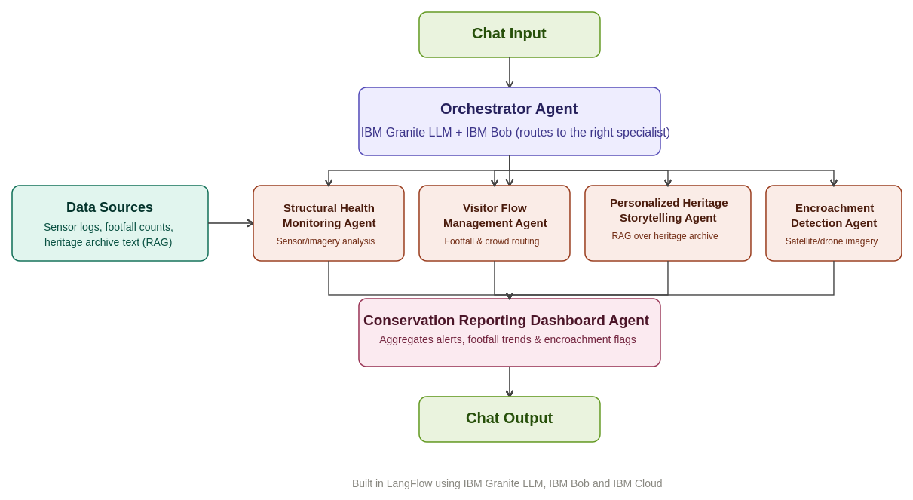
Langflow workflow -

Slide 8
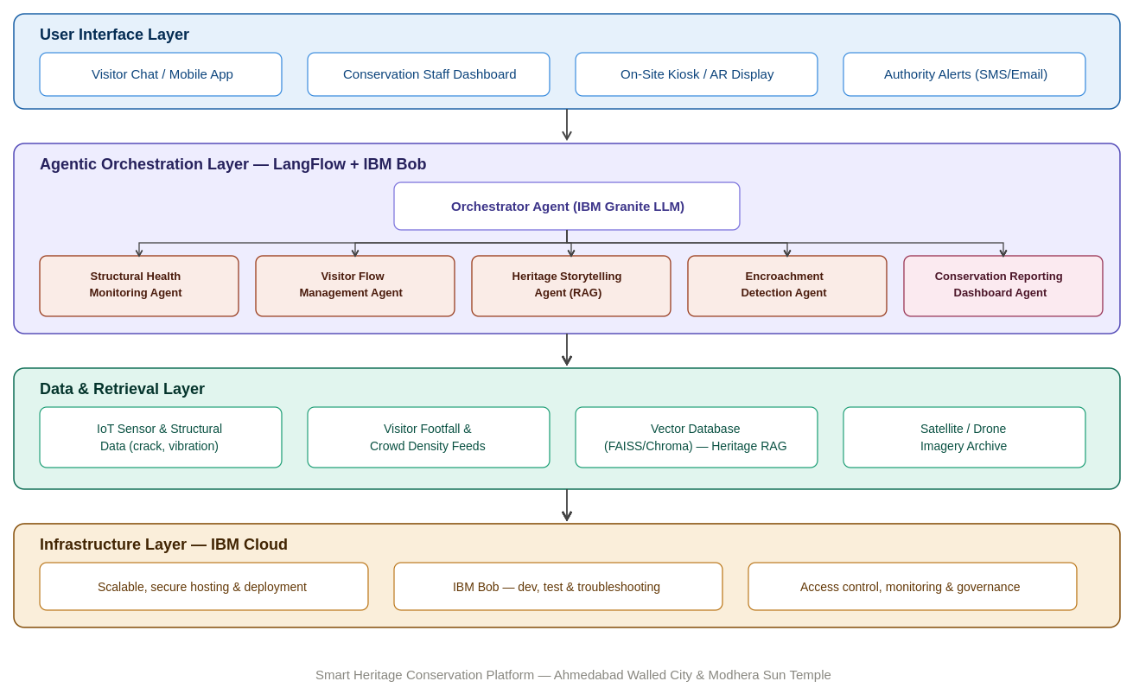
Architecture blueprint

Slide 9

Role of Agentic AI in the solution
Role of Agentic AI in the Heritage Conservation Platform
Agentic AI enables the platform to function as an intelligent, autonomous system rather than a simple monitoring tool. Using IBM Bob and IBM Granite models, it coordinates multiple specialized agents to protect heritage sites and guide visitors.
Each agent performs a specific role—such as monitoring structural health, managing visitor flow, detecting encroachment, and generating cultural narratives—while working collaboratively. This multi-agent approach ensures efficient task execution and accurate, timely conservation decisions.
Agentic AI also brings context awareness, understanding site conditions, footfall patterns, and visitor profiles to generate tailored alerts and recommendations. It supports real-time adaptation, continuously updating structural risk assessments and visitor guidance as new sensor and footfall data arrives.
Additionally, agents communicate with each other, enabling better decision-making and improved outcomes.
Overall, Agentic AI makes the system proactive, protective, and visitor-focused, acting like a smart digital conservation guardian and cultural guide that helps preserve Gujarat's UNESCO heritage for future generations.

Slide 10
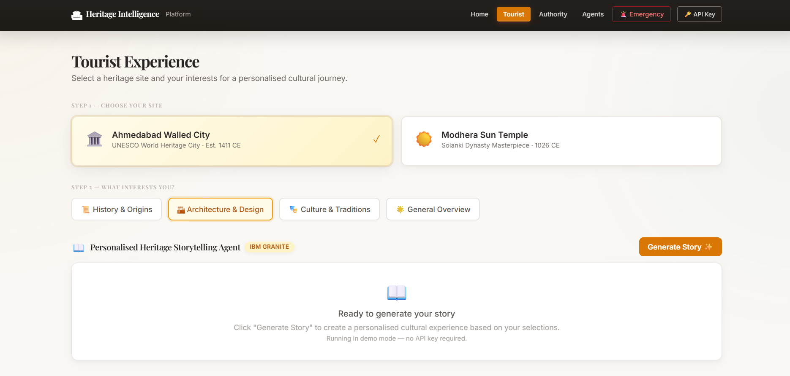
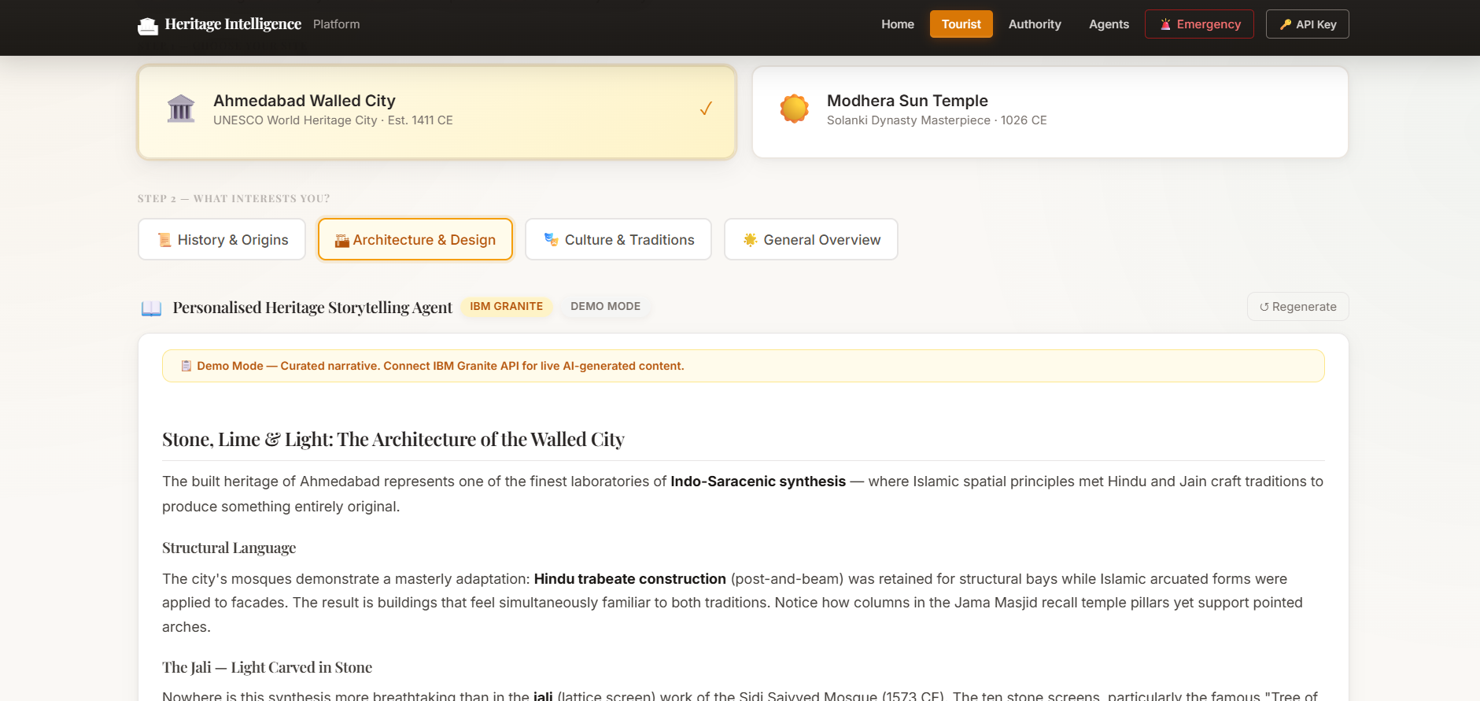
Token Usage
[Insert total tokens used from your LangFlow run]
Before Prompt
After the Prompt
·
·
·

Slide 11
Novelty and Uniqueness
The proposed Heritage Conservation Platform stands out by combining Agentic AI, real-time monitoring, and immersive personalization into a single intelligent system.
Multi-Agent Intelligence – Instead of a single monitoring tool, five specialized agents collaborate to protect heritage sites and guide visitors.
RAG-Based Accuracy – Integrates real-time structural, footfall, and archival data retrieval with AI generation, reducing misinformation and ensuring trustworthy conservation alerts.
Hyper-Personalization – Tailors heritage storytelling based on visitor interests, language, and cultural background.
Real-Time Feedback Loop – Continuously adapts visitor routing and structural risk alerts based on live sensor and footfall data.
Multi-Modal Input – Supports text, voice, image, and sensor-data inputs for comprehensive site monitoring and visitor interaction.
Preventive Conservation Focus – Goes beyond monitoring to flag early-stage structural risks and unauthorized encroachment before damage occurs.
Scalable & Enterprise-Ready – Built on IBM Cloud with IBM Bob and IBM Granite models, ensuring reliability and governance.
This makes the solution a smart, adaptive, and proactive digital conservation guardian, not just a static monitoring tool.

Slide 12
Git Hub Link
https://github.com/YashBadgujar15/Heritage-Intelligence-Platform
Project Link (Website)
https://yashbadgujar15.github.io/Heritage-Intelligence-Platform/
·
·
·

Slide 13
Future Scope
1. Integration with IoT Sensors & Drone Surveillance –
The system can be integrated with IoT-based structural sensors, weather stations, and drone-based aerial surveys to collect continuous real-time data on cracks, vibration, moisture, and encroachment. This will enable the platform to provide earlier warnings and more precise conservation recommendations.
2.AR/VR-Based Immersive Storytelling & Multilingual Support –
Enhancing the storytelling agent with AR/VR experiences and support for multiple languages will let visitors virtually reconstruct historical scenes and interact naturally in their preferred language, making heritage exploration more immersive and accessible to domestic and international tourists alike.
·
·
·

Slide 14
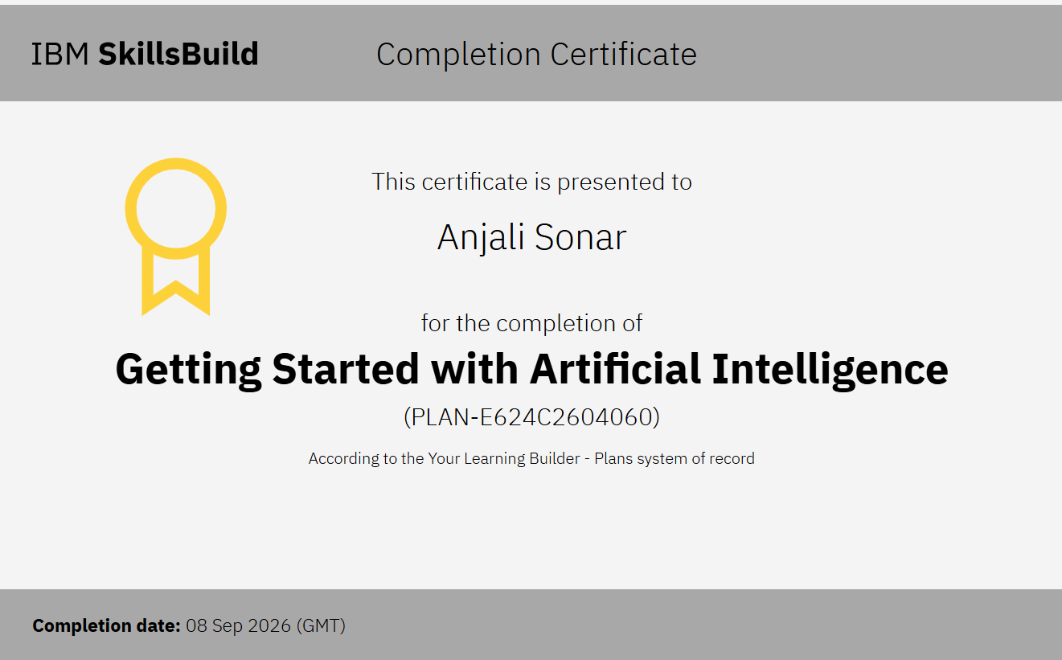
Certificates Earned:

Slide 15
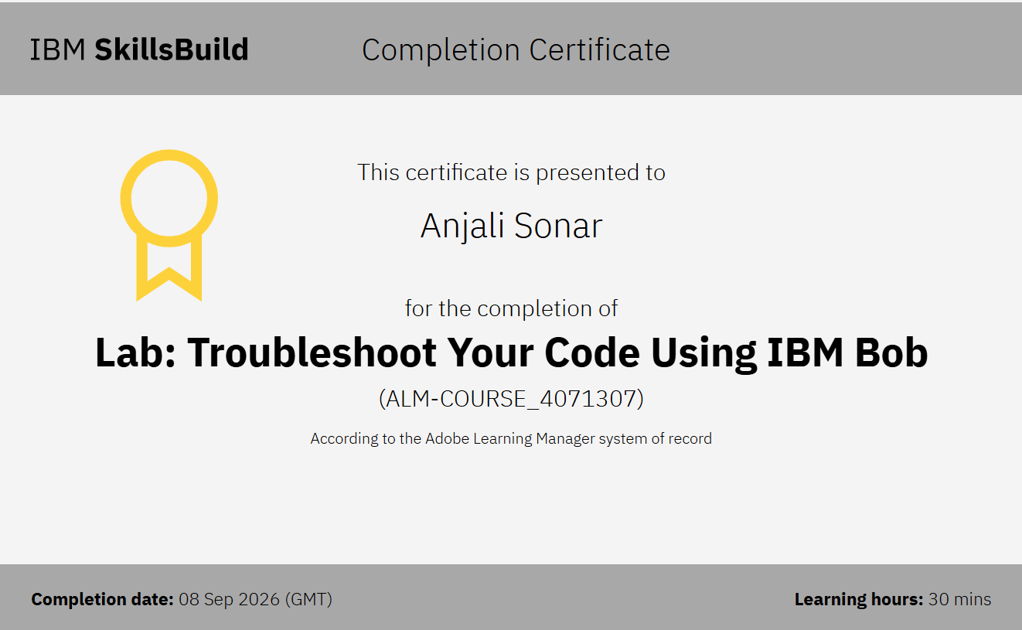
Certificates Earned:​

Slide 16


