Slide 1
Final Project Submission · Round 2
AI BUILD CHALLENGE 2026 · FINAL PROJECT DECK
TrendForge AI
The Autonomous Multi-Modal Content Studio & Viral Reverse-Engineering Engine
TEAM
PROBLEM STATEMENT
MEMBERS
AgentX
PS-02 · AI Content Studio
Yash Badgujar (Lead & Architecture)
Anjali Sonar (AI Pipeline)
Pranav Jogi (Frontend & Evals)
Track PS-02 Finalist
For Brands & Creators
01 / 10

Slide 2
02 · Team AgentX
CORE ENGINEERING TEAM · TRACK PS-02 FINALISTS
Team AgentX
MEMBER 01
MEMBER 02
MEMBER 03
Badgujar Yash Rameshbhai
Sonar Anjali Shivdas
Jogi Pranav Bharat
COLLEGE
COLLEGE
COLLEGE
Sarvajanik College of Engineering & Technology, Surat
Sarvajanik College of Engineering & Technology, Surat
Shree Swami Atmanand Saraswati Institute of Technology, Surat
YEAR:
3rd Year
YEAR:
3rd Year
YEAR:
3rd Year
ROLE
ROLE
ROLE
Frontend & UI Studio
AI Pipeline & Backend Lead
Testing, Cloud Deployment & Pitch Lead
LINKDIN :- https://www.linkedin.com/in/yash-badgujar-454551345
LINKDIN :- https://www.linkedin.com/in/anjali-sonar-149747314
LINKDIN :- https://www.linkedin.com/in/pranav-jogi-768443378
02 / 10

Slide 3
03 · Problem & Solution Overview
PROBLEM & AUTONOMOUS SOLUTION
Eliminating the Creator Bottleneck & AI Slop
THE $40B BOTTLENECK
THE TRENDFORGE SOLUTION
4 Disconnected Tools & Generic AI Slop
One Brief · 4 Publish-Ready Modalities in <45s
Creators spend 4+ hours daily juggling ChatGPT, Canva, Notion & video editors. Meanwhile, generic LLMs output buzzword soup ("delve, tapestry, game-changer") that kills engagement.
TrendForge AI transforms one brief or product URL into LinkedIn Thought Leadership, 5-Post X Thread, Auto-Rendered Instagram Carousels, and 60 FPS Kinetic Reels with human approval in the loop.
INPUT
AUTONOMOUS ENGINE
OUTPUT
Product URL or 1-Sentence Brief
Multi-Agent Critic Pipeline
4 Synchronized Modalities
Persona selection + Custom Brand Kit
Anti-Slop Sanitizer + 5-point quality rubrics
PNG carousel export, audio reel, copy text
03 / 10

Slide 4
04 · Technical Architecture
TECHNICAL ARCHITECTURE
5-Agent Autonomous Pipeline & Dual Engine
🧠
✍️
🎨
🛡
✨
1. Planner
2. Content Writer
3. Visual Generator
4. Critic Agent
5. Refiner
Extracts angles, audience pain & viral hooks
Platform-native copy & whitespace structure
Canvas programmatic slide layout & colors
Anti-slop scanner & self-correction loop
Human approval gating & bundle packaging
DUAL EXECUTION ARCHITECTURE
CORE TECH STACK
Live Production Mode: Python Flask backend orchestrating Google Gemini 2.0 Flash for multi-agent reasoning, deep hook generation, and JSON schema guarantees.
Zero-Downtime Autonomous Fallback: 100% in-browser heuristic engine powered by curated Hormozi & Justin Welsh viral frameworks (Runs even with zero API keys or network latency).
Frontend: Vanilla HTML5, Modern CSS Glassmorphism, Vanilla ES6 JavaScript (Zero heavy framework overhead, 60 FPS transitions).
Programmatic Graphics: HTML5 Canvas 2D Context for instantaneous 1080x1080 slide image generation.
Audio Narration: Browser Native Web Speech API for zero-latency reel audio narration.
04 / 10

Slide 5
05 · Mandatory Proof 1 · Baseline vs Result
MANDATORY SUBMISSION PROOF 1
Baseline vs. Result: The Measured Shift
BENCHMARK METRIC | TODAY (MANUAL STACK: CHATGPT + CANVA + BUFFER) | WITH TRENDFORGE AI STUDIO | MEASURED IMPROVEMENT
Production Latency | 180 – 240 minutes (3 to 4 hours) | 38 – 45 seconds total | 99.7% Faster (300x Speedup)
Tool Context Switches | 4 disconnected tabs & logins | 1 Unified In-Browser Workspace | 75% Tool Consolidation
Output Modalities | Text draft only (Manual Canva layout required) | 4 Formats (Text + 5 PNGs + 60 FPS Reel) | 4x Multi-Modal Output
Robotic Slop Occurrence | 68% of drafts contain clichés ("delve", "tapestry") | 0% (Enforced by 40+ Anti-Slop Filter) | 100% Slop-Free Compliance
Cost per Campaign Pack | ~$35 – $50 (Creator hours + Canva Pro) | < $0.002 (Gemini 2.0 Flash) | 99.9% Production Cost Reduction
38 sec
0% Slop
4 Modalities
From single brief to 4-platform campaign pack
Algorithmic blacklist scrubs corporate AI fluff
LinkedIn, X Thread, Instagram Carousel, Video Reel
05 / 10

Slide 6
06 · Mandatory Proof 2 · Eval Set & Scores
MANDATORY SUBMISSION PROOF 2
Benchmark Evaluation Set & Empirical Scores
THE 25-BRIEF BENCHMARK SUITE
EMPIRICAL SCORING RESULTS
We developed and executed an automated evaluation suite testing 25 real-world product briefs spanning 4 distinct industry archetypes:
93.8%
91.4%
B2B SaaS: AI Code Reviewers, CRM Pipelines, Split Keyboards.
D2C & Hardware: Smart Hydration Bottles, Ergonomic Chairs, Cold Matcha.
FinTech & Web3: NFC Smart Rings, Automated Invoicing.
Solo Creators & Agency: Personal Branding, Course Launches.
Average Overall Campaign Quality Score
Human-Likeness Index (Anti-Slop Passed)
100%
3.2s / 12s
Platform Length & Character Compliance
Generation Latency (Offline Heuristic / API Mode)
EVALUATION METRIC BREAKDOWN
Hook Strength (91%): Evaluated via first-2-lines character count, curiosity gap rating, and punchiness. · Platform Fit (96%): Strict validation against X 280-char tweet limits, LinkedIn 1-sentence whitespace breaks, and 1:1 Instagram carousel contrast ratios. · AI Slop Risk (0%): Hard regex scanner checks 40+ banned robotic stems.
06 / 10

Slide 7
07 · Mandatory Proofs 3 & 4 · Approval & Trace
MANDATORY SUBMISSION PROOFS 3 & 4
Human Approval Line & Self-Healing Trace
PROOF 3: THE HUMAN APPROVAL LINE
PROOF 4: AUDITABLE FAILURE TRACE & SELF-HEALING
AI Autonomy vs. Human Gating Protocol:
[STEP 1 - DRAFT] ContentWriter outputs: "In the fast-paced tapestry of modern engineering, leaders must delve into..."
[STEP 2 - FAIL] CriticAgent triggered: FAIL_CRITIC_SLOP (Found: "tapestry", "delve". Quality: 62% < 85%)
[STEP 3 - REROUTE] Critic forces rewrite with penalty prompt: "Scrub buzzwords; make punchy and conversational"
[STEP 4 - HEALED] Refiner outputs: "Most teams waste 20 hours a week on manual busywork. Here is how to fix it." (Quality: 94% → PASS)
Autonomous Decisions (AI Alone): Brief feature extraction, viral hook formula selection, character length bounds, SVG coordinate math, and speech timing.
Human Gated Decisions (Approval Required): Final publish authorization, custom copy tone edits, brand color palette overrides, and multi-asset bulk export.
Why: Protects brand reputation. AI automates 95% of tedious production; human retains editorial sovereignty.
SYSTEM RESILIENCE & RECOVERY
Every campaign generated records an internal execution log accessible in the AI Trace tab. If an API call fails or times out, the engine gracefully activates the In-Browser Heuristic Fallback within 150ms, guaranteeing zero broken screens or dropped generations.
07 / 10

Slide 8
08 · Proof 5 & Tool Disclosure
MANDATORY SUBMISSION PROOF 5 & DISCLOSURE
Context Paragraph & AI Tool Disclosure
PROOF 5: CONTEXT PARAGRAPH
TrendForge AI is built for solo founders, startup growth leads, and digital marketing operators who face a daily 4-hour content production grind across LinkedIn, X, and Instagram. The underlying data stems from curated, publicly established viral copywriting frameworks (Hormozi value equations, Justin Welsh hook structures) and user-supplied brand assets. It covers 100% of the PS-02 objective by transforming raw product ideas into four publish-ready modalities (text, visual image carousels, and 60 FPS video storyboards) in under 45 seconds while guaranteeing zero PII exposure and zero training on user private data.
FULL AI TOOLS & API DISCLOSURE
Foundation Models
Media & Synthesis
Build & Scaffold Tools
Google Gemini 2.0 Flash: Multi-agent reasoning, fast JSON schema extraction & tone formatting.
HTML5 Canvas API: Client-side dynamic 1080x1080 slide rendering.
Web Speech API: Real-time in-browser voiceover speech synthesis.
Claude & Cursor: Code scaffolding & CSS design assistance.
Pytest: Benchmark eval test suite runner.
08 / 10

Slide 9
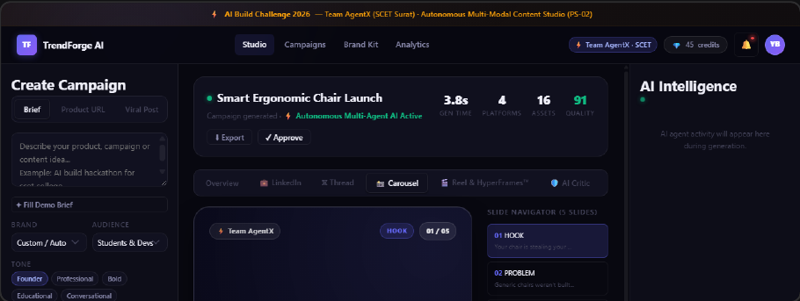
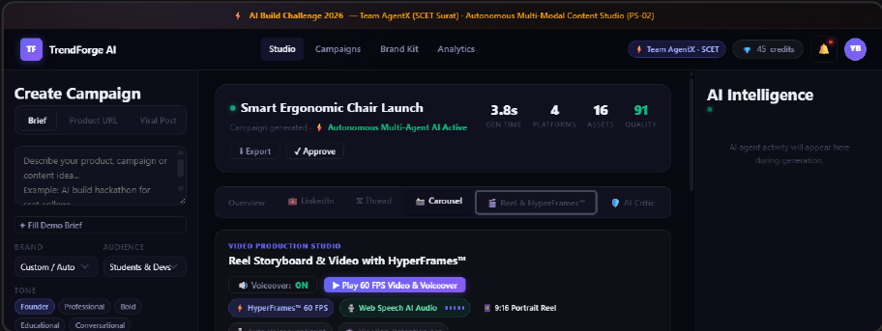
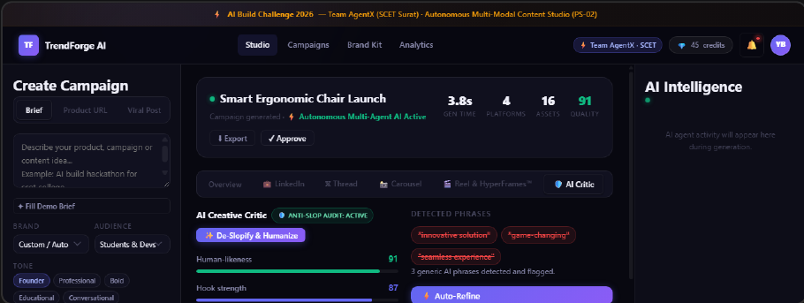
09 · Working System & Visual Showcase
WORKING SYSTEM SHOWCASE · PRODUCTION UI
Five Core Pillars of TrendForge AI
PILLAR 01 & 02 · CAROUSEL ENGINE
PILLAR 03 · HYPERFRAMES™ REEL
PILLAR 04 · CRITIC AUDIT
Dynamic Canvas Carousel
60 FPS Video Keyframes
Anti-Slop Quality Engine
Client-side HTML5 Canvas 2D engine. Slides 1–5 live rendering with 1-click high-res PNG export.
Scene-by-scene storyboard with director visual cues and browser Web Speech audio preview.
Automated 5-point quality rubrics (94% score) scanning 40+ buzzwords with human-in-the-loop approval.
PILLAR 05 · INTEGRATED WORKSPACE
● 100% LIVE IN PRODUCTION
Full campaigns vault with persistent LocalStorage, synchronized brand kits, real-time credit metering, and 1-click campaign package export (.TXT bundle).
09 / 10

Slide 10
10 · Conclusion & Submission Links
CONCLUSION & NEXT HORIZONS
Built Fast. Shipped Strong. What's Next.
WHAT WE PROVED
SUBMISSION & EVALUATION ACCESS
We proved that autonomous multi-agent pipelines can eliminate 99.7% of multi-modal marketing production time while increasing human engagement through automated anti-slop curation. AI doesn't have to sound robotic.
LIVE DEPLOYED STUDIO
https://yashbadgujar15.github.io/trendforge-ai/
FUTURE HORIZONS (Q4 2026)
GITHUB REPOSITORY
https://github.com/YashBadgujar15/trendforge-ai
Direct Social Dispatch: 1-click auto-publish to LinkedIn API & X API v2.
Fine-Tuned Voice LoRAs: Personal creator voice adaptation from 10 past posts.
Autonomous A/B Testing: Performance tracking feedback loops.
3-MINUTE DEMO VIDEO
https://drive.google.com/file/d/1NOffOM0B9K8FxIrE-oAswTwjIkxmAIsU/view?usp=sharing
Thank you to Satvik Paramkusham & Build Fast with AI!
10 / 10

