Slide 1
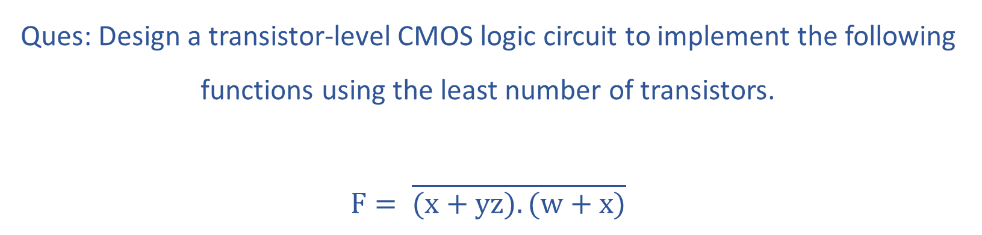
Ques: Design a transistor-level CMOS logic circuit to implement the following functions using the least number of transistors.
$$F= \overline{(x+yz).(w+x)}$$

Slide 2

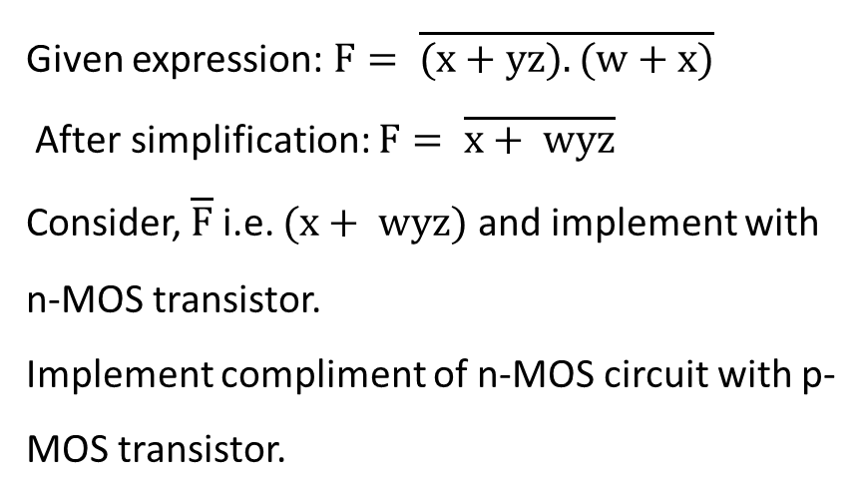

$${+V}_{DD}$$
Given expression: $F= \overline{(x+yz).(w+x)}$
After simplification: $F= \overline{x+ wyz}$
Consider, $\overline{F}$ i.e. $(x+ wyz)$ and implement with n-MOS transistor.
Implement compliment of n-MOS circuit with p-MOS transistor.
w
y
z
x
$$F= \overline{x+ wyz}$$
w
x
y
z

Slide 3
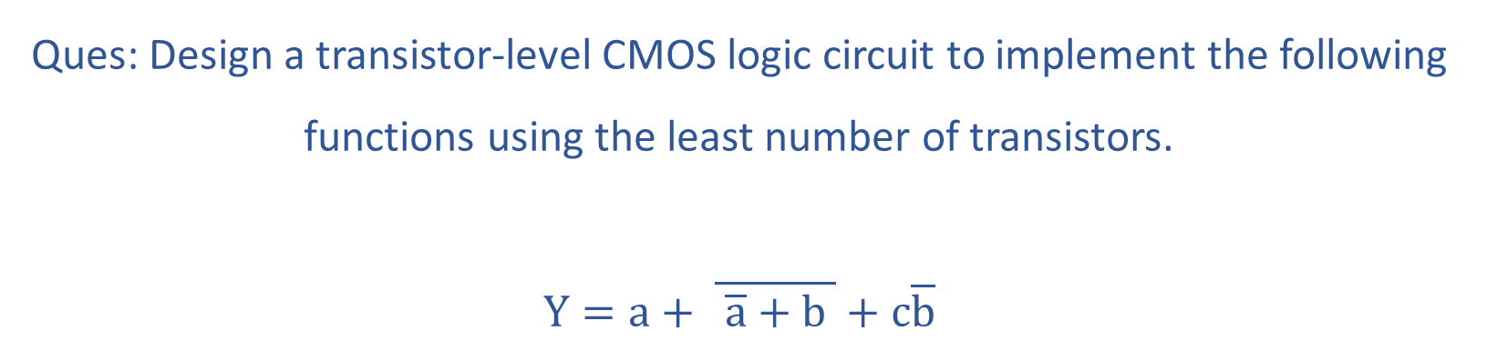
Ques: Design a transistor-level CMOS logic circuit to implement the following functions using the least number of transistors.
$$Y=a+ \overline{ \overline{a}+b }+c\overline{b}$$

Slide 4



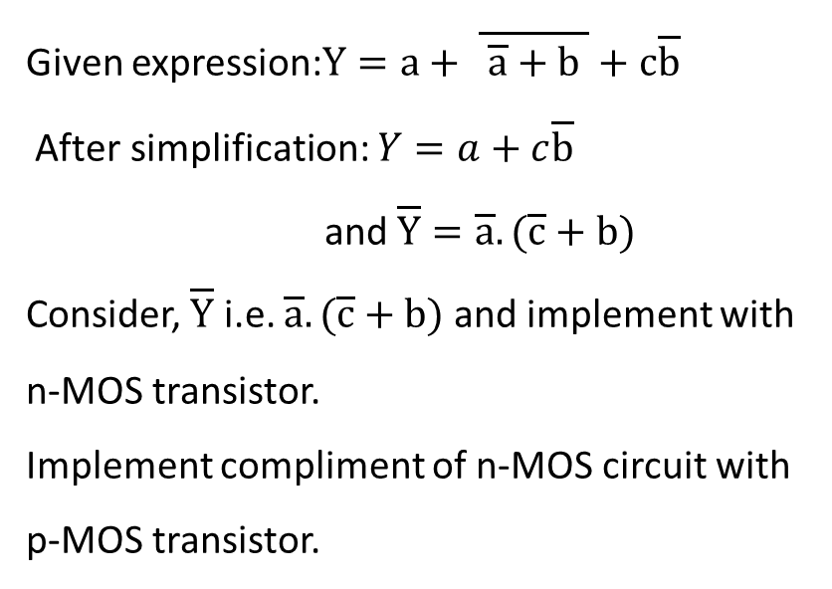



$${+V}_{DD}$$
Given expression:$Y=a+ \overline{ \overline{a}+b }+c\overline{b}$
After simplification: $Y=a+c\overline{b}$
and $\overline{Y}=\overline{a}. (\overline{c}+b)$
Consider, $\overline{Y}$ i.e. $\overline{a}. (\overline{c}+b)$ and implement with n-MOS transistor.
Implement compliment of n-MOS circuit with p-MOS transistor.
$$\overline{c}$$
$$\overline{a}$$
d
$Y=a+c\overline{b}$
$$\overline{a}$$
$$\overline{c}$$
d

Slide 5
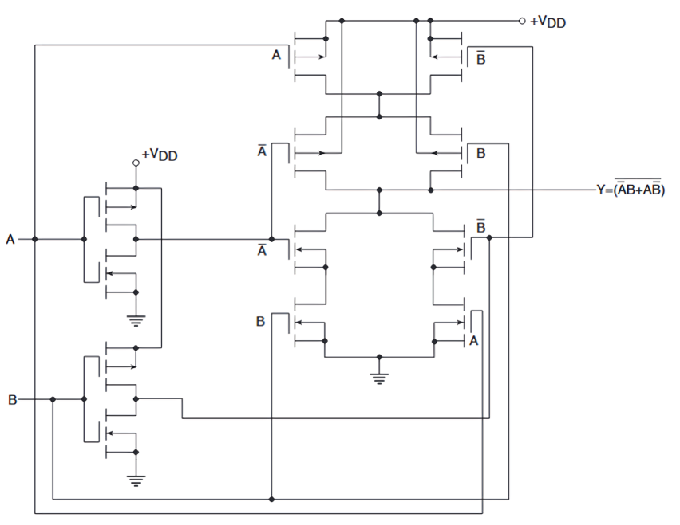
Ques: Determine the logic function implemented by the circuit shown below
Y
A
B

Slide 7
Ques: Implement the X-OR function using CMOS transmission gates (TG). Inputs are available in true form.

Slide 8














$$\overline{A}$$
A | B | F
0 | 0 | 0
0 | 1 | 1
1 | 0 | 1
1 | 1 | 0
$$A$$
$$B$$
$$B$$
$$A$$
$$F$$
$$F$$
$$\overline{B}$$
$$\overline{B}$$
$$B$$
$$\overline{A}$$
$$A$$
$$F$$
$$B$$

Slide 9
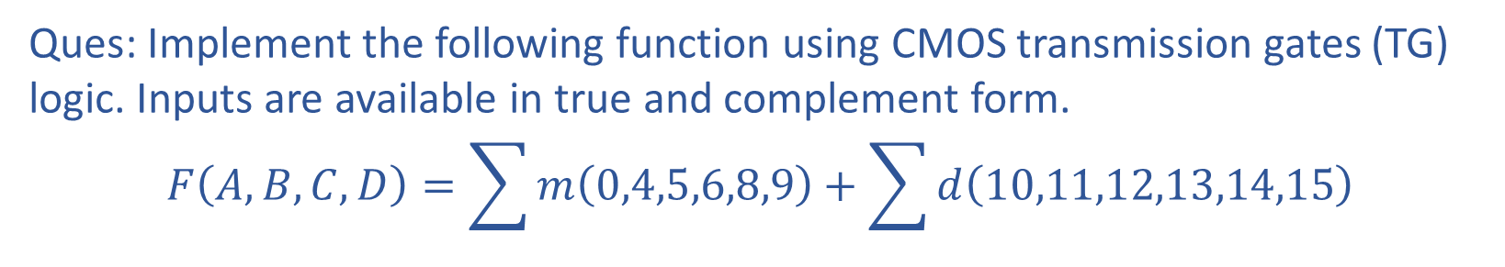
Ques: Implement the following function using CMOS transmission gates (TG) logic. Inputs are available in true and complement form.
$$F\left(A,B,C,D\right)=\sum{m\left(0,4,5,6,8,9\right)+\sum{d\left(10,11,12,13,14,15\right)}}$$

Slide 10























A | B | C | D | F
0 | 0 | 0 | 0 | 1
0 | 0 | 0 | 1 | 0
0 | 0 | 1 | 0 | 0
0 | 0 | 1 | 1 | 0
0 | 1 | 0 | 0 | 1
0 | 1 | 0 | 1 | 1
0 | 1 | 1 | 0 | 1
0 | 1 | 1 | 1 | 0
1 | 0 | 0 | 0 | 1
1 | 0 | 0 | 1 | 1
1 | 0 | 1 | 0 | X
1 | 0 | 1 | 1 | X
1 | 1 | 0 | 0 | X
1 | 1 | 0 | 1 | X
1 | 1 | 1 | 0 | X
1 | 1 | 1 | 1 | X
$$\overline{C}$$
$$\overline{D}$$
$$\overline{D}$$
$$0$$
$$C$$
$$\overline{B}$$
$$1$$
$$0$$
$$\overline{A}$$
$$\overline{D}$$
$$\overline{C}$$
$$B$$
$$\overline{C}$$
$$A$$
$$F$$
$$1$$
$$1$$
$$1$$
$$\overline{B}$$
$$C$$
$$\overline{A}$$
$$\overline{D}$$
$$\overline{C}$$

Slide 11
Ques: Implement NOR-based SR Flipflop using transistor-level CMOS logic circuit.

Slide 12
















$${+V}_{DD}$$
$${+V}_{DD}$$
$$CLK$$
$$R$$
$$S$$
$$S$$
$$\overline{Q}$$
$$Q$$
$$CLK$$
$$\overline{Q}$$
$$Q$$
$$S$$
$$R$$
$$R$$
$$CLK$$
$$CLK$$

