Slide 2
In TTL circuits, the input stage uses a special transistor called a multi-emitter transistor. Instead of using multiple diodes as in Diode-Transistor Logic (DTL), TTL employs a single transistor with multiple emitters—one for each input. This design:
  Reduces chip area significantly
  Decreases parasitic capacitance, increasing switching speed
  Provides better current steering characteristics
Each emitter-base junction acts like a diode. When any input is LOW (logic 0), the corresponding emitter-base junction becomes forward-biased, steering current away from subsequent stages.
Totem-Pole Output Stage
The output uses a totem-pole configuration—two transistors (Q3 and Q4) stacked vertically with a diode (D1) between them. This configuration:
  Provides active pull-up (Q3) and active pull-down (Q4)
  Ensures low output impedance for both HIGH and LOW states
  Enables faster switching by actively driving capacitive loads
  Prevents both transistors from being ON simultaneously (which would create a short circuit through the diode D1)

Slide 3
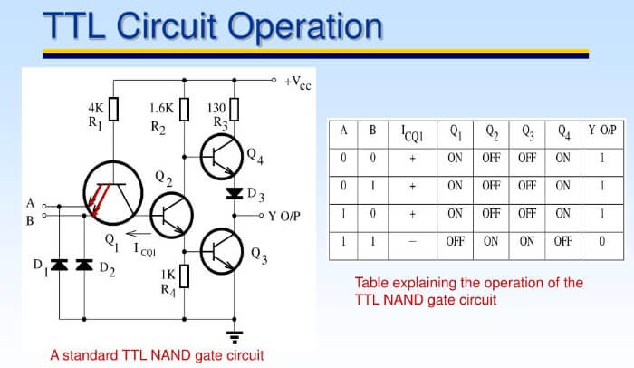
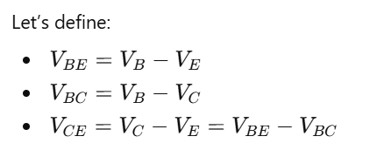

Slide 4
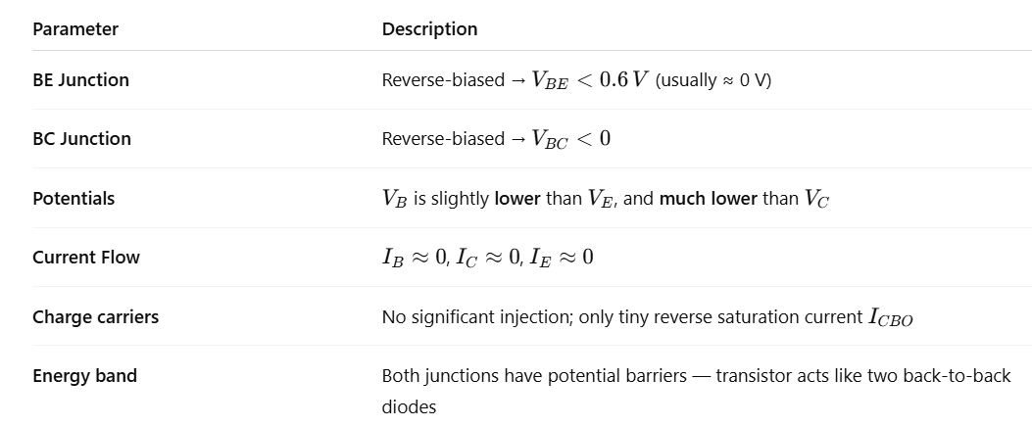

Slide 5
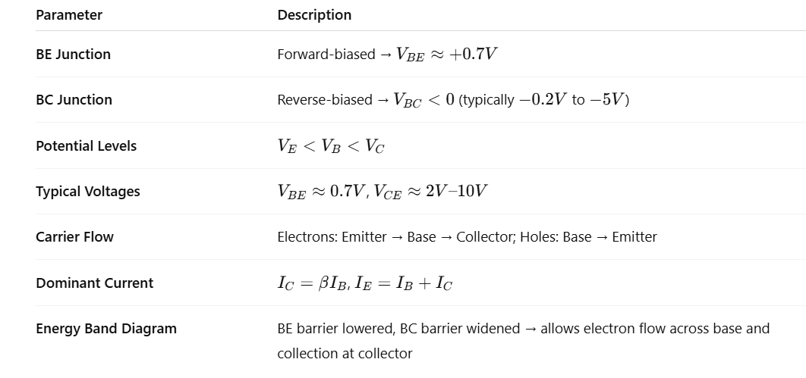

Slide 6
Region | BE Junction | BC Junction | (V_BE) | (V_CE) | Description
Cutoff | Reverse | Reverse | < 0.6 V | High | OFF (no current)
Active | Forward | Reverse | ≈ 0.7 V | Moderate | Amplifier mode
Saturation | Forward | Forward | ≈ 0.8 V | ≈ 0.2 V | Fully ON (switch)
Reverse Active | Reverse | Forward | < 0 V | Negative | Rarely used
In digital logic, we operate BJTs in cutoff and saturation — i.e., treat them as binary switches.

Slide 7
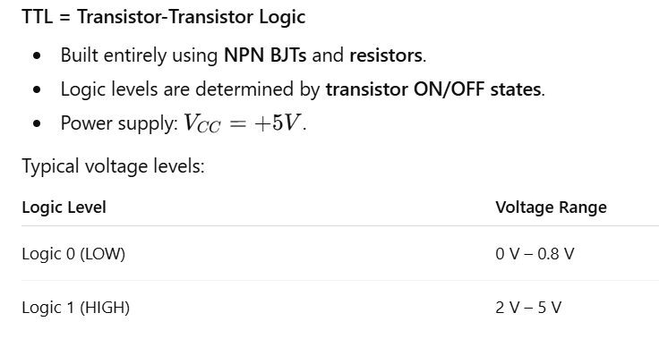

Slide 8
Region | (VE) | (VB) | (VC) | Description
Cutoff | 0 V | < 0.6 V | ≈ Vcc (5 V) | Logic 1 path open
Saturation | 0 V | ≈ 0.8 V | ≈ 0.2 V | Logic 0 path closed
Active | 0 V | ≈ 0.7 V | 1–3 V | Intermediate, avoided
Reverse active | — | — | — | Not used in logic

Slide 9
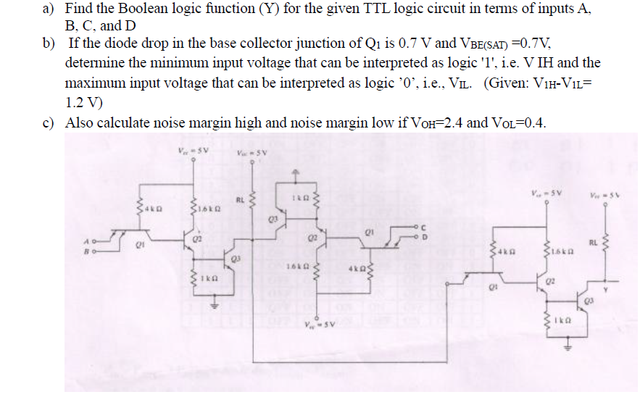
Question 1

Slide 10
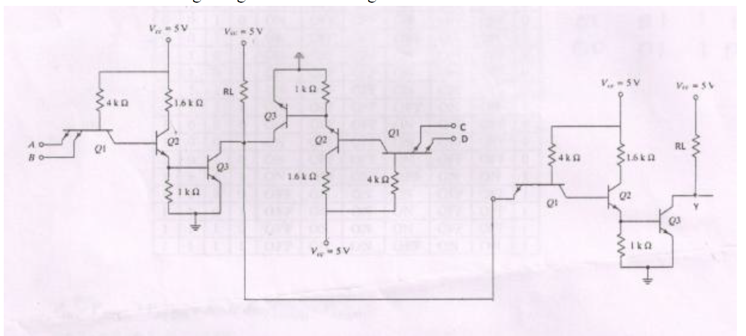
c
A
D
B
In TTL logic, the input stage uses multi-emitter transistors (each emitter = one input).
Each input transistor behaves like a wired-AND gate at the emitter side, because:
  The base-emitter junction must be forward-biased (≈ 0.7 V) for current to flow.
  If any emitter input is low (0 V), the base-emitter junction conducts and pulls the base low, cutting off current to the next stage.
  Thus, all inputs must be logic ‘1’ for the transistor to remain off and allow output to rise high.
👉 In simpler words:
For a multi-emitter transistor, the output (collector) can go HIGH only if all emitter inputs are HIGH.
Hence, the transistor acts like an AND gate.
There are two such input transistor groups, one handling inputs A & B, another handling C & D.
Their collectors are tied together to a common output transistor.
That means:
Group 1 transistor conducts when both A & B are 1.
Group 2 transistor conducts when both C & D are 1.
The two collector outputs are wired together, which means the effect is OR between these groups.

Slide 11

Analyze the Input Stage (Q1, Q2, Q3, Q4):
  The circuit uses a standard TTL NAND gate structure with multiple-emitter transistors.
  Q1 has multiple emitters (A, B). Each emitter acts as an input; if any input is LOW (0), Q1 will conduct and clamp the base of Q2.
  When BOTH A and B are HIGH (1), Q1 does NOT conduct, leaving Q2 base pulled up via resistor.
NAND Gate Structure:
  Q2 and Q3 form a phase-splitter and Q4, Q5 provide output drive.
  The output (Y) is LOW only when ALL inputs A, B, and subsequently C (when extending to the next stage in the chain) are HIGH.
3. Extending to Four Inputs:
  The circuit shown continues with another 2-input NAND (right side: C, D).
  The outputs of two NAND stages (A,B and C,D) are connected to a final NAND.

Slide 12
Two-Input Logic Gate
  Inputs: Points A and B are the logic inputs.
  Q1: Acts as a switching transistor triggered by the combination of A and B.
  Q2 and Q3: Form a typical RTL NAND gate configuration.
Operation:
  If both A and B are high, Q1 turns on, pulling the base of Q2 low, keeping Q2 off.
  If either A or B is low, Q1 is off, so Q2 can turn on, which pulls down the base of Q3.
  Q3 is configured as a common-emitter inverter, providing a buffered output to the next stage.
  The output across RL (collector of Q3) is thus a logic function (such as NAND or NOR depending on detailed node wiring).

Slide 13
Cascaded Stage
  Q1, Q2, Resistor Network: Similar logic configuration as before, with inputs C and D.
  Output Tied to Next Section: The output of Q3 here drives the next logic stage, maintaining signal integrity.
Operation:
  This block acts as another logic function, often AND or OR depending on the RTL wiring.
  The chain ensures that the signal can drive further logic without degradation.

Slide 14
Final Output Stage
Inputs: The line driven from the center stage supplies the input.
Q1 (Input Buffer), Q2, Q3: Forms another logic function.
Y is the Final Output: This is the logic signal after three stages of processing, showing how a complex Boolean expression can be built from simple transistor-resistor networks.

Slide 15
Step-by-Step Process
  Identify Each Stage: The circuit contains three stages, each built with BJTs. Each stage implements a simple combinational logic function (generally NAND or NOR in RTL style).
  Follow Signal Flow: Track how the inputs A, B, C, D affect the state of each transistor and the resulting output at each stage.
  Determine Boolean Expressions:
    Analyze each stage to derive the logical operation it performs (e.g., NAND, AND, NOR, OR).
    Express the output of each stage as a Boolean expression in terms of its inputs.
    Cascade these expressions stage by stage to get the final expression for Y.
  Substitute Values: Once you know the logic function, substitute the values of A, B, C, D to find the output Y for any given input combination.
Practical Shortcut
  In such RTL circuits, each "Q3" typically inverts the logic from the previous stage.
  Many textbook circuits like this implement a combination of NAND/NOR logic. If each block is a NAND, then three stages of NAND (with inverting outputs) can realize complex expressions (e.g., Y = (A·B + C·D) with appropriate connections).
  The exact Boolean equation for Y will depend on the input configuration (wiring of A, B, C, D).

Slide 16
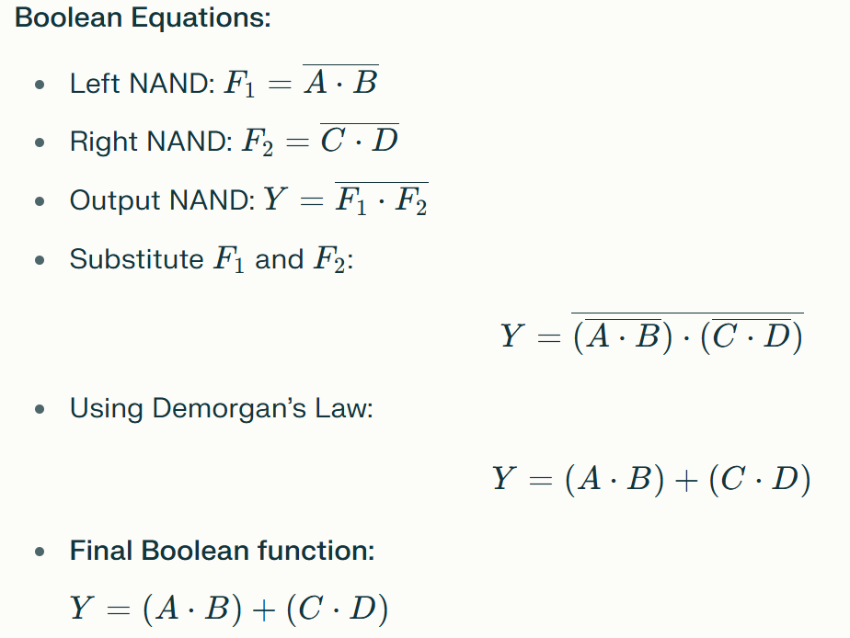

Slide 17
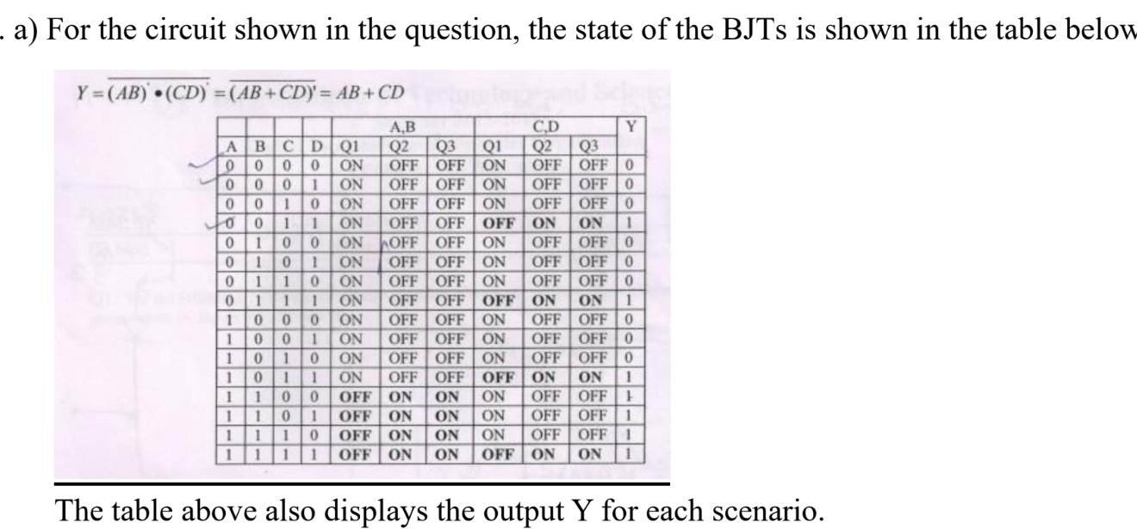

Slide 18
🔸 Step 1: Input Pair “A–B” (Emitter Group 1)
A and B feed a multi-emitter transistor Q₁.
Only when A = 1 and B = 1 are both emitters reverse-biased (no base current path).
Then Q₁’s collector node is pulled high via its pull-up path.
So the logic from this pair is:
Y₁​=A⋅B
If either A or B = 0, the base-emitter junction conducts, grounding the base, and pulling collector low → output = 0.
🔸 Step 2: Input Pair “C–D” (Emitter Group 2)
Similar story for Q₂.
Its collector node is also connected to the same output node.
This means:
Y₂​=C⋅D
🔸 Step 3: Combining Collector Outputs
The two collectors are tied together — this is a wired-OR connection in TTL positive logic.
So if either transistor pair allows its collector to go high, the common node goes high.
Thus, the total output is:
Y=Y₁​+Y₂​=(A⋅B)+(C⋅D)

Slide 19
Summary
Stage | Circuit Behavior | Logical Function
Input transistor Q₁ | Requires A = 1, B = 1 to go high | ( A.B )
Input transistor Q₂ | Requires C = 1, D = 1 to go high | (C.D )
Collector combination | Common node, either can pull high | ( (A·B) + (C·D) )
Final TTL output buffer | Inverts or amplifies depending on configuration | Passes Boolean result

Slide 20
Physical Level | Logical Interpretation
Each input emitter path (A, B or C, D) | AND gate (series condition)
Collectors tied together | OR gate (parallel condition)
Pull-up resistor / transistor | Provides high-level when none conducts
Output transistor (totem pole) | Buffers and defines logic level

Slide 21
(b) Input Thresholds
We’re told:
Each diode or BJT junction drop ≈ 0.7 V.
V_{BE(SAT)}​=0.7V.
V_{1H}​−V_{1L}​=1.2V.
The circuit path that defines the threshold voltage (VTH) passes through:
One base-emitter junction (0.7 V),
One base-collector diode drop (0.7 V),
And the network voltage differences cancel another 0.7 V drop.
Hence:
V_{TH}​=0.7+0.7+0.7−0.7=1.4 V

Slide 22
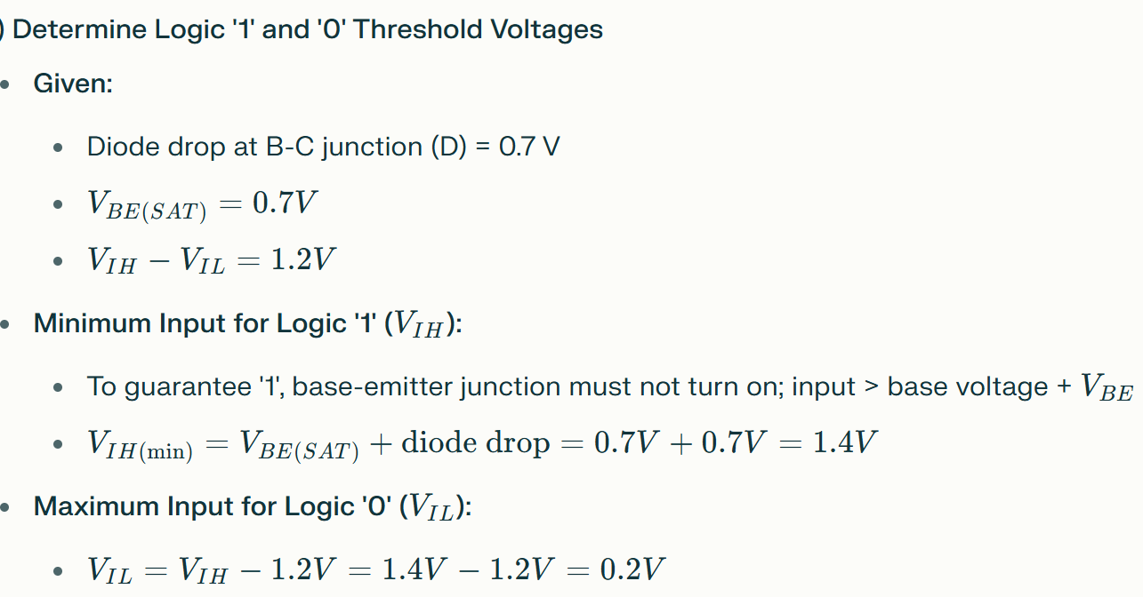

Slide 23
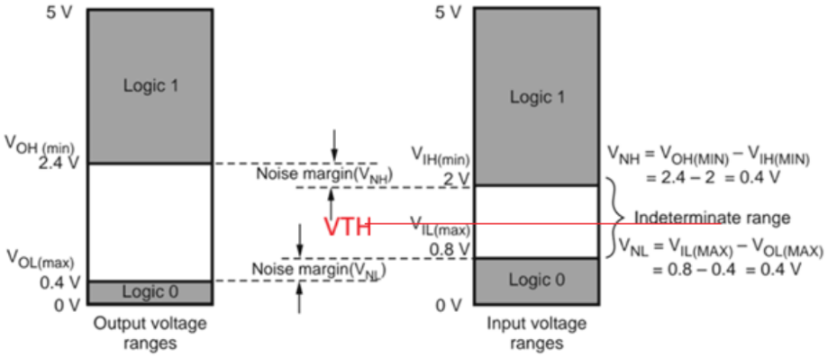
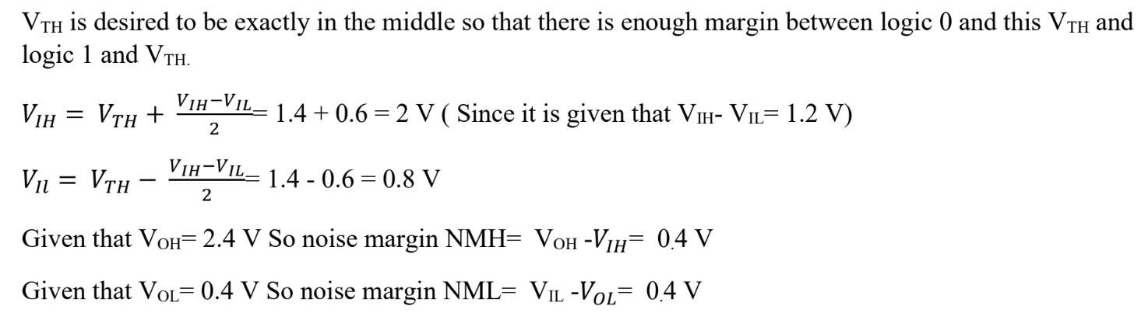

Slide 24
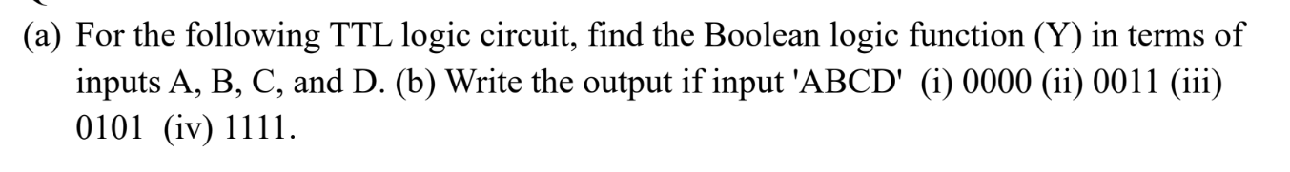
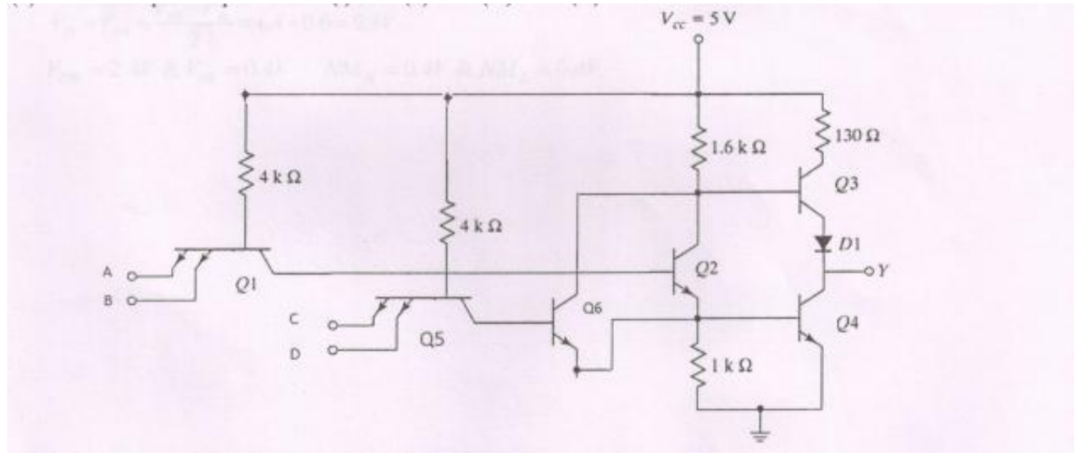
Question 2

Slide 25
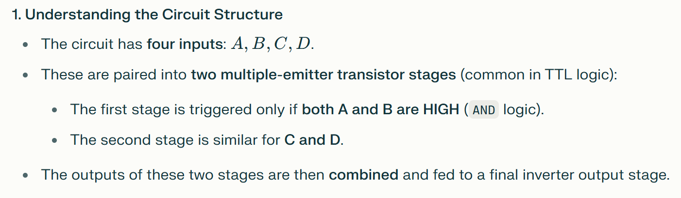
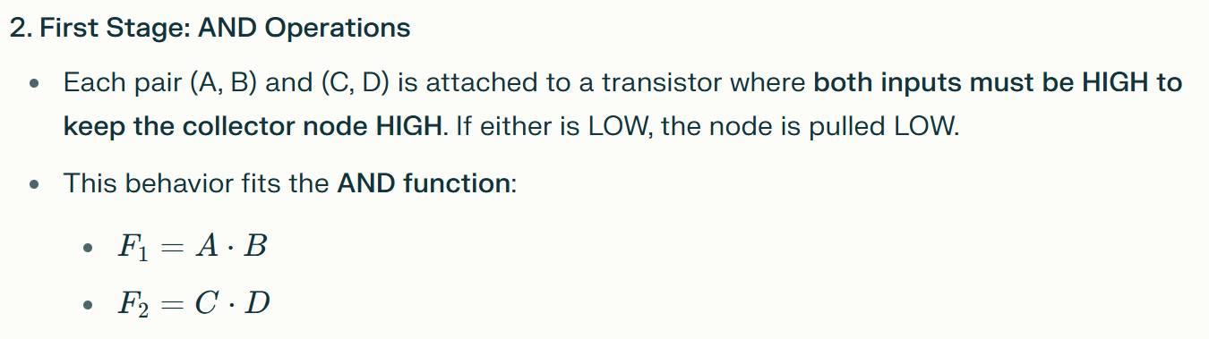
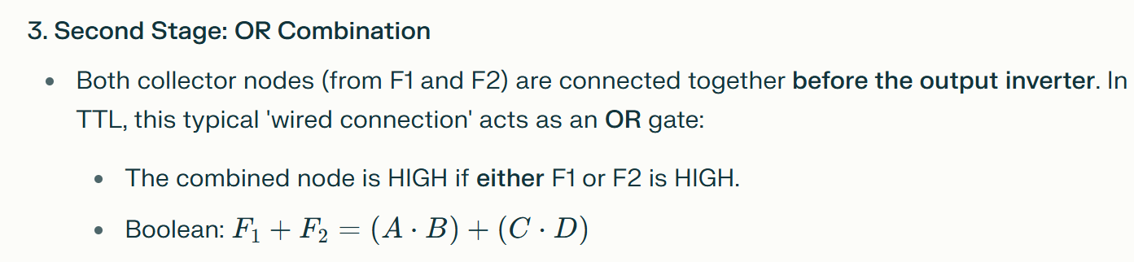

Slide 26
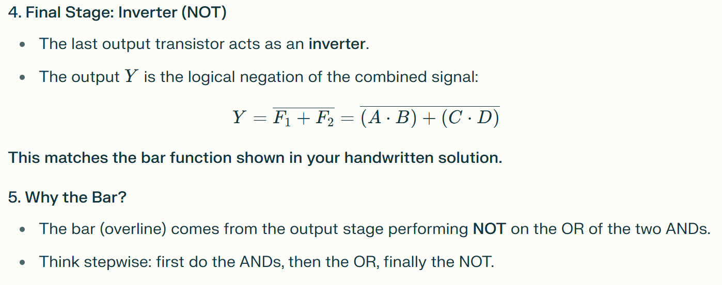

Slide 28
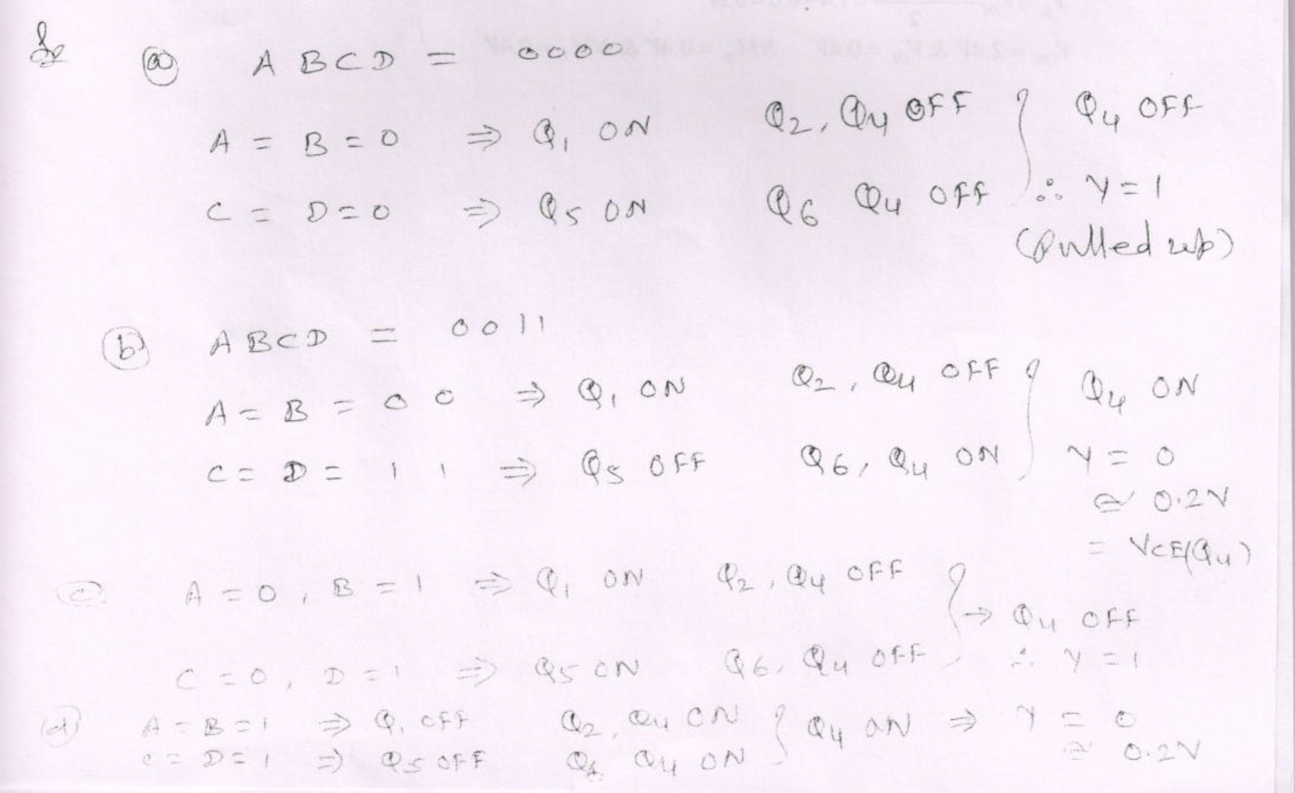

Slide 29
Circuit Configuration:
Inputs A, B connect to multi-emitter transistor Q1
Input C connects to transistor Q5
Input D connects to transistor Q6
Output stage has totem-pole configuration (Q3, Q4)
Step 1: Analyze A-B Input Section
When A = 0 OR B = 0:
Q1 is ON (saturated)
Q2 is OFF (no base current)
Q2 emitter = LOW, Q2 collector = HIGH
Contribution: Does NOT activate Q4
When A = 1 AND B = 1:
Q1 is OFF (reverse active)
Q2 is ON (saturated)
Q2 emitter = HIGH, Q2 collector = LOW
Contribution: CAN activate Q4 through emitter path
AB Section Logic Output: Provides HIGH signal when AB = 1
Step 2: Analyze C Input Section
Looking at the circuit, input C directly affects the logic.​
When C = 0:
Does NOT contribute to pulling output LOW
When C = 1:
Contributes to activating output stage
Can pull output LOW

Slide 30
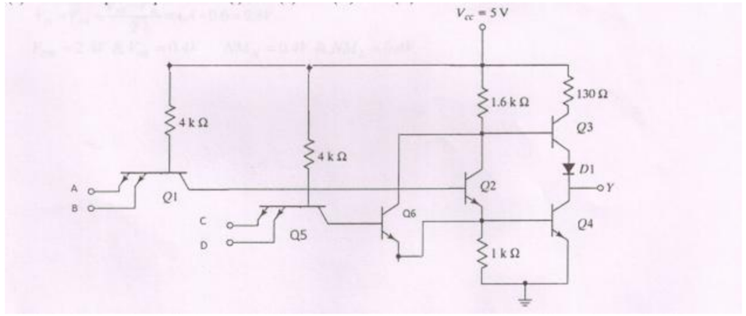
(i) ABCD = 0000
Analysis:
A = 0, B = 0 → Q1 ON, Q2 and Q3 OFF → Q4 OFF (upper path inactive)
C = 0, D = 0 → Q5 ON, Q6 OFF → Q4 remains OFF
With Q4 OFF, output is pulled HIGH through pull-up resistor
Output: Y = 1 (HIGH)
(ii) ABCD = 0011
Analysis:
A = 0, B = 0 → Q1 ON, Q2 and Q3 OFF
C = 1, D = 1 → Q5 OFF, Q6 ON → Q4 turns ON
When Q4 is ON (saturated), it pulls output to ground
Output: Y = 0 (LOW) ≈ 0.2 V
The 0.2 V represents V_CE(SAT) of the saturated transistor Q4.

Slide 31
(iii) ABCD = 0101
Analysis:
A = 0, B = 1 → Q1 ON, Q2 and Q3 OFF → Q4 OFF
C = 0, D = 1 → Q5 ON, Q6 OFF → Q4 remains OFF
Both paths keep Q4 OFF, output pulled HIGH
Output: Y = 1 (HIGH)
(iv) ABCD = 1111
Analysis:
A = 1, B = 1 → Q1 OFF, Q2 and Q3 ON → Provides path to activate Q4
C = 1, D = 1 → Q5 OFF, Q6 ON → Also activates Q4
Both conditions pull Q4 ON strongly
Output: Y = 0 (LOW) ≈ 0.2 V

