Slide 1
Tutorial 14 – Digital Design
Intuitive Explanations
EX-OR timing • Verilog to Circuit • 4‑bit Adder/Subtractor
Notes:
This session focuses on three fundamental digital design skills:
Understanding how delays affect gate-level circuits (EX-OR example).
Mapping Verilog code to hardware circuits and identifying standard blocks like full adders.
Designing an adder–subtracter using conditional operators in Verilog.
These concepts build intuition for real hardware, not just theoretical symbols.

Slide 2
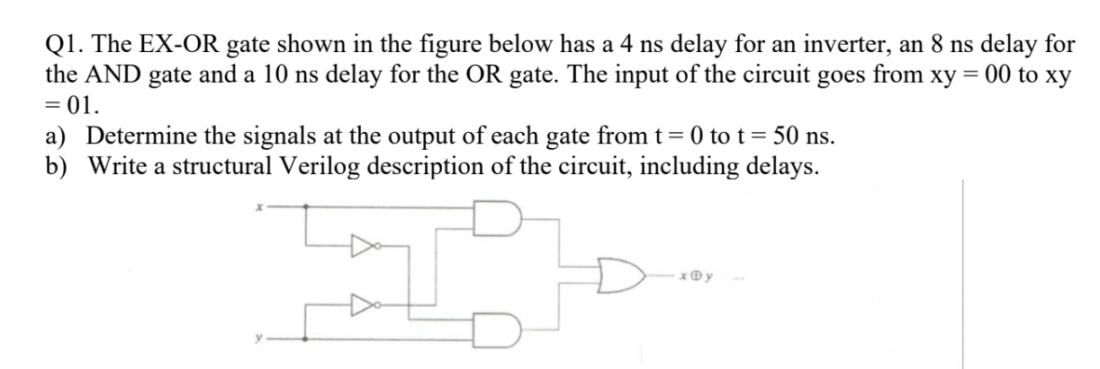

Slide 3
Propagation delay is the time required for a signal to travel through a logic gate. When we cascade multiple gates (connect output of one to input of another), these delays accumulate. Understanding this is crucial because:
Each gate adds its own delay to the signal path
Signals ripple through the circuit, creating different states at different times
Final output only reflects the true logic function after all delays accumulate
The circuit is an XOR (Exclusive OR) gate, which outputs 1 when inputs differ and 0 when they’re the same.
Circuit Structure
The XOR gate consists of: - Two NOT gates (inverters): delay = 4 ns each - Two AND gates: delay = 8 ns each
- One OR gate: delay = 10 ns
The logic function is: OUT = (X · Y’) + (Y · X’), where prime (’) means NOT.
Input Condition
The input transitions from xy = 00 to xy = 01 (x goes from 0 to 1, y stays 0).
Wait, there’s an important clarification in the provided solution: Initially x=1, y=1 at t=0 (not 00). The change happens at t=0, so we track from there.

Slide 4
Q1: Understanding the EX‑OR Gate (Basics)
EX‑OR = outputs 1 only when inputs differ (0,1 or 1,0)
Implemented using: two NOT gates, two AND gates, one OR gate
Each gate has delay → output does not change instantly
Goal: Track how signals propagate from t=0 → 50 ns
Notes:
Notes:
An EX-OR gate outputs 1 only when the inputs differ.
To understand its timing behavior, we break the EX-OR into basic gates:
Two NOT gates
Two AND gates
One OR gate
Real electrical circuits never change output instantly.
Every logic gate has a propagation delay → this governs when each internal signal actually updates.

Slide 5
Q1: Why Propagation Delay Matters
A gate takes time to react to input changes
Think of delay like water flowing through pipes — change at input takes time to reach output
NOT gate: 4 ns delay
AND gate: 8 ns
OR gate: 10 ns
Total path delay = sum of delays along the path
Notes:
Notes:
Propagation delay is like water flow:
If you turn a tap, water doesn't exit the pipe instantly.
Similarly, a change at a gate’s input takes time to appear at its output.
Gate delays:
NOT = 4 ns
AND = 8 ns
OR = 10 ns
Understanding delay helps interpret timing diagrams, glitches, and hazards in real circuits.

Slide 6
Q1: Step‑by‑Step Signal Evolution
t=0: initial x=1, y=1 (from file)
t=4 ns: NOT gates update → xnot=0, ynot=0
t=12 ns: AND gates update based on new NOT outputs
t=22 ns: OR gate produces final EX‑OR output
Waveform shows how each internal node changes at its own delayed time
Notes:
Notes:
Students often assume the EX-OR output changes immediately — but here we track the signals properly:
t = 0: Input is x=1, y=1
t = 4 ns: NOT gates respond → xnot=0, ynot=0
t = 12 ns: AND gates use updated NOT values → both AND outputs become 0
t = 22 ns: OR gate combines AND outputs → final output = 0
This step-by-step tracing is how timing analysis is done in digital design.

Slide 7
Q1: Structural Verilog (with Delays)
Each gate is instantiated with a delay (#number)
Example: not #4 n1(xnot, x); → NOT gate with 4 ns delay
This models real hardware timing
The OR gate combines the AND outputs with 10 ns delay
Notes:
Notes:
Structural Verilog allows us to instantiate actual gates and assign delays.
Example:
not #4 n1(xnot, x); means a NOT gate with a 4 ns propagation delay.
This models the real hardware response, not just ideal logic.
Students should learn structural modeling before relying on behavioral descriptions.

Slide 8
Time (ns) | Event | Intuition
t = 0 | Input changes: x=0→1, y=1→1 (or x=1, y=1 as per solution) | Inputs stabilize at new value
t = 0 to t = 4 | NOT gates are processing | Inverters need 4 ns to respond
t = 4 | xnot = 0, ynot = 0 | Inverted signals become available after 4 ns delay
t = 4 to t = 12 | AND gates are processing | AND gates need 8 ns from their inputs
t = 12 | a = (x · ynot) = 1 · 0 = 0 | First AND output: x=1, ynot=0 → 0
 | b = (y · xnot) = 1 · 0 = 0 | Second AND output: y=1, xnot=0 → 0
t = 12 to t = 22 | OR gate is processing | OR gate needs 10 ns from AND inputs
t = 22 | out = (a OR b) = 0 OR 0 = 0 | Final output: 0 (both AND outputs are 0)
t = 22 to t = 50 | Output stable | No more changes, output remains 0

Slide 9
Time | x | y | xnot | ynot | a (x·ynot) | b (y·xnot) | out
------|---|---|------|------|------------|------------|-----
0 | 1 | 1 | X | X | X | X | X
1-3 | 1 | 1 | X | X | X | X | X
4 | 1 | 1 | 0 | 0 | X | X | X
5-11 | 1 | 1 | 0 | 0 | X | X | X
12 | 1 | 1 | 0 | 0 | 0 | 0 | X
13-21 | 1 | 1 | 0 | 0 | 0 | 0 | X
22 | 1 | 1 | 0 | 0 | 0 | 0 | 0
23-50 | 1 | 1 | 0 | 0 | 0 | 0 | 0
Where X means: signal not yet determined/undefined

Slide 10
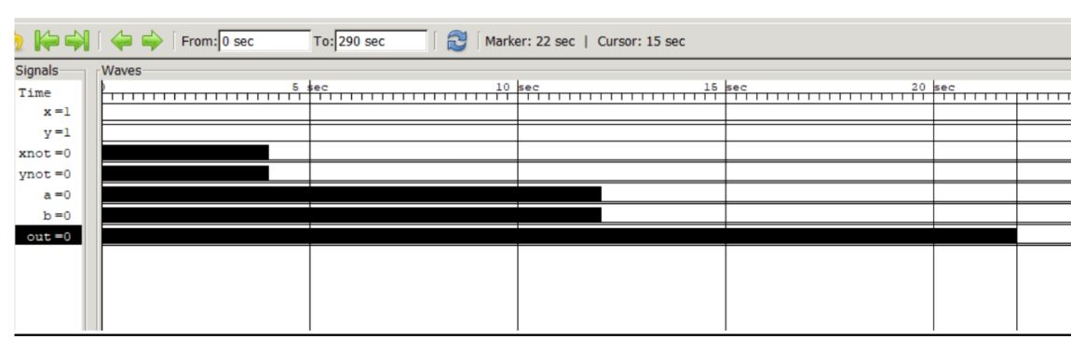

Slide 11
module xor_gate_structural (
input x, y,
output out
);
// Internal wires to connect gates
// These represent the metal wires in physical circuit
wire xnot, ynot; // Outputs of inverters
wire a, b; // Outputs of AND gates
// NOT gate instantiation: inverts x
// #4 specifies 4 ns propagation delay
// n1 is the instance name (unique identifier for this gate)
not #4 n1(xnot, x);
// NOT gate instantiation: inverts y
not #4 n2(ynot, y);
// AND gate instantiation: a = x AND (NOT y)
// #8 specifies 8 ns propagation delay
// Inputs: x, ynot | Output: a
and #8 a1(a, x, ynot);
// AND gate instantiation: b = y AND (NOT x)
// Inputs: y, xnot | Output: b
and #8 a2(b, y, xnot);
// OR gate instantiation: out = a OR b
// #10 specifies 10 ns propagation delay
// This is the final stage combining both AND outputs
or #10 o1(out, a, b);
endmodule
Code Explanation
Module Declaration: - module xor_gate_structural: Module name - input x, y: Two 1-bit inputs - output out: One 1-bit output
Wire Declaration: - wire xnot, ynot: Internal signals (inverted inputs) - wire a, b: Internal signals (AND gate outputs)
Gate Instantiations: - Format: gate_type #(delay) instance_name(output, inputs...); - not #4 n1(xnot, x): NOT gate with 4ns delay, input=x, output=xnot - Similar pattern for all other gates
Delay Specification: - #4, #8, #10: Propagation delays in nanoseconds - These model real-world gate delays

Slide 12
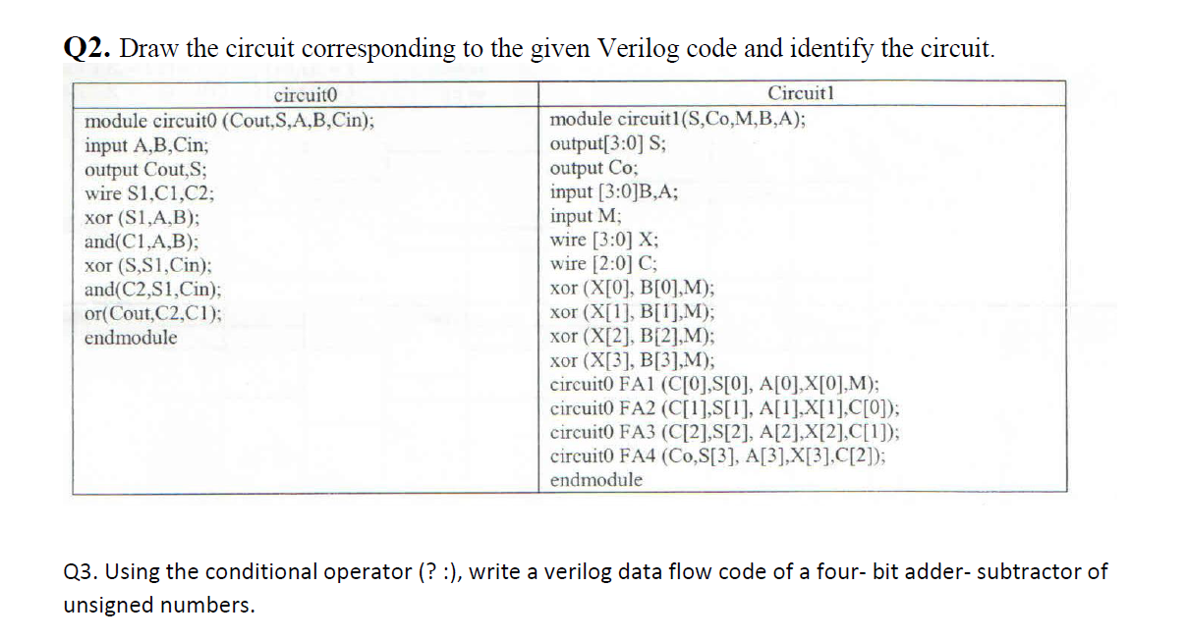

Slide 13
Q2: From Verilog to Circuit (Fundamental Idea)
Verilog describes hardware behavior → can be mapped to physical gates
We analyze each always block / assign statement
Goal: Draw equivalent logic circuit
Also identify what standard digital block it represents
Notes:
Notes:
Important skill:
Given Verilog code → Draw its hardware circuit → Identify what block it represents.
Every hardware designer must be able to translate between:
Code
Gates
Standard templates (adders, subtractors, decoders, muxes)
This problem teaches pattern recognition in digital logic.

Slide 14
Q2: Intuition — Recognizing Patterns
Digital circuits follow common templates:
• A ⊕ B implemented using XOR expression
• A + B implemented using AND/OR/Carry logic
If code includes 'cin', 'sum', 'carry' → likely full adder
If code uses B ⊕ sel and carry=sel → it's adder/subtractor
Notes:
Notes:
Many circuits repeat standard forms. For example:
EX-OR patterns → addition or comparison
sum = A ⊕ B ⊕ Cin → Full Adder
carry = AB + Cin(A ⊕ B) → Full Adder carry
If B is modified using XOR with a select signal, it's usually an adder/subtractor.
Students should learn to detect these patterns instantly.

Slide 15
Q2: Circuit0 → Full Adder
Inputs: A, B, Cin
Outputs: Sum and Carry
Pattern: sum = A ⊕ B ⊕ Cin
carry = AB + Cin(A ⊕ B)
This is exactly the behavior encoded in circuit0
Notes:
Notes:
Circuit0 implements:
Sum = A ⊕ B ⊕ Cin
Carry = AB + Cin(A ⊕ B)
This matches exactly the logic of a full adder, a fundamental arithmetic building block used in ALUs, microprocessors, and counters.
Full adders chain together to form multi-bit ripple adders.

Slide 16
Q2: Circuit1 → Why It Is an Adder/Subtractor
Key trick: Subtraction A − B can be done as A + (~B + 1)
Verilog typically uses:
• Bxor = B ⊕ sel
• Cin = sel
If sel=0: Bxor = B, Cin=0 → A + B
If sel=1: Bxor = ~B, Cin=1 → A + (~B+1) = A − B
Thus circuit1 toggles between add/sub depending on sel
Notes:
Notes:
Key digital trick:
A − B = A + (~B + 1)
Verilog commonly does this by:
Computing B⊕sel
Using sel as the carry-in
If sel = 0 →
B⊕0 = B
Cin = 0
→ Performs A + B
If sel = 1 →
B⊕1 = ~B
Cin = 1
→ Performs A + (~B + 1) = A − B
Thus with a single bit select input, the circuit can switch between addition and subtraction.
This is one of the MOST important ideas in arithmetic circuits.

Slide 17
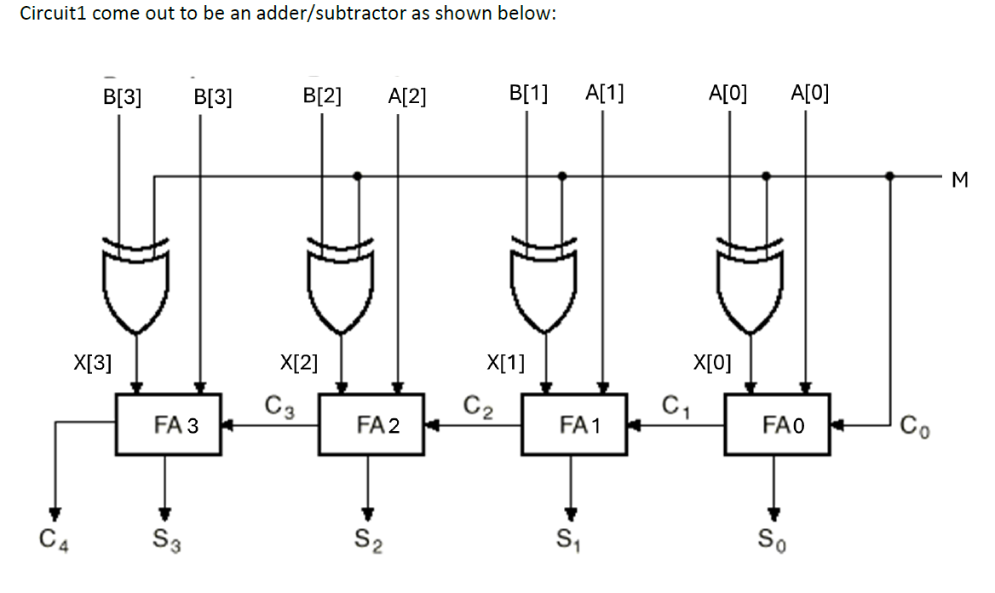

Slide 18
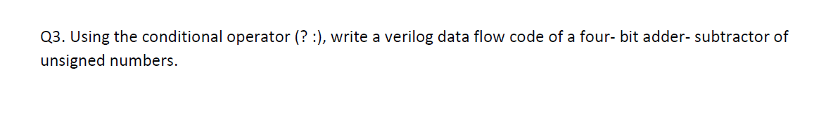

Slide 19
Q3: 4‑bit Adder/Subtractor Using ?: Operator
Conditional operator: (condition) ? expr1 : expr2
One‑line arithmetic selector
{carry, result} = sel ? A+B : A−B;
sel=0 → subtraction, sel=1 → addition
Compact behavioral modeling
Notes:
otes:
The conditional operator allows compact code:
sel ? A+B : A-B
This does not show gate-level implementation, but it is useful for higher-level behavioral design.
Hardware mapping still follows the same logic as circuit1.

Slide 20
Background: Data Flow vs. Structural Modeling
Structural: Describes gate connections (how it’s built)
Data Flow: Describes behavior using operations like +, -, ?, : (what it does)
Data flow is more abstract and easier to write for arithmetic operations.
The Conditional Operator (? :)
Syntax: condition ? true_value : false_value
Intuition: “If condition is true, use this value; otherwise use that value”

Slide 21
Example:
assign max = (a > b) ? a : b; // Selects larger of a or b
Solution: 4-Bit Adder-Subtractor Code
module adder_subtractor_4bit (
output [3:0] sum_diff, // 4-bit output (sum or difference)
output carry_borrow, // Carry out or borrow
input [3:0] A, // 4-bit input A
input [3:0] B, // 4-bit input B
input sel_diff // Selection: 0=add, 1=subtract
);
// Conditional operator selects operation based on sel_diff
// {carry_borrow, sum_diff} creates a 5-bit result
// Upper bit is carry/borrow, lower 4 bits are the sum/difference
assign {carry_borrow, sum_diff} = sel_diff ? (A - B) : (A + B);
endmodule

Slide 22
Code Breakdown
Output Declaration: - [3:0] sum_diff: 4-bit output for result - carry_borrow: 1-bit output for carry (addition) or borrow (subtraction) - {carry_borrow, sum_diff}: Concatenation creating 5-bit result
Input Declaration: - [3:0] A, B: Two 4-bit unsigned numbers - sel_diff: Control signal (0 for add, 1 for subtract)
Operation Selection:
sel_diff ? (A - B) : (A + B)
When sel_diff = 0: Performs A + B (addition)
When sel_diff = 1: Performs A - B (subtraction)

Slide 23
Key Takeaways
Propagation delay defines timing behavior → essential for real circuits
Structural Verilog maps directly to gate-level diagrams
Adder/Subtractor logic relies on B ⊕ sel and Cin=sel trick
Conditional operator provides compact arithmetic description
Notes:
Notes:
Timing analysis helps understand real circuit behavior.
Structural Verilog → maps exactly to physical gate networks.
Add/Sub trick using XOR and Cin is a universal digital design technique.
Conditional operator simplifies behavioral coding.
These skills help students bridge the gap between theory and real hardware implementation.

