Slide 1
DIGITAL DESIGN(DD)
INSTR F243/EEE F215 /ECE F215 /CS F215
16/09/2025- Tutorial # 6

Slide 2
Q1. A PN flip-flop has four operations: set to 1, no change, complement, and clear to 0, when inputs P and N are 00, 01, 10, and 11, respectively.
Tabulate the characteristic table.
Derive the characteristic equation.
Tabulate the excitation table.
The truth table for PN flip-flop is
P | N | Q_{n+1}
0 | 0 | 1
0 | 1 | Q_{n}
1 | 0 | Q_{n}’
1 | 1 | 0

Slide 3
characteristic table
characteristic equation
 | P | N | Q_{n} | Q_{n+1}
0 | 0 | 0 | 0
1 | 0 | 0 | 1
2 | 0 | 1 | 0
3 | 0 | 1 | 1
4 | 1 | 0 | 0
5 | 1 | 0 | 1
6 | 1 | 1 | 0
7 | 1 | 1 | 1
Q_{n+1}
NQ_{n}
1
1
P
 | 00 | 01 | 11 | 10
0 | 0 | 1 | 3 | 2
1 | 4 | 5 | 7 | 6
0
1
1
1
1
1
1
0
0
0
Q_{n+1}=N’Q_{n}’ + P’Q_{n}

Slide 4
Excitation table
Q_{n} | Q_{n+1} | P | N
0 | 0
0 | 1
1 | 0
1 | 1
1
0
1
0

Slide 5
Q2. For the following sequential circuit, construct the state table and state diagram. Also, state whether it is a Mealy or Moore machine?

Slide 6
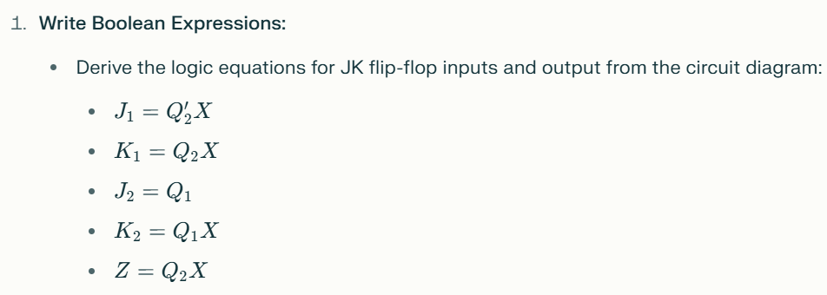

Slide 7
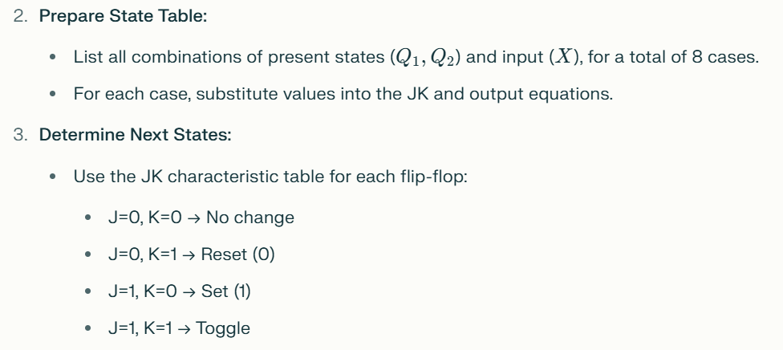

Slide 8
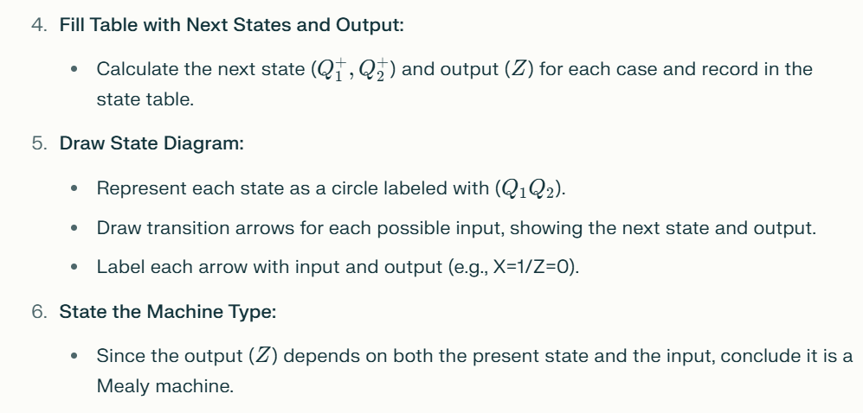

Slide 9
(a)
(i) Find the Boolean expressions for the JK flip-flop inputs

Slide 10
(ii) Use the expressions to find the actual JK flip-flop input values and output Z for each possible combination of present states and input
(iii) Use the JK flip-flop characteristic table to find the next states (NS), based on the JK flip-flop input vales and the present states (PS).
PS
I/P
NS
O/P
Q1 | Q2 | X | J1 | K1 | J2 | K2 | Q1+ | Q2+ | Z
0 | 0 | 0
0 | 0 | 1
0 | 1 | 0
0 | 1 | 1
1 | 0 | 0
1 | 0 | 1
1 | 1 | 0
1 | 1 | 1
0
0
0
0
0
0
0
1
1
0
1
1
0
1
J | K | Q_{n+1}
0 | 0 | Q_{n}
0 | 1 | 0
1 | 0 | 1
1 | 1 | Q_{n}’
0
0
0
0
0
1
1
0
1
0
1
0
0
0
0
0
0
0
1
0
0
1
1
1
1
0
1
1
0
0
0
0
1
1
1
0
1
1
1
0
0
0

Slide 11
State diagram
0/0
0/1
State table
00
1/0
01
 |  |  | X=0 |  | X=1
PS |  |  | NS | Z | NS | Z
0 | 0 | 0 | 0 | 0 | 2 | 1
0 | 1 | 1 | 1 | 1 | 0 | 0
1 | 0 | 2 | 2 | 0 | 1 | 1
1 | 1 | 3 | 3 | 1 | 0 | 0
1/1
1/0
1/1
11
10
0/0
0/1
Since the output depends on the present states and the present input, the sequential circuit is a Mealy machine

Slide 12
Q3. Design a sequential circuit using JK flip-flops and logic gates for the following state diagram.

Slide 13
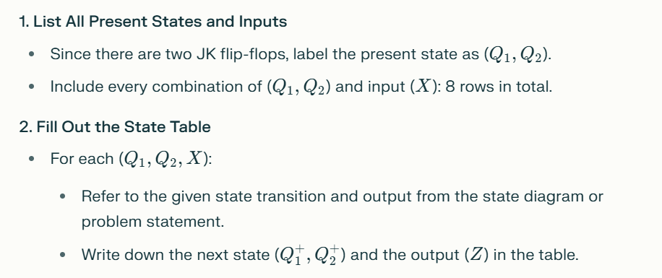
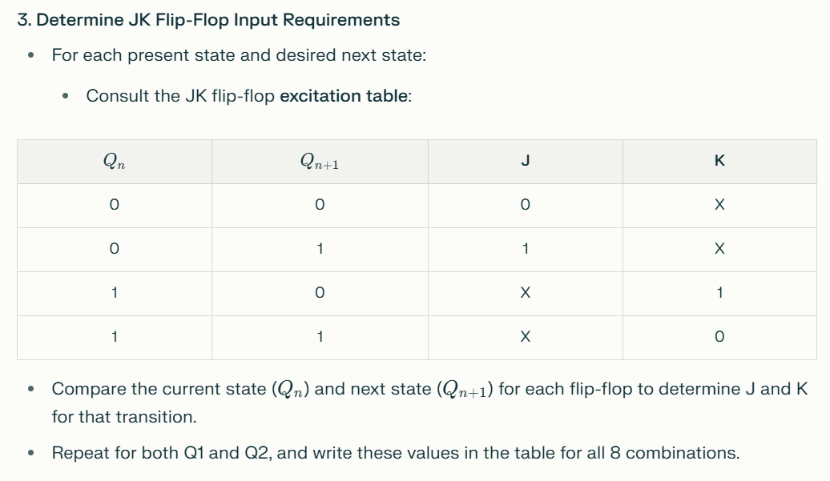

Slide 14
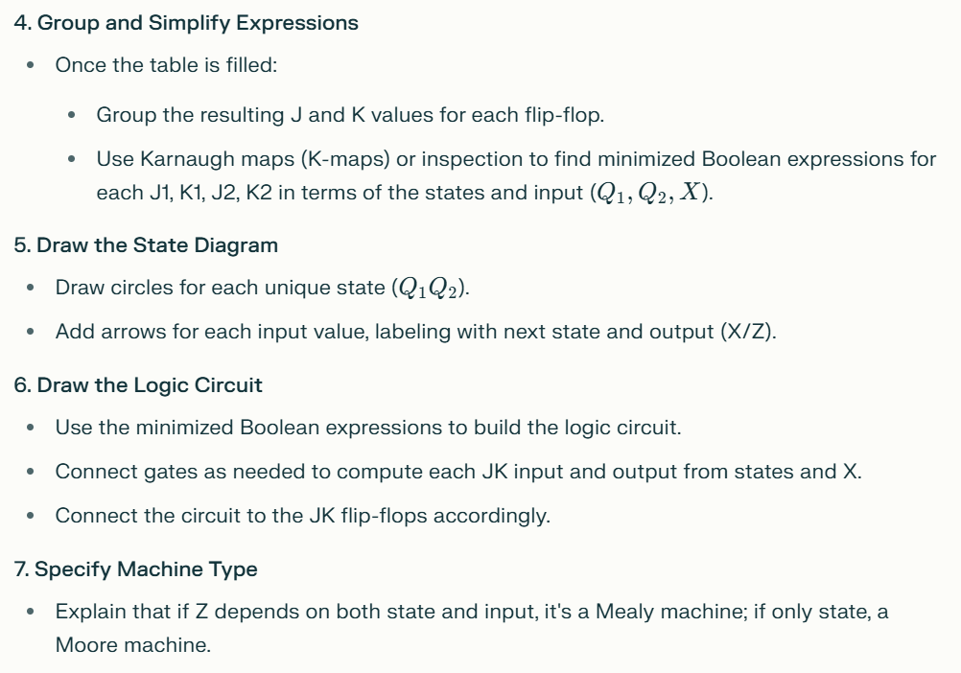

Slide 15
PS
I/P
NS
O/P
Q1 | Q2 | X | Q1+ | Q2+ | Z
0 | 0 | 0
0 | 0 | 1
0 | 1 | 0
0 | 1 | 1
1 | 0 | 0
1 | 0 | 1
1 | 1 | 0
1 | 1 | 1
0
0
0
A
Four states are present in the state diagram, so two JK flip-flops are required.
Tabulate the state table with present states (PS) and next states (NS) along with input and output, as shown in the state diagram.
0
1
0
1
0
0
B
0
1
0
1
1
0
C
0
1
0
0
0
0
D
0
1
1

Slide 16
PS
I/P
NS
O/P
Q1 | Q2 | X | Q1+ | Q2+ | Z
0 | 0 | 0
0 | 0 | 1
0 | 1 | 0
0 | 1 | 1
1 | 0 | 0
1 | 0 | 1
1 | 1 | 0
1 | 1 | 1
J1 | K1 | J2 | K2
0
0
0
0
0
A
0
1
0
0
1
1
0
0
1
1
B
0
1
0
0
0
1
1
0
0
1
C
0
1
0
1
1
0
0
0
1
1
D
0
1
1
1
0
Excitation table
Q_{n} | Q_{n+1} | J | K
0 | 0
0 | 1
1 | 0
1 | 1
From the present states (PS) and next states (NS) fill out the JK flip-flop inputs using the excitation table for JK flip-flop.
Then use the K maps to find the expressions for the JK flip-flop inputs
0
1
1
0

Slide 17
Draw the sequential circuit

