Slide 1
Design of Differential and Multiphase Ring Oscillators
Chapter 4 Razavi PLL
Presented by Deepa Kulkarni
Guided by Neeraj Mishra, BITS Pilani

Slide 2
Presentation Topics
Differential Ring Oscillators.
Phase consideration & 2nd harmonics
Basic Differential Ring Design & Improvements.
Methods for Obtaining Desired Frequency.
Two-Stage Ring Oscillators.
Tuning Techniques for Differential Rings.
Inverter-Based Oscillators with Complementary or Quadrature Outputs.
Ring Oscillators with LC Loads.

Slide 3
Differential Ring Oscillators.
Why Differential Circuits?
They are less sensitive to supply noise than single-ended rings because:
  Common-mode rejection :
    They amplify the difference between two signals while rejecting signals that are common to both.
    Supply noise is common to both and gets rejected in the process.
  Constant Current Source:
    A high-impedance tail current source ensures the total current (ISS ) remains constant despite VDD changes.
    This stabilizes the common-mode voltage (Vp) and prevents supply noise from directly altering the charging currents, which keeps the oscillation frequency stable.
    We will look into ISS impacts later in the presentation
Notes:
Supply noise tends to appear as a common-mode signal on both sides of the differential pair. The differential stages inherently suppress this common-mode noise.
What is high impedance?
Means high resistance to current flow.
High Imp path is like an open-circuit. Ideally it should be infinite resistance.
IN TAIL CURRENT, the high impedance means the current it supplies is almost independent of the voltage across it.

Slide 4
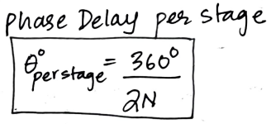
  Drain Resistance Dominance:
    The resistors at the drain are less sensitive to supply noise than the CMOS "on" resistance in the simple-ended inverters.
  Reduced Voltage Swing:
    Smaller single-ended voltage swings. Faster transitions and less sensitivity to noise.
2. Multiphase O/p generation:
  3-stage diff ring have 6 output phases with 60 degrees separation.
  4 -stage diff ring have 8 output phases with 45 degrees separation.
  Every stage has V1+ and V1-
  N stages have 2N output nodes.
  Applications: Modulators, Mixers, Multiphase clocks.
  In inverters, transistors have only 1 output phase per input.

Slide 5
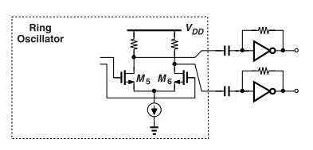
3. Higher Speed:
  Delay per stage is less than CMOS inverters.
    Reduced Voltage Swings.: Faster transistors because voltage swing does not reach ISS X Rd.
    Lower capacitance load: Differential rings use resistors and not PMOS. Resistors add very little capacitance than PMOS. Resistors charge and discharge very quickly at X and Y nodes.
Disadvantages of Differential Rings:
Lower Voltage swings :
  Low rail-to-rail voltage swings.
  To achieve full swing, a separate circuit called a level converter is added.
  It is a Self-biased capacitive sensing inverter.
  They also consume more power!
Notes:
“Self-biased inverters with capacitive sensing” means:
Inverters are designed to bias themselves without needing an external bias circuit.
They sense the differential output of the ring oscillator through capacitors, rather than directly connecting to it.
→ This avoids loading the oscillator too much
How does it help in achieving full swing?
These inverters amplify small differential swings to full logic levels using capacitive coupling and internal biasing.

Slide 6
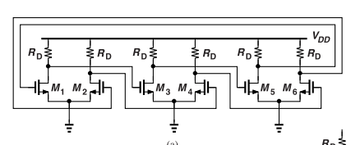
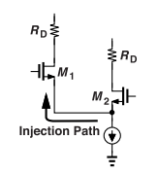
Role of Tail Current source (ISS):
Without the Tail current source:
  The circuit effectively splits into 2 simple single ended rings independently working on their own oscillation frequency and phase shifts.
  This happens when the tail current source is replaced with resistors of low value.
    Low-value resistors allow signals to go to ground easily.
    Weak coupling between the two sides cause them to oscillate separately
With Tail current source:
Injection Locking
  ISS is a high-impedance tail current source.
  One side can inject current into the other through
  shared source nodes. (point 'P').
  M1 and M2 act as Source Follower and CG stage alternatively.
Notes:
How does ISS being high impedance path help in injection locking?
it prevents signal loss to ground.
Source follower?
The input is at the gate. The output is at the source. (Connected to ISS)
The drain is connected to a supply or load (Rd here)
The output follows the input.
Common gate?
Gate is fixed (usually biased at a DC level).
Input is at the source.
Output is at the drain.
Working?
M1 is "ON" --> acts a source follower.
Vgs of M1 increases and M1 starts conducting.
M1’s source voltage (shared node) to rise.
M1’s gate is controlling its source. Source follows the gate.
M1 pushes current into the shared source node.
M2 acts as a common gate stage.
Because Vgs of M2 is fixed and source voltage of m2 rises.
M2 accepts current from M1 and passes it to its drain.
This generates Voltage swing at the output.

Slide 7

Phase consideration
Principal drawback : Differential rings have higher phase noise due to less voltage swings.
Thermal Phase noise :
  Inversely related to tail current.
  Example: If we increase the no. Of stages, how will it affect phase noise?
    As N increase, Reduce ISS, W/L, and increase RD to keep power & frequency constant.
    But phase noise increases proportional to ISS.
Flicker Noise contributions:
  Flicker noise adds to phase noise when :
    Rise and fall edges are asymmetric. (at X and Y nodes).
    Non-cancellation of these →cause more phase jitter.
Notes:
Why do differential rings have higher phase noise?
Because:
They use current sources and operate with lower signal swings,
Which makes them more sensitive to thermal noise from transistors and bias circuits.
Even though differential design helps with common-mode noise rejection,
it still amplifies internal noise.

Slide 8
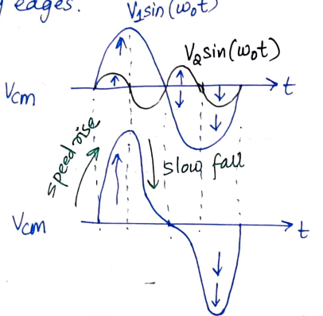
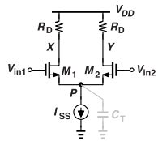
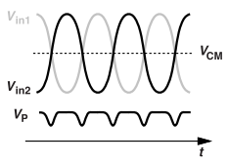
2nd harmonics & Its origins
2nd harmonics in Vx and Vy leads to unequal slopes.
Suppose, Vx (t) = V₁ sin(ω0t) + V₂ sin(2ω0t) + V_{CM}
V_{CM} alternates between (V_{1ω0} + 2V_{2ω0}) and (−V_{1ω0} + 2V_{2ω0} ).
Origins of 2nd harmonics:
A) Vp drops around crossing of Vin1 and Vin2.
This is due to switching of M1/M2 which cause C_{T} fluctuations.
  Vp is pulled up twice per cycle by M1 and M2 (as source followers).
  So, Vp oscillates at 2ω₀.
This generates current in CT, leading to unequal slopes in Vx and Vy.
If Transistor widths are increased in the ring osc,
  Signal Swing V0 rises, CT increases and VGS-VTH falls.
  which enhances 2nd harmonics.

Slide 9
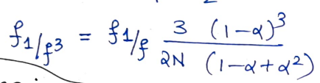
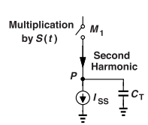
B) Flicker noise corner frequency f_{1/f}³
Ratio of positive and negative slopes is alpha.(Asymmetric ratio).
If α = (V₁+2V₂)/(V₁−2V₂).
Larger asymmetry increases corner frequency.
Example: M1 switching frequency is f0. It acts as a mixer and 2nd harmonic current drawn by CT is mixed with f0 to produce f0, and 3f0.
Thus, tail-induced 2nd harmonic doesn’t create asymmetry.
Why is this wrong?
M1 multiplies tail current with a square wave S(t) (0 to 1).
Fourier series of S(t) is 0.5
It is not fully canceled; Part of ID1 still has 2nd harmonics.
Causes asymmetry in rise/fall of VX and VY.

Slide 10
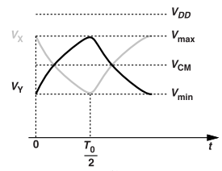
Basic Differential Ring Design
Focuses on performance and phase noise
Requirements to ensure proper oscillation.
Start-up condition: Small-signal low frequency voltage gain (gmRd) ≥ 2.
Voltage swings for low phase noise: Bigger swings help reduce phase noise.
  Voltage swing, V= IDD x Rd ;
Why Single-Ended Swing is less than ISS·RD in 3-Stage
differential Ring even if we steer all current ?
Oscillation frequency = f0
For a 3-stage ring, T0 = 1/ f0 = (2π/ √3)*Rd*CL.
Working:
  Vx & Vy are complimentary. VCM is common-mode level of Vx and Vy.
  Voltage swing is limited by charging/discharging rates of CL through Rd.
  Voltage swing at one end (Vx or Vy) never reaches VDD (VDD= ISS*Rd).

Slide 11
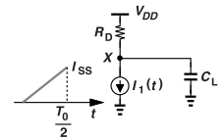
Single-ended voltage swing calculation:
  Current through RD reaches CL and charges it.
  This is a ramp function u(t) : 0 to ISS in T0/2 seconds:
    I₁(t) = ISS*t*(1/0.5*T0) u(t)
    Peak-to-peak single-ended voltage swing = 0.54 *Rd *ISS
Things to observe:
1. VCM doesn’t change.
  VCM = VDD - (Rd*ISS)/2
  Balanced Resistors on both sides give the same voltage drop across them
  Vx=Vy
2. Increase N-stages to reach full swing
  More N-stages slows down transitions : better pull/push towards VDD.
3. Small signal estimate of T0 still valid for large signal
  ω0 = √3 / (Rd*CL) ; Is based on 60-degree phase shift and is required.

Slide 12
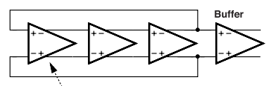
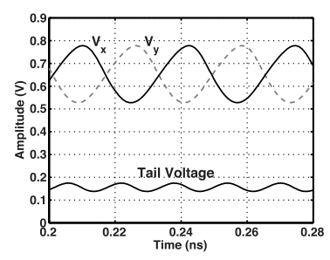
Sample circuit and Simulation results
Specs:
ISS=100uA, Rd = 6 kΩ
  Expected swing = 0.54·ISS·Rd ≈ 320 mV.
W/L = 400 nm / 40 nm : Ensures gmRd ≥ 2 for startup.
Process corner: Slow-Slow ; 75 °C ; VDD=0.95V ; CL= 0.6fF.
Results:
Single-ended swing: Only ~150 mV (≈ 0.25*ISS*Rd)
  Less than expected due to:
    Short loop delay (faster transitions).
    Incomplete current steering (ID1, ID2 swing from 30 µA to 70 µA).
Oscillation frequency: 42 GHz (2x faster than inverter-based rings).
Tail node voltage (Vp) = 80 mV is low
  Low due to large transistor overdrive (Vgs- Vth = 0.3V).
  Leaving limited Headroom for tail current source (= VDD-Vp = 0.87V).
Notes:
Up-conversion?
Low frequency noise(1/f) is converted to phase noise at higher freq. near oscillation output frequency.
Headroom?
The tail current source (typically NMOS) needs MINIMUM Vds to be in Saturation.
If Vp is very high, m1 and m2 may leave SR.
Headroom = VDD- Vp.
Here, Vp = 80mV and VDD=0.95V =>
Headroom is 0.87V which is very low to maintain stable ISS
Overdrive?
Vgs-Vth is the overdrive voltage. : Controls how strongly a MOSFET turns ON
Higher overdrive voltage → more current drive.
But, it reduced VDS headroom. → less voltage left across the transistor.
Vp is dependent on Vgs. So Vp increases Vgs increases, reducing Vds.

Slide 13
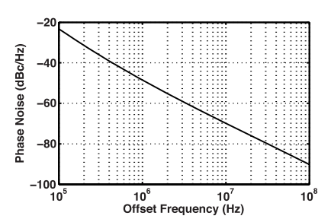
Phase noise Analysis
Flicker noise dominant < 1 MHz:
  26 dB drop from 100 kHz to 1 MHz
Thermal noise dominates at 100 MHz:
  Theoretical Sφn ≈ −99.5 dBc/Hz
  Simulated Sφn ≈ −90 dBc/Hz : worse due to incomplete switching
    Ideal derivation assumes full swing.
Low 1/f upconversion due to :
  Small swing
  Large Vgs-Vth (overdrive)
  2nd harmonic in Vx and Vy is –37dB (is low and good!)
Notes:
What happens if low upconversion is observed?
It is good.
The flicker noise stays at low frequencies and doesn’t degrade the oscillator’s phase noise near the carrier – better signal quality, lower jitter and clearer spectrum.

Slide 14
Design Improvements.
Performance comparison between differential ring and single-ended:
Differential rings have high power consumption and higher phase noise but produce a higher oscillation frequency.
We modify the circuit to get :- better headroom for ISS and complete switching.
Differential ring | Single-ended ring
Fosc = 42GHz | Fosc = 22.6GHz
Thermal noise at 100MHz= -90dBc/Hz | Thermal noise at 100Mhz = -104dBc/Hz
Power = 285uW | Power= 57uW
FOM = less comparatively | FOM = 15.6dB better

Slide 15
Improvement 1: Increase the width (double them to improve current steering).
W/L = 800nm/40nm
Results:
  Drain swing increases to 250 mV (from 150mVpp).
  Tail current swings from 17.5 µA to 87 µA.
  Frequency decreases to 31.3 GHz.
  Tail voltage swing increases : Vp peak-to-peak is 35mV
  Leading to higher 2f0 current due to tail capacitance = −23 dB.
Phase Noise:
  Expected drop at 100 MHz: ~7 dB, actual drop: 8 dB.
  When overdrive voltage = 220 mV
    Theoretical phase noise = −101 dBc/Hz.
    4dB lower than simulated. Actual= -97dBc/Hz
  Due to asymmetry and 2nd harmonics, Flicker noise upconversion increases.
Notes:
How does Vp swing increasing affect the 2nd harmonics?
Vp swing increases.
This swing interacts with the tail capacitances
This generates current at 2f0 frequency. {2nd harmonic of osc freq}.
This current flows through the differential circuit distorting the drain voltages.
-23dB is more than –37dB in the last circuit. It becomes dominant!
LES Symmetry and less linearity.

Slide 16
Improvement 2 – Again, double transistor size to enhance switching.
W/L = 1600nm/40nm
Results:
  Swing increases to 270 mVpp (from 250mVpp). Closer to 0.54*ISS*Rd.
  Frequency decreases to 20.8 GHz. (from 31.3GHz)
  Larger Voltage swing increases 2nd harmonic −19 dB.
  Rise/fall times: 21 ps / 28 ps (still asymmetric).
Phase Noise:
  Thermal noise drop at 100 MHz: 4.5 dB (due to freq. & swing increase ).
  Theoretical noise predicts = −103.7 dBc/Hz.
    Actual : 1.2dB lower than expected
  Flicker noise reduction: only 6 dB (expected: 7.25 dB from area increase).
    Low Due to asymmetry and increased 2nd harmonics
Increase W to increase Swings and reduce thermal phase noise.
It reduces Osc Freq, increases 2nd harmonics, consumes more power.

Slide 17

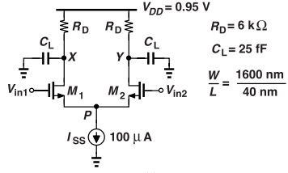
Methods for Obtaining Desired Frequency.
Aim is to produce oscillations of frequency 2GHz
1. Adding capacitance
Large external load capacitance (CL = 25 fF) is added to lower frequency.
This increases total node (X, Y) capacitance ; reduces f0, as per:
Result:
  f0 drops to 2.14 GHz from 20.89Ghz.
  Phase noise improves by ~18 dB (close to the expected 19.8 dB drop)
  Supply sensitivity improves to 74 MHz/V (because CL dominates over nonlinear intrinsic capacitance C_{DB})
Lower phase noise as oscillation frequency decreases.
Lower flicker noise as CL increases and Osc. freq decreases.

Slide 18
2. Larger transistors : Increase width and length.
W/L increased: from 1600 nm/40 nm → 8 μm/240 nm
Result:
  f0 drops to 2.27 GHz from 20.89Ghz.
  Voltage swing increases to 360 mV from 270mV.
    Due to complete switching producing full current steering.
  Phase noise improves:
    100 MHz offset: decreases by 21.5 dB
    Flicker noise decreases by 6.8 dB : expected is 26dB.
      Less than due to waveform asymmetry, rise of 2nd harmonics.
  Supply sensitivity worsens: 228 MHz/V
  - (It is worse because larger transistors → bigger parasitic caps)
  Larger Transistors are superior in phase noise but KVdd gets worse
    Compared to 1

Slide 19
3. Greater No. Of stages
Two opposing trends:
Higher N translates to Higher phase noise for constant power.
Higher N : Larger swings but lowering normalized phase noise.
The opposing trends mentioned above partly cancel each other out if N= 3 to 4
- Transistor dimensions (W/L): 4 µm / 240 nm and N=4
Results
  Oscillation frequency (f₀): 2.16 GHz
  Voltage swing (Vx, Vy): ~420 mV peak-to-peak
  Improved Supply sensitivity (KVdd): 194 MHz/V
  Phase noise:
    About 1 dB worse than large-transistor 3-stage design.
Larger transistor case : have the best FOM
4-stage case : has More phases & larger swings.

Slide 20
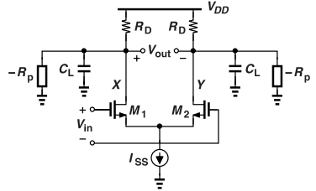
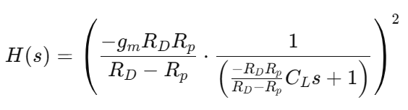

Two-Stage Ring Oscillators.
Initial challenge:
Two simple differential pairs cannot oscillate on their own.
They provide only 2 poles and fail to provide 180 phase shift at any finite f.
Proposed Solution: Negative resistance concept:
-Rp is connected from each o/p of the differential pair to the ground.
This cancels loss and initiates oscillation.
Each stage is a differential pair + negative resistance to ensure sufficient loop gain and phase shift.
Loop gain for 2 stages is square of gain of 1 stage :-
  Solving for s that makes H(s)=-1:
  This means:
    Right-half-plane poles (i.e., unstable)
    The system naturally amplifies noise
    grows exponentially until nonlinearity (saturation) limits the amplitude.

Slide 21
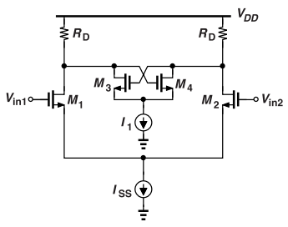
What does the circuit predict if (a) Rp = ∞, or (b) Rp = RD?
(a) Rp = ∞:
RL = (RD⋅∞ ) / (RD−∞) = −RD
Poles are in the left half plane ; no oscillation (system is stable).
(b) Rp=RD: also true if Rp>RD
RL = ∞ :
Load resistance for NMOS and PMOS is same
Poles are on the jω-axis ; ideal sustained oscillation.
Circuit behaves like two ideal integrators ; perfectly satisfies Barkhausen criterion.
Practical Realization of Negative resistance:
To physically implement the negative resistance Rp<RD.
Use a cross-coupled pair (M3, M4) between outputs X and Y. Rp =1/ gm3,4.
So, RL =RD / (gm_{3,4}*RD−1)
Notes:
An integrator is a system whose output is the integral of its input—in Laplace domain, its transfer function is: H(s)=1/s;
when you have two ideal integrators in cascade: H(s)= 1/s^2 :
This gives a −180° phase shift.

Slide 22
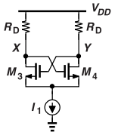
Example: Can gm1,2 be chosen arbitrarily?
If gm1,2 = 0:
  M1/M2 differential pair reduced to 2-uncoupled cross-coupled pairs.
  M3 and M4 act as negative resistance.
  These cannot oscillate. This cause Latch-up.
The latch-up problem:
  Gm3,4 must be above unity for poles to be created on RHS.
  Positive feedback in cross-coupled circuit around the loop pushed Vx and Vy in opposite directions preventing latch-up.
  Forcing Vx & Vy to diverge completely until one mosfet switches off and the other conducts all current.
  NO negative resistance to help oscillate.
Solution: keep gm1,2 large and ISS large
Notes:
Why keep gm1,2 and ISS large?
To inject enough current into differential circuit
Periodically kick the latched pair 3&4 back into active mode
So to have negative resistance and oscillate!

Slide 23
PMOS cross-coupled pair
PMOS M3, M4 draw current from VDD through RD.
For M3 & M4 to be "ON" and providing negative resistance,
  |Vgs3,4| must be there.
  Common-mode : Vx and Vy = VDD - |Vgs3,4|
VDD needs to accommodate for voltage drop across PMOS, VDS, V:
  VDD ≥ |Vgs3,4| +VDS_{1,2} + V_{ISS,}
Comparision to NMOS: VDD = (ISS + I1)RD/2 + VDS_{1,2} + V_{ISS}
Why is PMOS worse for headroom?
PMOS adds |Vgs3,4| to VDD drops. This is a fixed threshold-like voltage.
It forces VDD to be higher. Consumes more headroom.
Notes:
NMOS is not constrained by a gate-source voltage

Slide 24
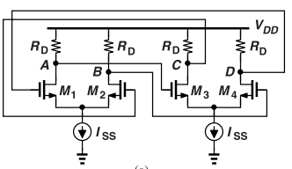
Two-stage differential ring and positive feedback
Why does it not latch up due to positive feedback?
  Anti-phase inputs due to differential operation force the output to change.
  Impossible Symmetric Latch-up:
    The assumed latch-up state (e.g., A = B = 1, C = D = 0) is not physically valid.
    It implies some differential pairs are fully on while others are fully off in a ring. (e.g., M1,M2 are off and M3, M4 are ON).
  All nodes start at the same voltage; oscillation starts due to device noise, not positive feedback.
  Unlike latch circuits, the tail nodes are connected to ISS, not ground.

Slide 25
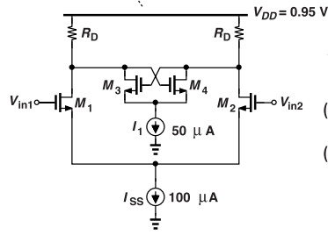
Design Examples
Initial Design:
  W/L ratios: M1,2: 8 µm / 120 nm M3,4: 4 µm / 120 nm
  Per stage: 150 µA total → 100 µA (differential pair)
  + 50 µA (cross-coupled pair)
  Results:
    Oscillation frequency: 2.14 GHz
    Swing: ~250 mVpp (less than 3-stage ring: 360mVpp).
    Phase noise: 3–4 dB worse than 3-stage design due to lower swing.
2. Shared tail:
  This enables automatic current splitting.
  Advantage: higher voltage swing
  Disadvantage: 10–15 dB higher flicker noise up-conversion.

Slide 26
Tail node waveforms of differential and cross-coupled pairs.
Of one stage, tail nodes are off by 90 degrees input/ouput.
Separate Tails:
  P generates 2f0 voltage waveform.
  Q node receives 90 degree shifted o/p. Also generates 2f0 waveforms.
  Vp and VQ are 180 degree out of phase.
Shared tails:
  P and Q are shorted 180 degree out of phase.
  2f0 waveforms get partially cancelled out.
  If they cancel out exactly:
    The shared node becomes an AC ground. (The voltage remains same).
    This increases 2nd order non-linearity and flicker noise due to absence of common source node voltage.
  This occurs even without tail capacitance. The cancellation itself—not capacitance—causes the issue
Notes:
2f₀ components from differential and cross-coupled pairs cancel at the shared tail node,
making it an AC ground. This:
Prevents source node voltage modulation
Removes beneficial degeneration
Increases second-order nonlinearity
Worsens flicker noise up-conversion

Slide 27
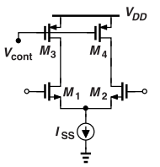
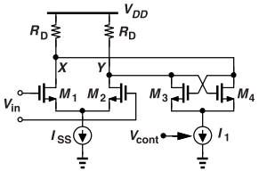
Tuning Techniques for Differential Rings.
The 3 types of tuning techniques are:
Resistive Tuning
  PMOS Load Tuning:
    PMOS in triode acts as voltage-controlled resistor.
    Issues faced:
      Voltage swings changes with resistance.
      Range of Vcont is limited to keep PMOS in triode.
      Leads to nonlinear frequency tuning.
  Negative Resistance Tuning :
    Cross-coupled pair M3 & M4 parallel with Rd introduces tunable –2/gm resistance.
    I1 current sets the strength of the negative resistance.
    Allows continuous tuning of 10–20% f₀
Notes:
Talk about how negative resistance is being created here?

Slide 28
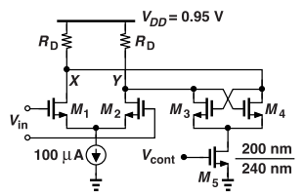
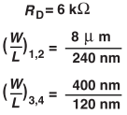
Design Example:
f₀: 2.2 GHz → 1.83 GHz as Vcont increases.
Swings: 360 mV → 480 mV
KVCO ≈ 1 GHz/V
Keep M5 in saturation by limiting Vcont.
What if M5 enters triode region?
It behaves more like a resistor than a current source.
When VX = VY, the voltage across M5 depends on VDD.
  Specifically: Vds5 = VDD − V_{RD} − Vgs of M3/M4
Any fluctuation in VDD affects the current through M3 and M4 (ID3,4)
That changes their gm, which controls the negative resistance.
Thereby modulating oscillation frequency.
Supply rejection gets worse

Slide 29
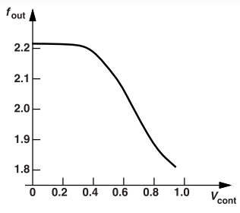
Phase Noise Behavior with Negative-Resistance Tuning
Thermal noise f₀ = 2.2 GHz to 1.83 GHz,
  phase noise is expected to be 1.6 dB due to reduced frequency.
  Actual drop is 3 dB at 100 MHz offset
At 100 kHz offset, phase noise remains at −62 dBc/Hz.
  Reason: Flicker noise from tuning transistor M5 is dominant, as its noise directly affects Vcont.
  Doubling M5’s W and L reduces phase noise by 1 dB.
Observations:
  Flat zone in tuning curve for Vcont = 0 to 400 mV.
  High KVCO in the range 400 mV < Vcont < 900 mV.
    Can be Reduced KVCO by scaling down M3–M5.
  Lower PVT variations compared to invt rings.
    Frequency depends on Rd and CL ; More stable than transistors.
    RD: ±15%, CL: ±5% for frequency ±20%.

Slide 30
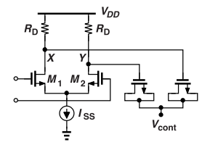
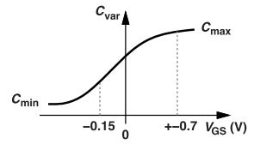
2. Varactor tuning:
Uses MOS varactors for frequency tuning.
Varactor network adds negligible phase noise:
  much cleaner control compared to transistor-based tuning
Preferred technique due to:
  low flicker noise
  stable tuning range
  no direct transistor in control path → less noise injection.
Relies on accurate varactor models to set tuning range.
EXAMPLE: Varactor Tuning Range
As the control voltage Vcont varies from 0 to VDD:
Vcont goes from V1 to V2, the varactors’ voltage varies from VDD −ISSRD/2− V1 to VDD −ISSRD/2−V2.
This causes the varactor to operate across most of its C-V curve.
If capacitance doesn’t flatten at high VGS, f₀ keeps changing as Vcont decreases.
Notes:
How does Varactor operate across most of its cv curve?
At low Vcont , VGSV is positive → Capacitance is high (accumulation).
At high VcontV, VGSV becomes negative → Capacitance is low (depletion/inversion).

Slide 31
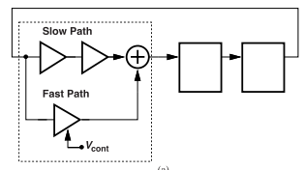
3. Tuning the number of stages:
Each stage has a slow path and a fast path.
Vcont controls the strength of the fast path.
If fast path is off → only slow path → lowest frequency.
If fast path is fully on → signal bypasses slow path → highest frequency.
Intermediate Vcont → circuit interpolates between both paths.
Effectively changes the number of active stages from 6 to 3.
Overall
Resistive : poor linearity/noise
N-stages: wide range and high Phase noise
Varactor : Best case

Slide 32
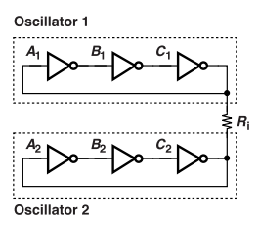
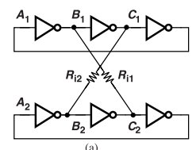
Inverter-Based Oscillators with Complementary or Quadrature Outputs.
Coupled oscillator: Single-ended rings require odd no of stages for oscillations. Coupled osc can generate oscillations which are 180 degree shifted.
Single Resister (Ri)
  They operate in-phase.
  No current flows through Ri.
  Minimum energy exchange.
  No complimentary outputs.
Two resistors
  The outputs are 180 degree out of phase.
  Less energy exchange per cycle
  Only 0- or 180-degree phase difference is possible due to symmetry.
  Intermediate values lead to unbalanced energy transfer.
  Energy operation for In-phase is 2/3 and out-of-phase is 1/3 of the times.
Notes:
In-phase operation is 2/3 and out-of-phase is 1/3 of the times.
How is this possible?

Slide 33
How is this possible?
Ri1 connects B1 to C2
Ri2 connects C1 to B2
Each oscillator has 3 stages, so signals at nodes A,B, and C are 120 degree out of phase with each other.
In-phase : energy exchange is for 2/3rd times:
  When in-phase, signals at A1/A2, B1/B2 etc., rise & fall together.
  But signals at B1 and C2, C1 and B2 are not perfectly aligned.
  Current flows through the resistors due to the voltage difference.
  (B1 & C2), (C1 & B2) differ in voltage for two-thirds of the cycle.
  So, energy exchange happens for 2/3 of the time.
Out of phase : energy exchange is for 1/3rd times:
  When out of phase by 180 degrees, signals are complementary. (A1= 1; A2=0).
  B1 to C2 and C1 to B2 align better when out-of-phase and thus less energy exchange.

Slide 34
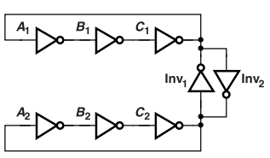
3. Inverter based:
A) Inv1 and Inv2 are anti-parallel.
They inject a fraction of one oscillation signal into another.
A1 and A2 are out of phase by 180 degrees is encouraged.
  Inverters only inject current (transient), minimizing disruption.
A1 and A2 are in-phase disrupts the the operation.
  Inv1 and Inv2 are weak :
    Oscillator suffers from a frequency mismatch
    Synchronization (“injection locking”) does not occur.
  Inv1 and Inv2 are strong:
    They act as a regenerative latch : circuit locks into ONE/ZERO.
Strength of these inverters should be 20% of the main inverters.

Slide 35
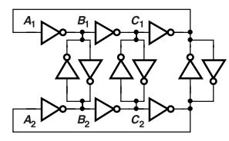
B) Solving phase mismatch from coupling inverters.
Coupling inverters load only A1 and A2, causing phase mismatches across the ring.
Applications that need all phase outputs, this is a problem.
Solution is to add similar coupling inverters at other nodes to balance loading.
Resulting phase steps become 60° (not 180°/2M).
Phase noise consideration
Design goal: To design coupled osc topology for 2GHz
Uses stages derived from 2.5GHz 3-stage ring from chapter 3.
Results: 2.3GHz
This coupled design has 30 "unit" inverters {6 main 4xstrength+ 6coupling}
Expected power/noise tradeoff: 10xpower should reduce 10dB Phase noise.
Observed: 115uA of supply current. Lower frequency & 10db Reduction in PN!
This generates Complementary o/ps' with little penalty to FOM

Slide 36
Example: Does Differential o/p reduce supply sensitivity?
In true differential oscillators, supply noise affects both sides and gets cancelled off.
But, in coupled inverter rings, though outputs are complimentary, all inverters depend on VDD for switching.
So, if VDD changes, all inverter delays change.
  Affects frequency of operation
  Shifts frequency for both rings (top & bottom) in the same direction.
  Thus, No cancellation of this effect.
Result: Only ~15% reduction in supply sensitivity vs. a single ring.

Slide 37
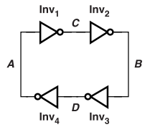
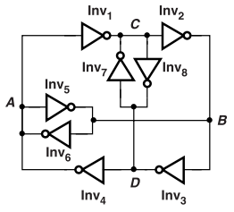
Direct Quadrature Generation (4-stage)
Get A,B,C,D waveforms.
A&B, and C&D are complimentary, but A&C are 90 degrees apart {Quadrature}
Each inverter adds delay which are 90 degrees apart.
Problem: Latch-up possible
Solution: Add a cross-coupled inverter (invt : 5 to 8).
  This will fight equal states and forces transitions to occur.
  Keep Inverter 5 to 8 weaker than the main ones to prevent latch-up.
  Results:
    Higher frequency than 3-stage, slightly worse FOM
    Higher power consumption.
Quadrature generation trades power efficiency for multi-phase outputs.

Slide 38
Quadrature Generation by interpolation
Goal: Generate quadrature outputs from a simple ring oscillator using phase interpolation.
To create intermediate phases without special topology.
Working and Implementation:
Add outputs from two stages with different phases (e.g., B1 + C2) → result is ~90° shifted.
Use two inverters and short their outputs to compute (B1 + C2)/2. -A quadrature.
Output approximates interpolated phase D1,D2, etc.
When B1 and C2 are both high or both low → output is clean, no extra power used in changing the o/p when B1 and C2 do not match.
During switching : one inverter pulls up, the other pulls down : Static current
This causes power loss and some error in output.
Notes:
How does static current flow?

Slide 39
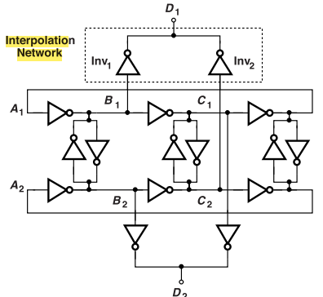
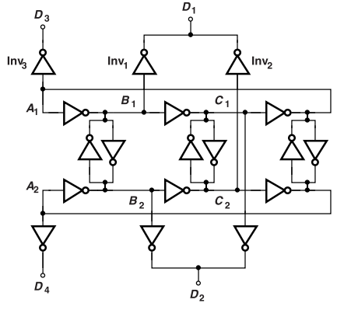
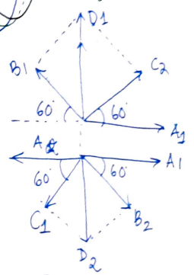
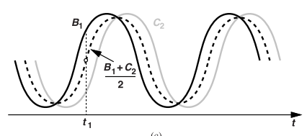
Issues:
The load cap introduced by the interpolating inverters creates a phase mismatch between B1 and A1 (and B2 and A2).
Finite delay of Inv1 and Inv2 lead to mismatch between D1 and A1, D2 and A2.
Figure b alleviates these issues.
interpolated waves
Quadrature
phasor
Fig A : Original
Fig B: modified

Slide 40

Ring Oscillators with LC Loads.
Why LC loads?
Traditional ring oscillators are limited by stage count and load capacitance especially when generating multiple phases.
LC Tank per Stage:
Each stage includes an inductor (L) and capacitor (C) that form a resonant (RLC) circuit.
Oscillation Condition:
Each stage must provide 45° phase shift, so the ring (4 stages) achieves total 180° shift thus satisfies Barkhausen’s criterion.
Oscillation Frequency (approx.) :
But no phase shift at w0
Osc freq must depart from w0 so as to yield a phase shift of 45 degrees.

Slide 41
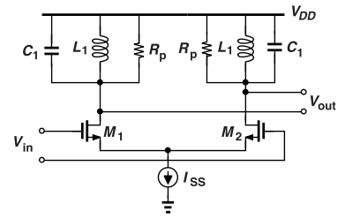
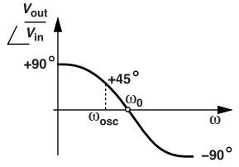
Advantages:
Low Supply Voltage:
Inductive loads have small DC voltage drop → allows operation near VDD.
Frequency Less Dependent on-Stage Count:
Oscillation frequency remains stable even with more stages.
Higher Frequency:
Load capacitance merges with LC tank → achieves higher oscillation frequency.
Disadvantages:
Area overhead:
Requires many spiral inductors.

