Slide 1

CYBER SECURTIY PROJECT Cracking WPA/WPA2 Networks(with Denial of service)
Name- Yash Dabas
Roll No.- 2021UCA1912
Class- CSAI 2
Mentor- Gaurav Singla Sir

Slide 2
What are WPA/WPA2 Networks
WPA (Wi-Fi Protected Access) and WPA2 (Wi-Fi Protected Access 2) are two security standards that protect wireless networks. WPA2 is the second generation of the Wi-Fi Protected Access security standard and so is more secure than its predecessor, WPA.

Slide 3
About the Attack
Cracking a WPA or WPA2 network requires tools like Aircrack-ng, wifite, reaver etc. In this presentation we will implement the attack using Aircrack and an example of wifite.
Aircrack-ng uses various techniques to crack WEP and WPA/WPA2-PSK keys. Airbase-ng is a multipurpose tool aimed at attacking clients as opposed to the Access Point itself. Airdecloak-ng removes WEP Cloaking from a packet capture file. Airdrop-ng is a rule based wireless deauthication tool.

Slide 4
1) Preparing for the attack
To start the attack we need to set the mode of our wifi adapter to “Monitor” and shut down our Network Manager.
Monitor mode is a special mode that allows your computer to listen to every wireless packet.
The instructions are-
ifconfig wlan0 down (It shuts the wireless card completely)
iwconfig wlan0 mode monitor (changes the mode of the wifi adapter)
Ifconfig wlan0 up ( Turns on the wireless card again)
airmon-ng check wlan0 (shows the process that can cause trouble, including network manager)
Kill PID (PID is the Process Identification Number of Network manager)

Slide 5
2) Exploring nearby Networks
Using command
airodump-ng wlan0
we will get the list of all nearby networks with their BSSID(Basic Service Set Identifier) which is unique for a given wifi network.

Slide 6
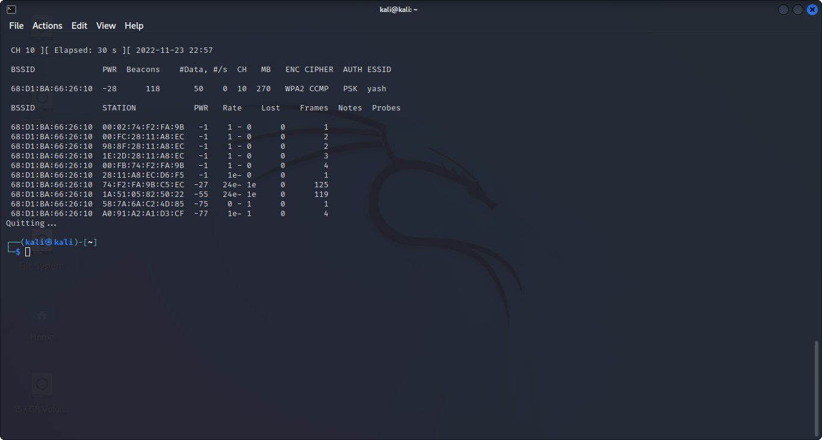

Slide 7
3) Selecting a Network
Airodump–ng –c 10 –w SCAN_test –bssid 68:D1:BA:66:26:10 wlan0
This command will select the network with specified bssid and show it’s properties along with the devices that are connected to it.
Here Airodump-ng is the main command, -c represents the channel (i.e 10 in this case), -w is followed by the name of the file in which the scan results are stored ( SCAN_test is the name of the file), --bssid is followed by the network we want to select and in the end the name of our wireless device (mine is wlan0).
Next slide shows the result of this command-

Slide 8
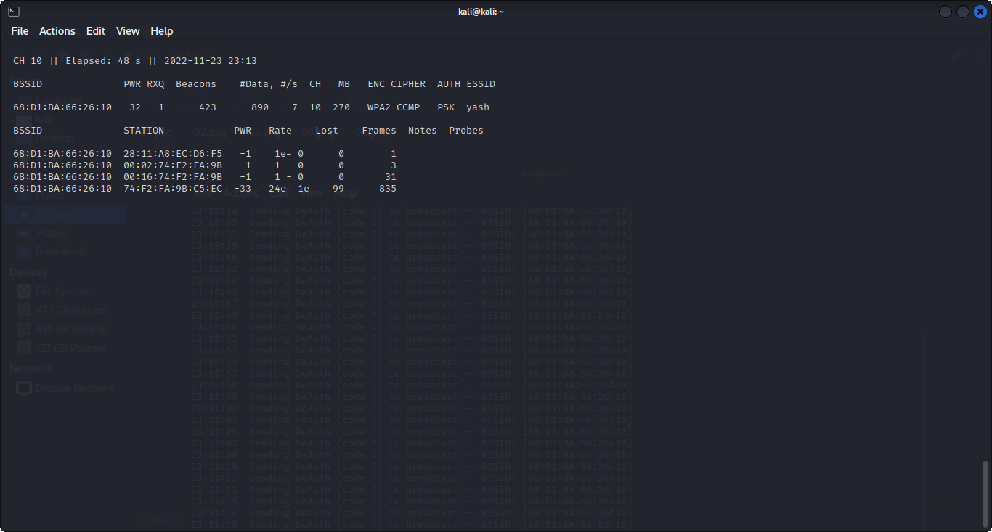

Slide 9
4) Denying Service to the Connected Devices
Decrypting the password of a WPA/WPA2 is by capturing a handshake.
A handshake in wireless networks is the exchange of information between the access point and the client at the time the client connects to it. This information contains a variety of keys, the exchange takes place in several stages.
A handshake can be captured while connecting a client who knows a valid password to a wireless access point
The handshake contains enough information to decrypt the password.

Slide 10
So, to capture a handshake we need to disconnect the devices from the network and then let them connect.
Aireplay-ng -0 0 –a 68:D1:BA:66:26:10 wlan0
Aireplay-ng is also a command of Aircrack-ng, -0 0 specifies the number of devices we want to limit for connecting to this network (In this case no device will be able to connect to the network)
This command will disconnect all the connected devices from the specified network until we stop the command.

Slide 11
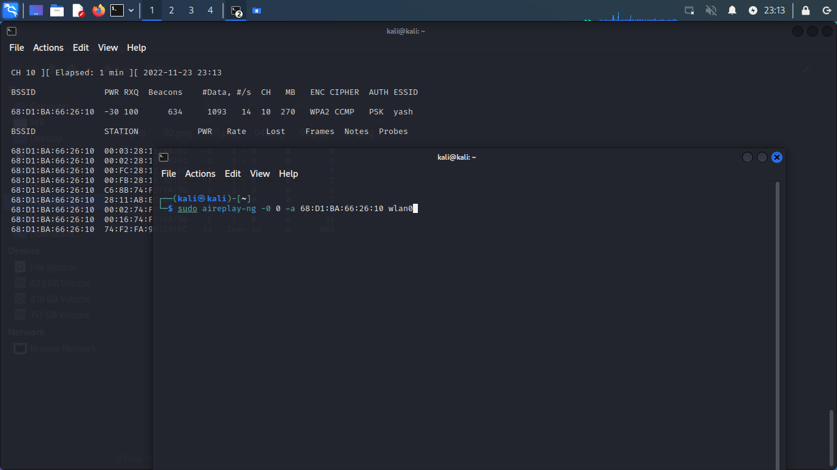

Slide 12
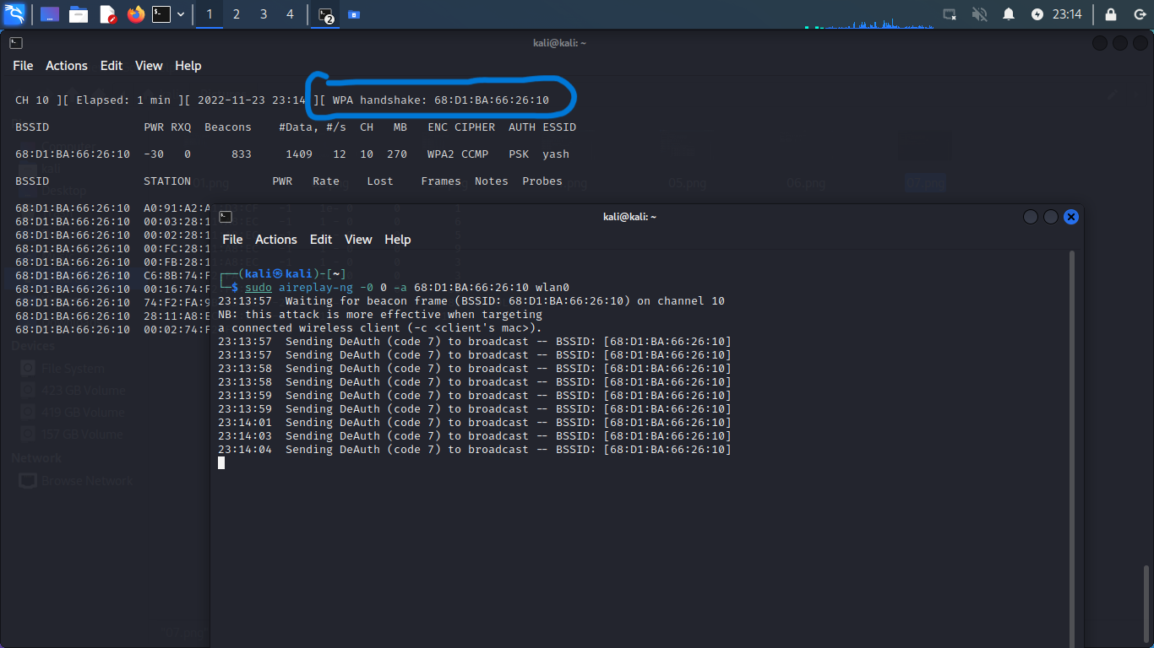

Slide 13
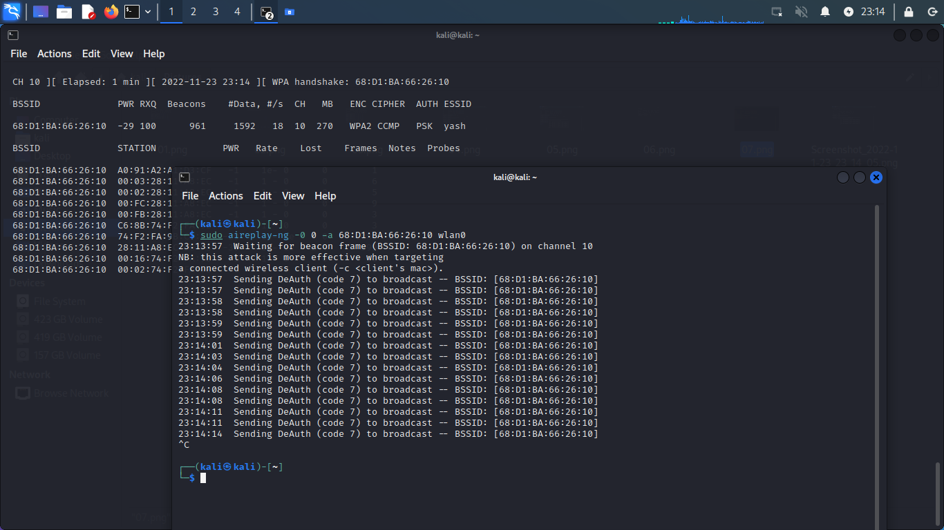

Slide 14
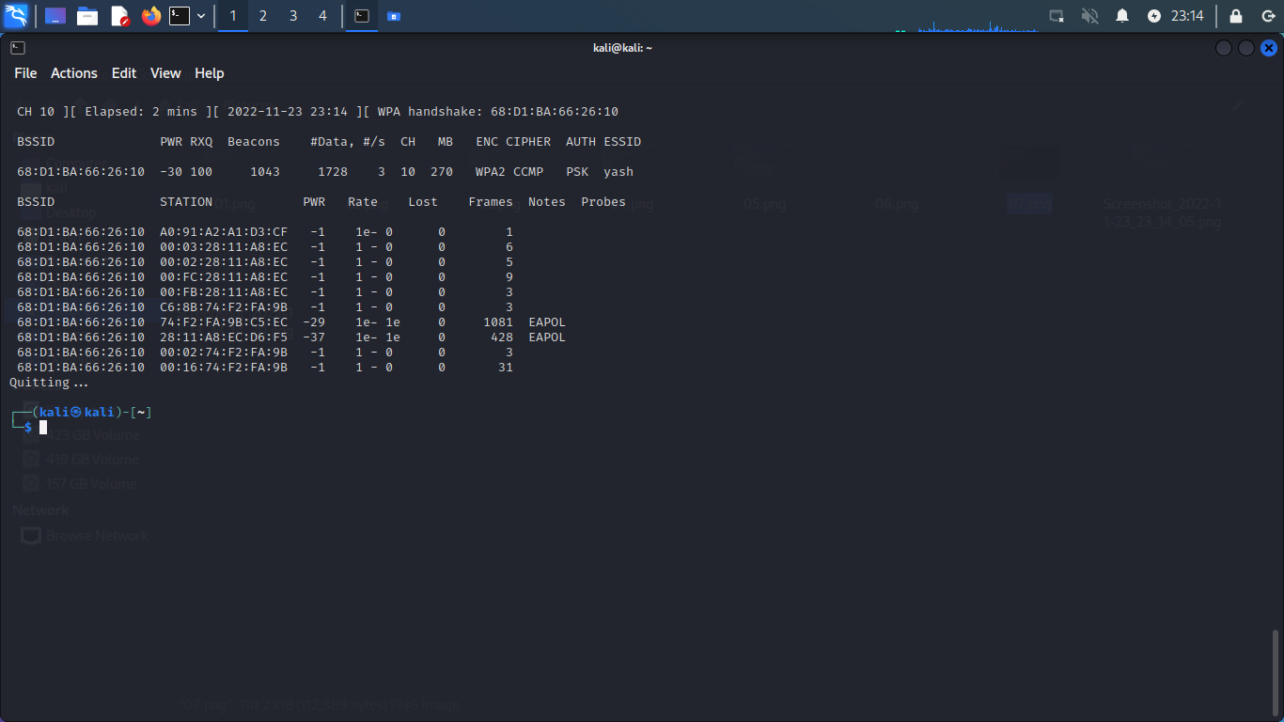

Slide 15
5) Brute Force Attack
Now a handshake is captured and decrypting the password from the handshake is done by brute force (brute force, brute-force). That is why the decryption of the password in the captured handshake has a probabilistic character. Those. does not always end well.
We can either run the simple brute force attack which will try every password from the wordlist already installed which includes commonly used passwords or a modified brute force attack which includes some details like the length of the password or name of the person, the number of character, symbols, etc. which makes the attack highly effective.

Slide 16
We will be doing a modified brute force attack.
Command-
crunch 9 9 –t yash^%%%% 12345678 | aircrack-ng –w – SCAN_test-05.cap –e yash
Crunch is a wordlist generator where you can specify a standard character set or any set of characters to be used in generating the wordlists. The wordlists are created through the combination and permutation of a set of characters. You can determine the amount of characters and list size.
9 is the size of word.
-t is followed by the word where
@ will insert lower case characters
, will insert upper case characters
^ , will insert symbol
%,will insert number
12345678 represents which numbers are to be shuffled to make the password.

Slide 17
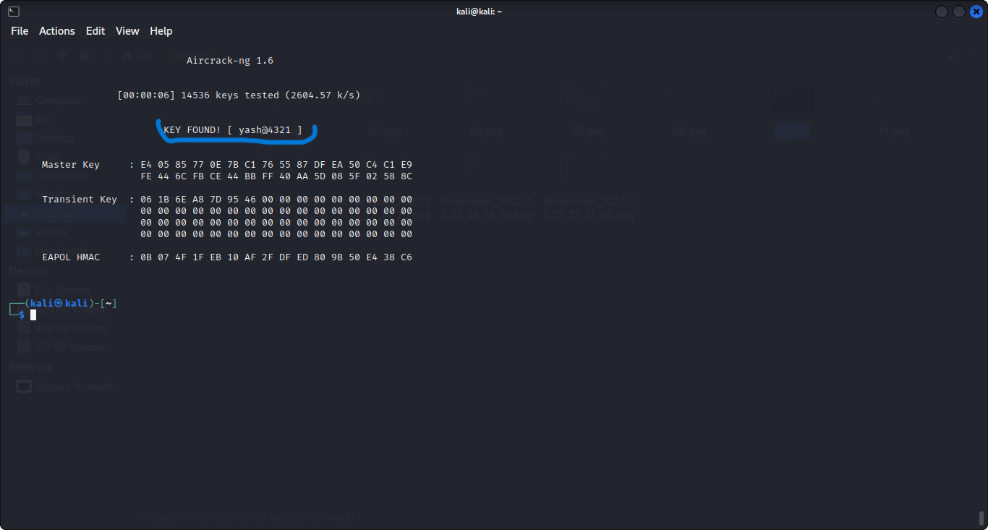

Slide 18
The password is encrypted and came out to be yash@4321.
Simple brute force attack to encrypt passwords can also be done by wifite.
Wifite is a tool to audit WEP or WPA encrypted wireless networks. It uses aircrack-ng, pyrit, reaver, tshark tools to perform the audit. This tool is customizable to be automated with only a few arguments and can be trusted to run without supervision.
Below is an example-

Slide 19
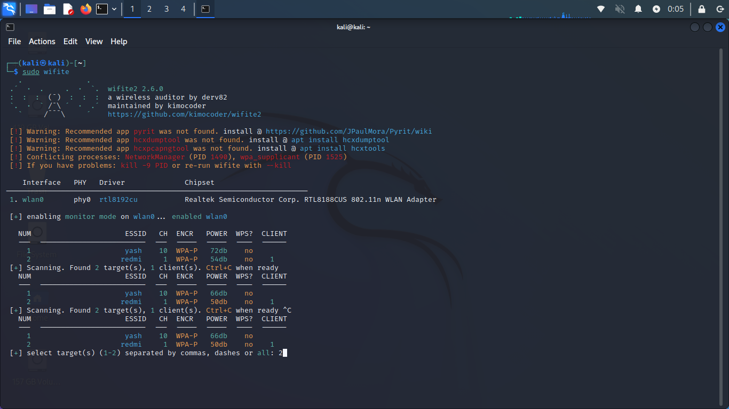

Slide 20
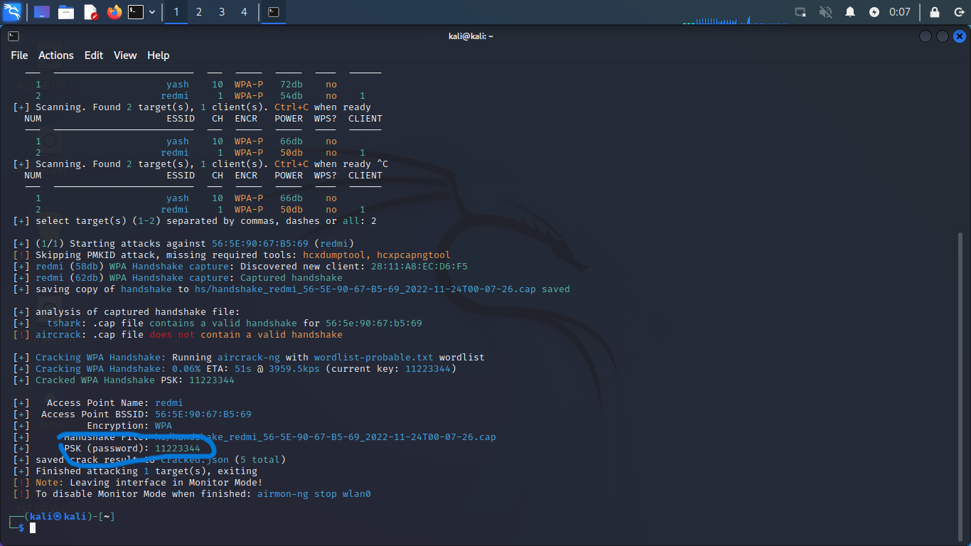

Slide 21


