Slide 1


Food Delivery System Using Graph, Queue, and Linked List
SUBMITTED BY : NAME – YASH CLASS – 24BCA (6B)
UID –24BCA10393
SUBMITTED TO: NAME – JOYTI RANI MA’AM

Slide 2
1.Abstract:
This project simulates a Food Delivery System that utilizes core data structures: Graph, Queue, and Linked List. The system models locations (restaurants, customers) using a graph to calculate shortest delivery paths using Dijkstra’s algorithm. A queue handles customer orders in First-Come-First-Serve (FCFS) manner. The linked list is used to dynamically store and display the restaurant menu and order history. This project demonstrates how data structures help manage real-world delivery systems efficiently.

Slide 3
2.Project Report (Summary):
Project Title: Food Delivery System using Graph, Queue & Linked List
Programming Language: C
Concepts Used:
Graph: For route calculation and shortest path (Dijkstra’s Algorithm)
Queue: To handle incoming orders in FCFS fashion
Linked List: For dynamic menu and order storage
Modules:
Menu management using linked list
Order processing using queue
Delivery routing using graph
Outcome: Practical understanding of how data structures are applied to simulate real-world systems.

Slide 4
3. Objective:
To design and implement a Food Delivery System using advanced data structures: Queue, Linked List, and Graph.
To optimize delivery routes using Dijkstra’s Algorithm and provide efficient order processing and menu handling.
To simulate a real-world scenario where food orders are dynamically stored, processed, and delivered efficiently.
4. Methodology:
The design of the system involves the following steps:
Queue is used for managing customer orders in a First-Come-First-Serve (FCFS) manner. When a customer places an order, it is enqueued and processed sequentially.
Linked List is used to store the restaurant’s menu items. Each node contains item name and price. The list allows dynamic updates (adding/removing items) as per restaurant offerings.
Graph is used to represent the delivery route between restaurants and customers. Nodes represent locations, and edges represent distances or time taken. Dijkstra’s Algorithm is implemented to find the shortest path for quick delivery.
This methodology ensures that the system is scalable, efficient, and realistic, mimicking an actual food delivery application.

Slide 5
5.Flowchart:
Queue Operations: When a customer places an order, it is enqueued into the order queue. Orders are processed and dequeued one at a time following the First-Come-First-Serve (FCFS) principle.
Graph Operations: Each location (restaurant, delivery point, customer) is a node in the graph. When a delivery is to be made, the graph is used to calculate the shortest path from the restaurant to the customer using Dijkstra’s algorithm.
Linked List Operations: The restaurant menu is stored in a linked list. Each menu item is a node containing the item name and price. When the menu is updated (add/remove items), the linked list is modified dynamically.

Slide 6
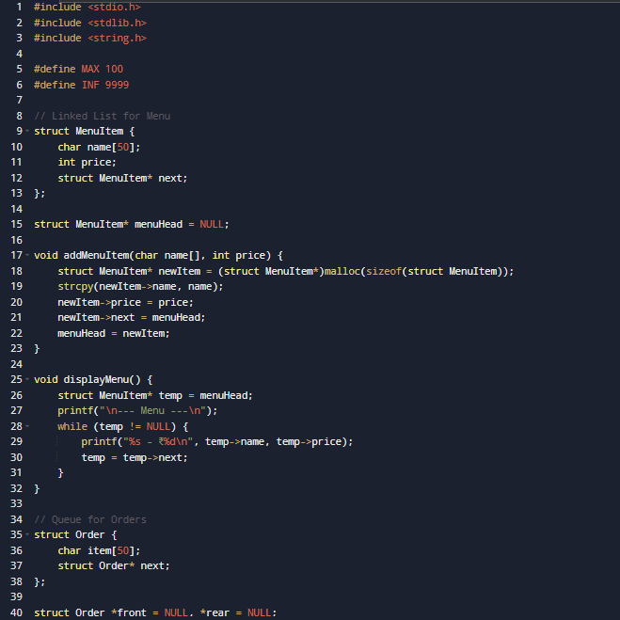
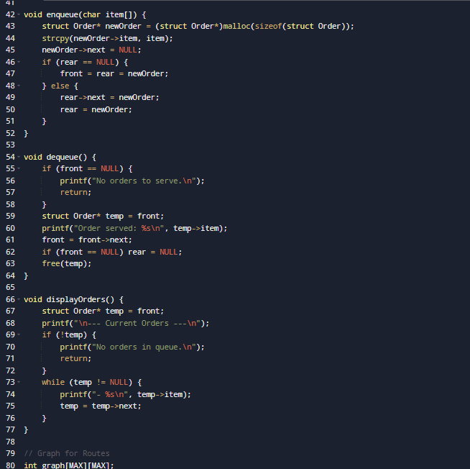

Slide 7
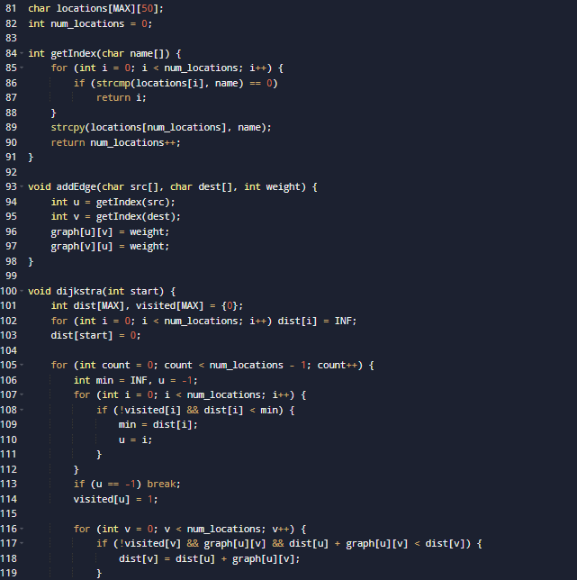
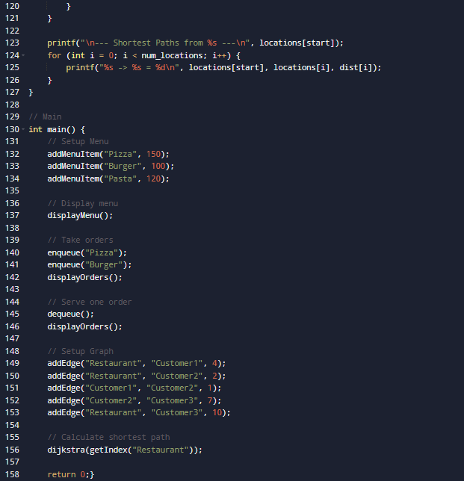

Slide 8
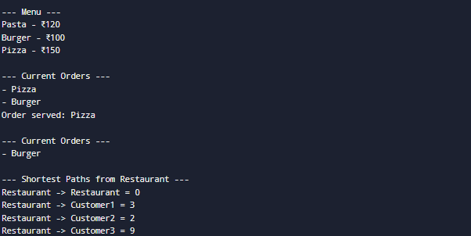
OUTPUT:

