Slide 1
P-2104B: Return to Service Decision
Mangalore Refinery and Petrochemicals Limited
Sovereign AI Workbench - On-premise agentic document intelligence
Generated on-premise 2026-09-03 20:14:15 | model qwen2.5:7b-instruct

Slide 2
Recommendation
• Pump P-2104B must not be returned to service on its existing seal arrangement. Vibration has
risen from 3.9 mm/s to 9.6 mm/s over eight weeks, crossing the 7.1 mm/s alert threshold on
2026-08-13 [VIB-CDU2-2026_Vibration_Log.xlsx, sheet Readings].

Slide 3
Evidence
• Overall velocity reached 9.6 mm/s on 2026-08-27, which is 87% of the 11.0 mm/s trip limit [VIB-
CDU2-2026_Vibration_Log.xlsx, sheet Limits].
• The August seal failure on the same machine was attributed to Plan 52 pot level loss
[INC-2026-0042_Seal_Failure_P-2104B.pdf, p.2].
• HAZOP action H7-03 covering seal-pot low-level alarms remains OVERDUE [HAZOP-
CDU2-2024_Node7_Action_Register.pdf, p.1].

Slide 4
Blockers
• Seal kit SK-682-2104-A3 shows zero on hand with a 45-day lead time [SPR-
ROT-001_Spares_Inventory.xlsx, sheet Stock].
• Hot work in CDU-2 is suspended until 2026-11-30 under circular SC-2026-11
[SC-2026-11_Hot_Work_Restriction_CDU2.pdf, p.1].
• Two operators have lapsed competency for the changeover SOP [TRN-
CDU2-MATRIX_Competency_Matrix.xlsx, sheet Matrix].

Slide 5
Next steps
• Raise an expedite request against the seal kit, close H7-03 before restart, and run the
changeover on P-2104A per SOP-CDU2-014 Rev 4 step 7 [SOP-CDU2-014_Rev4_Pump_Changeover.pdf,
p.3].

Slide 6
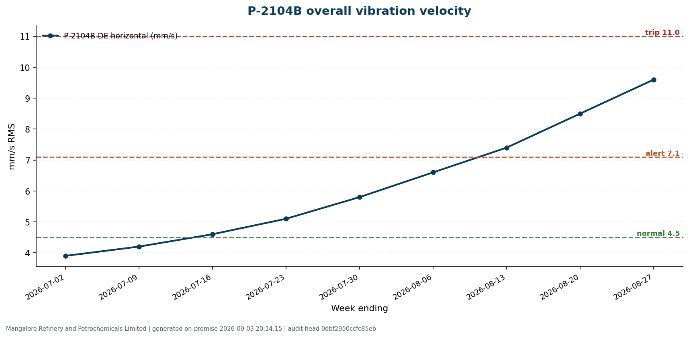
chart P 2104B overall vibration velocity 20260903 201415

Slide 7
Provenance and chain of custody
Generated: 2026-09-03 20:14:15 (on-premise)
Model: qwen2.5:7b-instruct served locally at http://127.0.0.1:11434
Question: Can we return P-2104B to service, and what is blocking the seal upgrade?
Sources cited: 6 document reference(s)
Audit chain: 32 records, intact, head 2bb426b247195b1262286dfd1bb272df
Session: 4194ed5e9f57
Sources:
1. VIB-CDU2-2026_Vibration_Log.xlsx, sheet Readings
2. INC-2026-0042_Seal_Failure_P-2104B.pdf, p.2
3. HAZOP-CDU2-2024_Node7_Action_Register.pdf, p.1
4. SPR-ROT-001_Spares_Inventory.xlsx, sheet Stock
5. SC-2026-11_Hot_Work_Restriction_CDU2.pdf, p.1
6. SOP-CDU2-014_Rev4_Pump_Changeover.pdf, p.3
Generated on-premise by the Sovereign AI Workbench. No data left this machine. Source documents are synthetic prototype data.

