Slide 1

SMART INDIA HACKATHON 2026
Team
PlotVortex
SatQuery AI
Problem Statement ID – SIH26167
Problem Statement Title – SatQuery AI-
An Interactive Vision-Language Assistant
for Multimodal Remote Sensing Image Analysis
through Text Queries
Theme – Space Technology
PS Category – Software
Team ID – [Your SIH Team ID]
Team Name – Team Plotvortex
🌐 Live Prototype: https://satquery-ai.demo | 💻 GitHub: github.com/TeamPlotVortex/SatQuery-AI

Slide 2
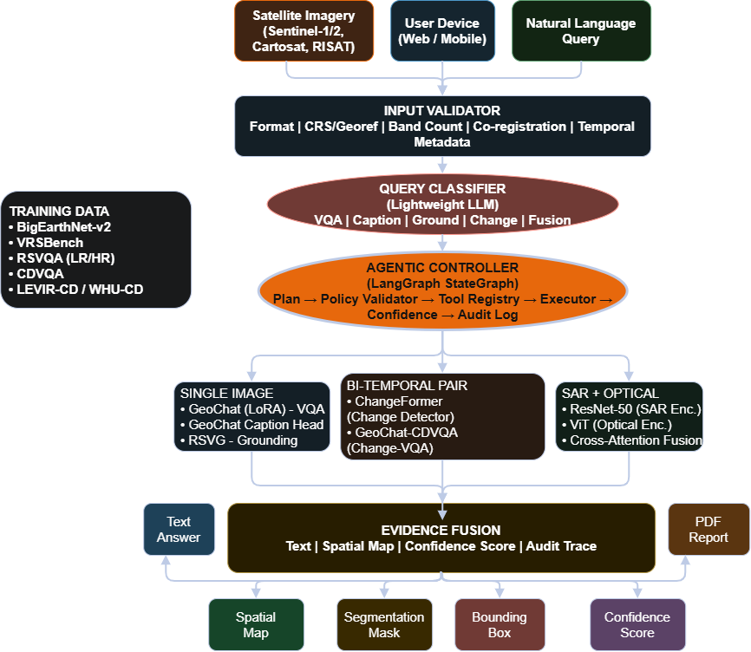
SatQuery AI – Agentic Vision-Language Assistant for Satellite Image Analysis
Team
PlotVortex
Problem -
• Extracting insights (VQA, Change detection, SAR analysis) requires Geographic
Information System expertise, Specialized software, and hours of Manual processing.
• Critical users — NDRF officers, forest departments, farmers, urban planners — cannot access this data during time-sensitive decisions.
• No existing system lets a user simply ASK a question about a
satellite image and get a grounded, visual answer instantly.
Proposed Solution -
• Agentic Vision-Language Platform — evidence-backed answers,
with zero GIS expertise required for any user query.
• Multi-Task Remote Sensing — Unifies Scene Captioning, Visual Grounding,
Bi-Temporal Change Detection, SAR–Optical Fusion, Visual Question Answering.
• Agentic Controller — Classifies query intent, selecting correct specialist model, execution, returns a fully auditable execution trace — nothing unvalidated.
• Evidence-Grounded Confidence Engine — Multi-factor confidence scoring instead of a hallucinated LLM guess.
• Deployment-Ready System — GeoTIFF-native ingestion, interactive map interface, downloadable reports, containerized with Docker —for real ISRO operational use.

Slide 3
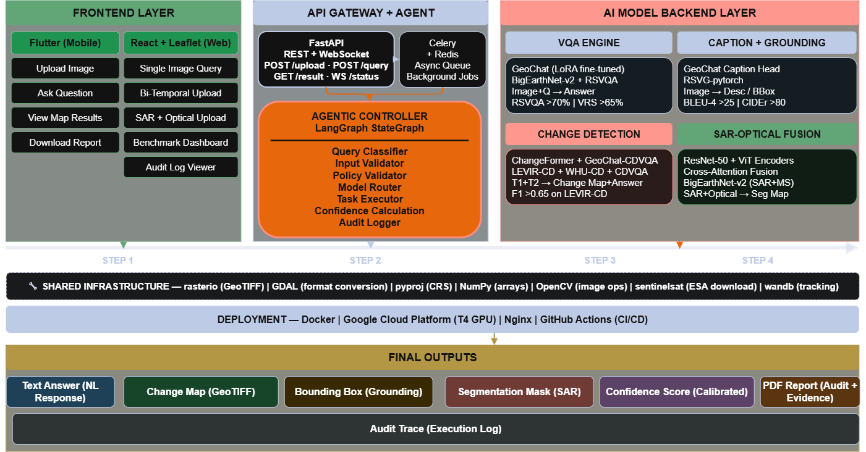
TECHNICAL APPROACH
Team
PlotVortex
Technology Stack -
• Frontend - React.js, Leaflet.js, Flutter, Tailwind CSS, Axios, React Query, Chart.js
• Backend & API - FastAPI, Redis, Celery, Uvicorn, Pydantic, REST & WebSocket API
• Agentic Controller - LangChain, Langgraph, StateGraph, Policy Validator, Tool Registry, asyncio
• AI Models - GeoChat, ChangeFormer, RSVG-pytorch, RemoteCLIP, ResNet-50,
ViT, PEFT, LoRA, HuggingFace Transformers, accelerate, timm, einops
• Satellite Data - rasterio , GDAL, pyproj, NumPy, OpenCV, sentinelsat, scipy, Pillow
• Training Datasets -VRSBench, RSVQA-LR, RSVQA-HR, CDVQA, LEVIR-CD, WHU-CD
• Deployment -Docker, GCP, Nginx, GitHub, Actions, wandb, evaluate, pycocoevalcap, scikit-learn

Slide 4
FEASIBILITY AND VIABILITY
Team
PlotVortex
Feasibility (Technical)
• Open-source base models – GeoChat, ChangeFormer,
RSVG already exist.
• LoRA fine-tuning – 7B model trained on single GPU, not clusters.
• BigEarthNet dataset – BigEarthNet.txt (464,044 Sentinel-1/2 pairs, 9.6M text annotations, arXiv:2603.29630).
• Modular architecture – VQA, Change Detection,
SAR-Fusion built independently.
• Free satellite data – ESA, ISRO Bhuvan, NASA all
no-cost sources.
Challenges
• SAR complexity – Radar noise differs from optical images
• Compute limits – Multi-dataset fine-tuning is GPU-heavy
• Unknown test data – ISRO's hidden Cartosat/RISAT set untestable
• Agent hallucination – LLM may fabricate numeric answers
• Fragile setup – GDAL/rasterio break easily if installed wrong
STRATEGY
• Locked agent design – LLM only classifies; models compute
real numbers
• Sensor-agnostic pipeline – Normalizes data for unseen satellite types
• Pre-built before hackathon – 36 hrs used only for integration + polish
• Live benchmark dashboard – Real VRSBench/RSVQA/CDVQA
scores shown
• Conda-first install rule – GDAL via conda, prevents
environment crashes
Viability
• Direct ISRO alignment – Solves their exact stated problem
• 50+ Indian satellites – Massive unused data pool to unlock
• Zero licensing cost – 100% open-source stack, no paid APIs
• Phased scalability – NDRF → Agriculture → Full ISRO deployment
• Realistic benchmarks – 65-70% accuracy target, proven achievable

Slide 5
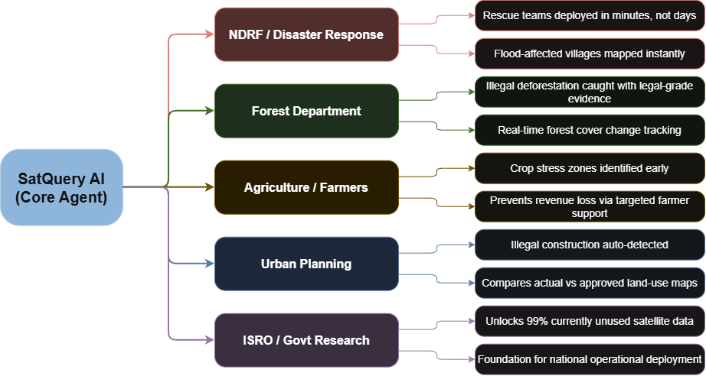
IMPACT AND BENEFITS
Team
PlotVortex
❖ Strategic Impact-
• Offers a fully auditable, evidence-grounded AI system — every answer traceable, nothing hallucinated.
• Strengthens India's autonomy in disaster management, precision agriculture, forest governance, and urban oversight — all from one platform.
• Directly advances Atmanirbhar Bharat in space-tech by building India's first indigenous agentic satellite-AI system deployable at national scale.
• Converts 50+ ISRO satellites' currently wasted data into actionable, real-time intelligence for every government department and citizen.
"One question. Any satellite image. Multi-sectors transformed — SatQuery AI makes every pixel count for India."

Slide 6
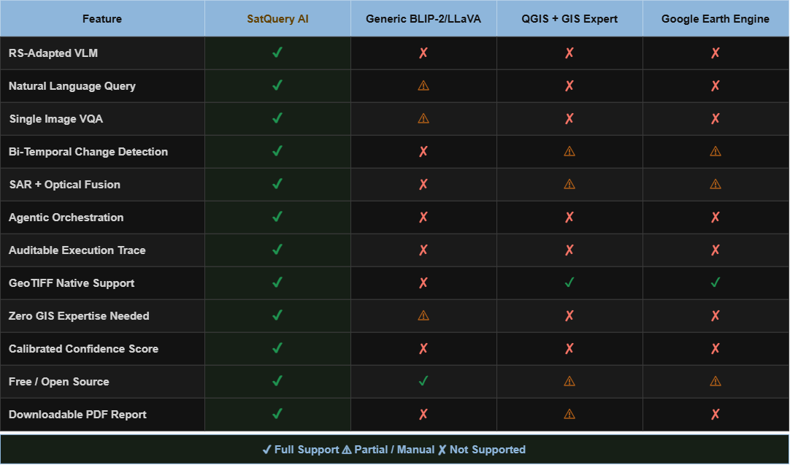
RESEARCH AND REFERENCES
Team
PlotVortex
Research Papers:
• GeoChat — Grounded Large Vision-Language Model for Remote Sensing:
https://arxiv.org/abs/2311.15826
• BigEarthNet-v2 — A Large-Scale Benchmark for RS Image Understanding:
https://arxiv.org/abs/2603.29630
• RSVQA — Visual Question Answering for Remote Sensing Data:
https://arxiv.org/abs/2003.07333
• RemoteCLIP — A Vision Language Foundation Model for Remote Sensing:
https://arxiv.org/abs/2306.11029
• BigEarthNet.txt — Multi-Modal RS Dataset (464K Sentinel-1/2 Pairs, 9.6M Annotations):
https://arxiv.org/abs/2603.29630
Problem Validation:
• ISRO Annual Report 2023—Data Utilization Gap:
https://www.isro.gov.in/AnnualReport_2023.html
• NDRF Disaster Response Report 2024:
https://ndma.gov.in/Resources/reports

