Slide 1
Mutual Fund Analytics Platform
Data Engineering, Risk Analytics & Investor Insights
Presented By: Yash Gothi
Tools Used: Python, Pandas, SQLite, SQLAlchemy, Jupyter, Power BI
Git & GitHub
Bluestock Fintech Capstone Project

Slide 2
Problem Statement
Mutual fund investors and fund houses require data-driven insights to understand:
Fund performance
Investor behavior
Portfolio risk
SIP continuity
Sector concentration
Project Objectives
✓ Build ETL pipelines
✓ Design analytical database
✓ Analyze investor behavior
✓ Evaluate risk-adjusted performance
✓ Develop a recommendation engine
✓ Create executive dashboards

Slide 3
DATA SOURCES
Dataset Used
External Source
mfapi.in API
Live NAV retrieval
Scheme validation

Slide 4
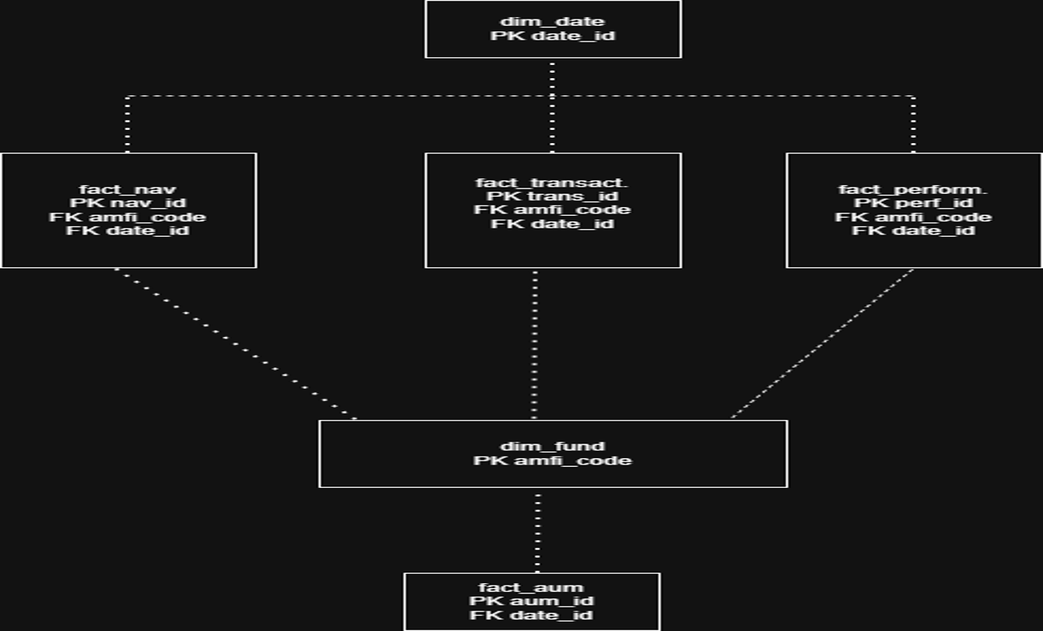
System Architecture
Raw Data → ETL → SQLite Warehouse → Analytics → Dashboard
CSV Files
↓
Python ETL
↓
Data Validation
↓
SQLite Database
↓
SQL Analytics
↓
Power BI / Reports
Star Schema Diagram

Slide 5
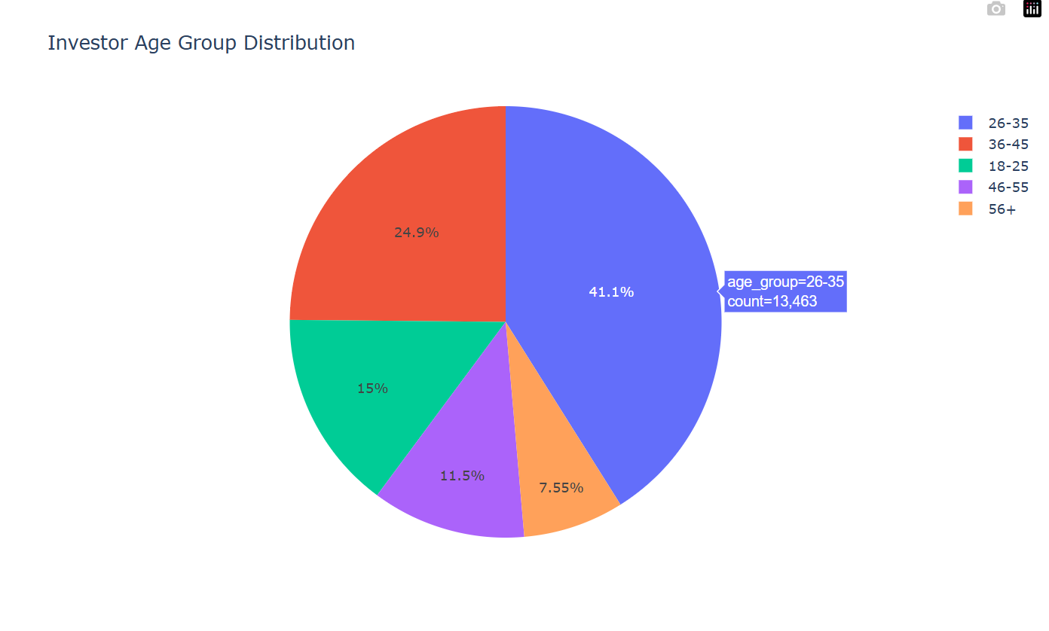
EDA HIGHLIGHTS (Investor Analytics)
Key Insights:
26–35 age group dominates investments
Working professionals drive SIP adoption
Female participation continues to grow

Slide 6
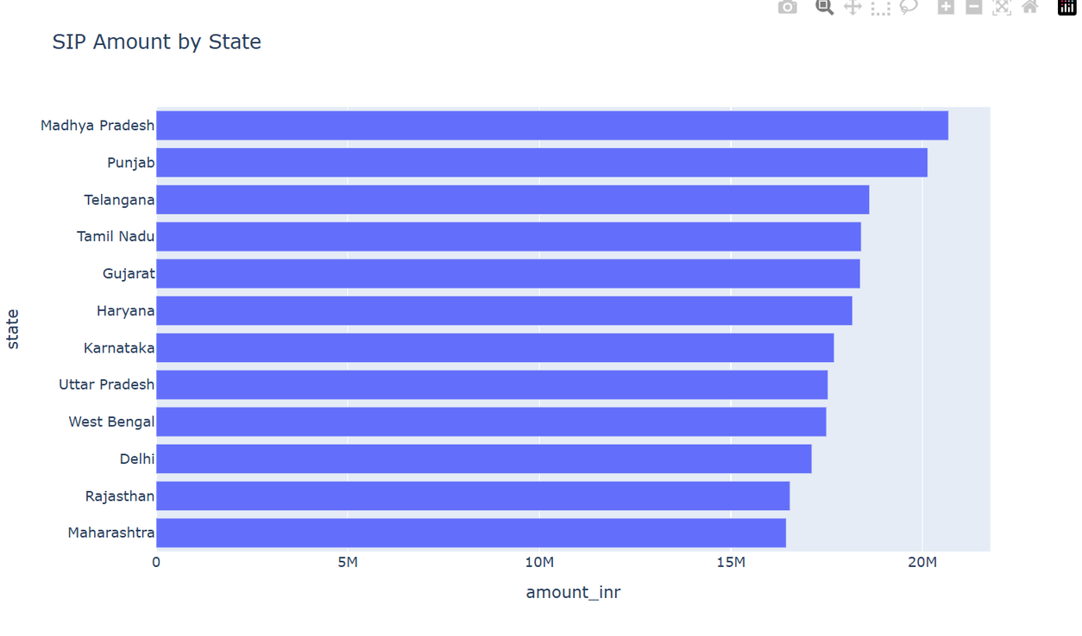
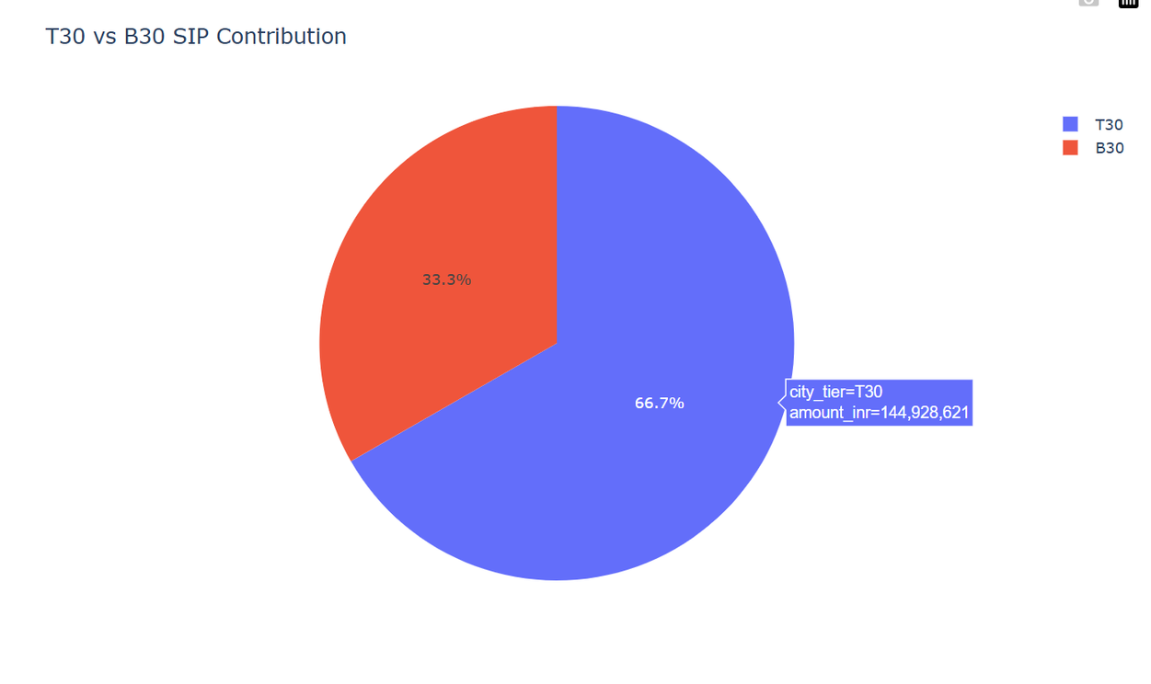
EDA Highlights (Geographic Analysis)
Key Insights
T30 cities contribute ~67% of SIP volume
Significant growth opportunity in B30 regions
Investments concentrated in a few large states

Slide 7
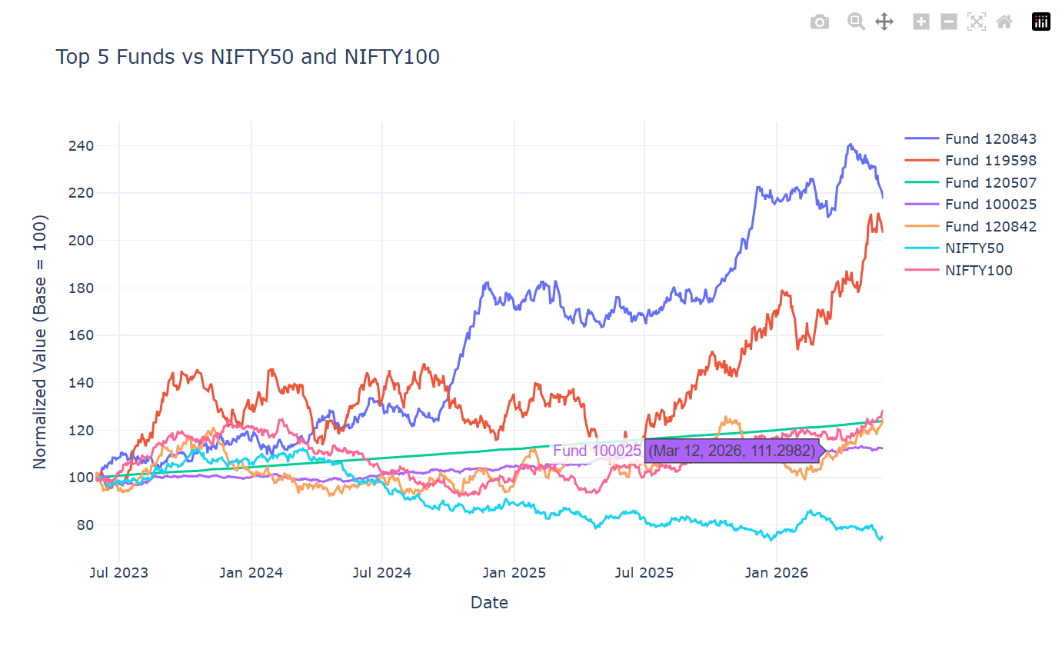
Performance Analytics
Key Insights
Several funds outperformed benchmark indices
Long-term compounding created significant alpha
Fund performance varies considerably across schemes

Slide 8
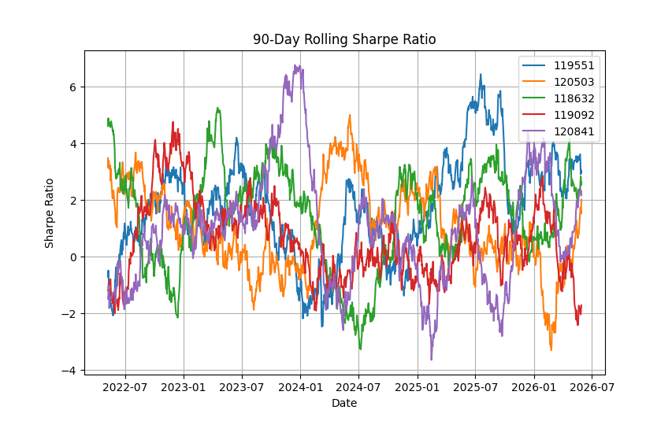
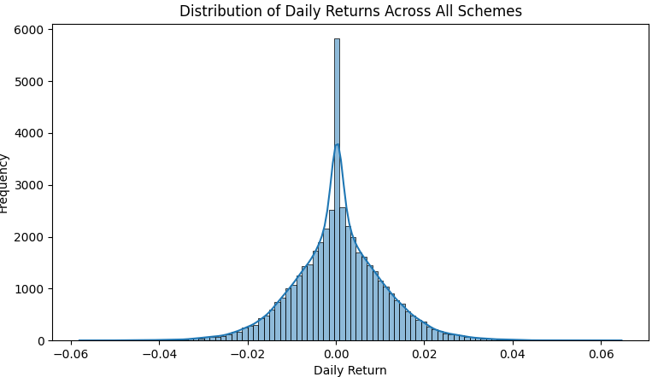
Risk Analytics
Rolling 90-Day Sharpe Ratio
Daily Returns Distribution
Metrics Used
Sharpe Ratio
VaR (95%)
CVaR
Correlation Analysis
Key Insight :
Risk-adjusted returns provide better investment evaluation than absolute returns alone

Slide 9
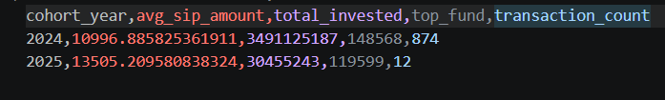
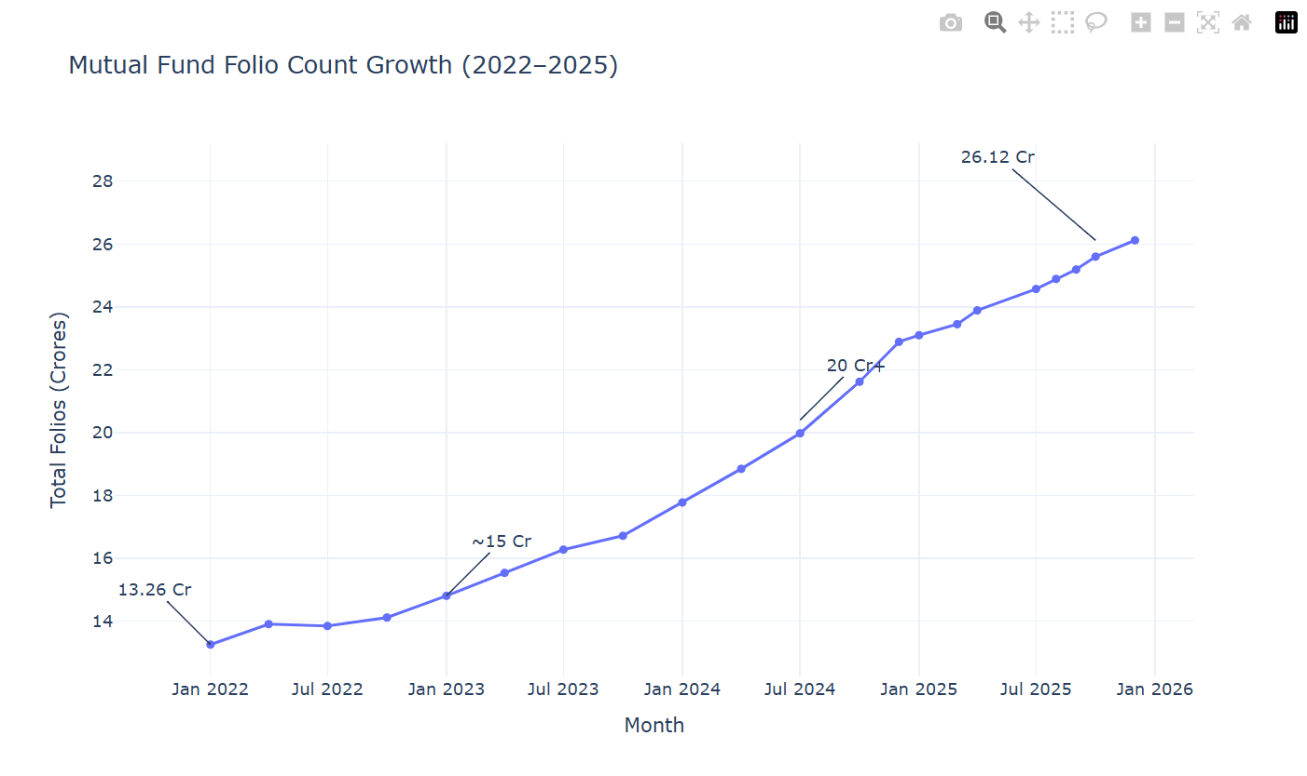
Dashboard Screenshots (Investor Dashboard)
Business Value
Investor segmentation
Retention monitoring
Growth tracking

Slide 10
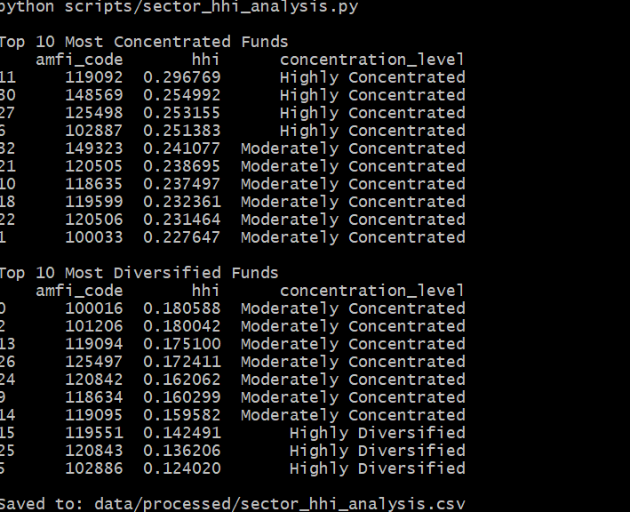
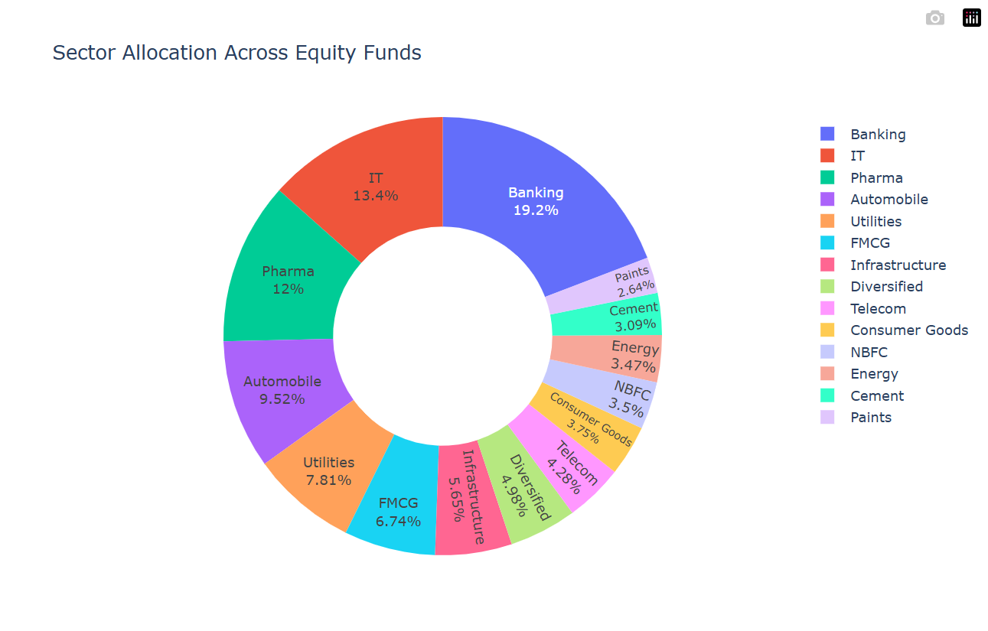
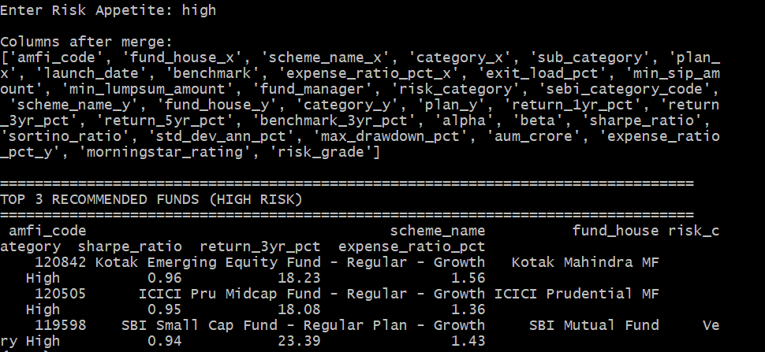
Dashboard Screenshots (Portfolio Analytics)
Business Value
Diversification assessment
Concentration risk detection
Personalized fund recommendations

Slide 11
Key Findings & Recommendations
Key Findings:
✓ Recent investor cohorts invest the most
✓ T30 cities contribute majority SIP inflows
✓ Some funds show significantly higher downside risk
✓ Diversification varies across equity funds
✓ High Sharpe Ratio funds consistently outperform peers
Recommendations:
Focus on risk-adjusted returns
Improve B30 penetration
Monitor SIP continuity
Increase portfolio diversification

Slide 12
Thank You
Mutual Fund Analytics Platform
Questions & Discussion
Presented By:
Yash Gothi
Tech Stack:
Python • SQL • SQLite • Power BI • Pandas • GitHub

