Slide 1
Hackathon Project Proposal
ZenLegacy - GenAI with Python

Slide 2

LearnForge
01
- AI powered Learning Assistant

Slide 3
Description of The Idea
The personalised AI-powered learning assistant leverages cutting-edge AI and web scraping technologies to help users master any topic of interest efficiently. Upon querying the assistant about a skill or subject, it evaluates the user’s prior knowledge through a brief interaction. Based on this, it scours the web for the best learning resources, generating a tailored roadmap for the user’s learning journey. After understanding the user’s time availability, the assistant creates a structured learning schedule, distributing topics across days. As users select topics from the schedule, the assistant scrapes the web for top resources and leverages a large language model (LLM) to explain the material through video. After watching the video, users take a customised test to gauge their comprehension. The assistant provides feedback on their performance and suggests additional strategies to deepen understanding, fostering a continuous and personalised learning experience.

Slide 4
How It Works
1. User Inquiry: User asks about a topic or skill.
2. Assessment: Assistant evaluates prior knowledge.
3. Resource Gathering: Finds and curates the best resources.
4. Roadmap Creation: Provides a learning path.
5. Schedule Generation: Creates a personalised schedule.
6. Learning Session: User selects a topic and learns through videos.
7. Assessment and Feedback: User takes a test and receives feedback.

Slide 5

Uniqueness of the solution !!
The idea combines several powerful elements into one seamless learning experience, making it highly personalised and adaptive. The following is what is unique about it:
1. Adaptive Learning Pathways
2. Web scraping using the best tools
3. AI-Powered Explanations (using LLMs from Langchain)
4. Progressive Learning through Testing
5. Personalised Study Scheduling
6. Continuous Feedback Loop
This blend of dynamic resource gathering, AI-driven explanations, personalised roadmaps, and adaptive feedback sets the learning assistant apart from traditional learning platforms.

Slide 6
Requirements
1. LangChain
2. Python Libraries and Frameworks
3. Beautiful Soup
4. LLMs
5. Scheduling Algorithms
6. Llama 3
7. Flask for Backend
8. PostgreSQL

Slide 7
IMPACT of the Solution
Personalized Learning Experience
Goal: To offer students a tailored learning experience that adapts to their needs, learning speed, and academic goals
Easy Upskilling
Goal: To promote continuous learning by offering courses, tutorials, and personalized recommendations even outside formal educational settings.
Time Saving
Goal: Make the learning faster and efficient for working professionals as well as students
4. Access to Dynamic Learning Resources
Goal: To provide the best resources for learning any new skill or subject by searching the web for content in different forms like text, videos, etc.

Slide 8
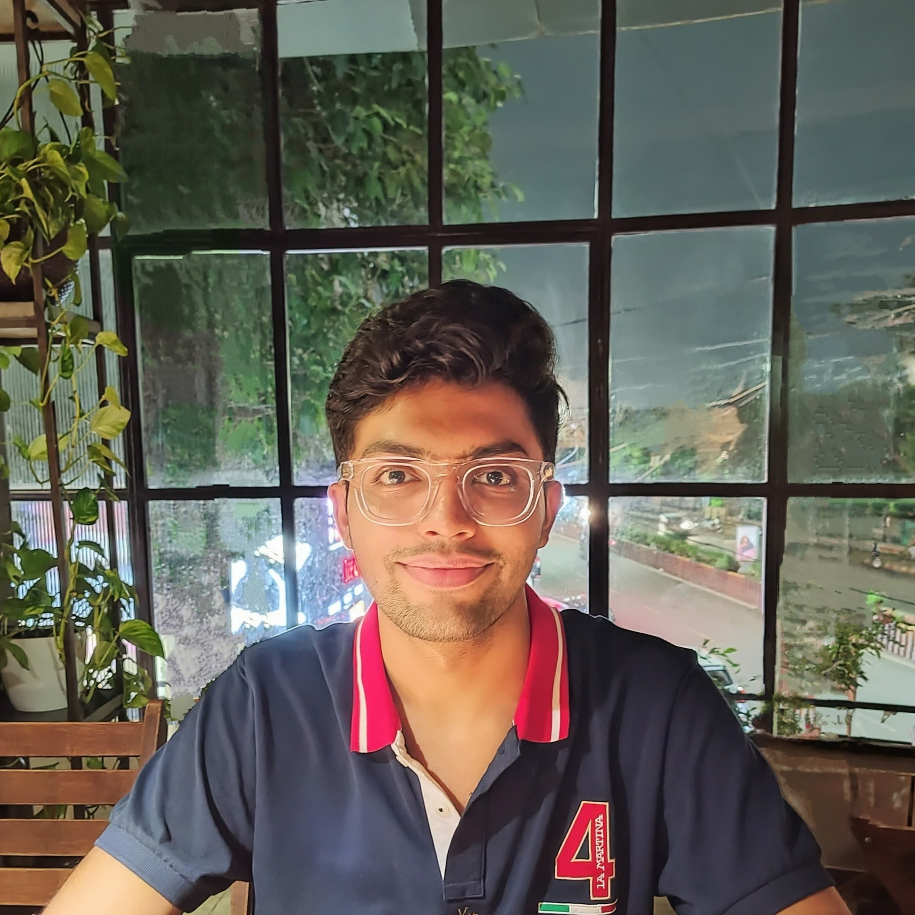


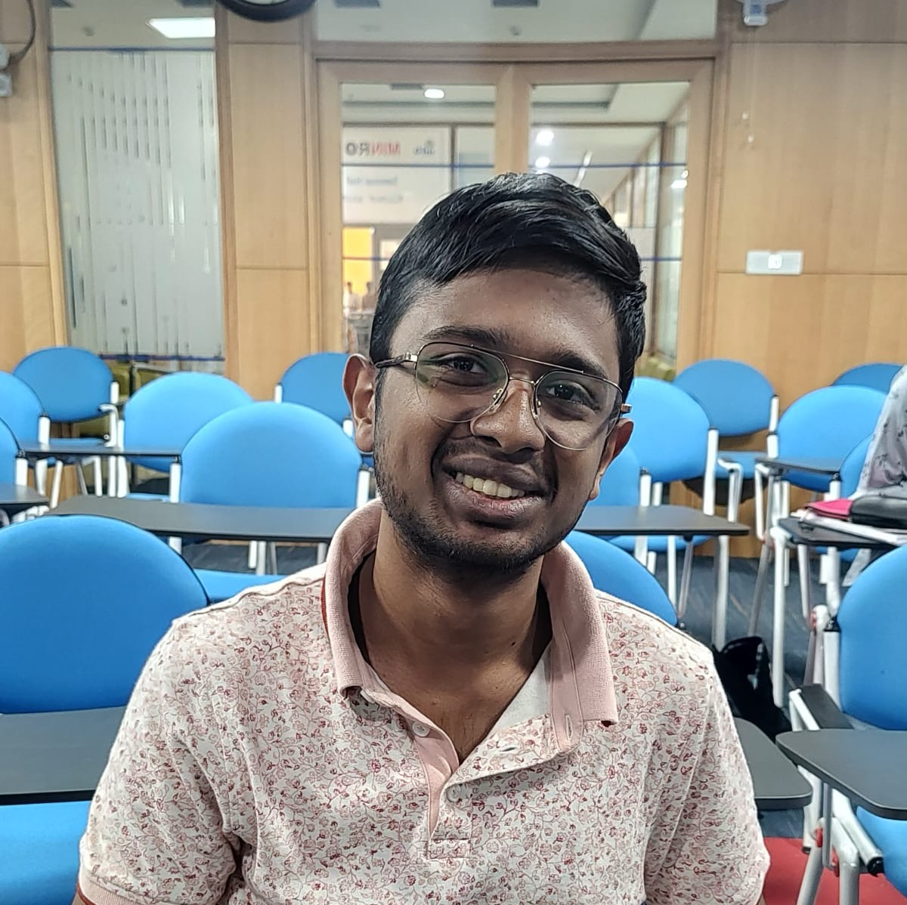
Our team
Aaryan Antala
Ramya Parsania
Ansh Gupta
Yash Gupta

