Slide 1
Software Engineering Lab · Assignment 8
14
Software Component Cataloguing System
use cases
A searchable catalogue of reusable design and code components, with usage tracking to find and purge the ones nobody uses.
27
10 notations: 4 design, 6 code
Keyword search with ranking
Usage counters and purge
functional requirements
IIT (ISM) Dhanbad · September 2026
Dinesh Krishna · Sankar · Vishesh · Sai Teja · Yash Agarwal · Yash Patidar
Notes:
This is the system we built for Assignment 8: a catalogue of reusable designs and code, as a web application. Cataloguers file components with keywords in a category tree, users find them by search or browsing, and the system counts uses so unused components can be purged.

Slide 2
Reuse fails when components cannot be found
1
Too many to browse. A flat list stops working, so components go in a category tree.
Component
2
Two kinds of component. Designs (UML, ERD, Structured Design, DFD) and code (Java, Python, C, C++, JavaScript, TypeScript) live in one catalogue.
Design
UML, ERD, Structured Design, DFD
Code
Java, Python, C, C++, JavaScript, TypeScript
3
Unused components pile up. The system counts uses, and searches that were not followed by a use, so a cataloguer can purge.
Category examples
Design patterns > Behavioural patterns > Observer pattern class diagram
Web development > Authentication > JWT auth middleware
Notation and category are separate properties of a component.
SCCS · Software Engineering · Assignment 8
2
Notes:
The problem statement asks for a catalogue, keyword search, a hierarchy, and counters to help purge. Notation (UML, Java, ...) and category (where it is filed) are two separate properties of a component.

Slide 3








27 functional requirements in 8 groups
Components and notations
Keywords
Accounts and access
Search
Create, edit, delete; design or code; notation kind must match.
Keyword sets per component; suggestions while typing.
Register as User, log in with JWT; only cataloguers write.
1 to 10 keywords, any or all, ranked, filters.
FR-1, 2, 4 to 10
FR-11, 16
FR-12, 13
FR-14, 15
Usage tracking
Reports, purge, audit
Categories
Browsing
"Use" button; hit and hit-not-used counters.
Summary, candidates, purge with re-check, audit log.
Tree of any depth, no cycles, delete with reassign.
Tree, details, filtered lists, sorting.
FR-17, 18
FR-19 to 22
FR-23, 24
FR-3, 25 to 27
Full list with IDs: SRS, section 2.
SCCS · Software Engineering · Assignment 8
3
Notes:
Each requirement has an ID and traces to a use case and a test. The eight groups follow section 2 of the SRS, so any ID can be looked up there.

Slide 4

11 non-functional requirements, each with evidence
Category | Requirement | Evidence
Performance (NFR-1) | Ranking 10,000 components with 5,000 keywords: 95th percentile under 500 ms (ranking only) | Benchmark T-40
Security (NFR-2) | Passwords bcrypt-hashed, never returned; JWT secret only from environment | T-44, T-47
Security (NFR-3) | Role checks on the server for every write and report | T-06, T-25
Security (NFR-10) | 20 login or register requests per IP per 15 minutes | T-48
Security (NFR-11) | CORS allow-list for browser origins | Checked by hand
Validation (NFR-4) | Shared zod schemas; fixed error shape; no stack traces | T-09, T-20
Usability (NFR-5) | Core tasks in 3 screens; keyboard use; no axe violations on 5 public pages | E2E T-41, T-42, T-45
Reliability (NFR-6) | /health reports API and database status | T-01
Data integrity (NFR-8) | Counters and cascades atomic; never negative | T-26, T-11, T-24
Maintainability (NFR-7) | Strict TypeScript, layers, at least 80% service coverage, CI | CI, coverage gate
Portability (NFR-9) | Node 22, configuration by environment variables | Windows and Linux CI
NFR-1 measures the ranking code only, not the network.
SCCS · Software Engineering · Assignment 8
4
Notes:
We only claim what we can show; the right column says how each one is checked. T-numbers are test cases in the test plan. NFR-11 (CORS) is the one checked by hand.

Slide 5
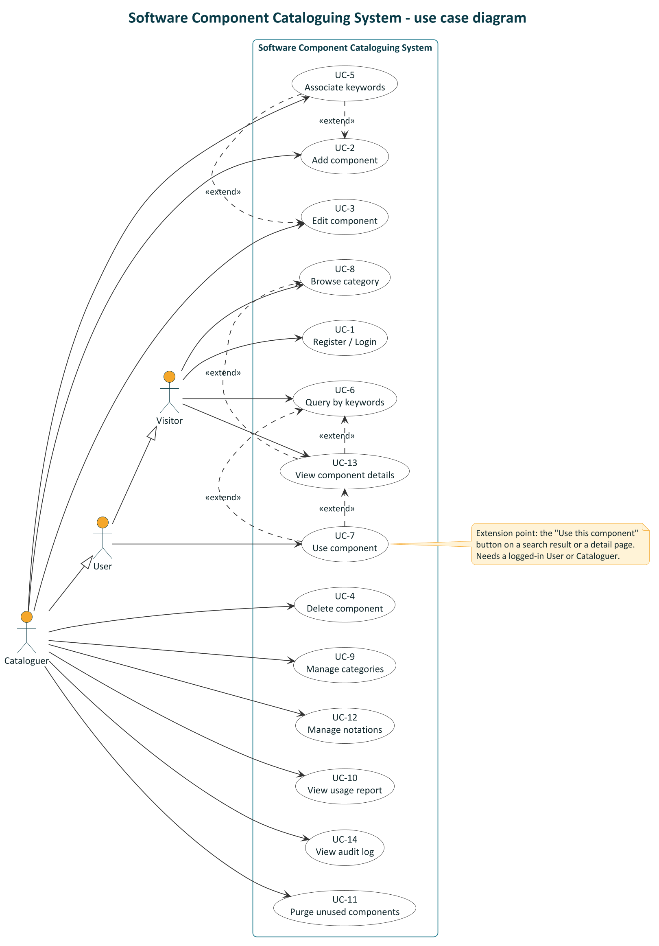



3 actors, 14 use cases
Visitor
Browse categories, view components, search, register or log in.
User (a logged-in Visitor)
Also uses a component (the "Use this component" button).
Cataloguer (a User with more rights)
Add, edit, delete components; associate keywords; manage categories and notations; view report and audit log; purge unused components.
How to read the arrows
Dashed arrow «extend»: optional extra behaviour. Hollow triangle: generalisation (a User is a Visitor).
Use component extends Query and View details; View details extends Query and Browse; Associate keywords extends Add and Edit.
SCCS · Software Engineering · Assignment 8
5
Notes:
There is no include relationship; every use case can be completed on its own. Actor generalisation means a Cataloguer can do everything a User can, and a User everything a Visitor can.

Slide 6
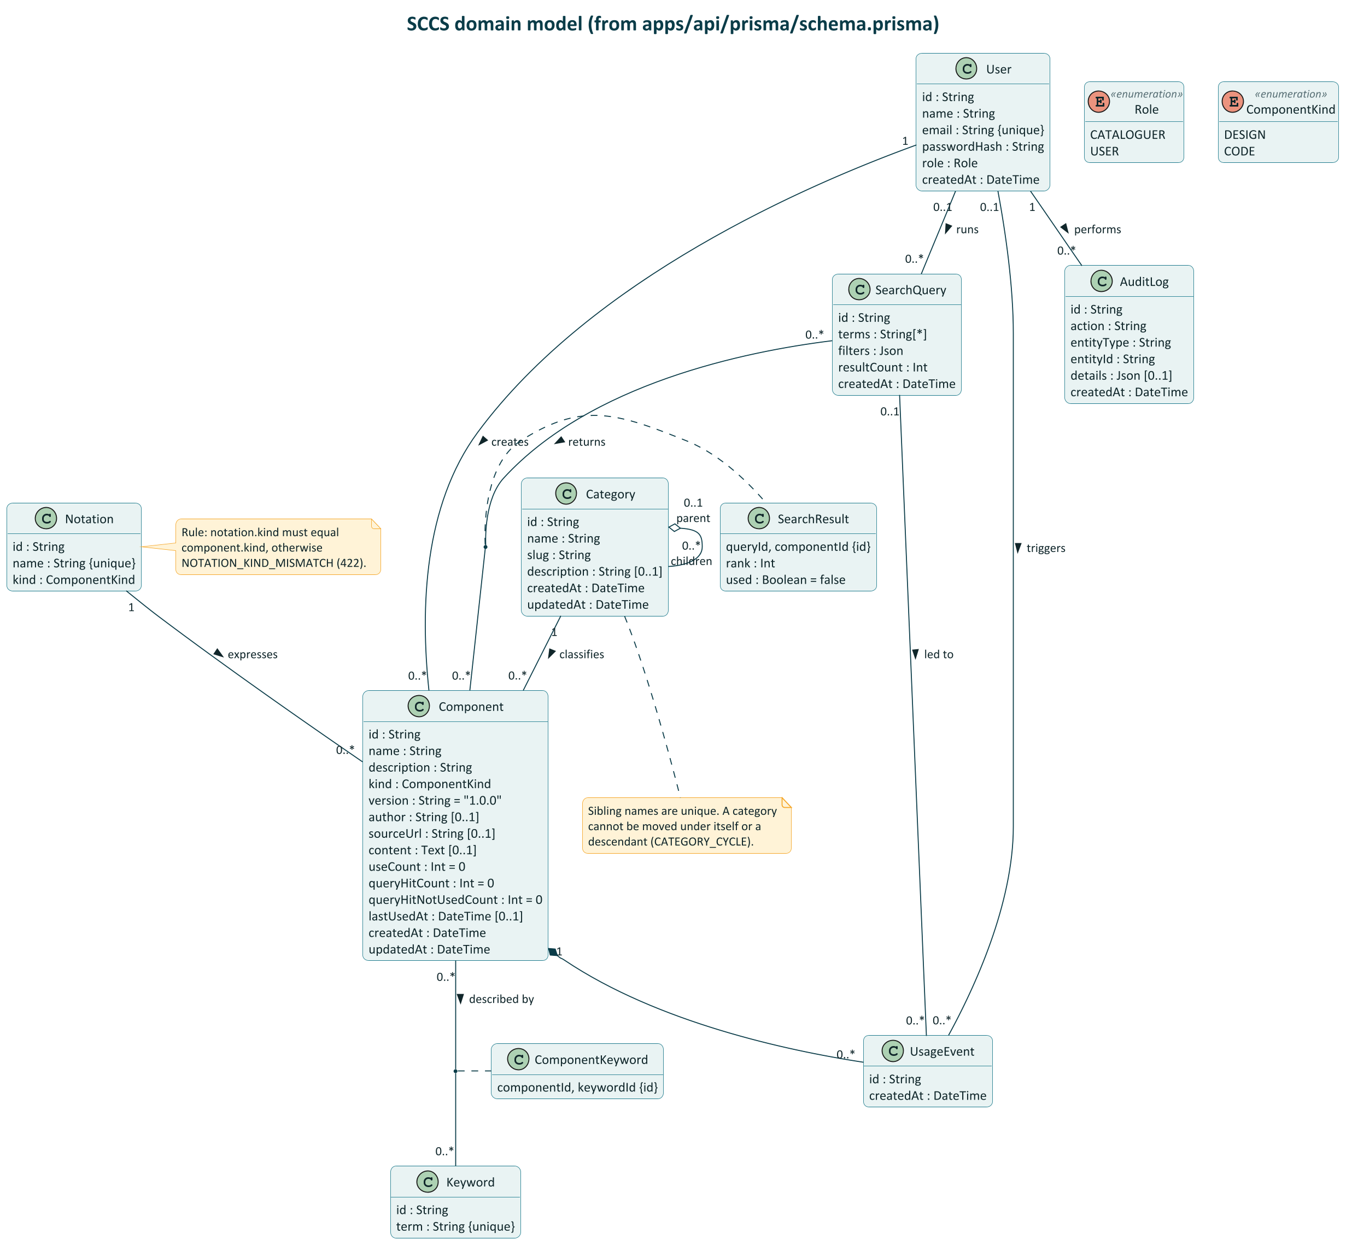





The domain model: 10 classes from the database schema
Association classes: SearchResult (rank, used) links a search to a component; ComponentKeyword links component and keyword.
Aggregation: A category holds sub-categories; they survive when the parent is removed (they are reassigned).
Composition: Usage events belong to a component and are deleted with it.
Rules: Notation kind must equal component kind; a category cannot move under itself.
No inheritance: Role is an attribute of User.
SCCS · Software Engineering · Assignment 8
6
Notes:
The diagram is drawn from apps/api/prisma/schema.prisma. Counters live on Component; every use also creates a UsageEvent row. Role and ComponentKind are enumerations.

Slide 7





A web app, an API and a database, in clear layers
Browser
Next.js web app
Express API
PostgreSQL
HTTPS
Vercel
JSON +
Bearer token
/api/v1, Vercel serverless
Prisma
Supabase
Inside the API (apps/api/src)
packages/shared: zod schemas used by the web app and the API, so both validate the same way.
Routes
Middleware: auth, rate limit, errors
One request, end to end (search)
Search form (app/search) > lib/api.ts adds the Bearer token > POST /api/v1/search > search controller parses the body with zod > search service ranks and saves the query and counters in one transaction > JSON back > the useMutation hook (TanStack Query) shows the results.
Controllers: parse input with zod
Services: all business rules and transactions
Prisma (lib/prisma.ts)
PostgreSQL
Only services touch the database.
SCCS · Software Engineering · Assignment 8
7
Notes:
The web app never touches the database; the API is the only path to the data. Inside the API each layer has one job: routes mount paths, middleware checks the token and role, controllers validate with the shared zod schemas, services hold every business rule and are the only code that imports Prisma.

Slide 8



One language end to end: TypeScript
Why
Web
API
Data
Shared validation schemas between web and API
Next.js 16, React 19, Tailwind CSS 4, shadcn/ui, TanStack Query
Node.js 22, Express 5, zod 4, JWT (HS256) and bcrypt
PostgreSQL (Supabase in production), Prisma 7, recursive SQL for category paths
A relational database for hierarchy and transactions
Quality
Deploy
Everything checked on every push by CI
Vitest, Supertest, Playwright with axe, ESLint, Prettier, GitHub Actions
Vercel for web and API, npm workspaces monorepo
SCCS · Software Engineering · Assignment 8
8
Notes:
Supabase is used only as managed PostgreSQL; authentication is our own API (JWT signed by Express). The shared package means a rule like 'keywords are trimmed and lowercase' is written once and used by both the form and the server.

Slide 9
From cataloguing to purge: five steps and four counters
1
Log in.
2
Catalogue.
3
Search.
4
Use.
5
Purge.
JWT, valid one day. Cataloguer accounts come from the seed script.
Pick kind, notation, category, keywords, optional source URL and content. Notation kind must match. An audit row is written.
1 to 10 keywords, any or all. Exact keyword = 2 points, prefix (3+ letters) = 1. For the components on the returned page: hits +1 and hits-not-used +1, in one transaction.
"Use this component" (login): uses +1, last used set. If it came from a search result not yet used: hits-not-used -1, never below 0.
Cataloguer sets criteria, reviews candidates, confirms. The server checks again and deletes; one audit entry each.
Manual, no scheduler
The counters (on Component)
useCount
queryHitCount
queryHitNotUsedCount
lastUsedAt
SCCS · Software Engineering · Assignment 8
9
Notes:
A component shown many times but never used is the purge candidate this design is built to find. Search and use are each one database transaction, so the counters are never half-updated. Purge is started by a cataloguer; there is no scheduled job.

Slide 10
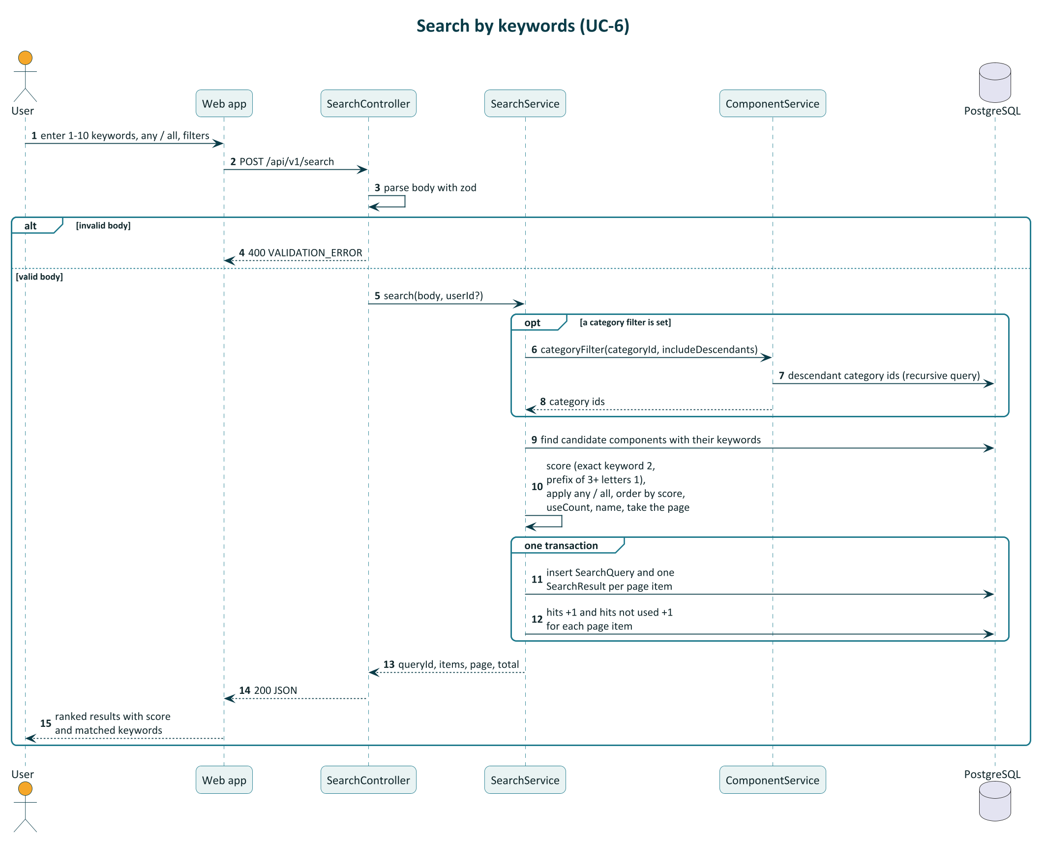
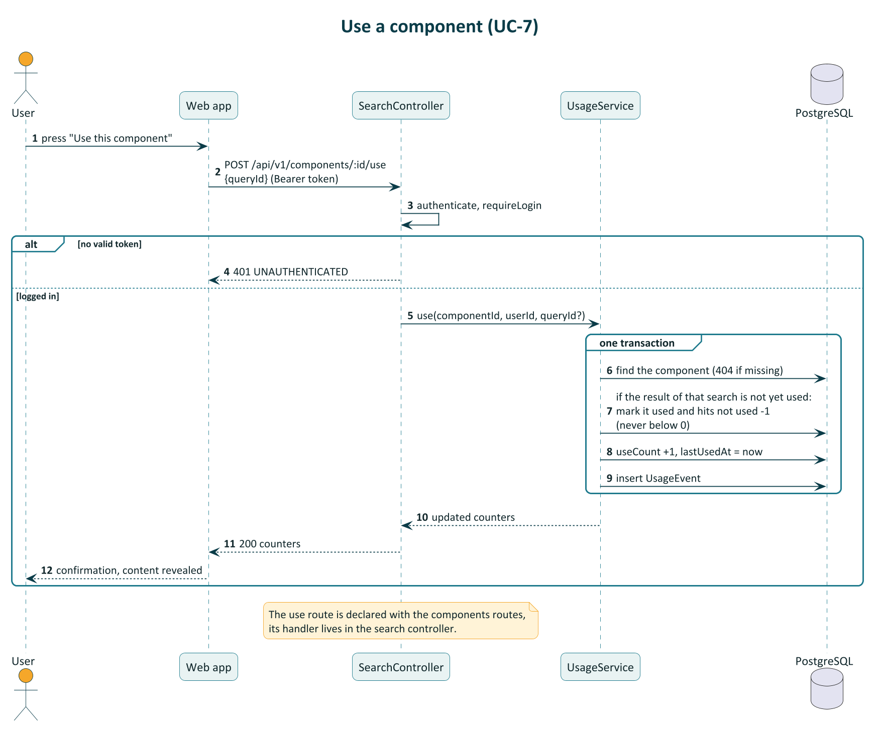
Search and use: both are single transactions
S
Search: validate, score, save the query and add the hit counters for the page, all in one transaction.
U
Use: mark the result used, lower hits-not-used, raise uses, log the event, all in one transaction.
SCCS · Software Engineering · Assignment 8
10
Notes:
A failure in either flow leaves nothing half-written; there is a test that forces a failure inside the transaction. The queryId returned by search is what links a later use back to that search result.

Slide 11

Public pages for everyone, a console for the cataloguer
Everyone
Cataloguer only
Public screen | Route | What you can do
Home | / | Search box, API and database status
Search | /search | Keywords, any or all, filters (kind, notation, category), scores, Use
Browse | /browse | Category tree, breadcrumb, component list, sort, subcategories
Component | /components/[id] | Details, keywords, counters, content, Use
Login, Register | /login, /register | Log in; register as User
Cataloguer screen | Route | What you can do
Reports | /console | Totals, top used, top not used, never used
Components | /console/components | List, create, edit, delete, keyword chips
Categories | /console/categories | Create, rename, move, delete with reassign
Notations | /console/notations | List and add notations
Purge | /console/purge | Criteria, candidates, confirm
Audit | /console/audit | Change history, filter by action
Use needs a login. The console is for cataloguers only.
SCCS · Software Engineering · Assignment 8
11
Notes:
The same site adapts to the role: visitors, users and cataloguers see different menus. The server still checks the role on every console API call, so hiding the menu is not the security.

Slide 12
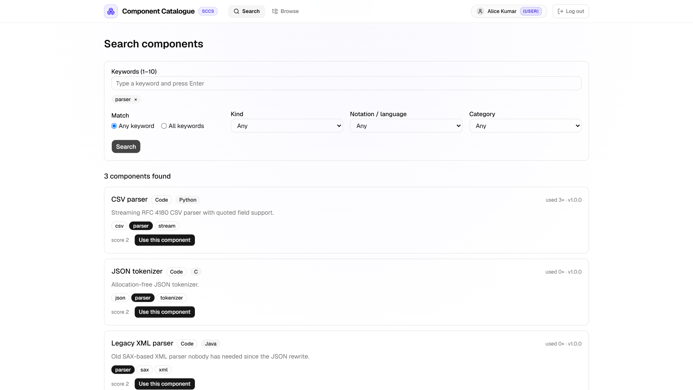
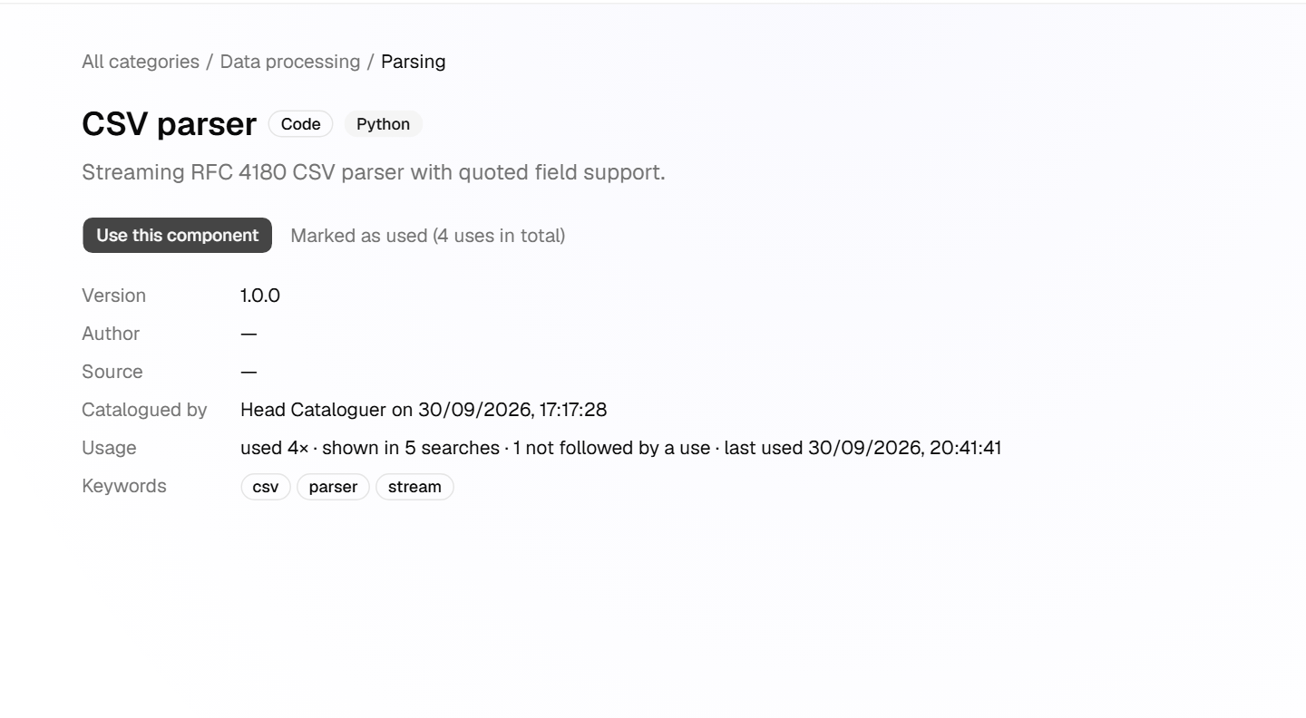
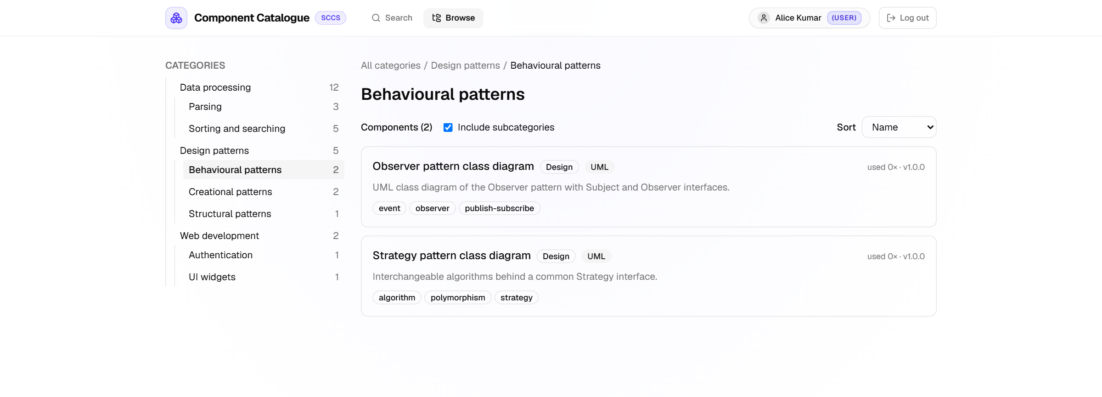

Demo: find a component and use it
2
Open a result: details and counters, after pressing Use
1
Search 'parser', any keyword: results with score and matched keywords
Counters change: hits-not-used goes down when the result is used.
3
Browse the tree: Design patterns > Behavioural patterns
SCCS · Software Engineering · Assignment 8
12
Notes:
Demo order: search, open, use, then show the counters change. Behind the Use button: POST /api/v1/components/:id/use with the queryId from the search, handled by the usage service in one transaction.

Slide 13
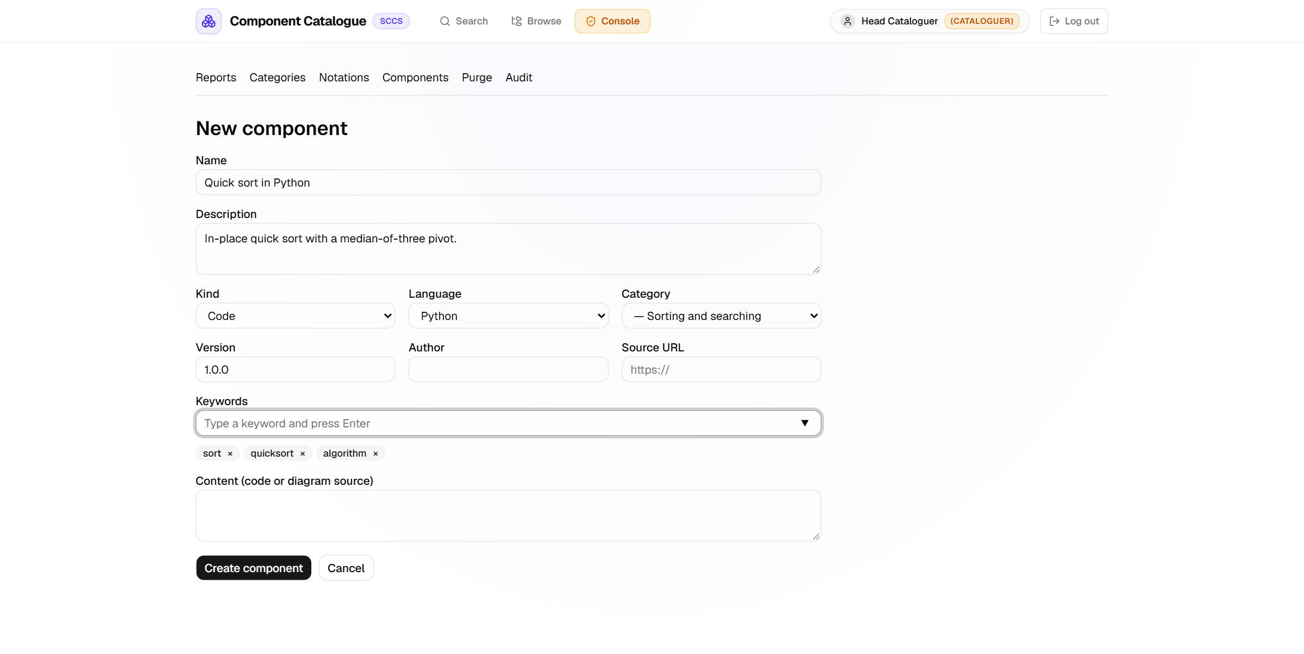
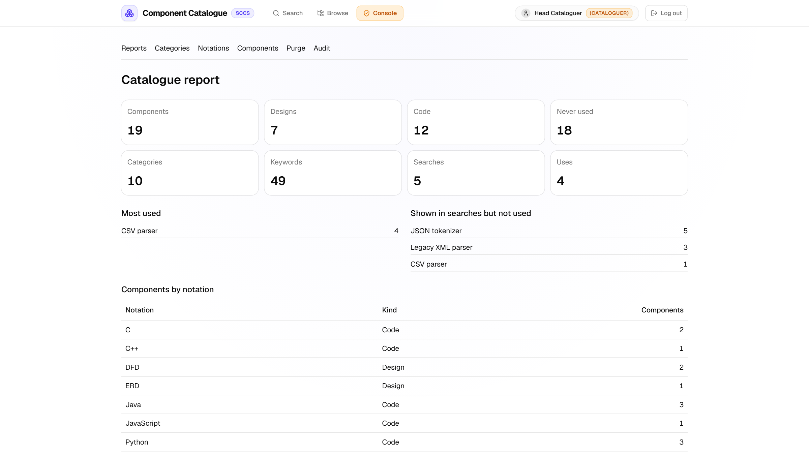
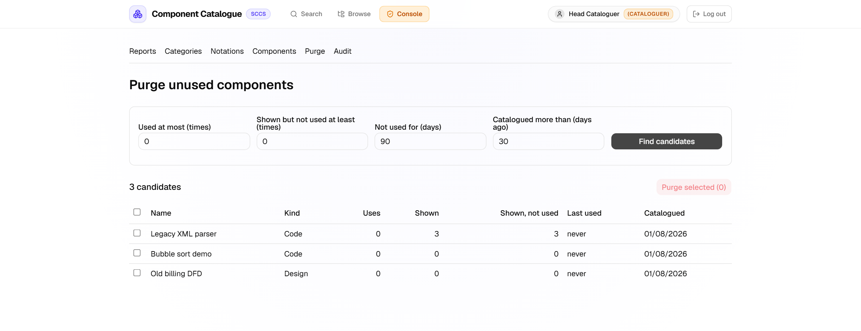
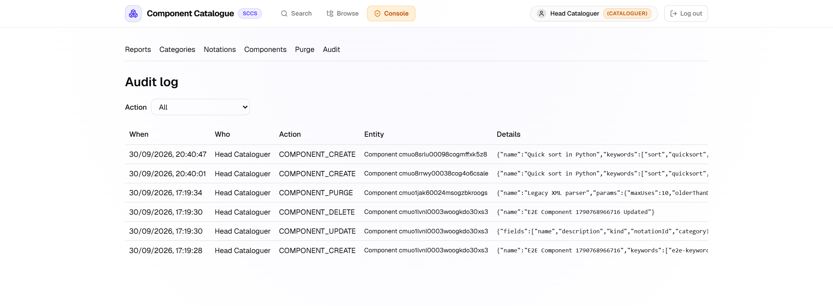
Demo: the cataloguer keeps the catalogue clean
1
Add a component with keyword chips
2
Reports: totals, top used, never used
3
Purge: 3 old unused components found with the default criteria
4
Audit log: every change recorded
SCCS · Software Engineering · Assignment 8
13
Notes:
Purge is deliberate: criteria, review, confirm, and the server checks again before deleting. Every cataloguer write, including each purge deletion, adds one audit row in the same transaction.

Slide 14



61 automated tests, 9 end-to-end scenarios, CI green
61
9
98%
48
unit and integration tests
end-to-end scenarios
line coverage of the API
numbered test cases traced to requirements
Levels
Techniques
Also checked
Unit: shared schemas, ranking
Integration: API with Supertest against a real PostgreSQL
End-to-end: Playwright, 3 user journeys, 5 axe scans, keyboard search
Performance: T-40, ranking only
Black-box: equivalence classes and boundary values (keywords 0, 1, 10, 11; term length 0, 1, 50, 51; page size 0, 1, 50, 51; purge thresholds at the boundary)
White-box: branch coverage of ranking, the use flow (4 paths), category delete and cycle rules
A forced failure inside a transaction leaves no partial data
Role checks
Passwords hashed
JWT secret required
Login rate limit
CORS
Not covered: web unit tests, console accessibility, 360 px layout, load tests.
SCCS · Software Engineering · Assignment 8
14
Notes:
Traceability from requirement to test is in the report. The numbers are from the last full run on 30 Sep 2026: 5 shared unit tests plus 56 API tests make 61, all passing, and CI is green.

Slide 15

What it does not do yet
Limitations
Future work
"Used" is self-reported: the user presses the button.
Synonym and embedding-based keyword suggestions
Report-only suggestions of what to purge
Duplicate detection by code similarity
Version history for a component
Token in an httpOnly cookie
A shared rate-limit store
Search matches exact keywords and prefixes; no synonyms or fuzzy matching.
The login rate limiter lives in one process's memory, so it is not shared across serverless instances; the login token is kept in browser local storage.
Speed was measured for the ranking code only, not under load.
The web app has no unit tests; accessibility was scanned on five public pages only.
Categories are curated by hand.
SCCS · Software Engineering · Assignment 8
15
Notes:
We list the limits ourselves, because each one has a clear next step. For example, the in-memory rate limiter works on one server but each serverless instance has its own counter, so a shared store would fix that.

Slide 16
Thank you
Questions?
Dinesh Krishna · Sankar · Vishesh · Sai Teja · Yash Agarwal · Yash Patidar
github.com/YashIIT0909/SWE_LAB_Assignment
Software Engineering Lab · Assignment 8 · IIT (ISM) Dhanbad · September 2026
Notes:
Thank you. We are happy to take questions, and we can show any part of the system live: search, use, the cataloguer console, or the purge.

Slide 17
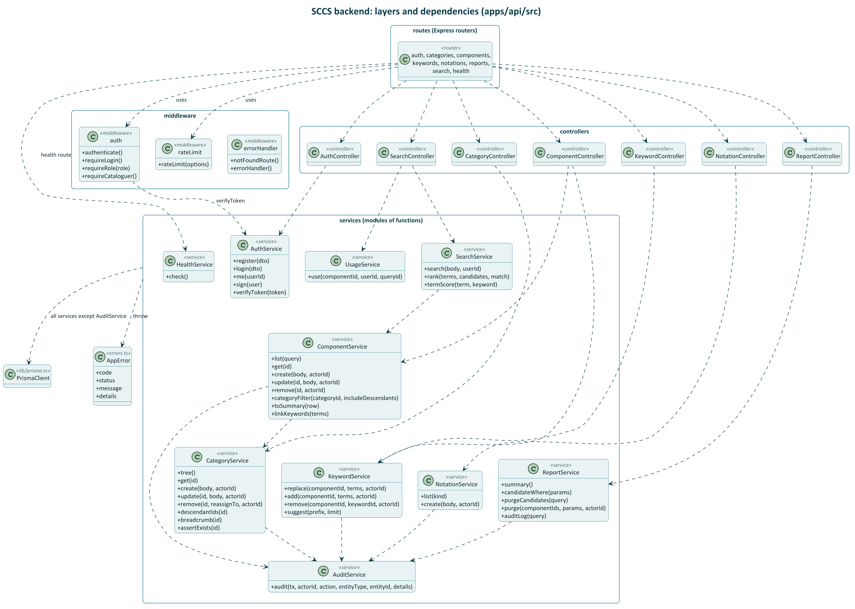
Backend classes and their dependencies
How to read it
Services are modules of functions, drawn as classes to show what each offers and depends on.
Dashed arrow: "depends on" (calls).
Routes use middleware and call one controller.
Controllers call services only.
Every writing service calls AuditService inside its transaction.
Services throw AppError; errorHandler turns it into JSON.
SCCS · Software Engineering · Assignment 8
A1
Notes:
This is the layered architecture as classes. Only services use PrismaClient, and AuditService is called by every service that writes, so each cataloguer change is logged in the same transaction.

Slide 18
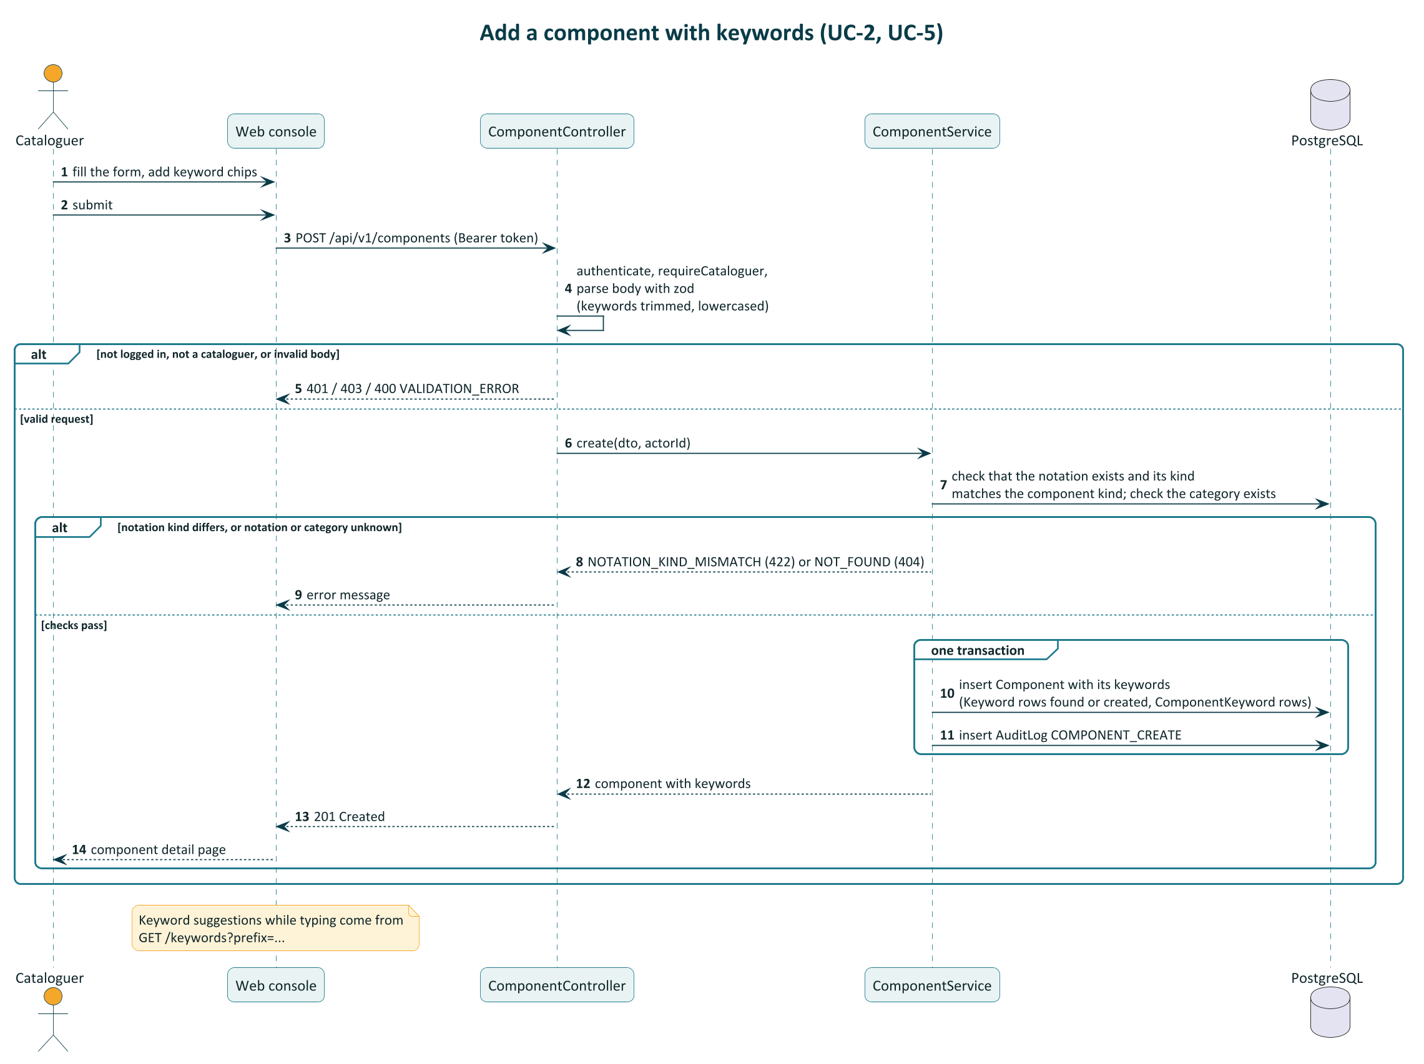
Adding a component with keywords
One transaction
The component, its keywords and the audit row are saved together, or not at all. Keyword suggestions while typing come from a separate call.
SCCS · Software Engineering · Assignment 8
A2
Notes:
POST /api/v1/components goes through requireCataloguer, the controller parses the body with zod, and the component service checks the notation kind, then writes component, keywords and audit row in one transaction.

Slide 19
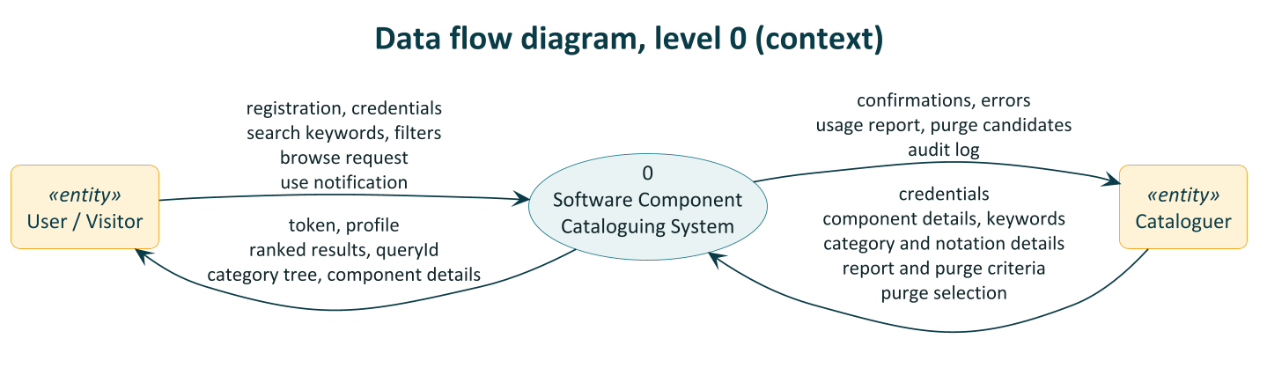
Data flow: the system and its two actors
User / Visitor sends
Cataloguer sends
Registration, credentials, search keywords, browse requests, use notifications
Credentials, component, category and notation details, report and purge criteria, purge selection
SCCS · Software Engineering · Assignment 8
A3
Notes:
The context diagram shows the whole system as one process with its two external entities and the data they exchange.

Slide 20
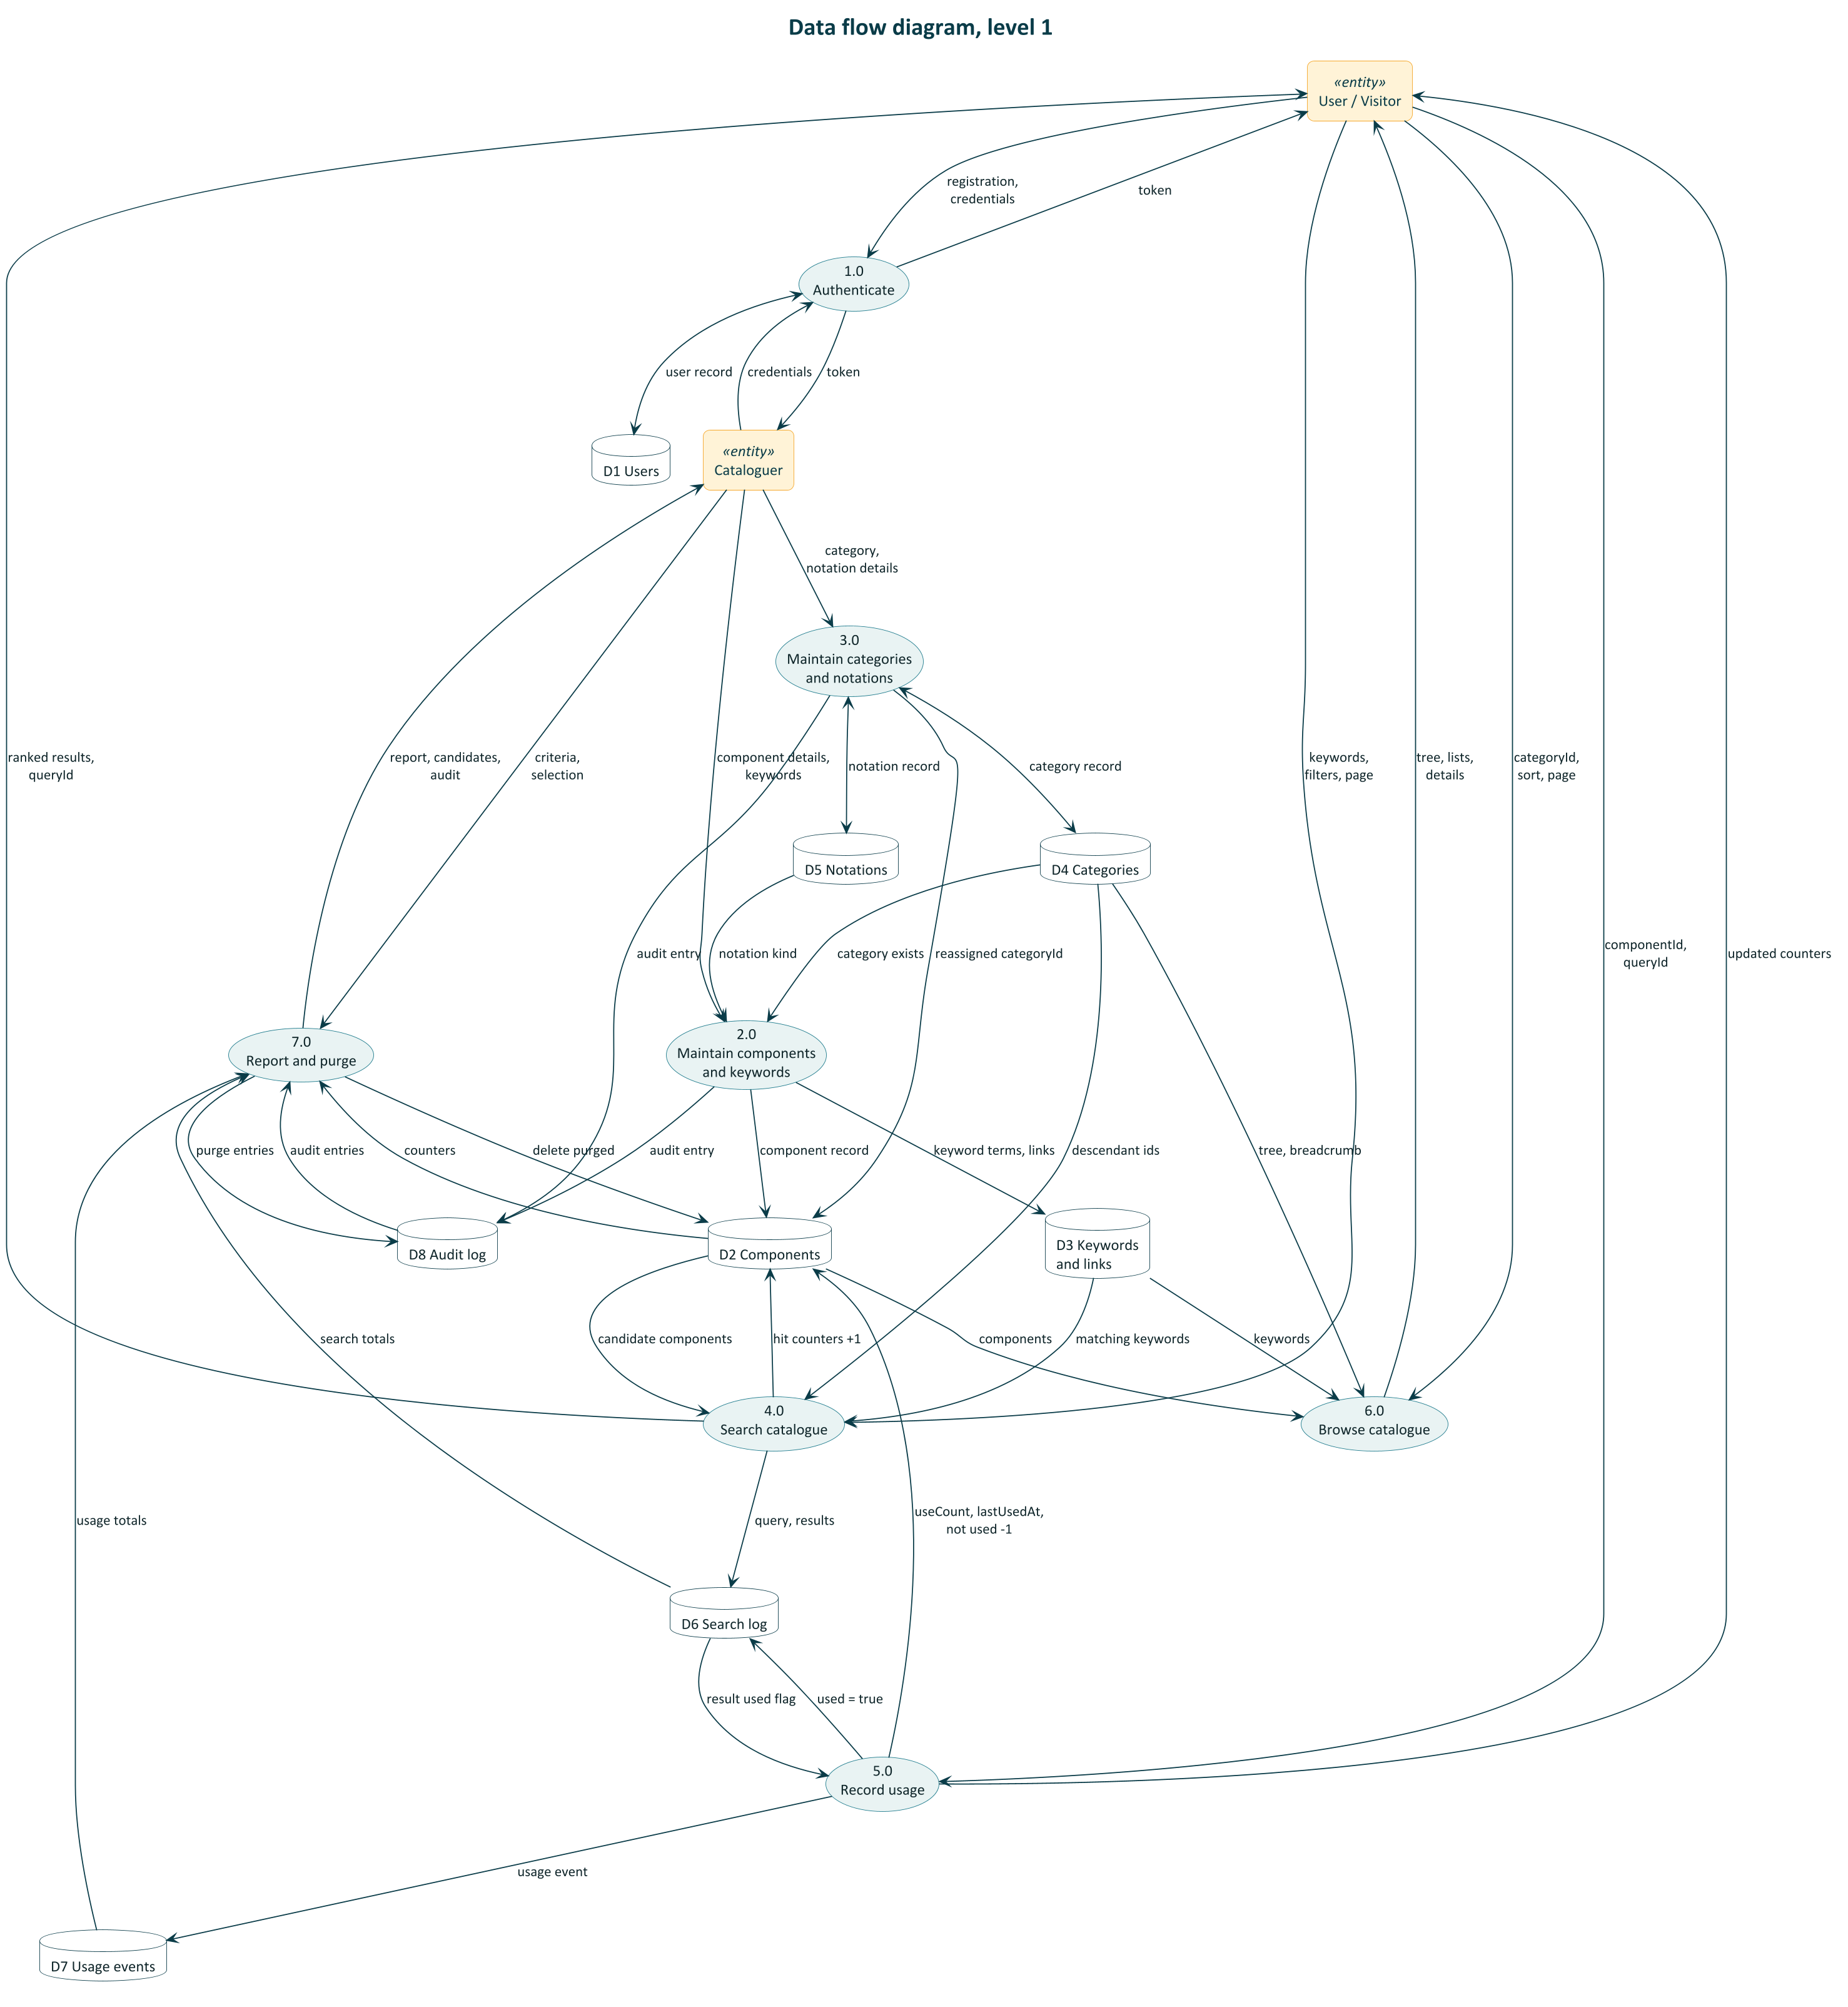
Data flow: seven processes and eight data stores
Processes
Data stores
1.0 Authenticate
2.0 Maintain components and keywords
3.0 Maintain categories and notations
4.0 Search catalogue
5.0 Record usage
6.0 Browse catalogue
7.0 Report and purge
D1 Users
D2 Components
D3 Keywords and links
D4 Categories
D5 Notations
D6 Search log
D7 Usage events
D8 Audit log
SCCS · Software Engineering · Assignment 8
A4
Notes:
Level 1 breaks the system into seven processes. Each data store maps to one or two database tables, for example D6 Search log is SearchQuery and SearchResult.

