Slide 1

AI-Powered Product Intelligence for
Team Details
Team Details
Team name: ShadowByte
Team leader name: Yash Munshi
Notes:
Fill in your team name and leader before submitting.

Slide 2

Brief about your solution
Unify : Every attribute carries its evidence.
Unify turns a one-line supplier row, a PDF datasheet or a product URL into a commerce-ready record in which every single attribute cites the exact span of the source it came from.
The hard part of enrichment is not extraction, it is trust. A distributor cannot publish a specification it is unable to defend.
So Unify classifies a SKU into its taxonomy, fills the attribute schema that class demands, then sends an adversarial critic to refute every value against its source. Sources that disagree are both kept on the record with the tie-break shown. Only what survives, and clears a 92% confidence gate, is published; everything else is routed to a human with the conflict visible. Measured on the working prototype: 479 of 479 quotes anchor to real character offsets, 91.4% of attributes clear the gate unattended, and average data quality rises from 33 to 96. Live at https://get-unify.vercel.app/

Slide 3
1. How does your solution enrich minimal product information?
Taxonomy first. The SKU is classified, and the class dictates exactly which attributes must exist, in which units, with which legal values : so extraction becomes “fill this schema” rather than “find what you can”, and completeness becomes measurable. Evidence is retrieved from the manufacturer datasheet, the product page, the catalog and any uploaded document, then read under a schema constraint that forces a verbatim citation. Normalisation collapses the dialects (DN 15 → 1/2″, CF8M → Stainless Steel 316, 138 bar ≡ 2000 psi). A 22-word supplier row becomes 22 attributes plus title, bullets, trade synonyms and facets.
2. How does your solution ensure accuracy and trust in the generated product data?
Five layers, all of them visible in the UI: ● Source authority ranking : manufacturer datasheet 1.00 > web 0.92 > catalog 0.84 > distributor 0.66 > marketplace 0.45. ● Adversarial critic : a separate pass prompted to refute, not confirm; returns SUPPORTED / UNSUPPORTED / CONTRADICTED. ● Rule-based validation : units, enum membership and plausible ranges; an out-of-range value is rejected outright. ● Assembled confidence : authority + corroboration − conflict penalty × critic × reader quality. Never a guessed number. ● Confidence gate + human queue : ≥ 92% publishes, 60–92% goes to a reviewer with the conflict shown, below that is dropped.
3. What makes your solution scalable for enterprise product catalogs?
● Large catalogs : stateless serverless pipeline, two-tier model routing; 14 SKUs run in 39 ms deterministically. ● New manufacturers : nothing is hard-coded to a brand; authority is by source type, so a new supplier needs no code. ● Document formats : PDF, HTML, pasted specs and tables share one reader; a class is data, so a new category is JSON. ● Continuous updates : re-running a SKU re-derives every value with a fresh trace; one table explodes into every part.

Slide 4
Opportunities
a. How different is it from any of the other existing ideas?
Most tools stop at extraction and emit JSON you have to take on faith. Unify treats provenance as a data-model decision rather than a feature: every value is stored as {value, unit, source, span, method, confidence, critic verdict} from the first commit. It also refuses to collapse “wrong” into “unknown”, a missing specification is a gap in the evidence, not a defect in the product and it answers “not found in the provided sources” instead of guessing.
b. How will it be able to solve the problem statement given?
The brief asks for enrichment, validation and explainable outputs. They map one-to-one onto the build: the taxonomy-driven schema filler is the enrichment, the adversarial critic and the confidence gate are the validation, and the evidence drawer, click any attribute, the source opens with the exact sentence highlighted, is the explanation.
c. USP of the proposed solution
“Every attribute carries its evidence.” 479/479 quotes anchored to real character offsets: not a paraphrase, not a page number, the exact span. It is the only enrichment output a buyer can audit line by line.

Slide 5
List of features offered by the solution
▸ Taxonomy-driven enrichment : the class dictates the attribute schema, units and legal values.
▸ Attribute-level provenance : click any value to open the source with the cited span highlighted.
▸ Adversarial validation : a critic prompted to refute; contradicted values never reach the record.
▸ Conflict resolution on the record : both values kept, with how the tie was broken.
▸ Confidence gating : publish at ≥ 92%, human review between 60% and 92%.
▸ Multi-format ingest : PDF datasheets, fetched product URLs, pasted spec blocks.
▸ Ask the datasheet : grounded Q&A with citations and an honest “not found”.
▸ Comparison copilot : plain-language requirements → matrix and a justified recommendation.
▸ Product knowledge graph : variants, alternatives, certifications and mating parts.
▸ Commerce output : SEO title, bullets, trade synonyms and facets from published values only.

Slide 6
Process flow diagram
Input: MPN + brand + one abbreviated supplier line, plus any document the user attaches.
01 Classify taxonomy + attribute schema
02 Retrieve authority-ranked evidence
03 Extract schema-constrained, cited
04 Normalize units, enums, ranges
05 Critique adversarial refutation
06 Resolve conflicts + confidence
07 Gate publish / review / reject
08 Compose SEO, synonyms, facets
Published ≥ 92% confidence : straight to the storefront
Human review 60–92% : queued with the conflict shown
Refuted / rejected contradicted or implausible : never published
Every stage emits a trace event. The trace is the audit log : “why does this record say 2000 PSI?” is answered by replaying it, not by trusting it.

Slide 7
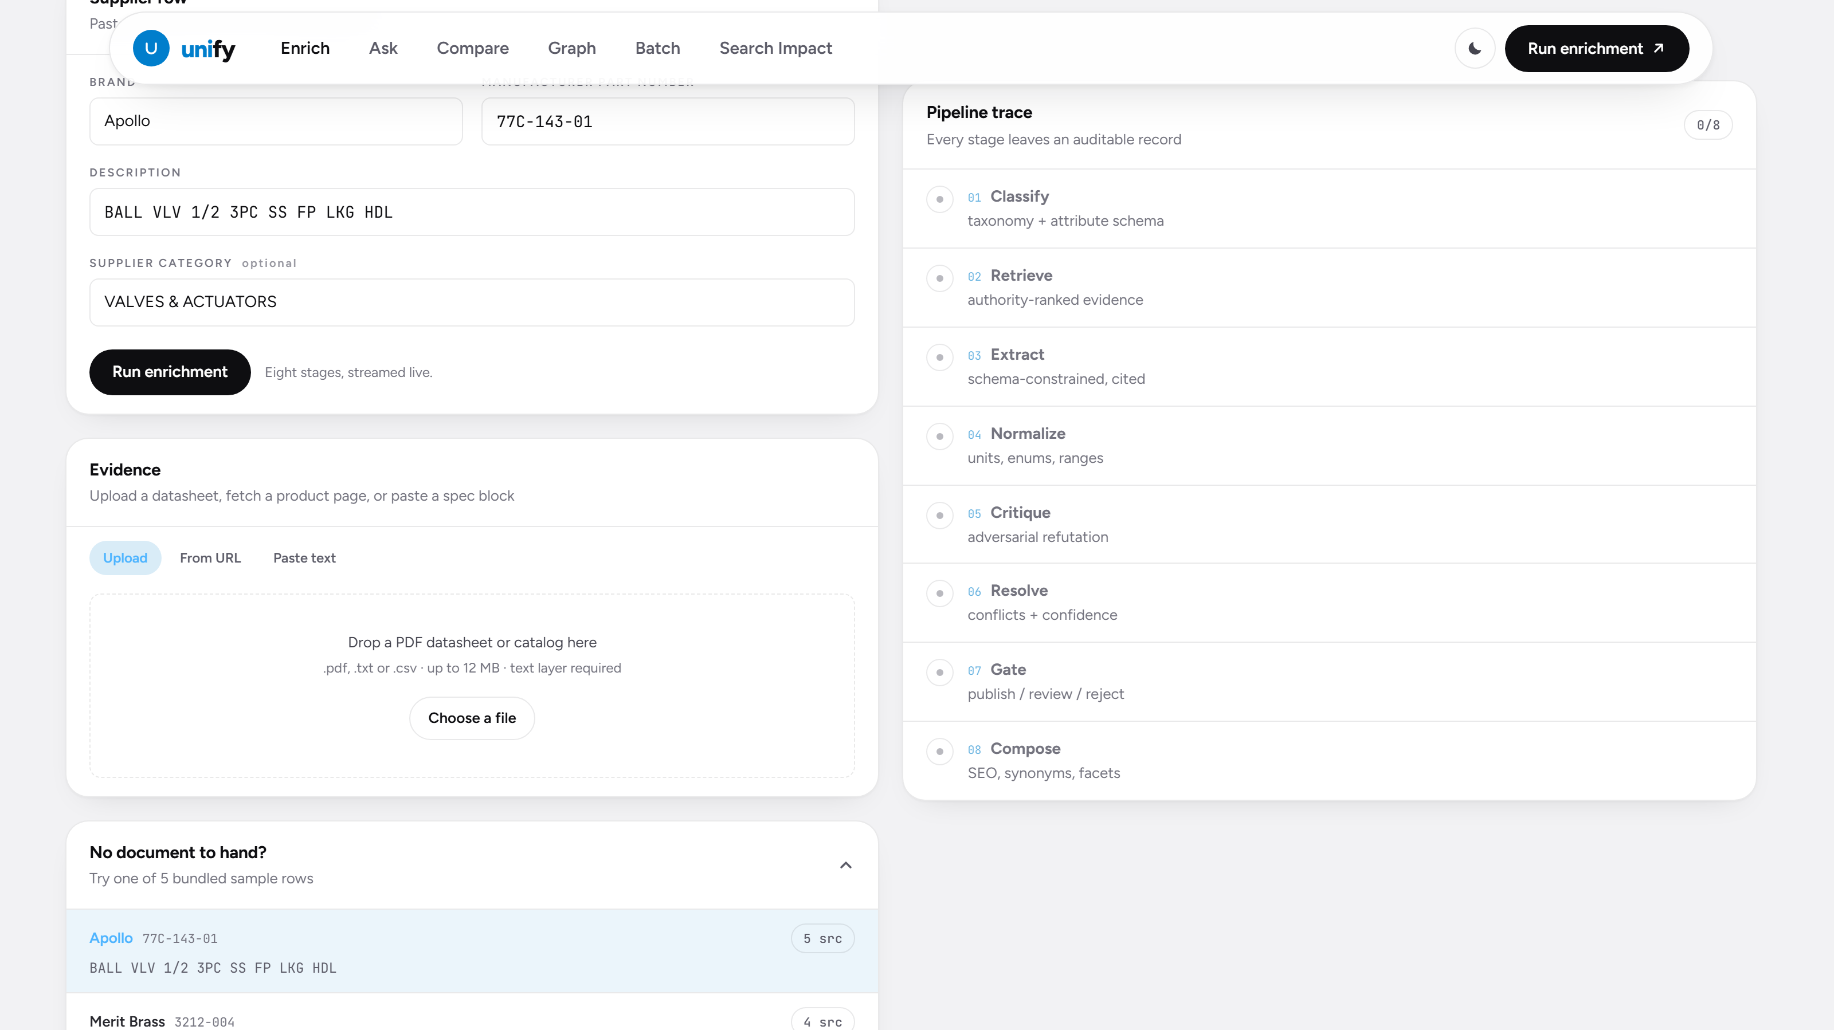
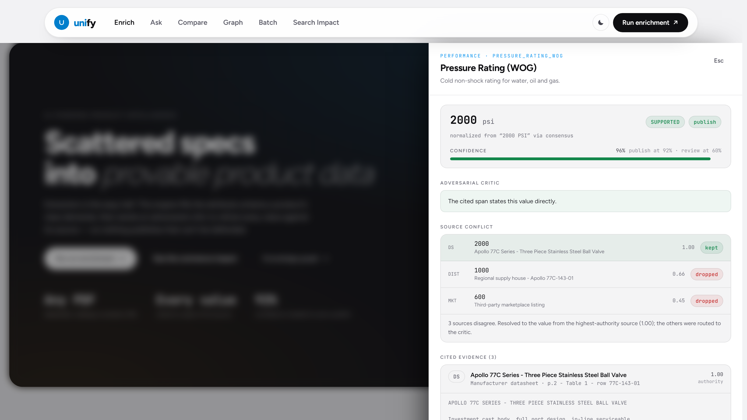
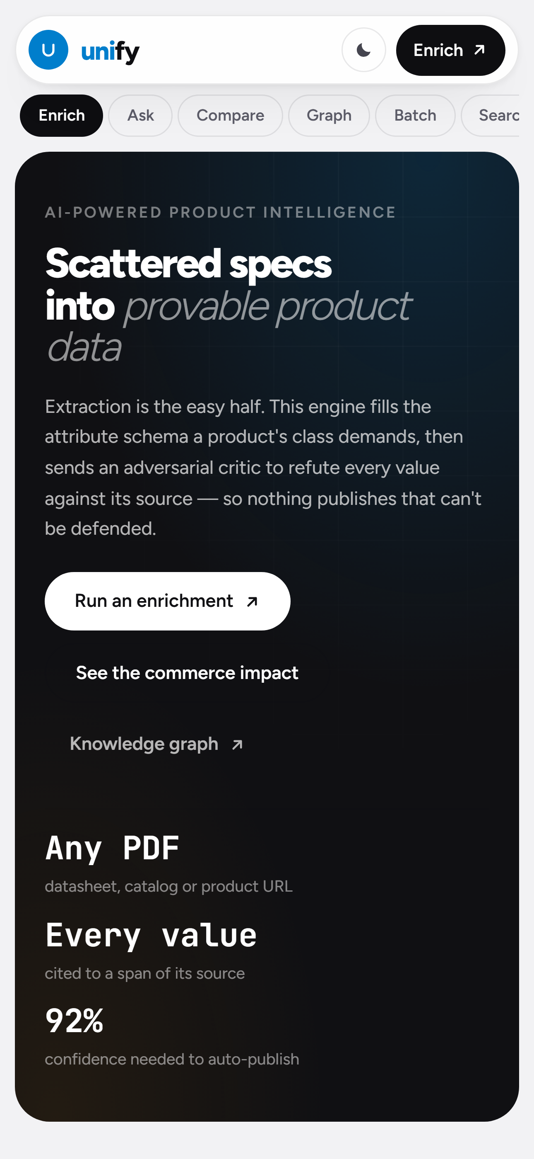
Wireframes / Mock diagrams of the proposed solution
The three surfaces the workflow lives in, captured from the working build.
1
2
3
1 Enrichment console
2 Evidence drawer
3 Responsive
Identity and evidence on the left, the eight-stage trace on the right.
Every value opens to the source, with the cited span highlighted.
Nav collapses to a chip row.
Supplier row
Evidence
Pipeline trace
Attribute record
Conflict panel
brand, MPN and the vendor line, starts empty
PDF upload, URL fetch or pasted spec, each with its authority
eight stages reporting live, with timings
value, provenance chips, confidence, gate decision
both contenders kept, with how the tie was broken

Slide 8
Architecture diagram of the proposed solution
SOURCES
INGEST + RETRIEVE
PIPELINE (8 stages)
MODEL LAYER
OUTPUTS
PDF datasheet unpdf text layer
/api/ingest PDF → text, HTML → text
Extract schema-constrained, cited
Gemini 3.7 Flash classify · normalize
Attribute record value + span + confidence
Product URL server-side fetch
Authority ranking datasheet → marketplace
Normalize units · enums · ranges
Gemini 3.1 Pro extract · critique · copy
Workspace browser-held catalogue
Pasted spec raw text
Taxonomy class → attribute schema
Adversarial critic SUPPORTED / CONTRADICTED
Deterministic reader runs with no API key
Search · facets · SEO commerce-ready
Cached corpus offline demo set
Evidence pool excerpt + offsets
Resolve + Gate confidence → decision
withFallback() model failure → degrade
Knowledge graph 90 nodes · 220 edges
Next.js 16 App Router on Vercel · stateless serverless API routes · SSE-streamed trace · the workspace lives in the browser, so the server holds no per-user state and scales horizontally without a session store.
Notes:
Mermaid source for this architecture:
flowchart LR
subgraph SRC["Sources"]
A1[PDF datasheet]
A2[Product URL]
A3[Pasted spec block]
A4[(Cached corpus)]
end
subgraph ING["Ingest & Retrieve"]
B1[/api/ingest\nunpdf + HTML to text/]
B2[Source authority ranking]
B3{{Taxonomy\nclass to attribute schema}}
B4[(Evidence pool\nexcerpt + char offsets)]
end
subgraph PIPE["Pipeline - 8 stages"]
C1[Classify]
C2[Retrieve]
C3[Extract\nschema-constrained, cited]
C4[Normalize\nunits, enums, ranges]
C5[Critique\nadversarial refutation]
C6[Resolve\nconflicts + confidence]
C7{Gate\n>=92% publish}
C8[Compose\nSEO, synonyms, facets]
end
subgraph MODEL["Model layer"]
M1[Gemini 3.7 Flash\nclassify, normalize]
M2[Gemini 3.1 Pro\nextract, critique, copy]
M3[Deterministic reader\nno API key required]
M4[[withFallback\nmodel failure degrades]]
end
subgraph OUT["Outputs"]
D1[Attribute record\nvalue + span + confidence]
D2[(Workspace\nbrowser-held catalogue)]
D3[Search, facets, SEO copy]
D4[Knowledge graph\n90 nodes / 220 edges]
D5[[Human review queue]]
end
A1 --> B1
A2 --> B1
A3 --> B1
A4 --> B2
B1 --> B2 --> B4
B3 --> C3
B4 --> C3
C1 --> C2 --> C3 --> C4 --> C5 --> C6 --> C7
C7 -->|publish| C8 --> D1
C7 -->|review| D5
C7 -->|reject| X[Dropped, logged with reason]
C1 -.-> M1
C4 -.-> M1
C3 -.-> M2
C5 -.-> M2
M1 -.-> M4
M2 -.-> M4
M4 -.-> M3
D1 --> D2 --> D3
D2 --> D4

Slide 9
Technologies used in the solution
Frontend
AI / ML
Data & processing
Infrastructure
• Next.js 16 (App Router)
• React 19 + TypeScript 5
• Tailwind CSS v4
• Server-Sent Events for the live trace
• Inline SVG graph + charts
• Google Gemini via @google/genai
• gemini-3.7-flash : classify, normalize
• gemini-3.1-pro : extract, critique
• Schema-constrained JSON output
• unpdf : PDF text-layer extraction
• Zod : request validation
• Custom unit + enum normalizer
• Deterministic heuristic reader
• PVF taxonomy as declarative data
• Vercel serverless functions
• Stateless API, no session store
• localStorage workspace
• Zero-config deploy, no env var required
• Graceful degradation on model failure
The entire engine runs deterministically with no API key at all, the model layer upgrades quality, it is never a dependency for the app to function.

Slide 10
Estimated implementation cost
Component
Basis
Monthly at 100k SKUs
Gemini Flash : classify + normalize
~1.2k tokens / SKU, high volume
≈ $18
Gemini Pro : extract + critique
~9k tokens / SKU, judgement calls
≈ $310
Vercel hosting
Serverless functions + bandwidth
$20 (Pro plan)
Storage / PDF cache
Object storage, optional
≈ $5
Human review
8.6% of attributes × ~8 s each
≈ 40 review-hours
Total infrastructure
excluding review labour
≈ $353 / month
Two-tier routing is what makes this affordable: the cheap model absorbs the high-volume decisions and the expensive model is reserved for extraction and critique. Running everything on the strong model would roughly triple the figure. Indicative rates, confirm against current pricing.

Slide 11
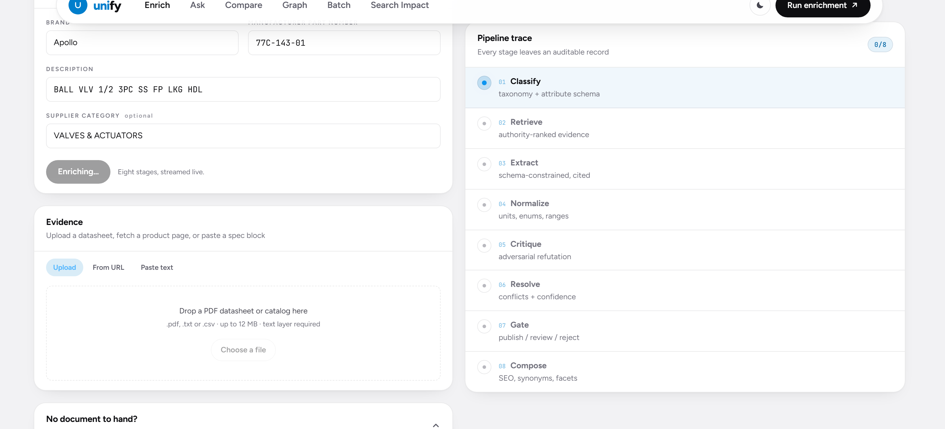
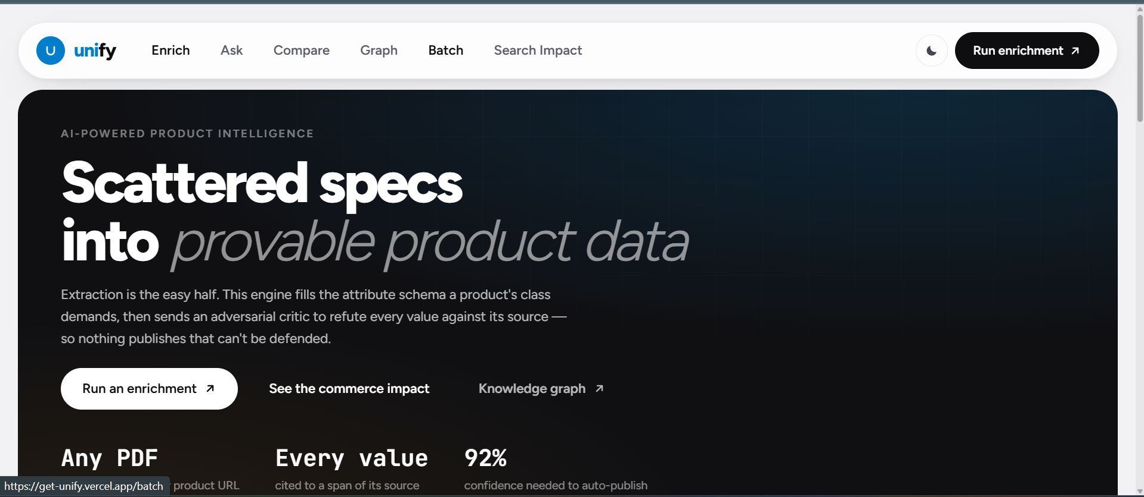
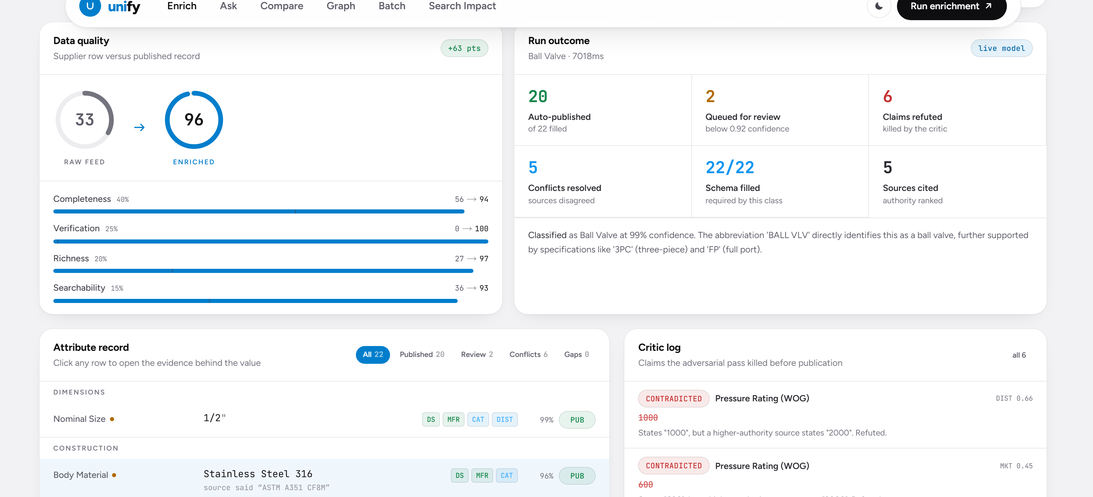
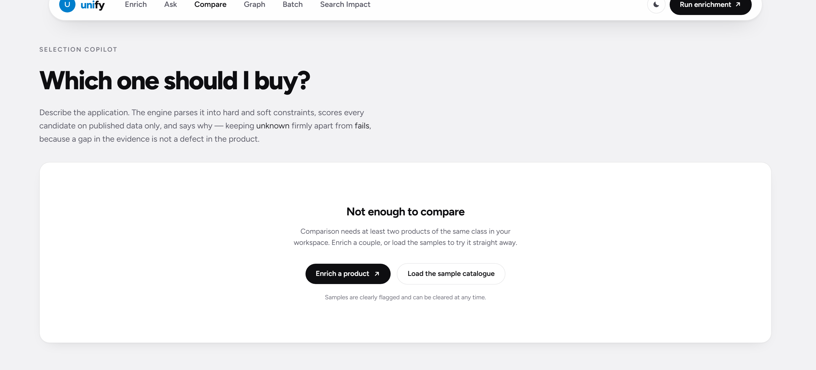
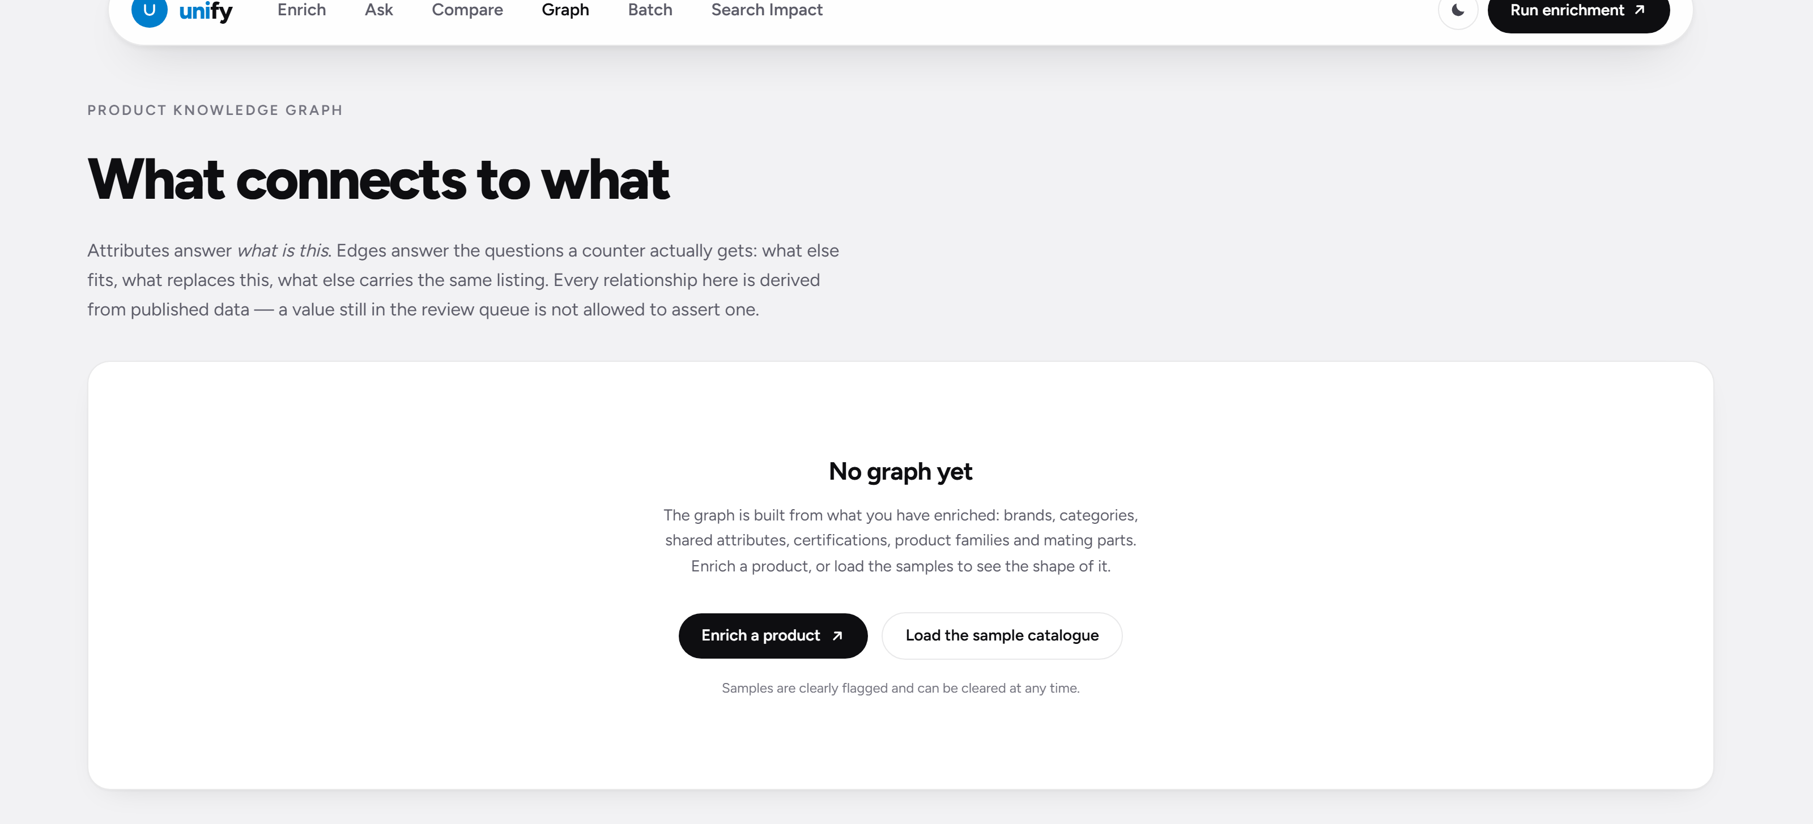
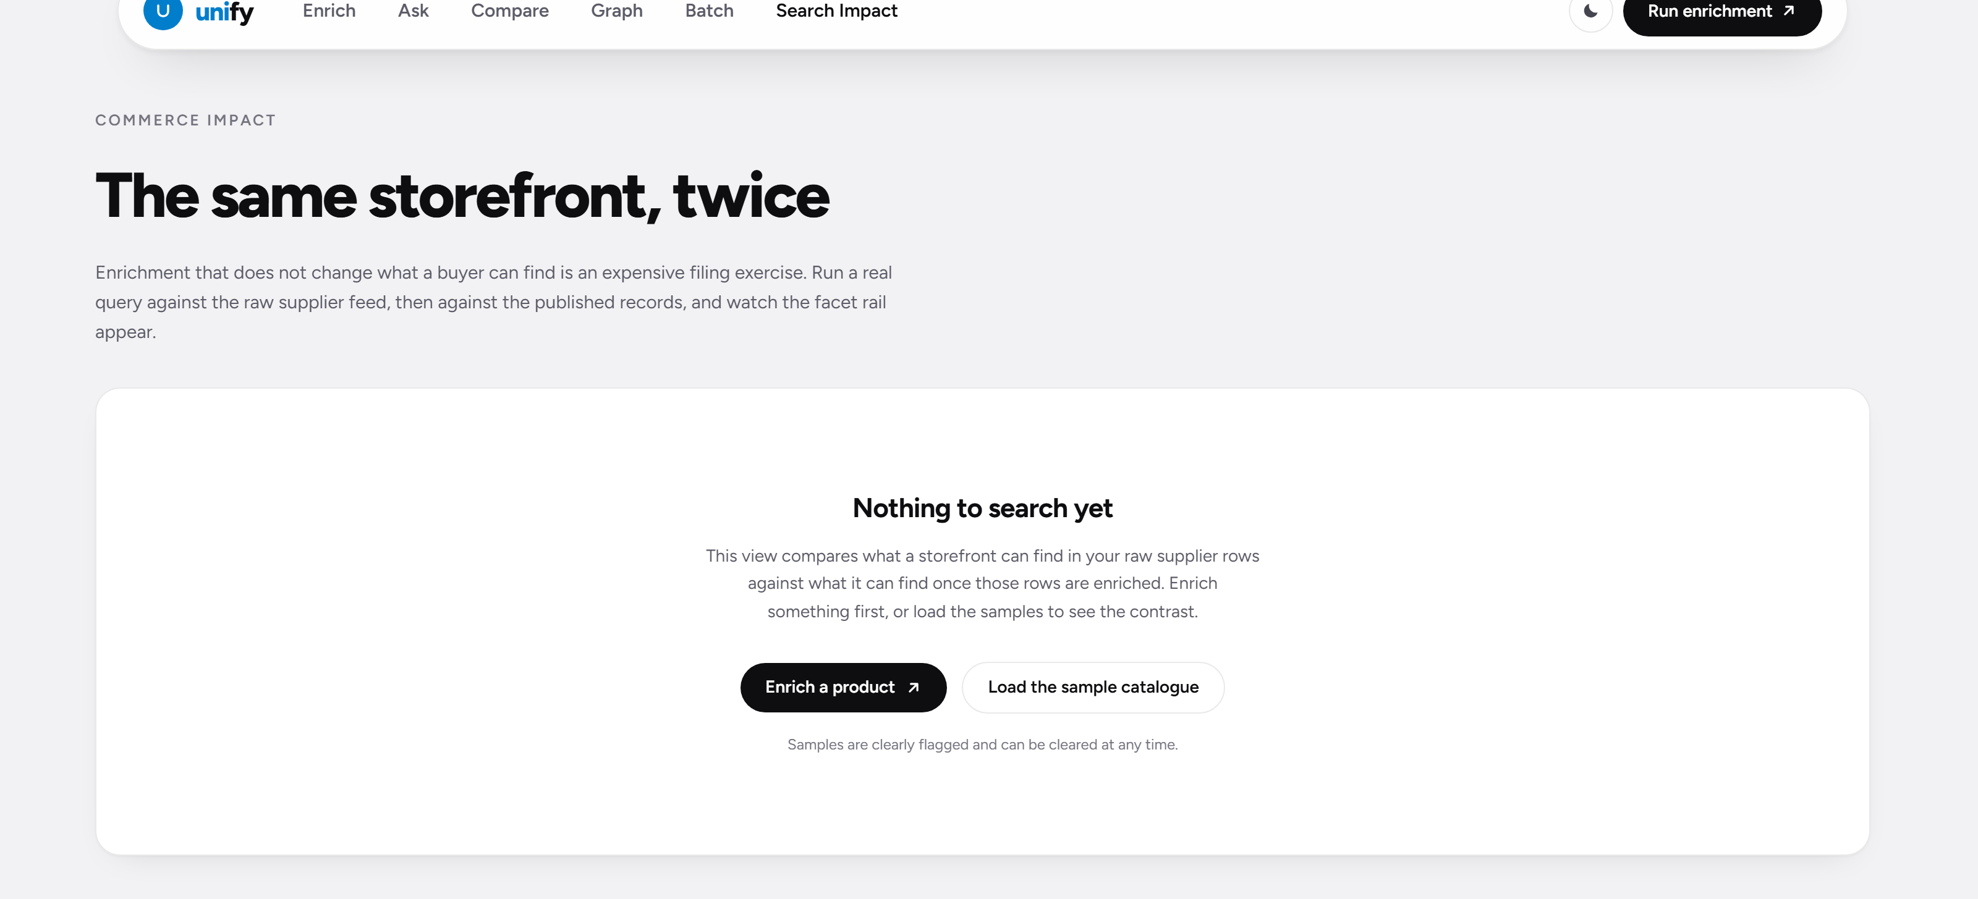
Snapshots of the MVP
Eight stages, streamed live
Click a value, see the evidence
The attribute record
the trace is the audit log
2000 psi kept · 1000 and 600 dropped
22 attributes, each gated on confidence
Comparison copilot
Product knowledge graph
Commerce impact
plain language in, a justified pick out
90 entities · 220 relationships
raw supplier rows versus enriched records

Slide 12
Additional Details / Future Development
▸ OCR for scanned datasheets : today a PDF needs a text layer; adding OCR opens the archive of older catalogs.
▸ Vision extraction from nameplates : the source type already exists in the model; reading a stamped plate is next.
▸ Learned source authority : authority is a fixed table now; it should be learned from how often a source is refuted.
▸ Reviewer feedback loop : every accept/reject in the review queue is training signal for the critic and the gate.
▸ ERP / PIM connectors : write published records straight into CIMM2, SAP or Akeneo instead of exporting.
▸ Supersession and lifecycle : the graph already models replacement; wiring in obsolescence feeds makes it actionable.
▸ Bulk pipeline at catalog scale : queue-backed workers with per-tenant rate limits for millions of SKUs.

Slide 13
Provide links to your:
1.
GitHub Public Repository
https://github.com/YashIsTheBest247/Unilog
2.
Demo Video Link (3 Minutes)
add link
3.
Working Prototype Link
https://get-unify.vercel.app
.

Slide 14


