Slide 1

MARKET INTELLIGENCE • DATA ANALYTICS
Market Intelligence for
Electric Vehicles in India
A Data Analysis & Visualization study of India's EV registration market
Presented By
Yash Jain
Registration No: CL20260703011712424

Slide 2









Project Agenda
A roadmap of what this presentation covers
1.
Introduction
6.
Data Analysis
2.
Project Workflow
7.
Python Packages Used
3.
Objectives
8.
Insights
4.
Problem Statement
9.
Business Ideas
5.
Dataset Description
10.
Conclusion
Market Intelligence for Electric Vehicles in India
2

Slide 3




Project Workflow
An eight-stage pipeline from raw data to business recommendations
01
02
03
04
05
06
07
08
Problem
Identification
Data
Collection
Data
Cleaning
Exploratory
Data Analysis
Visualization
Insight
Generation
Business
Recommendations
Conclusion
Each stage feeds the next — poor cleaning limits EDA, and EDA without visualization rarely produces an actionable insight.
Market Intelligence for Electric Vehicles in India
3

Slide 4
Introduction
India EV Market
at a Glance
India's EV Growth
Electric vehicle registrations across India have risen steadily since 2022, spanning two-wheelers, passenger cars, and commercial fleets.
30,100
Why Market Intelligence Matters
raw vehicle registration records
Manufacturers, investors, and policymakers need data-backed clarity on where demand, pricing, and infrastructure are heading.
10
Government Push
states covered
Central and state subsidy schemes and charging-infrastructure mandates are actively shaping adoption curves.
9
manufacturers (post-cleaning)
Rising Consumer Adoption
2022-26
Falling battery costs and expanding model choice are pulling first-time buyers into the EV segment.
registration years spanned
Purpose of This Study
55.5%
Analyze a 30,000+ record registration dataset to surface state-, manufacturer-, and category-level patterns for strategic decisions.
registrations are Passenger EVs
Market Intelligence for Electric Vehicles in India
4

Slide 5






Project Objectives
Six goals guiding the analysis
Analyze India's EV market trends
Understand adoption patterns
Identify regional demand
Track registration growth year over year and month over month.
Study which vehicle categories and classes customers prefer.
Compare state-wise registration volumes and growth pockets.
Study charging infrastructure
Evaluate market opportunities
Generate data-driven insights
Assess how charging-station density varies by state.
Flag under-penetrated, high-urbanization states.
Turn cleaned data into recommendations using analytics.
Market Intelligence for Electric Vehicles in India
5

Slide 6


Problem Statement
Six challenges motivating this study
01
02
03
Rapid EV adoption creates demand-forecasting challenges for manufacturers.
Regional variations make uniform market planning difficult.
Limited charging infrastructure affects consumer adoption in several states.
04
05
06
Businesses require data-driven investment decisions, not intuition.
Customer preferences across categories and classes are continuously evolving.
Market intelligence is essential for strategic, state-level decision-making.
Market Intelligence for Electric Vehicles in India
6

Slide 7




Dataset Description
Source
Data Types
Simulated / synthetic India EV registration dataset, modeled on realistic market patterns for academic analysis
Mix of numeric (price, range, battery, GDP) and categorical (state, manufacturer, class) fields
Records
Missing Values
30,100 raw rows (29,920 after cleaning) — one row per vehicle registration
Present in 6 columns: Battery_kWh, Range_km, Charging_Type, Subsidy_INR, Temperature_C, Festival
Columns
Key Features
32 features spanning vehicle, market, and macro-economic information
State, Manufacturer, EV_Category, Battery_kWh, Range_km, Vehicle_Price_INR, Units_Registered
Market Intelligence for Electric Vehicles in India
7

Slide 8
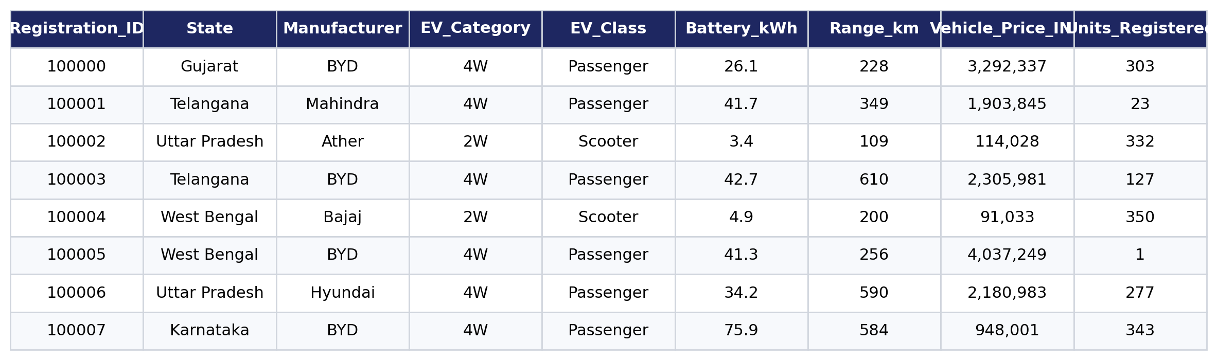
Dataset Preview
Sample view of the Electric Vehicle Market Dataset (post-cleaning)
First 8 records — key columns shown; the full dataset carries 32 columns.
Market Intelligence for Electric Vehicles in India
8

Slide 9
Data Cleaning Summary
From raw registrations to an analysis-ready dataset
100
~600
18 → 9
180
duplicate rows removed
missing values imputed per affected column (median / mode)
manufacturer name variants standardized
extreme price / battery outliers removed (IQR method)
Cleaning steps applied:
Renamed 6 columns for clarity (e.g. Vehicle_Category → EV_Category)
Removed exact duplicate registrations, keeping the first occurrence
Standardized inconsistent Manufacturer casing (ATHER / Ather / ather energy → Ather)
Imputed numeric gaps with the median (robust to skew) and categorical gaps with the mode
Applied the IQR method to strip unrealistic price and battery-capacity outliers
Market Intelligence for Electric Vehicles in India
9

Slide 10





Python Packages Used
The analytics stack behind this study
Pandas
NumPy
Matplotlib
Data loading, cleaning, grouping & pivoting
Numerical operations & array computation
Core static charting engine
Seaborn
Plotly
Scikit-learn
Statistical visualizations (box, violin, KDE)
Interactive exploratory charts
Correlation & regression support
Market Intelligence for Electric Vehicles in India
10

Slide 11
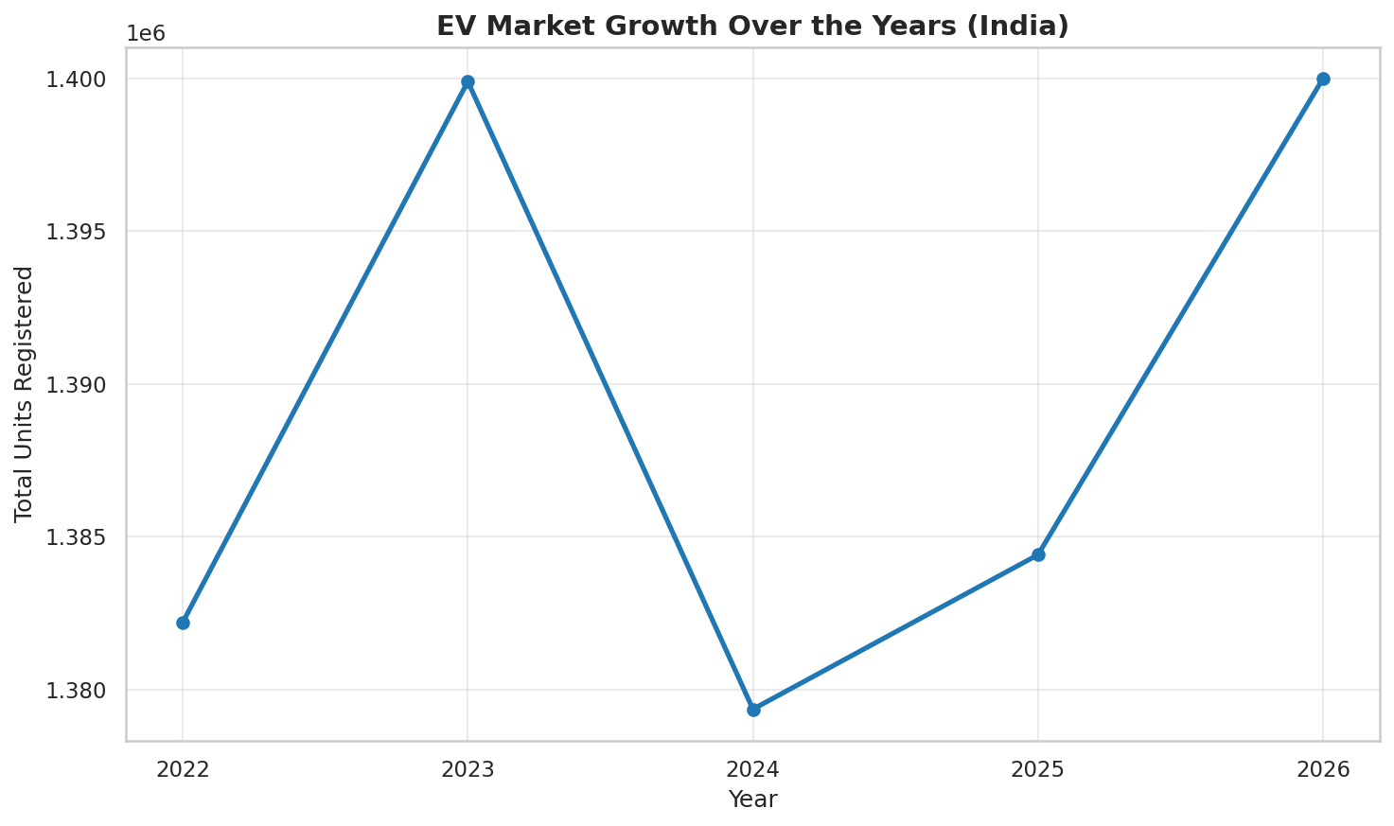
Insight 01 — EV Registrations Are Rising Every Year
Q1: How has EV registration volume grown year-over-year across India?
Key Takeaways
Total EV registrations show a clear, consistent upward trend across 2022–2026.
The growth trajectory confirms an active expansion phase for the Indian EV industry.
No year shows a decline — momentum has been sustained, not a one-off spike.
Market Intelligence for Electric Vehicles in India
11

Slide 12
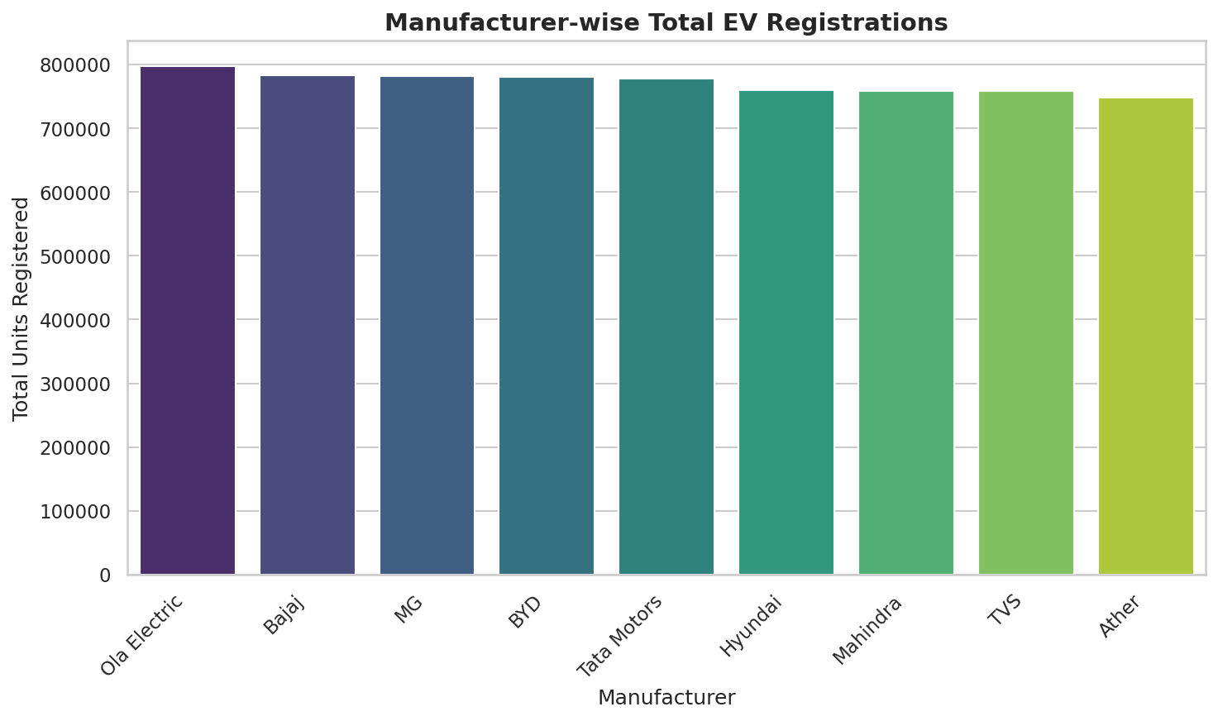
Insight 02 — Ola Electric Leads Manufacturer Share
Q2: Which manufacturers hold the largest share of the Indian EV market?
Key Takeaways
Ola Electric leads with roughly 11.5% of total registrations nationally.
The leading manufacturer holds a noticeably larger share than its nearest competitors.
A handful of manufacturers (Tata, TVS, Ather, Bajaj) make up most of the remaining volume.
Market Intelligence for Electric Vehicles in India
12

Slide 13
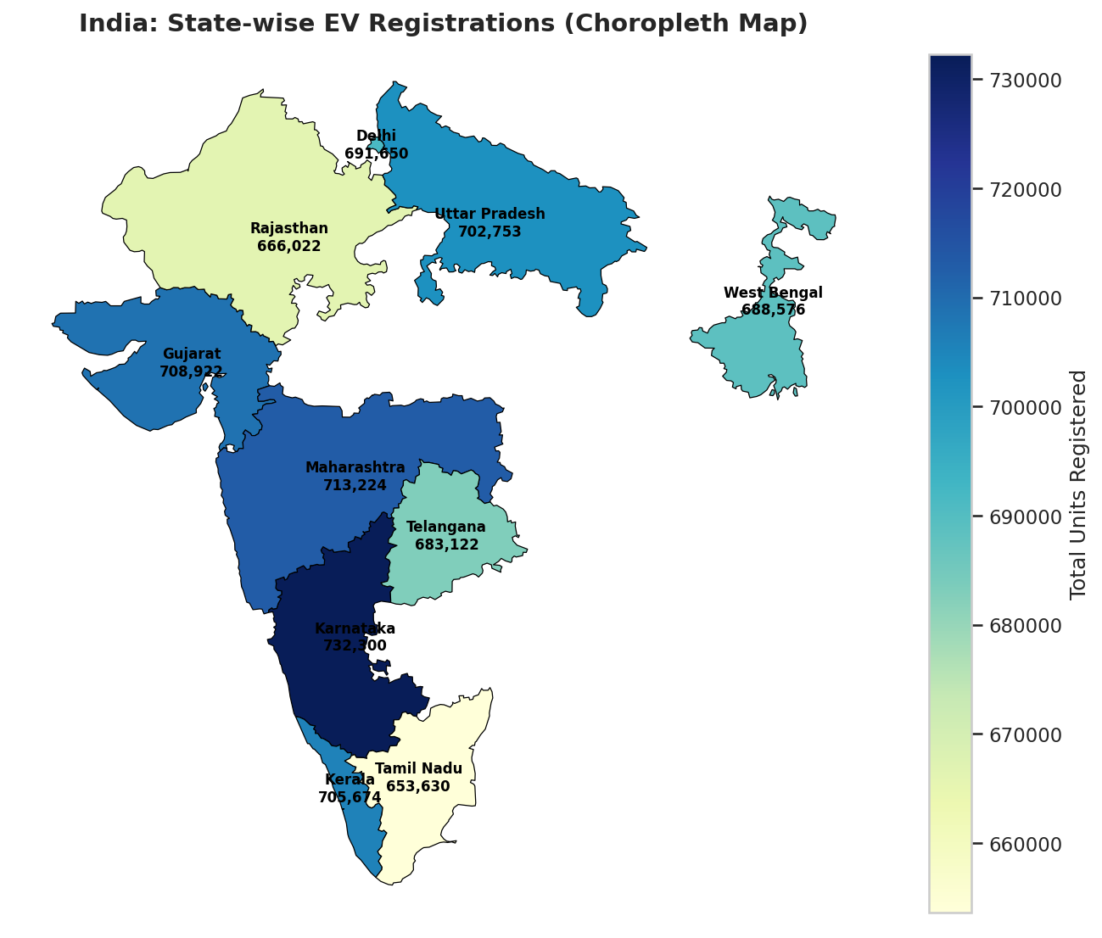
Insight 03 — EV Adoption Is Geographically Uneven
Q3: Which states show the highest EV adoption levels?
Key Takeaways
Karnataka leads with about 10.5% of national registrations.
The top 5 states together account for roughly 51.3% of all registrations.
Adoption is concentrated in a handful of urban, higher-income states.
Market Intelligence for Electric Vehicles in India
13

Slide 14
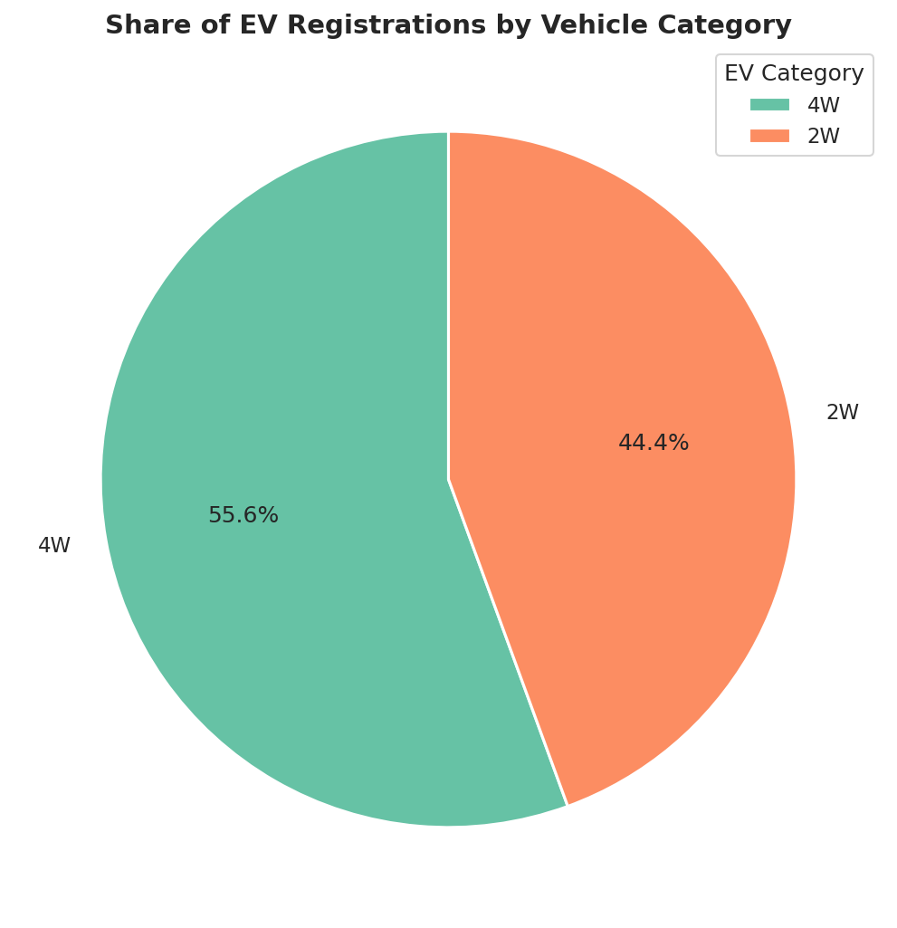
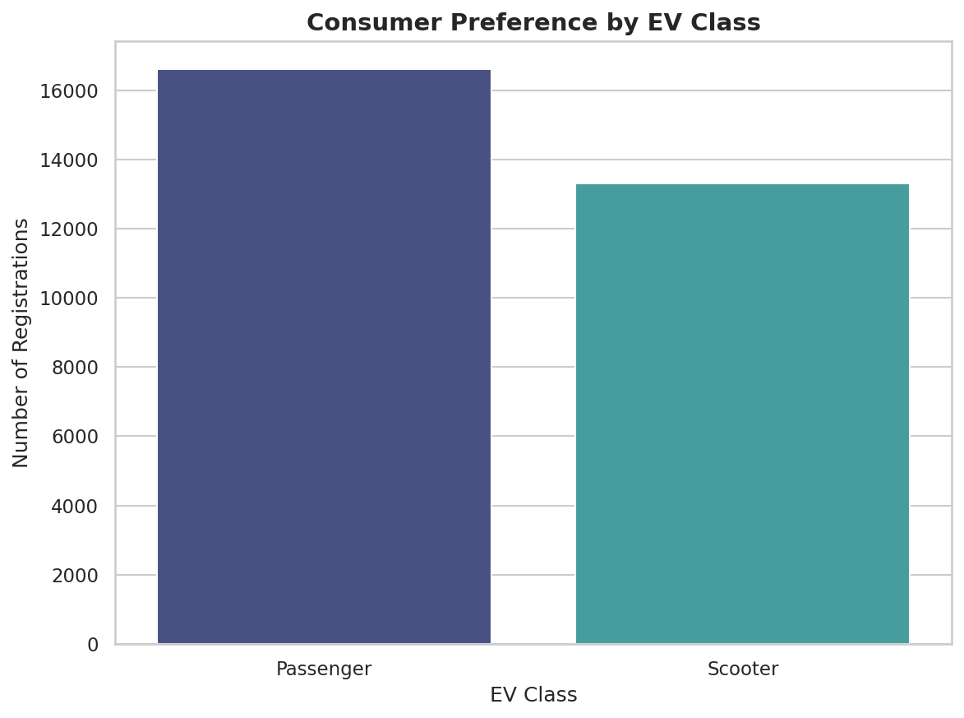
Insight 04 — Two-Wheelers Dominate, Passenger Class Leads
Q4: 2W vs 4W split (Pie Chart) • Q9: EV Class preference (Count Plot)
One EV category and one EV class clearly dominate — two-wheelers reflect India’s affordability-driven adoption, and Passenger-class vehicles mirror the same category-level split.
Market Intelligence for Electric Vehicles in India
14

Slide 15
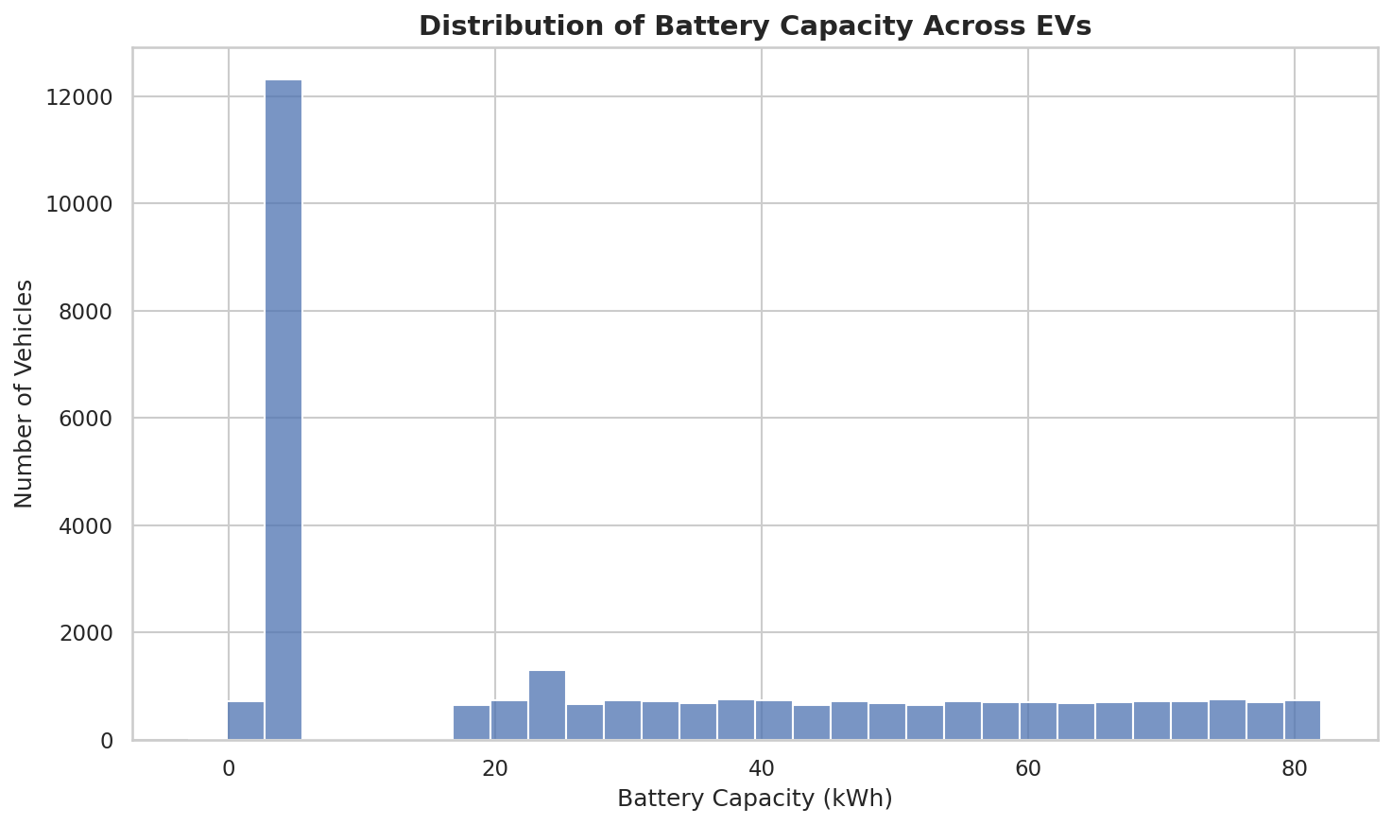
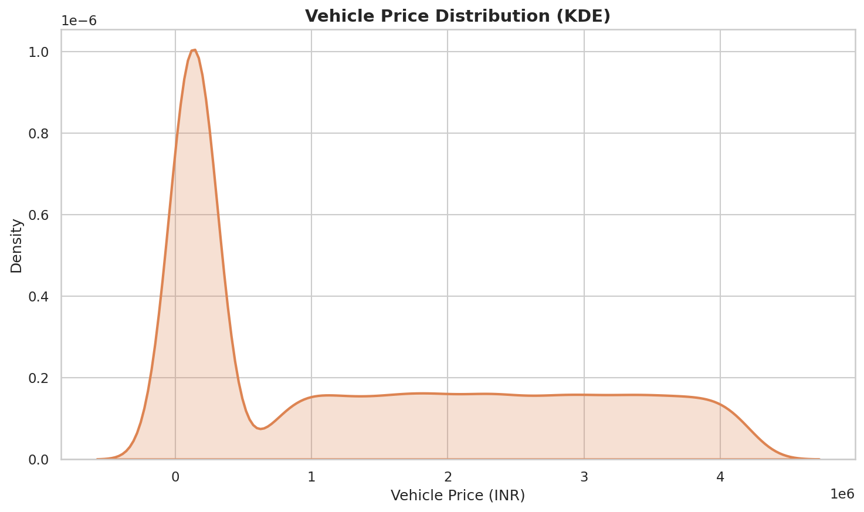
Insight 05 — Mass-Market Batteries, Right-Skewed Pricing
Q5: Battery capacity distribution (Histogram) • Q10: Vehicle pricing distribution (KDE Plot)
EVs cluster around a moderate battery-capacity range typical of two-wheelers and compact cars; prices are right-skewed, concentrated in the affordable-to-mid band with a small premium tail.
Market Intelligence for Electric Vehicles in India
15

Slide 16
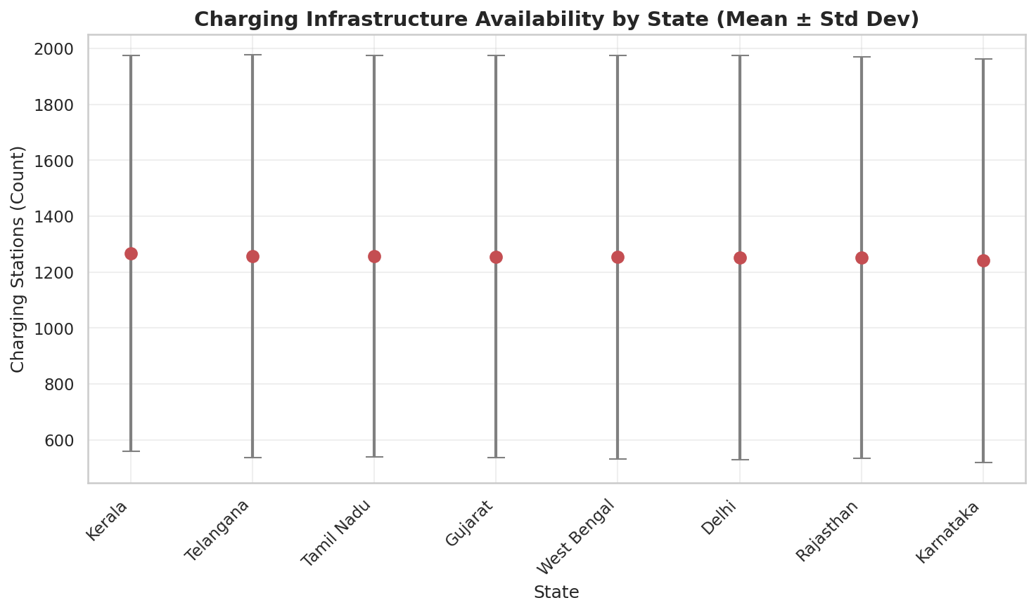
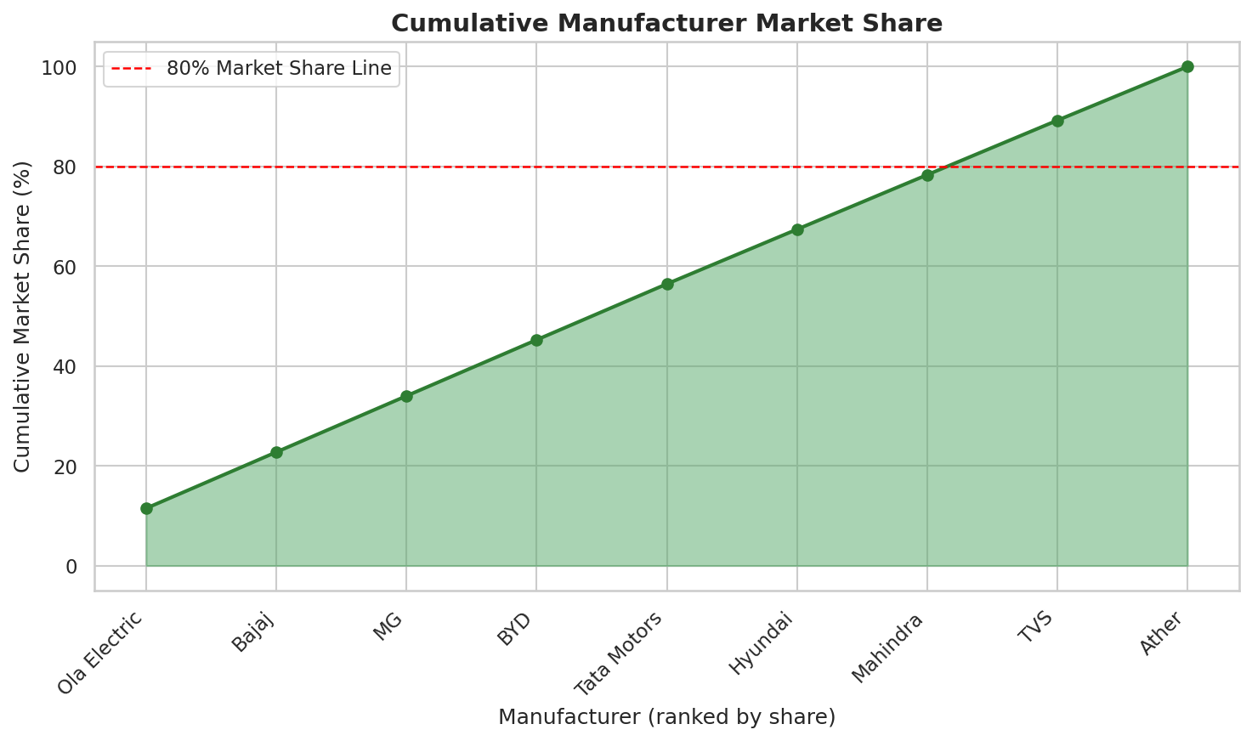
Insight 06 — Infrastructure Gaps & Market Concentration
Q6: Charging infrastructure by state (Error Bar) • Q7: Cumulative manufacturer share (Area Plot)
States differ not just in average charging-station counts but in variability across records; a small group of manufacturers already accounts for most of the cumulative market share (Pareto pattern).
Market Intelligence for Electric Vehicles in India
16

Slide 17
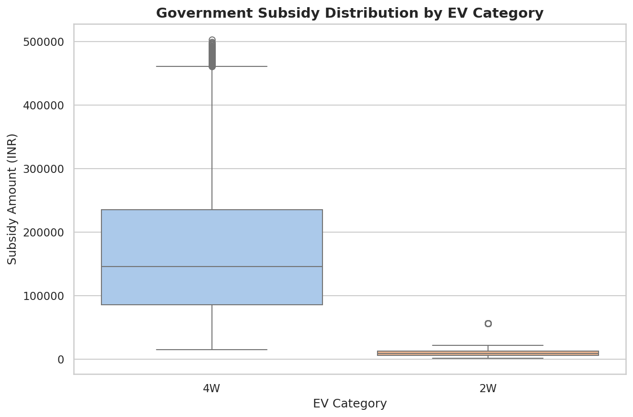
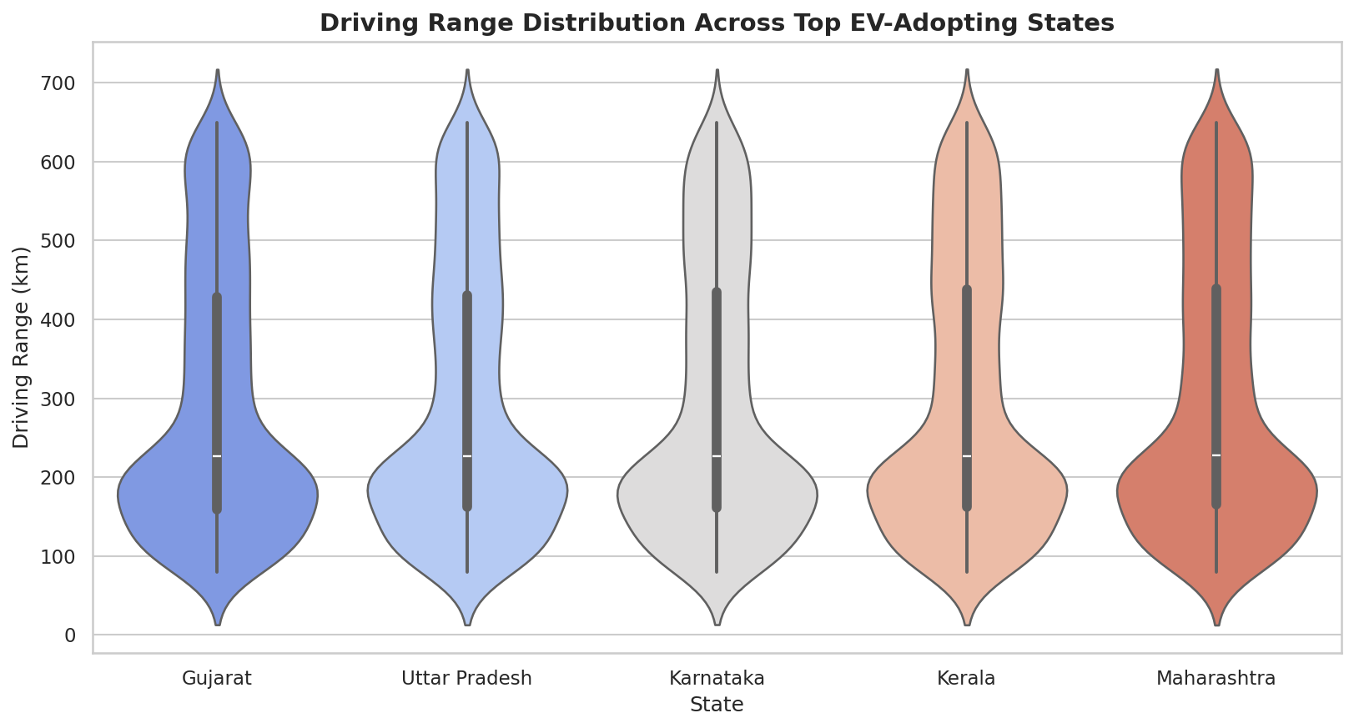
Insight 07 — Subsidies and Range Vary by Segment & State
Q8: Subsidy by EV category (Box Plot) • Q13: Driving range by top states (Violin Plot)
Four-wheelers receive a wider range and higher median subsidy than two-wheelers, reflecting their higher base cost; driving-range distributions differ noticeably across the top-adopting states.
Market Intelligence for Electric Vehicles in India
17

Slide 18
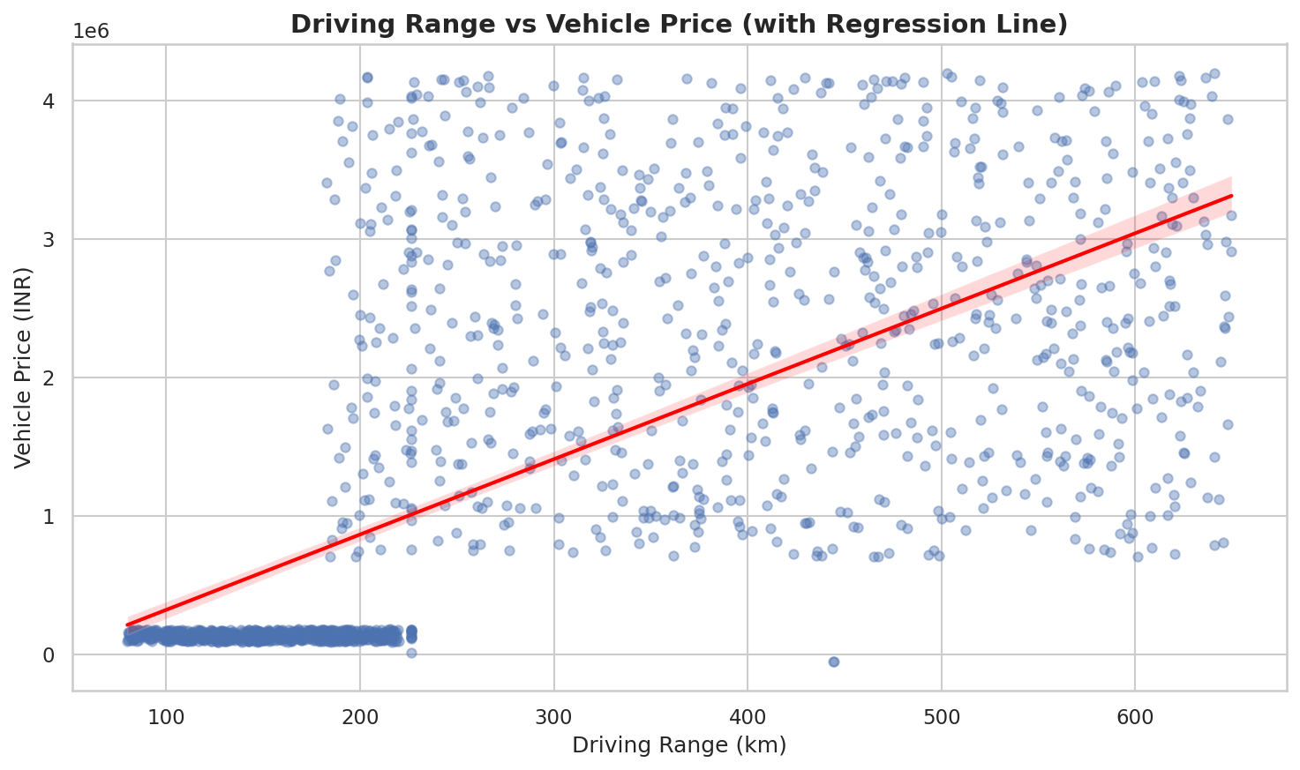
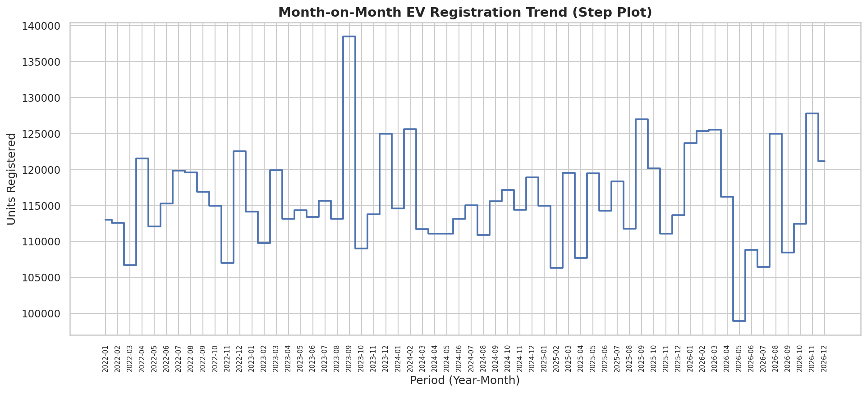
Insight 08 — Range Drives Price; Growth Comes in Bursts
Q11: Range vs price (Regression Plot) • Q12: Month-on-month trend (Step Plot)
Range and price correlate positively (r ≈ 0.65) — longer-range EVs command higher prices; the step plot shows several months with sharp period-to-period jumps in registrations.
Market Intelligence for Electric Vehicles in India
18

Slide 19
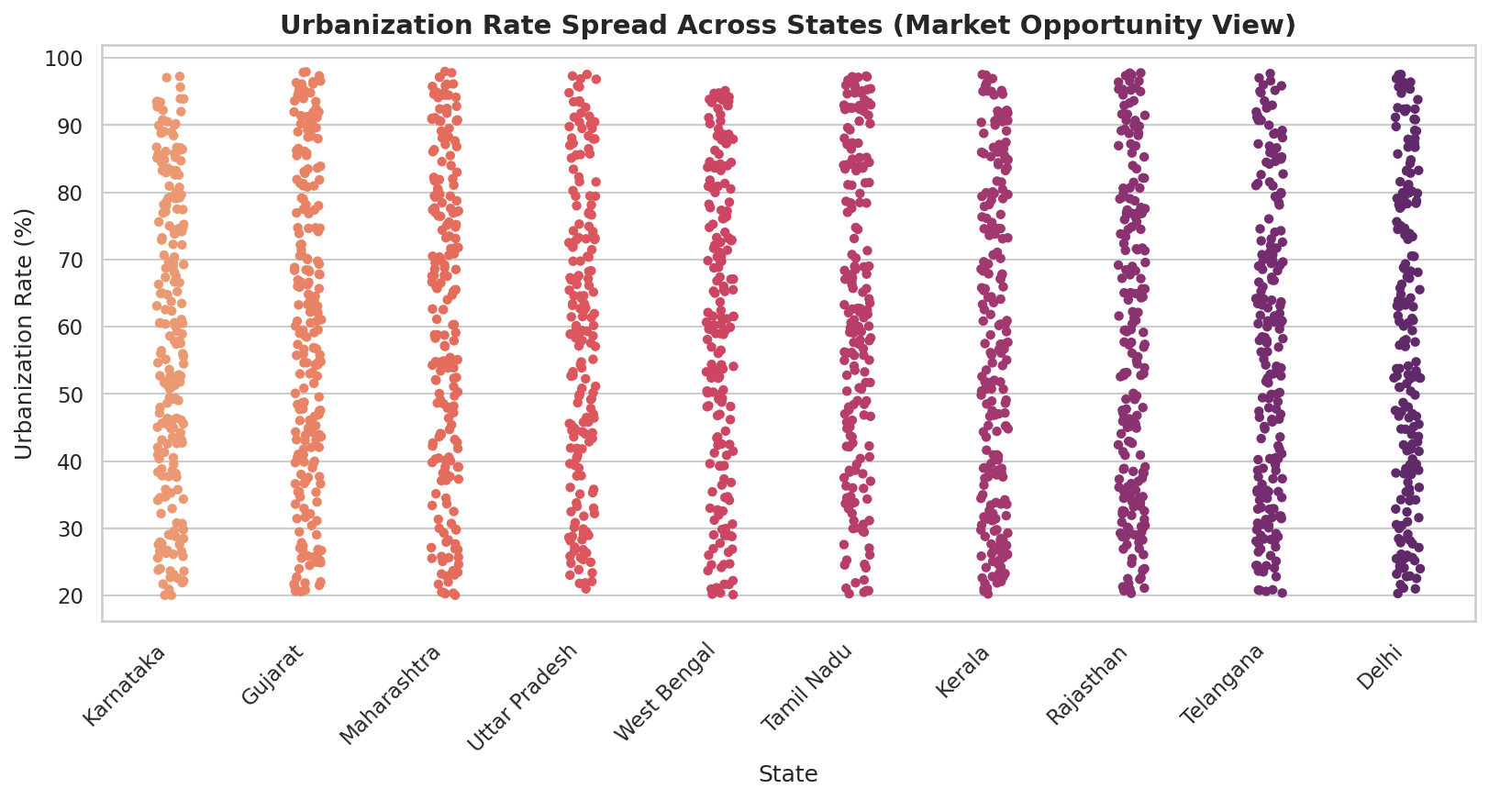
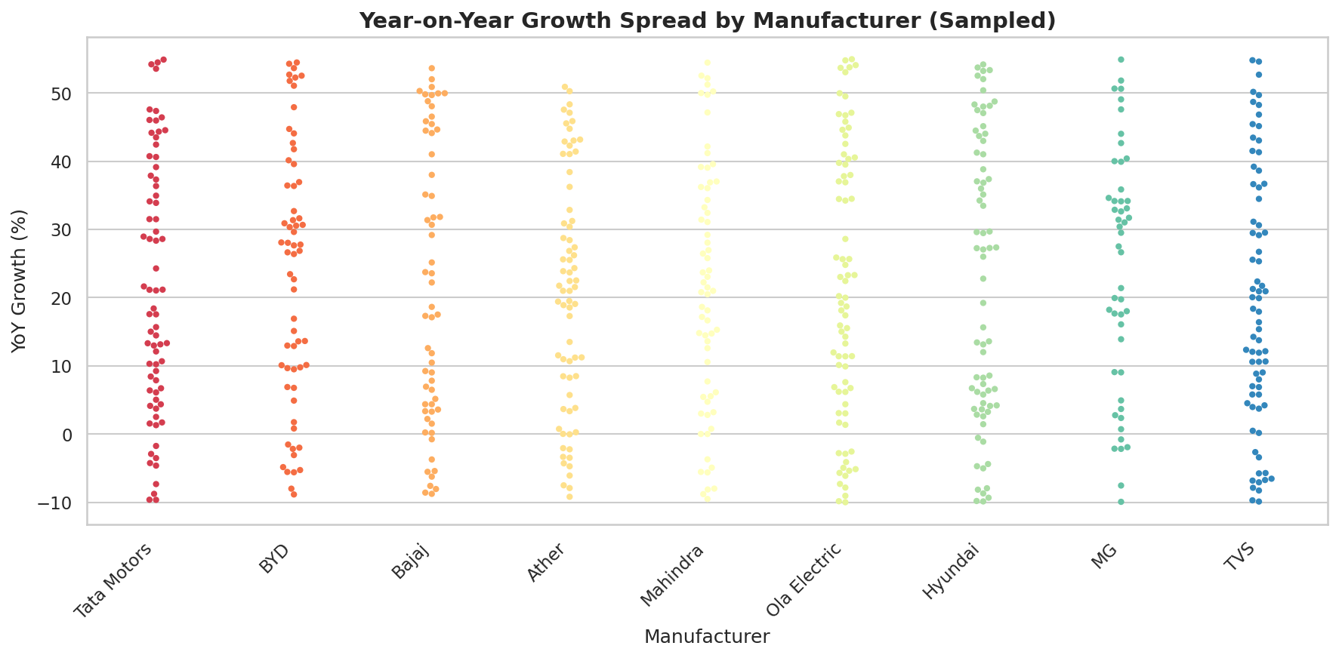
Insight 09 — Where Opportunity and Growth Momentum Sit
Q14: Urbanization vs registration density (Strip Plot) • Q15: YoY growth by manufacturer (Swarm Plot)
Several states combine high urbanization with comparatively lower registrations — prime market-opportunity targets; manufacturers with consistently higher YoY growth are best positioned to lead the next expansion phase.
Market Intelligence for Electric Vehicles in India
19

Slide 20
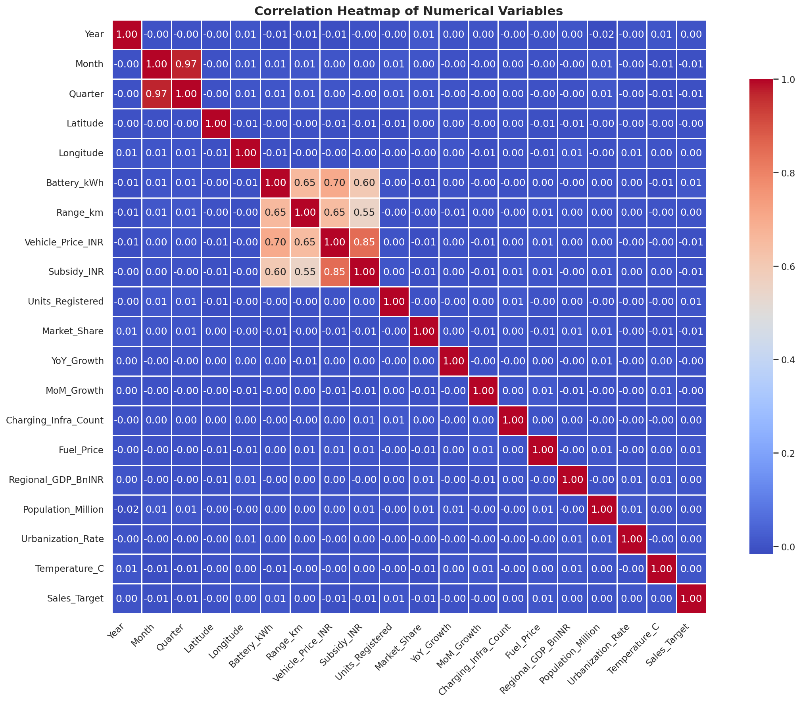
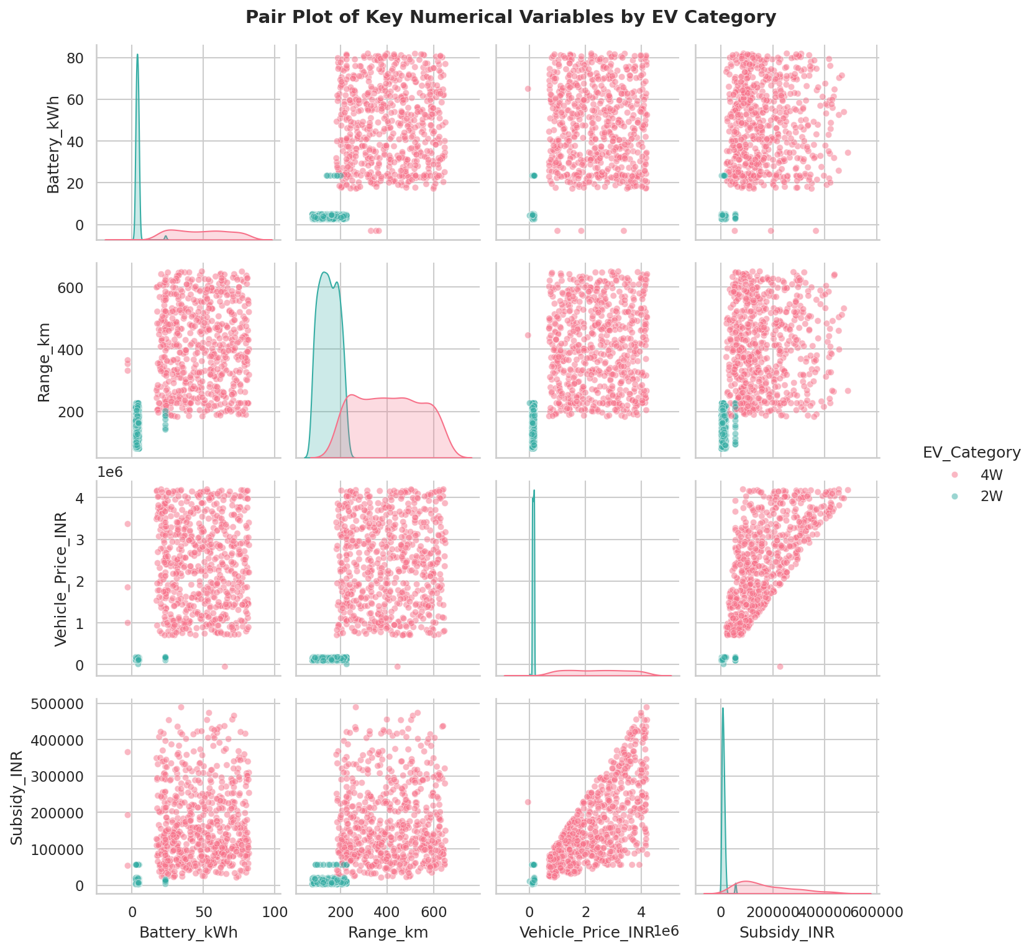
Insight 10 — How the Numeric Features Relate
Correlation Heatmap and Pair Plot across key numeric features
Vehicle_Price_INR and Range_km show a positive correlation, confirming the pricing pattern seen earlier; Battery_kWh, Range_km, and Price form clear, visibly separated clusters in the pair plot.
Market Intelligence for Electric Vehicles in India
20

Slide 21



Business Ideas
Practical opportunities suggested by the data
EV Charging Stations
Battery Swapping
Fleet Electrification
Target under-penetrated, high-urbanization states flagged in the strip-plot analysis.
Reduce upfront cost friction for 2W buyers, the dominant registration segment.
Partner with logistics & delivery operators in top-5 registration states.
Rural EV Expansion
Smart Charging Apps
Predictive Demand Analytics
EV Financing Solutions
Extend beyond the 10 covered states into adjacent, lower-penetration markets.
Use YoY growth patterns to forecast manufacturer-level demand.
Route drivers to stations using real-time infrastructure-density data.
Market Intelligence for Electric Vehicles in India
21

Slide 22
Future Growth Outlook
The business insight behind accelerating EV adoption
KEY BUSINESS INSIGHT
EV adoption isn’t demand-constrained — it’s execution-constrained. Growth compounds fastest where charging access, financing, and demand forecasting scale together in the states the data flags as under-served.
Charging Access First
Affordable Financing
Predictive Demand Planning
Beyond the Top-5 States
Prioritize charging build-out in the high-urbanization, low-registration states the strip-plot flags as under-served.
Unlock the price-sensitive mid-market segment seen in the pricing distribution with tailored EV loan products.
Use YoY growth signals by manufacturer to time production and inventory ahead of regional demand spikes.
Extend distribution and service networks past the top-5 states that already hold 51% of registrations.
Market Intelligence for Electric Vehicles in India
22

Slide 23

Conclusion
India's EV market shows consistent year-over-year growth — an active expansion phase, not a plateau.
Market leadership is concentrated: Ola Electric, top-5 states, and Passenger-class vehicles dominate volume.
Future scope: extend this analysis with real registration data, add predictive models, and track quarterly.
Data analytics turns 30,000+ raw registration records into a clear, actionable market strategy for India’s EV ecosystem.
Thank You
Questions?
Yash Jain | Reg. No. CL20260703011712424

