Slide 1

Solution Presentation of
Analytics Olympiad 2021
By - Yash Khandelwal

Slide 2
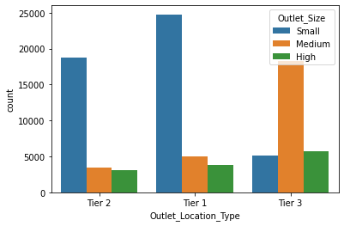
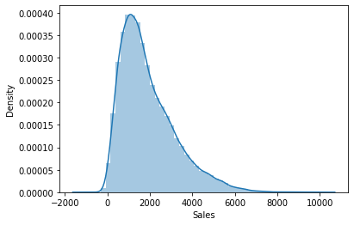
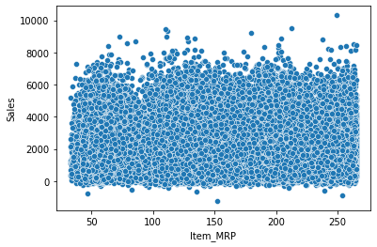
Data Understanding
Overview
The Training data has total 87,864 observations with 12 features out of which 7 are categorical and 5 are continuous. The Test data has 37,656 observations. The target feature is the Sales of items in the mega mart.
Highest number of observations in data are from small outlets from tier 1 cities.
The least number of observations are from large outlets from tier 2 cities.
Sales has a positively skewed distribution.
There is no linear relationship between MRP of items and their sales.

Slide 3
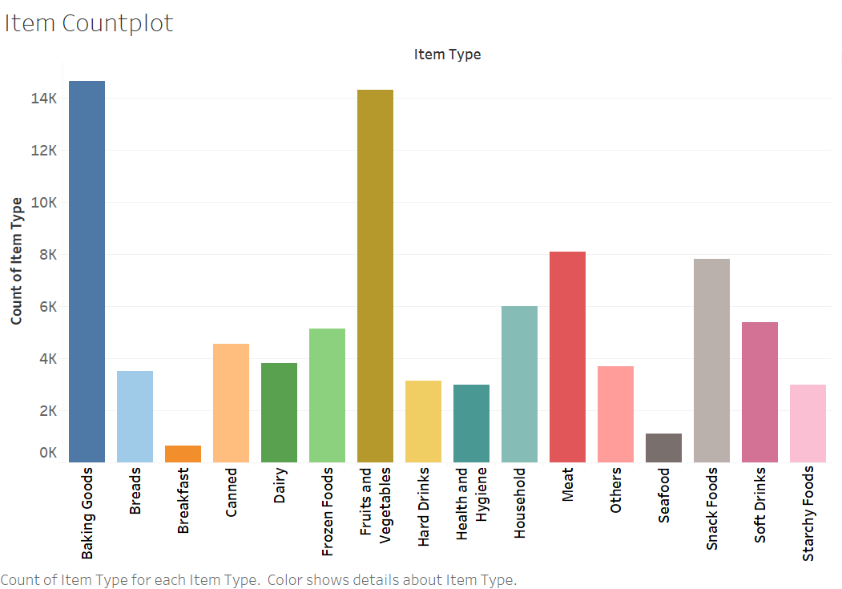
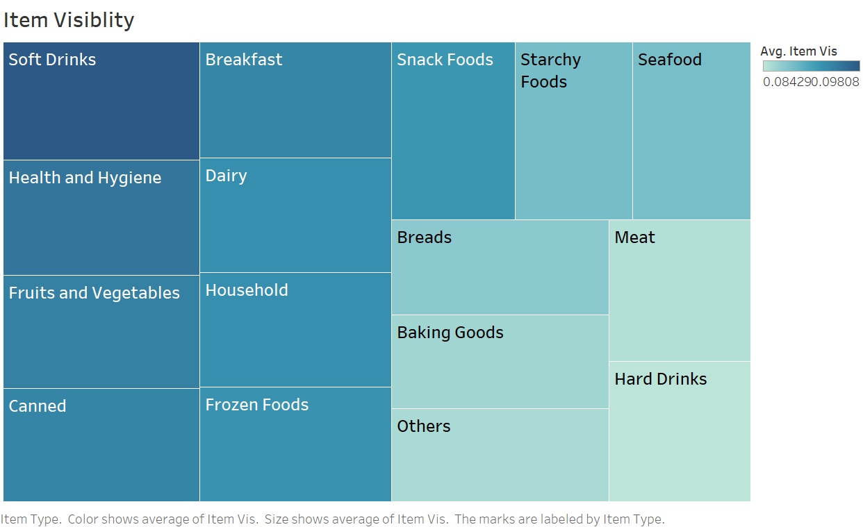
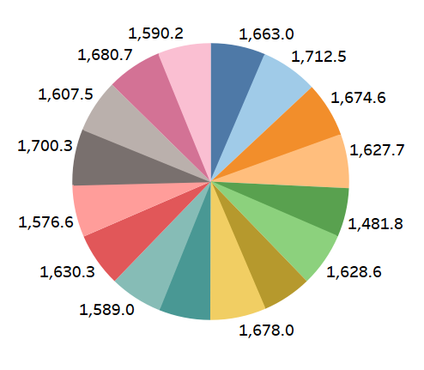
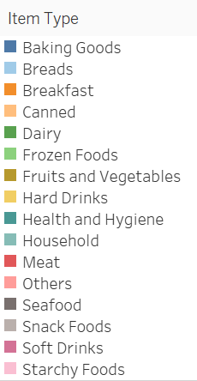
Data Understanding
Average sales of item Piechart
Items falling under Baking Goods and Fruits & Vegetables have the highest count in the mega mart.
The highest average (mean) item visibility in the mega mart is of Soft Drinks.
The lowest avg. visibility is of Hard Drinks.
Average (median) sales of all item types is almost equal.
Overall the avg. Sales of Breads is the highest.

Slide 4
Data Preparation
Dealing with missing data - No null values found in the data.
Dealing with Outliers - Found using inter-quartile range. 2,378 observations (2.7 %) in the Sales are the outliers. These outliers are not due to error in data entry but contain important information about unusually high/low sales of some items. Hence, I haven’t dropped the outliers.
Categorical Encoding (convert text data into numerical form) -
Outlet_ID - One Hot Encoding (There are 5 unique outlet ids. Sales of the product has significant relationship with outlet in which it was sold).
Item_Type, Outlet_Year, Outlet_Type - One Hot Encoding
Outlet_Size, Outlet_location_type, Item_FC - Ordinal Encoding (There is an ordinal relationship in these features: High > Medium > Small, Tier1 > Tier2 > Tier3, Regular Fat > Low Fat).

Slide 5
Feature Engineering
New Features Created -
Years_from_the_present
Calculation: 2021 - Outlet_Year
Explanation: Mega mart outlets that are established earlier (higher Years_from_the_present) tend to have a larger customer base and eventually may have a higher sales.
Item_ID_Type
Calculation: First 3 letters of Item_ID.
Explanation: Every item ID has a 3 letter word at the biggening which may contain some useful information such as brand of the item/ some manufacture detail.
Categorical Encoding: Ordinal Encoding on Item_MRP
Feature Selection - Permutation feature importance, XGBoost Importance used for feature selection. However, both gave increase in RMSE in the performance of baseline model.

Slide 6

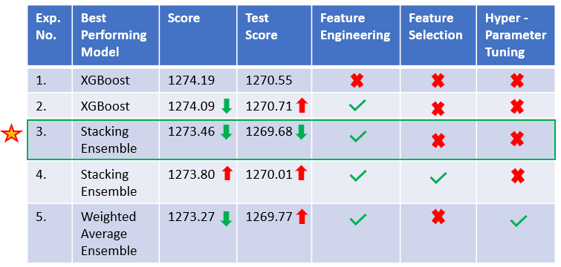
Model Building & Evaluation
Modelling Process -
Table: Experimental Results
Experiment 1. Scores of Ensemble &
Regularisation Regression methods -
XGBoost - 1274.19|Ridge - 1274.47
Gradient Boost - 1274.57|Lasso - 1274.54
Light GBM - 1275.92 | Elastic Net – 1283.8
Random Forest – 1304.35
Experiment 3. These 4 models from Experiment 2 were used to create an optimal Ensemble Stack model. Scores -
XGBoost - 1274.09|Ridge - 1274.47
Lasso -1274.56|LightGBM - 1275.73
Weighted Average Ensemble
Score - 1273.47, Test Score - 1269.76
Experiment 5. Scores of Hyperparameter Optimized models in ensemble stack -
LightGBM (Grid Search): 1274.15
XGBoost (Bayesian Opt.): 1274.53
Ridge (Grid Search): 1274.47
Lasso (Grid Search): 1274.43
Experiment 3.
Final Model = Stacking Ensemble
Details in next slide
Note for the Table
The experiments are carried out sequentially (Experiment 1 - First experiment, Experiment 5 - Final Experiment)
Metric = Root Mean Squared Error
Score = Mean Cross Validation RMSE (folds = 5) on Training data
Test score = RMSE on Test data reflected on Private LB.
= Lowest Test Score till that experiment, = Decrease in RMSE w.r.t. current lowest, = Increase in RMSE w.r.t. current lowest

Slide 7

Model Building & Evaluation
Stacking Ensemble
Lasso Regression
Predictions
d
Ridge Regression
d
Final Prediction
Data
D
Linear Regression
d
Sales
LGBM
Regressor
d
D = Test data
d = A Test observation/row
Meta Learner
XGBoost Regressor
Performance Explanation
Use of Stacking Ensemble: made better predictions and achieved better performance than any single contributing model by harnessing the capabilities of the individual best performing models.
Ensemble Stack
The Algorithm -
1. During Training, each model in the ensemble learns to predict the Sales while the meta learner learns to best combine the predictions of the Ensemble models.
2. During Inference, each model in the ensemble make the predictions. The meta learner input these predictions and make the final prediction.

Slide 8

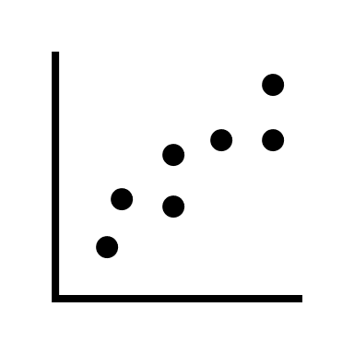







Results
Business Outcome
The Process
1. Predicting the sales
1. Improved Product Quality
2. Studying, analysing the data attributes, interpreting the predictions and making the changes in the respective attributes with the aim of increasing the sales.
3. Repeating the step 1 and step 2 until we find the optimal attribute values for the business model.
6. Sustained Sales Growth
2. Business Expansion
Outcome | Attribute - Target
Improved Product Quality | Improving the quality of items having low sales.
Business Expansion | Finding the best combination of outlet location type, outlet type and size to establish new outlets.
Improved Customer Service | 1. Increasing the visibility of items in demand. 2. Improving the customer service of Outlets with low sales.
Optimized Revenue | 1. Removing unprofitable items. 2. Adjusting item MRP.
Business Outcome
5. Optimized Revenue
3. Increased Customer Base
4. Improved Customer Service

Slide 9




Results
Real World Impact
1. Availability and improved quality of the products
2. Improved customer service
3. Opening mega mart outlets at new locations
4. Revenue optimization
Impact - More customers visiting the mega mart to make purchase.
Impact - Customers have an easy and enjoyable experience in shopping that would help the outlets to retain customers and grow sales.
Impact - New customers are attracted, there is an increase in market influence.
Impact - Increase in revenue generation and profit margin.

Slide 10
Recommendation
The Stacking Ensemble model can used for deployment. It has the best performance in terms of RMSE.
Along with it, SHAP (Shapley Additive Explaination), a python library, need to be used for interpreting the performance of boosting models (XGBoost, LGBM) in the ensemble.
Linear models like Ridge regression & Lasso regression can also be considered for deployment.
They have a higher RMSE than the best performing models but have a better machine learning explainablity and low computational cost. So, it is a profitable tradeoff.

Slide 11
Thank You!

